Slide 1
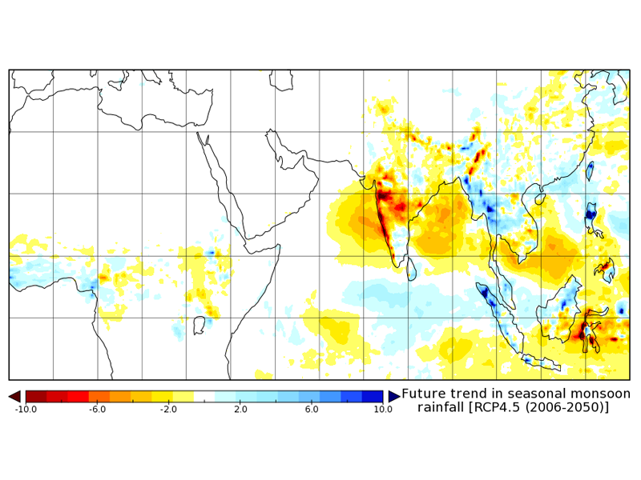
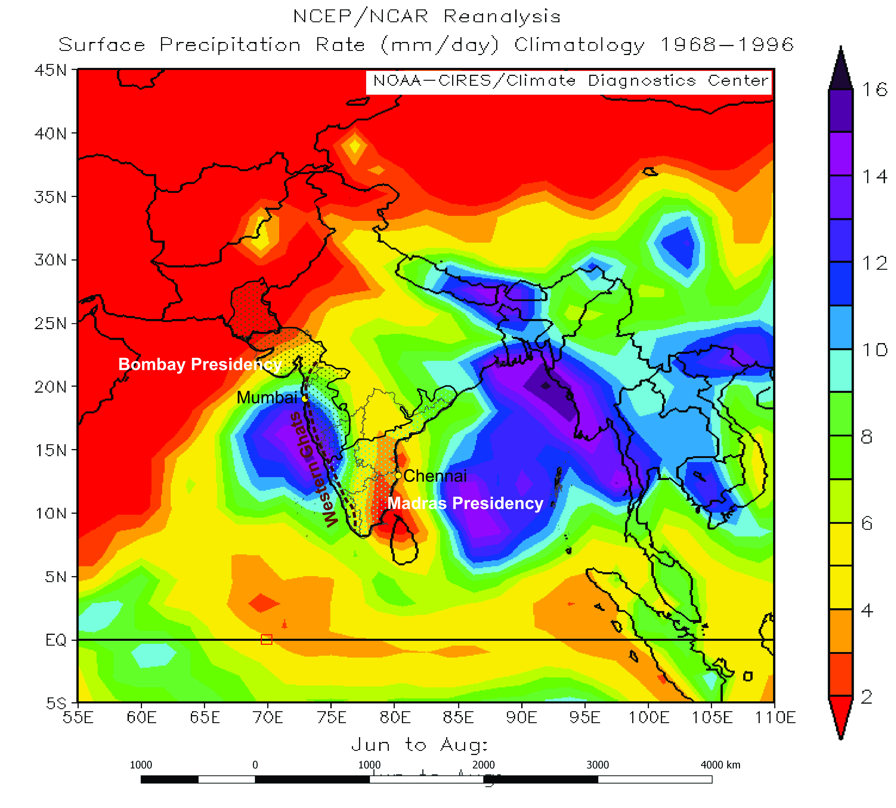
Assessing the impacts of climate variability - a study of institutional archival data spanning 1700-1947 (British Colonial Period) pertaining to semi-arid tracts of peninsular India
¹Ranjini Ray and^{2,3}Atreyee Bhattacharya Date: May 4, 2020
Paper no: EGU 2020-5350
Session: CL1.20 – Historical climatology and hydrology: the role of documentary evidence in the reconstruction of past (hydro)climate and its variabilities
Indian Institute for Human Settlements (IIHS)-Bangalore
University of Colorado Boulder and (3) Scripps Institution of Oceanography, University of California-San Diego
It will be critical to understand which modes of climate variability are associated with natural disasters and the nature of risk the peninsular region faces (in terms of propensity of rain failures as that is the most common mode of climatological shock to the peninsular human-environment system)
Semi arid region are expected to become drier (the red colored areas in peninsular India) over the coming decades. The major nodes of rainfall variability in these regions are 2-3 years (tied to ENSO cycles) and 4-7 year cycles, more prominent in the semi-arid interiors that are tied to land use patterns that impact land-atmosphere amplification of ENSO cycles
Objective of the study: We apply a novel methods of mining British Administrative Records of India between 1729-1947 pertaining to the Madras and Bombay presidencies (which encompass the peninsular India) and mapping our findings onto historical rain gauge and paleoclimate data available to understand what is the primary form of vulnerability to the system (e.g which disasters are more common and why and what are the impacts and what strategies appear to have worked
Ray and Bhattacharya (In prep)
Main conclusions: Famines due to rain failure are most common. 5-10year frequencies important for famines. 14% reduction below normal associated with famines. Farmers are most impacted. Alternate modes of employment assisted in averting human costs

Slide 2
Materials: We have reviewed over 600 British Colonial Institutional documents, archived in the Indian National Archives (New Delhi) and have extracted information on the incidence (location and date) of natural disasters-famines (both regional and local) caused by rain failures and floods, in both Bombay and Madras Presidencies between 1733-1947. In addition, we have also extracted information impacts of the famines as well as adaptation and mitigation strategies undertaken by the existing government (end of 18th century to 1857: Company period and 1858-1947: Crown period)
Method: We conducted the following analyses namely, (a) mapped the locations on long term climatology map of India, (b) mapped the famine years on the available historical rain gauge data both presidencies as well as on rainfall reconstructions using tree rings (while rain gauges were primarily located in urban centers of that time i.e. Bombay for the Bombay Presidency and Madras for the Madras Presidency, tree rings provide a more local record of rainfall variability, especially in the interiors where instrumental data is not available) and (c) mapped the famine years on long term rainfall climatology as represented in oxygen isotope values in cave deposits (also called speleothems, which provide regional long term climatology beyond the period covered by rain gauges i.e. 19th and 20th century or tree rings (19th and 20th century).
Results
Incidence
We find that famines caused by rain failures are the dominant type of disasters that impacted peninsular India. Most famines were regional i.e. affected more than 3-4 districts. There are only two instances of flooding-limited to the coastal areas of the Bombay presidency
Regional famines in both presidencies are associated with rain-failure that reflect the 5-10 year frequency in the semi-arid interiors of both presidencies
3. A reduction in 14% (or more) rainfall below the 19th-20th century average is associated with incidence of regional famines in both presidencies.
Impacts:Crop failure, food scarcity, grain price hike and export of grain outside the country (adoption of free market policy) led to wide-scale starvation, slavery, riots, epidemics, death, and migration. In both presidencies and during both periods. Farmers were the biggest section of society affected
Adaptation and mitigation (measures changed after 1876-78 Famine)
Formation of Famine Commission and Famine Codes 1880-1900
Appointment of engineers and doctors
Adoption of technology for example, canal, irrigation and railway that allowed movement of personnel (doctors, engineers and also food) from urban centers to interiors
4. Employment in alternate sectors-associated with seasonal migration- provided relief during drought years
5 . Although droughts kept occurring, no reports of famines were found after 1900 (also not reported in other documents we checked)

