Slide 1
Classification And Separation Of Diffraction Energy On Pre-migration Seismic Data Using Deep Learning
Brydon Lowney, Ivan Lokmer, Gareth O’Brien, Christopher Bean

Slide 2
Foreword
Introduction | Analytical Separation | Deep Learning Separation | Conclusions and Future Work
This presentation has been designed to give an overview of the topic of deep learning for diffraction separation.
Each slide contains additional information by clicking on the logo in the top left corner. Clicking the logo again will close the additional information and allow you to proceed with the presentation (using left click). Try it on this slide! The navigation panel at the top can also be used to move to specific points in the presentation.
Some images are also clickable, this is outlined where applicable.
I will be available for questions in the chat room on Wednesday 6th of May from 08:30-10:15 and can otherwise be contacted at brydon.lowney@ucdconnect.ie
Enjoy the Presentation!

Slide 3
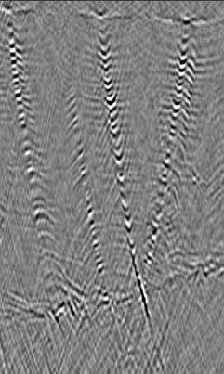
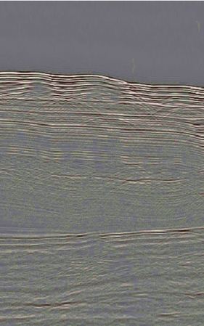
Contents
1
2
3
4
Introduction
What are diffractions | Why diffraction imaging | Diffraction imaging methods
Analytical Pre-Migration Separation
Plane-Wave Destruction
Deep Learning Separation
GANs | Multi-Domain Diffraction Identification | Direct Separation
Conclusions and Future Work

Slide 4
What are diffractions?
Introduction | Analytical Separation | Deep Learning Separation | Conclusions and Future Work
Diffractions originally referred to the bending of a wave into the geometrical shadow of an obstacle.
Diffractions later incorporated any non-geometrical scattering caused by objects or discontinuities (structurally and stratigraphically important).
(Thorne, 2015)

Slide 5
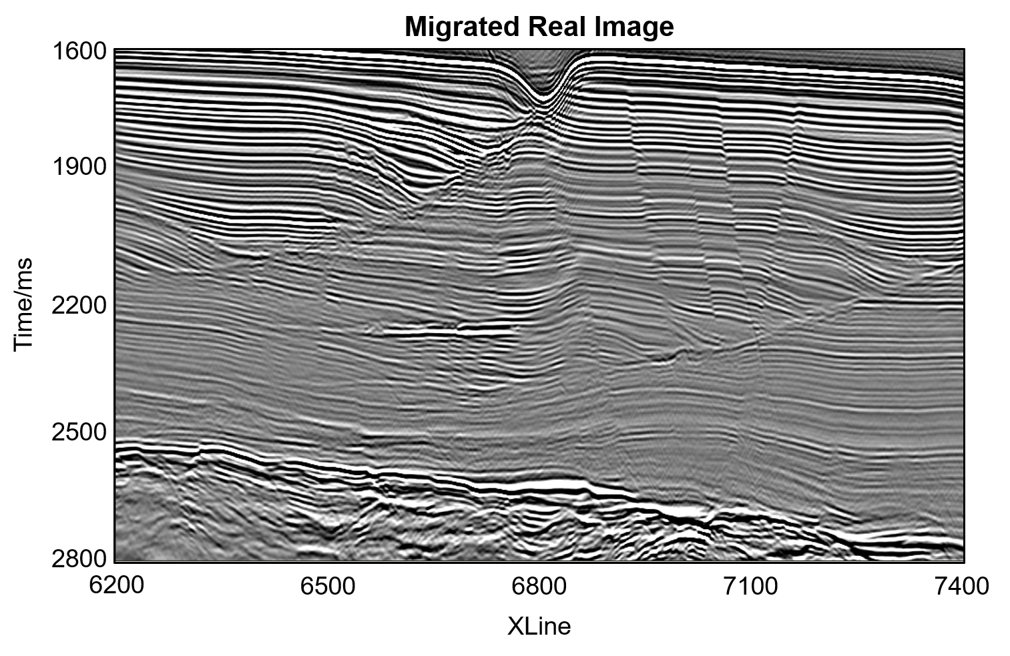
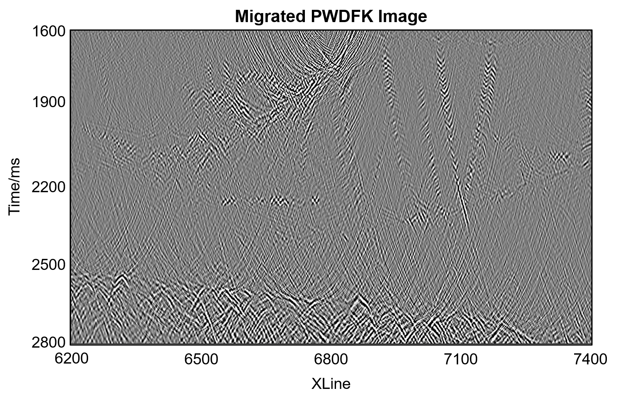
Why diffraction imaging?
Introduction | Analytical Separation | Deep Learning Separation | Conclusions and Future Work
As diffractions form from objects and discontinuities, by imaging the diffractions the objects which formed them can be directly imaged.
These are geologically significant both structurally and stratigraphically (i.e. faults, pinchouts, vugs, fractures etc.).
(Lowney et al., 2020a)

Slide 6
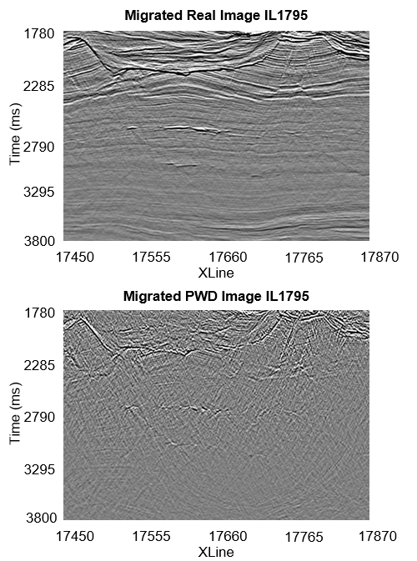
Diffraction imaging methods
Introduction | Analytical Separation | Deep Learning Separation | Conclusions and Future Work
Separation is the most challenging task in diffraction imaging.
There are several diffraction imaging methods:
Anti-stationary phase filtering.
Separation using dip-angle gathers.
Multi-focusing.
Plane-wave destruction.
F-K enhanced plane-wave destruction.
These all leave a volume with diffractions and noise
(Lowney et al., 2020a)

Slide 7
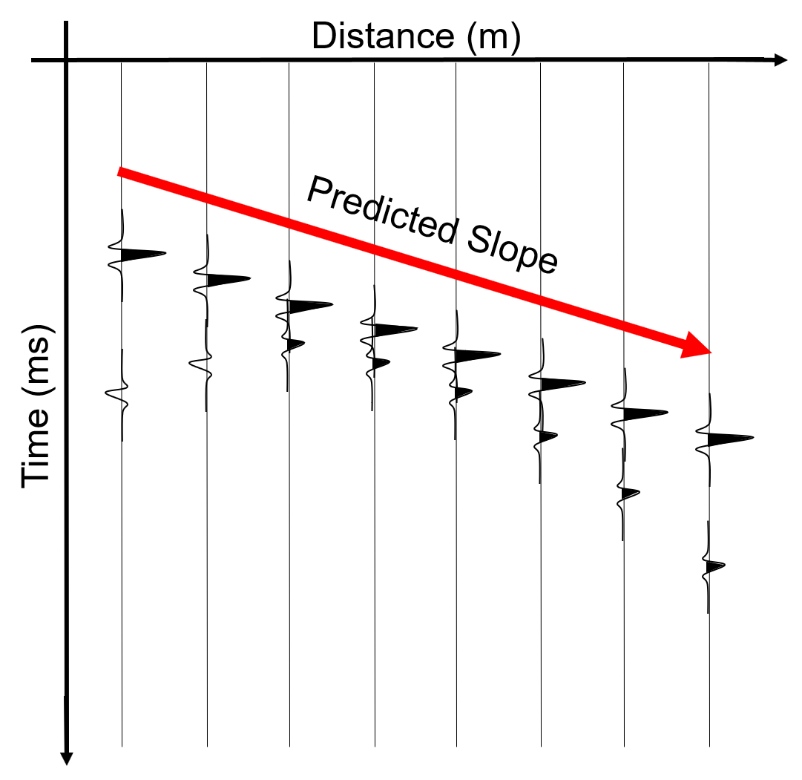
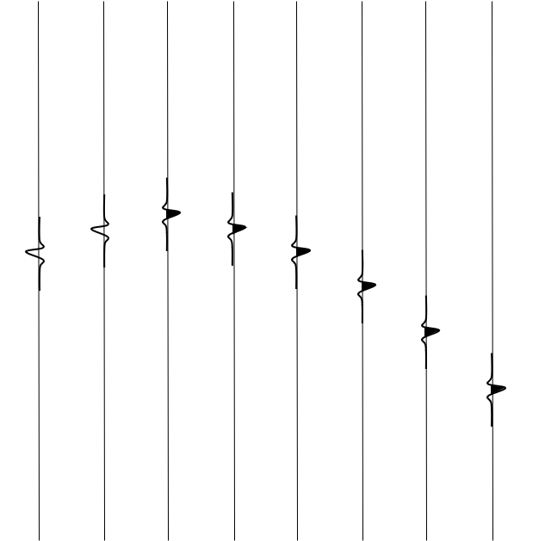
Plane-Wave Destruction
Introduction | Analytical Separation | Deep Learning Separation | Conclusions and Future Work
$$\frac{∂P}{∂x}+σ\frac{∂P}{∂t}=0$$
where:
$P(t,x)$ is the wavefield,
$σ$ is the local slope
This is separation through filtering reflections out by predicting the reflection energy from trace to trace

Slide 8
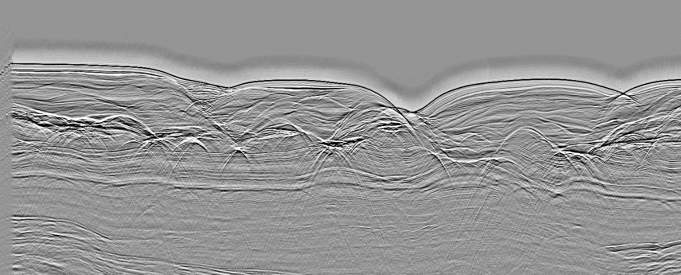
Plane-Wave Destruction
Introduction | Analytical Separation | Deep Learning Separation | Conclusions and Future Work
PWD works well to remove reflections but requires a continuously variable slope (so does not work well in synclines).
Crossline
15600
16600
17600
18600
19600
3300
3650
4000
Time (ms)
4350
4700
Raw Data
PWD Data

Slide 9
Deep Learning
Introduction | Analytical Separation | Deep Learning Separation | Conclusions and Future Work
Deep learning is a facet of machine learning which in turn is a facet of artificial intelligence.
It involves the use of a multi-layered neural network in order to understand complex data and apply its understanding to new data.
Here, we have used two neural network architectures:
Generative adversarial networks (GAN)
PatternNet
Artificial Intelligence
Machine Learning
Deep Learning

Slide 10
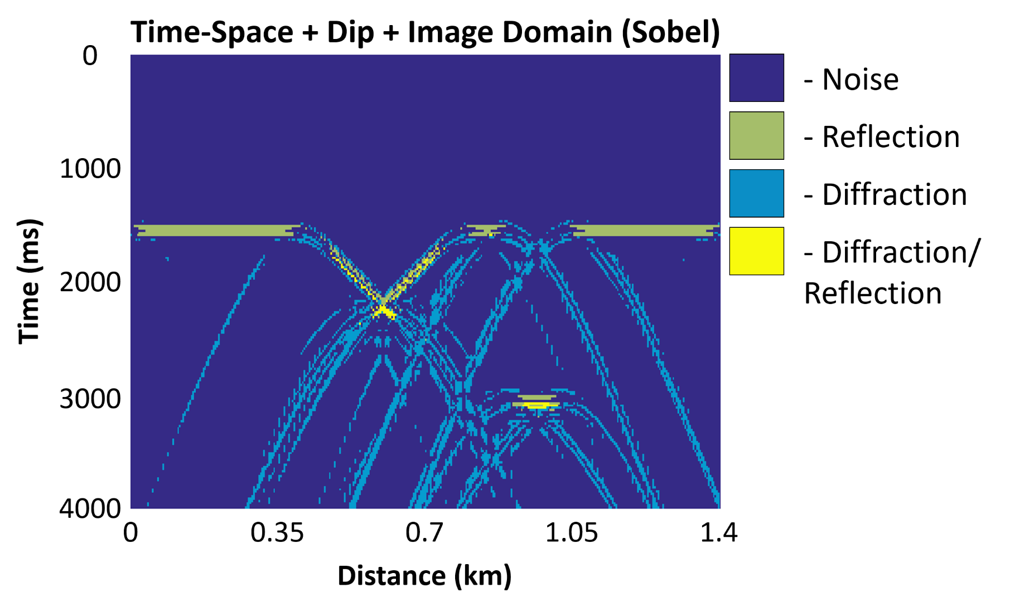
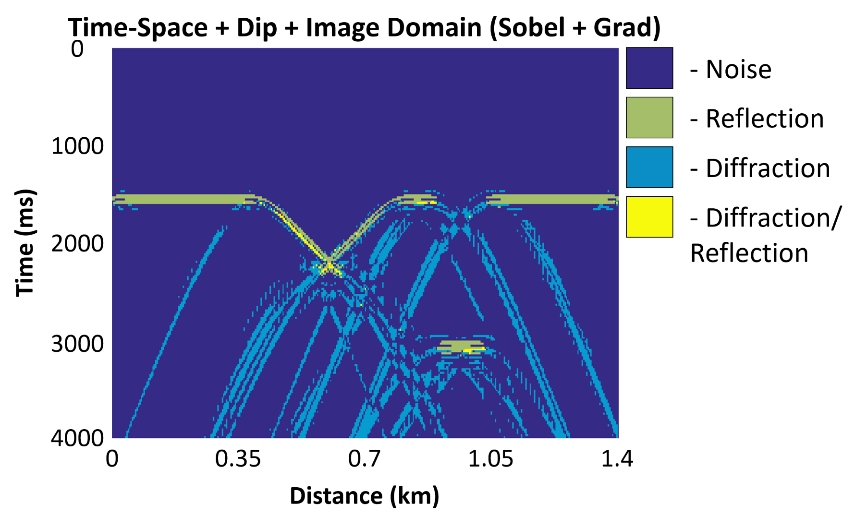
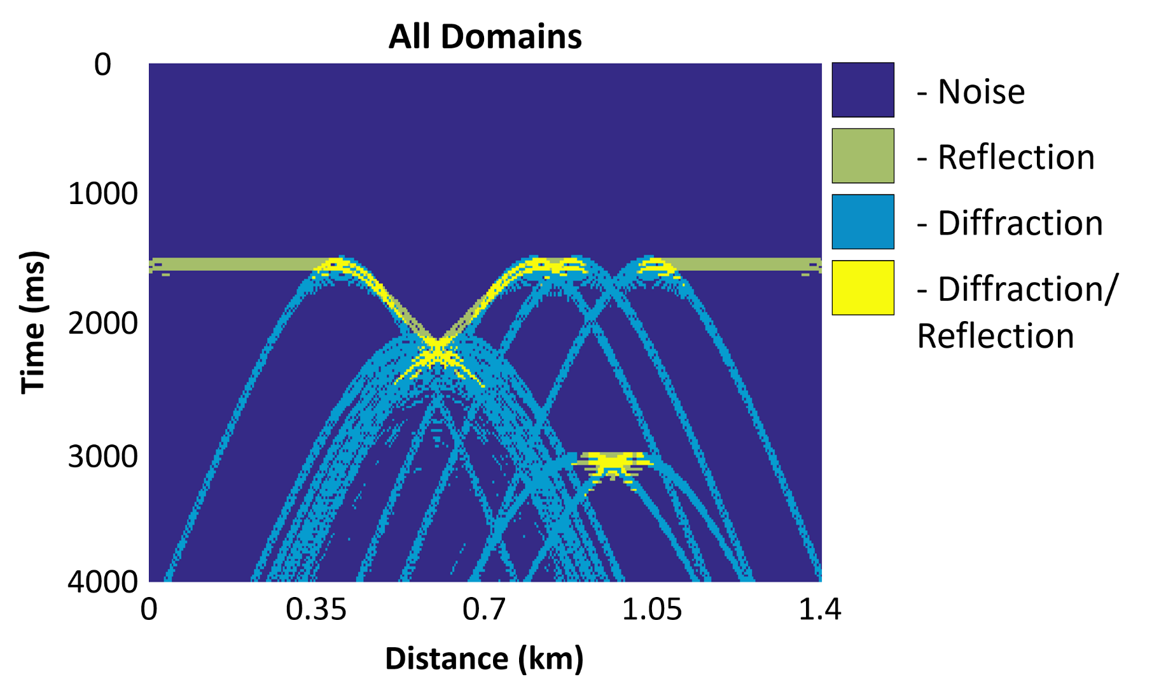
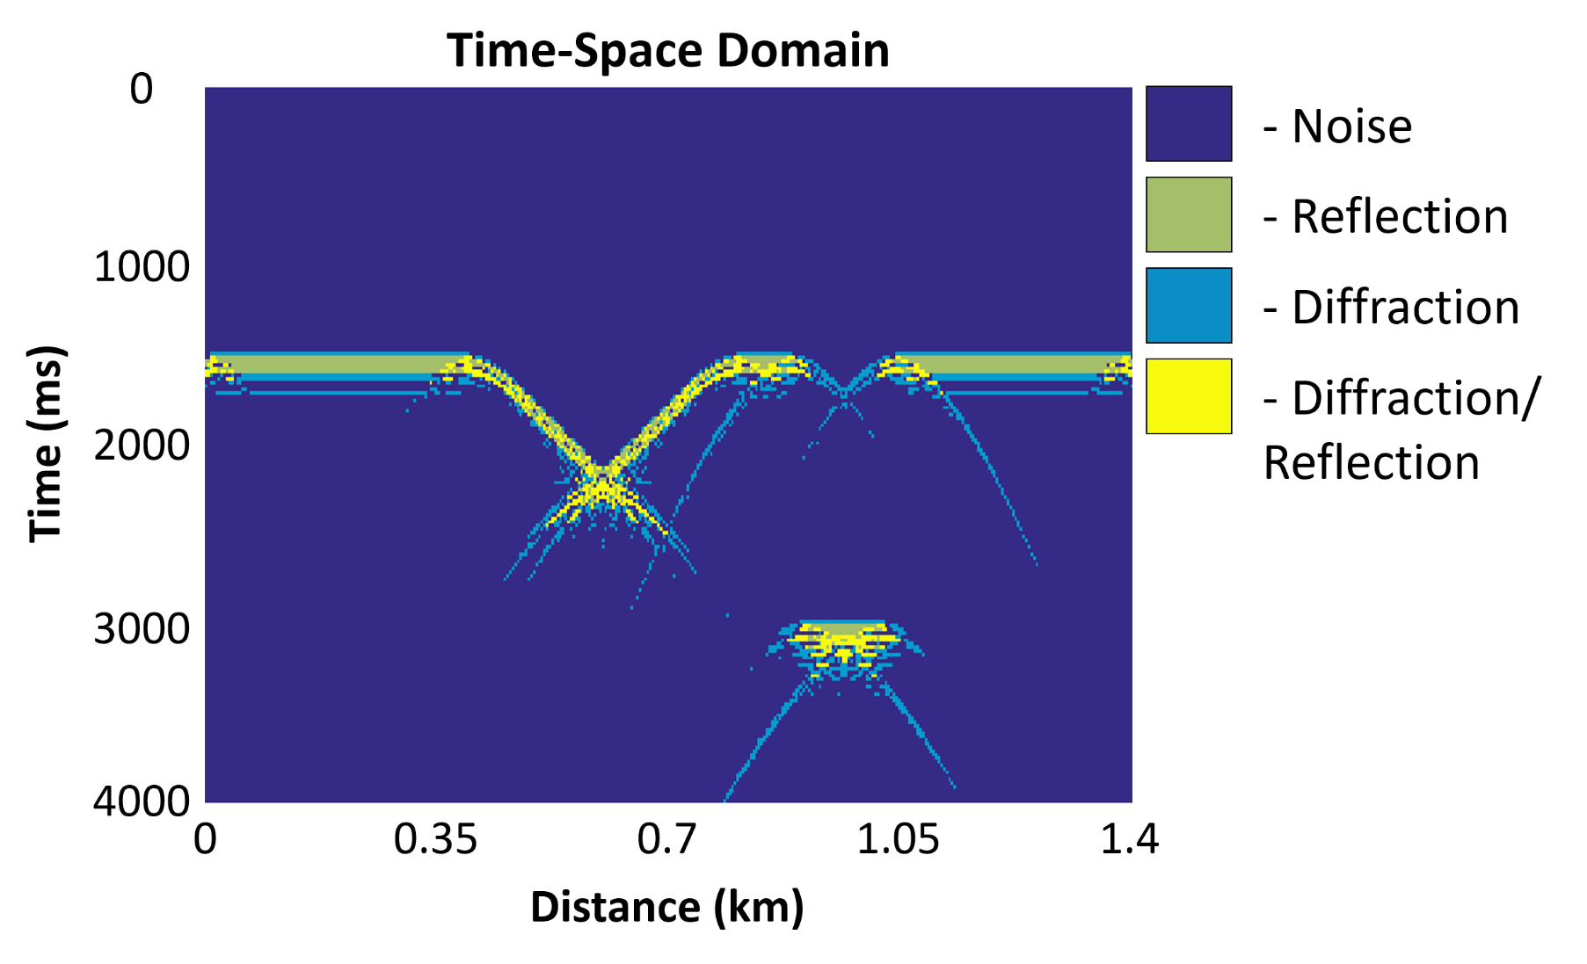
Multi-Domain Diffraction Identification
Introduction | Analytical Separation | Deep Learning Separation | Conclusions and Future Work
MDDI is a method of classifying seismic events using deep learning though requires additional separation
(Lowney et al., 2019)

Slide 11
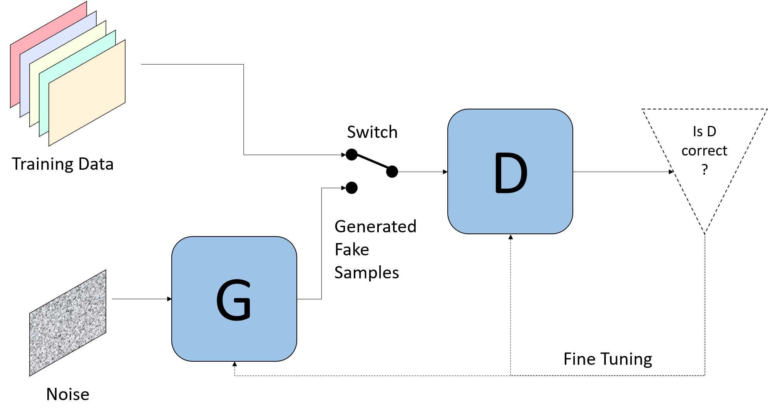
Generative Adversarial Networks
Introduction | Analytical Separation | Deep Learning Separation | Conclusions and Future Work
Generative Adversarial Networks (GAN) are a neural network architecture which contains two neural networks: a generator and a discriminator. Click on each step to discover more.

Slide 12
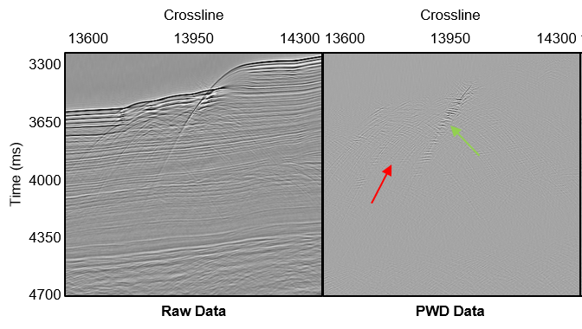
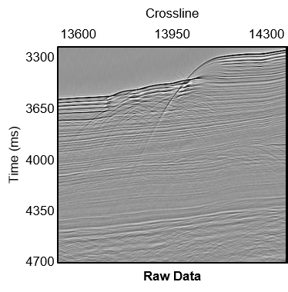
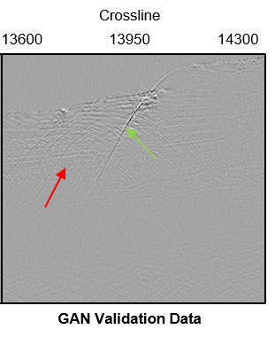
Direct Separation
Introduction | Analytical Separation | Deep Learning Separation | Conclusions and Future Work
Using a GAN, diffractions can be directly separated on pre-migration data without additional parameters (such as dip field) and in a fraction of the time.
(Lowney et al., 2020b)

Slide 13
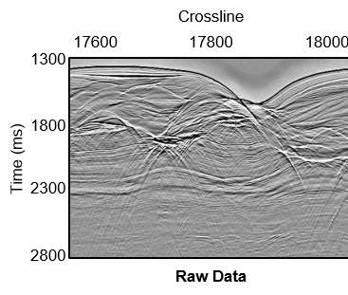
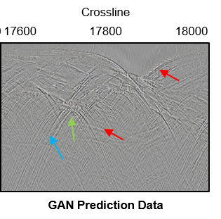
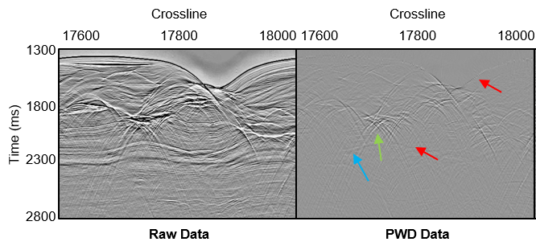
Direct Separation Example 2
Introduction | Analytical Separation | Deep Learning Separation | Conclusions and Future Work
This example was created from a geologically distinct dataset and was applied blind (using the trained GAN from the previous example).
(Lowney et al., 2020b)

Slide 14
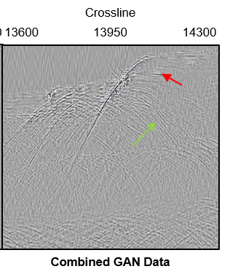
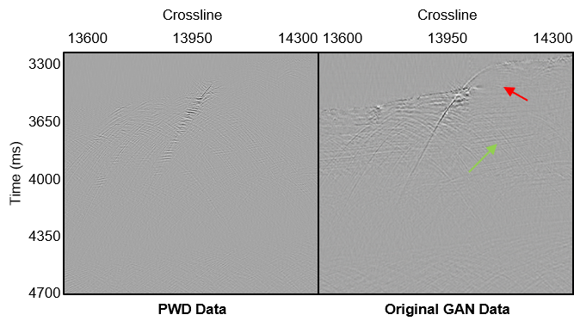
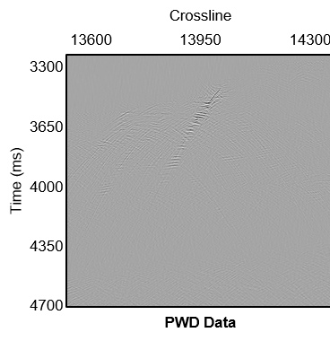
Additional Data
Introduction | Analytical Separation | Deep Learning Separation | Conclusions and Future Work
By combining multiple data sources in the training, the separation is improved on both existing and new data.
(Lowney et al., 2020b)

Slide 15
Conclusions and Future Work
Introduction | Analytical Separation | Deep Learning Separation | Conclusions and Future Work
Diffraction imaging is a powerful tool in a geophysicist’s arsenal, allowing structures to be imaged directly.
Existing diffraction imaging techniques may not be ideal due to issues involving noise and additional parameterisation.
Diffractions can be directly separated (i.e. classified and separated using a neural network) on pre-migration data using deep learning methods in order to remove the need for additional parameters such as dip.
Direct diffraction separation may be more ideal in complex wavefields and has the potential to remove noise, though in its prototype stage leaves more remnant reflection energy.
Future work will focus on improving the GAN with additional data (both in time-space and other domains), feature selection, and applying to GPR data.
INDEX

Slide 16
References
Claerbout, J.F. [1992] Earth soundings analysis: Processing versus inversion. Blackwell Scientific Publications, London.
Klokov, A., Fomel, S. [2012] Separation and imaging of seismic diffractions using migrated dip-angle gathers. Geophysics, 77, 131–143.
Landa, E., Keydar, S. [1998] Seismic monitoring of diffraction images for detection of local heterogeneities. Geophysics, 63, 1093–1100.
Lowney, B., Lokmer, I., Bean, C.J., O’Brien, G.S., Igoe, M. [2018] An Outlook on Seismic Diffraction Imaging Using Pattern Recognition. 80th EAGE Conference and Exhibition 2018, Extended Abstracts.
Lowney, B., Lokmer, I., Bean, C.J., O’Brien, G.S., Igoe, M. [2019] Multi-domain Diffraction Identification Using Deep Learning. 81st EAGE Conference and Exhibition, Extended Abstracts.
Lowney, B., Lokmer, I., O’Brien, G.S., Amy, L., Bean, C.J., Igoe, M. [2020a] Enhancing interpretability with diffraction imaging using plane-wave destruction aided by frequency-wavenumber f-k filtering. Interpretation, 8, 1-14.
Lowney, B., Lokmer, I., O’Brien, G.S., Bean, C.J. [2020b] Direct Diffraction Separation by Deep Learning on Pre-Migrated Seismic Data. 82nd EAGE Conference and Exhibition, Extended Abstracts.
Moser, T.J., Howard, C.B. [2008] Diffraction imaging in depth. Geophysical Prospecting, 56, 627–641.
Image references:
http://home.chpc.utah.edu/~thorne/animations.html (credit to Michael S. Thorne, H. Philip Crotwell, Gunnar Jahnke, and Heiner Igel)

Slide 17
Acknowledgements
This presentation has emanated from research supported in part by a research grant from Science Foundation Ireland (SFI) under Grant Number 13/RC/2092 and is co-funded under the European Regional Development Fund and by PIPCO RSG and its member companies.

Slide 18
Index

Slide 19
Foreword
Introduction | Analytical Separation | Deep Learning Separation | Conclusions and Future Work
This is an optional information slide, click the logo again to remove optional information and proceed!
This presentation has been designed to give an overview of the topic of deep learning for diffraction separation.
Each slide contains additional information by clicking on the logo in the top left corner. Clicking the logo again will close the additional information and allow you to proceed with the presentation (using left click). Try it on this slide! The navigation panel at the top can also be used to move to specific points in the presentation.
Some images are also clickable, this is outlined where applicable.
I will be available for questions in the chat room on Wednesday 6th of May from 08:30-10:15 and can otherwise be contacted at brydon.lowney@ucdconnect.ie
Enjoy the Presentation!

Slide 20
Contents
Click on any of the numbers to skip to this section of the presentation.
1
2
3
4
Introduction
What are diffractions | Why diffraction imaging | Diffraction imaging methods
Analytical Pre-Migration Separation
Plane-Wave Destruction
Deep Learning Separation
GANs | Multi-Domain Diffraction Identification | Direct Separation
Conclusions and Future Work

Slide 21
What are diffractions?
Introduction | Analytical Separation | Deep Learning Separation | Conclusions and Future Work
From this animation we can see that the source wave travels down until it reaches a boundary. At the horizontal boundary it is reflected, however at the edge, the wave spreads in all directions as a diffraction. This is what we know as an edge diffraction and is commonly formed in faults. Point diffractions also exist where the spreading occurs due to a point in the subsurface.
Diffractions originally referred to the bending of a wave into the geometrical shadow of an obstacle.
Diffractions later incorporated any non-geometrical scattering caused by objects or discontinuities (structurally and stratigraphically important).
(Thorne, 2015)

Slide 22
Why diffraction imaging?
Introduction | Analytical Separation | Deep Learning Separation | Conclusions and Future Work
In the diffraction image here, the diffractions are seen to result mostly from faults in the subsurface and by imaging these faults directly it allows us to have greater understanding and interpretation of said faults. Other diffractions here result from pinchouts and the edges of a sand-body. Click on the image for the diffraction image!
As diffractions form from objects and discontinuities, by imaging the diffractions the objects which formed them can be directly imaged.
These are geologically significant both structurally and stratigraphically (i.e. faults, pinchouts, vugs, fractures etc.).
(Lowney et al., 2020a)

Slide 23
Why diffraction imaging?
Introduction | Analytical Separation | Deep Learning Separation | Conclusions and Future Work
In the diffraction image here, the diffractions are seen to result mostly from faults in the subsurface and by imaging these faults directly it allows us to have greater understanding and interpretation of said faults. Other diffractions here result from pinchouts and the edges of a sand-body. Click on the image for an interpretation!
As diffractions form from objects and discontinuities, by imaging the diffractions the objects which formed them can be directly imaged.
These are geologically significant both structurally and stratigraphically (i.e. faults, pinchouts, vugs, fractures etc.).
(Lowney et al., 2020a)

Slide 24
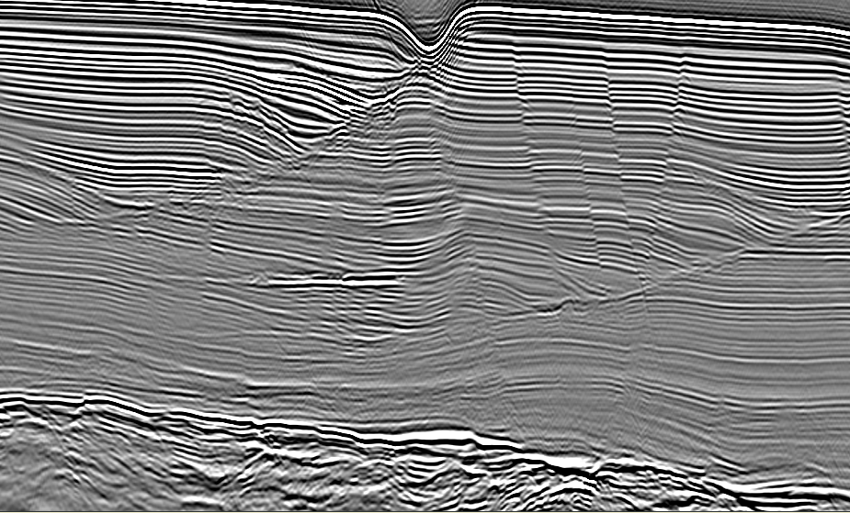
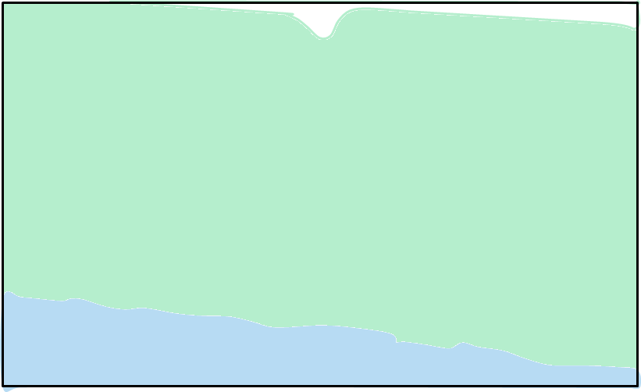
Why diffraction imaging?
Introduction | Analytical Separation | Deep Learning Separation | Conclusions and Future Work
In the diffraction image here, the diffractions are seen to result mostly from faults in the subsurface and by imaging these faults directly it allows us to have greater understanding and interpretation of said faults. Other diffractions here result from pinchouts and the edges of a sand-body. Click on the image for the reflection image!
As diffractions form from objects and discontinuities, by imaging the diffractions the objects which formed them can be directly imaged.
These are geologically significant both structurally and stratigraphically (i.e. faults, pinchouts, vugs, fractures etc.).
(Lowney et al., 2020a)

Slide 25
Diffraction imaging methods
Introduction | Analytical Separation | Deep Learning Separation | Conclusions and Future Work
Separation is the most challenging task in diffraction imaging.
There are several diffraction imaging methods:
Anti-stationary phase filtering.
Separation using dip-angle gathers.
Multi-focusing.
Plane-wave destruction.
F-K enhanced plane-wave destruction.
These all leave a volume with diffractions and noise
As seen by this image, the issue of leaving a volume with diffractions and noise is that diffractions are weak in amplitude (often of a level with noise) and thus can be hidden or otherwise hindered by the background noise. By using deep learning we aim to alleviate some of this noise.
(Lowney et al., 2020a)

Slide 26
Plane-Wave Destruction (PWD)
Introduction | Analytical Separation | Deep Learning Separation | Conclusions and Future Work
The local slope, $σ$, is generated to remove reflection energy. Any reflection energy which conforms to this slope is removed. However, this means that not only does PWD require the computation of this slope field (adding to the cost), any discrepancies in the slope field will be carried through to the diffraction image.
$$\frac{∂P}{∂x}+σ\frac{∂P}{∂t}=0$$
where:
$P(t,x)$ is the wavefield,
$σ$ is the local slope
This is separation through filtering reflections out by predicting the reflection energy from trace to trace

Slide 27
Plane-Wave Destruction
Introduction | Analytical Separation | Deep Learning Separation | Conclusions and Future Work
This is an example of synclinal remnant reflection energy post-PWD. During migration this will cause large, smile-like artefacts. Click image to see PWD data.
PWD works well to remove reflections but requires a continuously variable slope (so does not work well in synclines).
Crossline
15600
16600
17600
18600
19600
3300
3650
4000
Time (ms)
4350
4700
Raw Data

Slide 28
Plane-Wave Destruction
Introduction | Analytical Separation | Deep Learning Separation | Conclusions and Future Work
This is an example of synclinal remnant reflection energy post-PWD. During migration this will cause large, smile-like artefacts. Click image to see original data.
PWD works well to remove reflections but requires a continuously variable slope (so does not work well in synclines).
Crossline
15600
16600
17600
18600
19600
3300
3650
4000
Time (ms)
4350
4700
PWD Data

Slide 29
Deep Learning
Introduction | Analytical Separation | Deep Learning Separation | Conclusions and Future Work
Deep learning is a facet of machine learning which in turn is a facet of artificial intelligence.
It involves the use of a multi-layered neural network in order to understand complex data and apply its understanding to new data.
Here, we have used two neural network architectures:
Generative adversarial networks (GAN)
PatternNet
By using deep learning, we aim to alleviate some of the issues in analytical techniques namely the computational expense and the need for additional parameterisation (i.e. dip fields, smoothing parameters etc. which can negatively impact the final image if chosen incorrectly).
Artificial Intelligence
Machine Learning
Deep Learning

Slide 30
Multi-Domain Diffraction Identification
Introduction | Analytical Separation | Deep Learning Separation | Conclusions and Future Work
MDDI was an initial attempt at using deep learning for classification of seismic events using a PatternNet neural network. By combining multiple domains and using these as input features, the neural network is physically constrained in the features it can select and therefore choose features which are more representative of the data. As seen by the animation on the initial slide, when adding more domains, the separation improves.
MDDI is a method of classifying seismic events using deep learning though requires additional separation
(Lowney et al., 2019)

Slide 31
Generative Adversarial Networks
Introduction | Analytical Separation | Deep Learning Separation | Conclusions and Future Work
As MDDI required additional separation after classification, we switched to a more complex neural network architecture in order to obtain deeper understanding of the data and allow us to classify and separate diffractions on the data without the need for any additional parameters or inputs. Click on parts of the figure to find out more!
Generative Adversarial Networks (GAN) are a neural network architecture which contains two neural networks: a generator and a discriminator. Click on each step to discover more.

Slide 32
Generative Adversarial Networks
Introduction | Analytical Separation | Deep Learning Separation | Conclusions and Future Work
The training data originally consisted of synthetic data and later incorporated real data. It is divided into two: Input data and Target data. The input data is the pre-migrated seismic data while the target data has the reflections removed. This is simple with synthetic data and can be achieved perfectly, however, with real data PWD was applied to remove the reflections and then the data was screened to remove any areas where PWD did not work well (to prevent bias in the training)
Generative Adversarial Networks (GAN) are a neural network architecture which contains two neural networks: a generator and a discriminator. Click on each step to discover more.

Slide 33
Generative Adversarial Networks
Introduction | Analytical Separation | Deep Learning Separation | Conclusions and Future Work
Generative Adversarial Networks (GAN) are a neural network architecture which contains two neural networks: a generator and a discriminator. Click on each step to discover more.
The generator network is input with random noise which it transforms to mimic the training data.

Slide 34
Generative Adversarial Networks
Introduction | Analytical Separation | Deep Learning Separation | Conclusions and Future Work
The switch randomises whether the discriminator is receiving real data (from the training dataset) or generated data (from the generator network)
Generative Adversarial Networks (GAN) are a neural network architecture which contains two neural networks: a generator and a discriminator. Click on each step to discover more.

Slide 35
Generative Adversarial Networks
Introduction | Analytical Separation | Deep Learning Separation | Conclusions and Future Work
The discriminator network attempts to judge whether the data it has been given is real or generated. In this way the discriminator is trained as it must understand the training data in order to be an effective judge. The discriminator network here has a PatchGAN architecture.
Generative Adversarial Networks (GAN) are a neural network architecture which contains two neural networks: a generator and a discriminator. Click on each step to discover more.

Slide 36
Generative Adversarial Networks
Introduction | Analytical Separation | Deep Learning Separation | Conclusions and Future Work
Generative Adversarial Networks (GAN) are a neural network architecture which contains two neural networks: a generator and a discriminator. Click on each step to discover more.
The generator network creates fake data in order to try and fool the discriminator. In this way the generator is trained as it must understand the training data in order to effectively mimic it. The discriminator network here has a UNet architecture.

Slide 37
Generative Adversarial Networks
Introduction | Analytical Separation | Deep Learning Separation | Conclusions and Future Work
Generative Adversarial Networks (GAN) are a neural network architecture which contains two neural networks: a generator and a discriminator. Click on each step to discover more.
By training both neural networks simultaneously, the overall GAN achieves a far deeper understanding of the data compared to a conventional neural network. Once trained, this can then be used to predict data. While computationally expensive for training, the prediction has minimal computational expense.

Slide 38
Direct Separation
Introduction | Analytical Separation | Deep Learning Separation | Conclusions and Future Work
Compared to the PWD data, the GAN separated data contains stronger diffraction energy and works better in complex areas (as it doesn’t rely on the dip field), however, it also has more remnant reflection energy. The neural network here has only been trained on synthetic data and lines from the same dataset (though has never seen this line). Click the image to see the PWD Data.
Using a GAN, diffractions can be directly separated on pre-migration data without additional parameters (such as dip field) and in a fraction of the time.
(Lowney et al., 2020b)

Slide 39
Direct Separation
Introduction | Analytical Separation | Deep Learning Separation | Conclusions and Future Work
Compared to the PWD data, the GAN separated data contains stronger diffraction energy and works better in complex areas (as it doesn’t rely on the dip field), however, it also has more remnant reflection energy. The neural network here has only been trained on synthetic data and lines from the same dataset (though has never seen this line). Click the image to see the PWD Data.
Using a GAN, diffractions can be directly separated on pre-migration data without additional parameters (such as dip field) and in a fraction of the time.
(Lowney et al., 2020b)

Slide 40
Direct Separation Example 2
Introduction | Analytical Separation | Deep Learning Separation | Conclusions and Future Work
Compared to the PWD data, the GAN did not work as well in this example. This was likely as it has not been trained on enough data and has seen one real dataset before. The red arrows show areas worse on the GAN data while green and blue are better on the GAN data. Click on the image to see the GAN data.
This example was created from a geologically distinct dataset and was applied blind (using the trained GAN from the previous example).
(Lowney et al., 2020b)

Slide 41
Direct Separation Example 2
Introduction | Analytical Separation | Deep Learning Separation | Conclusions and Future Work
Compared to the PWD data, the GAN did not work as well in this example. This was likely as it has not been trained on enough data and has seen one real dataset before. The red arrows show areas worse on the GAN data while green and blue are better on the GAN data. Click on the image to see the PWD data.
This example was created from a geologically distinct dataset and was applied blind (using the trained GAN from the previous example).
(Lowney et al., 2020b)

Slide 42
Additional Data
Introduction | Analytical Separation | Deep Learning Separation | Conclusions and Future Work
As seen by this example, by adding both sets of data and reapplying the prediction, it can be improved. Therefore it can be hypothesised that even more data will improve it further. While the image is better, the amplitudes have been changed by the network hence why the noise looks worse. Click to see the new GAN data.
By combining multiple data sources in the training, the separation is improved on both existing and new data.
(Lowney et al., 2020b)

Slide 43
Additional Data
Introduction | Analytical Separation | Deep Learning Separation | Conclusions and Future Work
As seen by this example, by adding both sets of data and reapplying the prediction, it can be improved. Therefore it can be hypothesised that even more data will improve it further. While the image is better, the amplitudes have been changed by the network hence why the noise looks worse. Click to see the original GAN data.
By combining multiple data sources in the training, the separation is improved on both existing and new data.
(Lowney et al., 2020b)

Slide 44
Conclusions and Future Work
Introduction | Analytical Separation | Deep Learning Separation | Conclusions and Future Work
Diffraction imaging is a powerful tool in a geophysicist’s arsenal, allowing structures to be imaged directly.
Existing diffraction imaging techniques may not be ideal due to issues involving noise and additional parameterisation.
Diffractions can be directly separated (i.e. classified and separated using a neural network) on pre-migration data using deep learning methods in order to remove the need for additional parameters such as dip.
Direct diffraction separation may be more ideal in complex wavefields and has the potential to remove noise, though in its prototype stage leaves more remnant reflection energy.
Future work will focus on improving the GAN with additional data (both in time-space and other domains), feature selection, and applying to GPR data.
Thank you for your interest in this presentation, use the navigation panel at the top to return to any previous section or click on the link at the bottom of the page to be taken to an index where you can navigate to individual slide.
Any questions can be directed to brydon.lowney@ucdconnect.ie
INDEX

Slide 45
Index
Click on a slide to zoom to it

