Slide 1
3D Geodynamic Models of the Present-Day Altiplano-Puna Magmatic System
Arne Spang, Tobias Baumann & Boris Kaus
Johannes Gutenberg-Universität, Mainz
arspang@uni-mainz.de
08.05.2020
Watch my full talk including audio:
https://youtu.be/5bsUSOwzFws
magma-project.eu

Slide 2
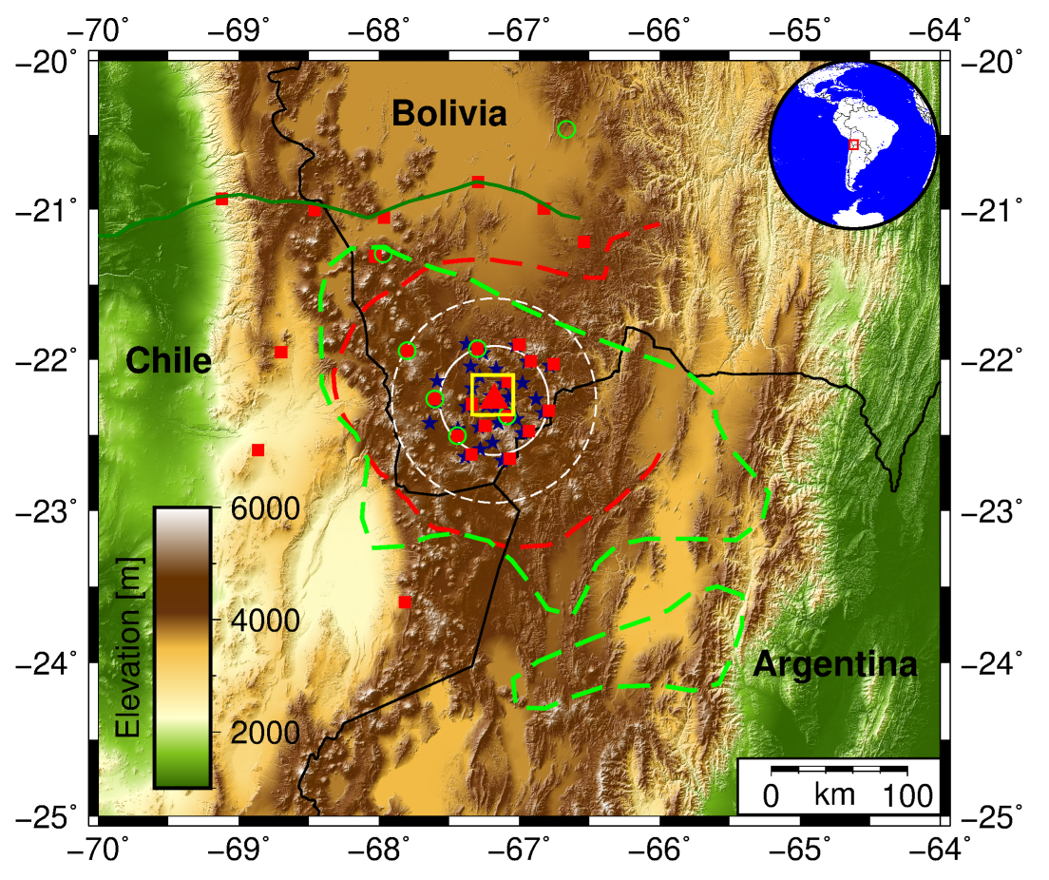
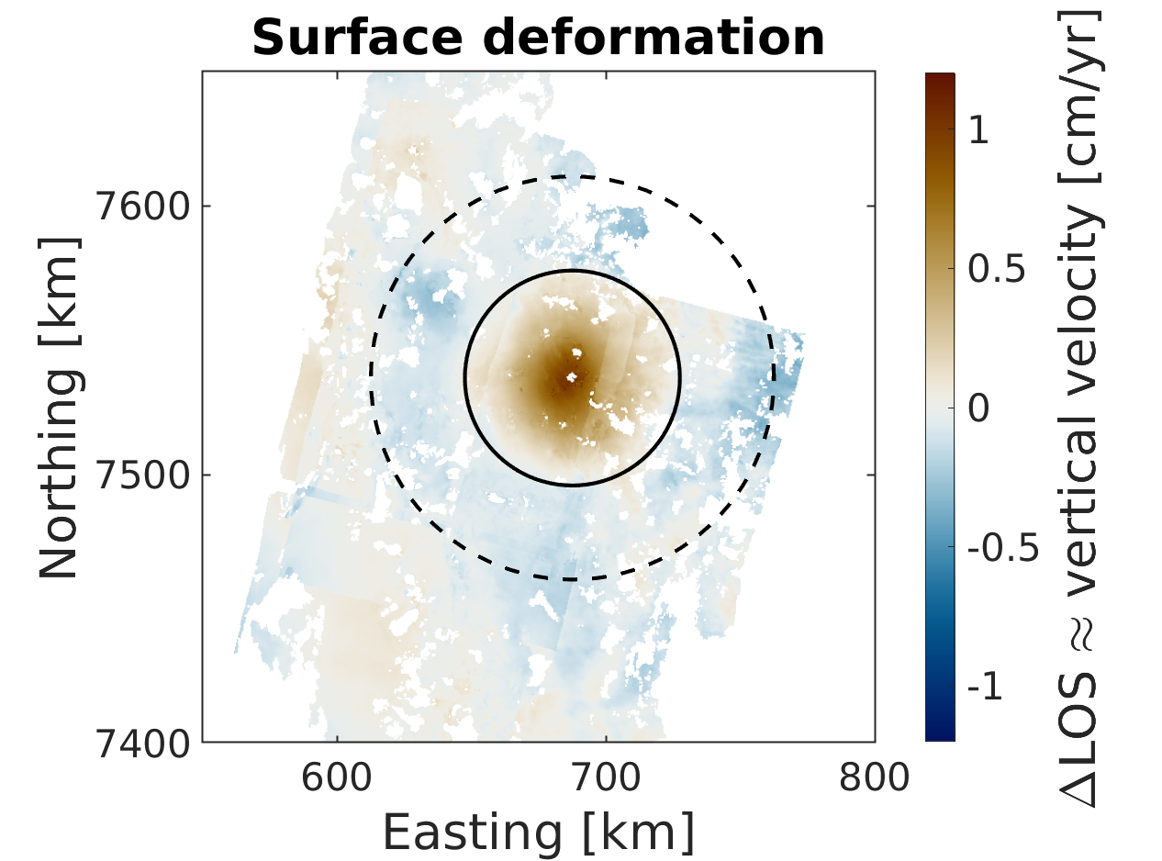
Motivation
Combining data from seismic imaging, gravity anomalies, petrology and geodesy (InSAR) with geodynamic modelling (Stokes code LaMEM^{[1]})
Making magma body geometry a variable quantity
Area of Interest
Puna Plateau, Andes
Concentric uplift at central volcano
Previous studies: Caused by inflating magma body
[1] Kaus et. al, 2016
Modified from Fialko & Pearse, 2012

Slide 3
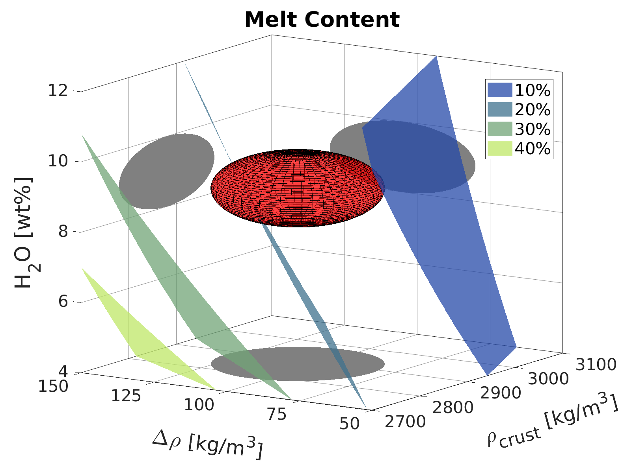
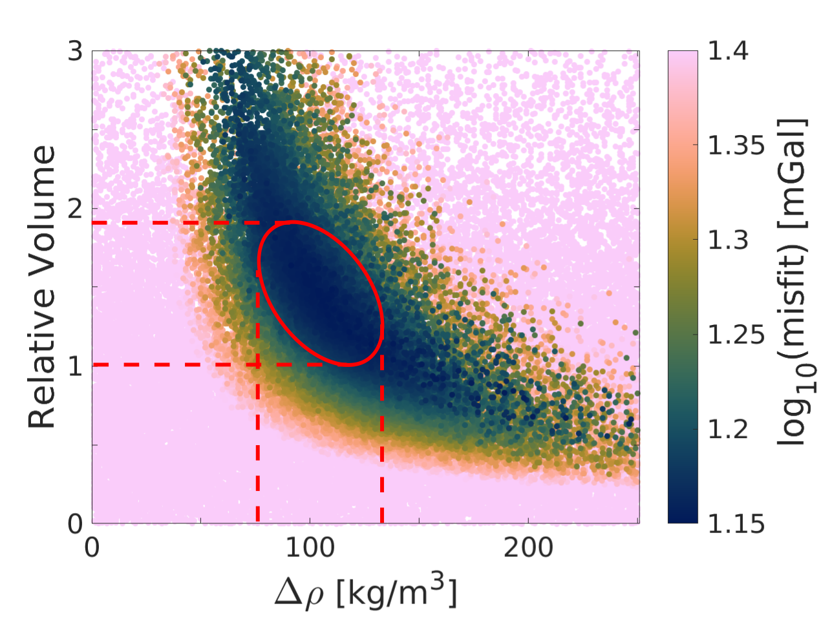
Findings - Gravity
Magma body could change shape, size and Δρ to the crust
Bouguer anomaly was computed and compared to data
Relative Volume = combination of 5 geometric parameters
→ Δρ = 80 - 130 kg/m³
Constraints on Δρ, ρ_{crust} & water content (red ellipsoid) and magma composition (from eruption products) allow for melt content estimation
→ 14-22% melt in magma body

Slide 4
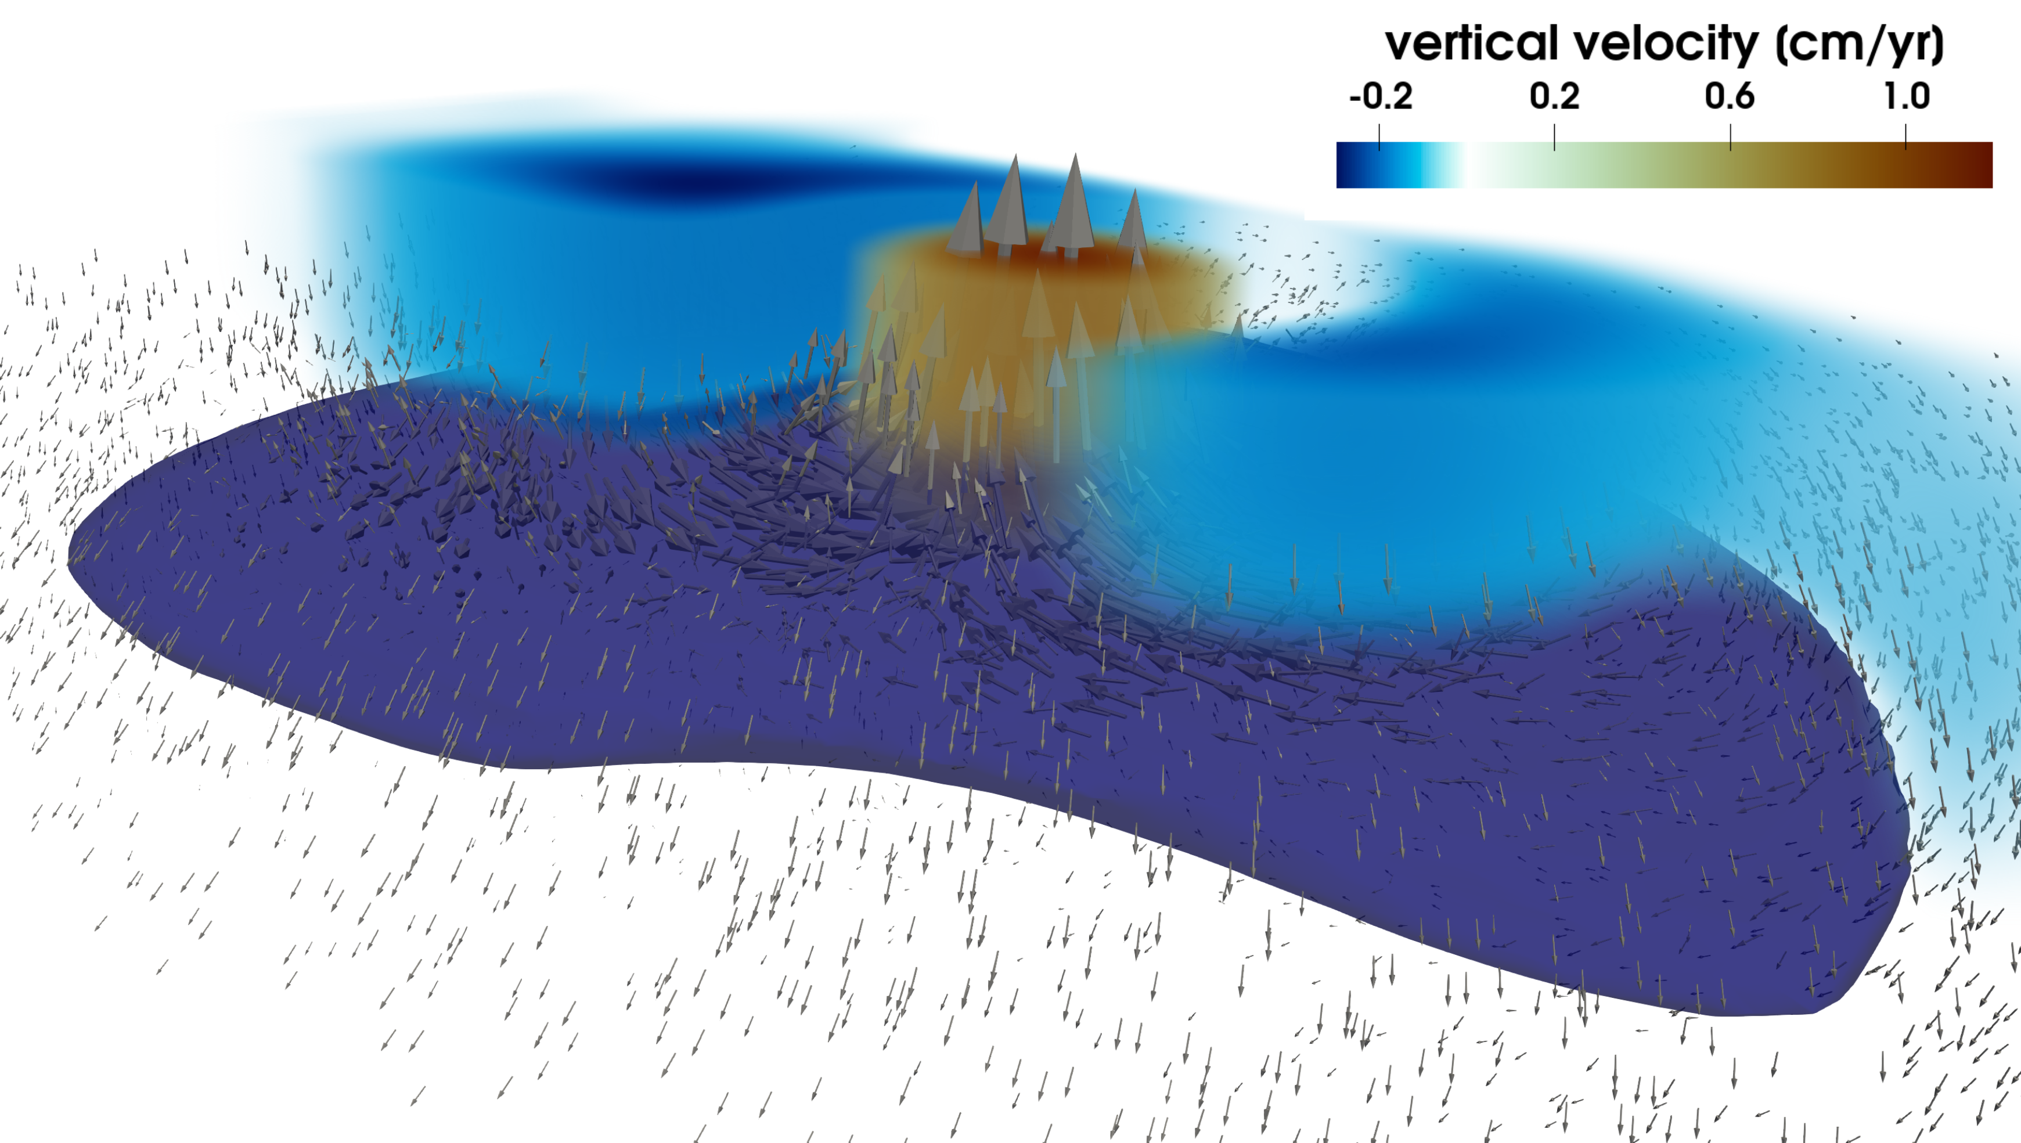
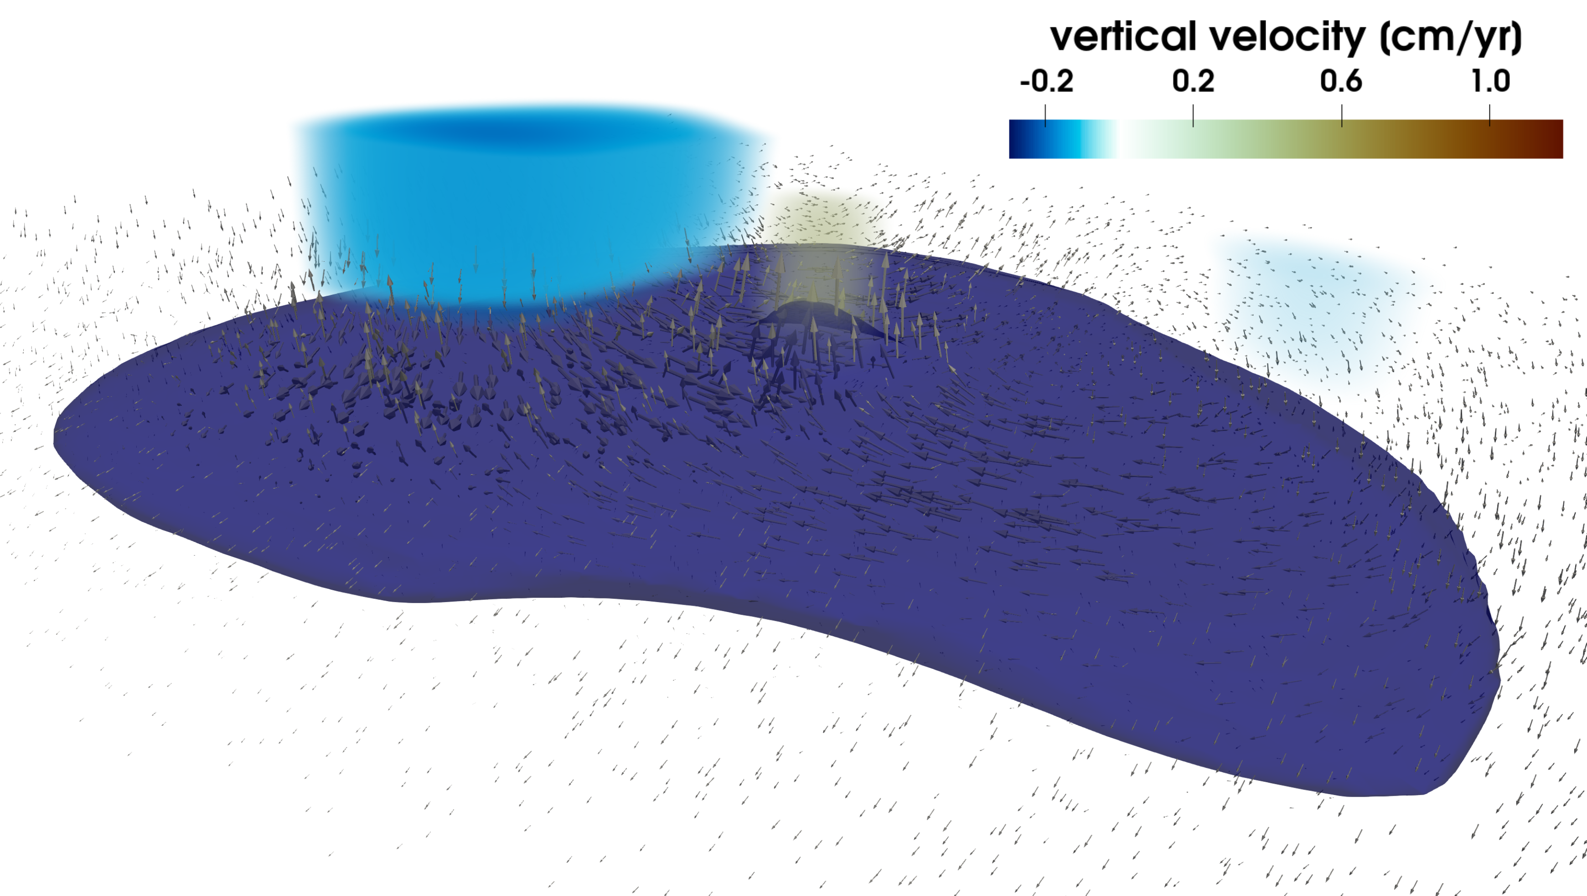
Findings - Geodynamics
Material flows from outskirts of magma body towards a central rise in the body (Figure A)
Flow strongly reduced for narrower central rise (half diameter of A) (Figure B)
→ Surface velocity solely caused by buoyancy
→ Flow pattern develops self- consistently (no prescribed pressure/inflation)
→ Surface velocity strongly depends on geometry of central rise
Reference run
Narrow central rise (50%)
A
B
InSAR data

Slide 5
Watch my full talk including audio:
https://youtu.be/5bsUSOwzFws

