Slide 1
Contributions from extratropical North Pacific to Arctic summer atmospheric temperature and circulation
Shengping He, [Shengping.He@uib.no]
Tore Furevik
[Postdoctor]: Geophysical Institute, University of Bergen and Bjerknes Centre for Climate Research
Rights are reserved

Slide 2
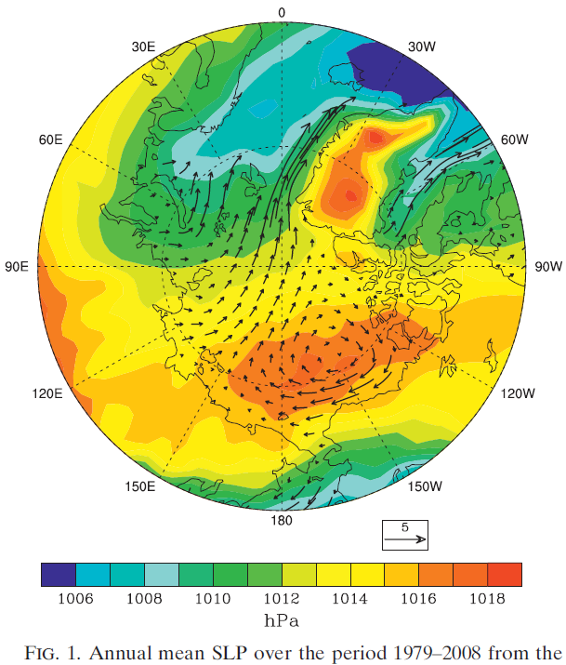
1. Feature of the Arctic atmospheric anomaly
Vectors: sea ice velocity
Serreze and Barrett, 2011, J. Climate
Notes:
In all seasons but autumn, there is a strong high pressure system over the Beaufort ['bəufət] Sea.
Such a high pressure is usually associated with positive surface temperature anomalies over much of the Arctic Ocean.

Slide 3
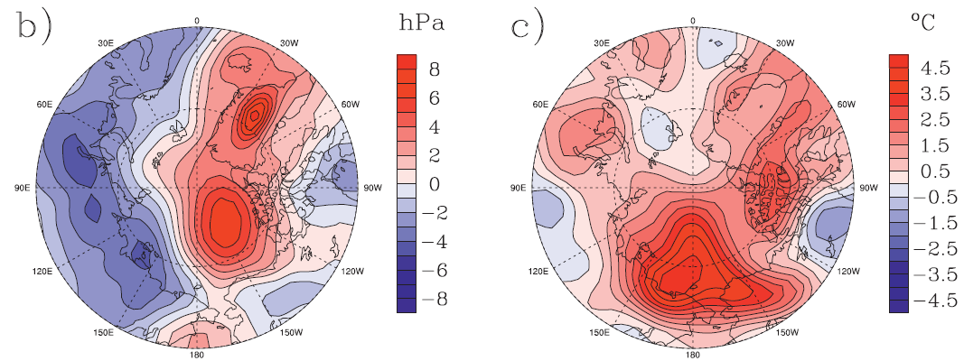
1. Feature of the Arctic atmospheric anomaly
SLP anomaly in JJA 2007
925-T anomaly in JJA 2007
Serreze and Barrett, 2011, J. Climate
3
Notes:
1. The record September sea ice minimum of 2007 have called many studies to focus on the summer Arctic atmospheric circulation.

Slide 4
1. Feature of the Arctic atmospheric anomaly
Regression of JJA Z200 onto Sep sea ice
“trends in summertime atmospheric circulation may have contributed as much as 60% to the September sea-ice extent decline since 1979”
4
Ding et al 2017, Nature Climate Change

Slide 5
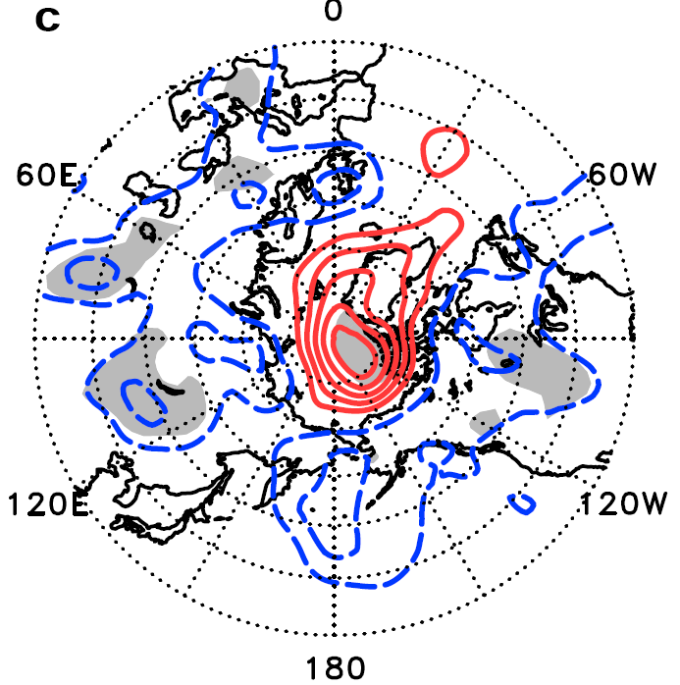
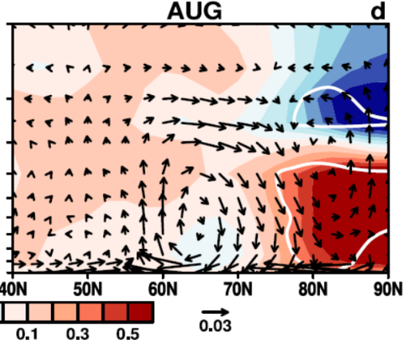
2.Contributors to the Arctic atmospheric anomaly
JJA, Z, 1000 hPa
“subsidence occurs over the cold Arctic and/or subarctic, giving rise to Arctic lower- to mid tropospheric warming as a result of adiabatic heating”
Regressed onto spring Eurasian snow cover
Matsumura et al., 2014, J. Climate
5

Slide 6
2. Contributors to the Arctic atmospheric anomaly
Annual mean, Z200 positive trend
Rossby wave from tropical Pacific
Ding et al 2014, Nature, Research Letter
6

Slide 7
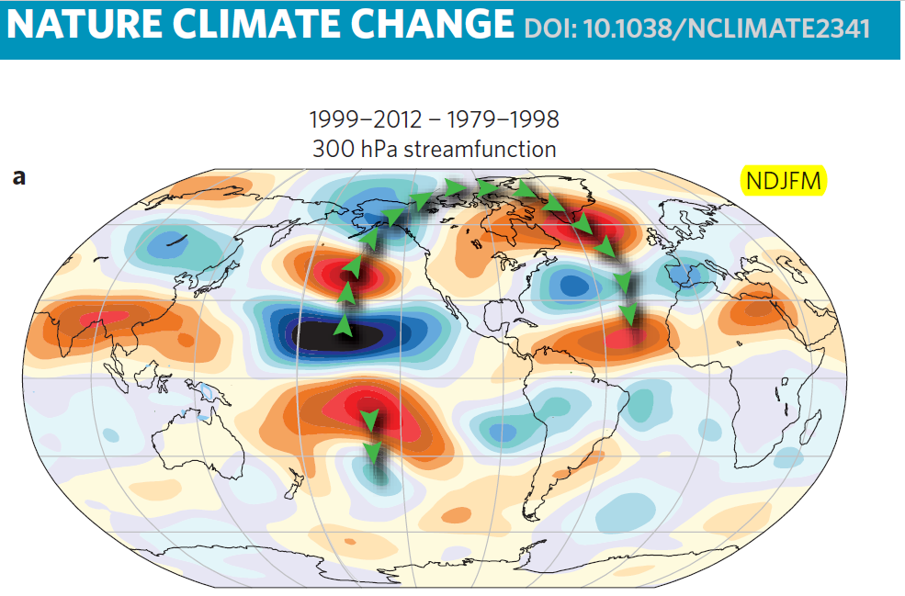
2. Contributors to the Arctic atmospheric anomaly
Trenberth et al 2014, Nature Climate Change
Notes:
In winters during 1999-2012, global warming slowed down and the Arctic shows significant warming.
These features are accompanied by upper tropospheric teleconnection wave patterns that extend throughout the Pacific, to polar regions, and into the Atlantic.
3. tropical Pacific forcing
4. Is there a teleconnection between the Arctic and the Pacific in summer?

Slide 8
3. Leading mode of Arctic Atmospheric circulation
Empirical Orthogonal Function (EOF) analysis
Time series of EOF1 for JJA Z200
Leading mode of JJA Z200
During 1979-2016 [ERA-interim]
Datasets: monthly atmospheric variables derive from ERA-Interim
8

Slide 9
4. Contribution from the extratropical North Pacific?
Z500 and wave activity flux related to
summer Arctic atmospheric circulation
9

Slide 10
4. Contribution from the extratropical North Pacific?
JJA Z200
May SST
Maximum covariance analysis
“looks for patterns in two space-time datasets which explain a maximum fraction of the covariance between them”
10

Slide 11
5. Possible explanation – dynamic analyses
(vwnd, omega) & temperature [shading]
“subsidence occurs over the cold Arctic and/or subarctic, giving rise to Arctic lower- to mid tropospheric warming as a result of adiabatic heating”
Matsumura et al., 2014, J. Climate
11

Slide 12
5. Possible explanation – model simulations
Whole Atmosphere Community Climate Model (WACCM, [Marsh et al., 2013])
Boundary conditions are the sea-ice concentration and SST and all fixed other external variables
Control experiment is forced by seasonal varying climatologic (1979–2000) sea-ice concentration and SST; integrated over 40 years;
Sensitivity experiment from January to December is performed, with SST perturbations in the extratropical North Pacific from May to August, while other months are prescribed by climatological SST; integrated over 60 years
12

Slide 13
5. Possible explanation – model simulations
200-hPa geopotential height anomalies
13

Slide 14
5. Possible explanation – model simulations
Zonal wind
Geopotential height
ERA-I
WACCM
14

Slide 15
5. Possible explanation – model simulations
T at 700 hPa
Zonal mean T
ERA-I
WACCM
15

Slide 16
6. Summary
reduced temperature gradient
reduced Eady growth rate
Decelerated circumpolar westerly
Subsidence & adiabatic heating
High & warming anomalies
16

Slide 17
Contributions from extratropical North Pacific to Arctic summer atmospheric temperature and circulation
Shengping He, [Shengping.He@uib.no]
Tore Furevik
Thanks for your attention!
[Postdoctor]: Geophysical Institute, University of Bergen and Bjerknes Centre for Climate Research

