Slide 1


Opposite response of low-latitude ionosphere at Asian and American sectors
during storm recovery phase: drivers from below and above
Chao Xiong¹, Hermann Lühr¹, and Yosuke Yamazaki¹
GFZ, German Research Centre for Geosciences, Telegrafenberg,
14473 Potsdam, Germany
ST3.2, D2643
1
8 May 2020, 14:00-15:45

Slide 2
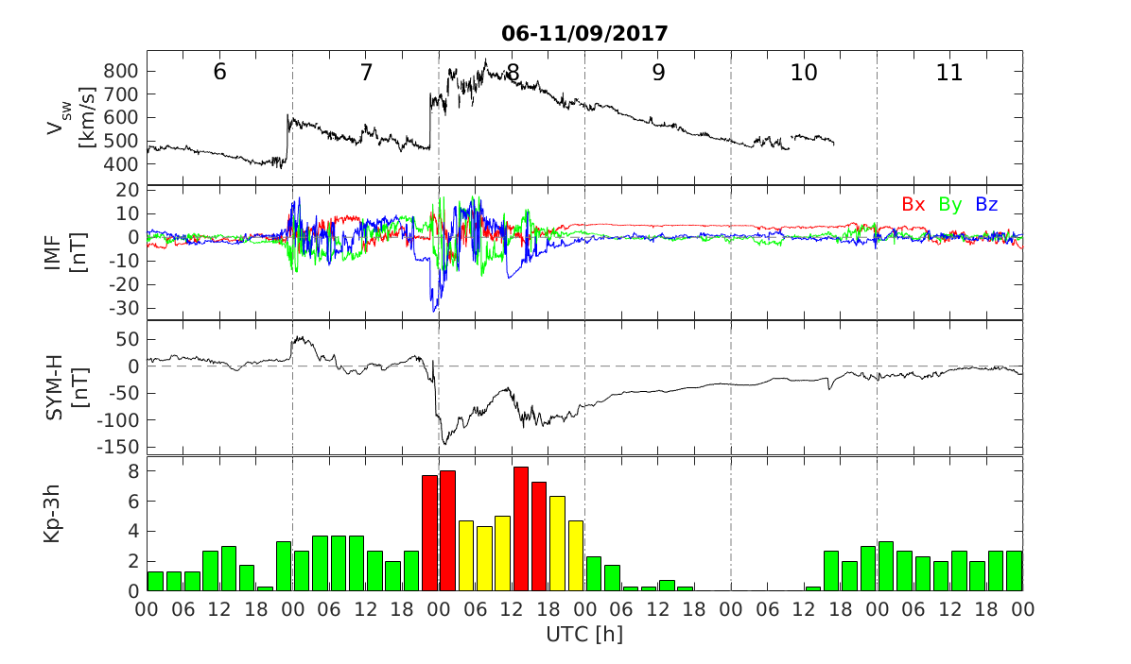
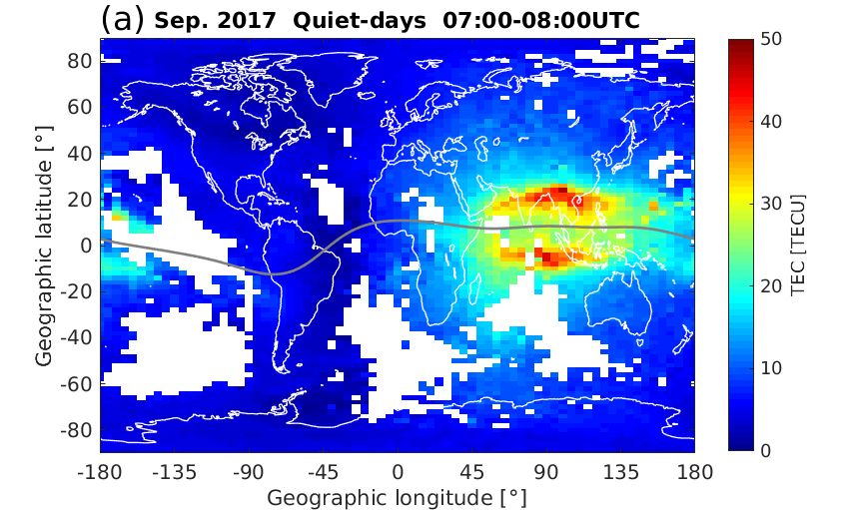
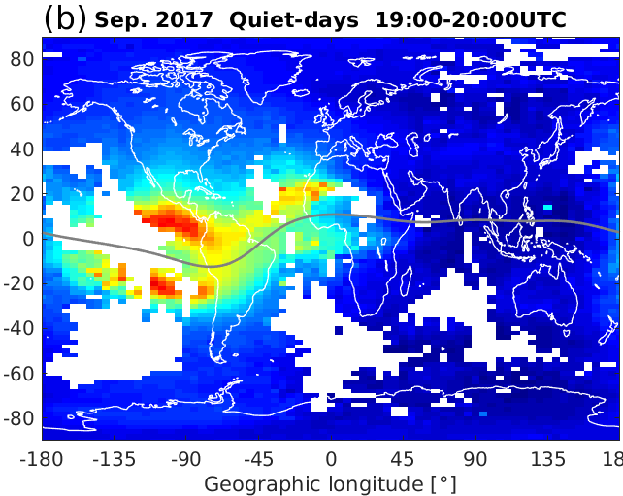
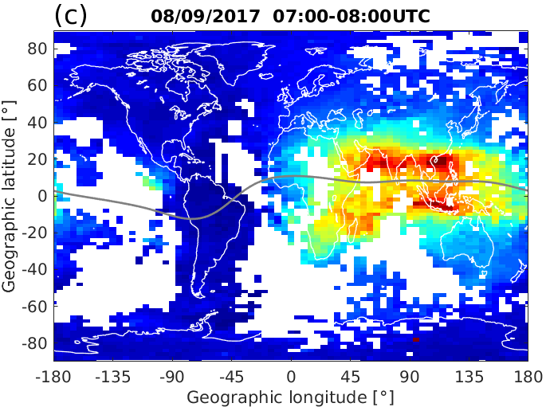
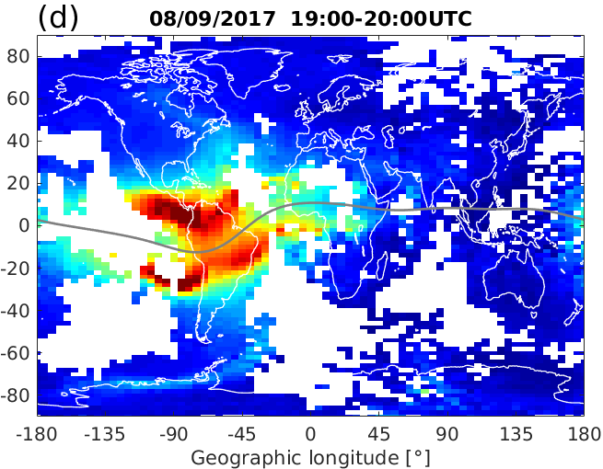
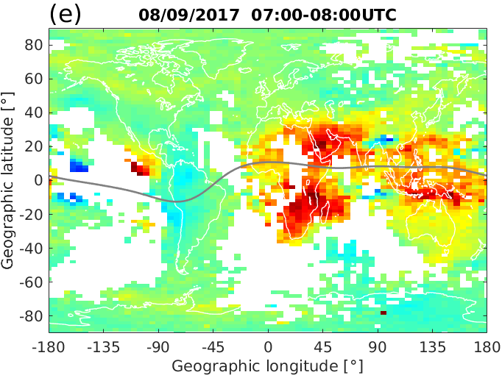
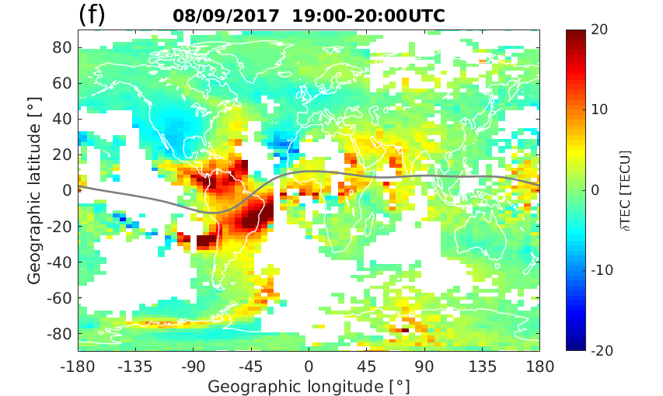
Geomagnetic storm on 07-08 September 2017: main phase
Quiet day
Main Phase
CME driven geomagnetic storm
Two storm main phases: southward Bz
Several solar flares (4 X-class and 27 M-class)
IMF are less dynamic on storm recovery phase
Asian and American sectors: local noon
Main phase: enhanced TEC at both longitudes
Main Phase
ST3.2, D2643
2
8 May 2020, 14:00-15:45

Slide 3
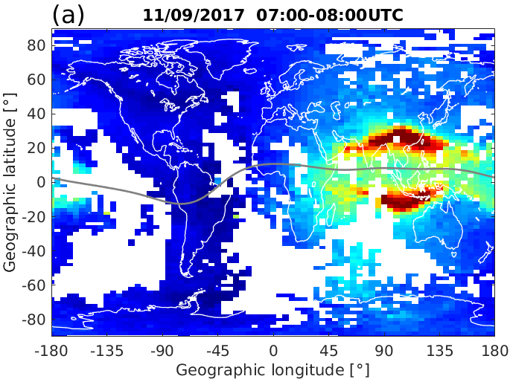
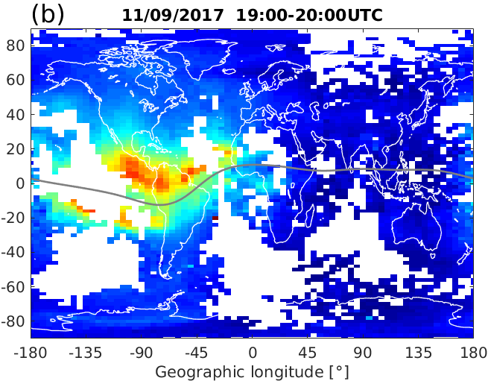
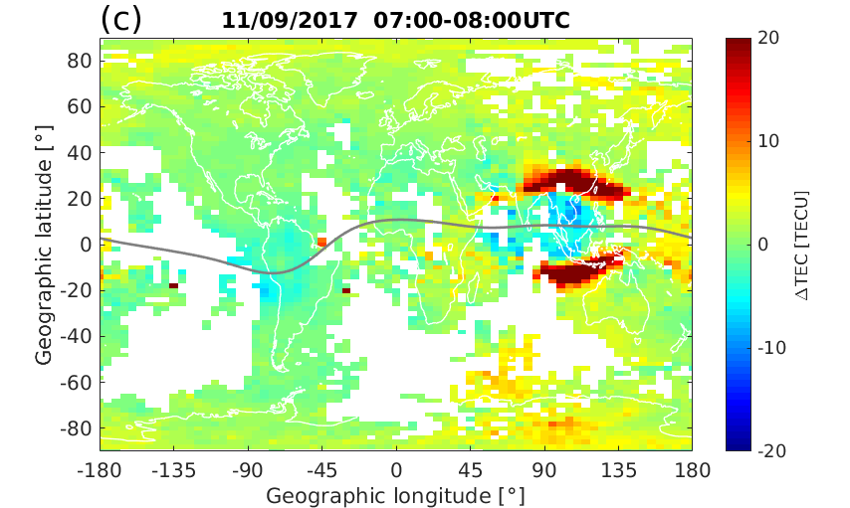
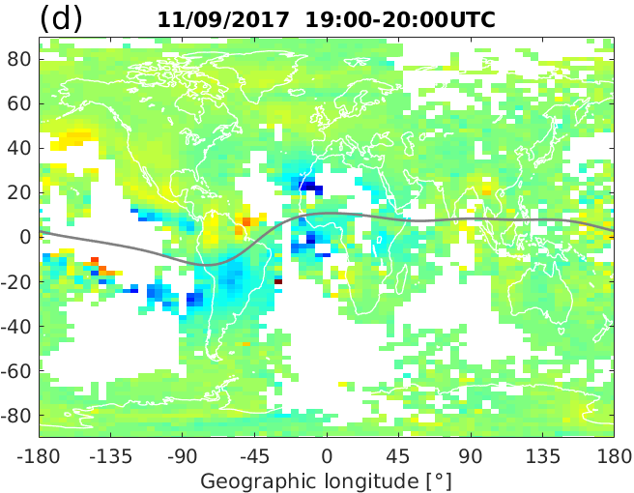
Geomagnetic storm on 07-08 September 2017: recovery phase
Recovery Phase
CME driven geomagnetic storm
Two storm main phases: southward Bz
Several solar flares (4 X-class and 27 M-class)
IMF are less dynamic on storm recovery phase
Asian and American sectors: local noon
Main phase: enhanced TEC at both longitudes
Recovery phase: Asian-> enhanced
American -> decreased
Recovery Phase
ST3.2, D2643
3
8 May 2020, 14:00-15:45

Slide 4
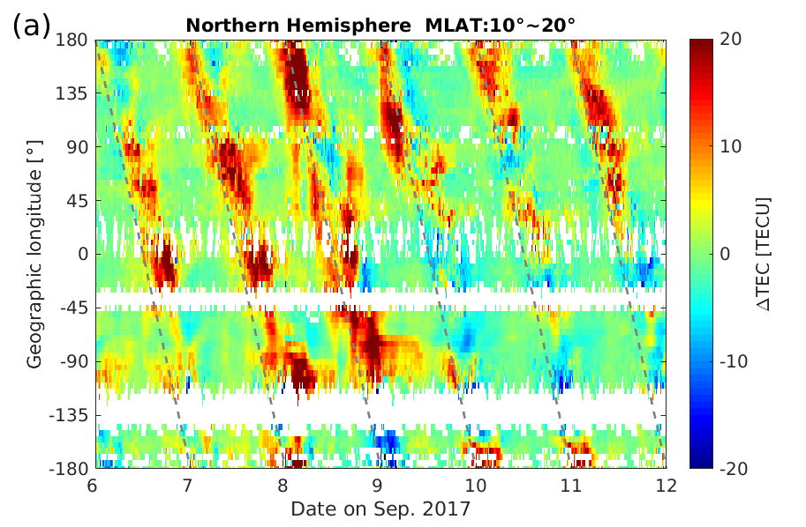
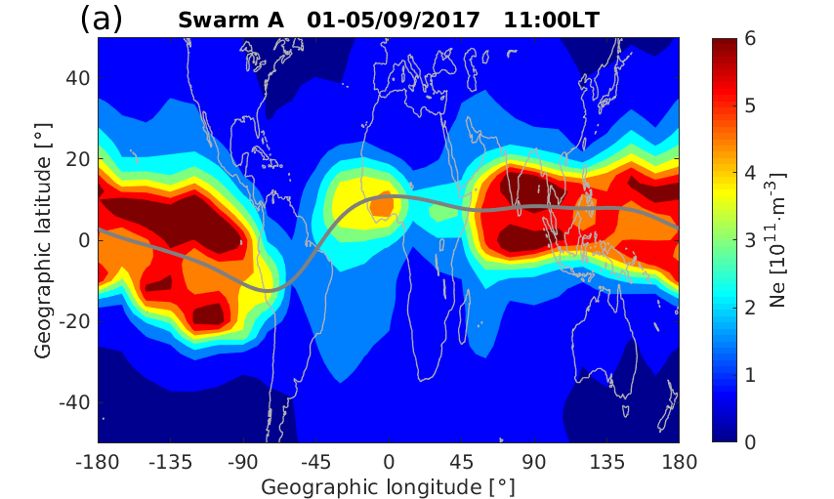
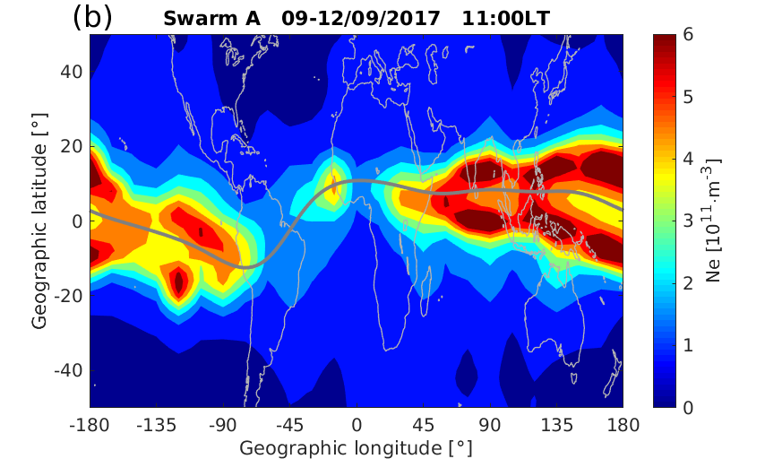
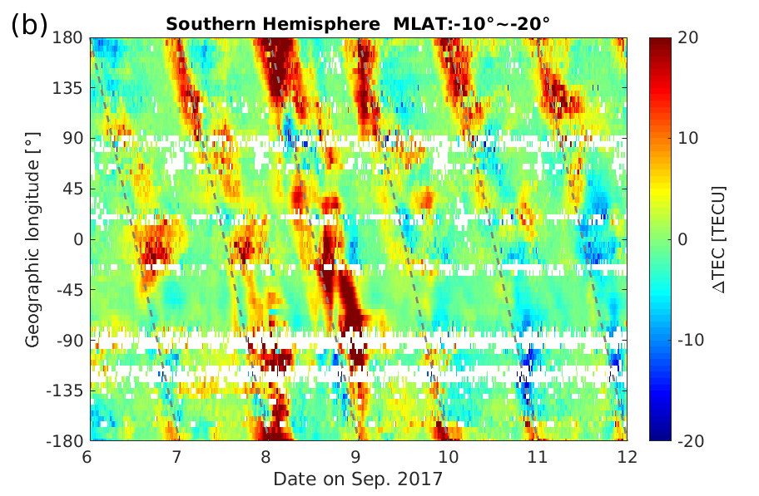
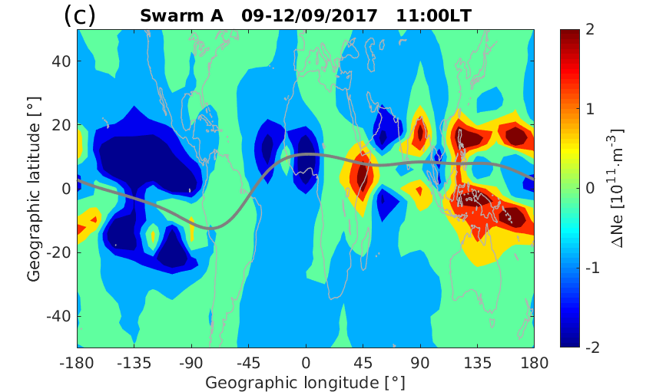
Ground-based TEC and F-region Ne from Swarm
F-region Ne
Swarm A
about 450 km
Northern EIA
10⁰-20⁰ MLAT
Recovery phase:
Asian-> enhanced
American -> decreased
Southern EIA
10⁰-20⁰ MLAT
ST3.2, D2643
4
8 May 2020, 14:00-15:45

Slide 5
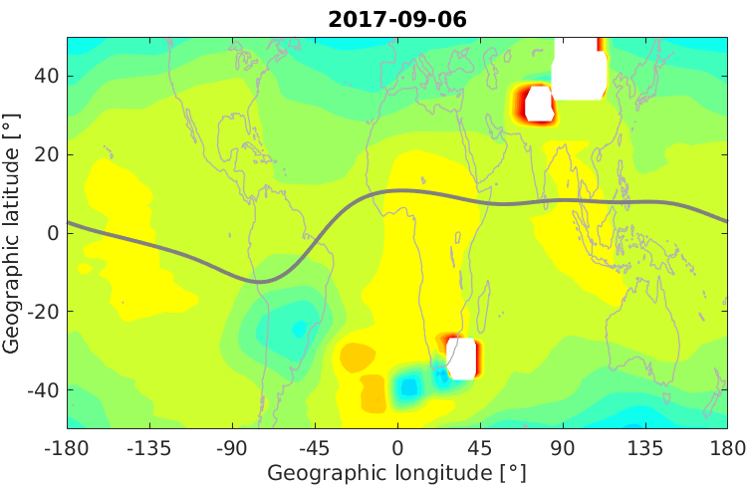
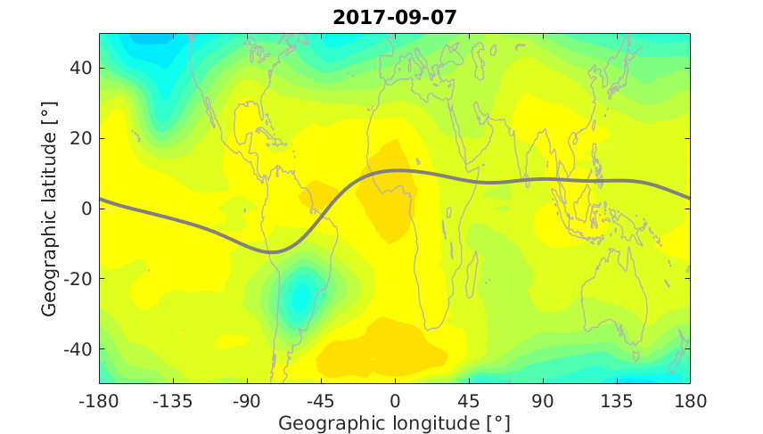
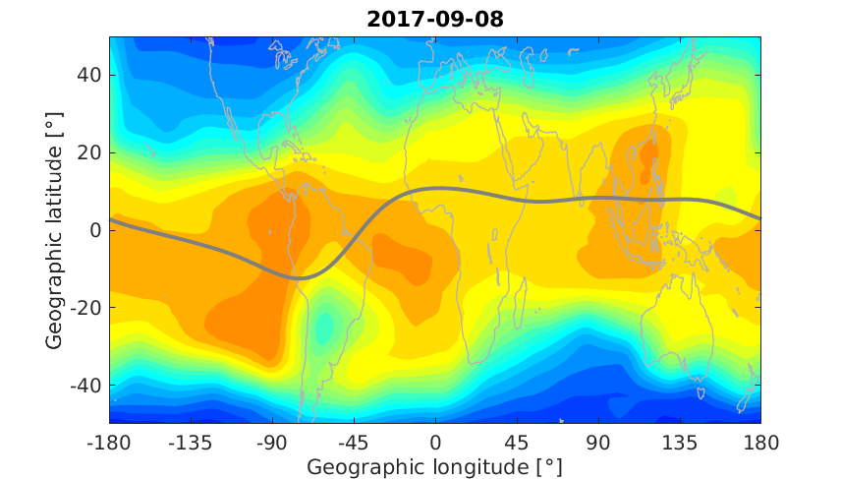
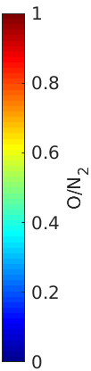
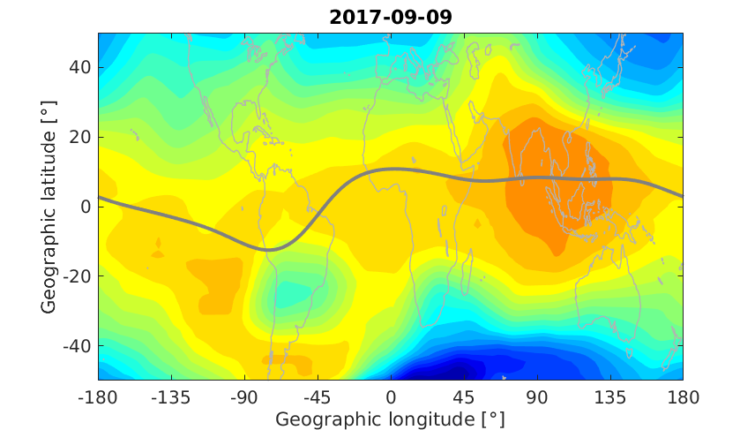
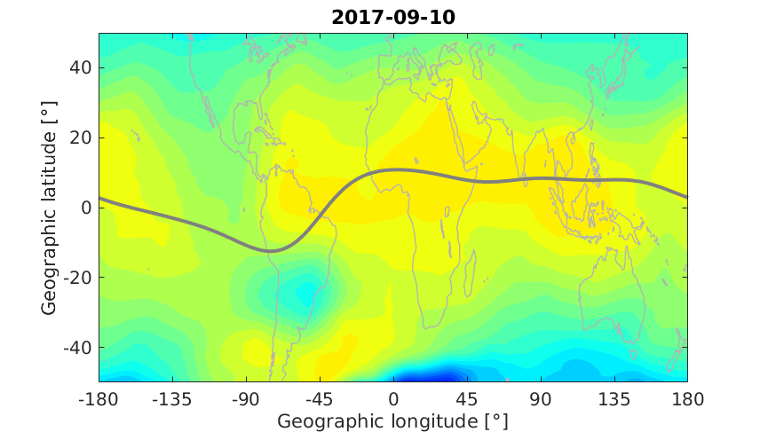
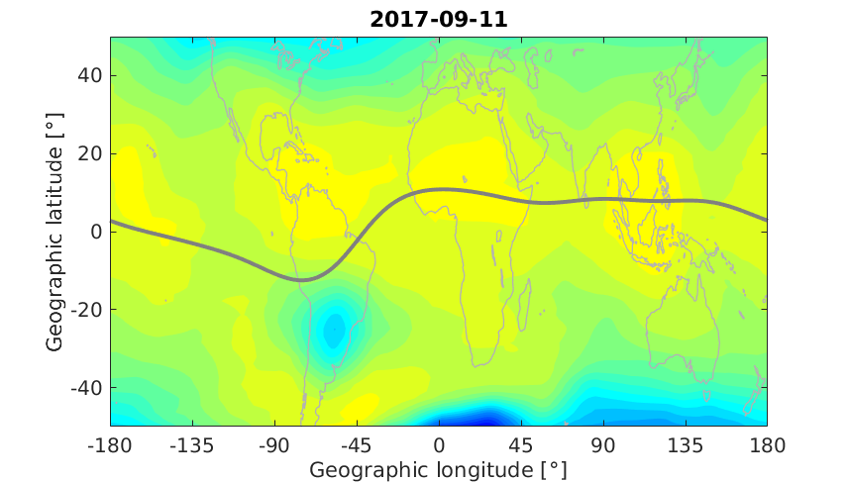
O/N₂ observations from GUVI onboard TIMED satellite (around 10:20 LT)
ST3.2, D2643
5
8 May 2020, 14:00-15:45

Slide 6
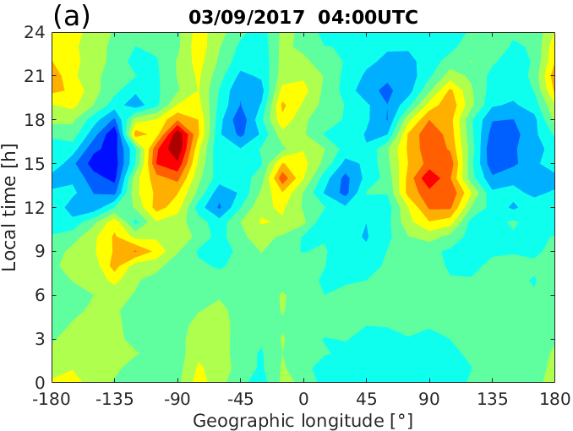
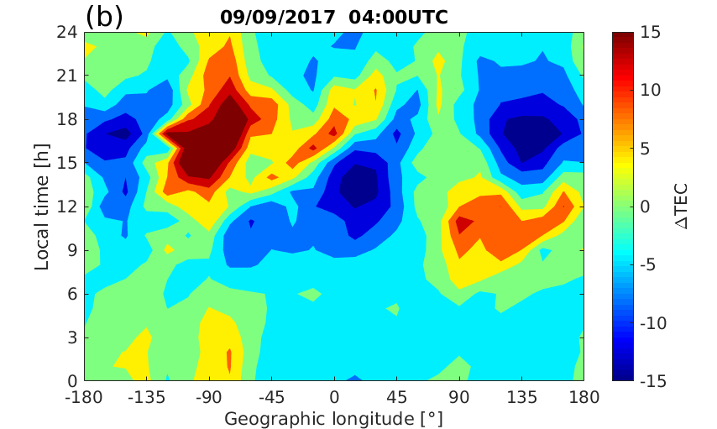
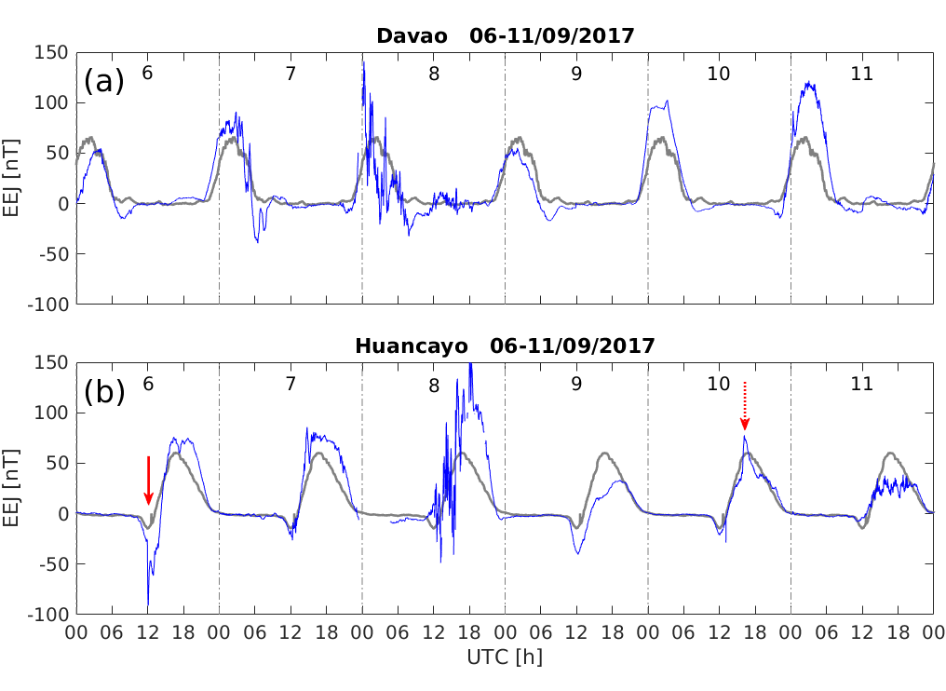
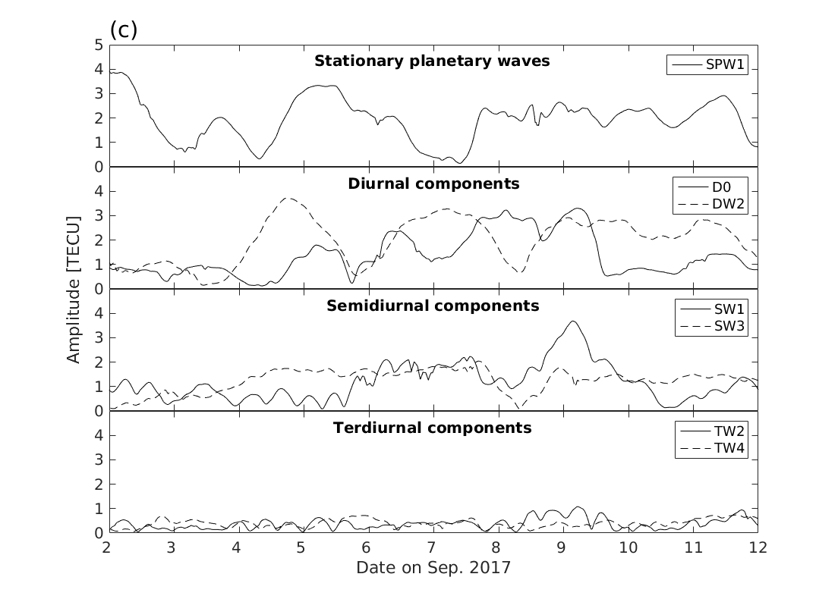
EEJ at Asian (Davao) and American (Huancayo) sectors, and Non-migrating tides derived from TEC
X8.2 class
X9.3 class
ST3.2, D2643
6
8 May 2020, 14:00-15:45

Slide 7
Summary
The ground-based TEC and F region Ne show both an interesting feature that at low and equatorial latitudes the dayside ionosphere exhibits a prominent positive and negative response at Asian and American sectors, respectively.
The global distribution of thermospheric O/N₂ ratio cannot well explain such longitudinal opposite response of ionosphere.
Comparison between the EEJ from stations at Huancayo and Davao suggests that the longitudinally opposite ionospheric response is closely associated with the interplay of E region electrodynamics.
By applying nonmigrating tidal analysis to TEC data, we find that the diurnal components, D0 and DW2, as well as semidiurnal component SW1 are clearly enhanced over pre-storm days and persist into the early recovery phase, indicating the possibility of lower atmospheric forcing contributing to the longitudinal opposite response of ionosphere on 9-11 September 2017.
Ref: Xiong, C., H. Lhr, Y. Yamazaki (2019), An opposite response of the low-latitude ionosphere at Asian and American sectors during storm recovery phases: drivers from below or above, JGR-Space Physics, https://doi.org/10.1029/2019JA026917.
ST3.2, D2643
7
8 May 2020, 14:00-15:45

