Slide 1

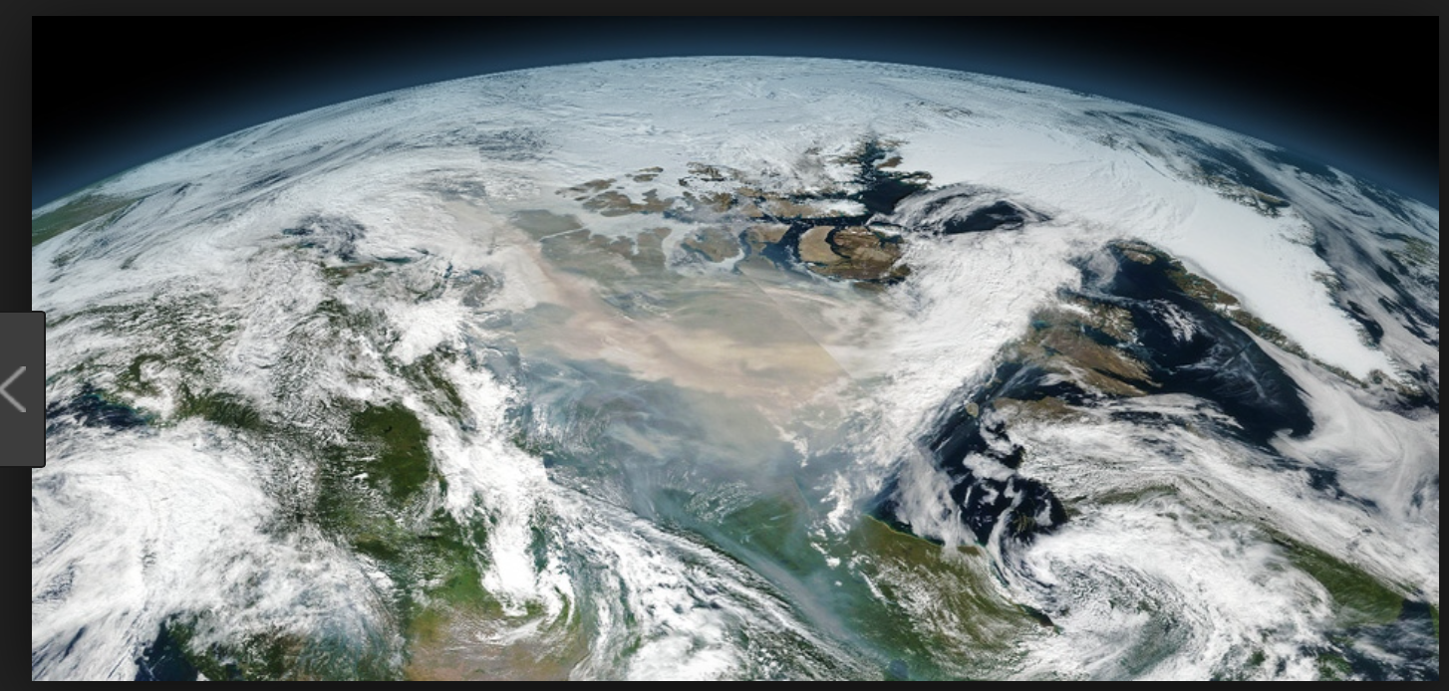
Global-scale Multidecadal variability driven by the Atlantic multidecadal oscillation
National Science Review,
accepted
Young-Min Yang
Co-authors : S.-I. An, , J. H. Park and B. Wang

Slide 2
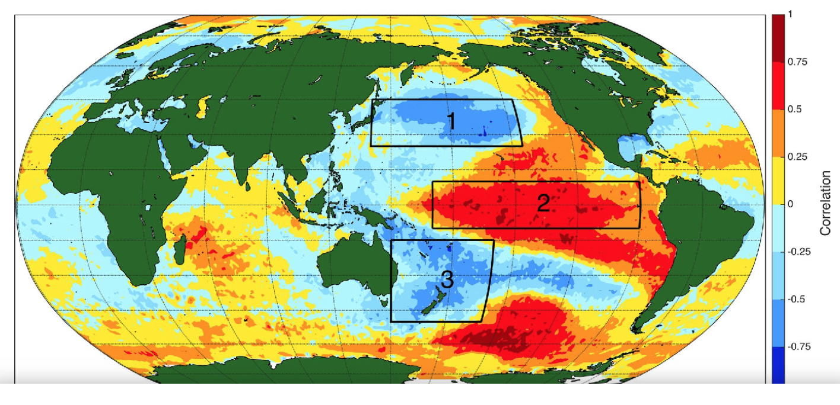
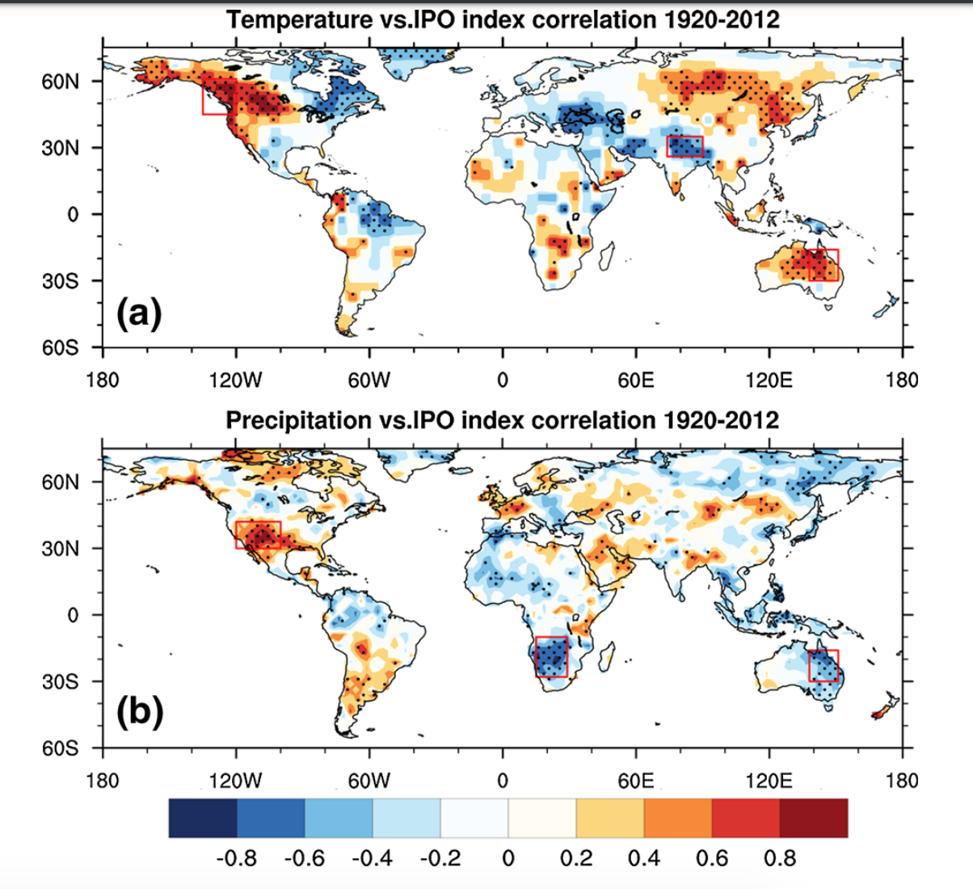
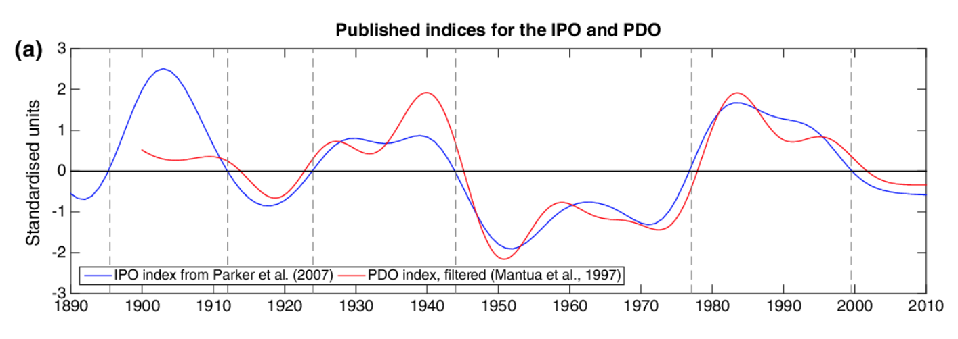
Introduction – Interdecadal Pacific Oscillation
EOF analysis of global SST
(120-280E, 40S-60N, 1900-2014)

Slide 3
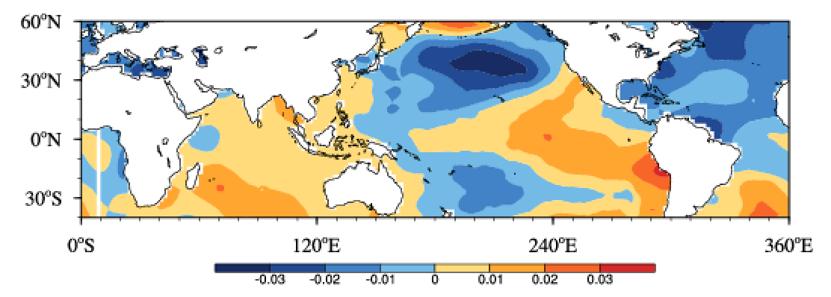
Global-scale Multidecadal Variability (GMV)
EOF analysis of global SST
(detrended, 11yr running mean)
(0-360E, 40S-60N, 1900-2014)
(a) 1st EOF (68.6%)
ENSO-like pattern in the tropical Pacific
a PDO-like pattern in the North Pacific.
Similar pattern in the South Pacific with a relatively weak magnitude.
an AMO negative phase In the North Atlantic,
In PC, two positive phases (1900–1921, 1972–1998) and two negative phases (1922–1972, 1999–2014) (red line in figure c)
(b) 2nd EOF (8.94%)
GMV
(c) Time series of PC
1st EOF (x0.01)
2nd EOF (x0.02)

Slide 4
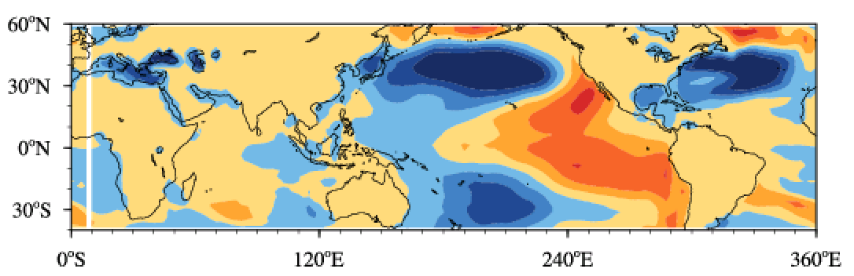
Is “GMV” independent on “IPO” ?
(a) GMV
(b) IPO
Horizontal
pattern
Power spectrum
analysis

Slide 5
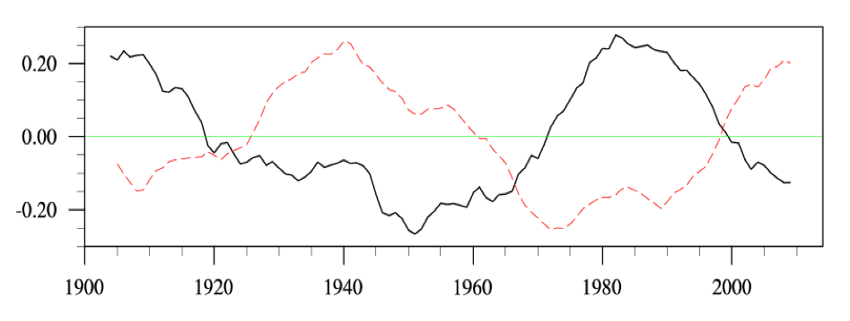
Relationship between AMO and GMV
(a) Horizontal
EOF2 (8.94%)
(d) PC
cor. = -0.71
Horizontal
pattern
GMO (x0.02)
AMO
(a) GMV
(b) AMO
Power spectrum
analysis

Slide 6
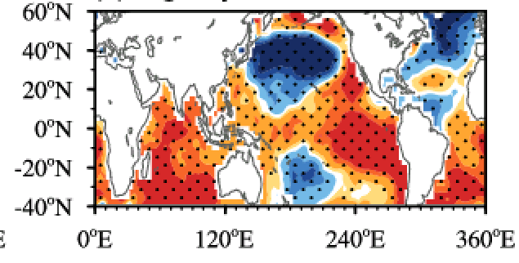
Relationship between AMO and global SST
GMV horizontal pattern

Slide 7
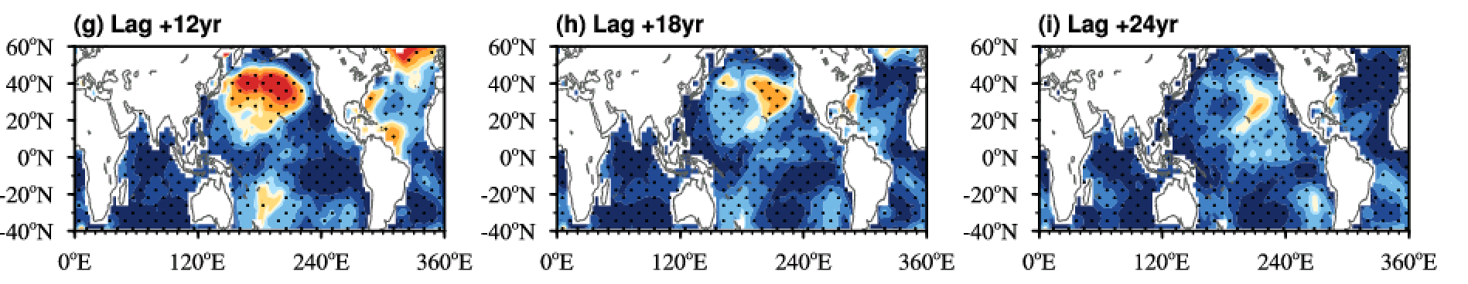
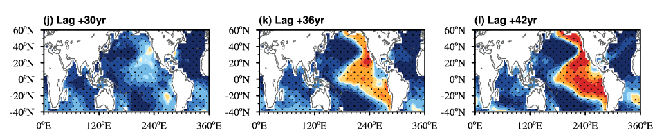

Slide 8
Numerical experiment
NESM3 : Atmosphere (ECHAM 6.3)+Land (JSBACH)+Ocean(NEMO) + Sea ice (CICE)
* Reasonable AMO simultions as well as SST climatology and its evolution according to GHG forcings
NESM3 with AMO SST anomalies (1900-2014) over AMO region
NESM3 with climatological SST (1900-2014) over AMO region
In Other regions, the atmosphere and ocean is freely coupled

Slide 9
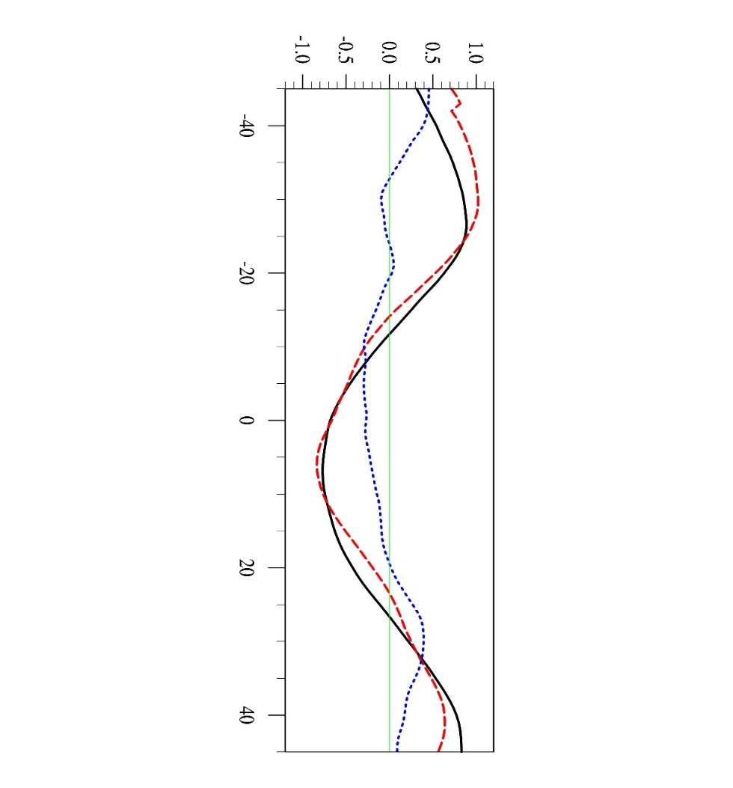
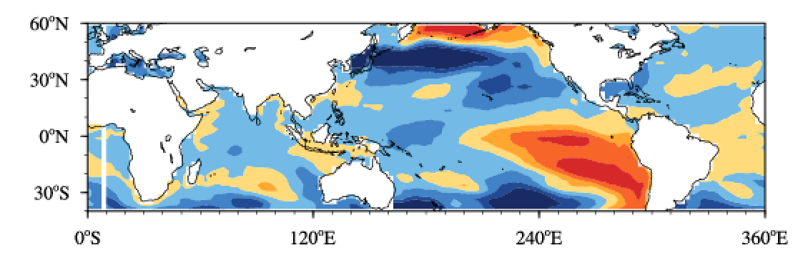
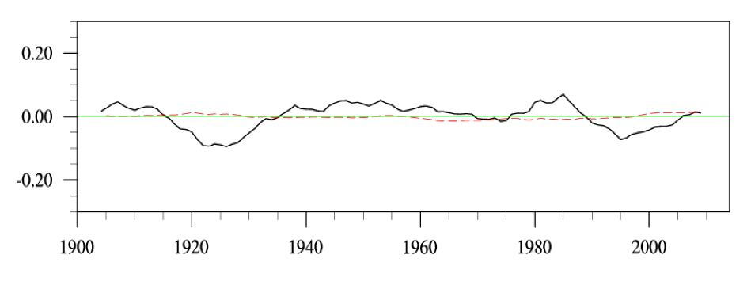
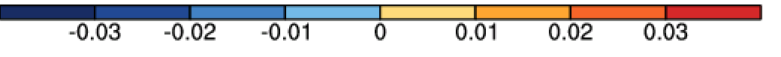
AMO can induce GMV? (Model results)
(a) OBS
EOF2 (8.94%)
(d) OBS
cor. = -0.71
GMO (x0.02)
AMO
(b) NESM_AMO
EOF2 (9.05%)
(e) NESM_AMO
cor. = -0.80
(g)
GMO (x0.02)
OBS
AMO
NESM_AMO
NESM_CLIM
AMO lead
(c) NESM_CLM
EOF2 (5.65%, 0.41)
(f) NESM_CLIM
cor. = -0.39
GMO (x0.02)
AMO

Slide 10
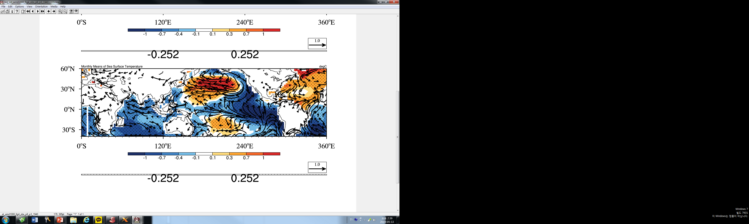
How AMO can induce GMV?
(a) Observation (regressed on AMO index
Lag -6 years (1000 hPa)
Lag -6 years (200 hPa)
Lag 0 years (1000 hPa)
Lag 0 years (200 hPa)
Lag +6 years (1000 hPa)
Lag +6 years (200 hPa)
Fig. 3 Horizontal structure of (a-c) global SST (shading, K) and surface wind vectors (m s⁻¹), and (d-e) 200 hPa velocity potential (shading, 10⁵ m² s⁻¹) and divergent winds (m s⁻¹) from NESM_AMO, depicted by the regressed SST (K), surface wind vectors (m s⁻¹), 200 hPa velocity potential (10⁵ m² s⁻¹) and divergent winds (m s⁻¹) onto the AMO index (0°S–70°N, 80W°–0°W) with lead times of -6 years (top), 0 years (middle) and =6 years (bottom). 11yrs running mean data are used and long-term linear trends in SST data were removed prior to the regression analysis. The dotted area represents 95% significance level.

Slide 11
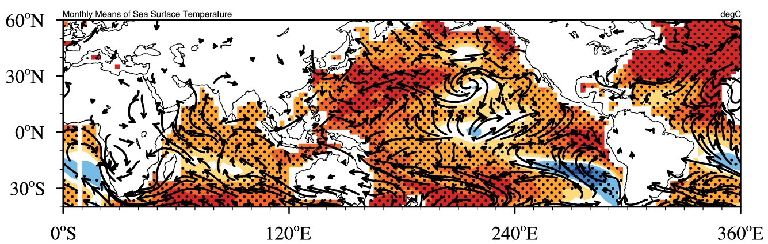
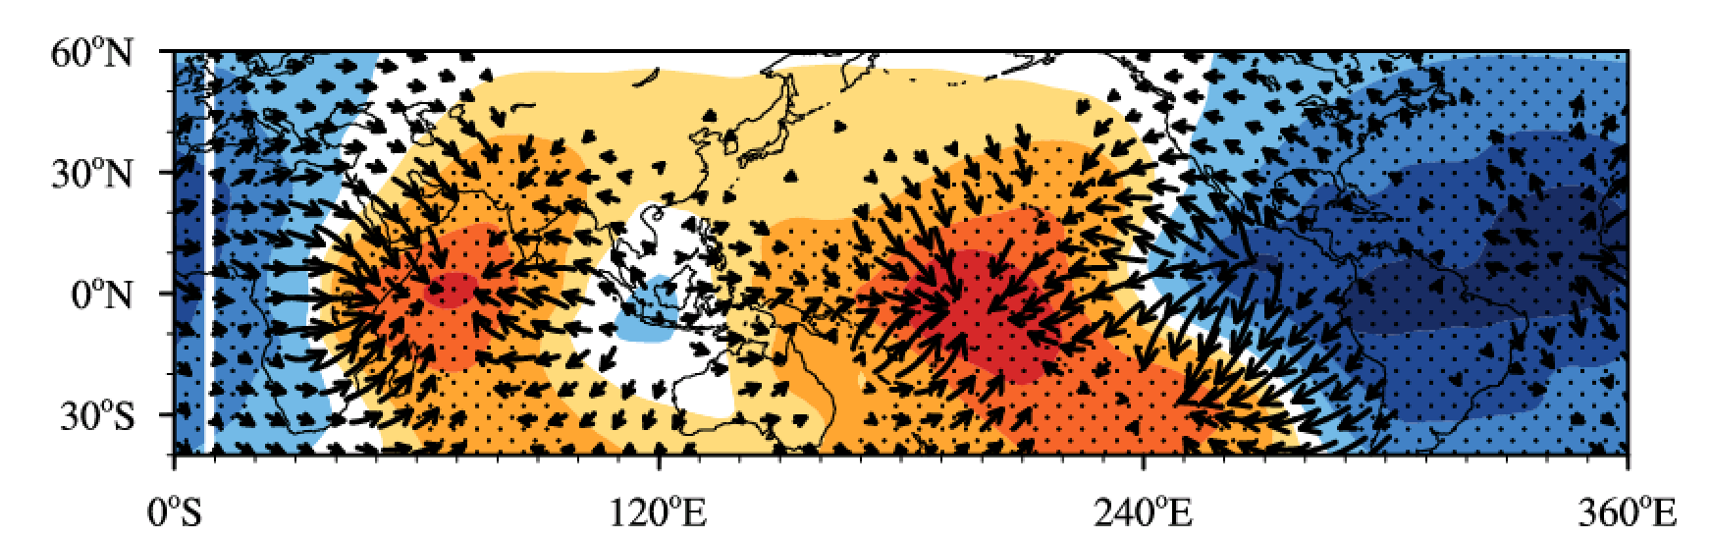
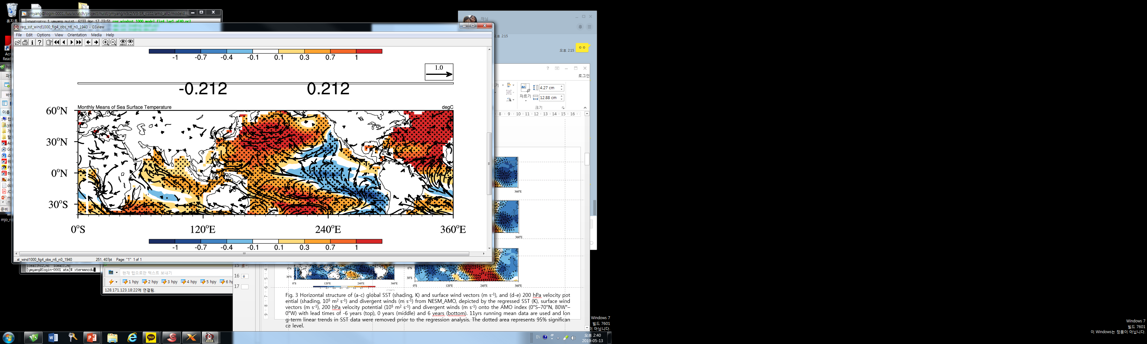
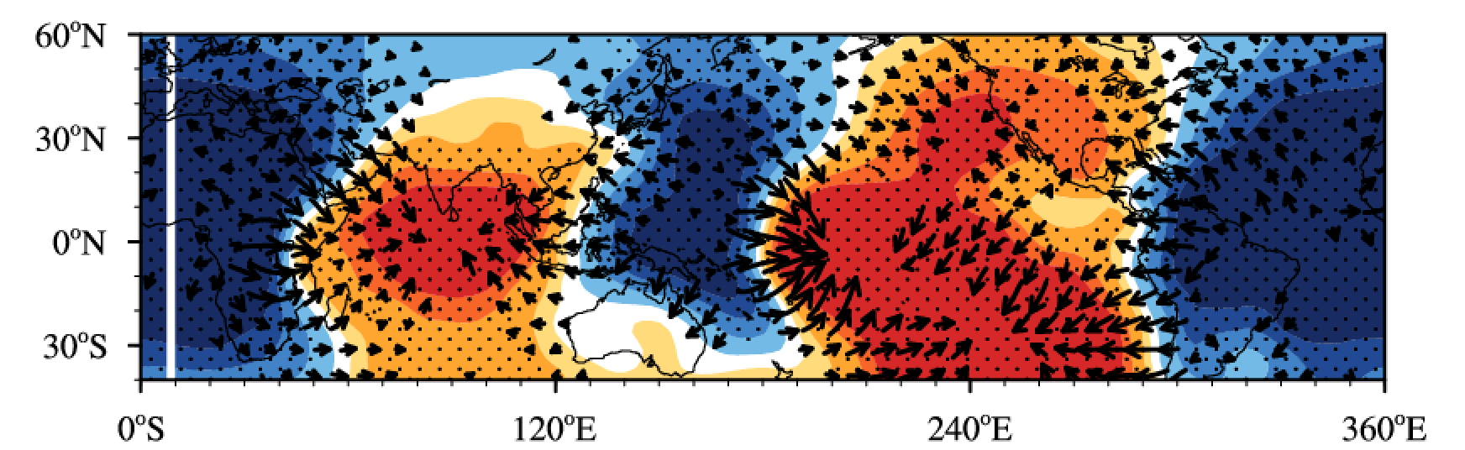
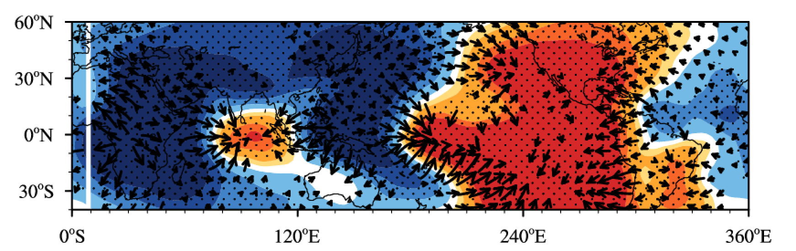
(b) NESM_AMO
Lag -6 years (1000 hPa)
Lag -6 years (200 hPa)
Lag 0 years (1000 hPa)
Lag 0 years (200 hPa)
(c) Lag 6 years
Lag +6 years (1000 hPa)
Lag +6 years (200 hPa)
Fig. 3 Horizontal structure of (a-c) global SST (shading, K) and surface wind vectors (m s⁻¹), and (d-e) 200 hPa velocity potential (shading, 10⁵ m² s⁻¹) and divergent winds (m s⁻¹) from NESM_AMO, depicted by the regressed SST (K), surface wind vectors (m s⁻¹), 200 hPa velocity potential (10⁵ m² s⁻¹) and divergent winds (m s⁻¹) onto the AMO index (0°S–70°N, 80W°–0°W) with lead times of -6 years (top), 0 years (middle) and =6 years (bottom). 11yrs running mean data are used and long-term linear trends in SST data were removed prior to the regression analysis. The dotted area represents 95% significance level.

Slide 12
Possible mechanisms & other issues
Upper ocean (thermocline depth) may induce GMV
Aerosol or global warming forcing may induce GCM
Pacific may induce AMO

Slide 13
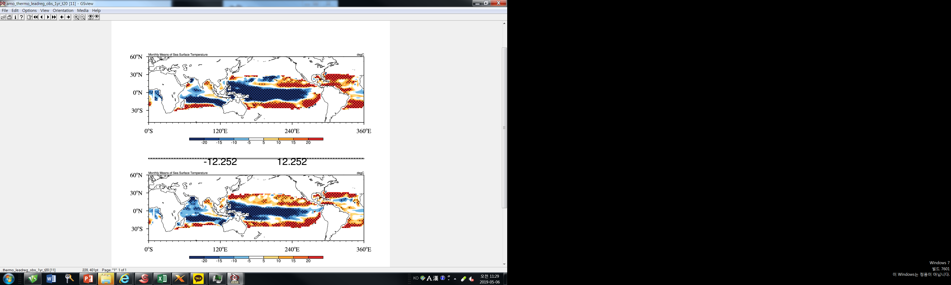
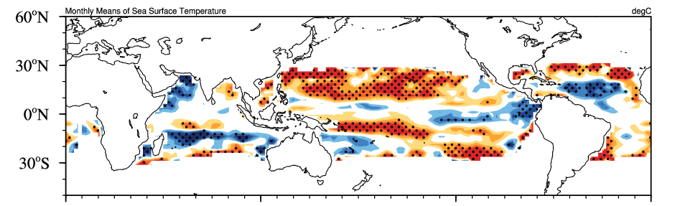
Can Thermocline depth can induce GMV?
(a) Lag -9 years
Lag -6 years (1000 hPa)
(b) Lag 0 years (1000 hPa)
Lag 0 years (1000 hPa)
(b) Lag -3 years
Lag +6 years (1000 hPa)
(c) Lag +3 years

Slide 14
Can aerosol or global warming forcing can induce GMV?
Additional experiment with pre-industrial forcing and AMO SST anomalies
(d) NESM_AMO
(a) NESM_AMO
EOF2 (8.94%)
cor. = -0.80
GMO (x0.02)
AMO
(b) NESM_PI
EOF2 (9.05%)
cor. = -0.71
(c) NESM_PI (Power spectra)
GMO (x0.02)
AMO

Slide 15
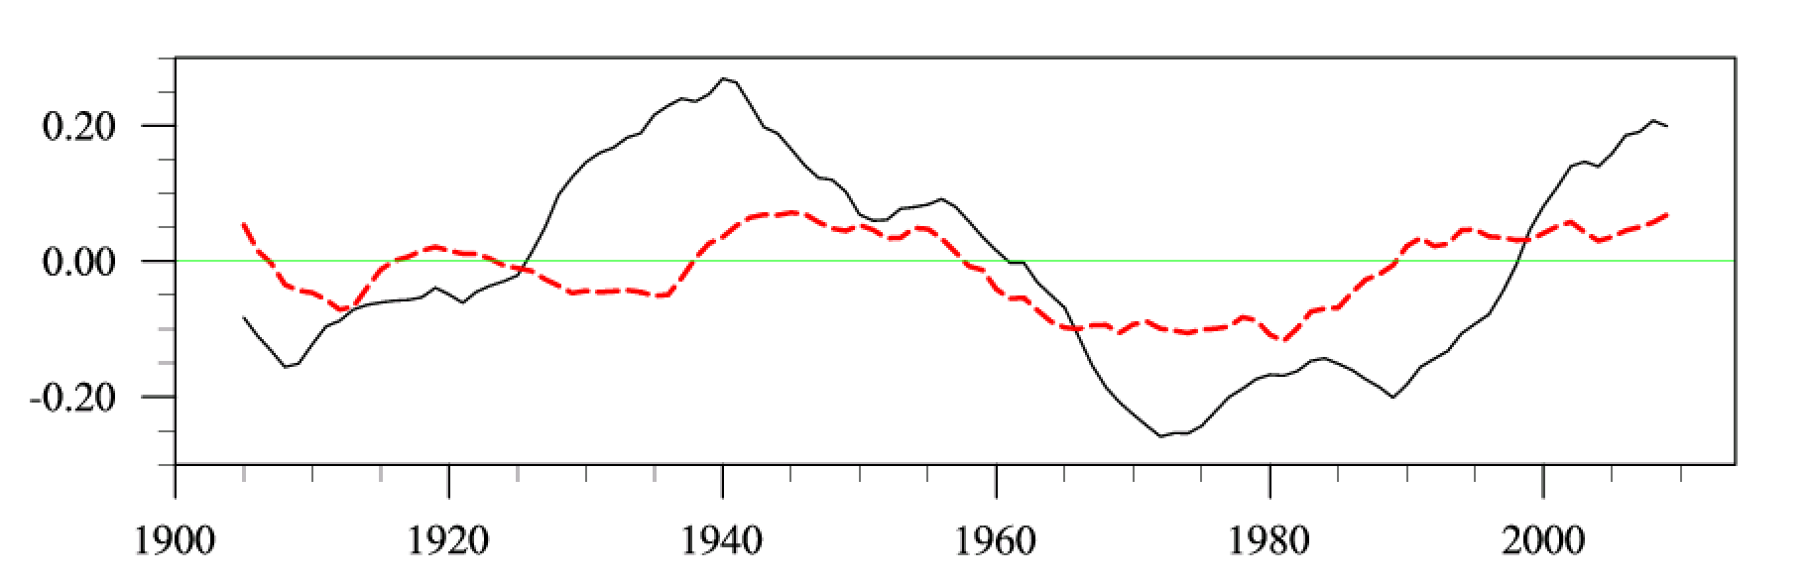
Can Pacific interdecadal oscillation can induce AMO ?
(a) NESM_IPO
EOF2 (9.1%)
cor. = 0.56
AMO (OBS)
AMO (NESM_IPO)
Figure S4. Horizontal pattern (left panel) and time series (right panel) of IPO from model simulations with observed SST over Pacific region (70°S-70°N,120°-280°E).

Slide 16
Summary
This study found a global SST variability with multi-decadal time scale, which is generated by long-term variability of North Atlantic ocean
through atmospheric teleconnection.

Slide 17
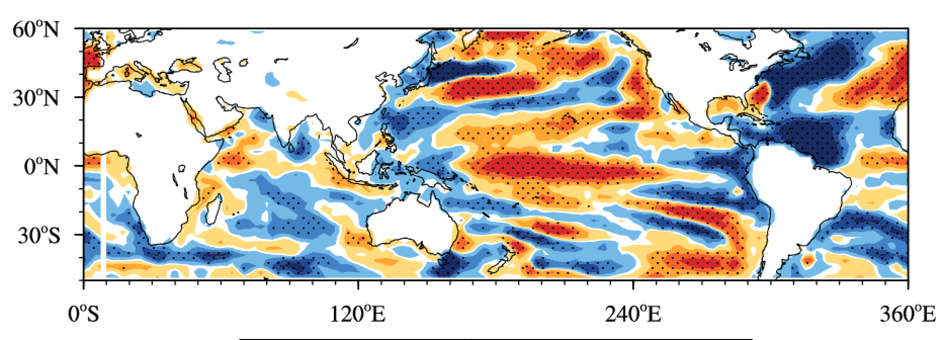
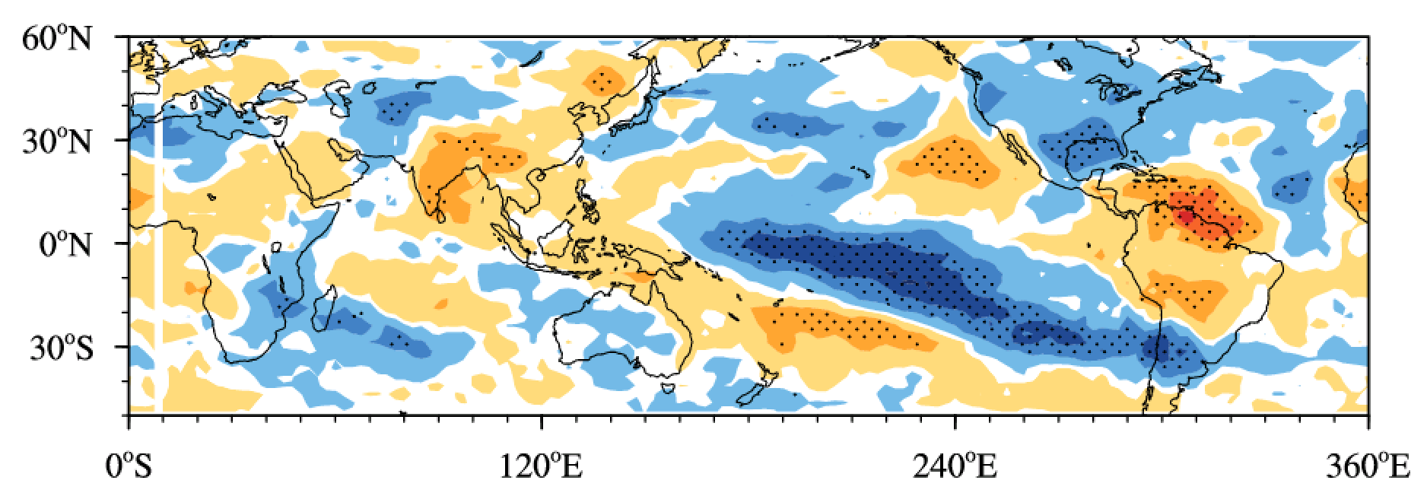
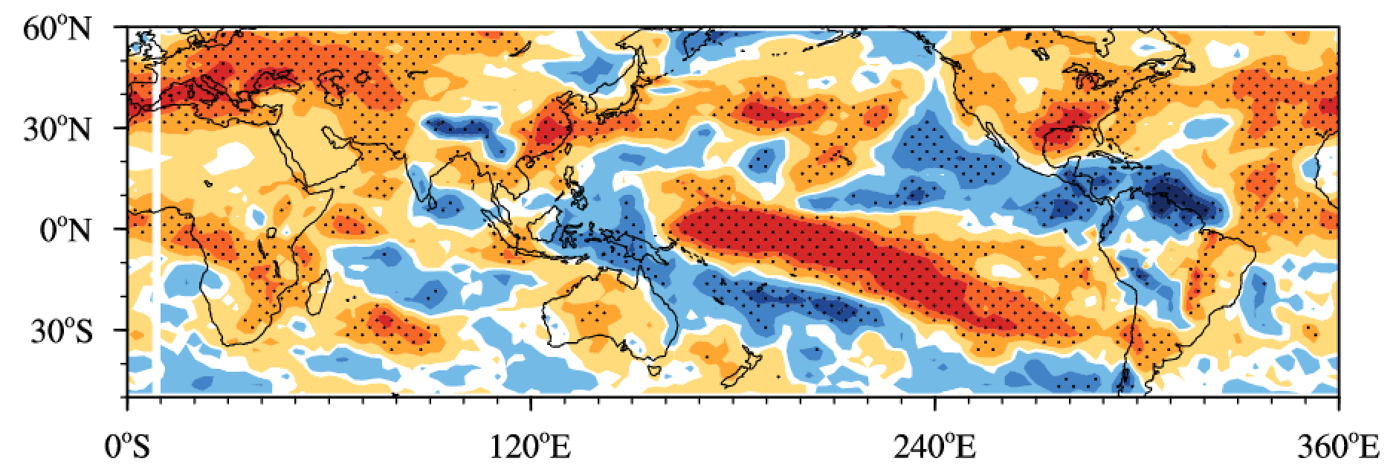
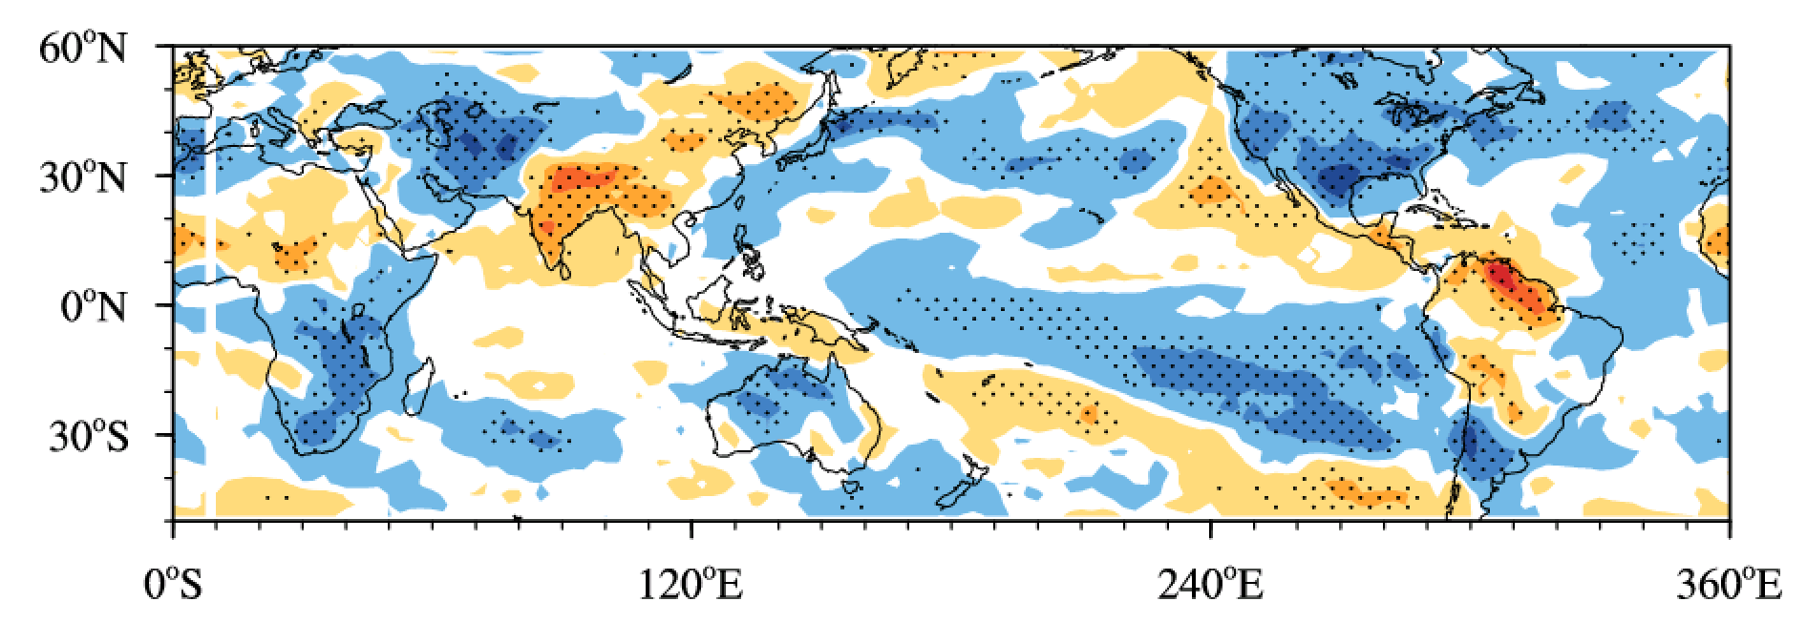
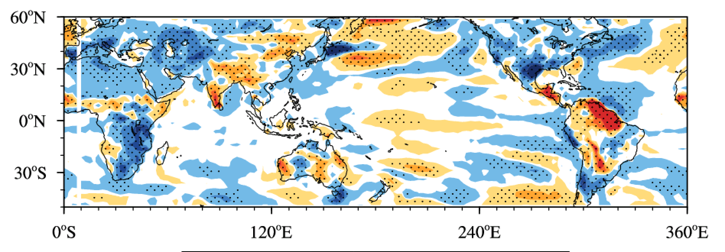
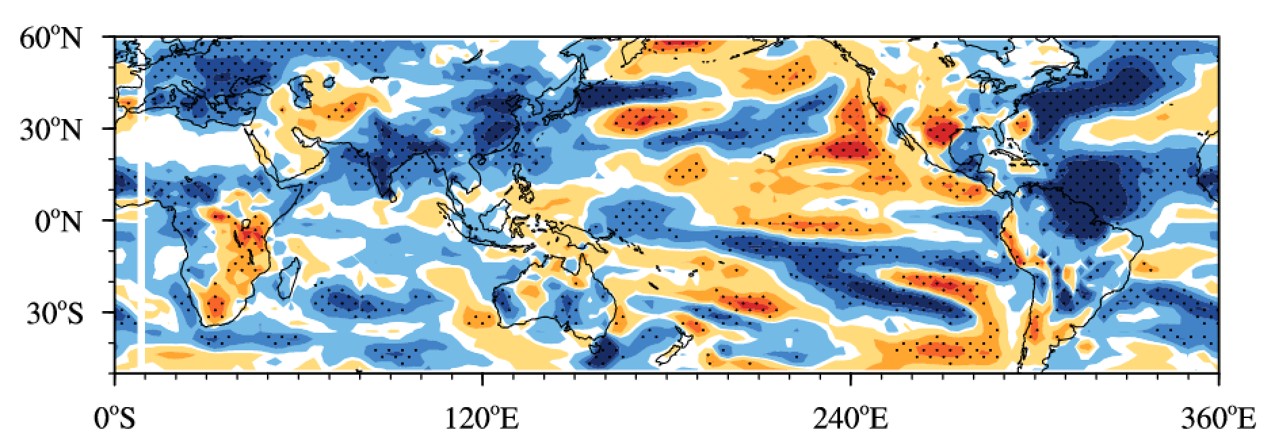
(a) Net surface heat flux
(b) Total cloud cover
(b) Lag +42yrs
(c) Shortwave radiation
(d) Longwave radiation
(e) Sensible heat flux
(f) Latent heat flux
Figure S4. The lagged regression coefficients of (a) net surface heat flux (W m⁻²), (b) total cloud cover (%), (c) shortwave radiation (W m⁻²), (d) longwave radiation (W m⁻²), (e) sensible heat flux (W m⁻²) and (f) latent heat flux (W m⁻²) anomalies on AMO index with 6yr from NESM_AMO.

Slide 18
Supplement figures

Slide 19
(b) NESM_AMO
Lag -6 years (1000 hPa)
Lag -6 years (200 hPa)
Lag 0 years (1000 hPa)
Lag 0 years (200 hPa)
Lag +6 years (1000 hPa)
Lag +6 years (200 hPa)
Fig. 3 Horizontal structure of (a-c) global SST (shading, K) and surface wind vectors (m s⁻¹), and (d-e) 200 hPa velocity potential (shading, 10⁵ m² s⁻¹) and divergent winds (m s⁻¹) from NESM_AMO, depicted by the regressed SST (K), surface wind vectors (m s⁻¹), 200 hPa velocity potential (10⁵ m² s⁻¹) and divergent winds (m s⁻¹) onto the AMO index (0°S–70°N, 80W°–0°W) with lead times of -6 years (top), 0 years (middle) and =6 years (bottom). 11yrs running mean data are used and long-term linear trends in SST data were removed prior to the regression analysis. The dotted area represents 95% significance level.

Slide 20
(a) 1st EOF (68.6%)
(b) 2nd EOF (8.94%)
(c) Time series of PC
1st EOF (x0.01)
2nd EOF (x0.02)

Slide 21
(a) GMV
(c) IPO
(b) AMO
(d) NESM_AMO

Slide 22
Fig. S1 Horizontal structure of global SST in observation, depicted by the regressed SST (K) onto the AMO index (0°S–70°N, 80W°–0°W) with different lead times at decadal timescales (11yrs running mean,1920-2018). The long-term linear trends in SST data were removed prior to the regression analysis.

Slide 23
Cor. = 0.76
Observaction (x0.02)
NESM_AMO (x0.02)
Fig. S2. Time series of IPO from observation and NESM_AMO

Slide 24
OBS
NESM_AMO
NESM_CLIM

Slide 25
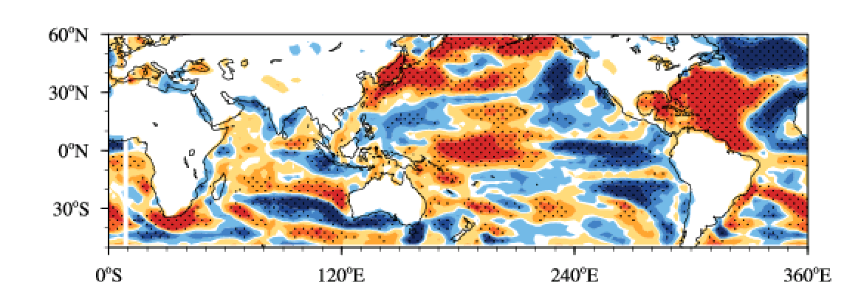
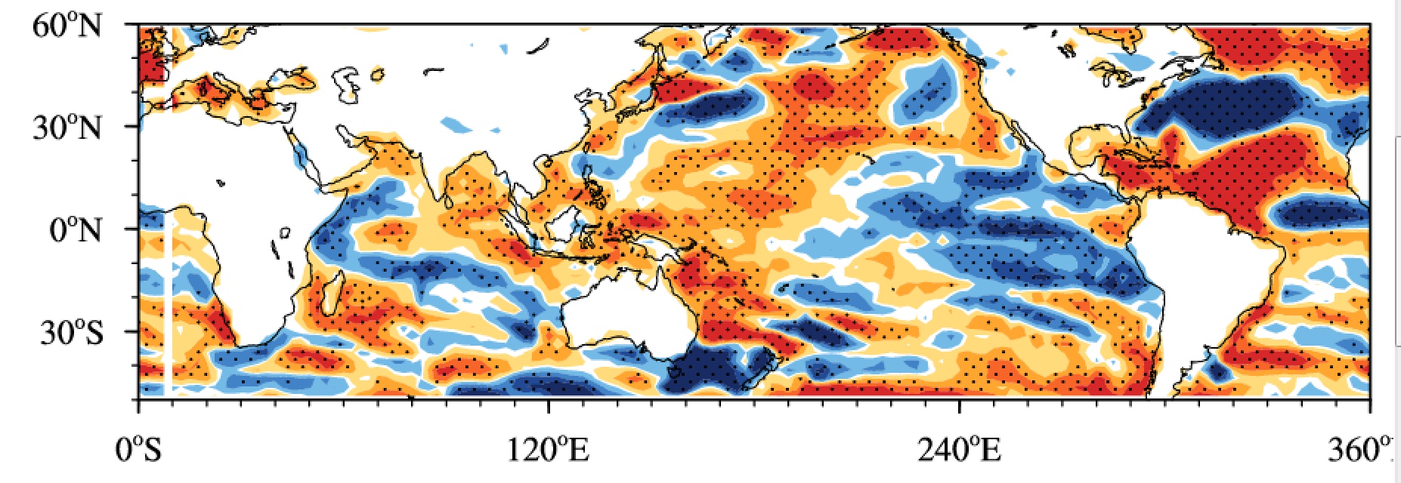
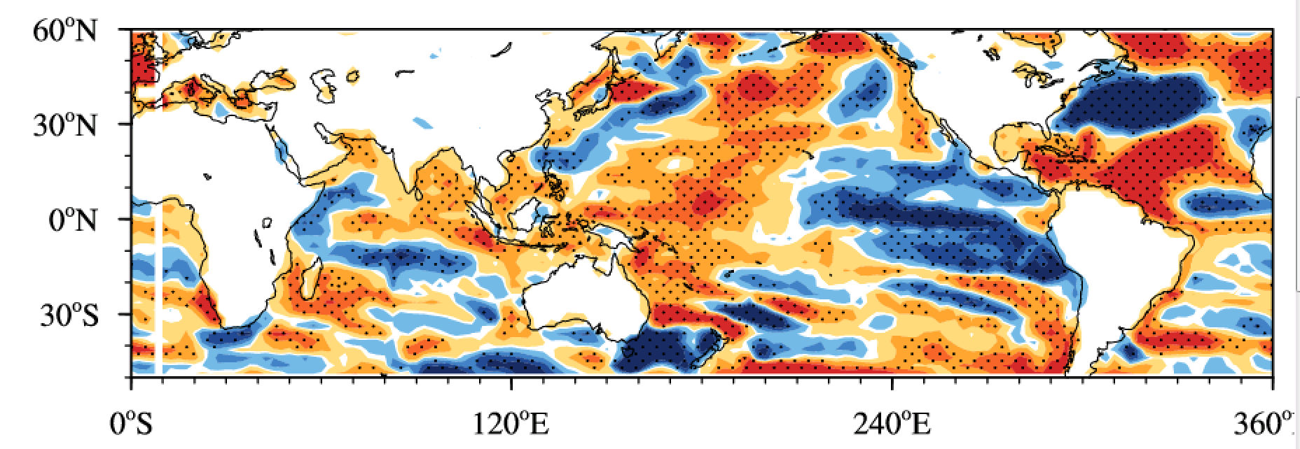
(a) Lag -9 years (net heat flux)
Figure S3. The lagged regression coefficients of net surface heat flux (W m⁻²) anomalies on AMO index with (a) -9 yr, (b) -3 year and (c) +3yr from NESM_AMO. The latitude-depth structure of ocean circulation averaged over 200E-260E, depicted by the regressed ocean circulation onto the AMO index (0°S–70°N, 80W°–0°W) with lead times of -9 years. 11yrs running mean data are used and long-term linear trends in SST data were removed prior to the regression analysis.
(b) Lag -3 years (net heat flux)
(c) Lag +3years (net heat flux)

Slide 26
(a) NESM_IPO
EOF2 (9.1%)
cor. = 0.56
AMO (OBS)
AMO (NESM_IPO)
Figure S4. Horizontal pattern (left panel) and time series (right panel) of IPO from model simulations with observed SST over Pacific region (70°S-70°N,120°-280°E).

Slide 27
Observation (x0.02)
NESM_AMO (x0.02)
Fig. S2. Time series of IPO from observation and NESM_AMO

Slide 28
(a) Lag -6 years (1000 hPa)
(d) Lag -6 years (200 hPa)
(b) Lag 0 years (1000 hPa)
(e) Lag 0 years (200 hPa)
(c) Lag 6 years
(c) Lag +6 years (1000 hPa)
(f) Lag +6 years (200 hPa)
Fig. 3 Horizontal structure of (a-c) global SST (shading, K) and surface wind vectors (m s⁻¹), and (d-e) 200 hPa velocity potential (shading, 10⁵ m² s⁻¹) and divergent winds (m s⁻¹) from NESM_AMO, depicted by the regressed SST (K), surface wind vectors (m s⁻¹), 200 hPa velocity potential (10⁵ m² s⁻¹) and divergent winds (m s⁻¹) onto the AMO index (0°S–70°N, 80W°–0°W) with lead times of -6 years (top), 0 years (middle) and =6 years (bottom). 11yrs running mean data are used and long-term linear trends in SST data were removed prior to the regression analysis. The dotted area represents 95% significance level.

Slide 29
(a) Lag -6 years (1000 hPa)
(d) Lag -6 years (200 hPa)
(b) Lag 0 years (1000 hPa)
(e) Lag 0 years (200 hPa)
(c) Lag 6 years
(c) Lag +6 years (1000 hPa)
(f) Lag +6 years (200 hPa)
Fig. 3 Horizontal structure of (a-c) global SST (shading, K) and surface wind vectors (m s⁻¹), and (d-e) 200 hPa velocity potential (shading, 10⁵ m² s⁻¹) and divergent winds (m s⁻¹) from NESM_AMO, depicted by the regressed SST (K), surface wind vectors (m s⁻¹), 200 hPa velocity potential (10⁵ m² s⁻¹) and divergent winds (m s⁻¹) onto the AMO index (0°S–70°N, 80W°–0°W) with lead times of -6 years (top), 0 years (middle) and =6 years (bottom). 11yrs running mean data are used and long-term linear trends in SST data were removed prior to the regression analysis. The dotted area represents 95% significance level.

Slide 30
cor. = -0.71
(a) OBS
EOF2 (8.94%)
(d) OBS
GMO (x0.02)
AMO
Figure 1. (a-c) Horizontal pattern and (d-f) time series of IPO (black line) and AMO (red line) from (a,d) observation and model simulations with (b,e) observed SST and (c,f) climatological SST over AMO region (0°S–70°N, 80W°–0°W) at decadal timescales (11yrs running mean,1900-2014). IPO is defined as second EOF modes of global SST (0°-360°E,40°S-60°N). AMO is defined as SST averaged over 300°-360°E,0°N-70°N). The long-term linear trends in SST data were removed prior to the regression analysis and first and last 11yrs are excluded for analysis.
(g) Lead-lag phase relationship between IPO and AMO time series from observation and model simulations. Dashed gray horizontal lines represents 95% significant levels.
(b) NESM_AMO
EOF2 (9.05%, 0,60)
(e) NESM_AMO
cor. = -0.69
GMO (x0.02)
AMO
Exp6,exp9,exp7
(c) NESM_CLM
EOF2 (5.65%, 0.41)
(f) NESM_CLIM
cor. = -0.39
GMO (x0.02)
AMO
AMO lead

Slide 31
(a) NESM_AMO
EOF2 (8.94%)
cor. = -0.80
GMO (x0.02)
AMO
Figure 1. (a-c) Horizontal pattern and (d-f) time series of IPO (black line) and AMO (red line) from (a,d) observation and model simulations with (b,e) observed SST and (c,f) climatological SST over AMO region (0°S–70°N, 80W°–0°W) at decadal timescales (11yrs running mean,1900-2014). IPO is defined as second EOF modes of global SST (0°-360°E,40°S-60°N). AMO is defined as SST averaged over 300°-360°E,0°N-70°N). The long-term linear trends in SST data were removed prior to the regression analysis and first and last 11yrs are excluded for analysis.
(g) Lead-lag phase relationship between IPO and AMO time series from observation and model simulations. Dashed gray horizontal lines represents 95% significant levels.
(b) NESM_PI
EOF2 (9.05%)
cor. = -0.71
GMO (x0.02)
AMO
(c) NESM_PI (Power spectra)
Exp6,exp9,exp7
AMO lead

Slide 32
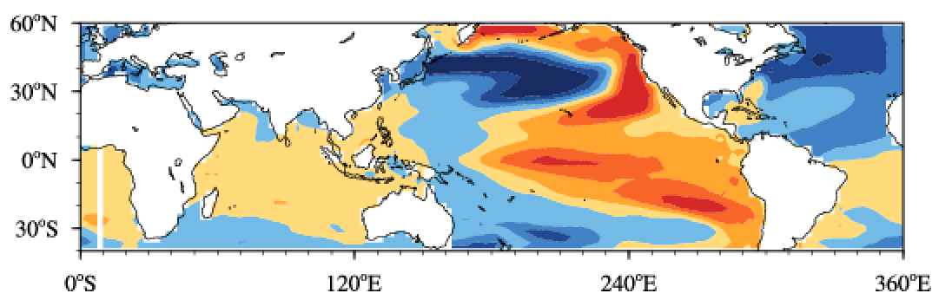
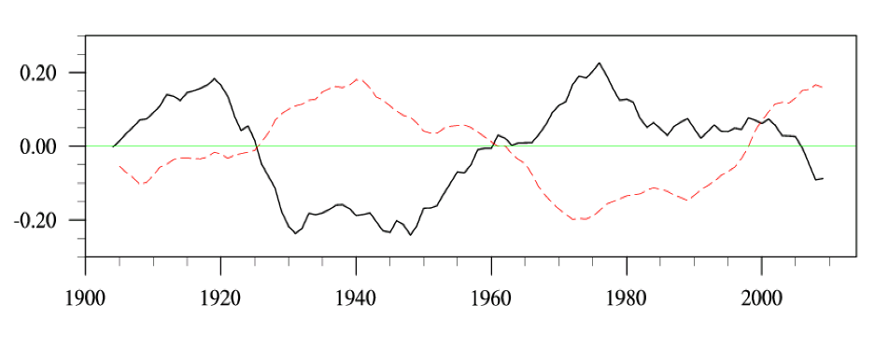

Slide 34
a
b
c
d
OBS
NESM_AMO
NESM_CLIM
(b)
OBS
NESM_AMO
NESM_CLIM
AMO lead

Slide 35
(a)
a
b
c
d
1
2
3
4
(a)
OBS
NESM_AMO
NESM_CLIM
(cb)
OBS
NESM_AMO
NESM_CLIM
AMO lead

Slide 36
(a) OBS
EOF2 (8.94%)
(d) OBS
cor. = -0.71
GMO (x0.02)
AMO
Figure 1. (a-c) Horizontal pattern and (d-f) time series of IPO (black line) and AMO (red line) from (a,d) observation and model simulations with (b,e) observed SST and (c,f) climatological SST over AMO region (0°S–70°N, 80W°–0°W) at decadal timescales (11yrs running mean,1900-2014). IPO is defined as second EOF modes of global SST (0°-360°E,40°S-60°N). AMO is defined as SST averaged over 300°-360°E,0°N-70°N). The long-term linear trends in SST data were removed prior to the regression analysis and first and last 11yrs are excluded for analysis.
(g) Lead-lag phase relationship between IPO and AMO time series from observation and model simulations. Dashed gray horizontal lines represents 95% significant levels.
(b) NESM_AMO
EOF2 (9.05%, 0,65)
(e) NESM_AMO
cor. = -0.80
GMO (x0.02)
AMO
Exp6,exp9,exp7
(c) NESM_CLM
EOF2 (5.65%, 0.41)
(f) NESM_CLIM
cor. = -0.39
GMO (x0.02)
AMO
(g)
OBS
NESM_AMO
NESM_CLIM
AMO lead

Slide 37
(a) OBS
EOF2 (8.94%)
cor. = -0.71
GMO (x0.02)
AMO
Figure 1. (a-c) Horizontal pattern and (d-f) time series of IPO (black line) and AMO (red line) from (a,d) observation and model simulations with (b,e) observed SST and (c,f) climatological SST over AMO region (0°S–70°N, 80W°–0°W) at decadal timescales (11yrs running mean,1900-2014). IPO is defined as second EOF modes of global SST (0°-360°E,40°S-60°N). AMO is defined as SST averaged over 300°-360°E,0°N-70°N). The long-term linear trends in SST data were removed prior to the regression analysis and first and last 11yrs are excluded for analysis.
(g) Lead-lag phase relationship between IPO and AMO time series from observation and model simulations. Dashed gray horizontal lines represents 95% significant levels.
(b) NESM_AMO
EOF2 (9.05%)
cor. = -0.80
GMO (x0.02)
AMO
Exp6,exp9,exp7
(c) NESM_AMO_OLD
EOF2 (9.2%)
cor. = -0.77
GMO (x0.02)
AMO

Slide 38
(a) Lag -36yr
(b) Lag -30yr
(c) Lag -24yr

Slide 40
Other materials

Slide 41
(a) OBS
EOF2 (8.94%)
(d) OBS
cor. = -0.71
GMO (x0.02)
AMO
Figure 1. (a-c) Horizontal pattern and (d-f) time series of IPO (black line) and AMO (red line) from (a,d) observation and model simulations with (b,e) observed SST and (c,f) climatological SST over AMO region (0°S–70°N, 80W°–0°W) at decadal timescales (11yrs running mean,1900-2014). IPO is defined as second EOF modes of global SST (0°-360°E,40°S-60°N). AMO is defined as SST averaged over 300°-360°E,0°N-70°N). The long-term linear trends in SST data were removed prior to the regression analysis and first and last 11yrs are excluded for analysis.
(g) Lead-lag phase relationship between IPO and AMO time series from observation and model simulations. Dashed gray horizontal lines represents 95% significant levels.
(b) NESM_AMO
EOF2 (9.2%)
(e) NESM_AMO
cor. = -0.77
GMO (x0.02)
AMO
(c) NESM_CLM
EOF2 (5.65%)
(f) NESM_CLIM
cor. = -0.39
GMO (x0.02)
AMO
(g)
OBS
NESM_AMO
NESM_CLIM
AMO lead

Slide 42
(a) Lag -6 years (1000 hPa)
(d) Lag -6 years (200 hPa)
(b) Lag 0 years (1000 hPa)
(e) Lag 0 years (200 hPa)
(c) Lag 6 years
(c) Lag +6 years (1000 hPa)
(f) Lag +6 years (200 hPa)
Fig. 3 Horizontal structure of (a-c) global SST (shading, K) and surface wind vectors (m s⁻¹), and (d-e) 200 hPa velocity potential (shading, 10⁵ m² s⁻¹) and divergent winds (m s⁻¹) from NESM_AMO, depicted by the regressed SST (K), surface wind vectors (m s⁻¹), 200 hPa velocity potential (10⁵ m² s⁻¹) and divergent winds (m s⁻¹) onto the AMO index (0°S–70°N, 80W°–0°W) with lead times of -6 years (top), 0 years (middle) and 6 years (bottom). 11yrs running mean data are used and long-term linear trends in SST data were removed prior to the regression analysis. The dotted area represents 95% significance level.

Slide 43
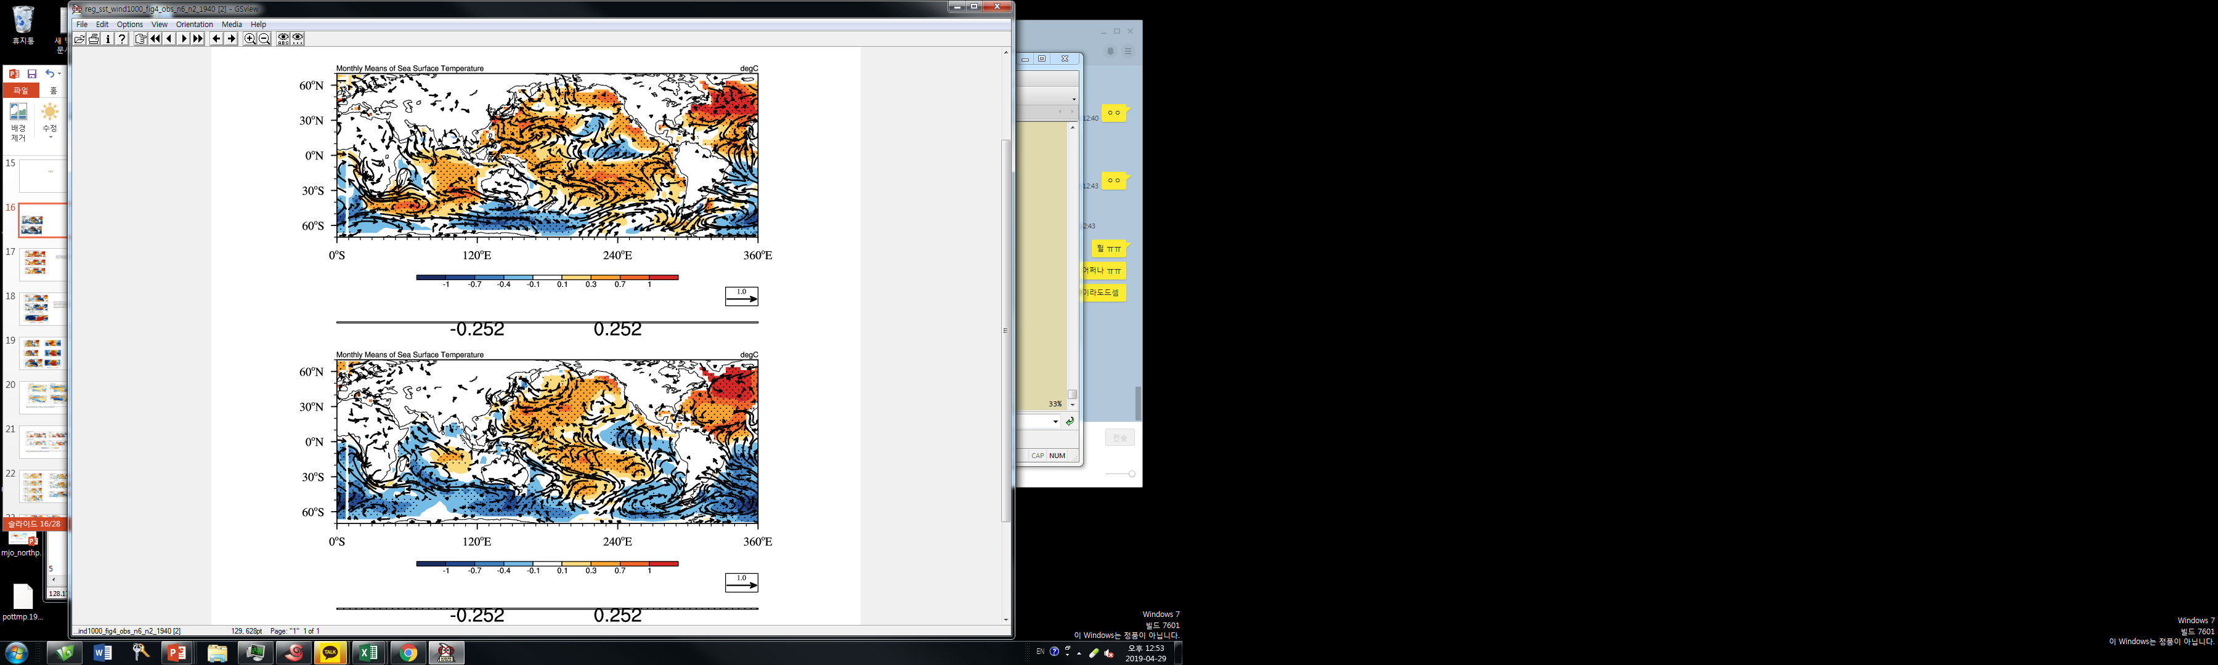
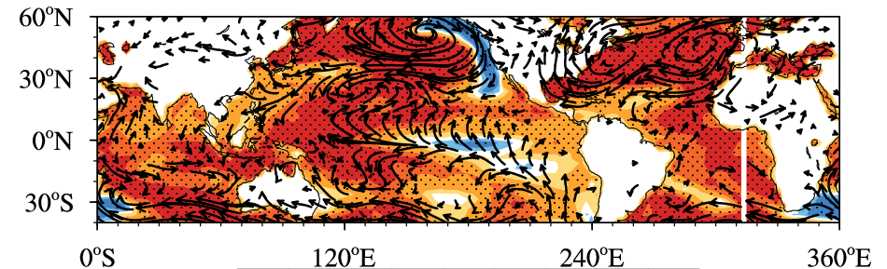
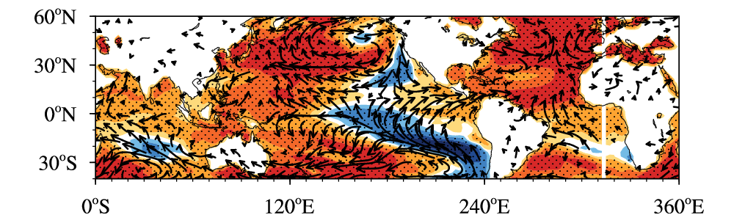
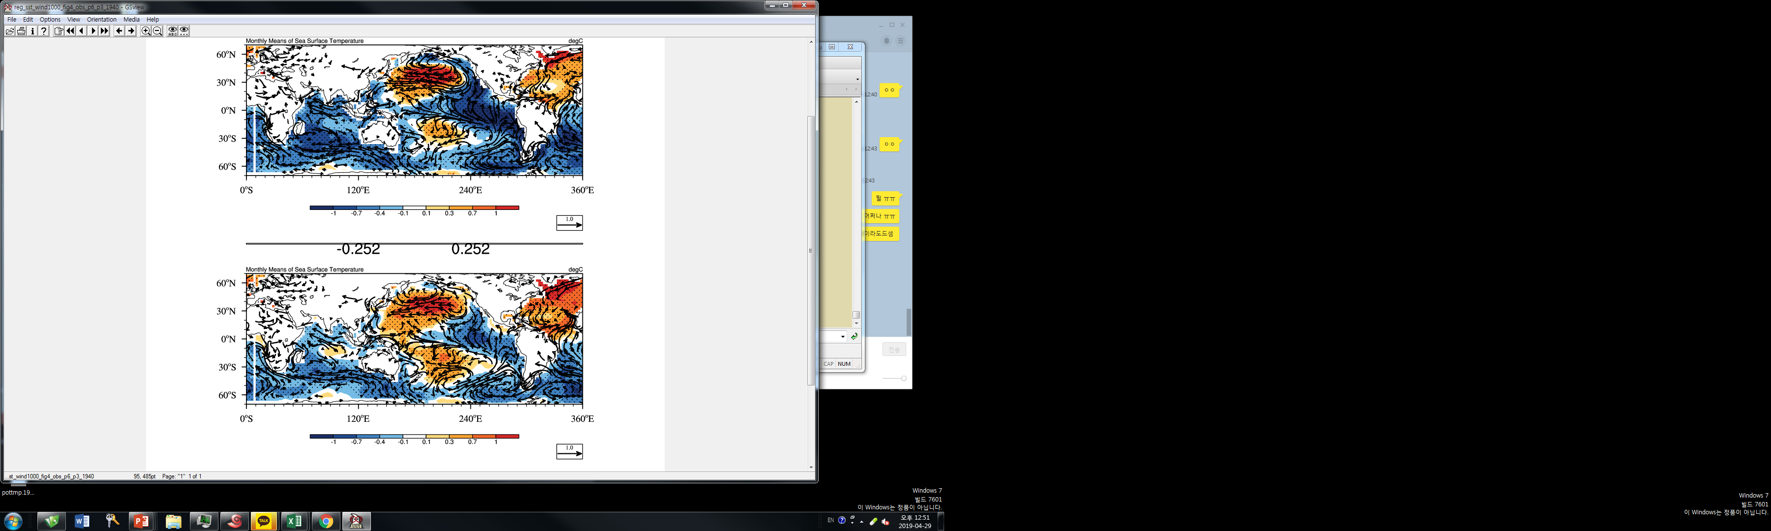
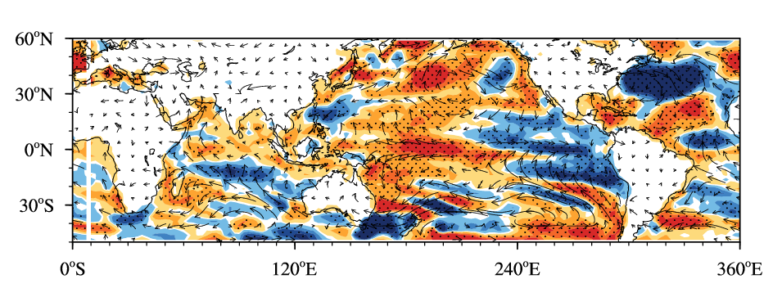
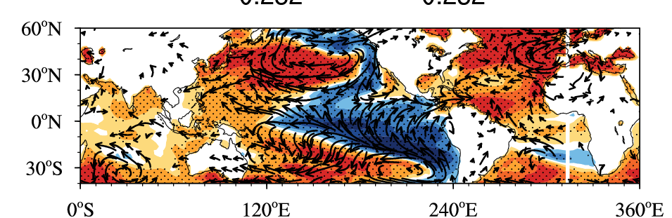

Slide 44
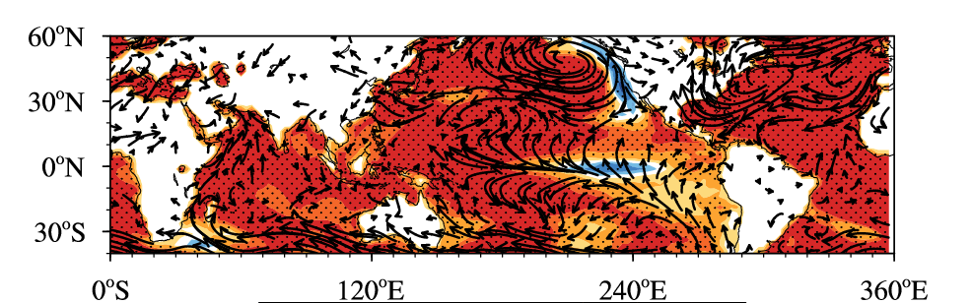

Slide 45
(b) NESM_AMO
Lag -6 years (1000 hPa)
Lag -6 years (200 hPa)
Lag 0 years (1000 hPa)
Lag 0 years (200 hPa)
(c) Lag 6 years
Lag +6 years (1000 hPa)
Lag +6 years (200 hPa)
Fig. 3 Horizontal structure of (a-c) global SST (shading, K) and surface wind vectors (m s⁻¹), and (d-e) 200 hPa velocity potential (shading, 10⁵ m² s⁻¹) and divergent winds (m s⁻¹) from NESM_AMO, depicted by the regressed SST (K), surface wind vectors (m s⁻¹), 200 hPa velocity potential (10⁵ m² s⁻¹) and divergent winds (m s⁻¹) onto the AMO index (0°S–70°N, 80W°–0°W) with lead times of -6 years (top), 0 years (middle) and =6 years (bottom). 11yrs running mean data are used and long-term linear trends in SST data were removed prior to the regression analysis. The dotted area represents 95% significance level.

Slide 46
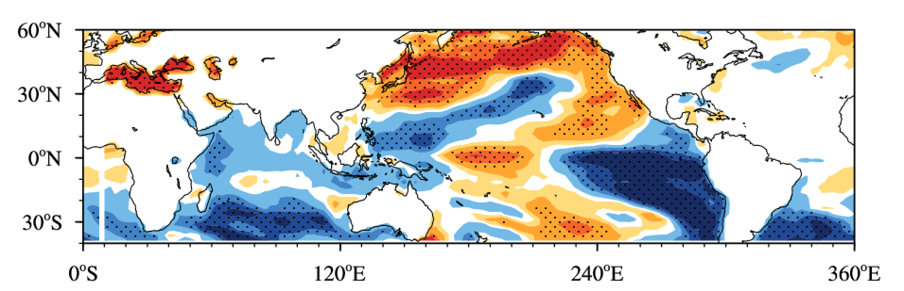
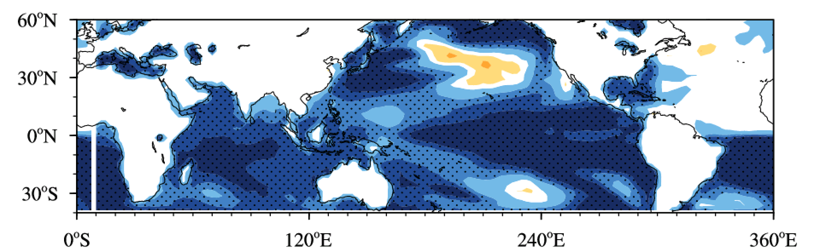
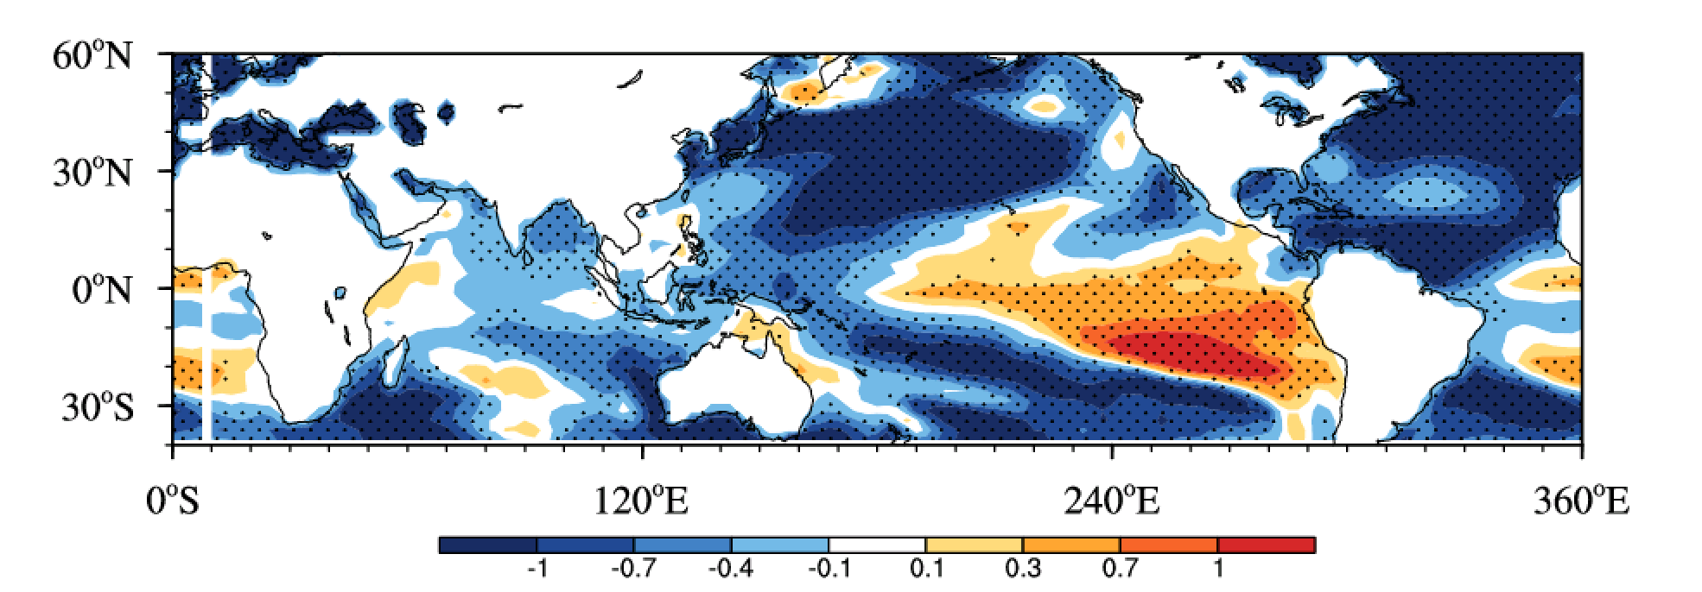
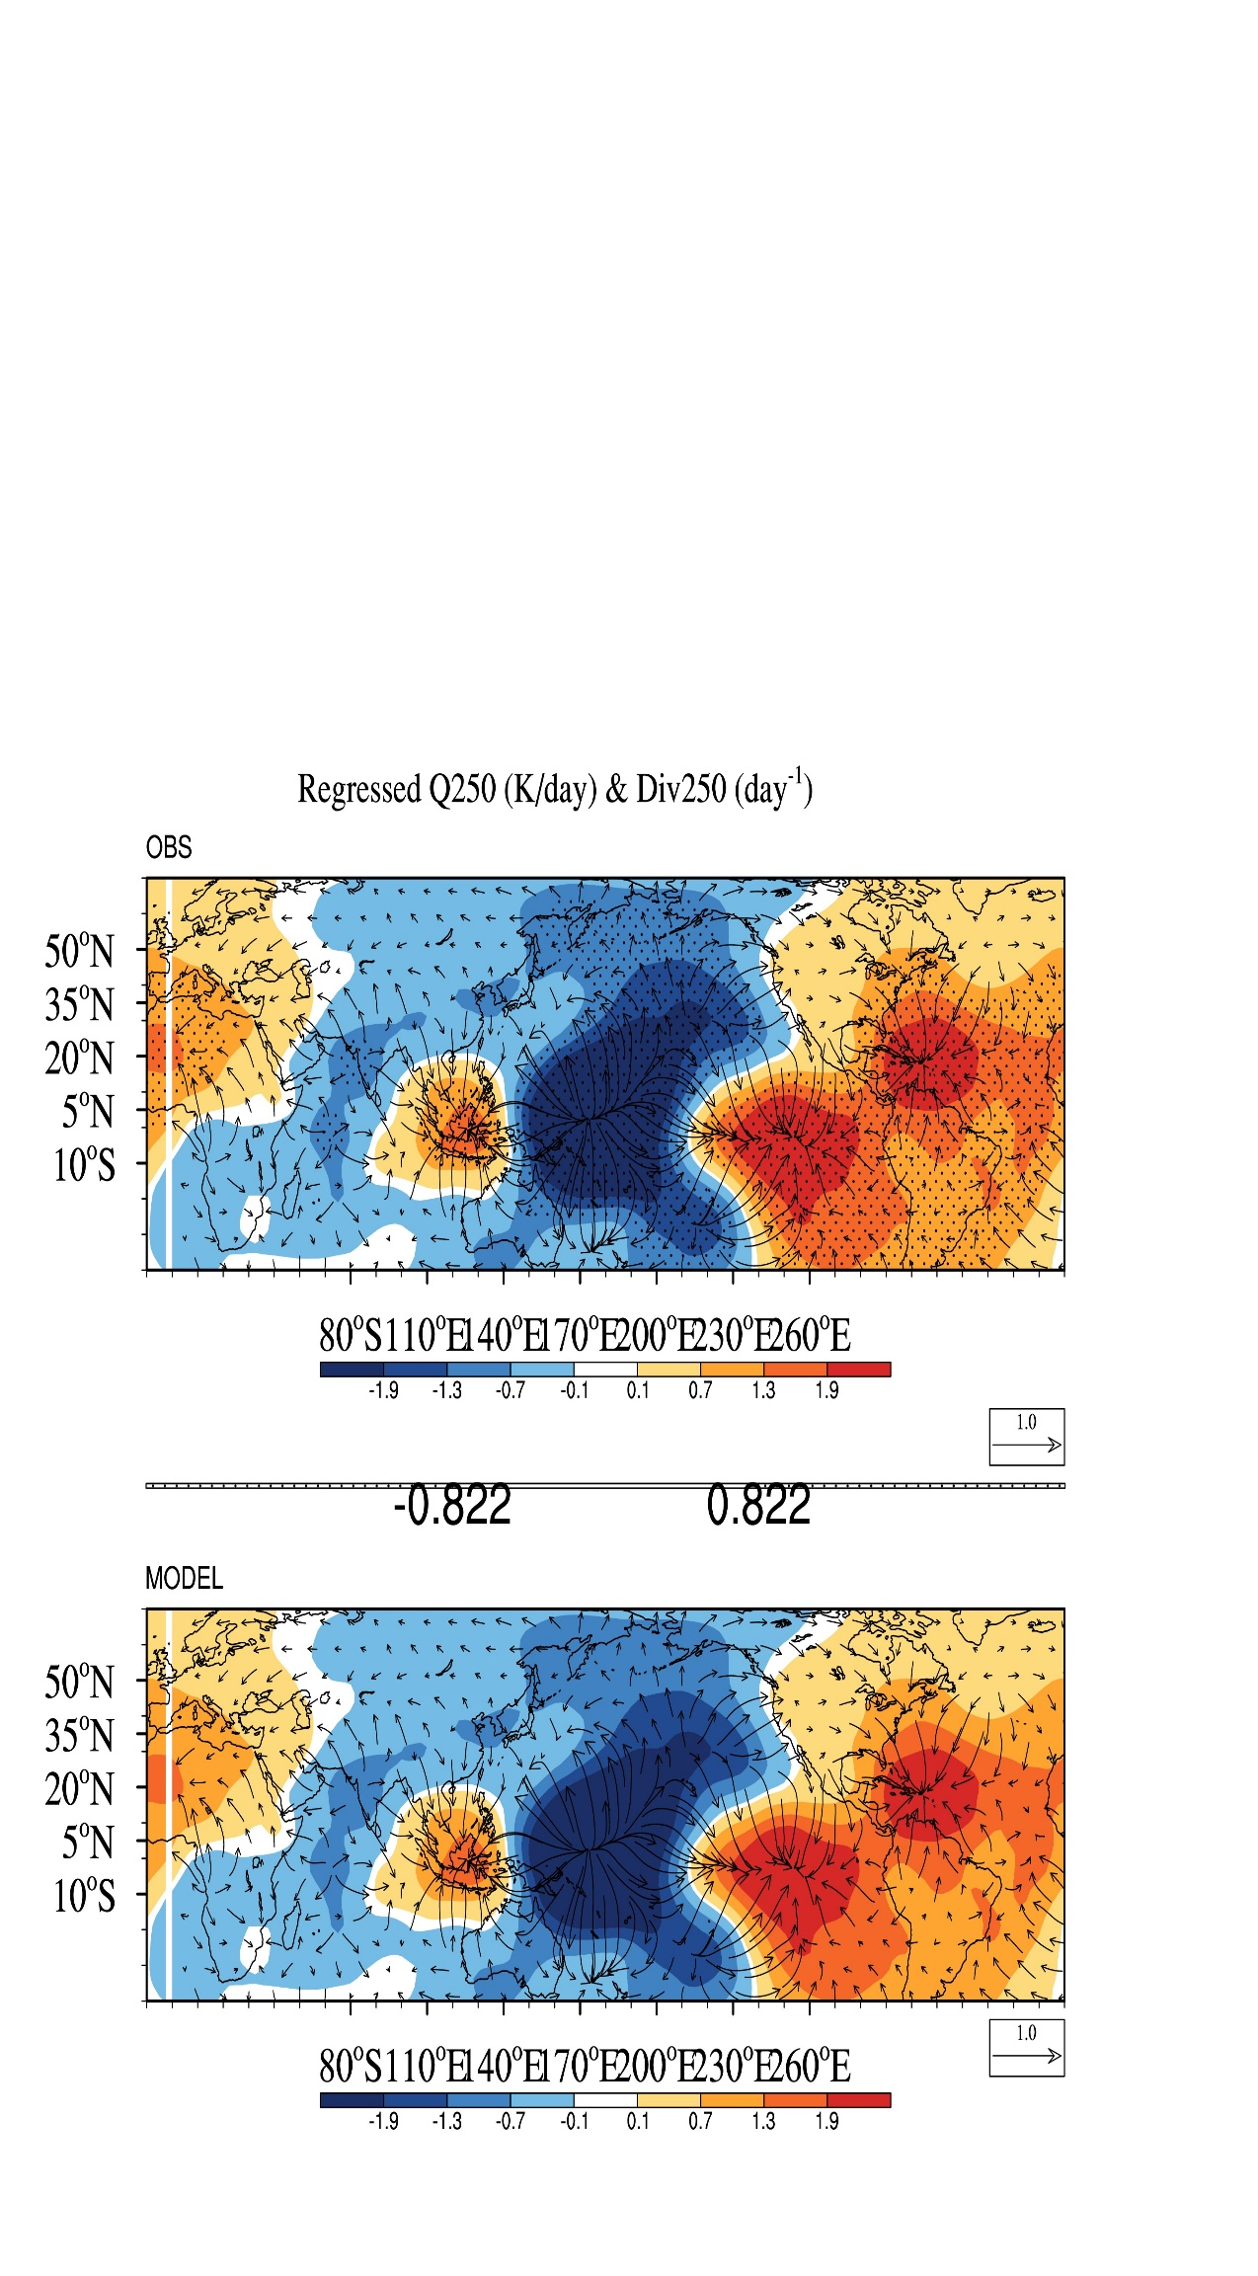
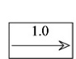

(a) NESM_CLM (SST, 6yr)
Figure 4s. Same as figure 4 except for NESM_CLIM
(b) NESM_CLM (SST, 43yr)
(c) NESM_CLM (velocity potential & wind, 6yrs)

Slide 47
END

