Slide 1

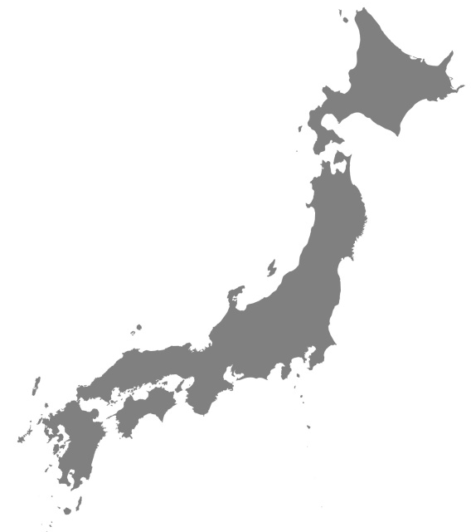


Slip-dependent weakening revealed for a shallow megasplay fault in the Nankai subduction zone
PLEASE CLICK ON ME
A. Roesner, M.J. Ikari, A. Huepers, A.J. Kopf
Japan
study site
EGU 2020 Session: Understanding large subduction earthquakes and tsunamigenesis

Slide 2
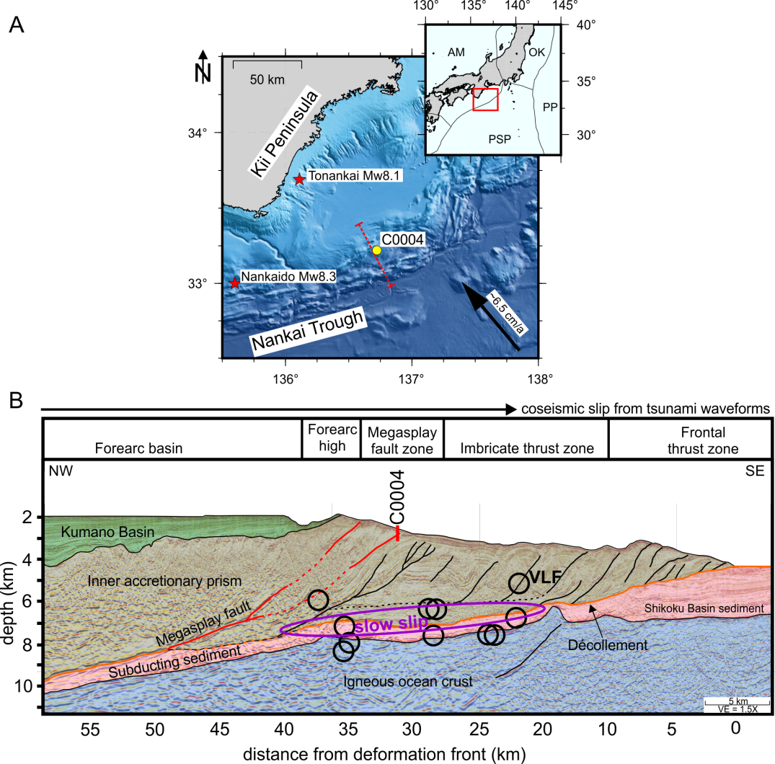
Introduction
Nankai Trough Subduction Zone
Various deformation phenomena
  Slow slip
  Very low frequency EQ
  Megathrust EQ
Tsunami hazard
Submarine landslides
Research Motivation
Megasplay fault sediment shows velocity- and slip-dependent weakening (¹Roesner et al.2020). Is there a dominant weakening process?
¹Roesner, A., Ikari, M.J., Saffer, D.M., Stanislowski, K., Eijsink, A.M., Kopf, A.J., 2020. Friction experiments under in-situ stress reveal unexpected velocity-weakening in Nankai accretionary prism samples. EPSL

Slide 3
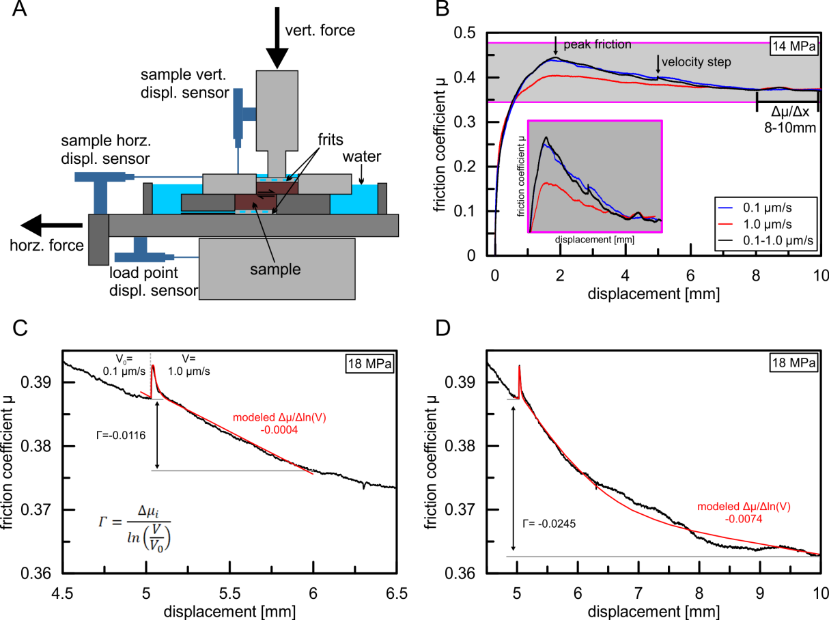
Direct Shear Experiments
Powdered samples at effective normal stresses (σ_{n}‘) 2-18 MPa
Drained experiments at 21°C
Constant velocity experiments at 0.1 & 1.0 µm/s
Velocity step test 0.1-1.0 µm/s
  (a-b) RSF modeling over 1 & 5 mm displacement
  Net weakening (Γ) over 1 & 5 mm displacement
Slip dependence (Δµ/Δx) at 8-10 mm displacement

Slide 4
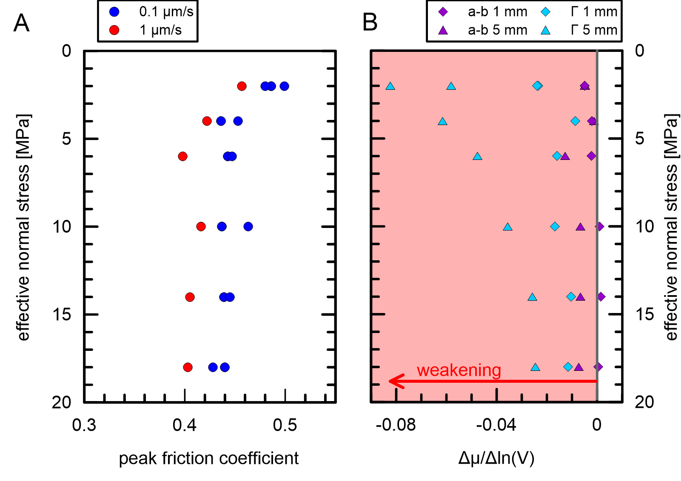
Results & Discussion
Phyllosilicate rich normally consolidated powder samples exhibit peak friction
Increasing σ_{n}‘ and increasing velocity decreases peak friction
Velocity-step experiments are dominated by weakening processes
Net weakening > velocity weakening for 1 mm but drastically for 5 mm RSF modeling at low stresses

Slide 5

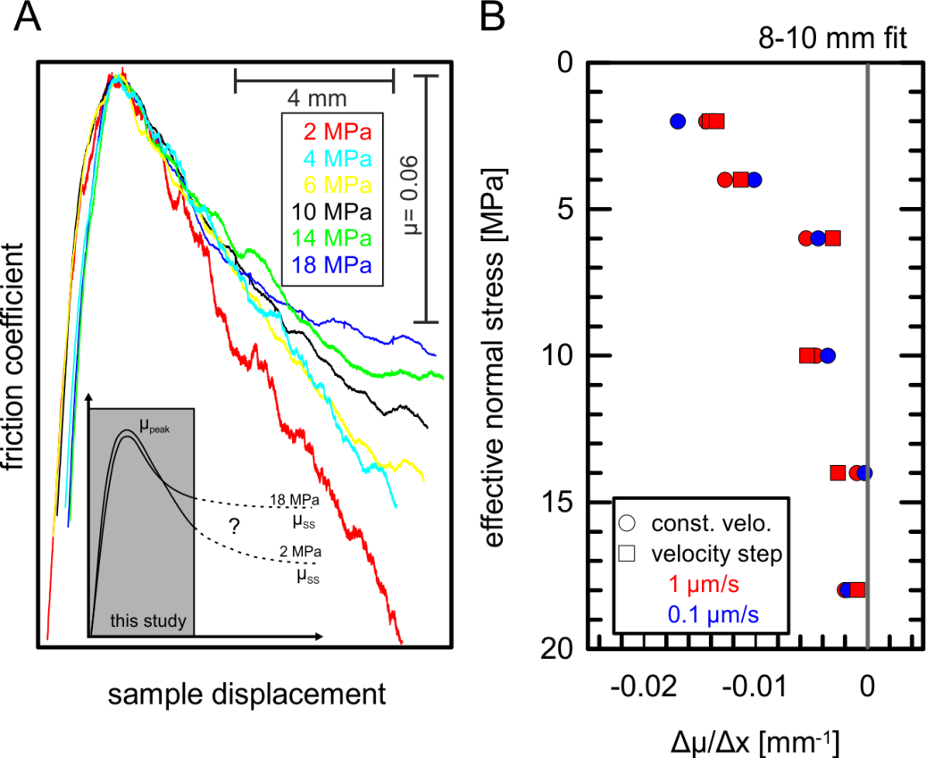
Results & Discussion
All experiments show slip-dependent weakening Δµ/Δx<0 over 10 mm
Slip weakening is controlled by σ_{n}‘
Neither velocity perturbations nor shear velocity affect slip-weakening behavior systematically
High-effective normal stress experiments reach steady-state friction in shorter displacement

Slide 6
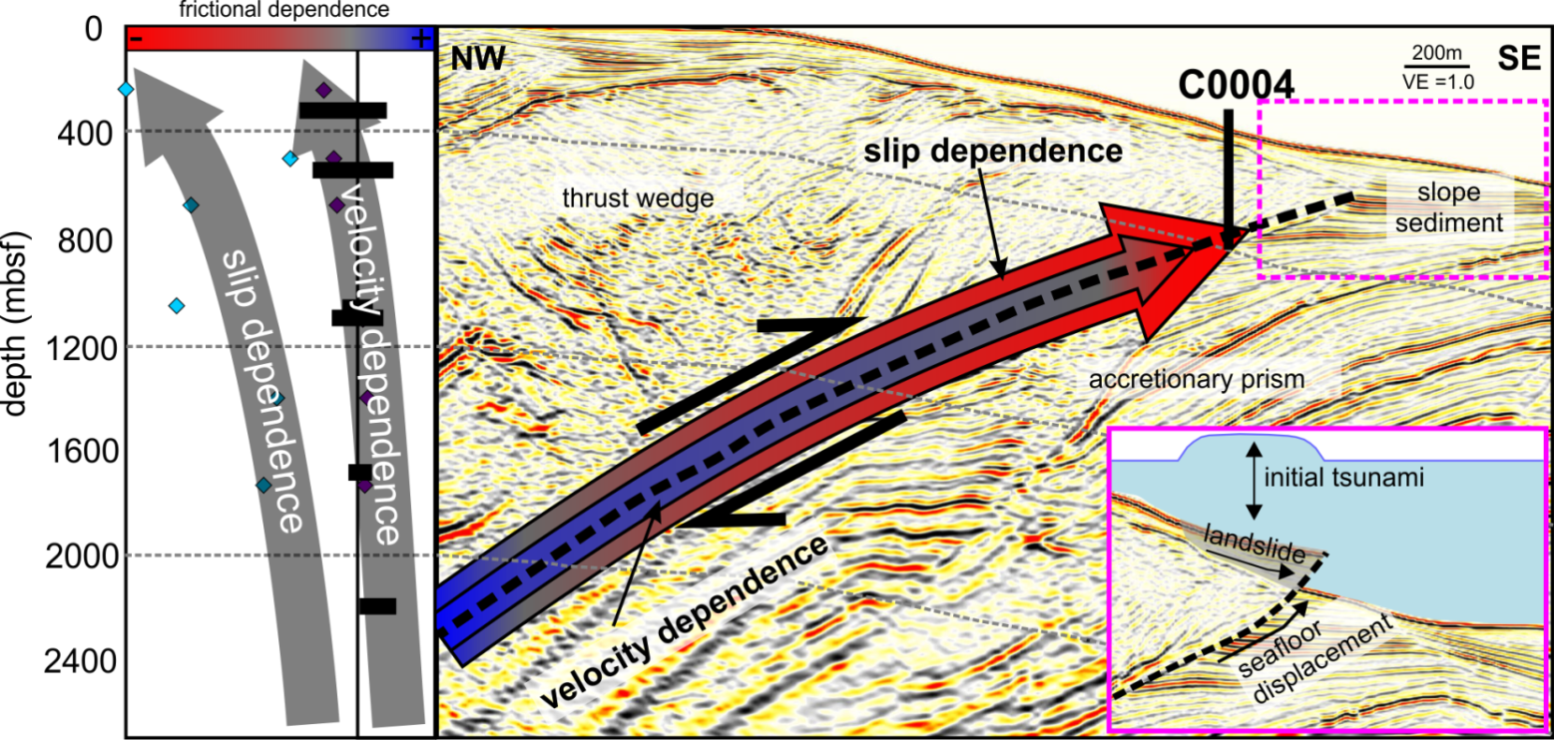
Conclusion
Slip- and velocity weakening increases with shallow depth favoring coseismic up-dip propagation
Slip dependence causes larger stress drop over displacement
Seafloor deformation is likely in the next megathrust EQ causing tsunamis and landslides

Slide 7
Supplementary Slides

Slide 8
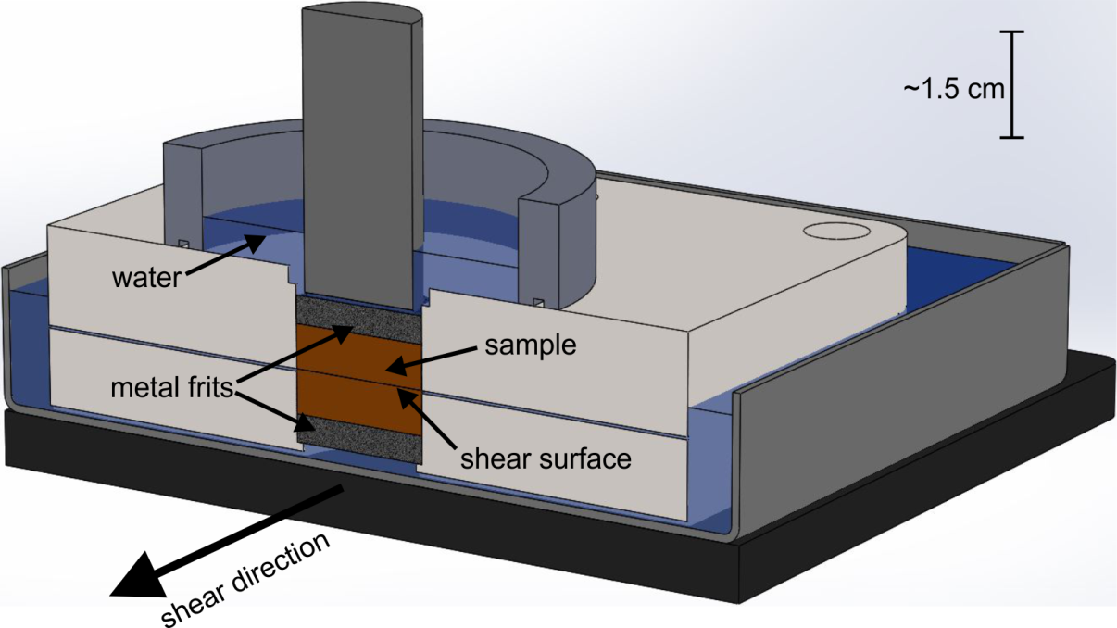
Technical drawing of sample holder. Drawing indicates drainage pathways.

Slide 9
Sediment composition in weight percent from X-Ray diffraction measurement after Vogt et al. (2002)(abundances >3 wt%). Due to limited amount of core material, we re-used the sample for each experiment in this study. X-Ray diffraction measurements were done at the pristine core material and the remolded material.

