Slide 1
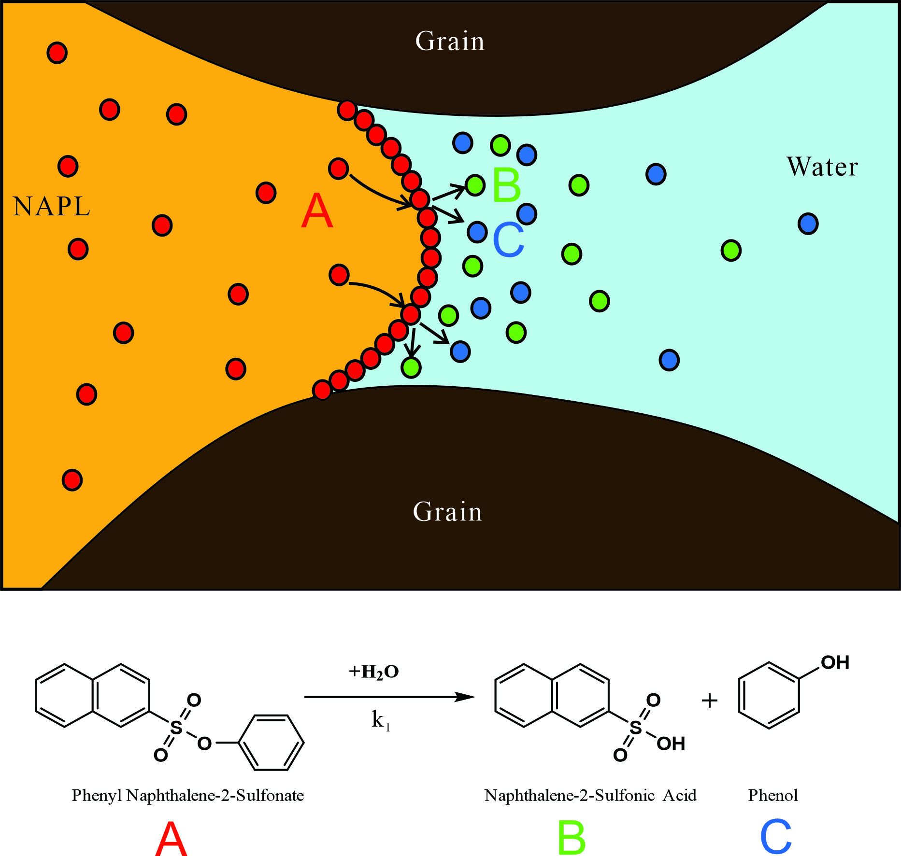
Kinetic Interfacial Sensitive tracer reactive transport process in porous media two-phase flow systems: pore-scale modeling with phase-field method
Mathematic model:
Fig. 1 Sketch of KIS tracer working process

Slide 2
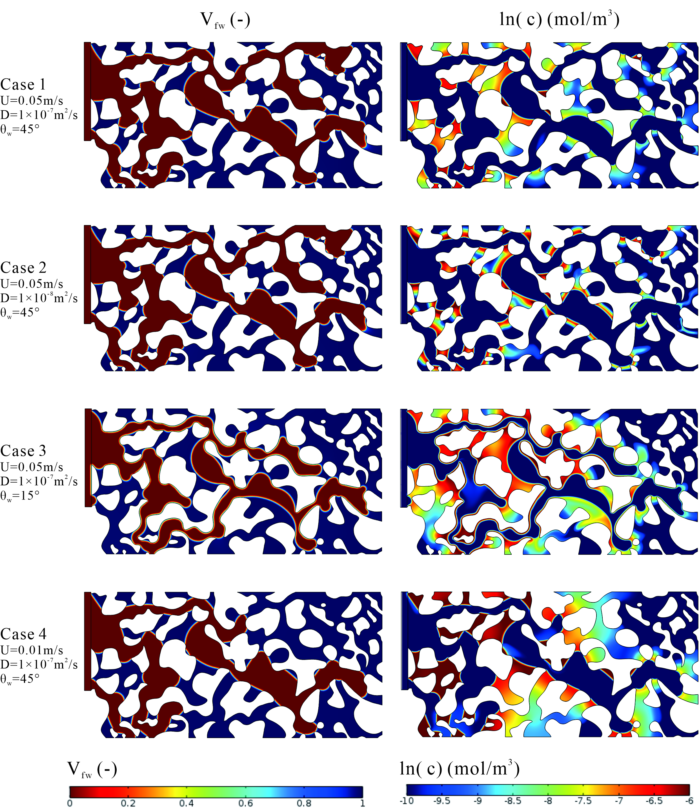
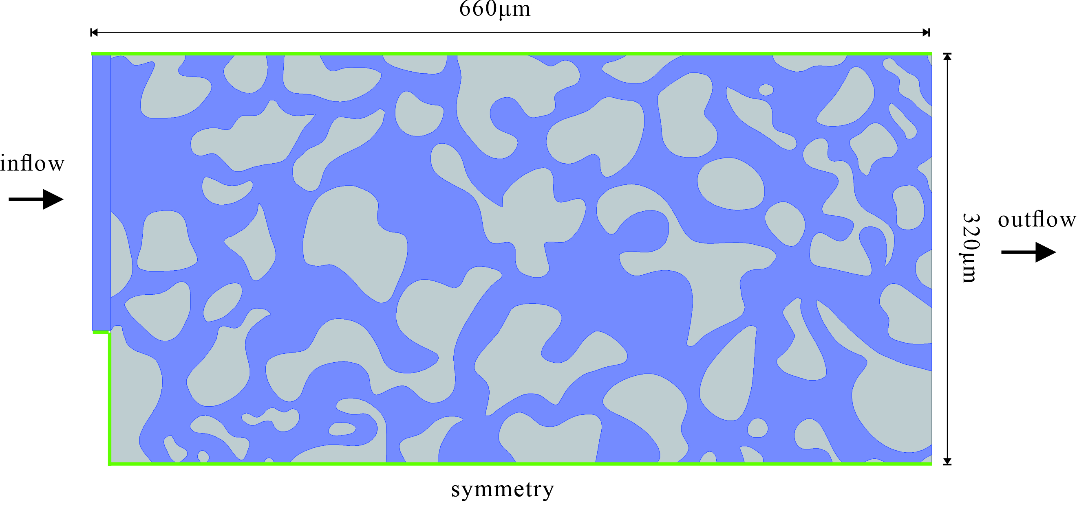
Results:
The parameters for the non-wetting fluid: ρ_{octane}=703kg/m³ and μ_{octane}=0.54×10³Pa∙s, and interfacial tension for n-octane/water σ=0.0504 N/m.
Fig. 3 Geometry and boundaries
Fig. 4 Plot of volume fraction of water phase (left) and solute concentration (right) before breakthrough for each case.

Slide 3
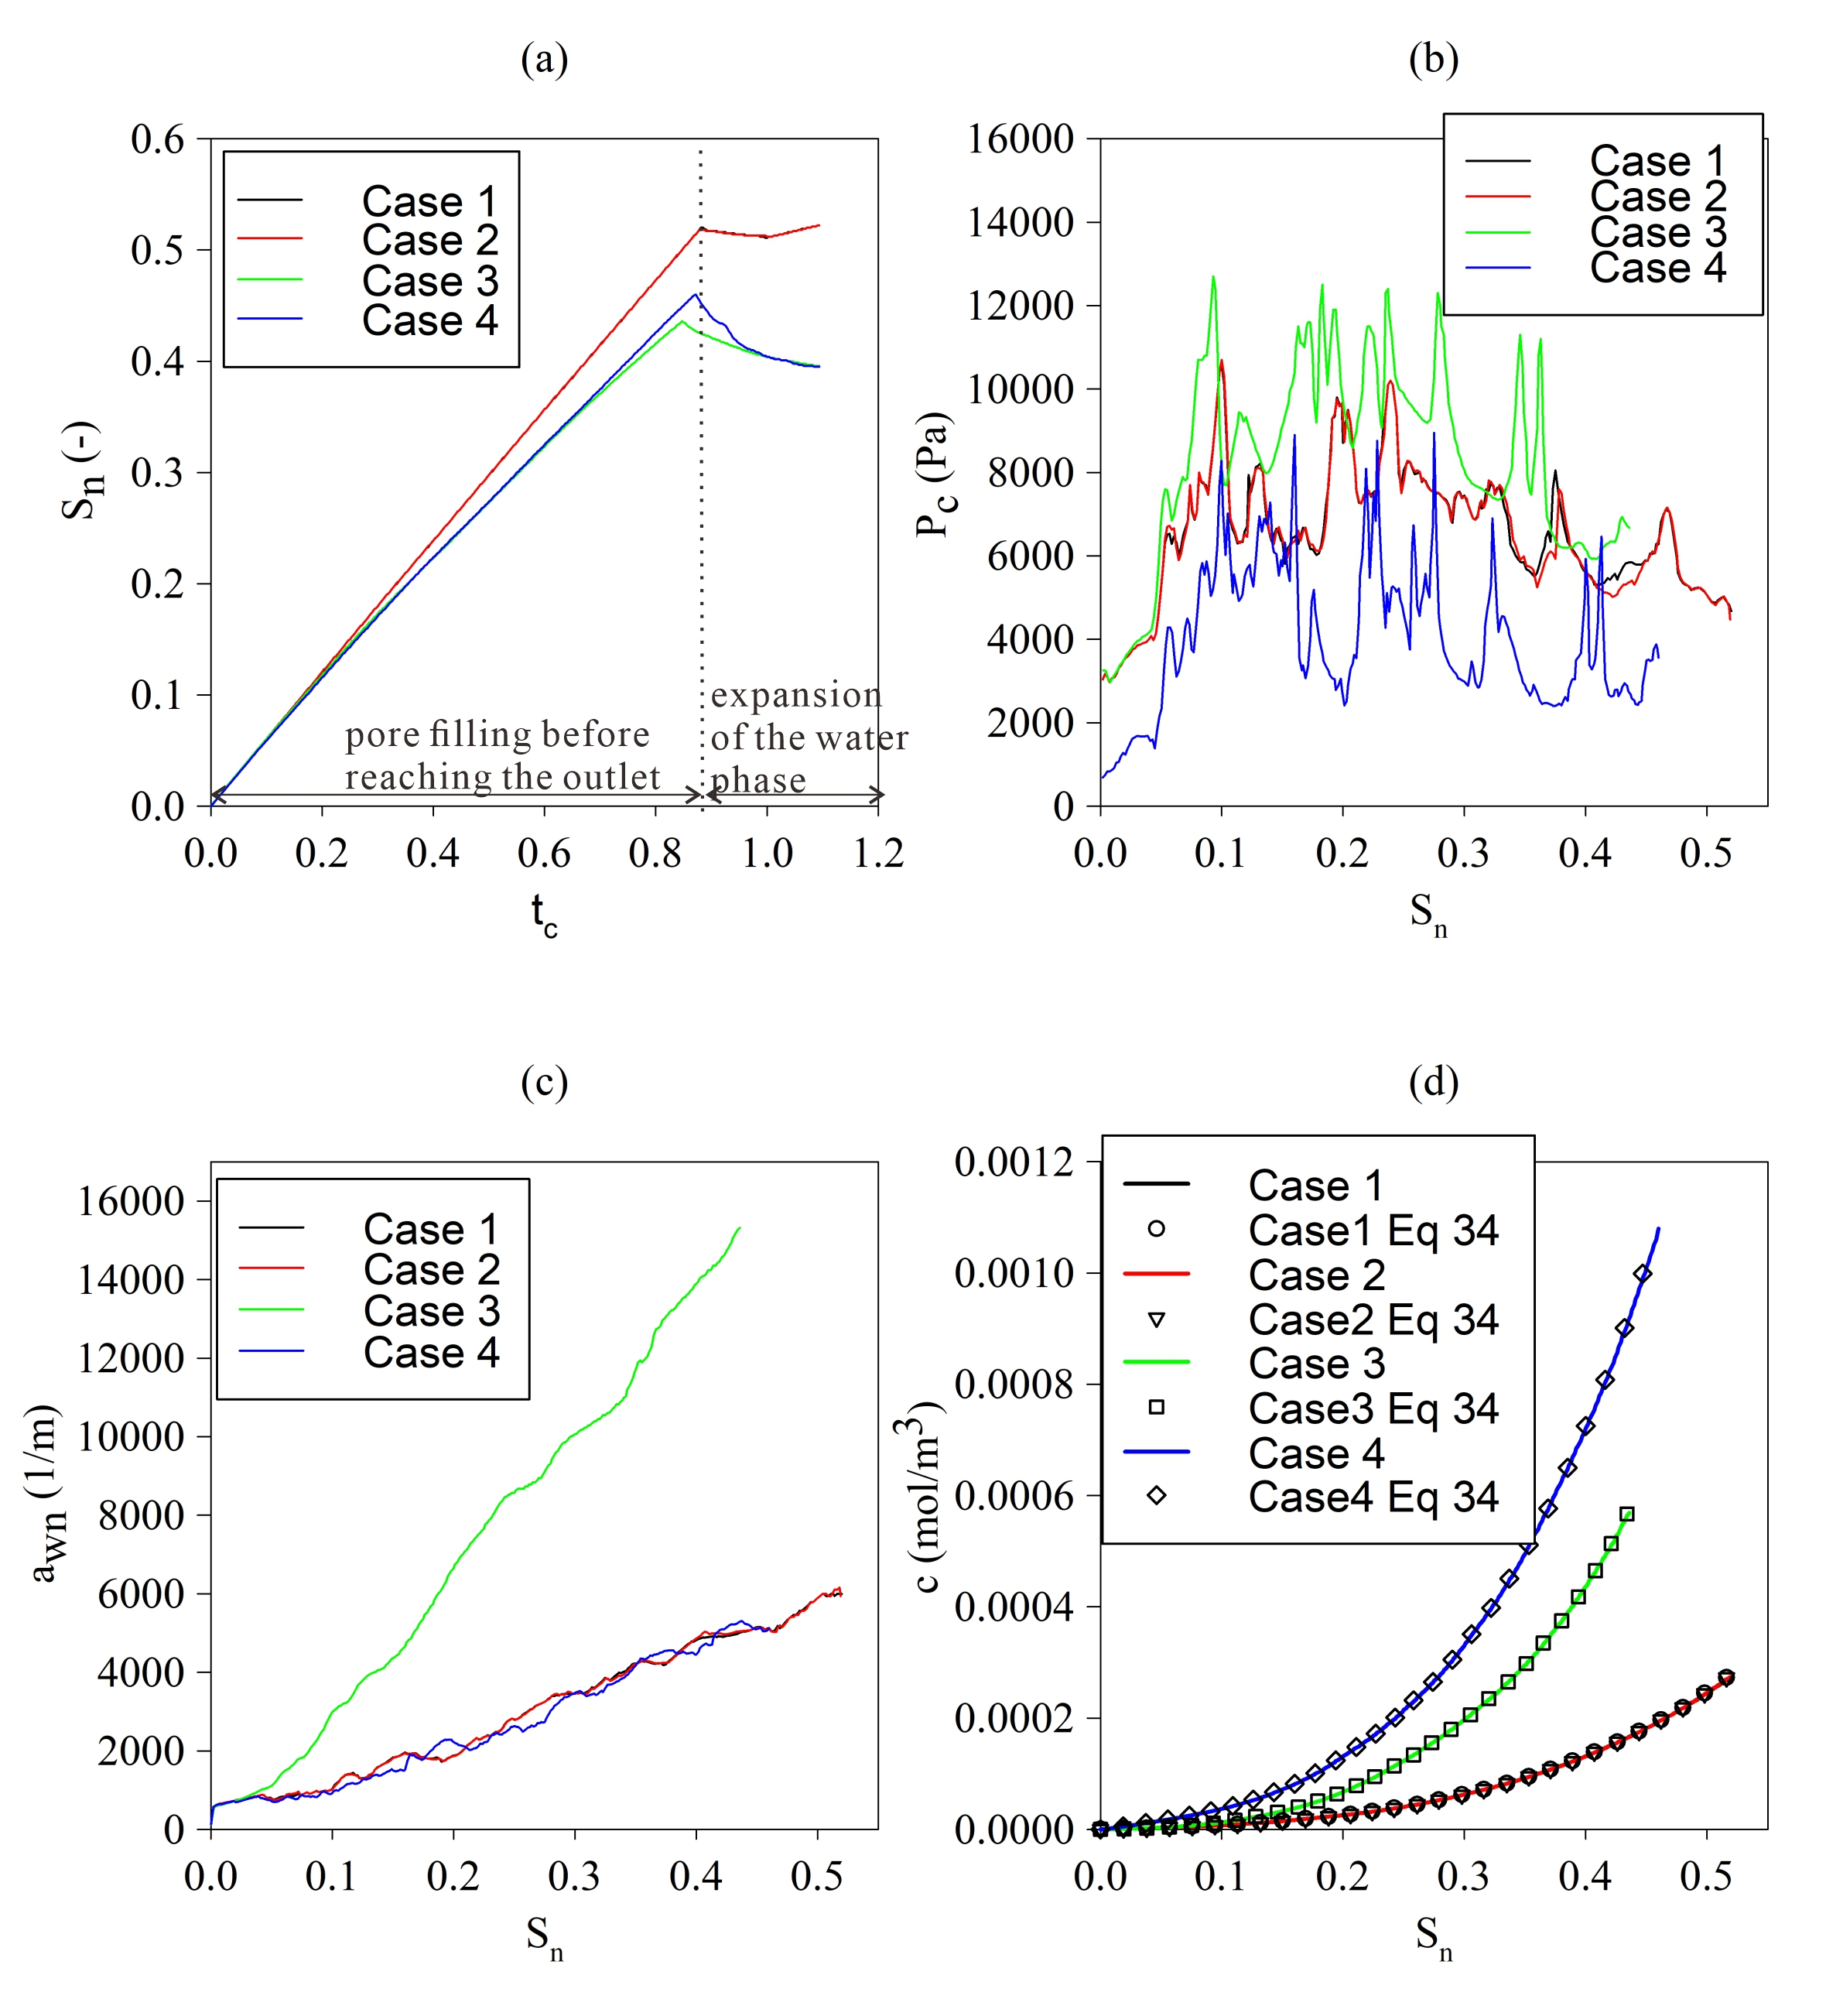
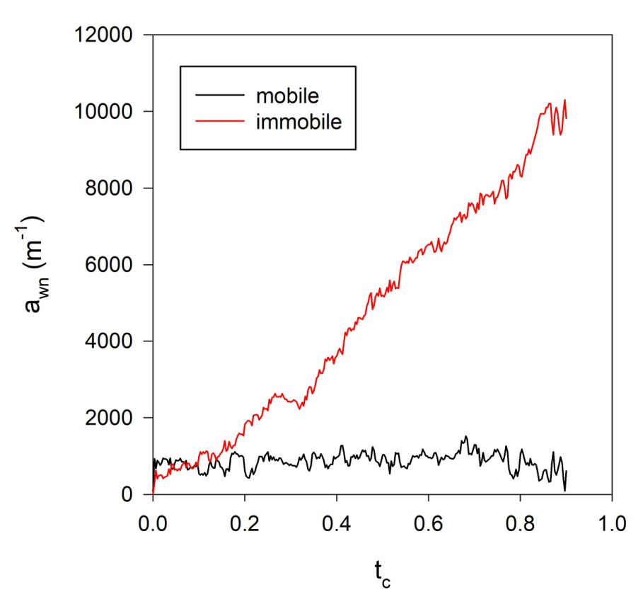
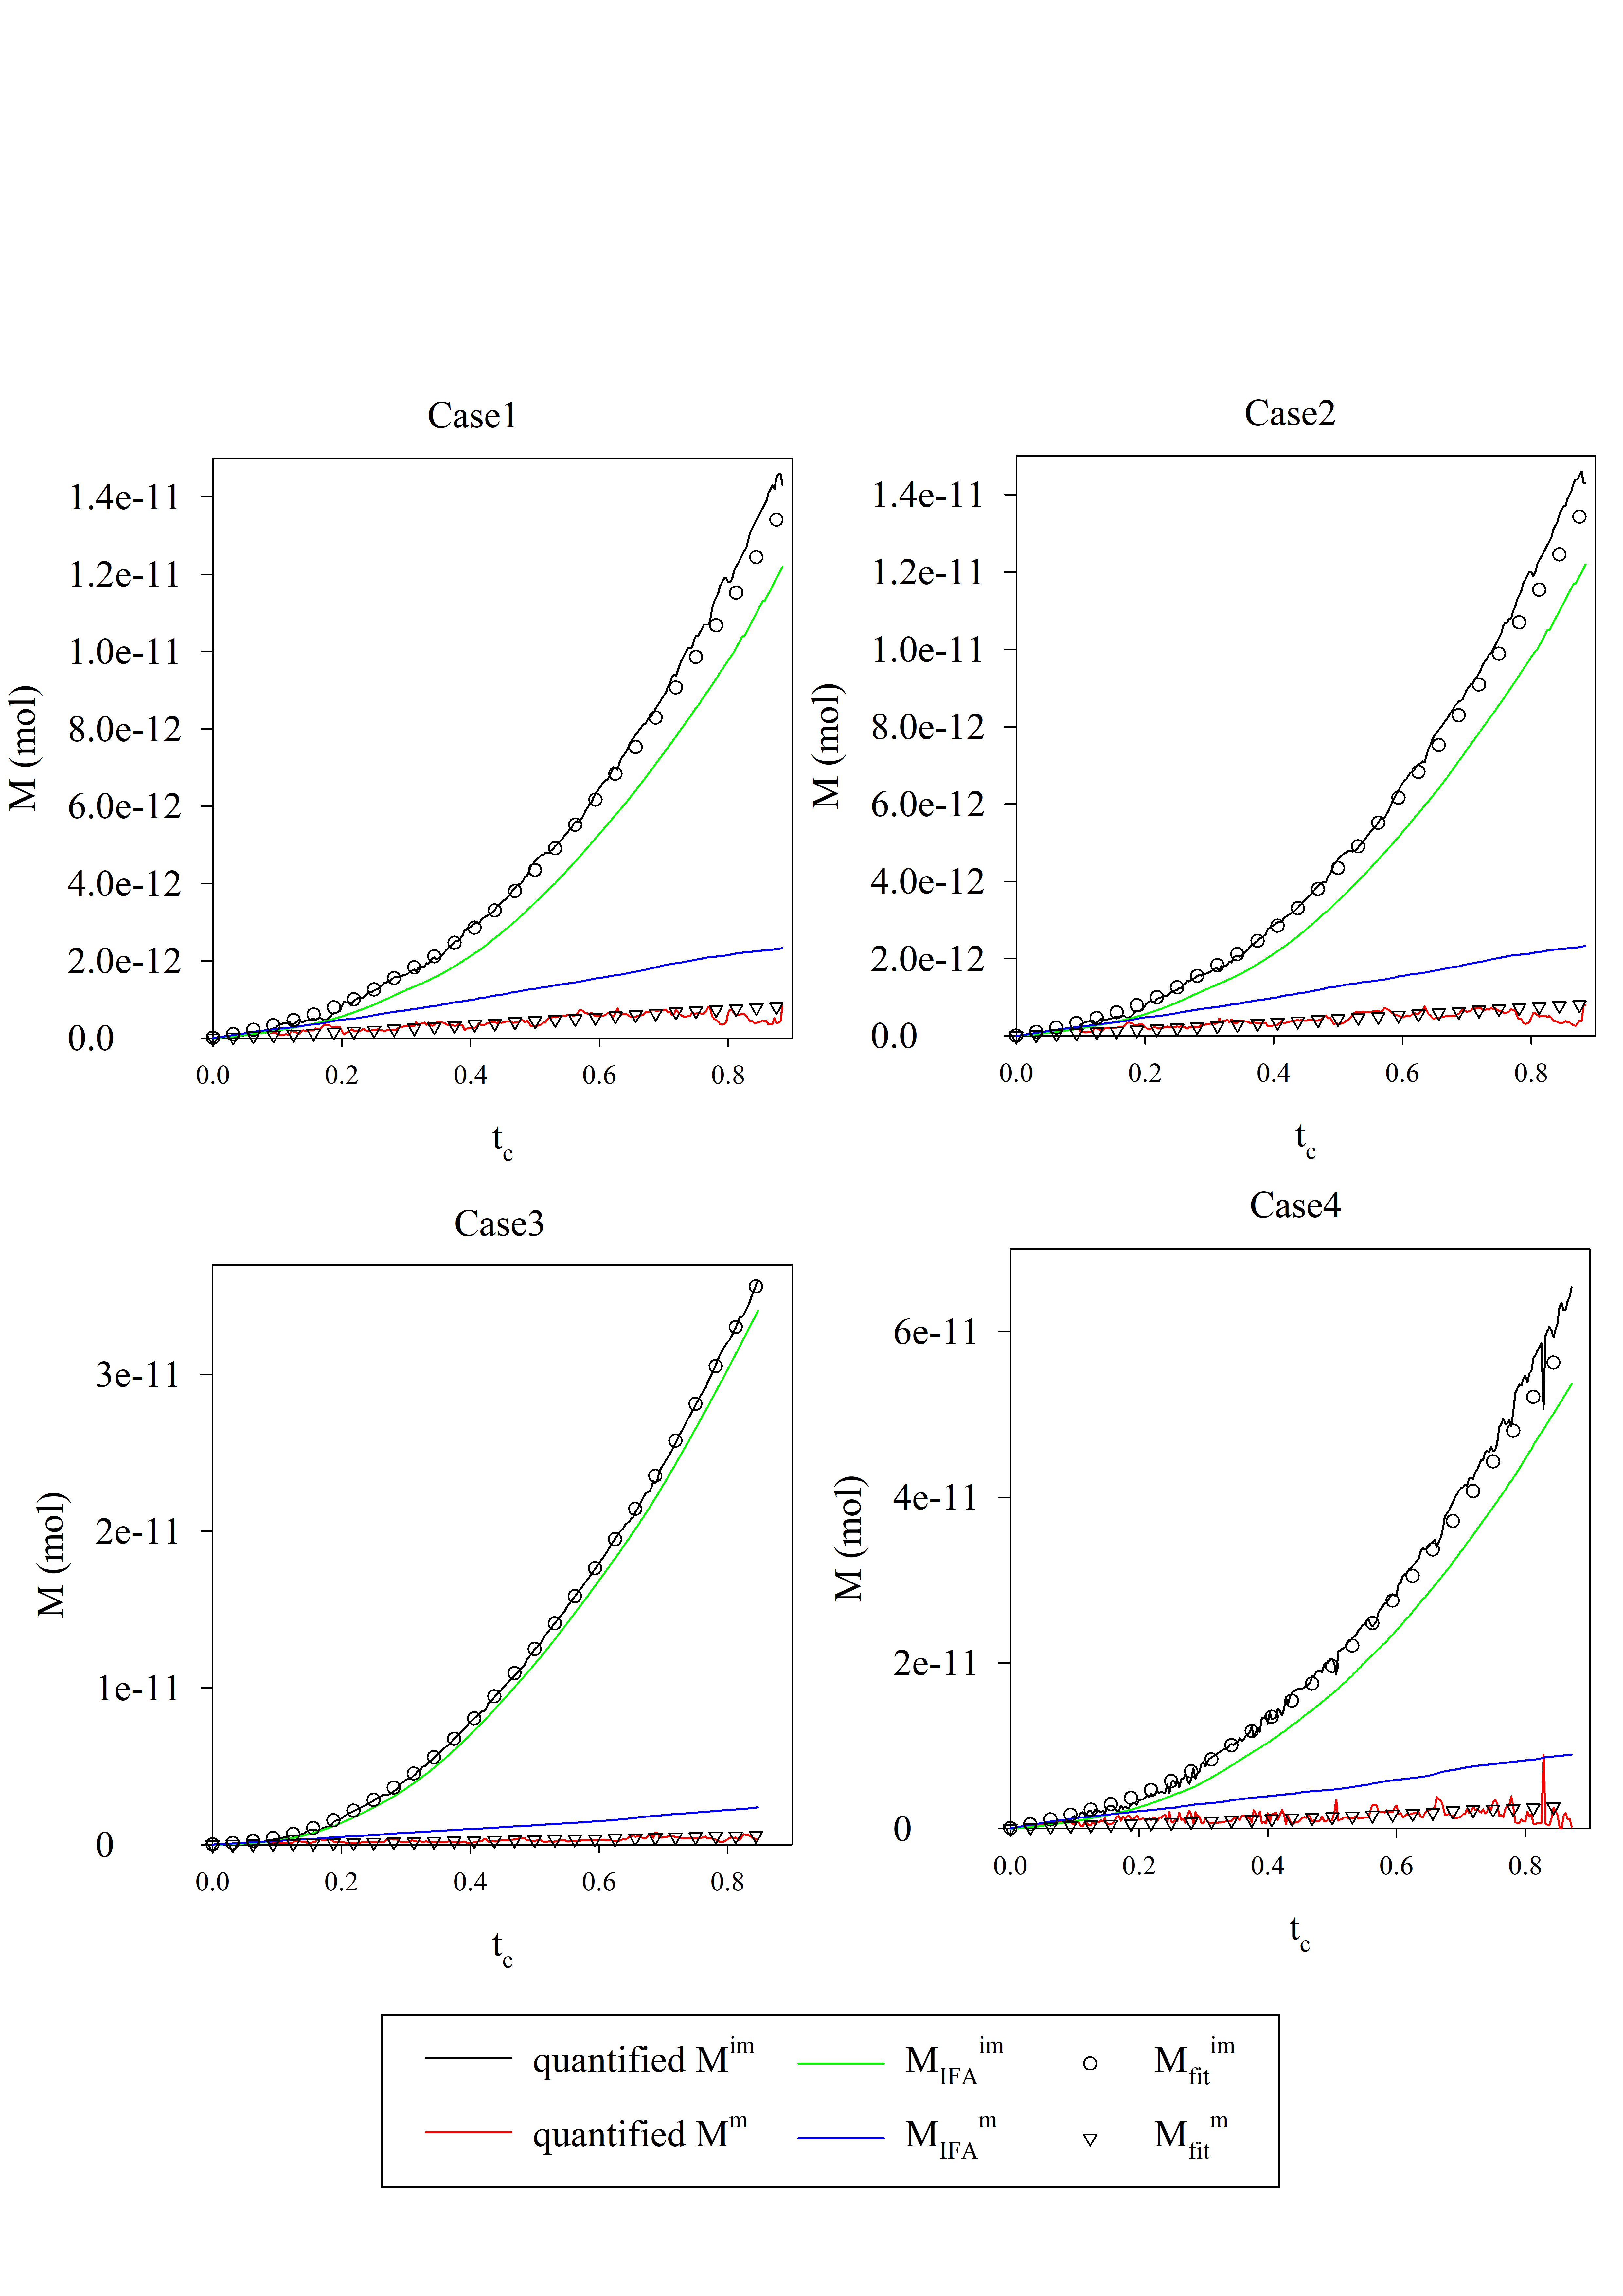
Fig. 6 plot the interfacial areas (left) and solute mass (right)
Fig. 5 plot of quantified macroscopic parameters
The model show its capacity for simulate the KIS tracer reactive transport process at pore-scale
The measurable KIS tracer reacted solute mass is directly related to the mobile part of the interfacial area.
Conclusion:

