Slide 1
Monitoring Oil Exploitation Infrastructure and Dirt Roads with Object-Based Image Analysis and Random Forest in the Eastern Mongolian Steppe
MORE STEP
Batnyambuu D, Jörg Bendix & Lukas Lehnert

Slide 2
Outlines
Study area and aims
Methodology and remote sensing data
Classification results of long-term remote sensing data
Comparison of different spatial resolution data classification
Conclusion
Appendix

Slide 3
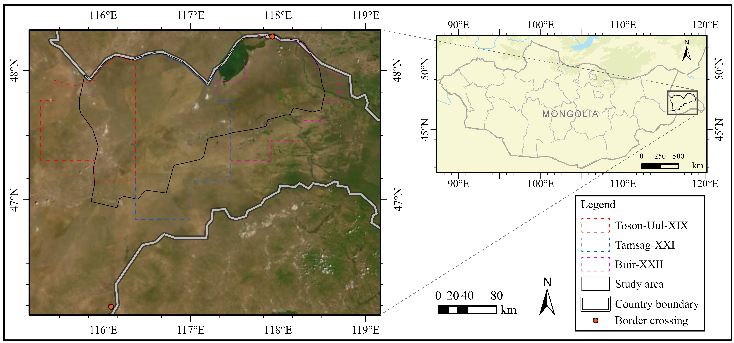
Study area
The research area is a part of “The Eastern Mongolian Steppe” which called “Menen Steppe” (Menengyn Tal), is located in Dornod province of the Eastern Mongolia.
The Eastern Mongolian Steppe is one of the largest flat-steppes of Mongolia. In addition, the study area is registered World Heritage List of the UNESCO.

Slide 4
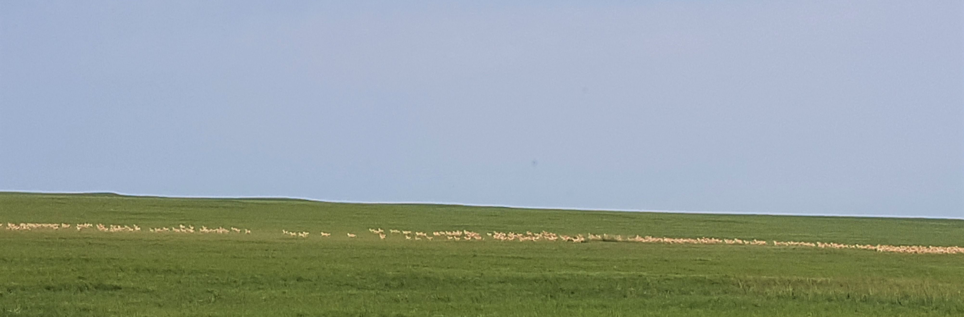
Land cover
The steppe mainly consists of broad plains and rolling hills where the vegetation is dominated by Artemisia sp. and bunch grasses like Stipa sp.
The temperate grasslands in Mongolia support a large assemblage of native wildlife including Grey wolf, Red fox, Corsac fox, Pallas cat, Great bustard, Saker Falcon, Lesser Kestrel, Siberian marmot and over one million Mongolian gazelle.

Slide 5
Problem statements
Threats and pressures on grassland have increased dramatically following the transition to a market economy in 1990.
Specifically petroleum exploration and exploitation is increasing dramatically. Though the direct impacts of mining on land are significant and can reach far beyond the mine site, perhaps the most urgent threat to land degradation is created by transportation infrastructure.
In the last decades, land degradation due to dirt road and petroleum transportation infrastructure has become one of the most important ecological issues in the semi-arid grassland of the eastern Mongolia.

Slide 6
Study aims
The major aim of the study is to provide a satellite based land-use classification monitoring product which is useful to detect land-use types such as infrastructure which are attributed to grassland degradation in the Eastern. Specifically, this study aimed to:
Evaluate the suitability of machine learning based supervised object-based classification techniques and multiscale and multispectral remote sensing data to detect grasslands disturbed by dirt roads, road construction, oil extraction field and other infrastructure.
The predictive power of multispectral bands, spectral indices and segment properties provided by PlanetScope, RapidEye, and Landsat were examined for linear object classification and
The drivers of land degradation were assessed by analysing recent land use changes in the Eastern Mongolian Steppe.

Slide 7
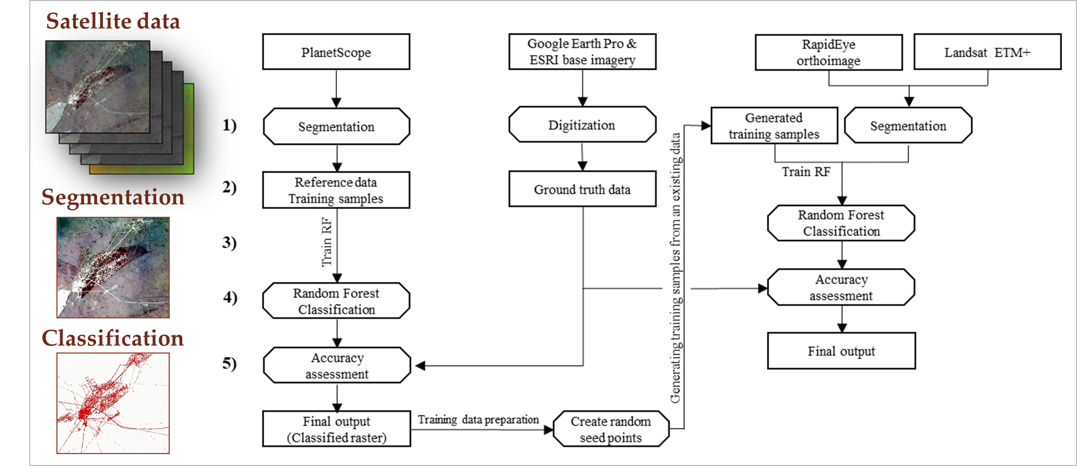
Methodology
In this research, the dirt roads and oil exploitation infrastructures were detected by object based image analysis and random forest classification.

Slide 8
Example of the features characteristic
Information of spectral, textural and geometric variables was used as predictors in classification, which extracted from remote sensing data.
Main dirt roads
Exploration temporary dirt roads
Oil extraction dirt roads & infrastructure
Oil extraction field

Slide 9
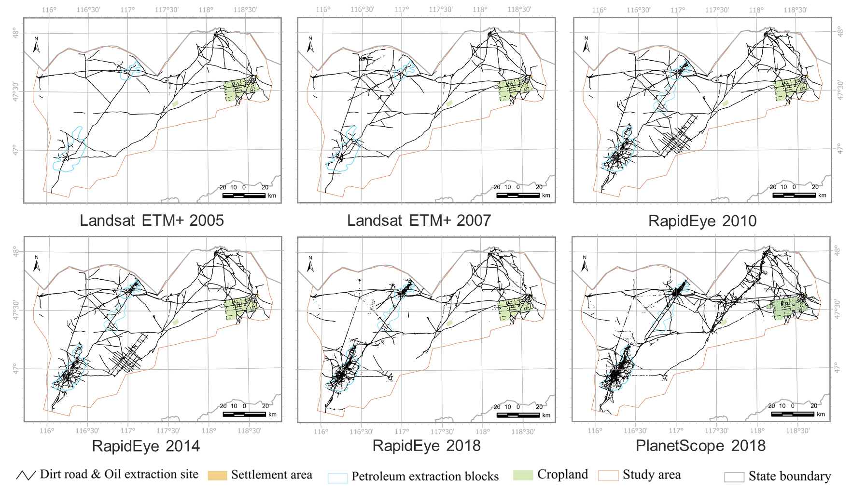
Classification results
Cohen‘s Kappa score:
PlanetScope 0.5-091
RapidEye 0.85-0.93
Landsat ETM+ 0.65-0.75
The map products of land use change indicates significant shifts in dirt road and infrastructure over the last 13 years.
The most pronounced change detected in this study was the expansion of dirt roads and infrastructure due to growth of oil exploitation, exploration and transportation.

Slide 10
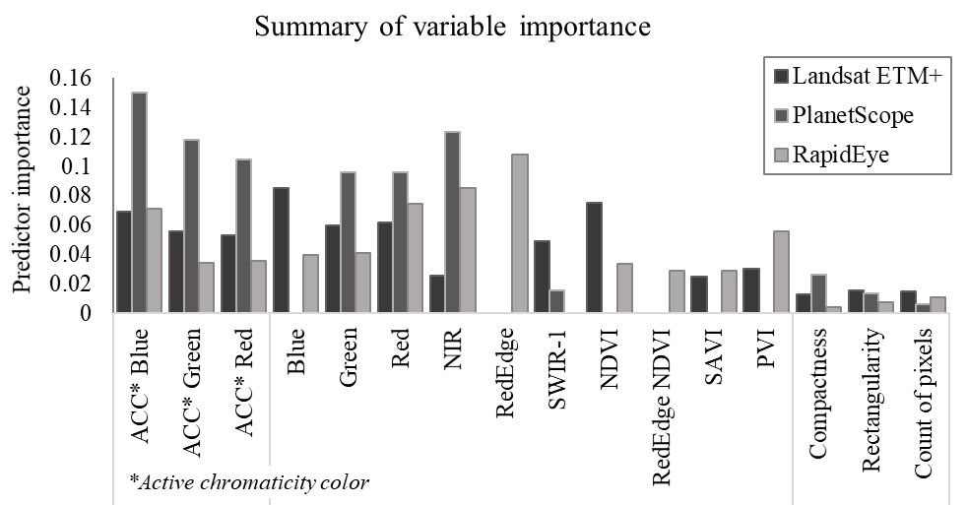
Variable importance for linear-feature classification
Top variables are:
Landsat ETM+
Blue band
NVDI
PlanetScope
ACC* Blue
NIR band
RapidEye
NIR band
Red edge band

Slide 11
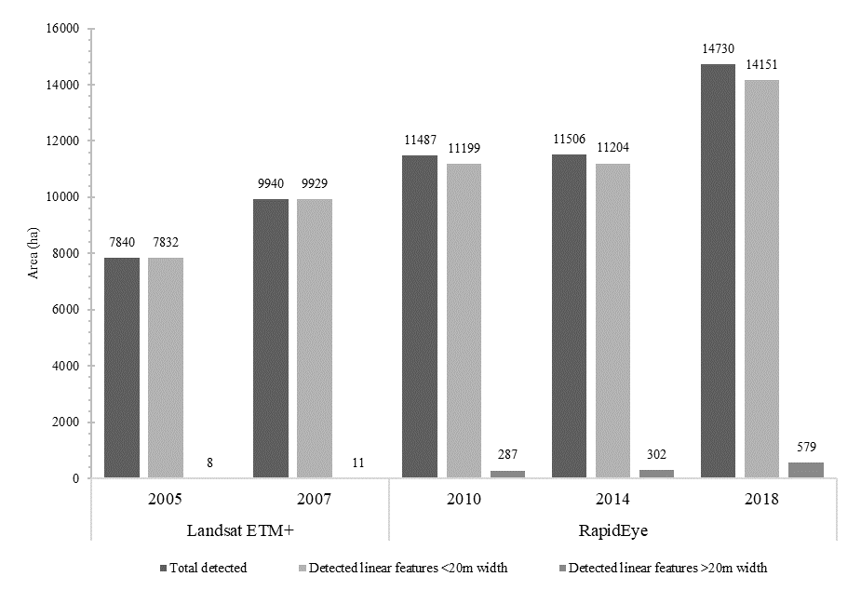
Land use change 2005-2018
The total disturbed grassland of dirt road and oil extraction infrastructure increased sharply from 7840 ha in 2005 to 14,730 ha in 2018.
Detected linear features of less than 20 m in width accounted to 8 ha and 11 ha in 2005 and 2007, respectively.
For the years 2010, 2015, and 2018, the dirt roads and oil extraction infrastructure with >20 m in width occupied areas of 287 ha, 302 ha, and 579 ha.

Slide 12
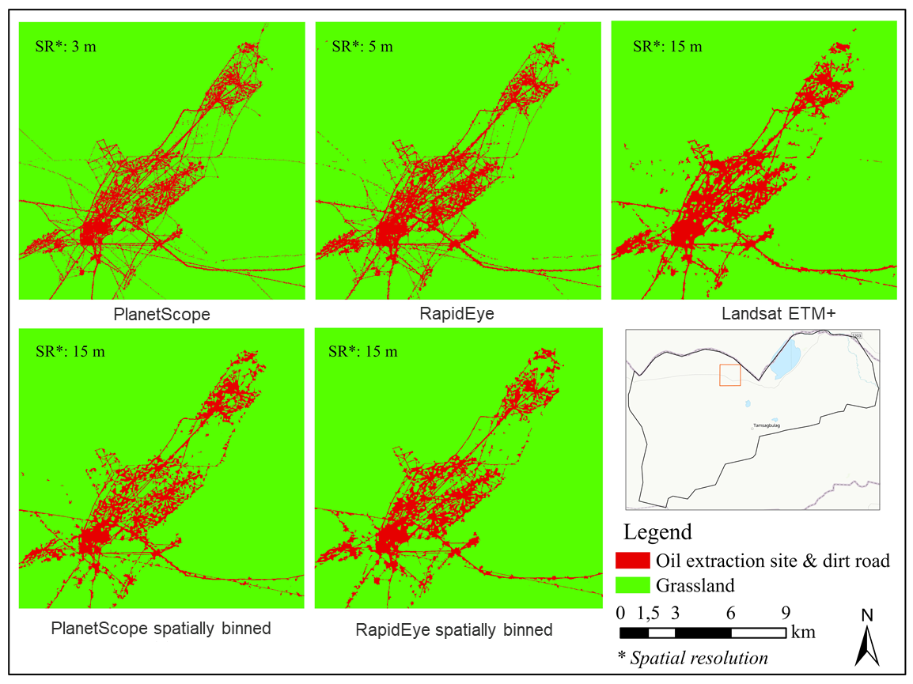
Comparison of multiscale image classification
Following points were summarised when using different sensors:
If target land cover object is small and linear than data resolution, they affected differently in classifiction results.
Classification of coarser spatial resolution images commonly lost narrow linear features that detectable from finer resolution data.
The higher-spectral resolution data could not provide the possibilities to deal effectively with the detection of smaller and linear feature than their spatial resolution.
Results of coarser resolution data were valuable to comparing the spatial distribution of linear features that was above 20 m in widths.

Slide 13
Conclusion
For the extraction of linear features, the method was well-suited to identify dirt roads and infrastructure from PlanetScope, RapidEye and Landsat ETM+ imagery, which obtained accurate results and opened up possibilities to apply the methodology to other areas.
Calculation of variable importance in all satellite imagery indicated that the variables of spectral bands and spectral indices are important to detecting linear features.
The classified results of 13 years of satellite data indicate that the land usage for dirt road and infrastructure in the Eastern Mongolian Steppe is increasing due to the active oil exploitation and exploration.
Map products that obtained from different spatial resolution imagery of PlanetScope, RapidEye and Landsat ETM+, are possible to use as data source for further detailed land degradation assessments.

Slide 14
Thank you for your attention

Slide 15
Appendix: Remote sensing data
Data collection of PlanetScope & RapidEye was downloaded free-of-charge from the Planet Labs, Inc. as part of the Education and Research program.
Data collection of Landsat ETM+ was downloaded free-of-charge from the United States Geological Survey’s (USGS) website.
Satellite Data | Available date | Number of Bands | Ground Sample Distance (GSD) | Product Level | Number of Scenes
PlanetScope | 31 July - 29 Oct 2018 | 4 | MS: 3 m | 1B | 200
RapidEye | 13 - 16 Sep 2018 22 Aug - 17 Sep 2014 27 June - 10 Oct 2010 | 5 | MS: 5 m | 1B | 124
Landsat ETM+ | 16 October 2018 14 - 21 July 2007 | 8 | MS: 30 m Pan: 15 m | 1 | 10
 | 9 - 25 August 2005

Slide 16
Appendix: Spectral & segmentation predictor variables
Variable |  | Description
Data of single spectral bands
Mean value Standard deviation | The average digital number (DN) of each band Standard deviation of each bands
Spectral indices
NDVI | Value of the normalized difference vegetation index
NDVI_{Red-edge} | Normalized difference vegetation index ³: (NIR – RE)/(NIR + RE)
PVI | Perpendicular vegetation index ³: (NIR-a*Red-b)/(sqrt(1+a²))
SAVI | Soil-adjusted vegetation index^{.3}: ((NIR − Red) / (NIR + Red + L)) × (1 + L)
Segment
Average chromaticity color | The RGB color values of per-segment
Compactness | The degree to which a segment is compact or circular
Rectangularity | The degree to which a segment is rectangular
Count | The number of pixels comprising the segment

