Slide 1

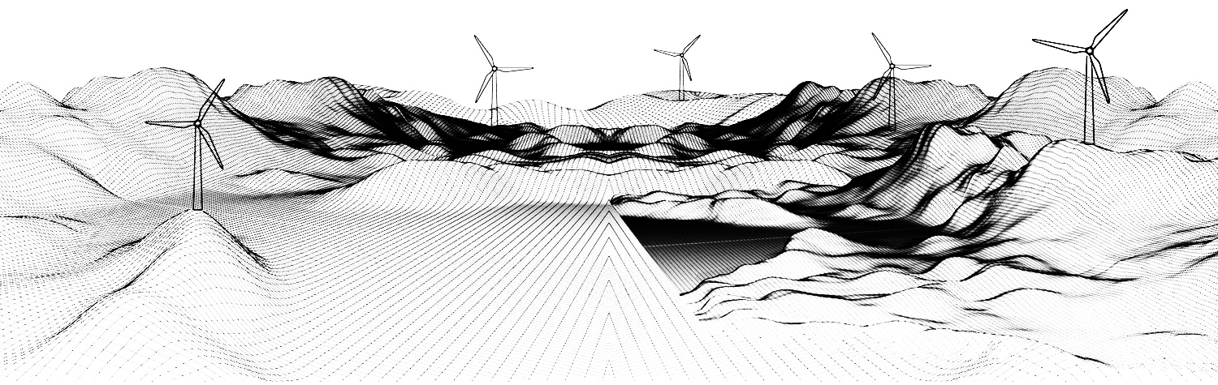


AESTHETIC EVALUATION OF WIND TURBINES IN STOCHASTIC SETTING: case study of Tinos island, Greece
National Technical University of Athens
School of Civil Engineering
Department of Water Resources and Environmental Engineering
European Geosciences Union General Assembly, Online, 4-8 May 2020
HS3.3/ERE6: Stochastic modelling and real-time control of complex environmental systems
Eleni Manta*, Romanos Ioannidis, G.-Fivos Sargentis and Andreas Efstratiadis
*eleni.mantas@gmail.com

Slide 2

introduction
The concept of landscape aesthetics introduces a different view for evaluating the natural environment. Landscape aesthetics prioritise the people's psychological delectation and the need for recreation. The natural landscape aspect acquaints the person with the natural environment, provided that it becomes perceivable, attractive and can be visited. Thus, the natural environment constitutes the subject of historical memory.
Aesthetics is a highly subjective issue, thus any attempt towards its quantification requires accounting for the uncertainty induced from subjectivity.
Nowadays, tradition and history have been trapped in museum-like preservation, while any new construction is synonymous to maximum "exploitation" and promotion. In this reality, the notion of integrating an activity and forming the natural environment is difficult to approach.
Often, the natural landscape changes rapidly or disappears altogether, be it in the name of progress and exploitation, or of the necessity for a public function. [1]

Slide 3

introduction
Characteristic example of a public function are wind turbines. They are large-scale engineering infrastructures that may cause significant social reactions, due to the anticipated aesthetic nuisance. [1]
Since aesthetics is a subjective matter, the stochastic methodology was introduced as a way of quantifying and evaluating the impact of wind turbines on the natural and historically rich landscape.
The mathematical field of Stochastics has been introduced as an alternative way of deterministic approaches, to model the so-called random, i.e., complex, unexplained or unpredictable, fluctuations observed in non-linear geophysical processes. Stochastics help develop a unified perception for natural phenomena and expel dichotomies like random vs. deterministic. [2]
In this research a stochastic computational tool called 2D-C is used to analyze landscape [3]. Key component of the methodology is the climacogram analysis.

Slide 4
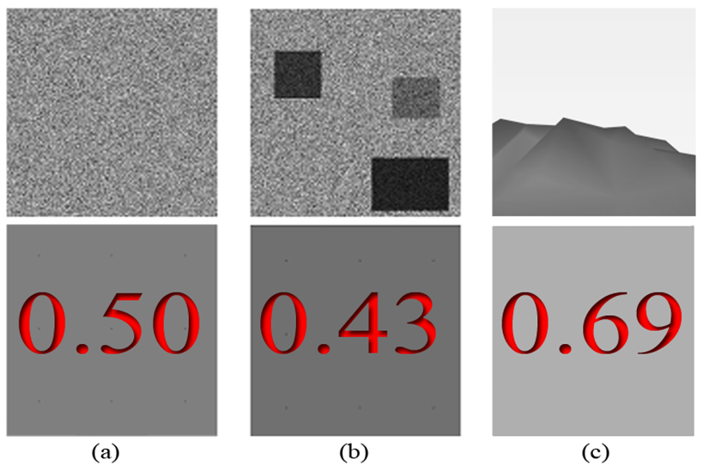


stochastic analysis of landscape images with 2D-C
Each image is digitized in 2D based on a grayscale color intensity and next the climacogram is calculated based on the geometric scales of adjacent pixels [3], [4; see parallel presentation EGU2020-19832]. In practice, this allows for evaluating the brightness of an image.
Assuming an area n Δ × n Δ, where n is the number of intervals (e.g., pixels) along each spatial direction and Δ is the discretization unit (determined by the image resolution, e.g., pixel length), the empirical classical estimator of the climacogram for a 2D process is expressed as:
Benchmark of image analysis; (a) White noise; (b) Image with clustering; (c) landscape; the lower row depicts the average brightness in the upper one.
(white=1, black=0)
where the “^” over γ denotes estimate, $κ$ is the dimensionless spatial scale, ${\underline{x}}_{i,j}^{(κ)}=\frac{1}{κ^{2}}\sum_{ψ=κ\left(j−1\right)+1}^{κj}{\sum_{ξ=κ\left(i−1\right)+1}^{κi}{{\underline{x}}_{ξ,ψ}}}$ is the sample average of the space-averaged process at scale $κ$, and $\overline{\underline{x}}=\sum_{i,j=1}^{n}{{\underline{x}}_{i,j}}/n^{2}$ is the sample average. Note that the maximum available scale for this estimator is n/2

Slide 5
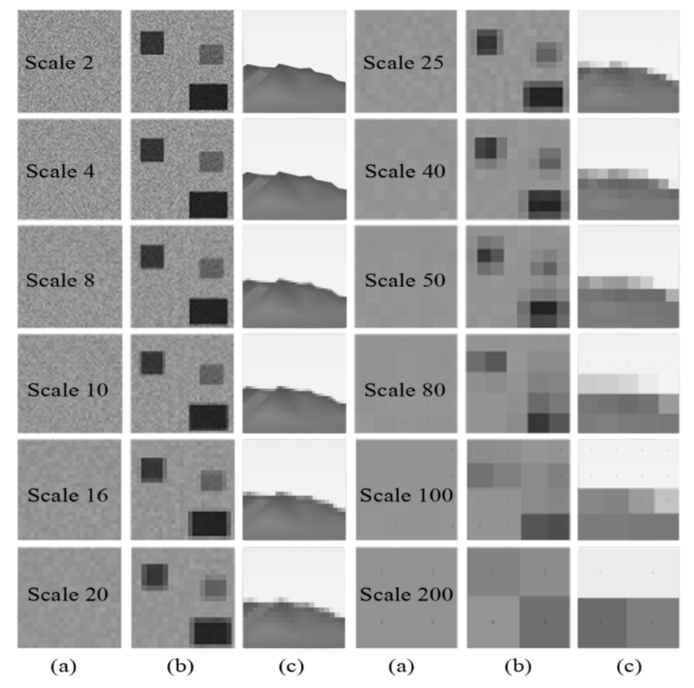
steps of stochastic analysis with 2D-C
Example of stochastic analysis of a 2D picture (Sargentis et al., 2020) [4]; Grouped pixels at scales k = 2, 4, 8, 16, 20, 25, 40, 50, 80, 100, and 200.
White noise;
Image with clustering;
Landscape.

Slide 6
results of stochastic analysis: climacograms
The presence of clustering is reflected in the climacogram, which shows a marked difference against white noise.
Specifically, the variance of the clustered images is notably higher than that of the white noise at all scales, indicating the variability of the process.
Likewise, comparing the clustered image and the landscape, the latter has the most pronounced clustering behavior and a greater degree of variability.
(a) Climacograms of the benchmark images.
(b) Standardized climacograms of the benchmark images.

Slide 7
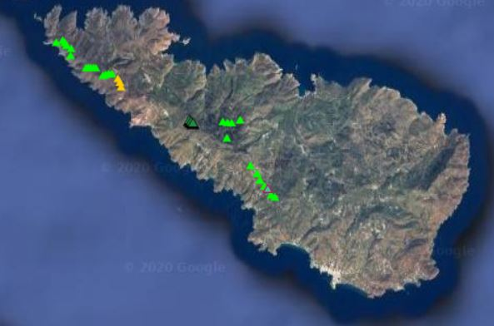
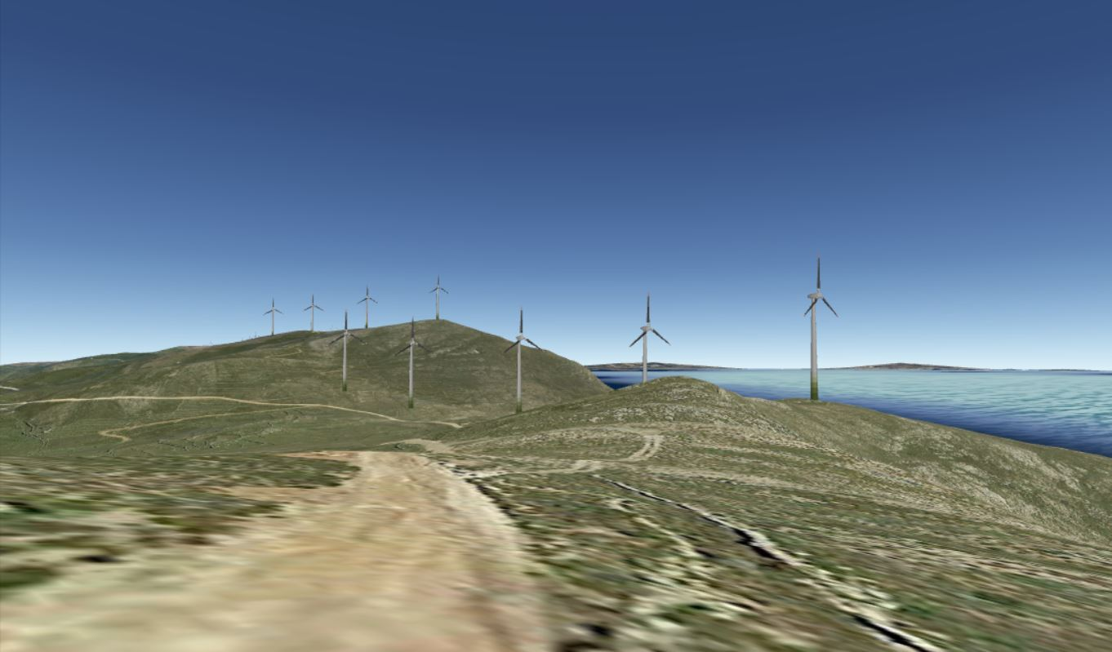
Tinos island vs. wind energy development
Tinos is a Cycladic island on the Aegean sea, east of Athens and north of Mykonos. It’s rich in architectural and art history, visited by thousands of tourists every summer. In this respect, the landscape is extremely important to the island’s identity and appeal.
Today, there are 53.7 MW of wind energy machines installed across an island of 194.5 km² .
The subject of this study is the aesthetic evaluation of three new wind turbines that are planned to be installed, of 1.8 MW total capacity.
Existing wind turbines on Tinos
3D representation using SketchUp and Google Earth

Slide 8


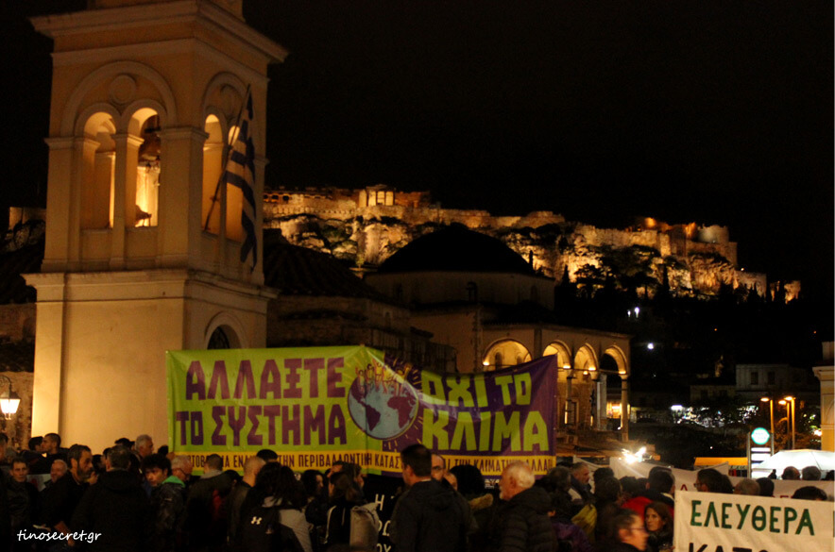

social reactions against the new wind turbines
Human chain at Tinos harbor as a form of protest against the wind turbines. [5]
Peaceful protest on the mountain that the new wind turbines are planned to be installed. [5]
Protest in Athens city center against the wind turbines. [5]
Citizens of Tinos blocking the coming of the materials needed for the installation of the new wind turbines. [5]

Slide 9
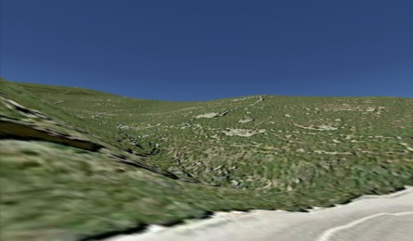

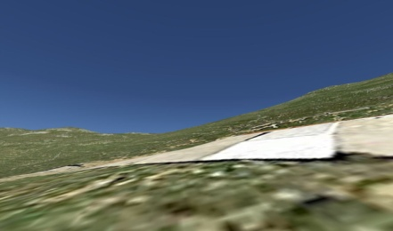
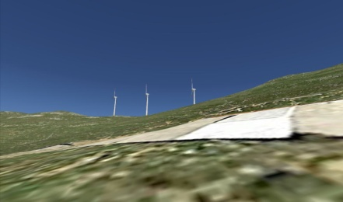

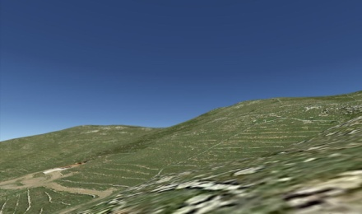
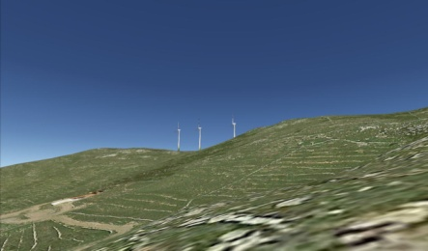
new wind turbines (3D representation on Google Earth)
Landscape
with wind turbines
Existing landscape
Area highly affected by landscape alterations
~ 9km² ~ 4.5% of the island’s surface

Slide 10
how the landscape is altered: theoretical analysis (1/2)
Multi-criteria tableau on landscape aesthetics [6] – [14]
 | 1 | 2 | 3 | 4 | 5 | 6 | 7
Form
Lines
Colours
Texture
Contrast
Sequence
Convergence
Condominium
Balance
Axis

Slide 11
how the landscape is altered: theoretical analysis (2/2)
 | 1 | 2 | 3 | 4 | 5 | 6 | 7
Observant’s position
Distance
Movement
Scale
Feeling right
Honesty
Utility
Respect/holiness
Sympathy
Architecture/art
Contact

Slide 12
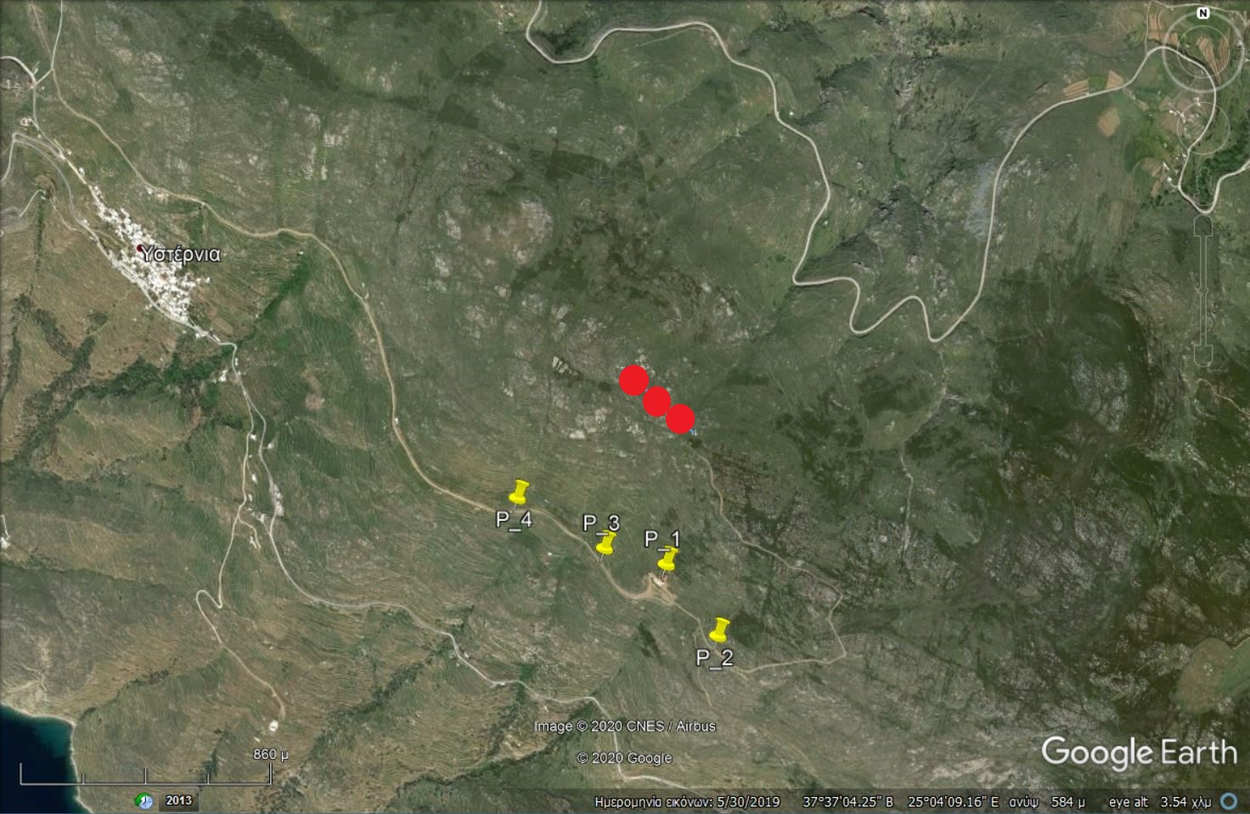
stochastic analysis of landscape change
New wind turbines (marked in red) and positions of observation

Slide 13

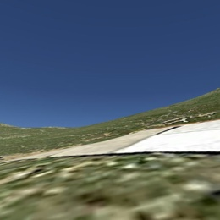
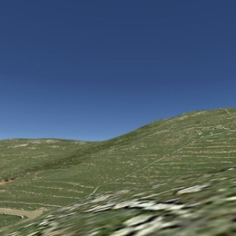
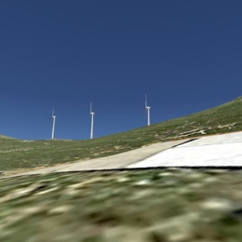
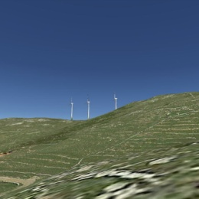
stochastic analysis of positions P_1 and P_2
P_1
P_2
Images analysed
Climacogram
Images analysed
Climacogram
1
1

Slide 14
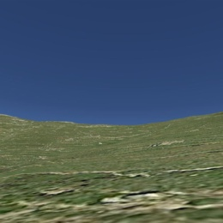
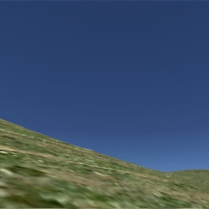
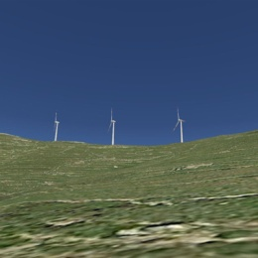
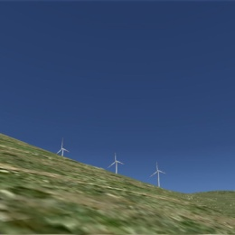
stochastic analysis of positions P_3 and P_4
P_3
P_4
Images analysed
Climacogram
Images analysed
Climacogram
1
1

Slide 15
comparative evaluation
Where R(k) = γ(κ) _{landscape} - γ(κ) _{landscape with turbine}
For each scenario, a new series were created by deducting the values of the climacogram of the picture of the landscape without the wind turbines from the climacogram of the picture including the wind turbine. These four new series are presented here.

Slide 16

conclusions
The necessity for developing renewables is undeniable, not only in order to protect the environment, but also to fulfill energy needs during the impending depletion of fossil fuels.
The Greek natural environment is deeply linked with the tradition and history of each place. In particular, the landscape of Greek islands is internationally recognised and constitutes an attraction for thousands of visitors every year.
Wind turbines are large-scale constructions that strongly antagonise the natural landscape, often resulting in irrevocably altering its qualities. Actually, their massive and reckless installation are in full contrast with the need for protecting its traditional identity.
The installation of wind turbines on top of a hill, which is the case of Tinos, causes the most intense visual heterogeneity which results to the most intensive landscape alteration, as reported by Ioannidis et al. [15; see parallel presentation EGU2020-18212] .
Stochastic analysis of landscapes offer an objective tool for evaluating the aesthetic footprint of such projects, and may also be incorporated in Environmental Impact Assessment studies.

Slide 17
REFERENCES
Kosmaki T., Lecture notes: Environmental Components of Planning and Housing Development: Protection, assessment and consideration of the natural landscape as part of the environment, National Technical University of Athens - School of Architecture.
Koutsoyiannis, D.: HESS Opinions "A random walk on water", Hydrol. Earth Syst. Sci., 14, 585–601, https://doi.org/10.5194/hess-14-585-2010, 2010.
Sargentis, G.-F., P. Dimitriadis, and D. Koutsoyiannis, Aesthetical Issues of Leonardo Da Vinci’s and Pablo Picasso’s Paintings with Stochastic Evaluation, Heritage, 3, 283-305, 2020.
Sargentis G.-F., R. Ioannidis, I.Taygetos Meletopoulos, P. Dimitriadis, and D. Koutsoyiannis, Aesthetical issues with stochastic evaluation, European Geosciences Union General Assembly 2020, Geophysical Research Abstracts, Vol. 22, Online, EGU2020- 19832, European Geosciences Union, 2020.
Google search results 02/03/2020 http://www.tinosnow.gr/2019/11/tinos-food-paths-16112019-photos.html, https://tinosecret.gr/alysida-anemogennitries/, https://tinosecret.gr/anemogennitries-ploio/, https://tinosecret.gr/poreia-aiolika/
Christofides, A., A. Efstratiadis, D. Koutsoyiannis, G.-F. Sargentis, and K. Hadjibiros, Resolving conflicting objectives in the management of the Plastiras Lake: can we quantify beauty?, Hydrology and Earth System Sciences, 9(5), 507–515, doi:10.5194/hess-9-507-2005, 2005.
Sargentis G.-F., The esthetical element in water, hydraulic works and dams, Diploma thesis, Department of Water Resources, Hydraulic and Maritime Engineering – National Technical University of Athens, Athens, 1998.
Betakova V., Vojar J., Sklenicka P., Wind turbines location: How many and how far?, Applied Energy. 151 (2015) 23–31
Bishop I. D., Determination of thresholds of visual impact: the case of wind turbines, Environment and Planning B: Planning and Design. 29 (2002) 707–718.
Buchan N., Visual Assessment of Windfarms Best Practice, University of Newcastle, Newcastle, 2002.
Scottish Natural Heritage [SNH], Siting and Designing Windfarms in the Landscape. Version 1., Scottish Natural Heritage, 2009.
Stevenson R., S. Griffiths, The visual impact of windfarms: lessons from the UK experience, Harwell Laboratory, Energy Technology Support Unit, 1994.
Stephanou I., The physiognomy of the Greek city, N.T.U.A. and Ministry of Regional Planning, Building and Urban Development, Athens, 2000
Sargentis, G.-F., P. Dimitriadis, R. Ioannidis, T. Iliopoulou, and D. Koutsoyiannis, Stochastic Evaluation of Landscapes Transformed by Renewable Energy Installations and Civil Works, Energies, 12, 2817, 2019.
Ioannidis R., I. T. Meletopoulos, P. Dimitriadis, G. –F. Sargentis, and D. Koutsoyiannis, Investigating the spatial characteristics of GIS visibility analyses and their correlation to visual impact perception with stochastic tools, European Geosciences Union General Assembly 2020.

