Slide 1
AMOC hysteresis in an eddy-permitting GCM and monitoring indicator
Laura Jackson and Richard Wood

Slide 2
Summary slide
We use coupled GCM (forerunner to CMIP6 model) and apply extra freshwater ‘hosing’ to the North Atlantic.
The AMOC does not recover (within a couple of hundred years) if it weakens to less than 8 Sv before hosing stops.
We also use these experiments to test other metrics which have been proposed to monitor the AMOC to see how well they can identify (and even provide early warning for) changes in the AMOC. We conclude that the best monitoring strategy would be to use multiple indicators

Slide 3
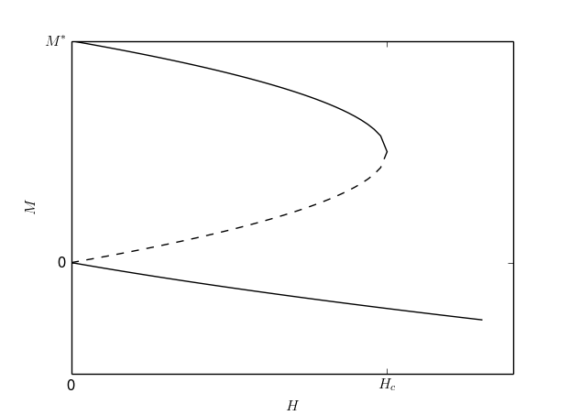
Method
Hose (additional surface fresh water flux) from 50N-Bering Straits.
Use volume compensation to conserve fresh water
Hose at rate H for T years where:
H = 0.1,0.2,0.3,0.5,1.0 Sv
T = 20,50 years (plus others where needed)
Then stop hosing.
H
T
MOC strength
?
Fresh water input (hosing)
Methods
Jackson and Wood, 2018. GRL

Slide 4
Model
HadGEM3-GC2 (pre CMIP6 model)
Fully coupled atmosphere, ocean and sea ice (doesn’t include flux adjustment)
NEMO ocean model
‘Eddy-permitting’ - nominally 0.25º with 75 levels (highest resolution for such a study)
No GM (sub-gridscale mixing)
Methods
Jackson and Wood, 2018. GRL

Slide 5
Continunous hosing of 0.3 Sv causes weakening of the AMOC.
When hosing is stopped after 20 years the AMOC recovers.
When hosing is stopped after 50 years the AMOC stays weak.
Control
Continuation after 20 yrs
Continuation after 50 yrs
Hosing
AMOC response
Jackson and Wood, 2018. GRL

Slide 6
If AMOC is weakened below 8 Sv before hosing stops then the AMOC stays in a weak state.
R
W
AMOC response
Jackson and Wood, 2018. GRL

Slide 7
Timescale of resilience (years)
The AMOC is resilient for 20 years of H=0.3 Sv but not 50 years. Therefore timescale of resilience for H=0.3Sv is 20 < t < 50. Timescale of resilience is less for stronger hosing.
AMOC response
Jackson and Wood, 2018. GRL

Slide 8
Why does the AMOC not recover in this model?
Mecking et al (2016) found that the AMOC in the same model didn’t recover after a large salinity perturbation. They attributed this to the strong salt transport by the AMOC.
When the AMOC collapses, the lack of salt input freshens the N Atlantic
This model has a very strong salt transport so greater freshening
Stronger salt transport may be due to resolution?
.
Background

Slide 9
Proposal for new MIP
Understand the signs and strengths of key feedbacks controlling AMOC hysteresis in order to better understand the likelihood of AMOC collapse in the future.
Repeat a small number of experiments (ie 0.3 Sv for 20 and 50 years) with other GCMs
Do any other models show a non-recovery of the AMOC?
Does the density/salinity in the subpolar N Atlantic/whole Atlantic vary with the AMOC? How does this relationship vary across models?
What are the signs and relative strengths of the various feedbacks in the Atlantic? What are the dominant controls on the changes in salinity/ and how do these vary across models?
Please contact me if you are interested in being involved.

Slide 10
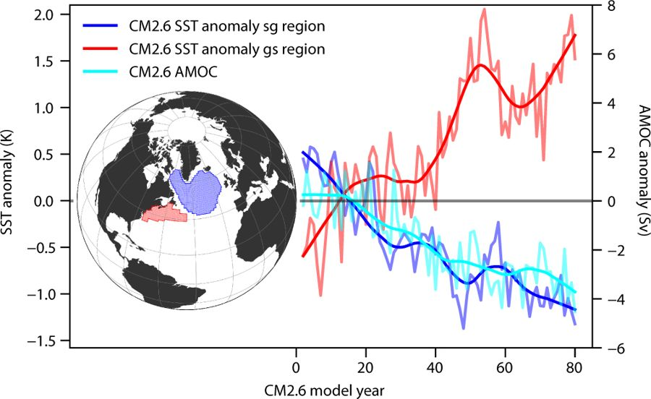
Monitoring indicators
A useful monitoring indicator should be observable and provide information.
We are already monitoring AMOC through RAPID and OSNAP. How useful are these and how useful are alternative 'fingerprints'?
Many AMOC fingerprints (metrics representing some aspect of the AMOC) have been suggested for different uses. e.g:
SST and heat content/subsurface temperature dipoles
Zhang, 2008. GRL
Caesar et al, 2018, Nature
Background

Slide 11
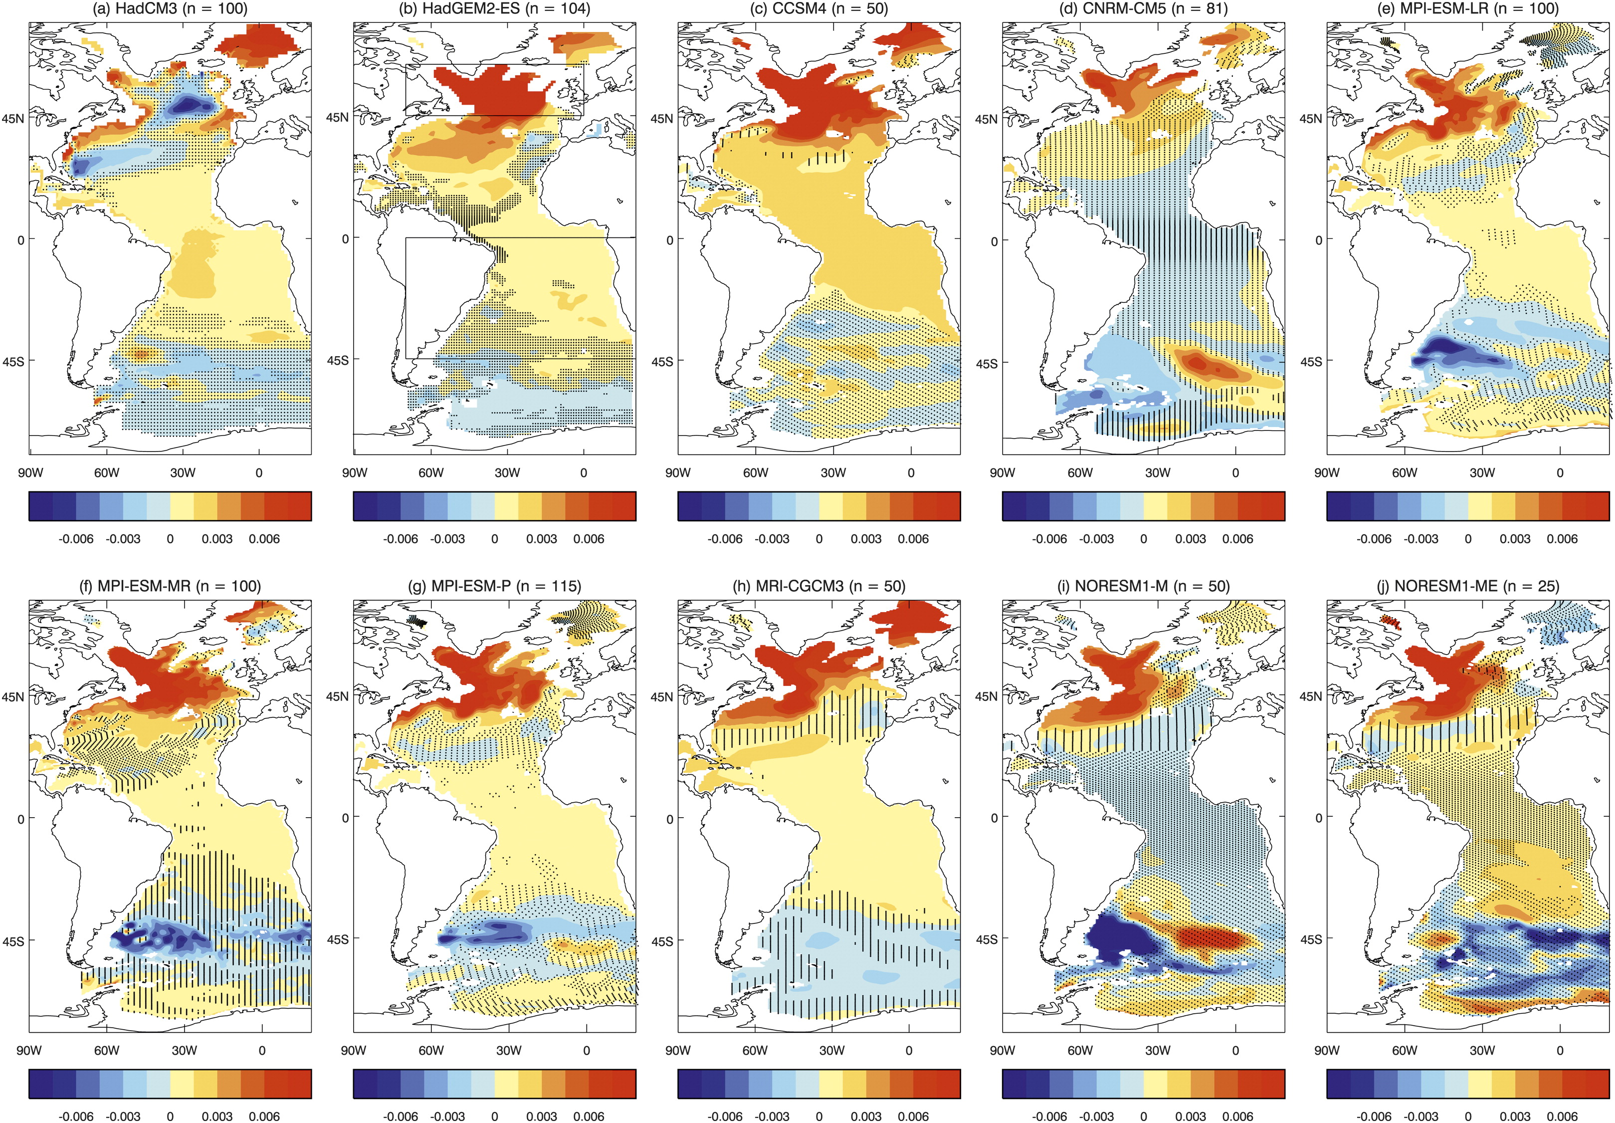
N Atlantic – global mean SST (ie AMV pattern)
Msadek et al, 2010. GRL
Also many others including
Density gradients (see left)
Mixed layer depths
Sea level gradients
Freshwater transports
Roberts et al, 2013. J Climate
Background

Slide 12
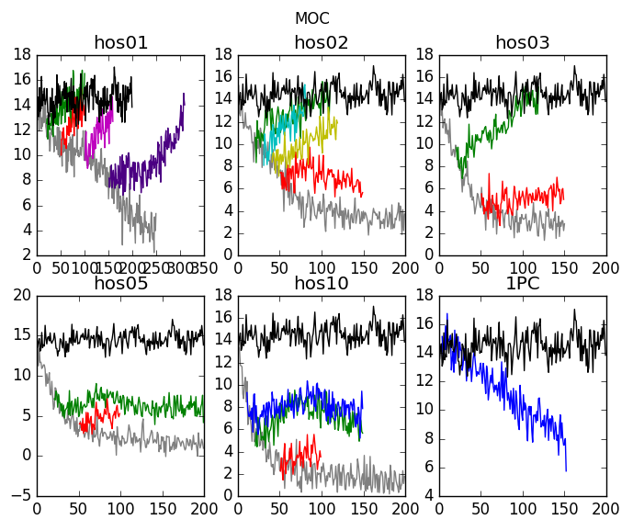
We use HadGEM3-GC2 again, and use experiments with different scenarios:
Control (for looking at variability)
1% increase in CO2
Hosing experiments and experiments where hosing is time-limited
Methods

Slide 13
Monitoring variability
Assess lagged correlation with AMOC at 26.5N
RAPID obviously very good, but also significant corr from upper mid ocean component alone and from OSNAP
Some temperature (left) and density (right) metrics have good correlations and some give a few years early warning, though some temperature metrics are lagged.
Temperature metrics
Density metrics
Metrics Results
Jackson and Wood, 2020. J Clim, under review

Slide 14
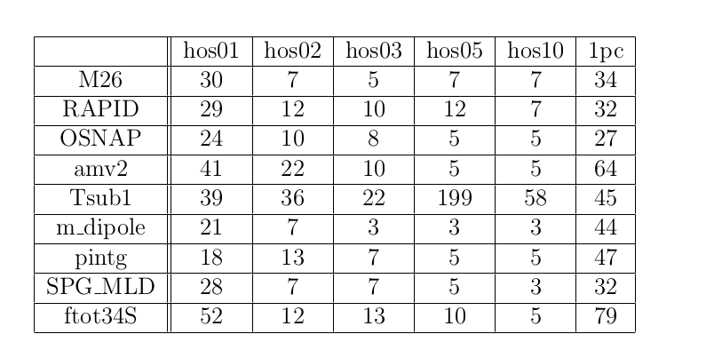
Detecting a weakening
Most indices show a weakening during hosing/1% scenarios. We calculate how long before a weakening is detected (ie signal>noise) in years.
RAPID and OSNAP monitoring detect weakening similarly to actual AMOC
Density metrics are faster most experiments because they have a greater signal to noise ratio (ie have less noise)
Maybe using multiple monitoring indicators would be better?
Metrics Results
Jackson and Wood, 2020. J Clim, under review

Slide 15
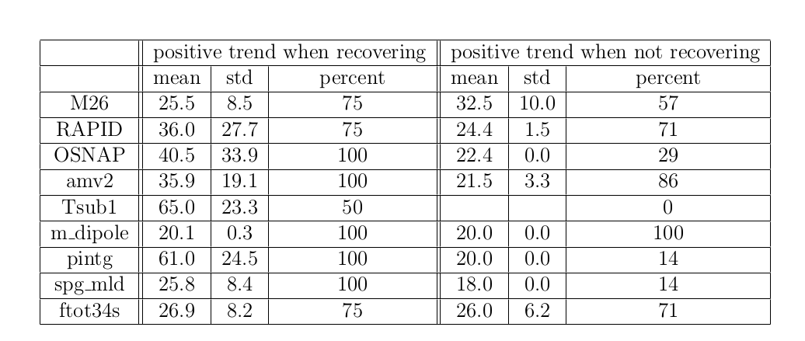
Detecting a recovery
AMOC at 26N detects recovery after an average of 25.5 years
Density dipole detects a recovery faster, but has a high false detection rate (positive trend in the index when the AMOC does not recover)
Subpolar mixed layer depth has a low false detection rate and a relatively fast recovery detection rate
Year to detect trend
% of exp where trend detected
Metrics Results
Jackson and Wood, 2020. J Clim, under review

Slide 16
Conclusions
There appears to be a limit beyond which the AMOC does not recover when hosing is applied - hysteresis
AMOC shows ‘temporary resilience’ – for ‘realistic’ levels of hosing would recover with < 100 years of hosing.
Appears to be related to magnitude of salt transport by the overturning within the Atlantic
Different monitoring indicators and 'fingerprints' are useful for monitoring different aspects of the AMOC's future evolution. This suggests that a monitoring strategy using multiple indicators would be best.
Results in Jackson and Wood (2018), GRL and Jackson and Wood (2020) J Clim (under review).
This project has received funding from the European Union’s Horizon 2020 research and innovation programme under grant agreement No 820970

