Slide 1
How fast to turn around: preventing tipping after a system has crossed a climate tipping threshold
Paul Ritchie, Jan Sieber and Peter Cox
EGU 2020: Sharing Geosciences Online
Wednesday 6th May 2020

Slide 2
Delays when the forcing is quick
Classical tipping scenario: a slowly varying system parameter crosses a critical threshold causing an instantaneous abrupt transition to an alternative state
However, it may be more natural to consider a rapidly changing parameter forcing; this induces a delay in tipping from when the critical threshold is crossed
$$\dot{x}=a_{o}(p\left(t\right)+κx^{2}), p\left(t\right)= p_{0}+rt$$
Slow forcing: $r$ small
Fast forcing: $r$ large

Slide 3
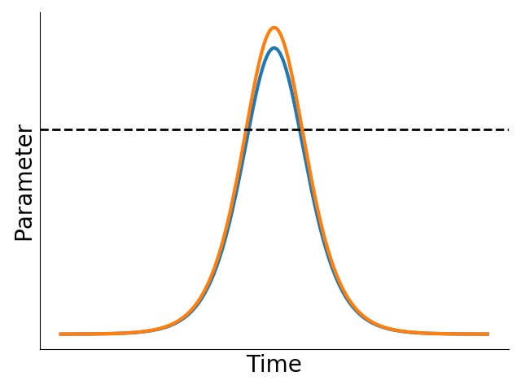
Overshooting tipping threshold
Parameter forcing
Tipping threshold
Delayed response can in principle be exploited to avoid tipping even after the tipping threshold has been passed if the reversal in the forcing is sufficiently fast
Blue parameter forcing
Orange parameter forcing

Slide 4
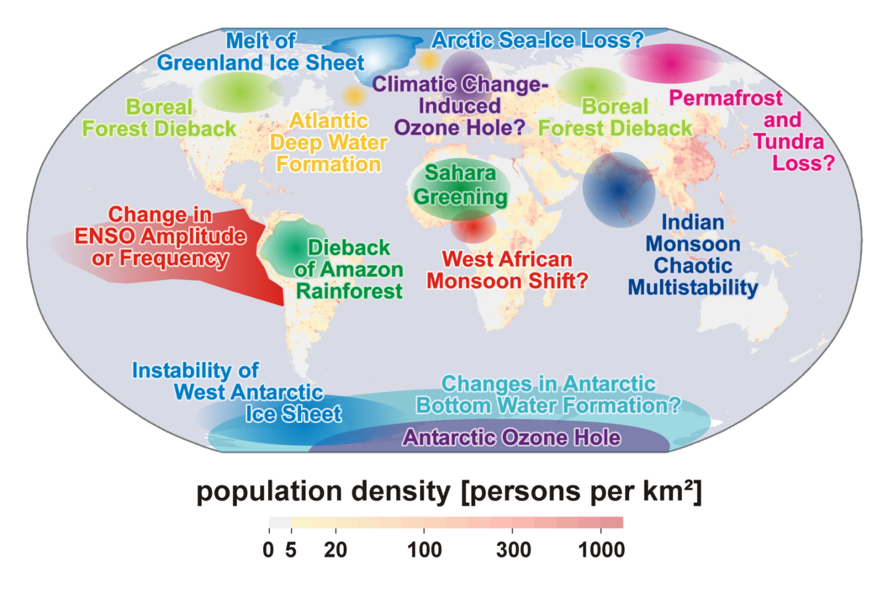
Models for tipping elements in the Climate System
We will use models of policy relevant tipping elements in the climate system to illustrate different concepts of overshooting a tipping threshold
Ice cap loss
(Herald et al., 2013)
AMOC collapse
(Cessi, 1994)
Vegetation dieback
(Cox, 2001)
Disruption to Indian Summer Monsoon
(Zickfeld, 2004)
Lenton et al., 2008

Slide 5
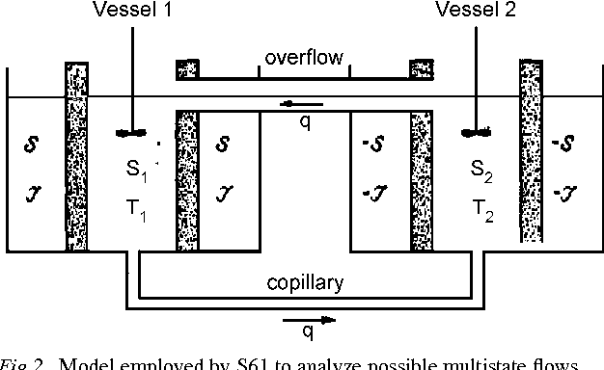
AMOC collapse
AMOC is a temperature and salinity driven circulation current in the Atlantic ocean
Adding freshwater to the North Atlantic (e.g. ice sheet melt) could disrupt overturning
Stommel, 1961
We use Cessi, 1994 simplification (assume diffusion time scale is much larger than temperature restoring time scale) of the Stommel 2 box model
$$\frac{dy}{dt}=F(t)+σ_{F}η−y\left(1+μ^{2}{\left(1−y\right)}^{2}\right)$$
Model salinity flux
Ratio of diffusive and advective time scales
Freshwater flux with variability

Slide 6
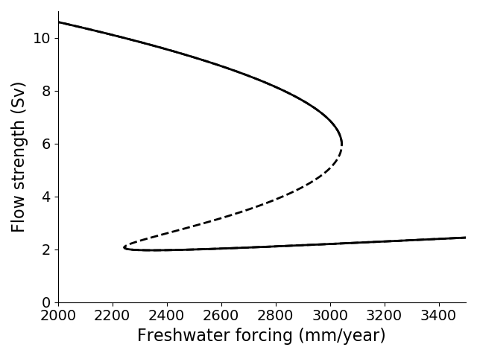
AMOC collapse - how fast to turn around
Consider one increasing forcing trajectory but with different turn around times
How fast we need to reverse the forcing depends on when action is taken
Late responses (large overshoots of the tipping threshold) require fast return forcings to avoid tipping compared to early responses
Bistable region
AMOC on
AMOC off
Critical trajectories for avoiding an AMOC collapse
Tipping threshold

Slide 7
Vegetation dieback model
Modified version of the TRIFFID model (Cox, 2001) for 1 vegetation species
$\frac{dv}{dt}=Gv\left(1−v\right)−γv$,
Model vegetation fraction
Growth parabolic in temperature
$$G=G_{0}−β{\left(T_{opt}−T_{∗}\right)}^{2}+σ_{G}η$$
Fixed mortality rate
Apply variability
Temperature changes with vegetation fraction
$$T_{∗}=T(t)+α(1−v)$$

Slide 8
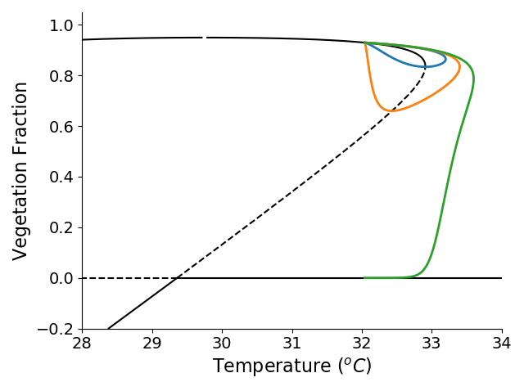
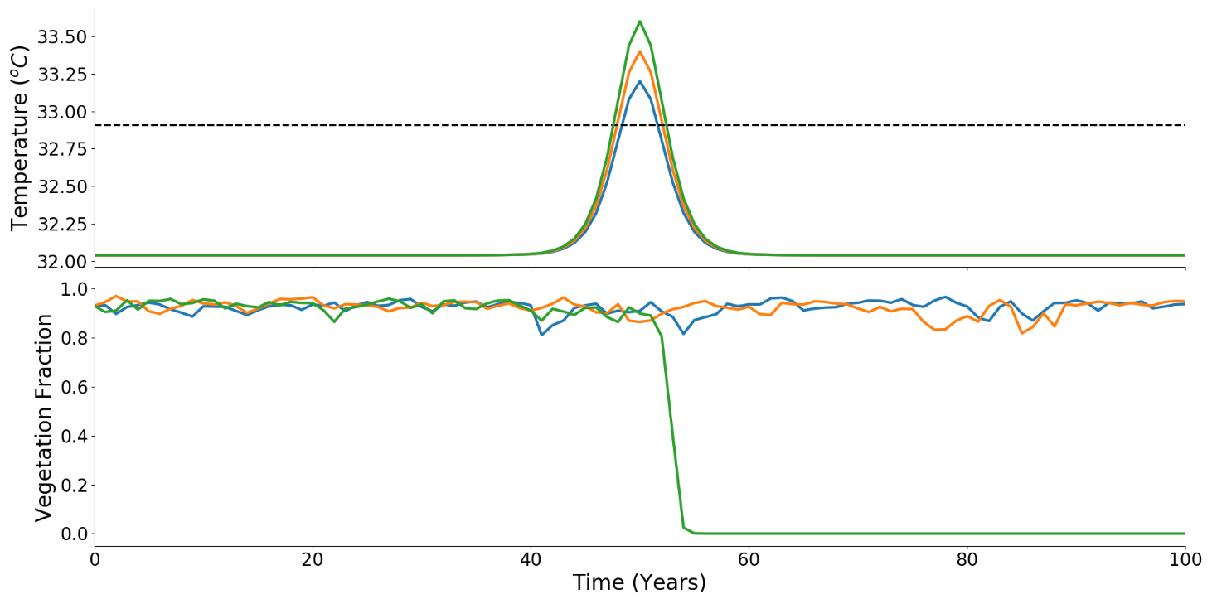
Vegetation dieback model
Consider three sample forcing paths of temperature for fixed exceedance times but variable maximal overshoots
Further beyond the tipping threshold the more likely the system will tip
Tipping threshold
Bistable region

Slide 9
Ice cap model
For sufficient warming, ice-albedo feedback leads to runaway scenario of sea-ice loss
Use Herald et al., 2013 simplified version of the ice cap model proposed by North, 1984, modelling ice cap size ($\sin{x}$: latitude of ice cap boundary) based on solar constant ($S_{0}$)
Solar constant is used as a proxy for warming/greenhouse gas levels
$$\frac{dx}{dt}=−0.003+\left(1−x\right)\left(\frac{S_{0}(t)+σ_{S}η}{4}−335+3{\left(\frac{x−0.89}{0.09}\right)}^{2}\right)$$

Slide 10
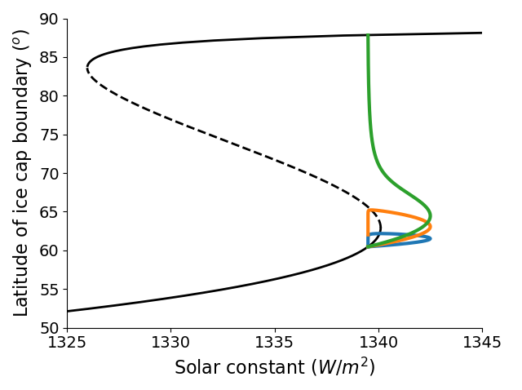
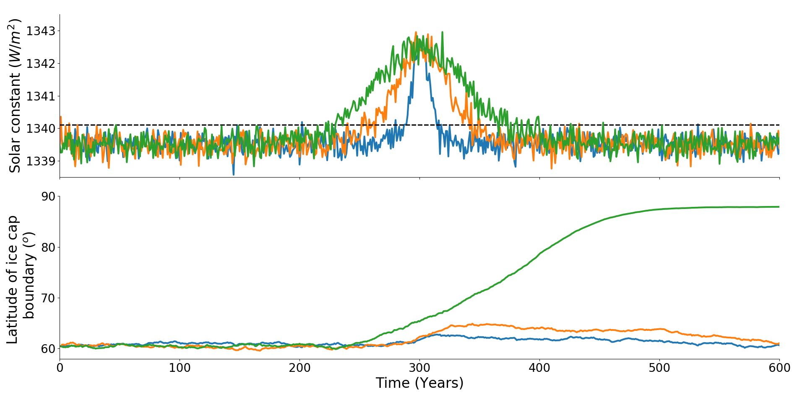
Ice cap model
Consider three sample forcing paths of solar constant for fixed maximal overshoot but variable exceedance times
Longer time spent above tipping threshold the more likely the system will tip
Ice free (Stable)
Tipping threshold
Small ice cap (Unstable)
Large ice cap (Stable)

Slide 11
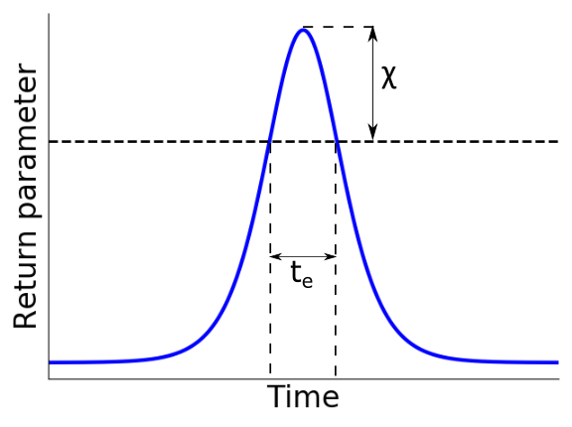
Inverse square law for overshooting tipping threshold
Ritchie et al., 2019 developed an inverse square relationship between the maximal overshoot $χ$ and exceedance time $t_{e}$above the tipping threshold, which defines a ‘safe’ overshoot
Tipping threshold
$$χ t_{e}^{2}<\frac{16}{d}$$
$d$ : System specific parameter, which can be calculated from the autocorrelation of the system’s time series

Slide 12
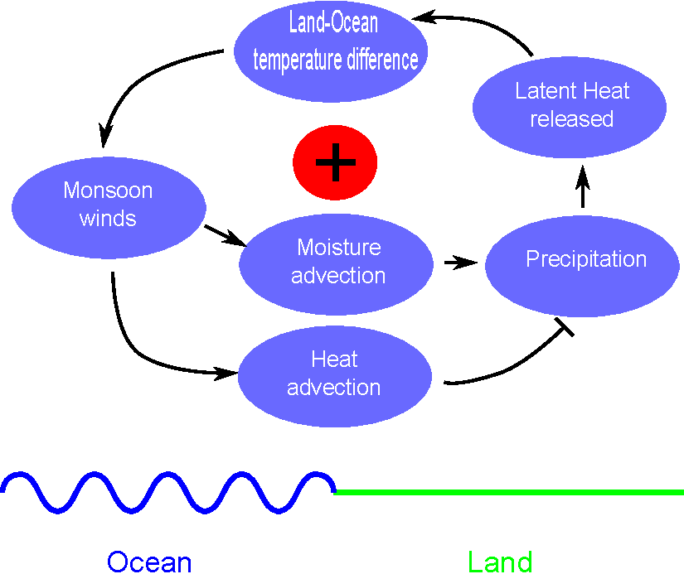
Indian Summer Monsoon model
Feedback loop key mechanism of the Indian Summer Monsoon
Reduced form model (Zickfeld, 2004) modelling specific humidity ($Q_{a}$) and atmospheric temperature ($T_{a}$):
$$\frac{dQ_{a}}{dt}=\frac{E−P+A_{v}}{I_{Q}}+σ_{Q}η$$
$$\frac{dT_{a}}{dt}=\frac{ℒ\left(P−E\right)−F_{↑}+F_{↓}\left(1−A_{sys}(t)\right)+A_{T}}{I_{T}}$$
(based on Levermann, 2009)
Vary planetary albedo

Slide 13
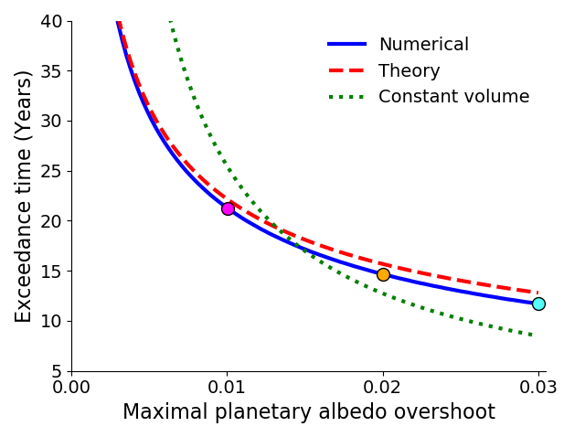
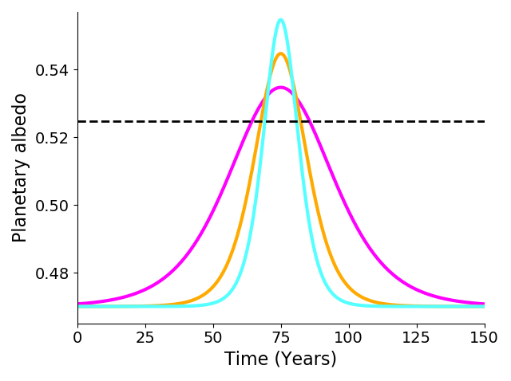
Indian Summer Monsoon model (with no variability)
Inverse square law applied to Indian Summer Monsoon model agrees well with numerical result
Constant volume curve illustrates, it is better to overshoot far and quick rather than a small overshoot for a long time
$$χ{ t}_{e}^{2}<\frac{16}{d}$$
Tipping threshold

Slide 14
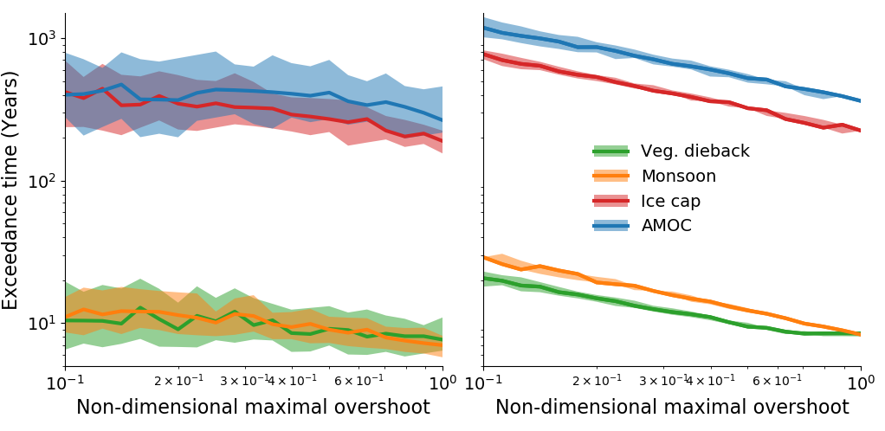
Critical overshoots for climate examples
Use non-dimensional maximal overshoot $\overline{χ}$ to compare climate examples
$$χ{ t}_{e}^{2}<\frac{16}{d} ⇒ { t}_{e}^{2}<16\frac{τ^{2}}{\overline{χ}}$$
Noise has larger impact on small and long overshoots
Realistic noise
Small noise limit
Separated based on relative time-scales $τ$ of climate examples

Slide 15
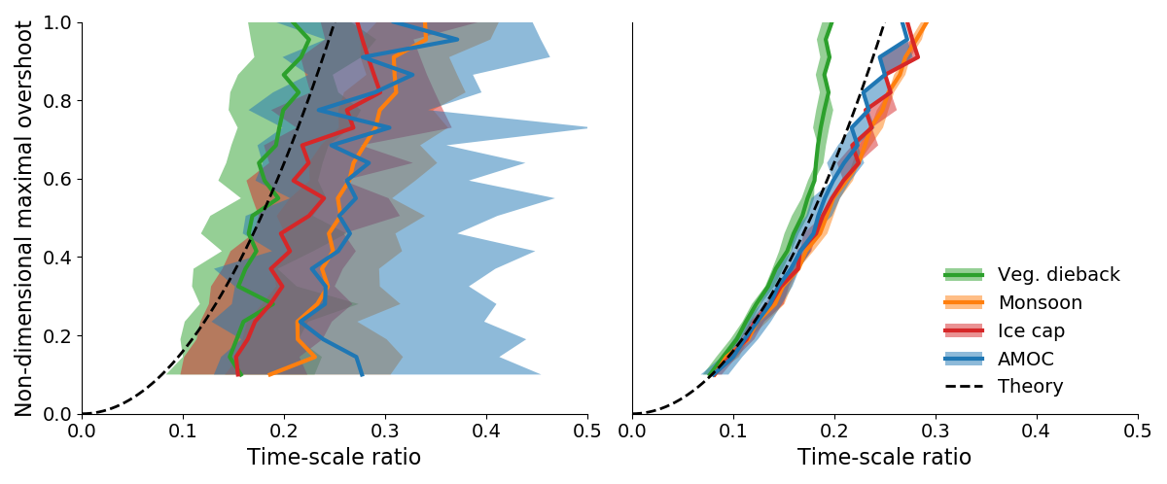
Critical overshoots for climate examples
Critical curves overlap after non-dimensionalising exceedance time $t_{e}$ with time-scale of the system $τ$
$$χ{ t}_{e}^{2}<\frac{16}{d} ⇒ \overline{χ}<16{\left(\frac{τ}{t_{e}}\right)}^{2}$$
Realistic noise
Small noise limit

Slide 16
Summary
If the forcing is fast or the time-scale of the system is slow there is the possibility to briefly overshoot a tipping threshold safely
Developed an inverse square law relationship between the maximal exceedance amplitude and exceedance time for overshooting a tipping threshold
Many simple models for climate tipping point examples follow the inverse square law relationship
Overshooting a tipping point is a risk and so reaching a tipping point should be avoided if possible but an overshoot can act as a safety net

