Slide 1
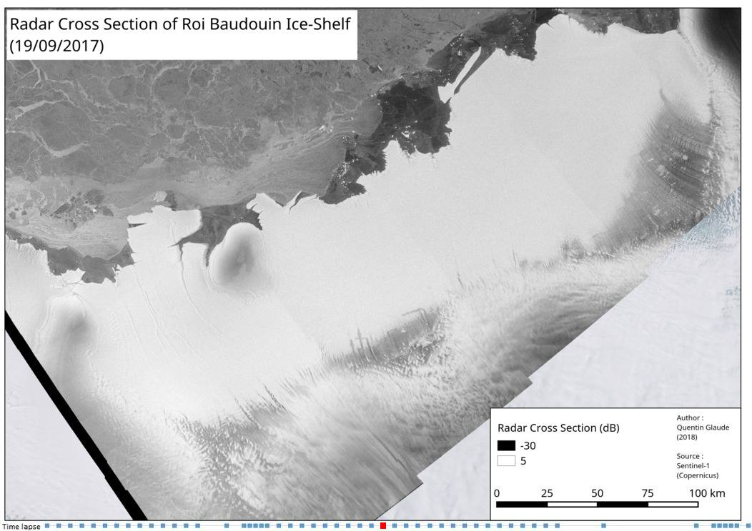
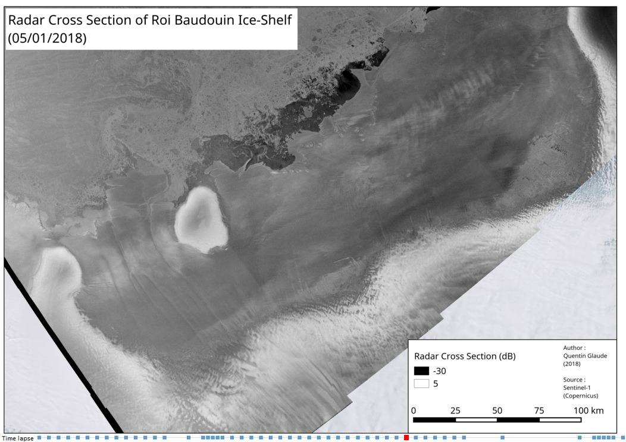
Comparison Between Surface Melt Days Estimation from a Regional Climate Model and Near-Daily Synthetic Aperture Radar Backscattering
Q. Glaude and C. Kittel

Slide 2
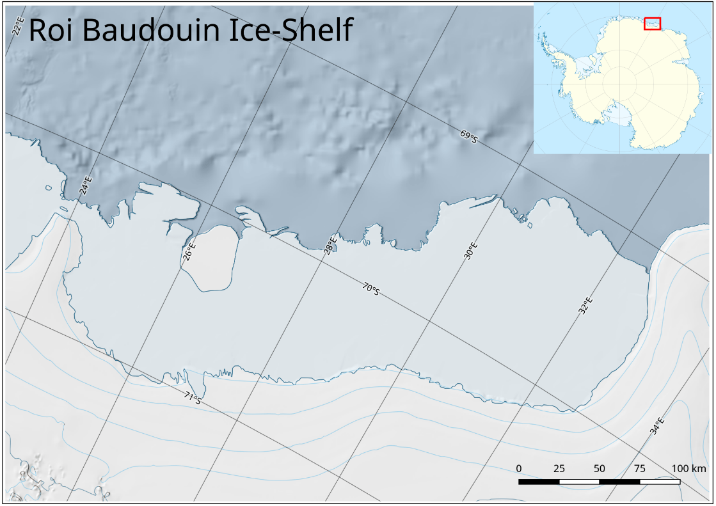
The methodology is applied in Dronning Maud Land – East Antarctica, but is also applicable elsewhere

Slide 3
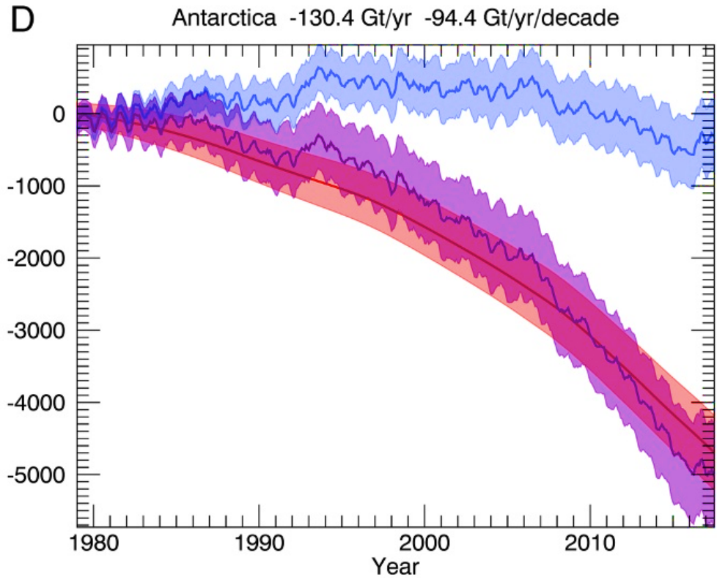
Antarctica is losing mass at an increasing rate, and requires a monitoring of its key variables such as surface melt
1980-1990 : -40 Gt/a
1990-2000 : -50 Gt/a
2000-2010 : -144 Gt/a
2010-2020 : -252 Gt/a
→ 6x more loss is 30 years
[E. Rignot et al., 2019]
Notes:
In this presentation, I will show results on the Roi Baudouin Ice Shelf, in Dronning Maud Land but please note that the method is not geographically dependent

Slide 4
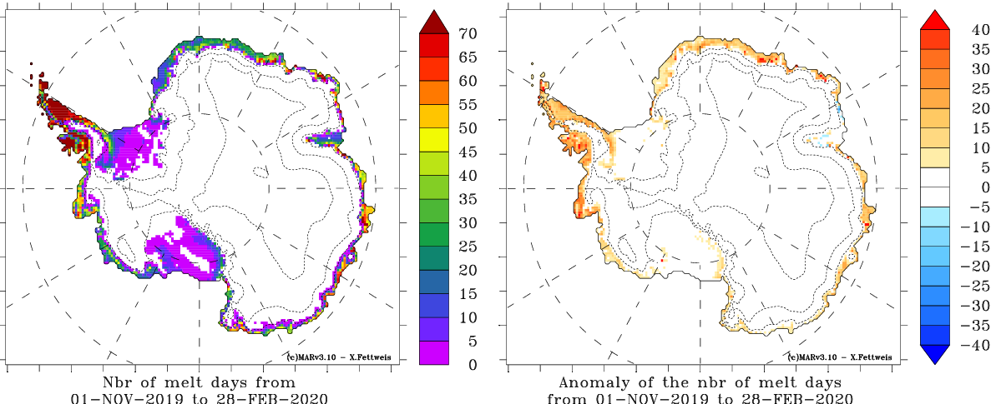
The Regional Climate Model (MAR) is able to model the surface melt in Antarctica

Slide 5
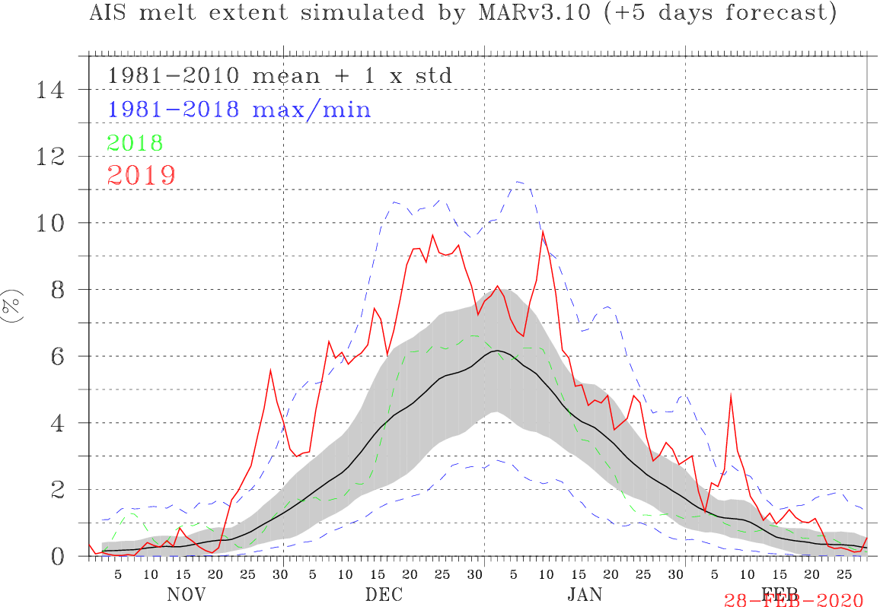
Using time series on the entire continent,
we can compute the whole ice melt coverage

Slide 6
These models constitute predictions based on our current knowledge of the geophysics and need to be verified
→ This is now possible with Remote Sensing using the very high revisit rate of current satellites

Slide 7
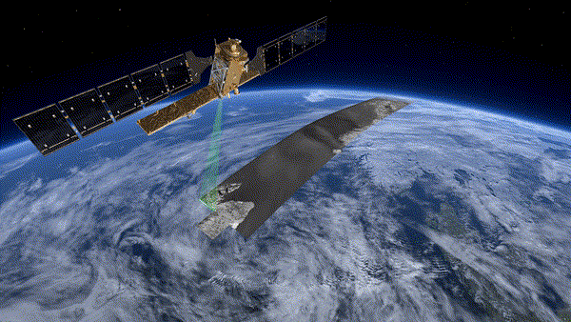
SAR is an imaging technique where a spaceborne sensor emits an electromagnetic wave and captures its return
[Copernicus, 2019]

Slide 8
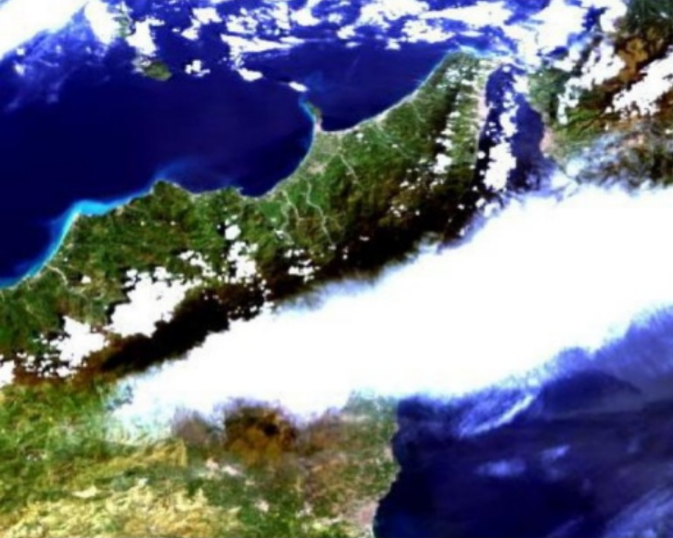
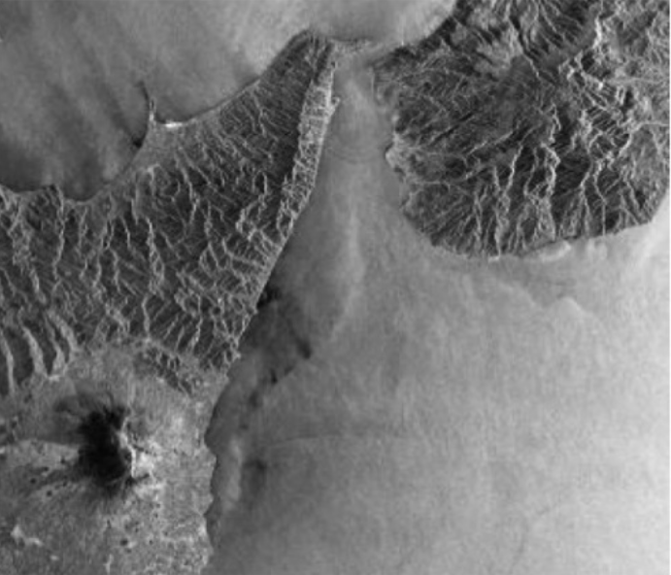
SAR Remote Sensing is independent of the Sun’s Illumination, which allows to work day-and-night, crucial in polar regions
Optical Image
SAR Image
[De Luca, C. 2017]

Slide 9
Surface melt can be observed using Radar Backscattering / Radar Cross Section (through changes of the dielectric constant)
Melting period :
→ strong decrease in radar cross section
Notes:
In our development we are using spaceborne radar, in particular Sentinel-1 which are the SAR satellites of the Copernicus constellation. These satellites are very popular nowadays because they free of charge and have a very short revisit time of 6 days, meaning an update of the velocity field every 6 days. A SAR satellite emits an electro magnetic wave in an oblique direction and then captures its return. Then in a SAR image, each pixel is composed of an amplitude which is related to the reflectivity of the ground, but also an information of phase which typically represents the location of the pixels in the electromagnetic wave.

Slide 10
Using time series on a given region, we can observe melt periods at very high spatial resolution and time
Play button →

Slide 11
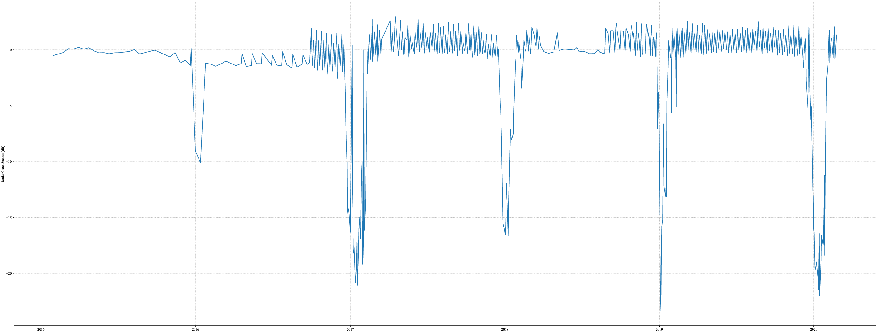
Time series analysis of Radar Cross Section (RCS) allows the estimation of melt days per year and per region

Slide 12
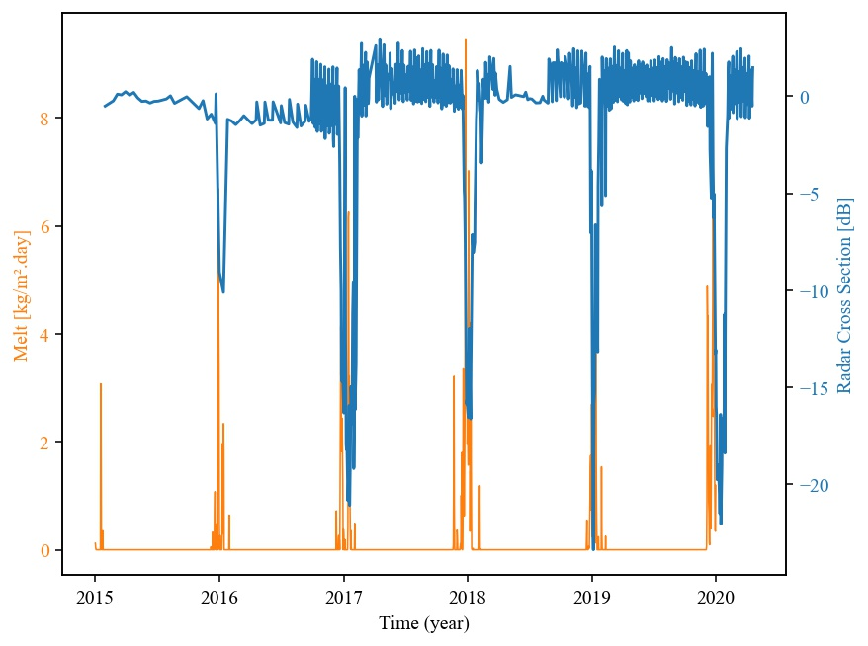
Preliminary results show a strong correlation between the RCS and the predicted surface melt from MAR

Slide 13
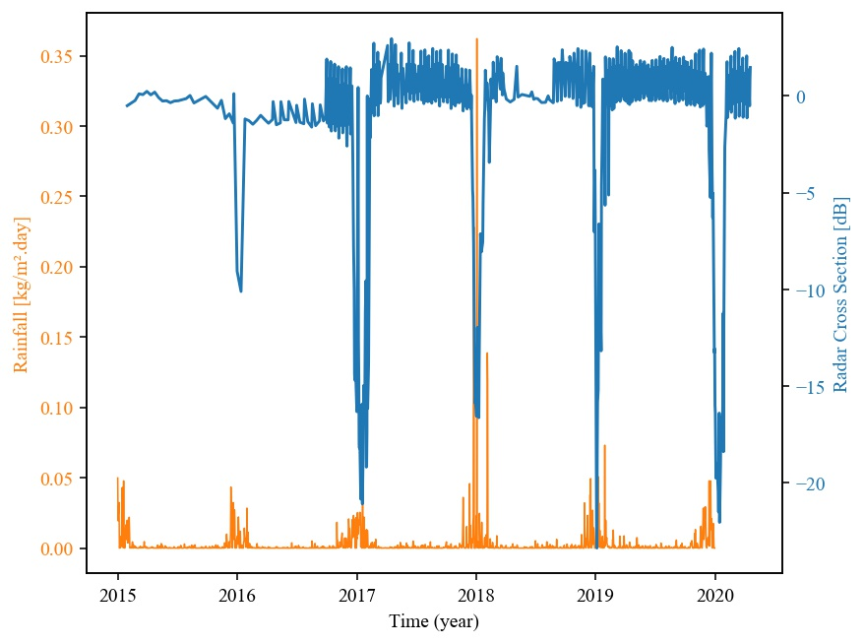
RCS is also correlated to rainfalls, since backscattering is impacted by surface moisture

Slide 14
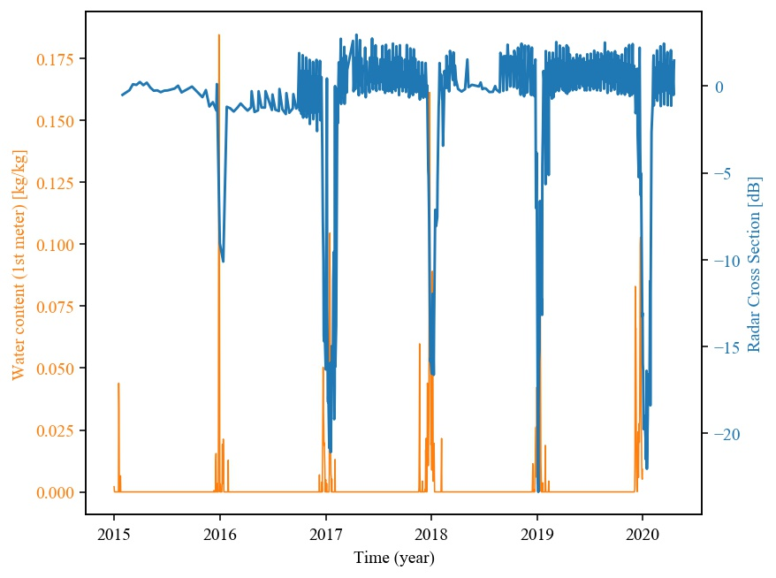
Similarly, there is a net correlation between RCS and water content (1st meter)

Slide 15
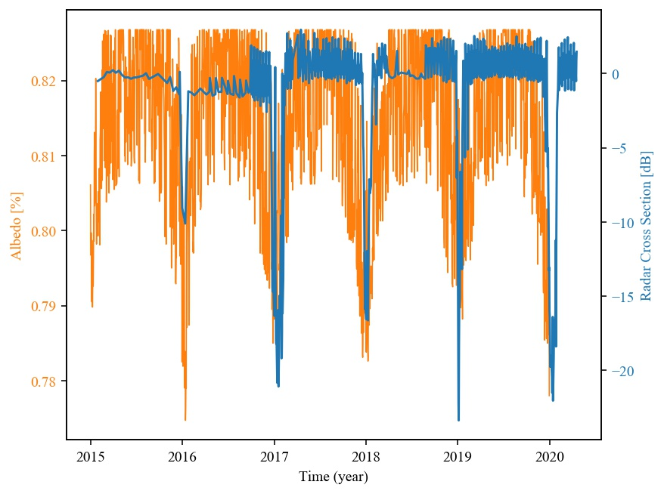
There is a positive correlation between RCS and albedo, although RCS is less variable

Slide 16
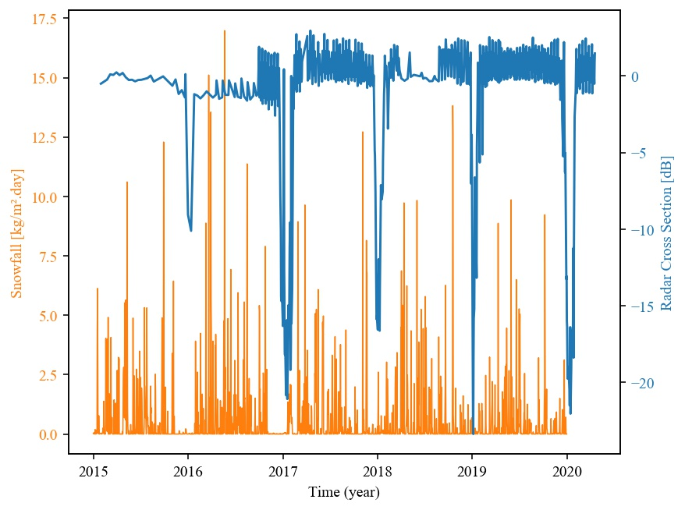
There is a low negative correlation between Radar Cross Section (RCS) and snowfall (less snowfall in melt periods)

Slide 17
To conclude, preliminary analysis compares SAR observations with MAR predictions. End goal of the project is to refine MAR by analyzing prediction anomalies
Statistical analysis : What is the difference between the number of melt days predicted by MAR and observed by SAR ?
Geospatial analysis : Where are located the differences between MAR and SAR? How is the spatial distribution of these residuals ? Can they be linked to geophysical elements ?
Time series analysis : When are the differences between MAR and SAR occurring ?

