Slide 1
The mean state and variability of the North Atlantic circulation: a perspective from ocean reanalyses
L C Jackson¹, C Dubois, G Forget, K Haines, M Harrison, D Iovino, A Köhl, D Mignac, S Masina, K A Peterson, C G Piecuch, C Roberts, J Robson, A Storto, T Toyoda, M Valdivieso, C Wilson, Y Wang 1. Met Office Hadley Centre, UK

Slide 2
We examine the mean state and recent changes in the North Atlantic (during the satellite period – after 1993) with global ocean reanalyses with the aim of answering the following questions:
Where is there agreement/disagreement?
Can we learn what makes a reanalysis good at specific processes?
Are there processes/time periods where we believe the reanalyses are informative?
Scientific themes:
Dynamics
AMOC (incl RAPID and OSNAP sections)
Gyres
Convection regions (mixed layer depth, densities)
Heat and fresh water
OHC and water mass properties
Ocean transports
See: Jackson et al, 2019. JGR, Oceans. DOI: 10.1029/2019JC0152`10

Slide 3
Ocean reanalyses
These are forced ocean models that assimilate various observational data sets
Advantages of reanalyses over observations alone
Infill regions with sparse data
Give dynamics (ie transports) that are difficult to measure
Provide consistent budgets (ie heat)
Disadvantages
How reliable are the reanalyses? Can we believe them?
Assimilation/relaxation of terms can dominate budgets
Note that there are 6 NEMO models (one 1/12 degree and five ¼ degree).
There are two models that use 4DVar (ECCO and GECCO) where surface fluxes are modified instead of increments added to T and S.
There is also a reanalysis with coupled, anomaly assimilation (NorCPM)

Slide 4
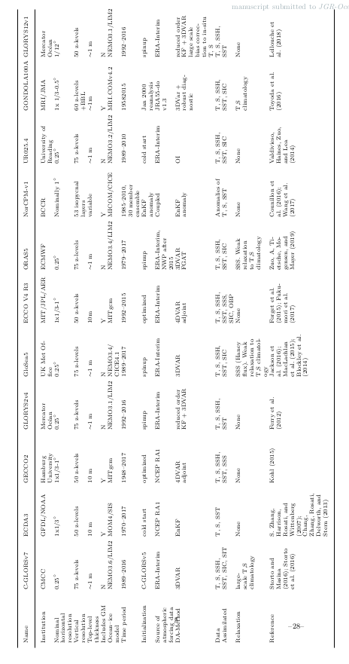

Slide 5
Mean state
AMOC
Apart from NorCPM (red, which is anomaly assimilation) there is good agreement at 26.5N with obs (black)
At 50N there is much greater range of AMOC strengths

Slide 6
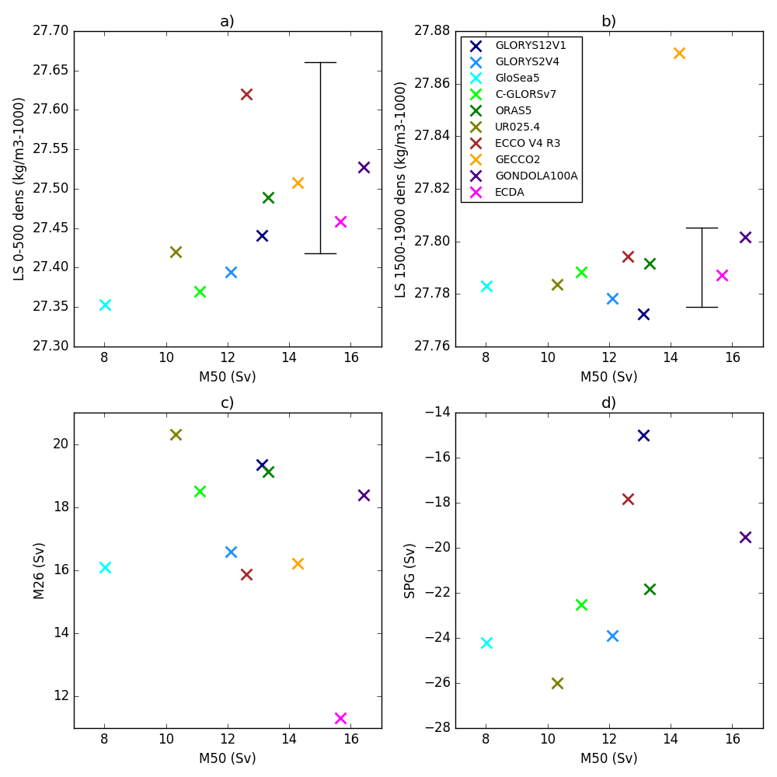
Mean state comparison
Across reanalyses there is some relationship between AMOC strength at 50N and the upper Labrador Sea density (a) and also the subpolar gyre strength (d).
No relationship between AMOC strength at 26.5 and 50N (c) or between AMOC at 50N and deeper LS density

Slide 7
Transports
Generally good agreement with obs although heat transports at 26.5N is underestimated by all except NorCPM (which has anomaly assimilation)
Reanalyses using higher resolution (0.25 and 1/12°), which all use NEMO, have more intense Gulf Streams and stronger transports from 30-50N

Slide 8
Transports
There is a relationship across reanalyses of AMOC strength and heat transport (both overturning component and total) at 26.5N
However the observations (circles) are offset. ie reanalyses underestimate the heat transport even when getting the AMOC right

Slide 9
Variability in the subtropical gyre
Water mass properties
See interannual variability of upper temperature and salinity combined with a warming and salinification (consistent with anthropogenic changes seen)
Temperature variability consistent across reanalyses
Cooling in 2010 consistent with AMOC and heat transport weakening then.

Slide 10
AMOC
Good agreement of most reanalyses with observations at 26.5N
All show weakening from 2006-2013 in agreement with obs (though not all capture the magnitude). All show previous strengthening (2001-2006) weakening (1999-2001)

Slide 11
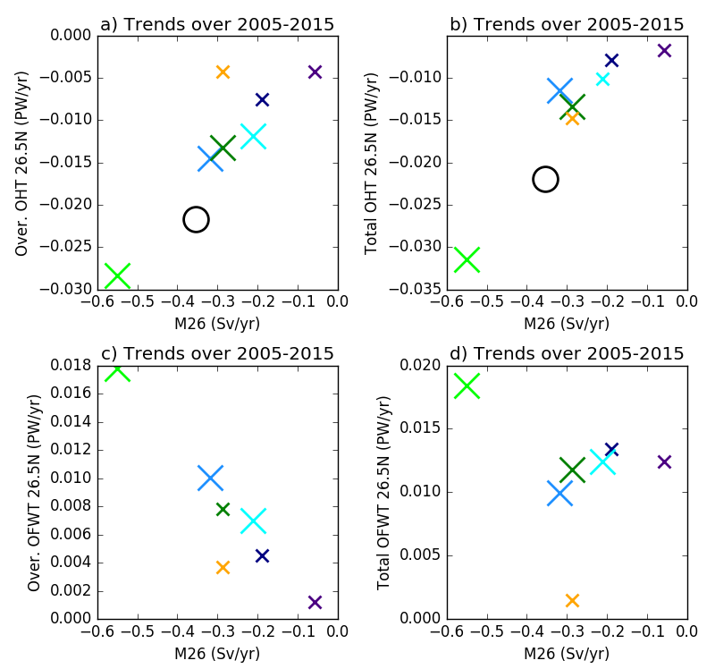
Transports
There is a strong relationship across reanalyses between trends in the AMOC at 26.5N (from 2005-2015) and trends in both the overturning and total heat transport. Hence AMOC change is a good indicator of heat transport change
For freshwater transport the gyre transport also plays a role.

Slide 12
Variability in the subpolar gyre
Water mass properties
Good agreement across reanalyses and between temperature and salinity that there was a warming and salinification from 1993-2006 and then a cooling and freshening.
Volume changes suggest a role for advection in these changes (although surface fluxes can also be important)

Slide 13
AMOC
Coherent variability of AMOC at 50N comes from Ekman forcing.
Also shows AMOC-Ekman weakening from 1995-2009, consistent with forced model studies showing a weakening following a previous strengthening

Slide 14
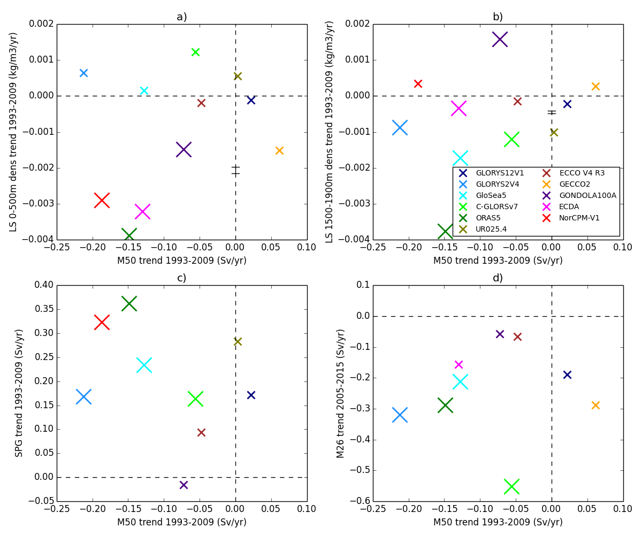
Relationships
See trends from 1995-2009 in various subpolar variables: Labrador sea density, subpolar gyre, AMOC at 50N.
There is no obvious cross-reanalysis relationship suggesting model-dependence of relationships

Slide 15
Transports
See trends in heat and freshwater transports, however no cross-reanalysis relationships to AMOC or subpolar gyre trends

Slide 16
Conclusions
We find that reanalyses show some consistency, in particular
a weakening of the subpolar gyre and AMOC at 50N from the mid-1990s until at least 2009 (related to decadal variability in previous studies)
a strengthening and then weakening of the AMOC at 26.5N since 2000, and impacts of circulation changes on transports.
We also see less spread across the ensemble in AMOC strength and mixed layer depth, suggesting improvements as the observational coverage has improved.
Reanalyses are promising tools to examine recent climate variability alongside free-running ocean models (which can experience biases) and observations (which are temporally and spatially sparse).

