Slide 1



Archeomagnetic studies of fired ceramics from Sakhtysh-I and Sakhtysh–II settlements (Ivanovo region, Russia)
Olga Pilipenko¹, Inga Nachasova¹, Yury Tsetlin², Eugeniya Filina³
(1) Schmidt Institute of Physics of the Earth RAS, Moscow
(2) Institute of Archeology RAS, Moscow
(3) Geophysical Center RAS, Moscow
Online | 4–8 May 2020
EGU2020 -5627

Slide 2
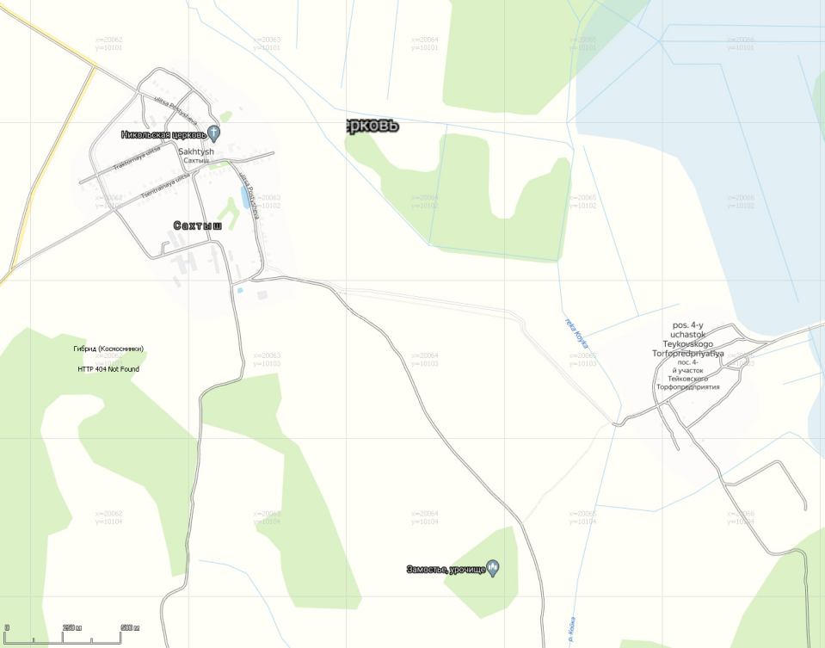
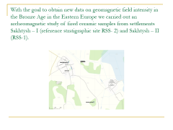
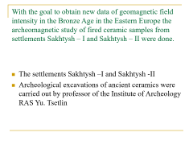
With the goal to obtain new data on geomagnetic field intensity in the Bronze Age in the Eastern Europe we carried out an archeomagnetic study of fired ceramic samples from settlements Sakhtysh – I (reference stratigraphic site RSS- 2) and Sakhtysh – II (RSS-1).

Slide 3
The settlements Sakhtysh –I and Sakhtysh –II are located in Teikovo district, Ivanovo region, Russia (φ=56º48' , λ=40º33'). Archeological excavations of ancient ceramics were carried out by the Upper Volga Archeological Expedition of the Institute of Archeology RAS.

Slide 4
The studied collection of pottery fragments from Sakhtysh –I settlement were found in three cultural layers and belongs to three ceramics cultures of Bronze Age: the Textile, the Stroked and the Fatyanoid. The depth of cultural layer is 5 cm.
Our number № | Museum number | Culture
Sakhtysh - I, RSS- 2, layer 1
9 | 30 | Textile
10 | 35 | Stroked
50 | 33 | Textile
48 | 38 | Bronze Age
51 | 70 | Bronze Age
Sakhtysh - I, RSS- 2, layer 2
53 | 283 | Textile
54 | 274 | Textile
55 | 265 | Textile
8 | 289 | Fatyainoid
Sakhtysh - I, RSS- 2, layer3
7 | 321 | Textile
56 | 334 | Textile
57 | 263 | Textile
58 | 360 | Textile

Slide 5
The pottery fragments from Sakhtysh –II settlement were found in four cultural layers and belongs to two ceramics cultures of Bronze Age: the Textile and the Fatyanoid
Sakhtysh - II, RSS- 1, layer 1
59 | 3 | Textile
60 | 7 | Fatyainoid
62 | 12 | Textile
63 | 8 | Bronze Age
Sakhtysh - II, RSS- 1, layer 2
26 | 30 | Textile
27 | 60 | Textile
28 | 43 | Textile
29 | 48 | Textile
30 | 63 | Textile
Sakhtysh - II, RSS- 1, layer 3
40 | 101 | Textile
41 | 139 | Textile
42 | 128 | Textile
43 | 149 | Textile
44 | 191 | Textile
Sakhtysh - II, RSS- 1, layer 4
21 | 170 | Textile
22 | 195 | Textile
23 | 196 | Bronze Age
20 | 176 | Textile
69 | 199 | Textile
71 | 203 | Textile

Slide 6
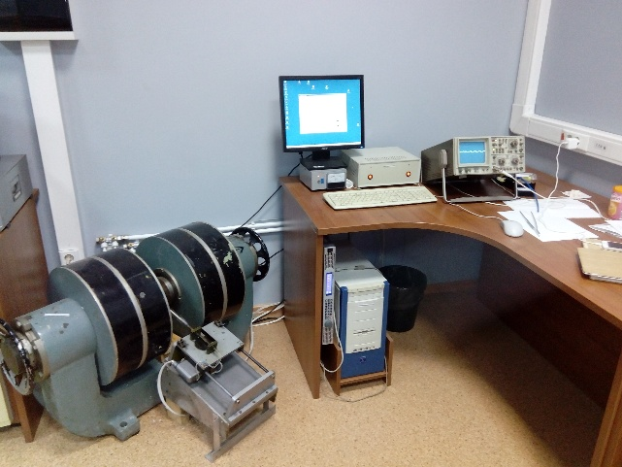
Temperature dependences of saturation magnetic moment to determine Curie temperatures were measured using a vibrating sample magnetometer (Orion, Russia).

Slide 7
Thermomagnetic analysis shows that the Curie temperatures for all samples are near 570-575º C. Bold line is the curve of the first heating, thin line is the curve of the second heating.

Slide 8
One can conclude that magnetite Fe₃O₄ is the dominant magnetization carrier. It appears to be quite resistant to heating.
black - up to 350 ºС
blue - up to 400ºС
light blue - up to 450ºС
violet - up to 500ºС
rouse - up to 700ºС

Slide 9
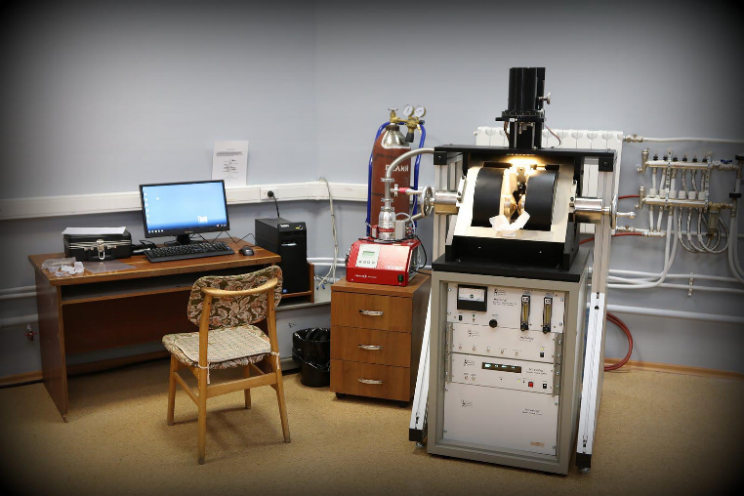
The domain structure of magnetite was evaluated from hysteresis loops measured using a vibrating sample magnetometer PMC Micro Mag 3900 ( Lake Shore, USA)

Slide 10
Mrs/Ms ratios range from 0.14 to 0.35 and Bcr/Bc ratios from 1.9 to 2.7 imply rather fine grainsize up to 15 μm if the magnetic phase is magnetite.
№ | Mrs, µА*m² | Ms, µА*m² | Mrs/Ms | Bcr, mТ | Bc, mТ | Bcr/Bc | Structure
Sakhtysh - I, layer 1
4(78) | 3,92 | 21,94 | 0,18 | 17,68 | 8,27 | 2,1 | PSD
9(30) | 12,17 | 50,57 | 0,24 | 20,95 | 11,23 | 1,9 | PSD
48(38) | 3,61 | 19,30 | 0,19 | 19,13 | 10,06 | 1,9 | PSD
50 (50) | 9,48 | 59,69 | 0,16 | 21,69 | 8,681 | 2,5 | PSD
51(70) | 1,21 | 5,69 | 0,21 | 57,74 | 22,25 | 2,6 | PSD
Sakhtysh - I, layer 2
8(209) | 6,47 | 18,41 | 0,35 | 66,31 | 30,63 | 2,2 | PSD
53(283) | 17,12 | 75,65 | 0,23 | 20,33 | 9,282 | 2,2 | PSD
54(274) | 22,96 | 84,13 | 0,27 | 17,93 | 9,86 | 1,8 | PSD
55(265) | 10,49 | 46,3 | 0,23 | 9,65 | 9,462 | 1,0 | SD, PSD
Sakhtysh - I, layer3
5(329) | 19,92 | 87,89 | 0,23 | 27,27 | 11,42 | 2,4 | PSD
7(321) | 25,43 | 80,88 | 0,31 | 26,95 | 14,44 | 1,9 | PSD
56(334) | 7,85 | 30,9 | 0,25 | 20,95 | 10,57 | 2,0 | PSD
57(263) | 41,28 | 146,9 | 0,28 | 28,06 | 13,39 | 2,1 | PSD
58(360) | 17,21 | 69,13 | 0,25 | 15,51 | 7,695 | 2,0 | PSD
Sakhtysh - II, layer 1
59(3) | 33,66 | 100,5 | 0,33 | 44,75 | 19,61 | 2,3 | PSD
62(12) | 5,94 | 24,44 | 0,24 | 23,89 | 11,62 | 2,1 | PSD
Sakhtysh - II, layer 2
27(60) | 19,06 | 65,62 | 0,29 | 23,75 | 11,99 | 2,0 | PSD
28(43) | 12,37 | 48,41 | 0,26 | 24,46 | 11,63 | 2,1 | PSD
29(48) | 10,13 | 74,96 | 0,14 | 25,54 | 9,58 | 2,7 | PSD
30(63) | 5,65 | 36,19 | 0,16 | 32,23 | 13,04 | 2,5 | PSD
Sakhtysh - II, layer 3
40(101) | 1,41 | 8,43 | 0,17 | 18,37 | 7,61 | 2,4 | PSD
41(139) | 12,03 | 85,54 | 0,14 | 26,06 | 9,66 | 2,7 | PSD
42(128) | 8,90 | 42,9 | 0,21 | 45,66 | 18,07 | 2,5 | PSD
43(149) | 19,04 | 96,32 | 0,20 | 17,62 | 8,69 | 2,0 | PSD
44(191) | 72,25 | 273,4 | 0,26 | 20,27 | 11,07 | 1,8 | PSD

Slide 11
In the Day plot representative points cluster tightly in the PSD range.

Slide 12
The determination of the ancient magnetic field intensity was carried out by Thellier -Coe method

Slide 13
Age of the pottery fragments corresponds to the Bronze Age and lies within c. 2000-1000 years BCE. Assuming uniform sedimentation rate, we can estimate values of the magnetic field intensity from the ceramic age.
Our number № | Museum number | Culture | Temperature Interval, ºC | В, µТ | σ, µТ | Вm, µТ | σ , µТ | Age,yr BCE | ± Δ, yr
Sakhtysh - I, RSS- 2, layer 1 |  |  |  |  |  | 48,4 | 1,4 | 1170 | 170
9 | 30 | Textile | 200-350 | 37,8 | 1,4
 |  |  | 150-425 | 54,4 | 2,9
10 | 35 | Stroked | 150-550 | 54,9 | 0,4
50 | 33 | Textile | 250-500 | 55,2 | 0,8
48 | 38 | Bronze Age | 200-525 | 27,6 | 0,7
51 | 70 | Bronze Age | 150-350 | 59,2 | 1,6
 |  |  | 150-475 | 50,0 | 1,8
Sakhtysh - I, RSS- 2, layer 2 |  |  |  |  |  | 57,6 | 1,6 | 1500 | 170
53 | 283 | Textile | 150-400 | 42,9 | 2,6
54 | 274 | Textile | 350-550 | 48,6 | 0,5
 |  |  | 325-575 | 57,7 | 1,1
55 | 265 | Textile | 250-550 | 70,0 | 0,2
 |  |  | 350-500 | 73,1 | 2,9
8 | 289 | Fatyainoid | 150-400 | 53,2 | 2,5
Sakhtysh - I, RSS- 2, layer 3 |  |  |  |  |  | 53,1 | 1,3 | 1830 | 170
7 | 321 | Textile | 350-500 | 40,7 | 0,5
56 | 334 | Textile | 150-550 | 49,4 | 1,3
 |  |  | 375-575 | 46,9 | 1,2
57 | 263 | Textile | 325-600 | 56,4 | 1,0
58 | 360 | Textile | 150-450 | 62,3 | 1,0
 |  |  | 225-500 | 62,6 | 2,5

Slide 14
The mean values of the geomagnetic field intensity and chronology of the Sakhtysh –II ceramic fragments
Our number № | Museum number | Culture | Temperature Interval, ºC | В, µТ | σ, µТ | Вm, µТ | σ , µТ | Age,yr BCE | ± Δ, yr
Sakhtysh - II, RSS- 1, layer 1 |  |  |  |  |  | 52,0 | 1,5 | 1090 | 90
59 | 3 | Textile | 150-500 | 54,8 | 2,0
 |  |  | 150-500 | 55,1 | 2,2
60 | 7 | Fatyainoid | 325-475 | 40,2 | 1,6
62 | 12 | Textile | 150-400 | 46,0 | 1,1
63 | 8 | Bronze Age | 175-475 | 63,9 | 0,4
Sakhtysh - II, RSS- 1, layer 2 |  |  |  |  |  | 53,3 | 1,1 | 1260 | 90
26 | 30 | Textile | 150-475 | 62,3 | 2,5
27 | 60 | Textile | 150-550 | 51,0 | 0,9
 |  |  | 475-600 | 50,7 | 0,9
28 | 43 | Textile | 175-550 | 41,1 | 0,9
29 | 48 | Textile | 350-500 | 61,4 | 0,2
 |  |  | 400-525 | 60,7 | 0,9
30 | 63 | Textile | 150-350 | 45,7 | 1,1
Sakhtysh - II, RSS- 1, layer 3 |  |  |  |  |  | 54,3 | 0,8 | 1440 | 90
40 | 101 | Textile | 350-550 | 45,8 | 0,1
 |  |  | 325-600 | 59,5 | 0,5
41 | 139 | Textile | 450-550 | 55,6 | 0,2
 |  |  | 150-475 | 60,3 | 1,1
42 | 128 | Textile | 350-500 | 50,9 | 0,1
 |  |  | 175-475 | 66,7 | 2,0
43 | 149 | Textile | 350-550 | 38,7 | 0,5
 |  |  | 200-525 | 60,8 | 1,1
44 | 191 | Textile | 350-550 | 50,5 | 1,6
Sakhtysh - II, RSS- 1, layer 4 |  |  |  |  |  | 59,1 | 2,0 | 1610 | 90
21 | 170 | Textile | 150-450 | 49,8 | 2,1
 |  |  | 200-450 | 50,1 | 2,5
22 | 195 | Textile | 250-550 | 54,1 | 0,6
23 | 196 | Bronze Age | 150-475 | 73,2 | 4,2
20 | 176 | Textile | 200-450 | 59,7 | 1,6
69 | 199 | Textile | 350-575 | 59,8 | 1,6
71 | 203 | Textile | 150-475 | 66,7 | 1,2

Slide 15
The obtained data provide new data on geomagnetic field intensity variations during the Bronze Age. We can construct a curve of geomagnetic field intensity variations from the age during V-II millennium BCE.
The blue squares –Sakhtysh -I , brawn triangles – Sakhtysh -II setlements.
Black symbols are results obtained previously for Neolithic ceramics from Sakhtysh –I settlement (Nachasova et al., 2018)*. Circles denote the values obtained for pit-comb ware; the triangle indicates Upper Volga culture ceramics; the square indicates Volga–Oka culture ceramics.
*Nachasova I. E., Pilipenko O. V. , Markov G. P. , Gribovb S. K., Tsetlin Yu. B. Geomagnetic Field Intensity during the Neolith in the Central East European Plain //Geomagnetism and Aeronomy. 2018.Vol. 58. No. 3. Pp. 438–447.

Slide 16
CONCLUSIONS
As a result of archaeomagnetic studies, the geomagnetic field intensity data were obtained for the center of the Russian Plain (in the areas of the Sakhtysh-I and Sakhtysh-II settlements,
φ = 56.48′N, λ= 40.33′E) in the II millennium BCE.
The geomagnetic field intensity varied mainly in the range from
~48 μT to ~59 μT during the II millennium BCE.
The obtained data for the II millennium BCE indicate an increase in the average intensity of the geomagnetic field compared with the second half of IV millennium - III millennium BCE (Nachasova et al., 2018).
This work was supported by the Russian Foundation for Basic Research grant N 19-55-18006 and the State Task of IPE RAS

Slide 17
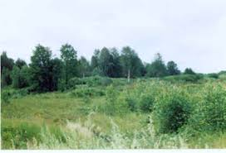




Thank you very match for your attention!

