Slide 1
Precipitation Nowcasting Using Spatiotemporal Models and Volumetric Radar Data
S. Pulkkinen, V. Chandrasekar and A. von Lerber

Slide 2
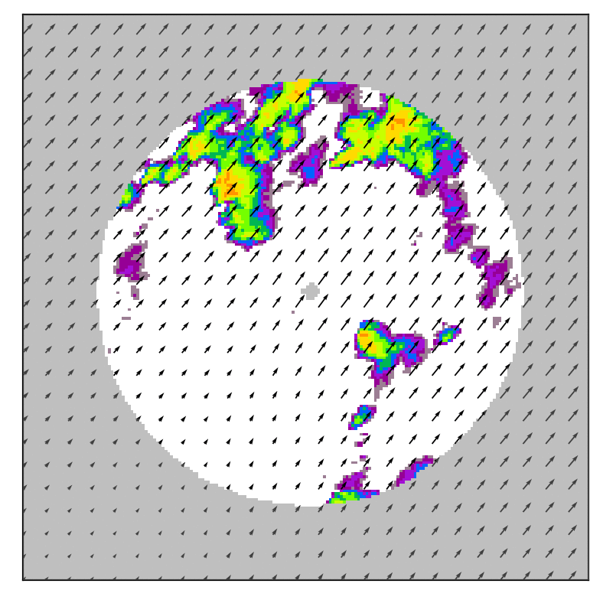
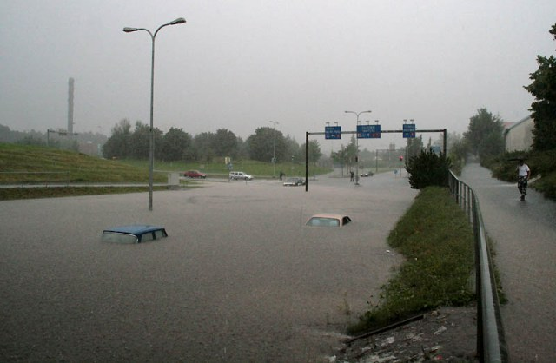
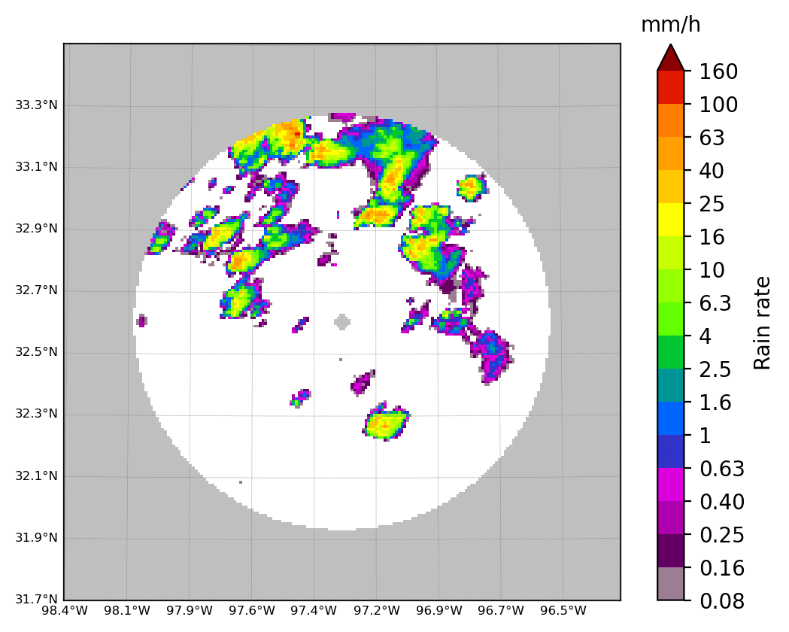
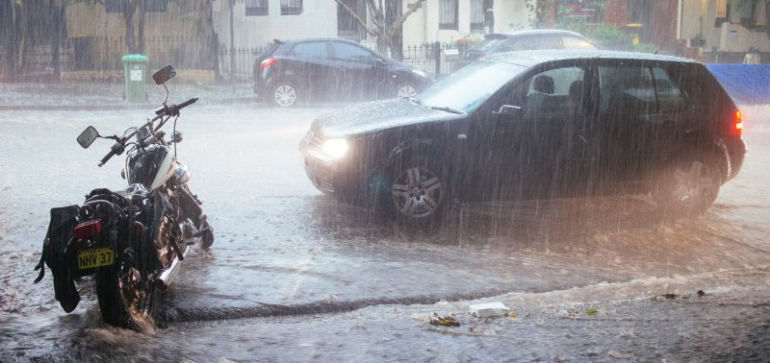
Introduction and Motivation
Providing early warning of severe rainfall and induced flash floods is critical for densely populated urban areas.
Numerical weather prediction (NWP) models are impractical for producing rapidly updated high-resolution nowcasts (e.g. 1 km² every 5 min).
Direct extrapolation of observations and machine vision/statistical methods are more appropriate.
Weather radars have the high spatial and temporal resolution needed for the task.
Objectives:
develop an improved machine vision/statistical model for rainfall nowcasting using weather radars
utilize three-dimensional radar volumes to capture the vertical profile of rainfall

Slide 3
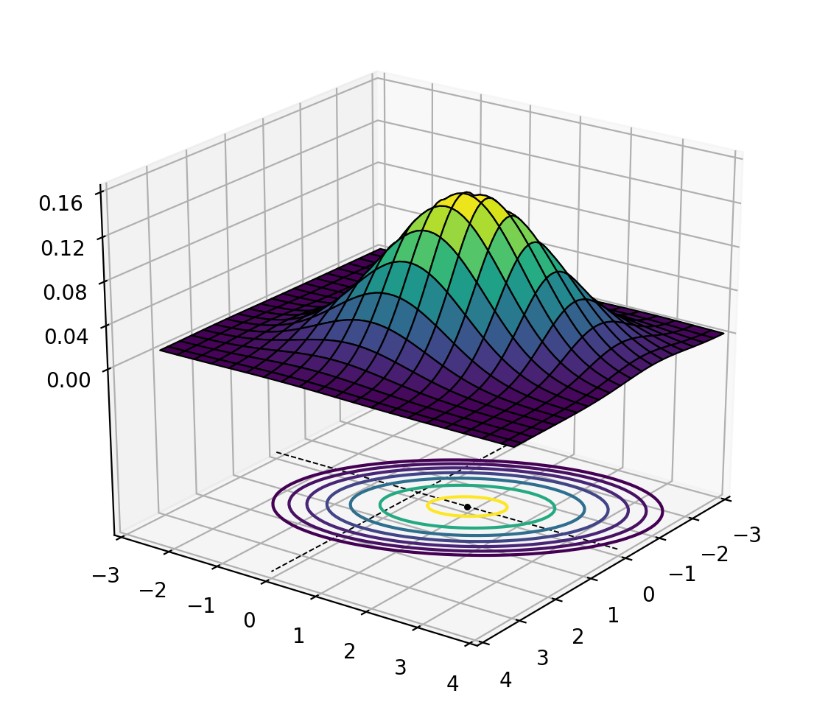
The Integro-Difference Equation (IDE) Model
The IDE process Y_{t} is determined by the kernel function.
A natural choice is the Gaussian kernel.
The kernel can describe:
advection via translation
loss of predictability via diffusion
anisotropic structure
missing or noisy data
In Xu et al. (2005), the model was formulated in a Bayesian framework.
Parameters and forecast ensembles are sampled from the posterior distribution using a Markov chain Monte Carlo (MCMC) scheme.
However, this is highly impractical and computationally too expensive for operational applications.
rotation
scaling
Advection + diffusion
K. Xu, C. K. Wikle, and N. I. Fox, ”A Kernel-Based Spatio-Temporal Dynamical Model for Nowcasting Weather Radar Reflectivities”, Journal of the American Statistical Association, vol. 100, no. 472, pp. 1133-1144, 2005.

Slide 4
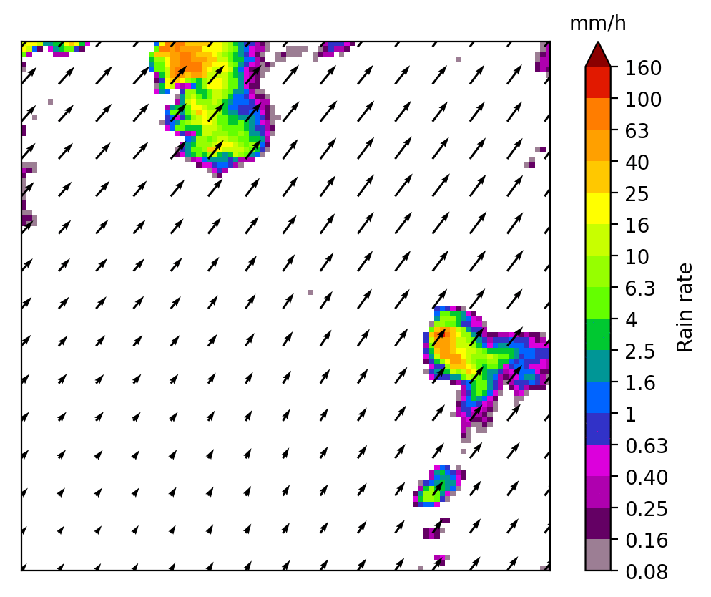
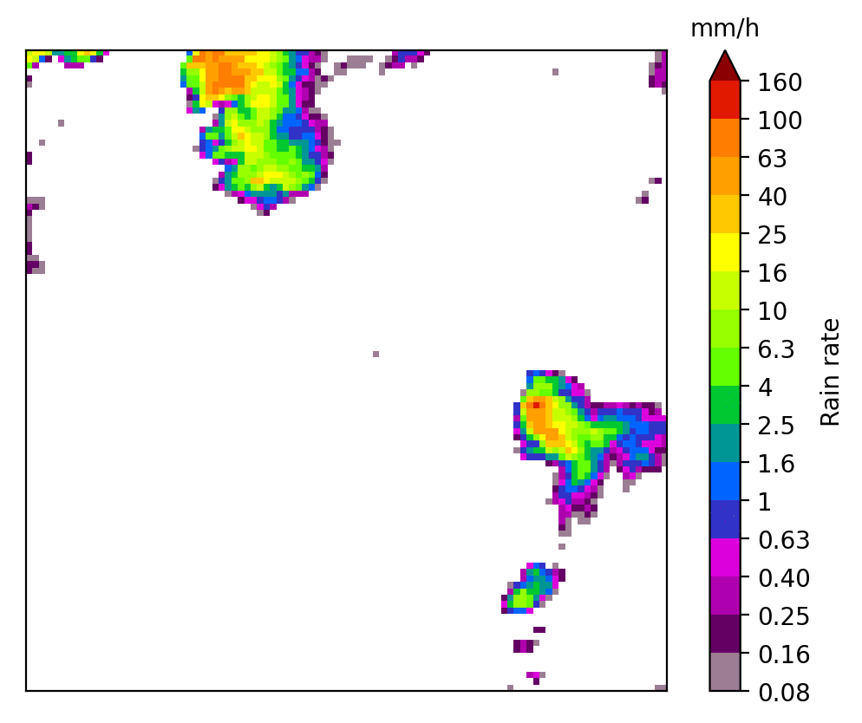
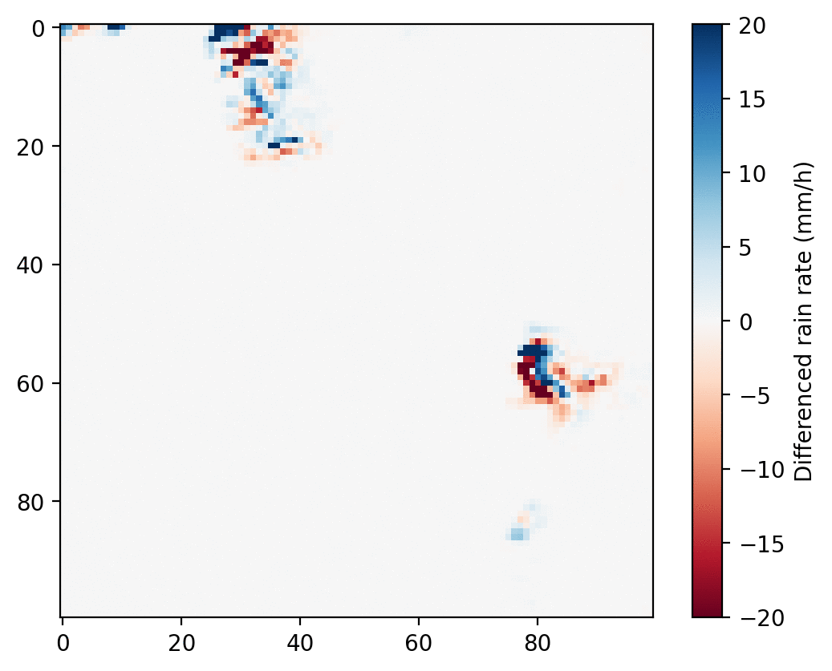
The Proposed Model
convolution
(loss of predictability)
stochastic perturbations
(uncertainty)
advection
A two-stage extension of the above IDE model:
Advection is done separately.
The remaining components are applied in Lagrangian coordinates.
The model is applied to differenced time series ΔY_{t} = Y_{t} - Y_{t-1} in Lagrangian coordinates to capture growth and decay.
To capture more complex dynamics, the model allows time lags of arbitrary order via the autoregressive AR(p) component.
The kernel is chosen as zero-mean Gaussian.
AR component
(growth and decay)
Key principle: separate the model into subcomponents and estimate the parameters of each component separately to keep the computational complexity low.
Eulerian
Lagrangian
Lagrangian / differenced

Slide 5
Parameter Estimation
convolution
(loss of predictability)
stochastic perturbations
(uncertainty)
advection
AR component
(growth and decay)
Hierarchical approach: each parameter set is estimated separately from each other in the following order:
Advection
Convolution
AR component
Perturbations
Shi-Tomasi feature tracker + Lucas-Kanade optical flow + RBF interpolation
(implemented by Daniele Nerini)
Spatiotemporal autocorrelation function (ACF) using the short-space Fourier transform (SSFT)
ordinary least squares (OLS) in a spatially localized window
estimation of the spatial covariance of residuals using the SSFT

Slide 6
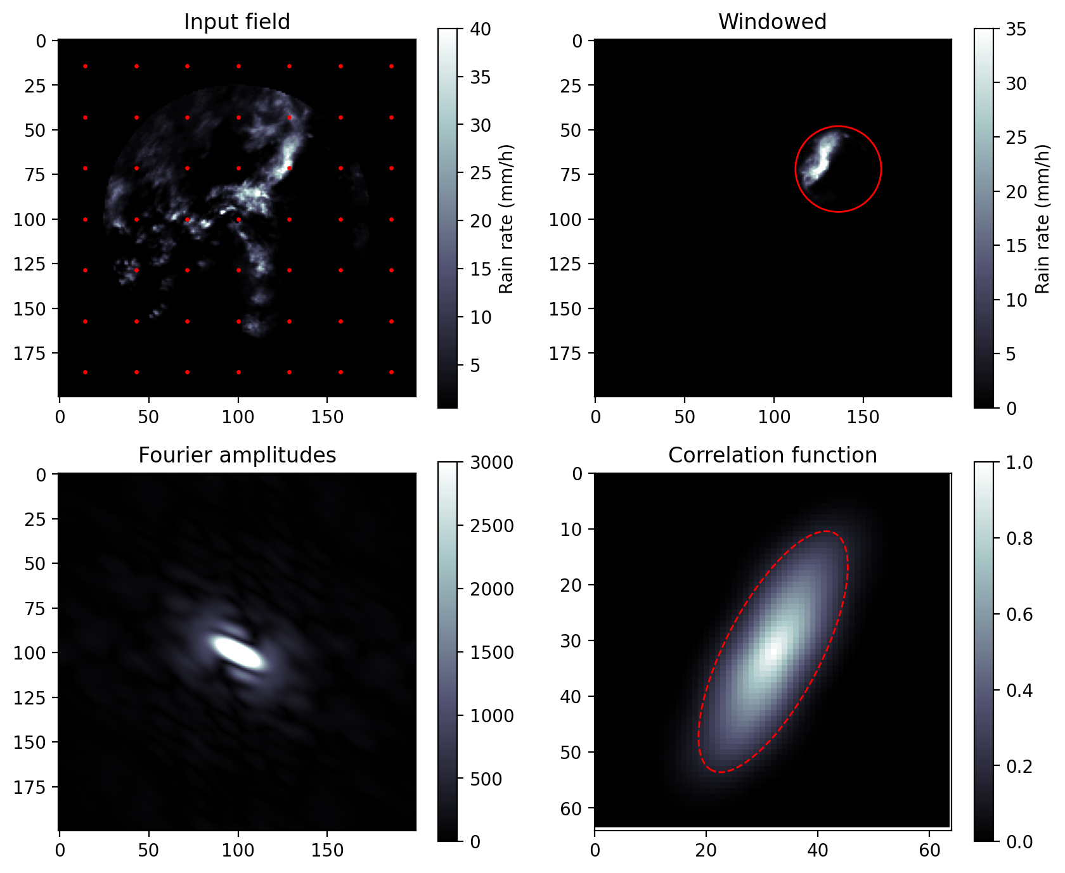
Estimation of the Convolution Kernel
window function
The convolution kernel is chosen as the estimated autocorrelation function (ACF) between the observed Y_{t} and Y_{t-1}.
The ACFs are obtained in a localized way using the short-space Fourier transform (SSFT, Nerini et al. 2017) and the cross-correlation theorem.
Gaussian functions are fitted to the empirical ACFs.
The above approach is also applied to estimate the spatial covariance of the perturbation fields.
D. Nerini, N. Besic, I. Sideris, U. Germann, and L. Foresti, ”A non-stationary stochastic ensemble generator for radar rainfall based on the short-space Fourier transform”, Hydrology and Earth System Sciences, vol. 21, no. 6, pp. 2777-2797, 2017.

Slide 7
Implementation
linear regression
backward semi-Lagrangian
Prototype implemented in Python / C / Fortran.
Built on top of the extrapolation nowcast implemented in the pysteps library (Pulkkinen et al. 2019).
S. Pulkkinen, D. Nerini, A. Pérez Hortal et al., ”Pysteps: an open-source Python library for probabilistic precipitation nowcasting (v1.0)”, Geoscientific Model Development, 2019, doi: 10.5194/gmd-12-4185-2019

Slide 8
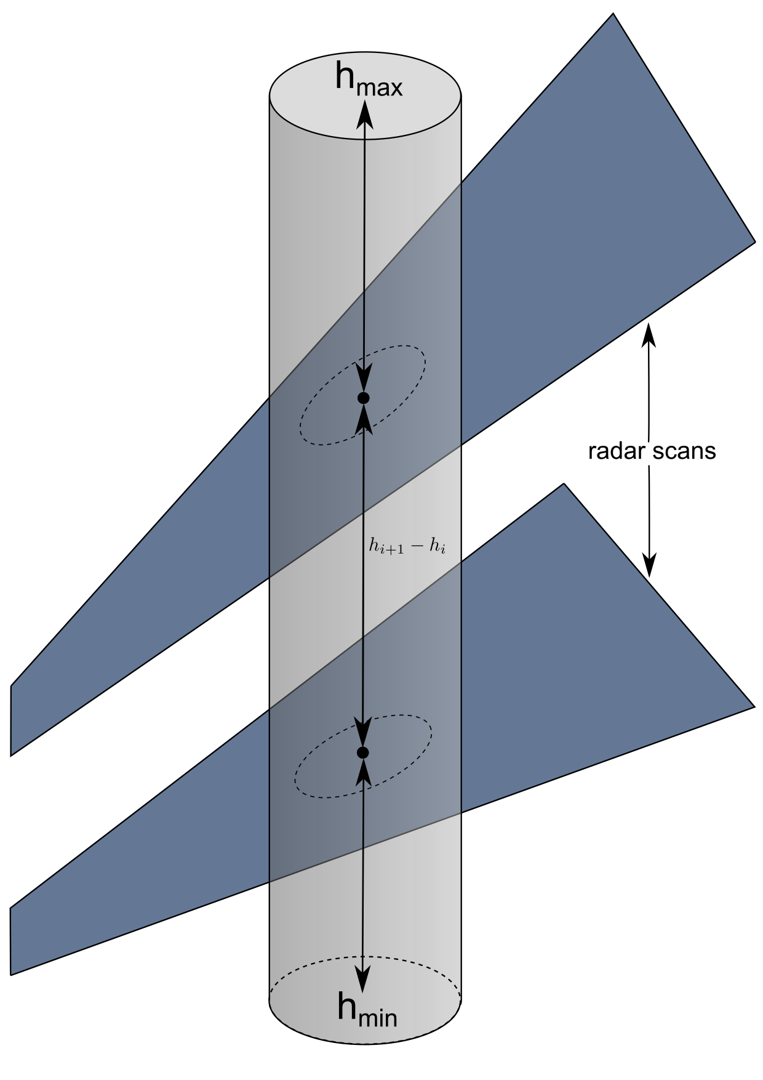
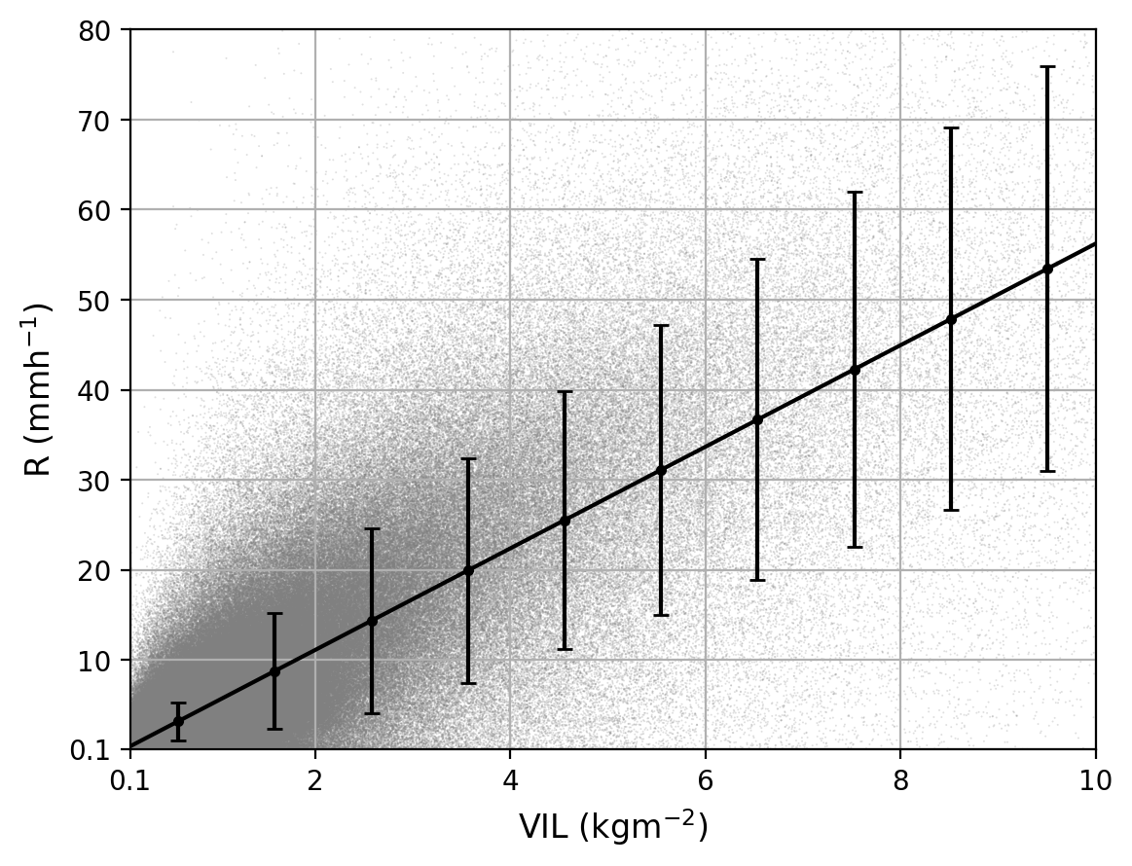
Vertically Integrated Liquid (VIL)
Integrate liquid water content W over columns with vertical extent [h_{min},h_{max}]:
The column top h_{max} is taken as the freezing level height.
Numerical integration is applied by using the available scans in each grid cell.
VIL is a more robust predictor than rain rate CAPPI or a lowest angle PPI.
It also gives a compact representation of the vertical profile of precipitation.
Conversion from VIL to rain rate is done via linear regression.

Slide 9
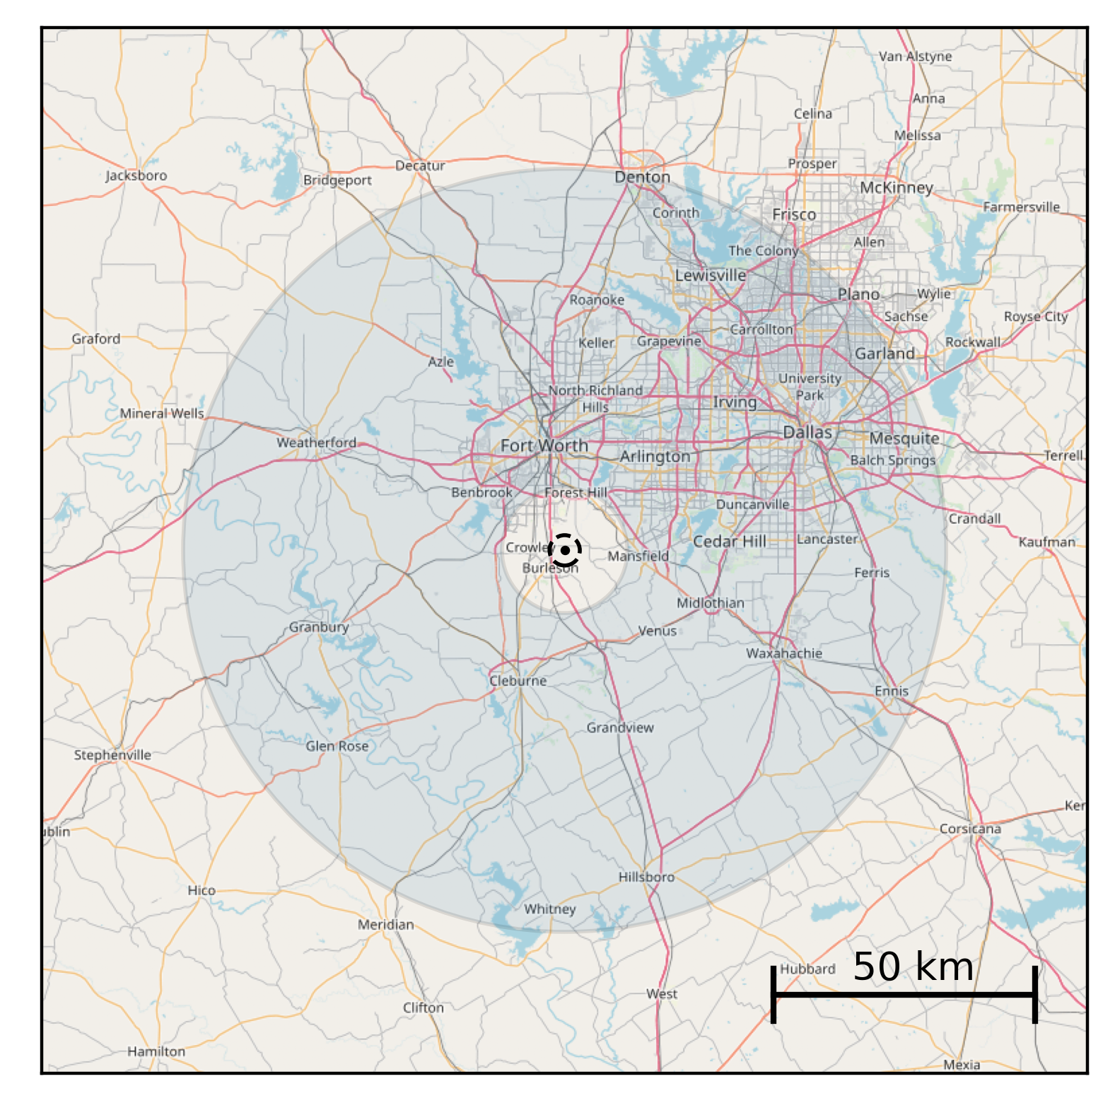
Study Domain and Data
The nowcast model was verified by using the NEXRAD/WSR-88D KFWS radar.
The radar covers the Fort Worth / Dallas metroplex with over 7 million people.
Key facts about the data:
level-II data in polar coordinates
14 elevation angles, 250 m radial resolution
time resolution 5-6 minutes
Intra-volume temporal interpolation was applied to synchronize the measurements.
The polar data was interpolated to a 1 km grid.
VIL and rain rate CAPPI were computed from attenuation-corrected reflectivity.
Freezing level height was obtained from radiosonde measurements.
CAPPI inner range
VIL inner range
VIL

Slide 10
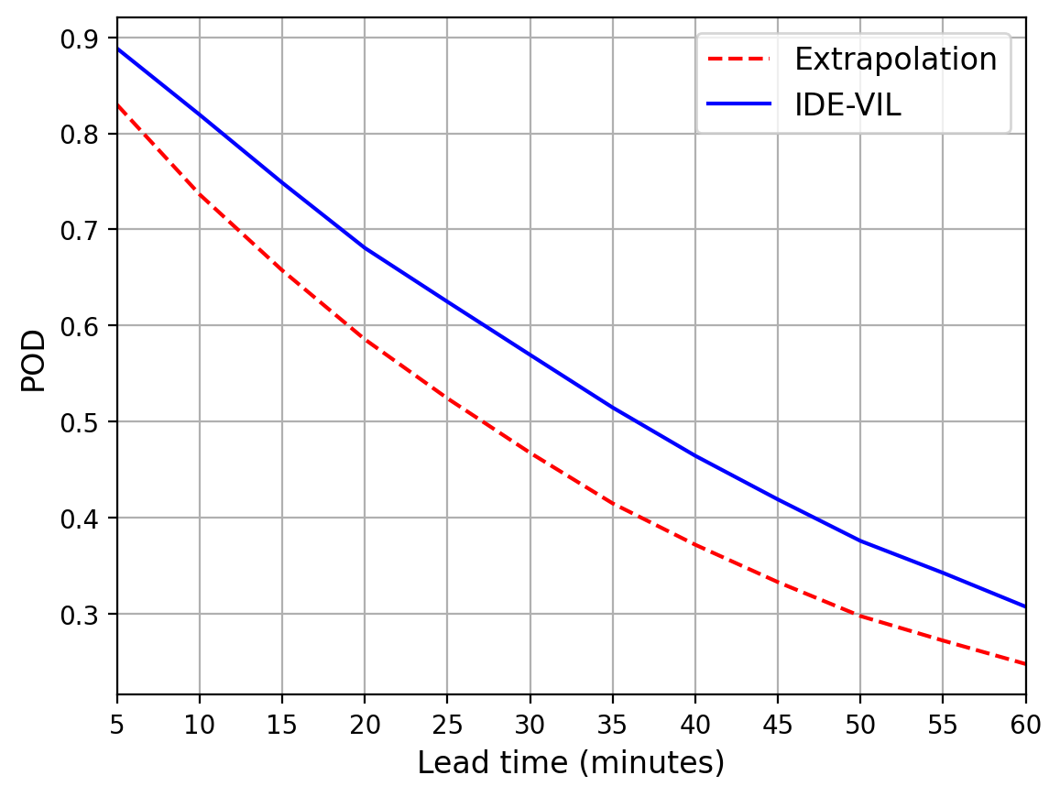
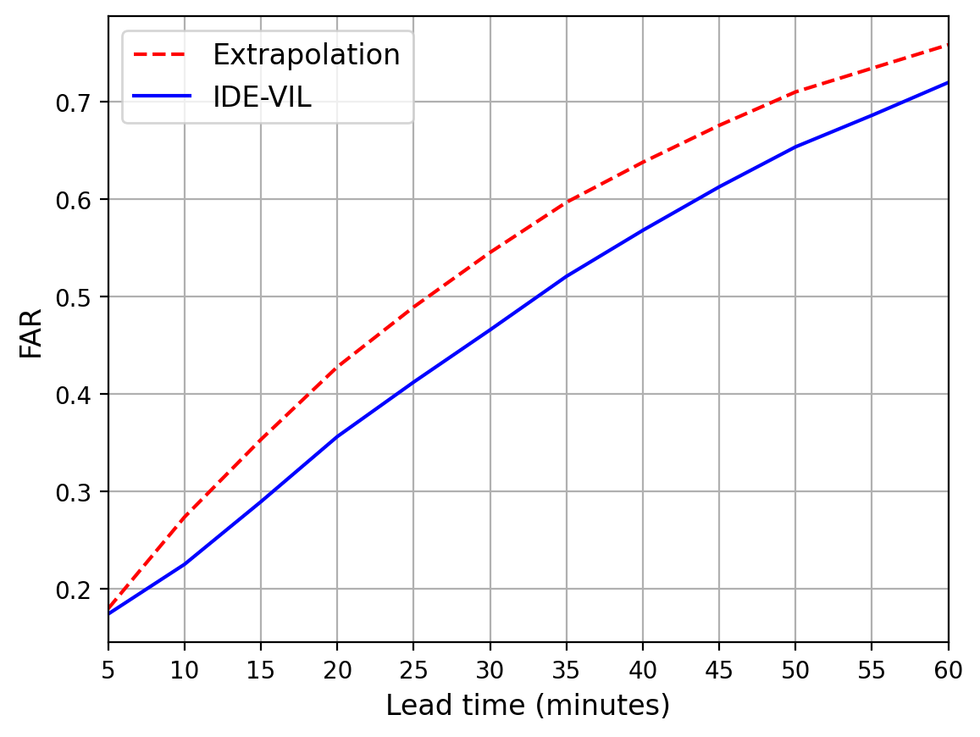
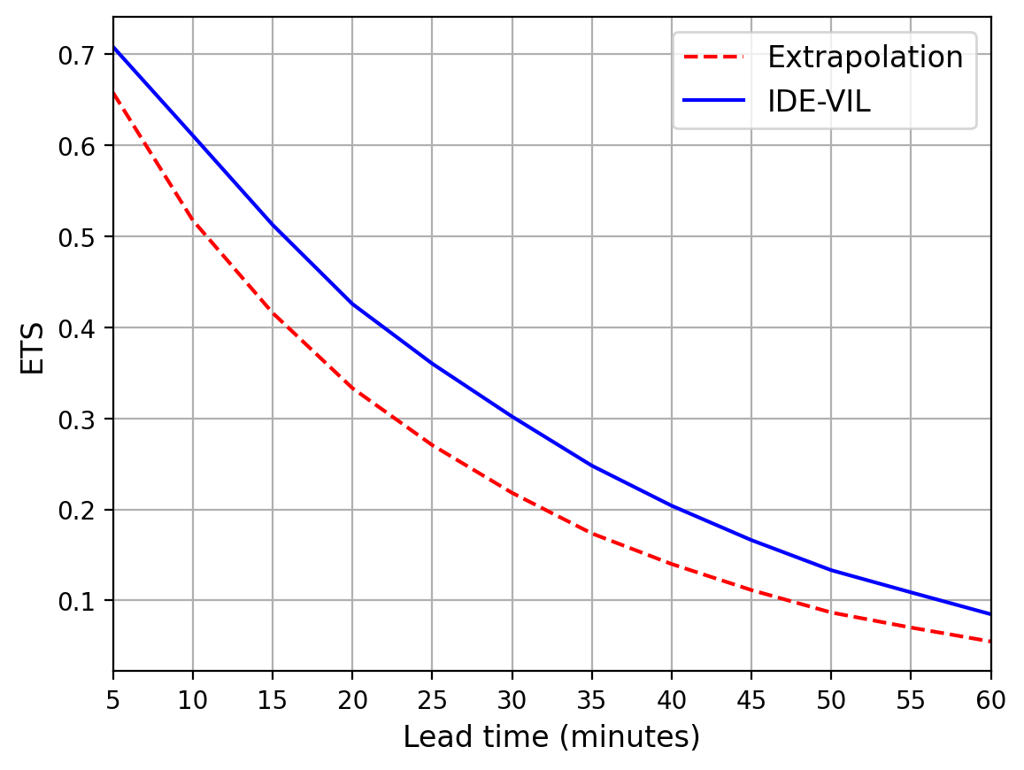
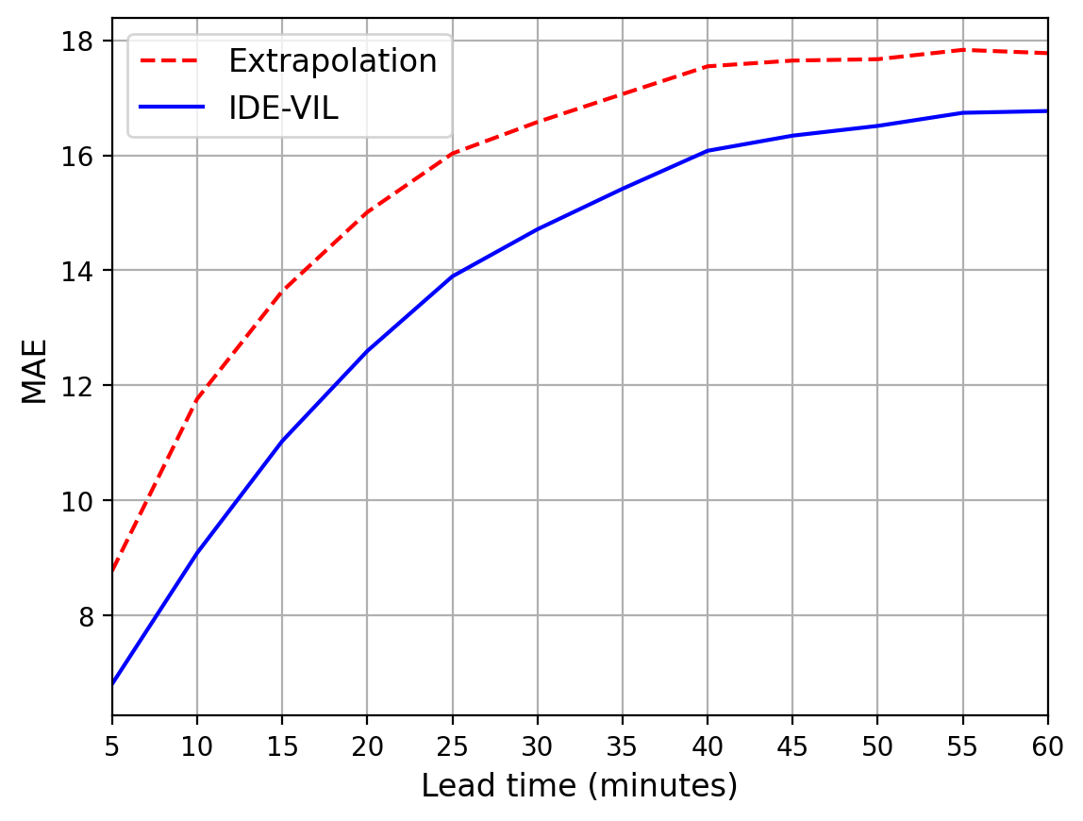
Verification
Date | Start time (UTC) | Duration (h)
2 May 2019 | 02:30 | 4
1 Jun 2019 | 22:00 | 8
24 Jun 2019 | 01:30 | 4
27 Aug 2019 | 10:30 | 6
Probability of detection (POD), false alarm ratio (FAR), equitable threat score (ETS) and mean absolute error (MAE) were computed for the 5 mm/h threshold for 4 events.
Simplified prototype implementation using an isotropic kernel.
POD, FAR and ETS show up to 30% improvement compared to extrapolation nowcast.
MAE is reduced up 20%, and the improvement is most significant for short lead times.
The performance is comparable to the previously proposed ANVIL method.
S. Pulkkinen, V. Chandrasekar, A. von Lerber, and A.-M. Harri, ”Nowcasting of Convective Rainfall Using Volumetric Radar Observations”, IEEE Transactions on Geoscience and Remote Sensing, 2020, doi: 10.1109/TGRS.2020.2984594.

Slide 11
Conclusions
A majot improvement compared to simple extrapolation nowcast. This is attributed to:
Using the integro-difference equation (IDE) model.
Utilization of three-dimensional information from the vertically integrated liquid (VIL).
The model combines an extrapolation nowcast and an IDE model.
Computationally efficient methods were developed for the parameter estimation.
Future work:
Implementing the anisotropic kernel is expected to further improve forecast skill.
Ensemble nowcasts by adding stochastic perturbations.
Questions?

