Slide 1
Reservoir Response to Heat Generating Nuclear Waste in Bedded Salt
Presented by:
Richard S. Jayne
EGU 2020 Virtual Meeting
Monday 4 May 2020

Slide 2
Brine Availability Test in Salt (BATS) Team
Sandia National Laboratories (SNL)
Kris Kuhlman, Melissa Mills, Rick Jayne, Courtney Herrick, Ed Matteo, Charles Choens, Martin Nemer, Yongliang Xiong, Jason Heath
Los Alamos National Laboratory (LANL)
Phil Stauffer, Hakim Boukhalfa, Eric Guiltinan, Thom Rahn, Doug Ware
WIPP Test Coordination Office (TCO), LANL
Doug Weaver, Brian Dozier, Shawn Otto
Lawrence Berkeley National Laboratory (LBNL)
Yuxin Wu, Jonny Rutqvist, Mengsu Hu

Slide 3
Brine Availability Test in Salt (BATS)
BATS Goal:
  Monitoring brine distribution, inflow, and chemistry from heated salt using geophysical methods and direct liquid & gas sampling
Why Salt?
  Salt long-term (10⁴ – 10⁶ yrs.) benefits at km-scale
    Low porosity and permeability
    High thermal conductivity
    No flowing groundwater
    Creep closure
Salt Complexities
  Brine and salt are corrosive
  Evaporites are very soluble in water
  Salt creep requires drift maintenance
  Excavation Damaged Zone (EDZ)
Borns & Stormont (1988)

Slide 4
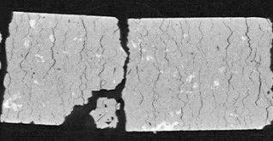
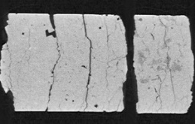

Background on Brine in Salt
Polyhalite
Intergranular
Fractures
Water types in bedded salt
  Disseminated clay ($<5$ vol-% total; $\sim 25$ vol-% brine)
  Intragranular brine (fluid inclusions; $1−2$ vol-%)
  Hydrous minerals (e.g., polyhalite, bischofite, epsomite)
  Intergranular brine (between salt crystals; $<<1$ vol-%)
These water types:
  respond differently to heat & pressure
  have varying chemical composition
  differ in stable water isotope makeup
EDZ increases intergranular $φ$ → primary flow path
Q: How do water types contribute to Brine Availability?
Fluid
Inclusions
Clay
WIPP fluid inclusions, 2 mm scale bar
(Caporuscio et al., 2013)
10.1 cm diameter core CT data (Betters et al., 2020)

Slide 5

Questions BATS Experiment Seeks to Answer
Understand and predict THMC processes impacting brine availability
  How much of each water type in bedded salt?
  Water response to pressure ($Δp$), stress ($Δσ$), and temperature ($ΔT$)?
  How does EDZ control migration of water ($φ$, $k$, relative perm. $k_{r}$)?
  How does EDZ evolve with $Δp$, $Δσ$, and $ΔT$?
  Is two-phase flow in EDZ important for predictions?
  How to best simulate brine pulse after heating?
OBJECTIVE: Utilize PFLOTRAN and TOUGH numerical modeling codes to match the most recent heating/cooling cycle at WIPP.

Slide 6
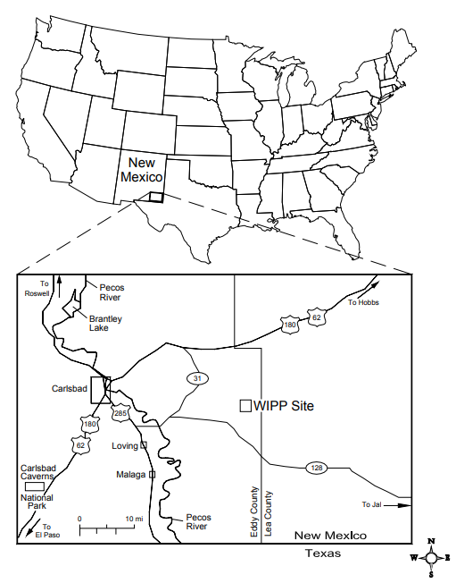
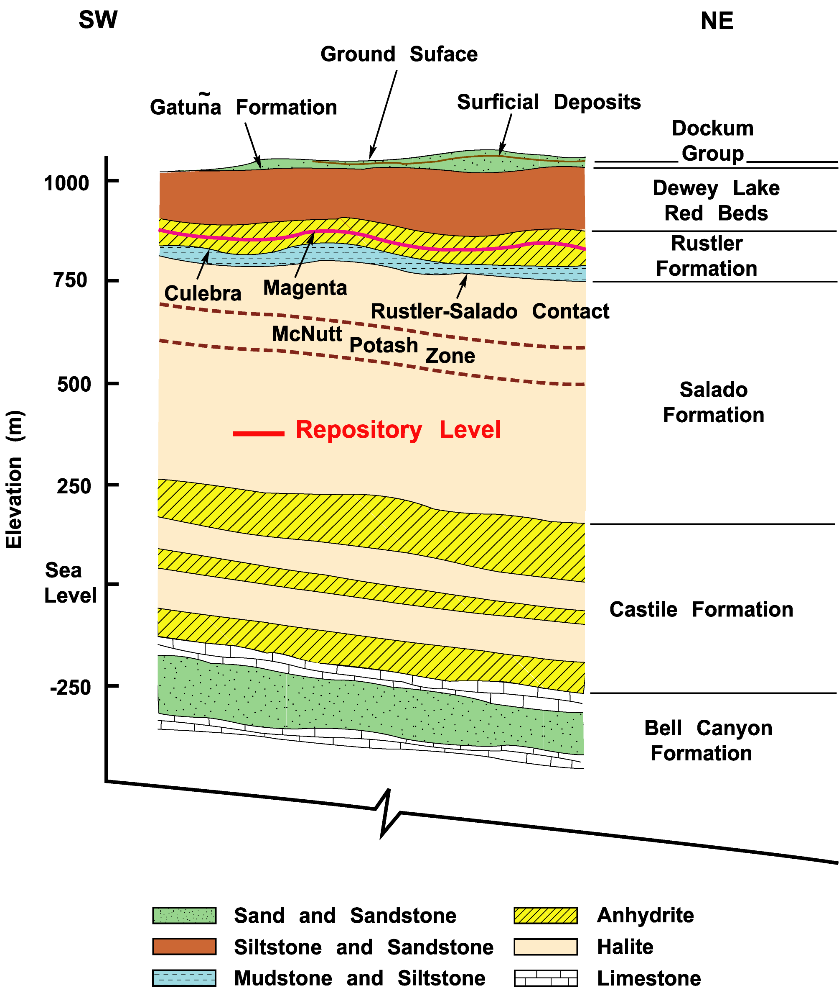
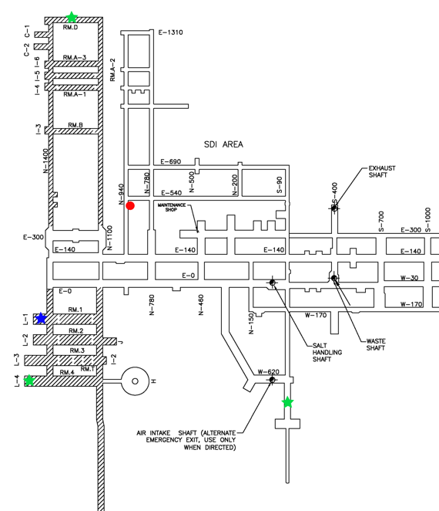
Waste Isolation Pilot Plant (WIPP) Context
Layout of WIPP North End
Small-scale
Brine inflow (1992)
BATS (2020)
650 m depth
⇽N
500 ft (152 m)
scale bar
Small-scale
Mine-by (1991)

Slide 7
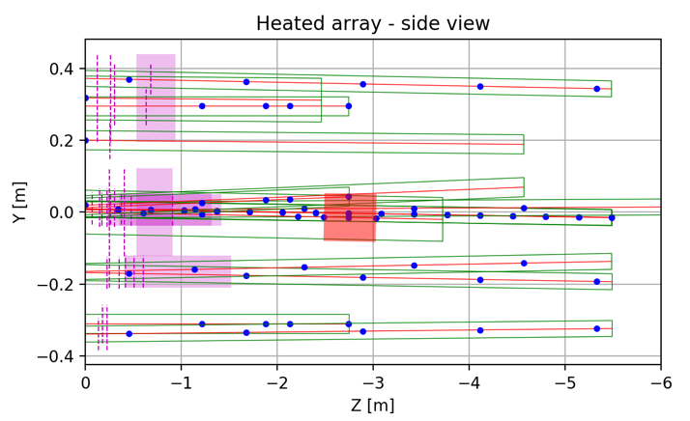
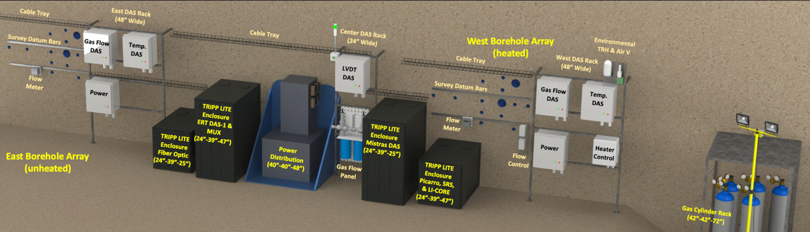
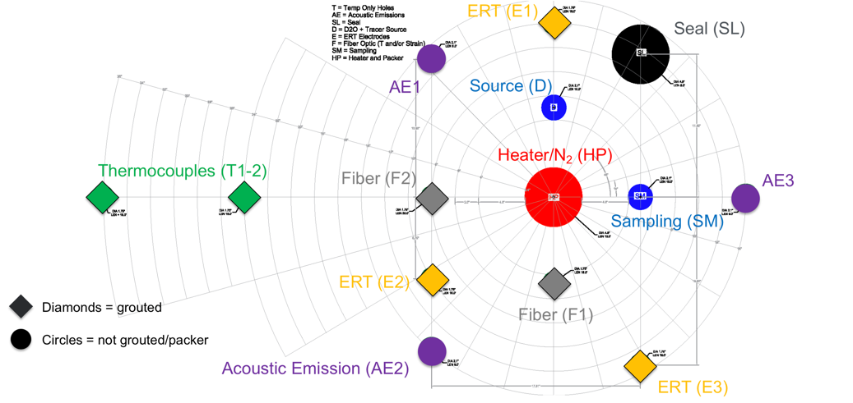
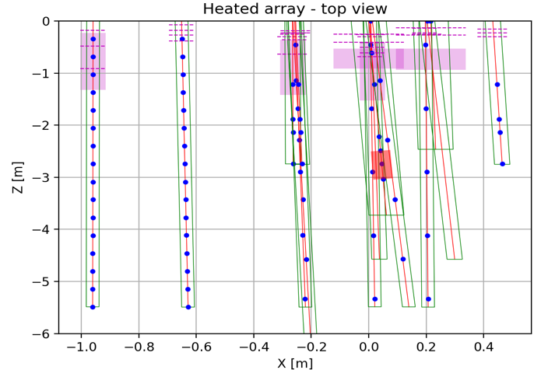
BATS Experimental Setup
(Drift layout drawing by WIPP TCO)
Unheated
Heated

Slide 8
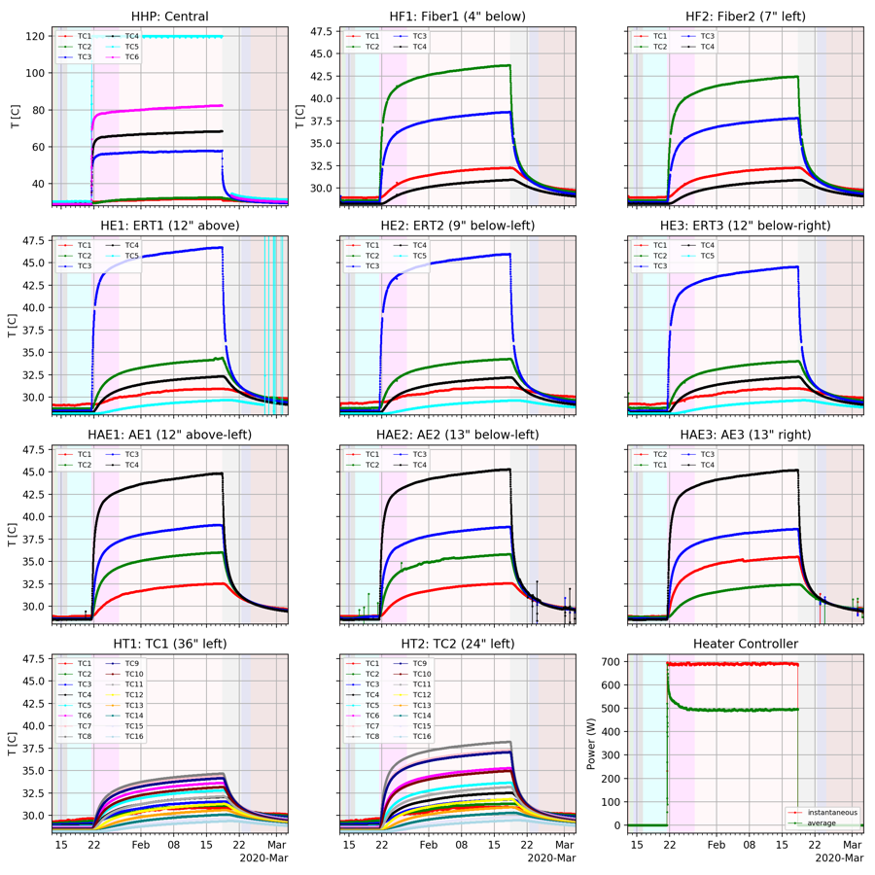
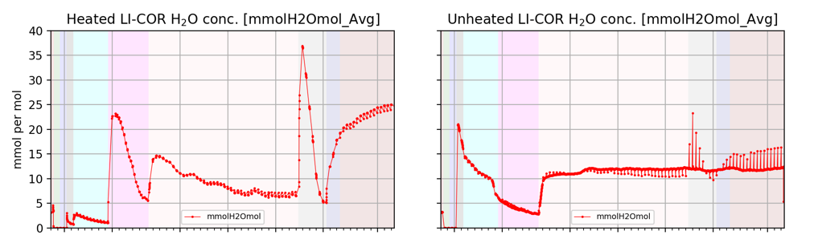
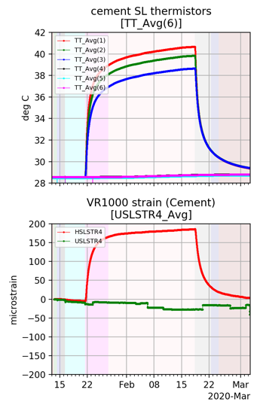
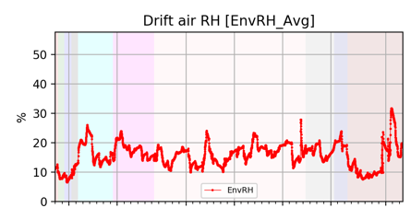
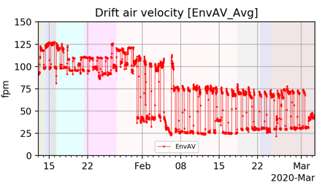
January - March 2020 BATS Test Data
Heat on
Heat off
N₂ flowrate change

Slide 9
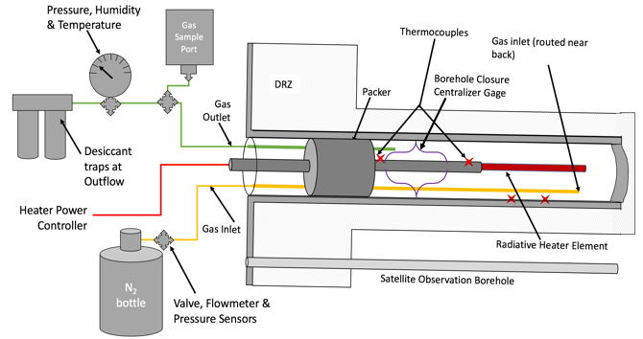
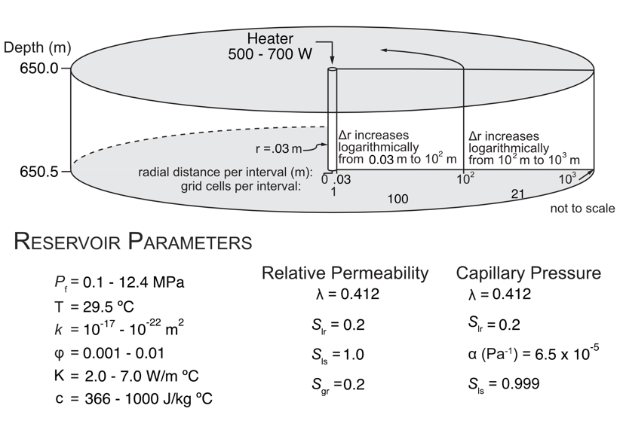
Utilizing 1-D Models to Match Field Test
Cross-section central
(HP) borehole
1D radially symmetric
  121 grid cells
  1 km total model domain (0.03 – 150 m)
  DRZ 0.03 – 1.75 m
Heater in contact with salt
  air causes issues with matching field data (radiative heating)
Simulate 29 days of heating and 13
  Incorporates the on/off cycles in early time and gradual lowering of energy input
Match temperatures measured at 3 thermocouples in-plane with heater
  HE1 – TC3 – 0.4m
  HT2 – TC8 – 0.68 m
  HT1 – TC8 – 1.01 m

Slide 10
Excavation Damaged Zone (EDZ) Strongly Controls Temperature profile

Slide 11

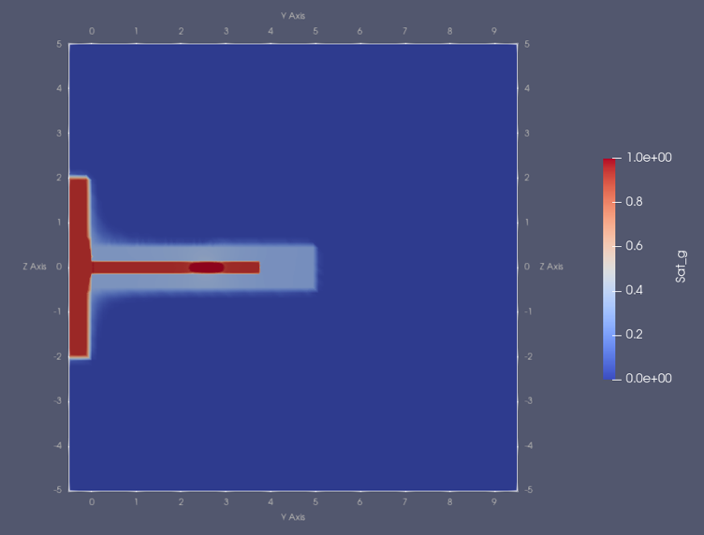
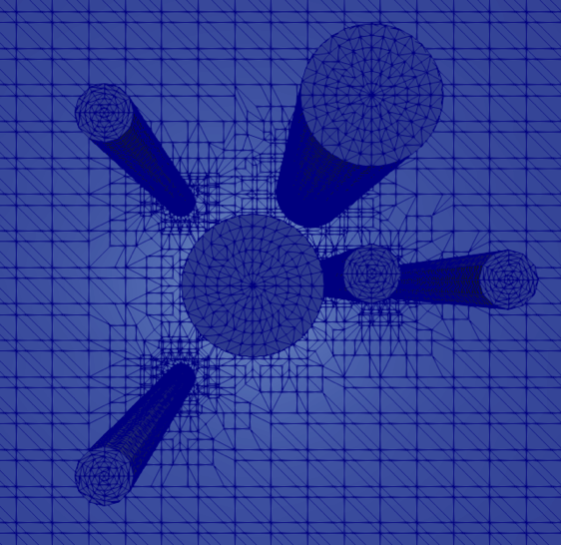
3-D Modeling of Field Test
Preliminary Results/Workflow
  Well geometry → LaGriT → Voronoi
    Outputs Voronoi mesh for TOUGH and PFLOTRAN
  10 m x 10 m x 10 m
    ~650,000 grid cells
  Include open-air boreholes
Refinement around wells
VOROCRUST
  Code developed at Sandia
  Voronoi cells
  Test discretization

Slide 12
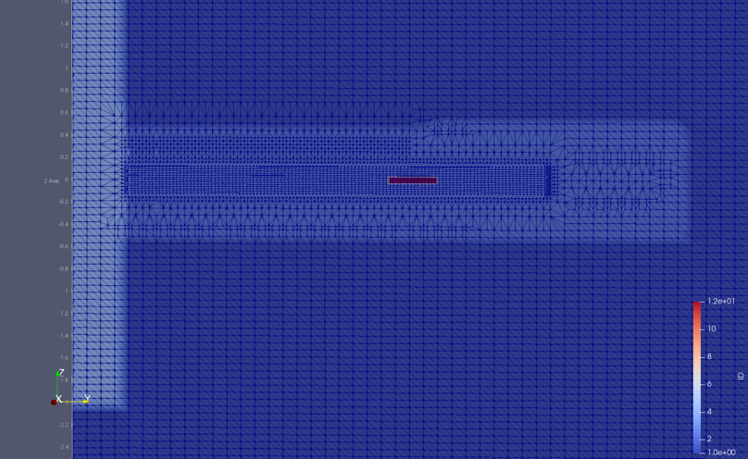
Future Work
Can we use 1-D models to map the EDZ to incorporate into more complex 3-D models?
Constrain reservoir parameters via laboratory experiments
  Thermal conductivity vs. temperature
  Heat capacity vs. temperature
Instead of a distinct separation of the EDZ and intact salt, have reservoir parameters decay as a function of distance from borehole and drift?
Match brine inflow into borehole.
How to incorporate permeability as a function of temperature?

Slide 13
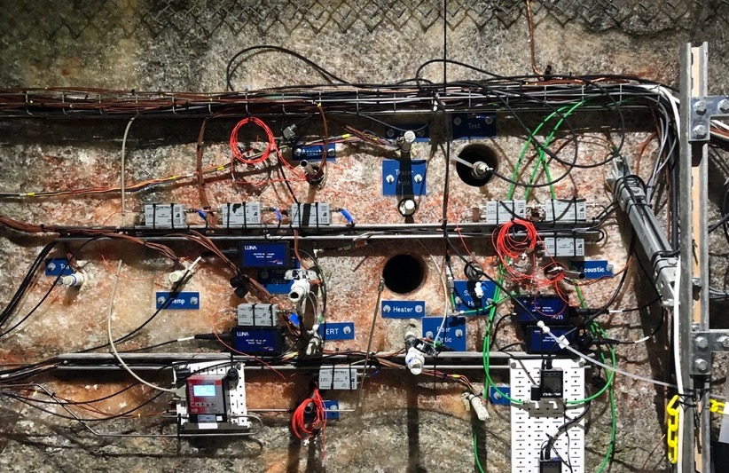
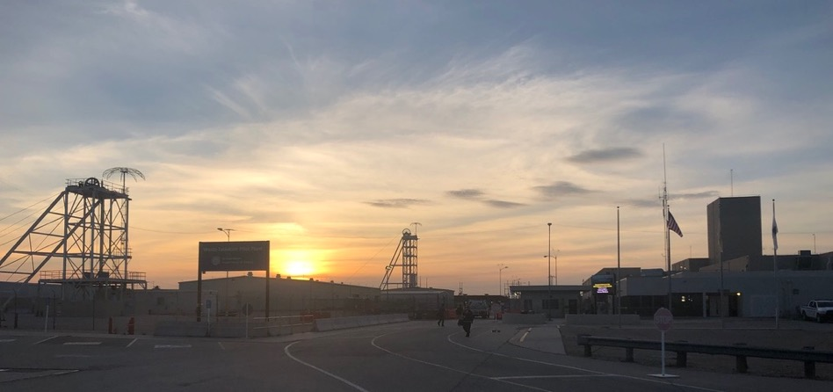
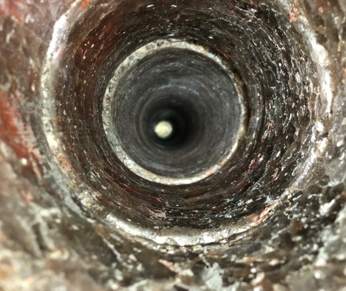
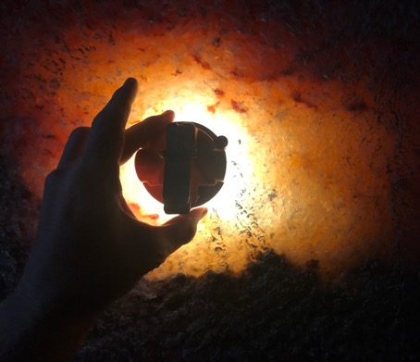
Thank You!

