Slide 1
Water Systems and Global Change Group (WSG)
Wageningen University & Research (WUR)
spyros.paparrizos@wur.nl

Slide 2
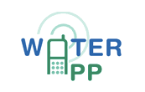
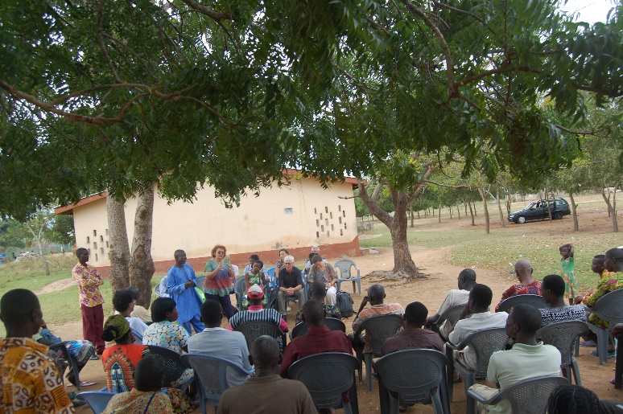
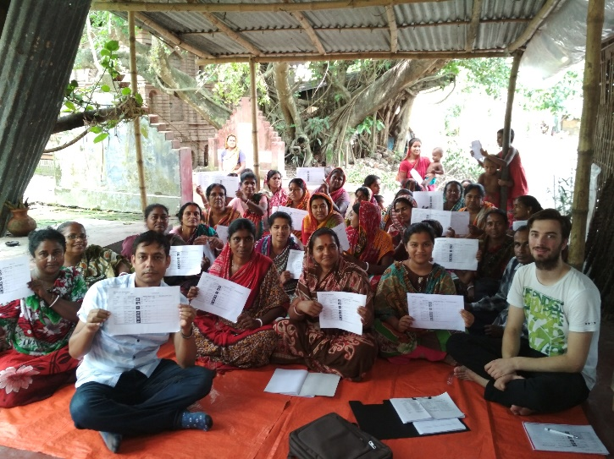
WATERAPPS project
2016-2021
Aim
Provide tailor-made water and climate information services with and for farmers for sustainable food production in peri-urban delta areas in Ghana and Bangladesh.
Ada, Ghana
Khulna, Bangladesh
Source: WaterApps website

Slide 3
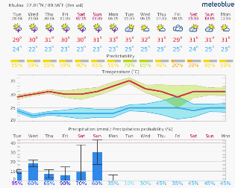
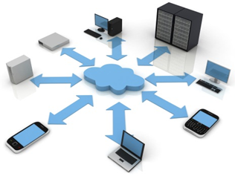
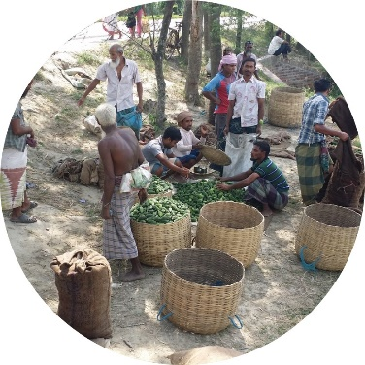
WATERAPPS: main research question
Weather & climate
forecasts
Sharing platforms &
virtual communities
Combine & leverage
Adaptive decision-making
Sustainable agriculture
Notes:
Overall RQ:
How can we combine and leverage the potential of water and climate availability forecasts and knowledge sharing platforms and virtual communities
-> to support adaptive decision-making for sustainable agriculture in peri-urban delta areas ?
How can the potential of water and climate availability forecasts and knowledge sharing platforms and virtual communities be leveraged to provide hydro-climate information services to support adaptive decision-making for sustainable agriculture in peri-urban delta areas ?

Slide 4
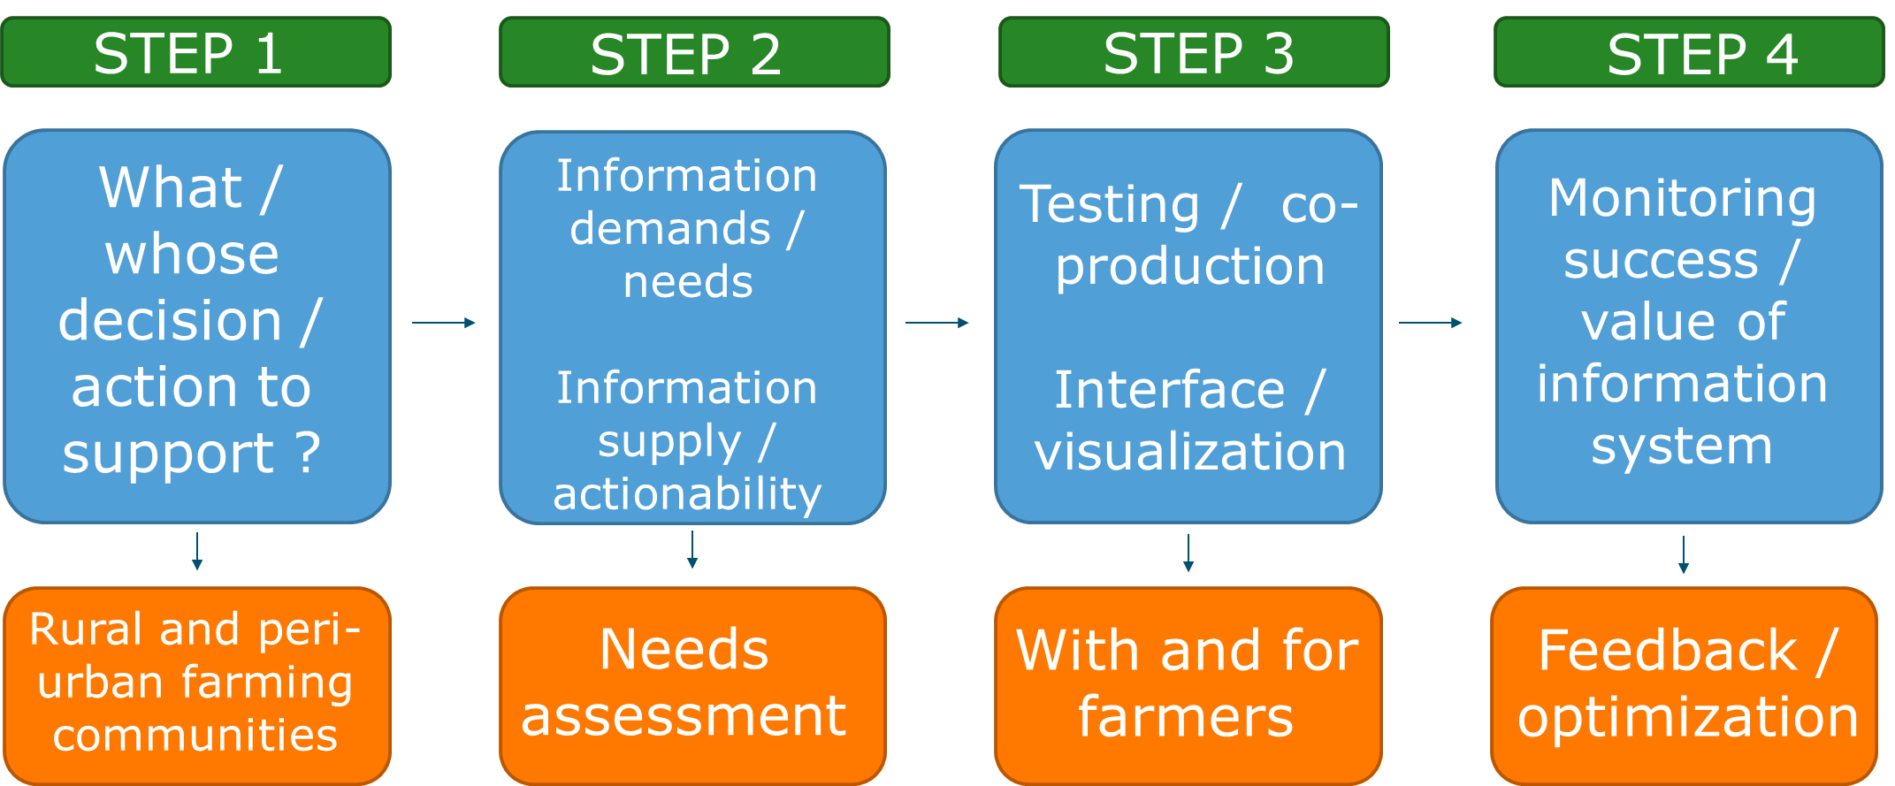
Conceptual framework
Notes:
We are trying to provide answers to the overal question as well as the sub-questions that have arisen from the main one through a conceptual framework where initially we perform a baseline study to see what is there and what are the users needs.
peri-urban farming communities
2a. Needs assessment
2b. What do we have now ?
WHEN WE KNOW WHAT IS THERE AND WHAT THE FARMERS NEED, WE GO AHEAD AND:
3. Co-develop tailor-made weather and climate information services with and for farmers through engagement in a participatory way
4. Feedback and evaluation of the information system

Slide 5
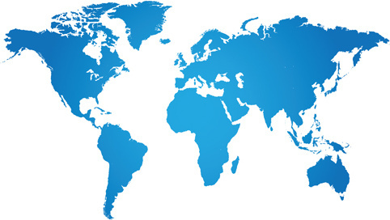
Tailor-made water and climate information services for sustainable agriculture in peri-urban Ganges Delta of Bangladesh
STUDY CASE: Khulna, Bangladesh
Notes:
The WATERAPPS project is is active in Ada, Ghana and Khulna Bangladesh.
Here, the example of Khulna, Bangladesh is presented.

Slide 6
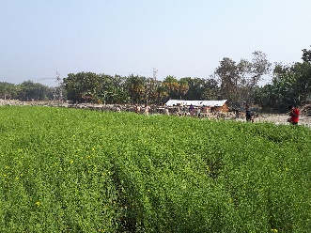
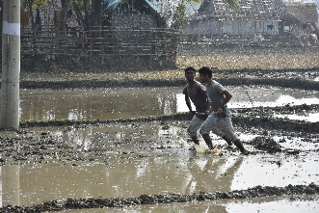
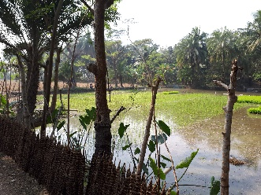
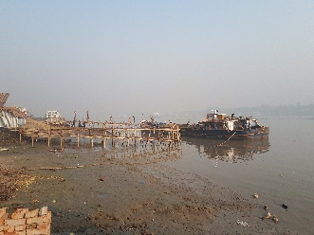
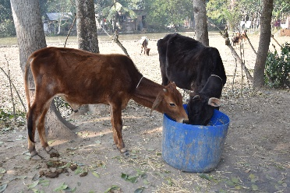
Bangladesh study case - Background
40% of households -> crop farming
Farmers are dependent on seasonal rainfall and other weather phenomena to make decisions
Beginning: Farmers had limited access to information
Available information and technology can help farmers manage water and climate risks and harness opportunities
Notes:
Bangladesh case study – Background information

Slide 7
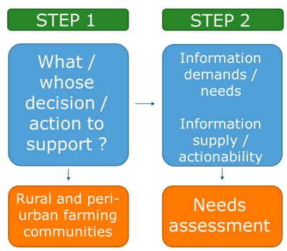
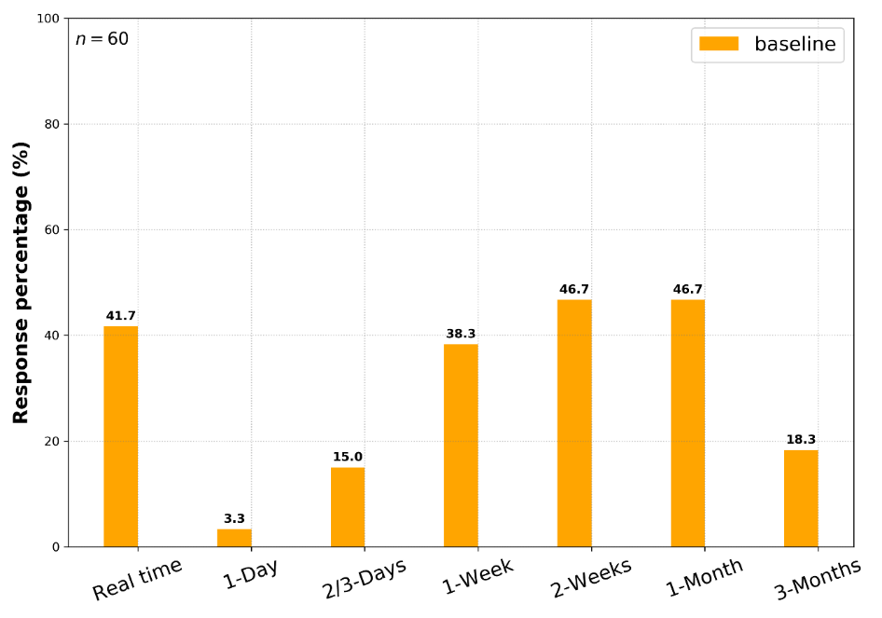
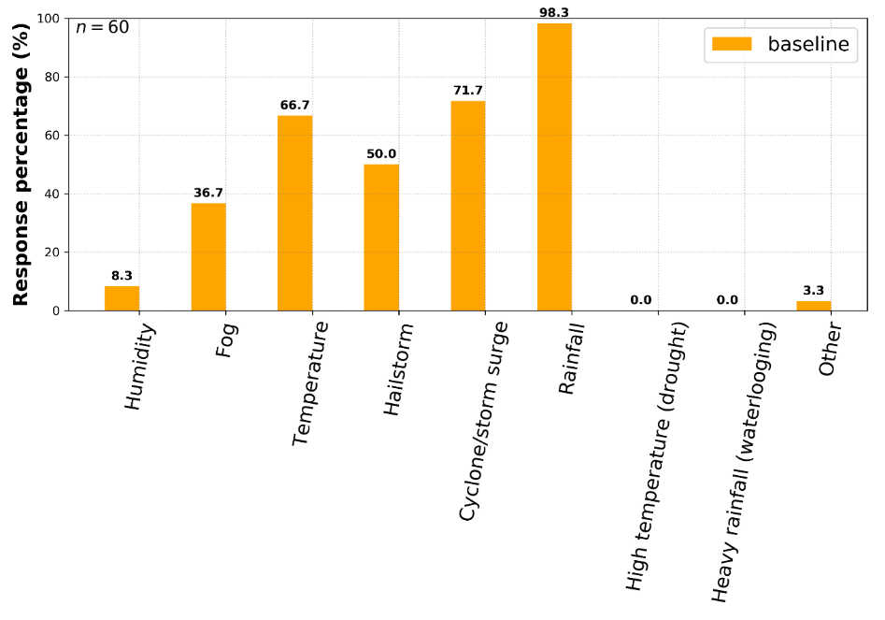
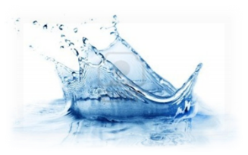
Preliminary analysis - needs assessment
- Quality of information: Poor
- Main sources: Peer farmers & TV programs
Time in advance
Information
needs
Notes:
Research Questions during these STEPS (1,2):
Current available information and needs ?
Perceived quality and role of available information ?
Influence of available information on decision-making ?

Slide 8
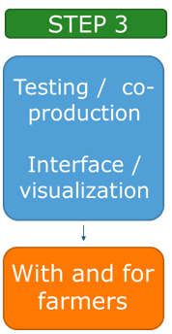
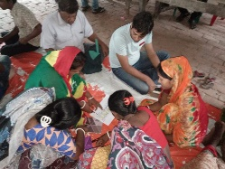
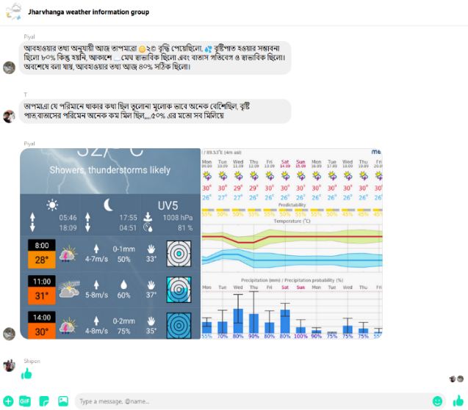
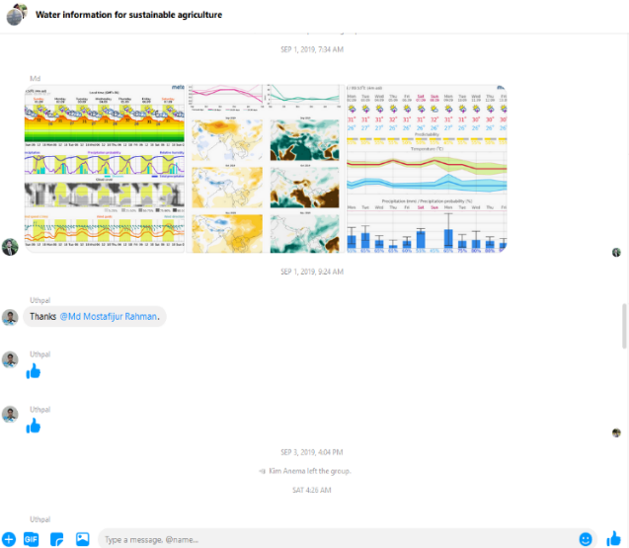
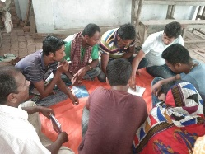
Co-development of CIS
Setup: WATERAPPS school (Farmers’ Field School – FFS)
Scope: Tailor/co-production of climate services
Crop season: Aman (rainfed season in Bangladesh)
Farmer field schools (FFS): 2 villages (32+26 ppl)
Communication mode: Sharing forecast information using ICT-platforms (messenger) + paper based (FFS)
Forecast source: meteoblue
Notes:
Research Questions during STEP 3:
RQ_1: How forecast visualization and mode of communication could improve farmers’ agricultural decision-making ?
RQ_2: What are the key impacts of inaccurate forecast ?
RQ_3: How do delta farmers in Khulna deal with forecasts inaccuracy ?
ANSWERS
RQ_1: Assess whether farmers could improve their daily and tactical farming decisions using the tailored information (premium package) communicated through traditional and ICT platforms.
RQ_2: Examine whether forecasts visualization makes any significant differences in farming decisions of the local farmers.
RQ_3: Assess whether forecast inaccuracy has any significant impact on crops, livestock and livelihood of the smallholder farmers.

Slide 9
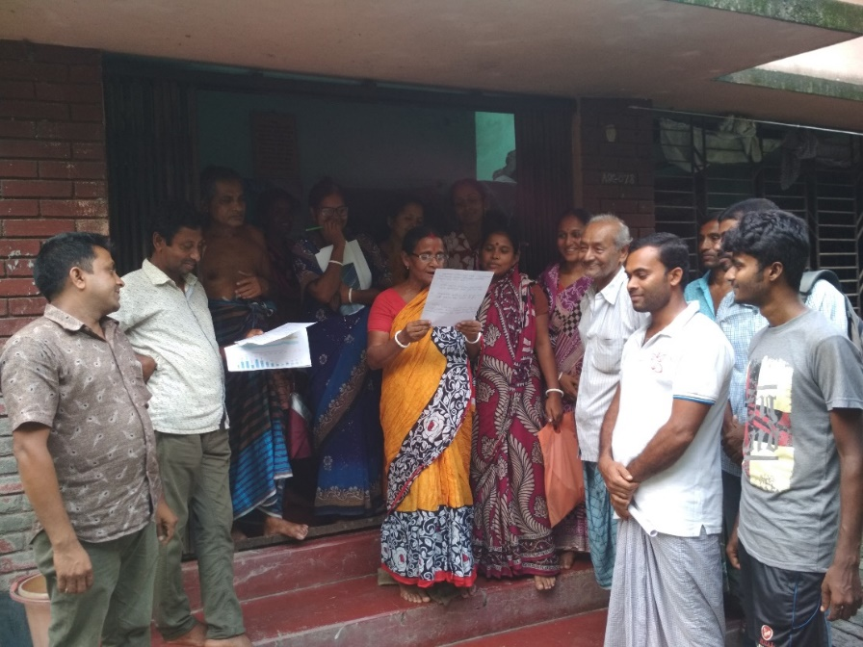
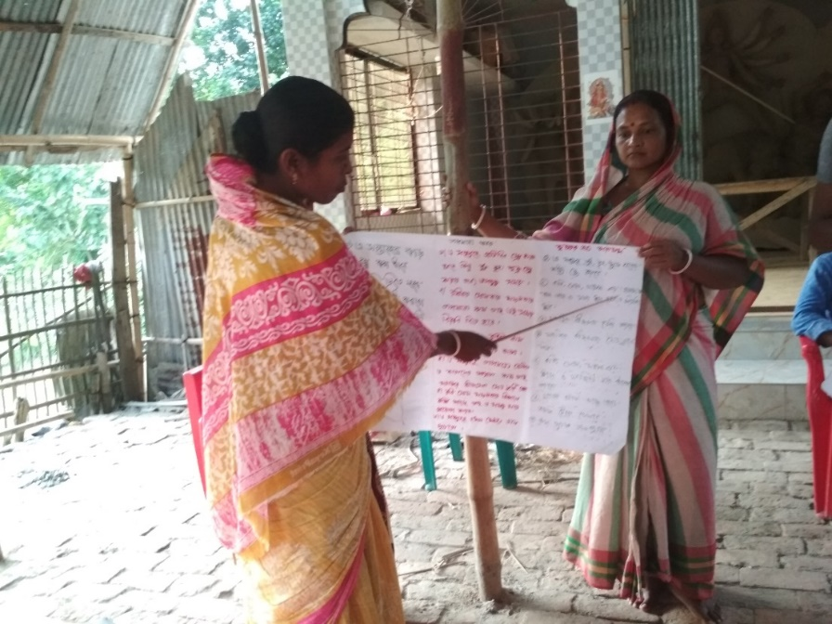
Face2Face in the Farmers’ Field School
Weekly session with three tasks:
1st 30 min feedback session
2nd 30 min forecasts sharing and discussion
3rd 30 min preparation of weekly advice for farmers
Female farmers sharing weekly agricultural advice and information that was developed by themselves
Notes:
During the Face2Face weekly sessions we identified 3 parts each time:
1. Discussion and feedback on last week’s agricultural activities in relation to the provided forecast.
2. Followed by sharing of the current week’s forecast as well as elaboration on that.
3. During th last part, farmers form groups and they jointly prepare their weekly agricultural activities based on the provided forecast.

Slide 10
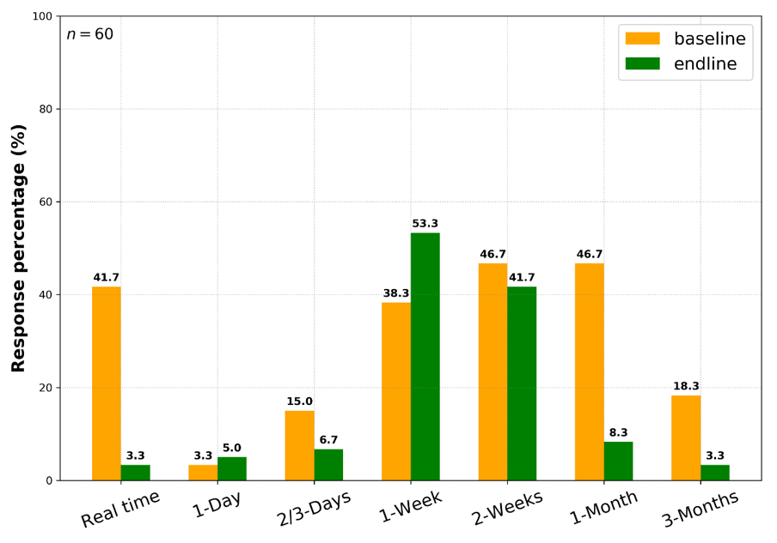
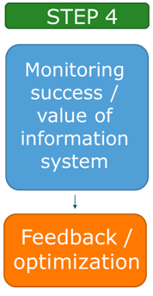
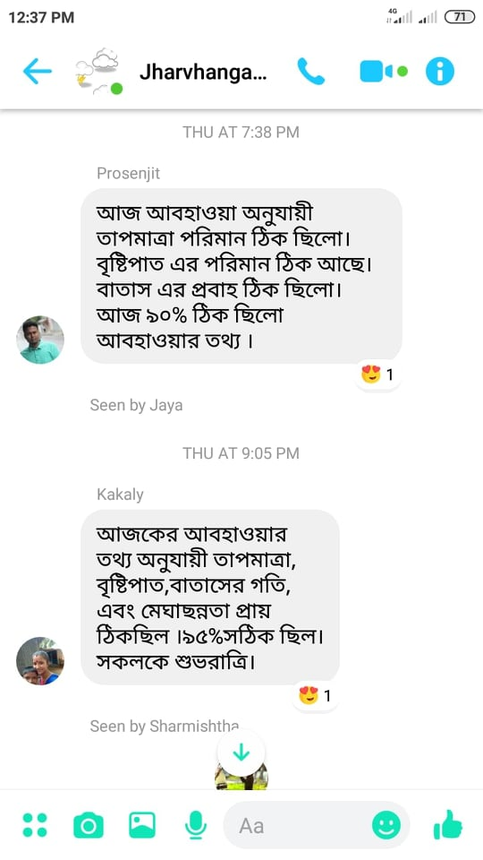
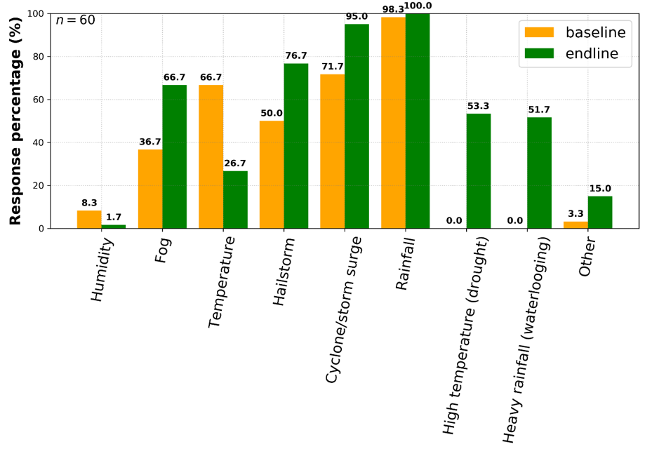
Evaluation – first outputs
Facebook groups
Time in advance
Information
needs
Notes:
We are currently on the evaluation phace, and we are already receiving the first outputs..
We have facebook groups where besides provide forecast information, farmers could also provide their feedback in real time..
Plots (right): baseline and now they include the endline.
Farmers are more knowledgable to select the advance time that they want to have information.
- Information needs include more parameters, mainly because the farmers know which indicator is crucial for each period and cultivation phase.

Slide 11
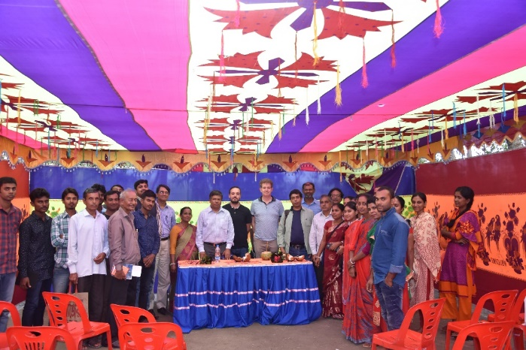
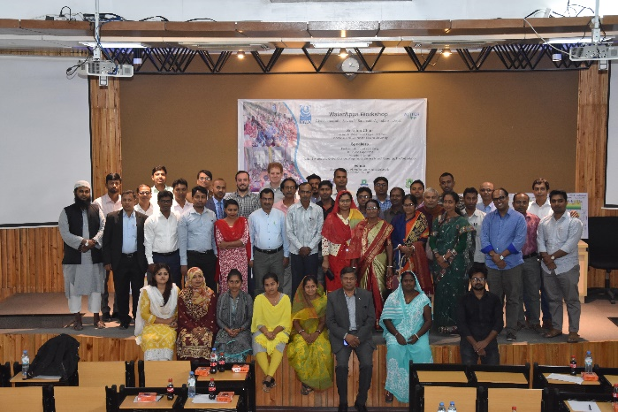
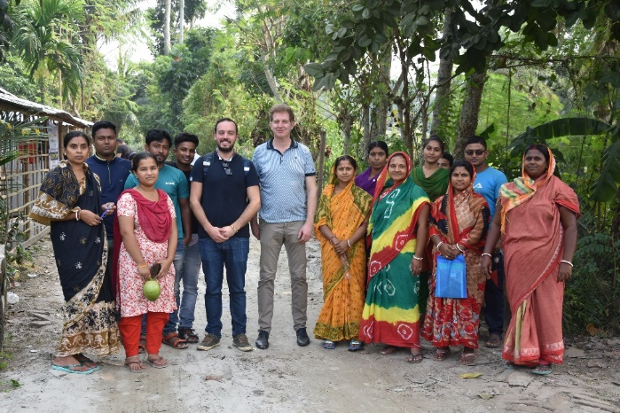
Improved livelihood outcomes
Increased economic output
Improved crop management practices
Knowledge and awareness on forecast information
Increased trust and dependency on scientific forecast (SF)
Combined use of SF and local forecast knowledge (LFK)
Appropriate decision ”on time”
Improved social relations and acceptance
Notes:
Long-term traditional farming practices main issue, in which we want to build upon.
Last point: we have numerous examples / success stories, video, etc. that indicate the success of the WATERAPPS project.

Slide 12
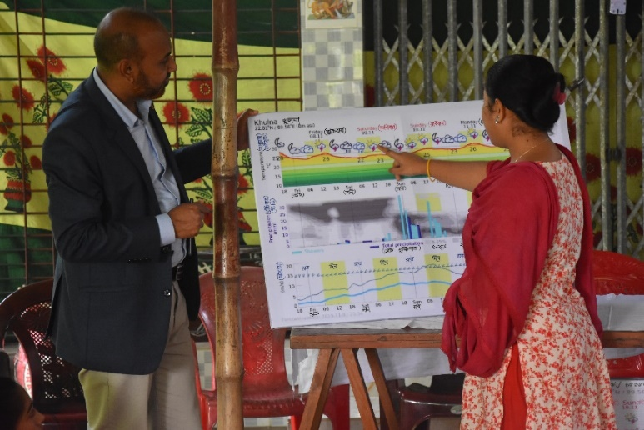
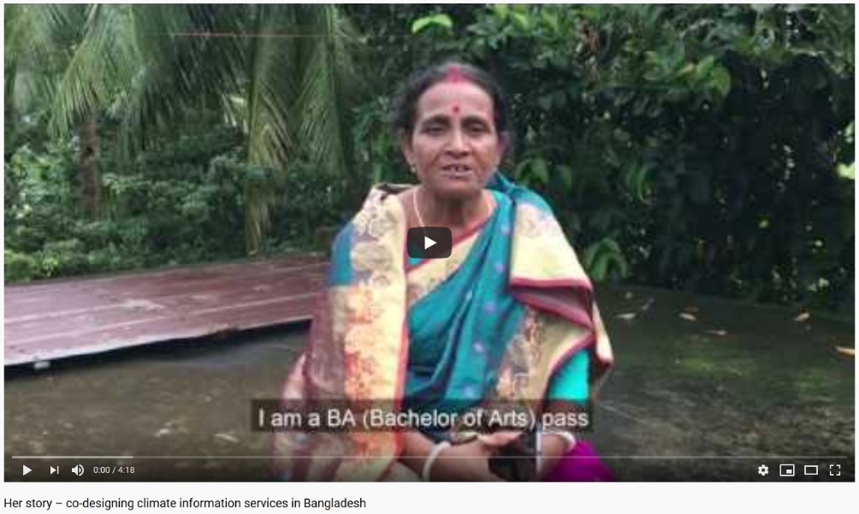
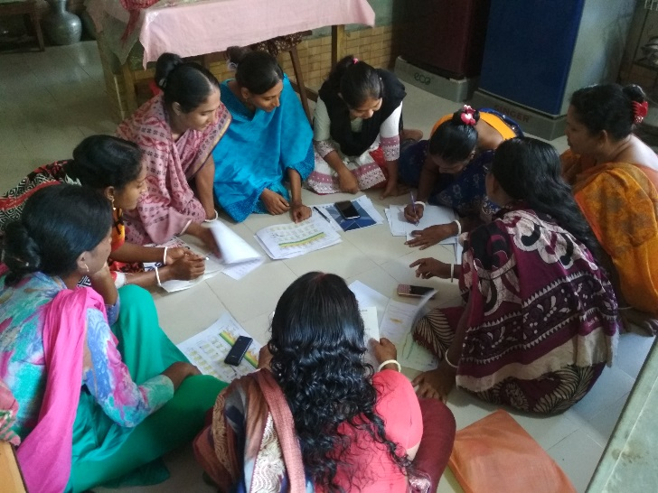
Improved livelihood outcomes
Increased leadership
Positive role in women empowerment
‘Her story’
Farmer explaining the forecast to the school participants
Participants of the WATERAPPS school discussing agricultural activities in relation to the forecast

Slide 13
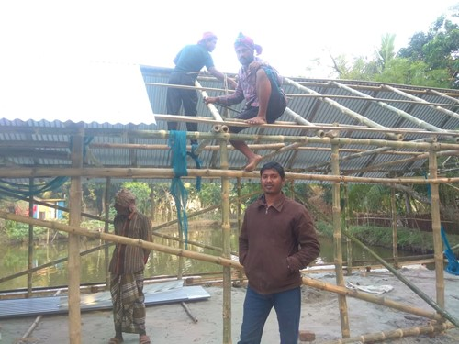
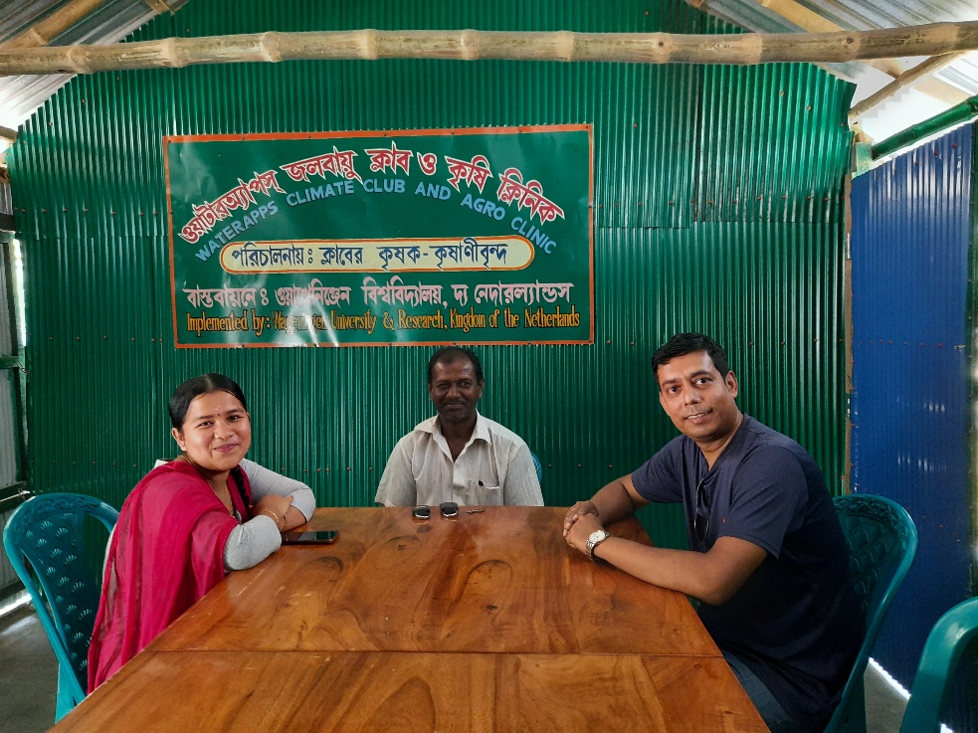
Weather Club in Khulna, Bangladesh
Farmers initiative: establishment of a ‘Weather Club’ at Sanchibunia village with the support of the WATERAPPS
Local farmers constructing the Weather school in Khulna with the support of the WATERAPPS
WATERAPPS PhD student Mr. Uthpal Kumar (right) with local farmers
Source: Weather club - WATERAPPS

Slide 14
Co-production of meteorological information for vegetable farmers in Ghana using seasonal forecasts and digital tools
EXAMPLE 2: Ada East District, Ghana
Notes:
The WATERAPPS project is is active in Ada, Ghana and Khulna Bangladesh.
Here, the example of Ada, Ghana is presented.

Slide 15
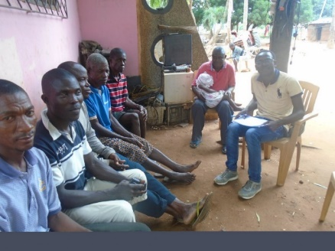
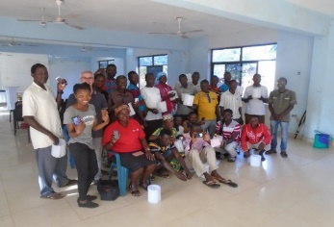
Preliminary analysis (outputs)
1. Reduce chain of communication
2. Easily understandable information
3. More reliable information
4. Respond to users’ needs
Notes:
Here we also followed the conceptual framework (4 steps) that the WATERAPPS is following.
After the baseline and needs assessment study, the target was to respond the users’ needs and reduce the chain of communication, while at the same time co-developing easily understandable and more reliable information because we were aware that rainfall is characterized by local patterns in the study areas that we are currently working.
One community has rainfall, the next 5 km away does not.

Slide 16
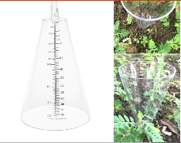
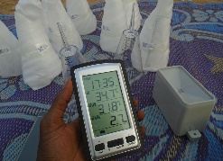
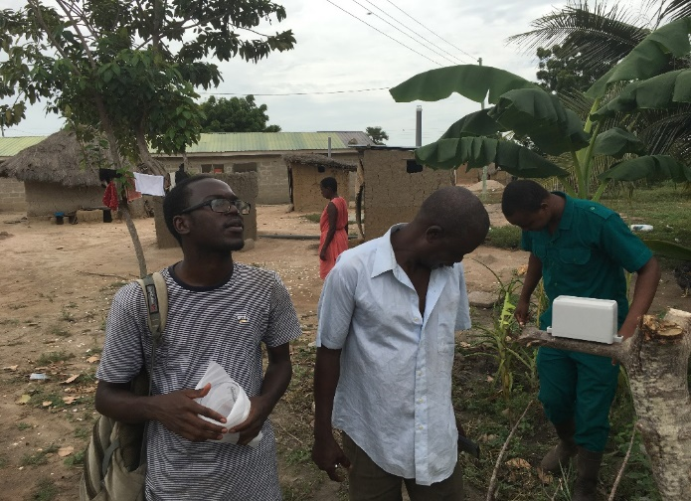
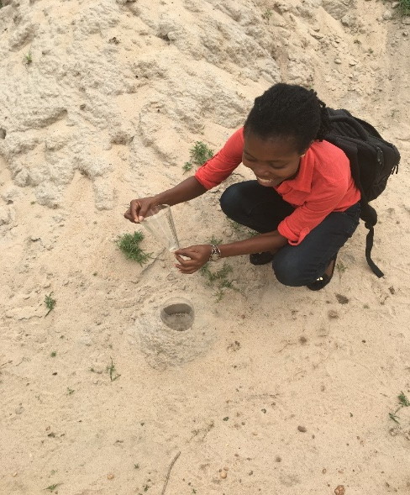
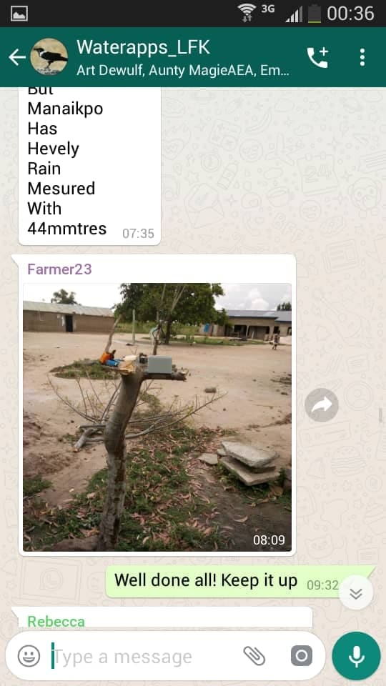
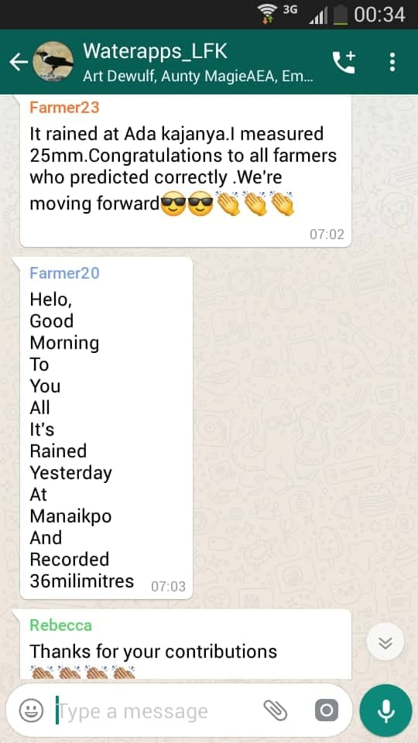
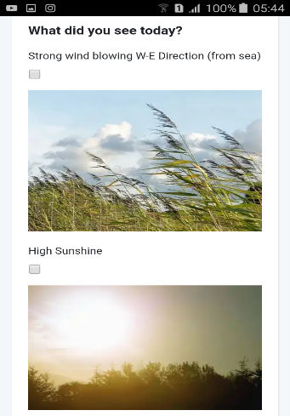
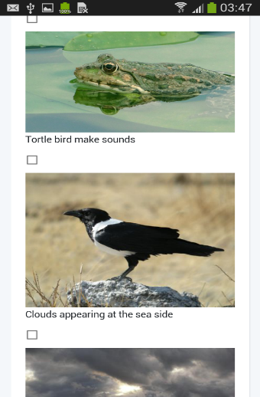
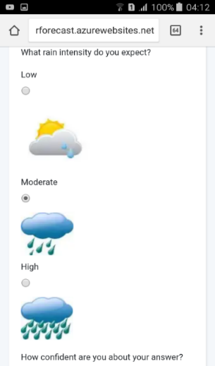
Field implementation
Co-learning: Farmers measure rainfall
Co-learning: Farmers interact
WATERAPPS PhD student Ms. Rebecca Sarku teaching local farmers how to install and measure rainfall
WATERAPPS PhD student Mr. Talardia Gbangou (left) with local farmers on the field
Co-learning: Farmers submit observations

Slide 17
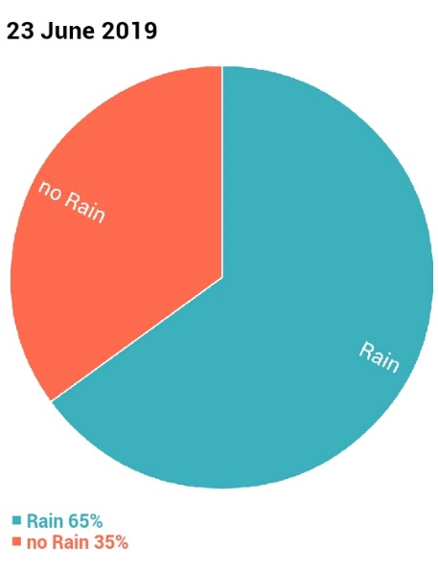
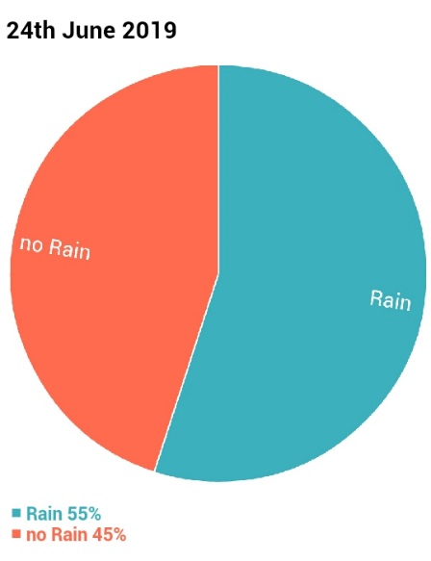
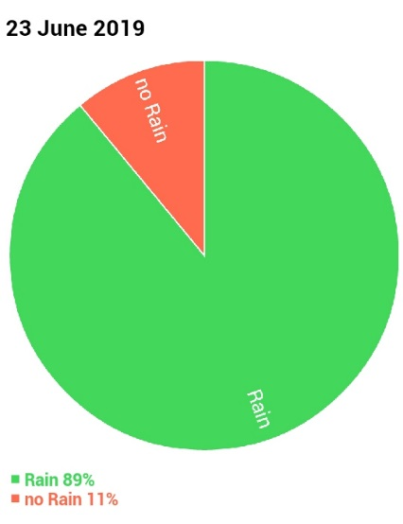
Integrating Scientific and Indigenous Knowledge in weather forecasting
ADDED VALUE! - Gbangou et al. (in review)
Farmers
Indigenous
Forecast
Scientific
Model Forecast
(meteoblue)
Notes:
Scientific – Indigenous knowledge integration.
We found out that indeed there’s some added value on the LFK.

Slide 18
Output: FarmerSupport APP
Climate Service location & time-specific information
Scientific Forecast Knowledge (SFK) Local Forecast (LFK)
LFK is based on local agro-meteorological indicators
Notes:
FarmerSupport is a hydro-climatic information service platform built to provide farmers in urbanizing deltas of the world location and time-specific weather information which is tailor-made to their agricultural decisions to intensify and improve crop production and simultaneously increase their adaptive capacity.
The APP incorporates local (LFK) and scientific forecast knowledge (SFK), and it also provides a hybrid forecast from the combination of LFK and SFK.
Within the APP in order for the local forecast to be generated, the users are called to add their personal assumption or probability (low, medium, high) of rainfall and sunshine based on various key agro-meteorological indicators that have been co-developed with the farmers that are also the end-users of the tool through the course of the WATERAPPS project.
Then the local forecast is generated and depicted.
Scientific forecast knowledge for 1-, 7- and 14-days is depicted in the APP), provided through and API:URL from meteoblue weather provider. Subsequently, the two forecasts are incorporated (Gbangou et al. 2020 in review) and a hybrid forecast is displayed.
The APP allows for rainfall and sunshine prediction with much higher skill that could support crop production in a more adequate way compared to the typical weather apps.
It is also built with great accessibilities to make it easy for the average local farmers who may not be highly educated to use it with ease or illiterate people because it provides audio feedback to the famers in their local language. In general, the design of the APP is very simple, colourful and easy to navigate.
Google store: end of May

Slide 19
WATERAPPS: Take home messages
Factors that limit information uptake
Long-term traditional practices
Lack of understanding and awareness
Lack of personal ability/capacity (age, literacy, ICT knowledge)
Lack of/bad quality of smartphone
Network problem and internet costs
Communication gaps due to personal reasons (remoteness)
Power relationship
Lessons learned
Potential for location-time-specific Climate Information Services for sustainable agriculture
2-Way communication is KEY!
ICT-based tools is highly preferred by young and educated farmers
Social, economic, technological and personal ability limit uptake of forecast information
Farmers need capacity building to deal with forecast information and reduce risks
Governmental officials have strong network with farmers and could help develop capacity

Slide 20
WATERAPPS: Synthesis
Source: Nyadzi et al. 2018

Slide 21
Thank you! Dank U!
Wageningen University,
The Netherlands

Slide 22
APPENDIX

Slide 23
APP proof of concept / implementation
Implement APP on the field in Ada, s. Ghana (postponed/pending...)
Implement APP on the field in Tamale, n. Ghana (WAGRINNOVA) (MSc. May 2020)
Implement APP on the field in Khulna, BGD (MSc. August 2020)
Implement the APP and collect LFK around in places where it has added value for agricultural decision-making (future work...)
Upscale the WATERAPPs activities in Bangladesh (future work...)
Notes:
Planning and upcoming work.

Slide 24
WATERAPPS (so far) research outputs
Ghana related:
Gbangou et al. 2019. Seasonal variability and predictability of agro-meteorological indices: Tailoring onset of rainy season estimation to meet farmers’ needs in Ghana. Climate services, 14, 19-30.
Gbangou et al. 2020. Rainfall and dry spell occurrence in Ghana: trends and seasonal predictions with a dynamical and a statistical model. Theoretical and Applied Climatology, accepted for publication
Gbangou et al. 2020 Harnessing local forecasting knowledge on weather and climate in Ghana: documentation, skills and integration with scientific forecasting knowledge, under revision
Sarku et al. 2020. Adaptive decision-making under conditions of uncertainty: The case of farming in the Volta delta, Ghana. Integrative Environmental Sciences Journal, 17(1), 1-33.
Sarku et al. 2020. Beyond ‘experts knowledge’: Locals and experts in a joint production of weatherApp and weather information for farming in the Volta Delta, Ghana. Handbook of Climate Change Management, accepted for publication
Bangladesh related:
Kumar et al. 2020. Role of information in farmers’ response to weather and water related stresses in the Ganges Delta of Bangladesh. Weather, Climate and Society Journal, under revision
Kumar et al. 2020. Understanding Hydro-Climatic Information Needs of Smallholder Farmers in the Bengal Delta. Climate Services, under revision
Combined:
Paparrizos et al. 2020. WATERAPPS: Co-producing tailor made water and weather information services with and for farmers in the peri-urban areas of Ghana and Bangladesh. Geophysical Research Abstracts, EGU2020-5712, Vienna, Austria.

Slide 25
WATERAPPS team
NETHERLANDS
Erik van Slobbe
Fulco Ludwig
Art Dewulf
Katrien Termeer
Saskia Werners
Spyros Paparrizos
BANGLADESH
Dilip Datta
Uthpal Kumar
GHANA
Gordana Kranjac
Rebecca Sarku
Talardia Gbangou
Notes:
The WATERAPPS core team is located in the Netherlands, while the WATERAPPs project is active in Ghana + Bangladesh.

Slide 26
WATERAPPS partners
Water authorities
Consultancy
Notes:
- The project brings together partners from Academia as well as business (collaboration)
- NWO is the main funder of the project and Rabobank is also cash contributing in the project.
- Several partners are comprising the consortium such as meteoblue (for data provision), Consultant and Water Authorities as well

Slide 27
WSG-WUR mission
Water Systems and Global Change Group, Wageningen University
Notes:
About the Water Systems and Global Change Group
We are a solution-oriented multidisciplinary research group focusing on water systems and global change. We are one of the chair groups in the Environmental Science Group of Wageningen University & Research.
Mission: create new knowledge to contribute to sustainable water systems in a changing environment
Vision: Sufficient, clean and climate-proof water for society and nature
We identify four main research lines and two cross-cutting researches (see illustration).
Ambition:
- To improve our understanding of water systems in changing global environment
- To investigate the impacts on nature and people in changing water systems
- To investigate water and land-use based options to mitigate global change
- To identify sustainable measures and pathways to adapt to these futures
- To educate students in water systems and global change
- To engage in solutions for water-related problems
- To advocate transition towards sustainable water systems worldwide, and in the long term

