Slide 1
A study of Cs-137 and Sr-90 distribution in the soil and vegetation cover of elementary landscape-geochemical systems in the zone of the East Ural Radioactive Trace
Elena Korobova¹, Sergey Romanov², Oleg Tarasov³, Vladimir Baranchukov¹, Victor Berezkin¹, Denis Dolgushin¹, Lyudmila Mikhailovskaya⁴, Makar Modorov⁴, and Vitaly Lukyanov⁵
¹Vernadsky Institute of Geochemistry and Analytical Chemistry, Russian Academy of Sciences, Moscow, Russian Federation
(korobova@geokhi.ru)
²Unitary Enterprize "Geoinformation systems", National Academy of Sciences of Belarus, Minsk, Republic of Belarus
³Federal State Unitary Enterprise "Mayak Production Association", State Enterprise "Rosatom", Ozersk, Russian Federation
⁴Institute of Plant and Animal Ecology, Russian Academy of Sciences Ural Branch, Ekaterinburg, Russian Federation
⁵National Research Center "Kurchatov Institute ", Moscow, Russian Federation
The first results of a detailed study of ¹³⁷Cs and ⁹⁰Sr distribution in elementary landscape- geochemical system (the top-slope-closing depression type, ELGS) are presented on the example of test sites located in the head zone of the East Ural Radioactive Trace formed during the Kyshtym accident in 1957.
The main goal of the study was to prove or reject a hypothesis of a definite accumulation of radionuclide contamination downslope ELGS.
The study was supported by the RFBR grant No. 19-05-00816.
EGU2020-5844
https://doi.org/10.5194/egusphere-egu2020-5844

Slide 2
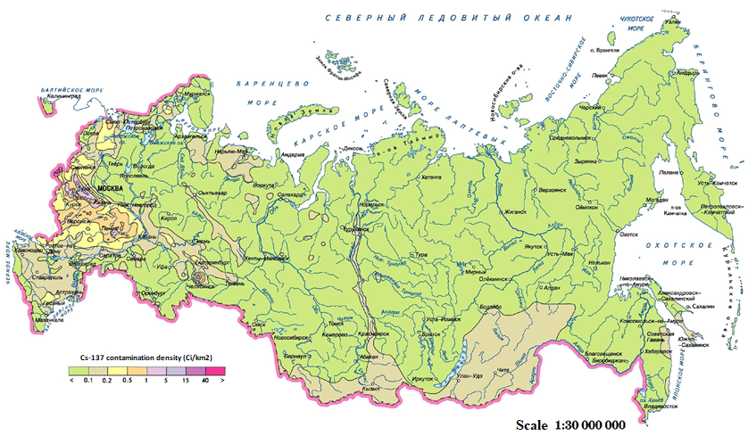
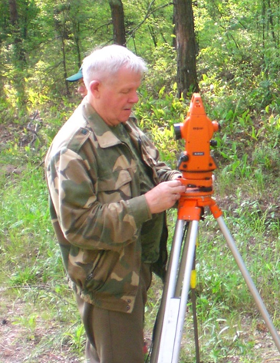
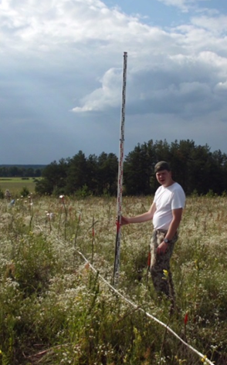
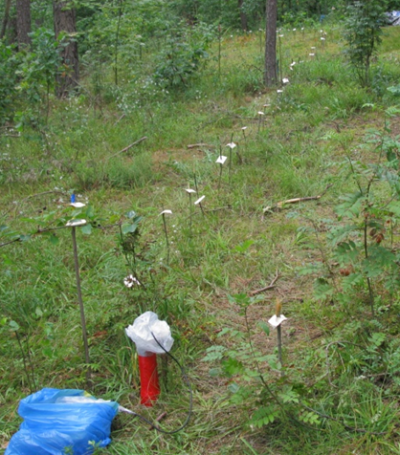
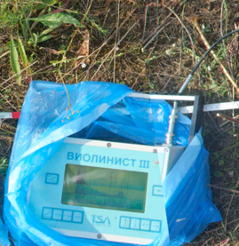
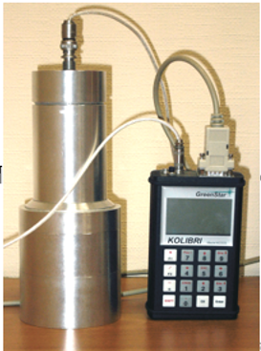
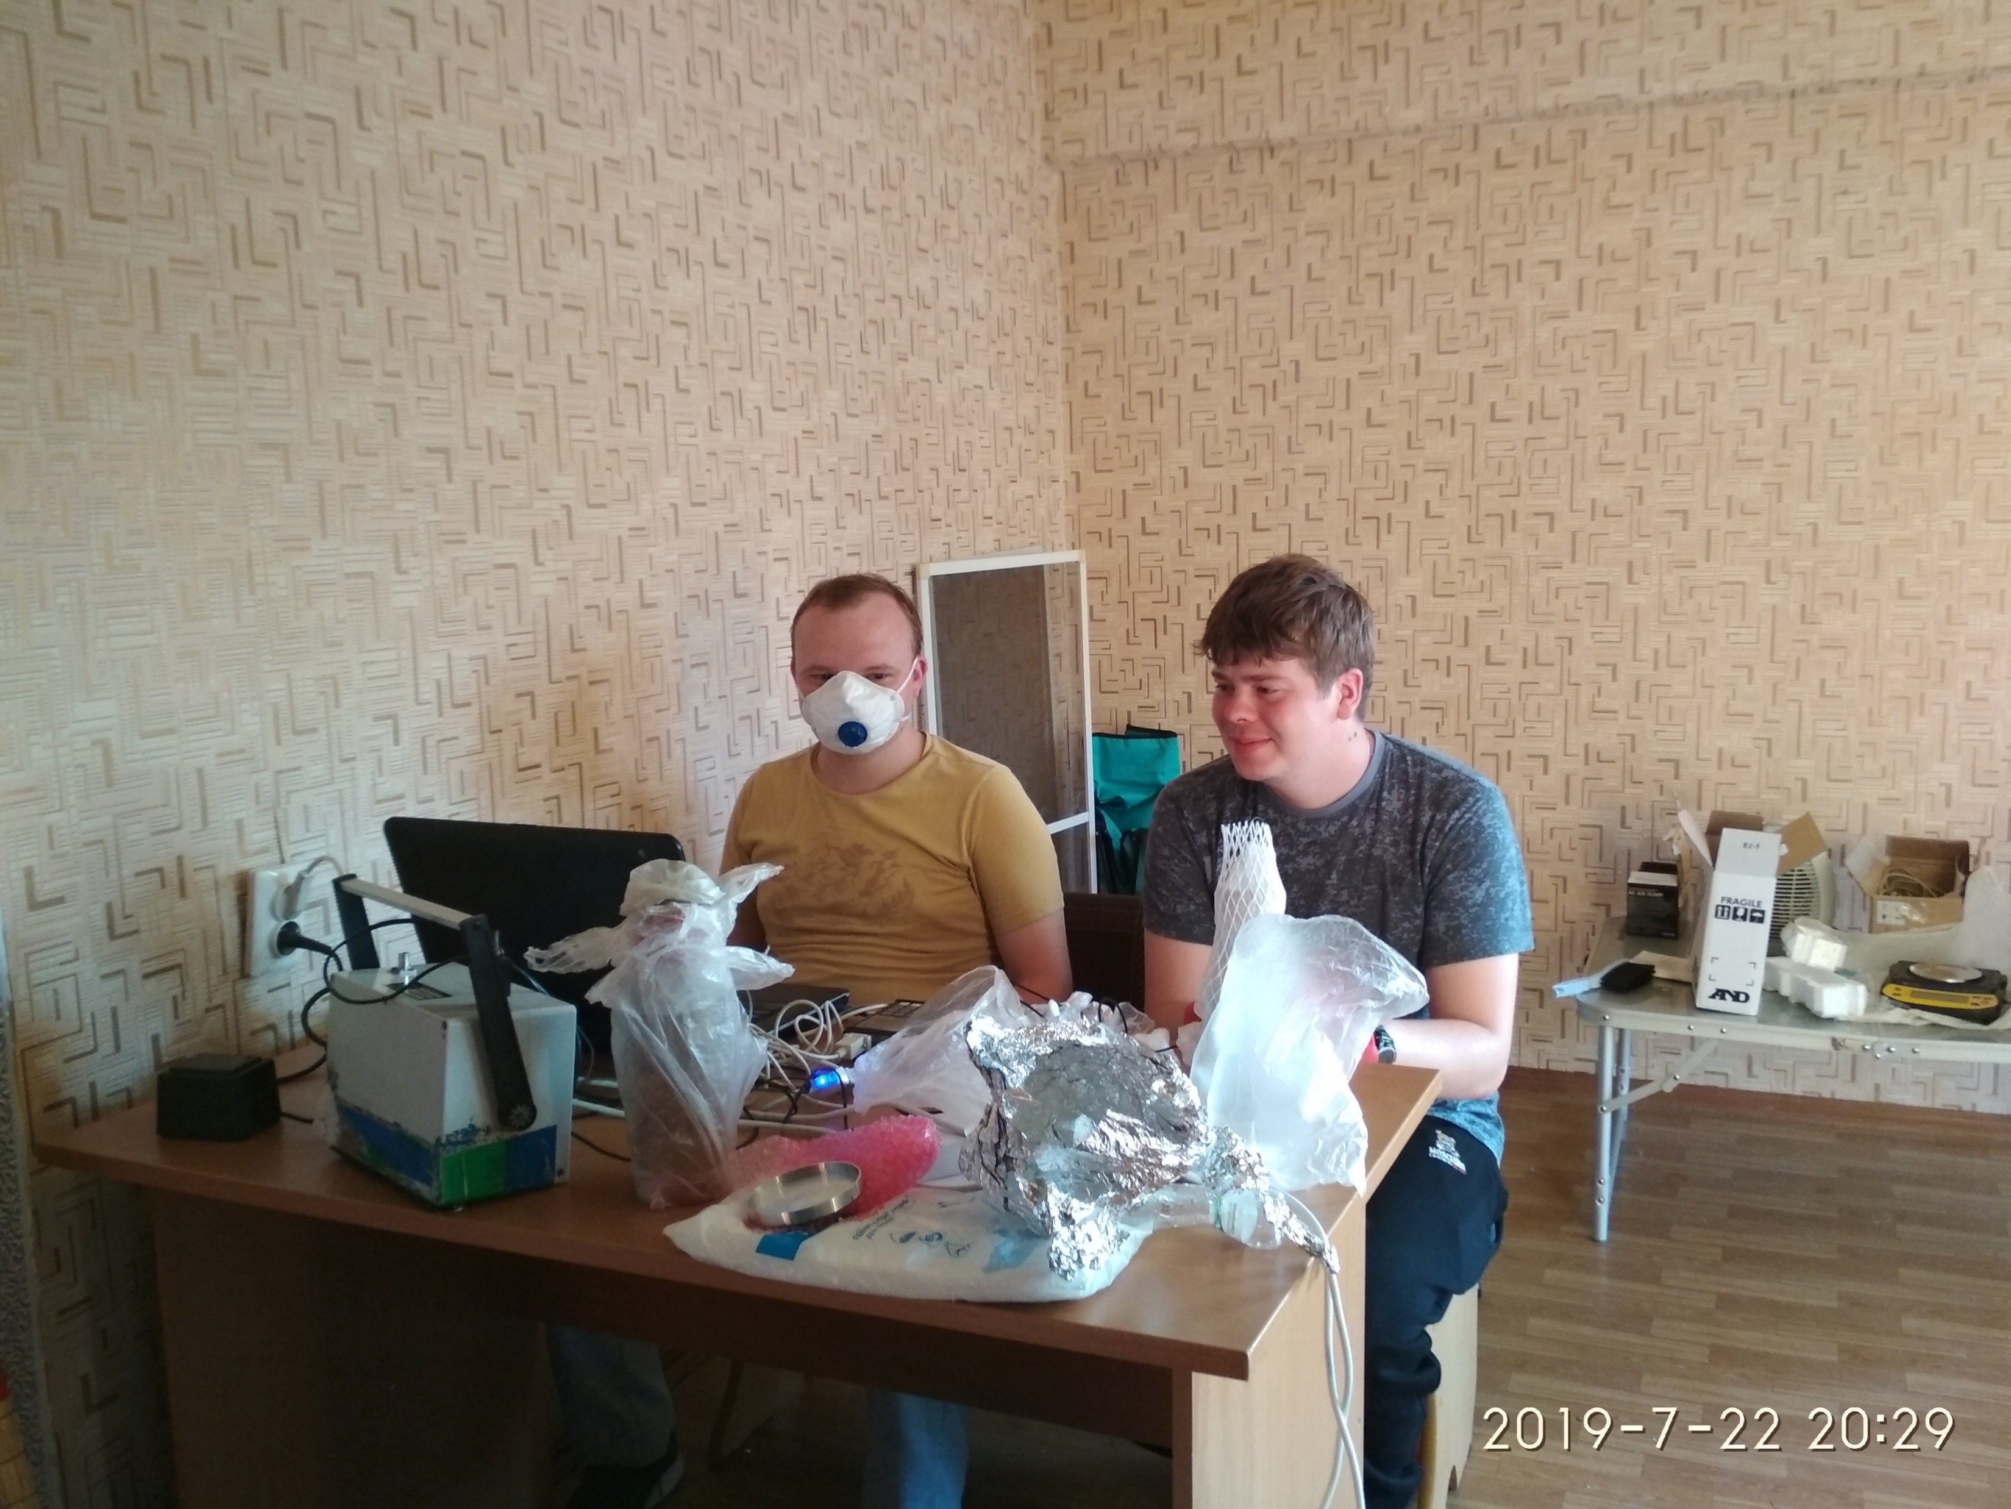
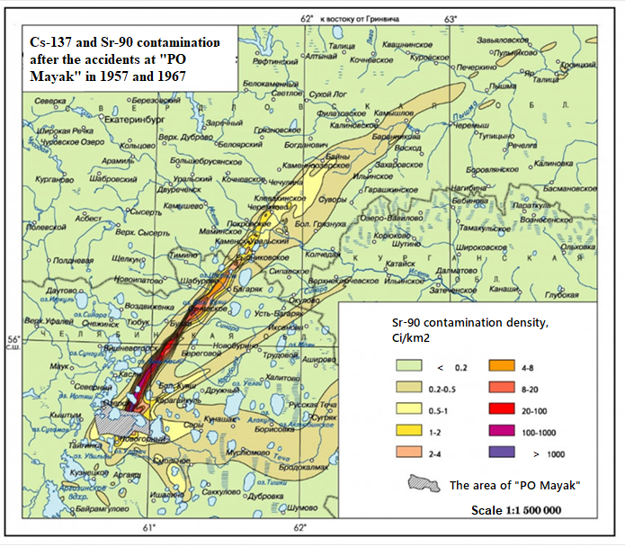
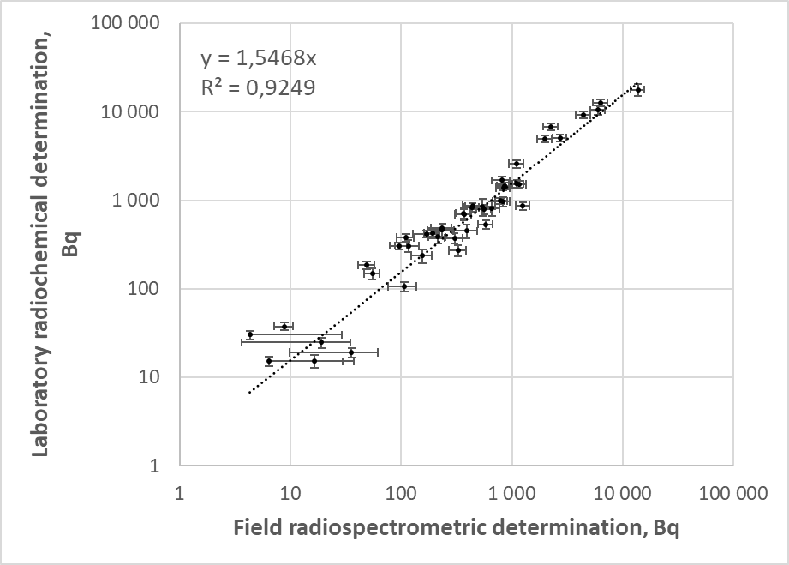
Study site and methods
Field investigation of the undisturbed and ploughed plots representing elementary landscape-geochemical systems included:
theodolite survey along cross-sections and in a grid manner with a step of 1 and 5 m to determine relative elevation of the points to be measured;
field measurements of activity at every point using modified Violinist-III field gamma- spectrometer (¹³⁷Cs, Fig. ) and the Kolibri spectrometric complex (⁹⁰Sr, in field and field laboratory conditions, Fig. );
soil core sampling at the selected points;
vegetation and a widespread plant species sampling.
Laboratory determination of ¹³⁷Сs was made by Canberra gamma-spectrometer (HPGe detector).
Sr-90 was also determined in laboratory in the selected samples using radiochemical technique to verify the field measurements. Correlation coefficient between the obtained instrumental and radiochemical values for ⁹⁰Sr activity equaled to r = 0.925 (n = 50).

Slide 3
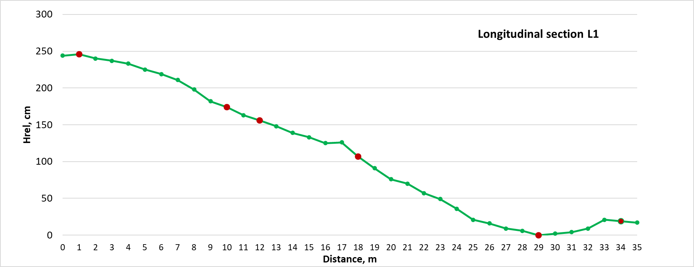
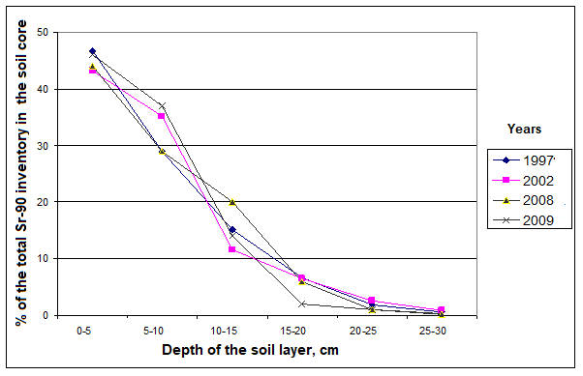
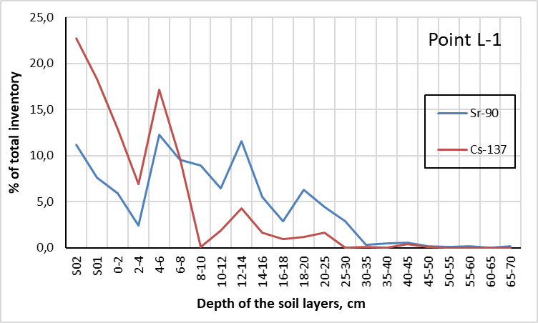
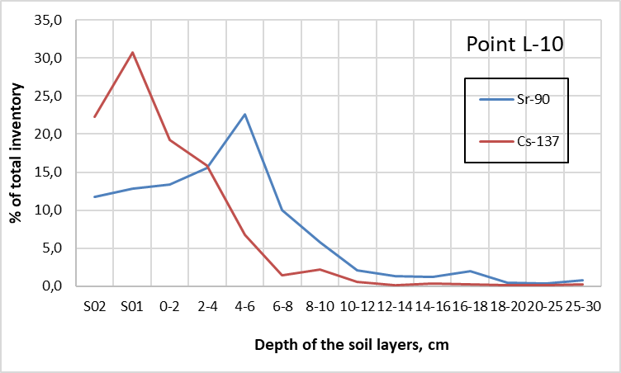
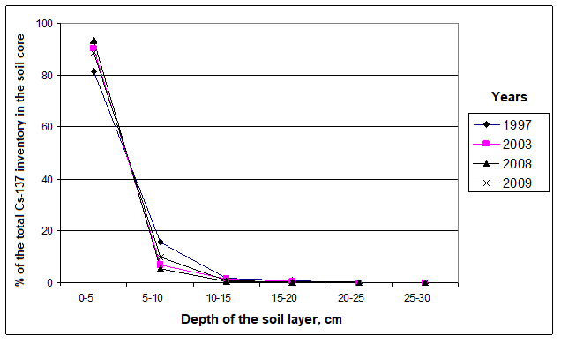
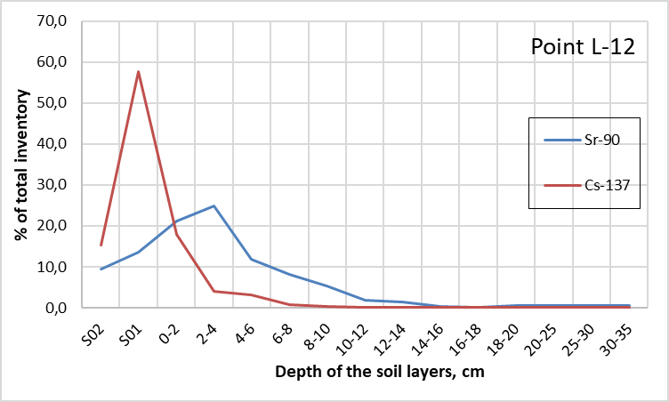
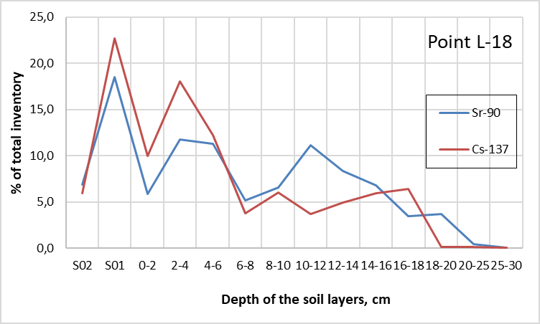
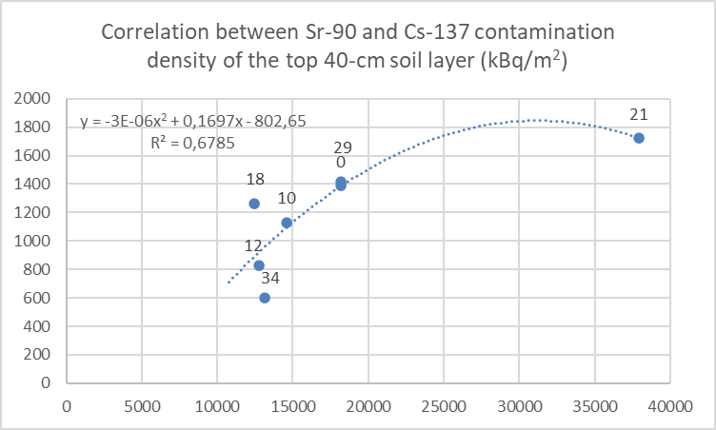
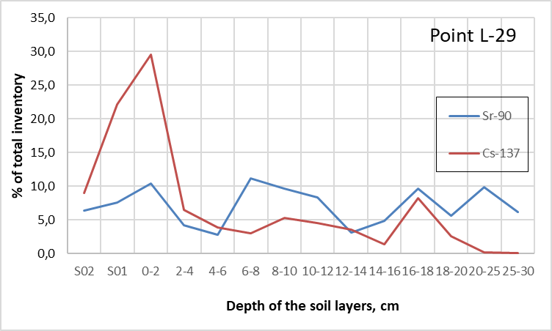
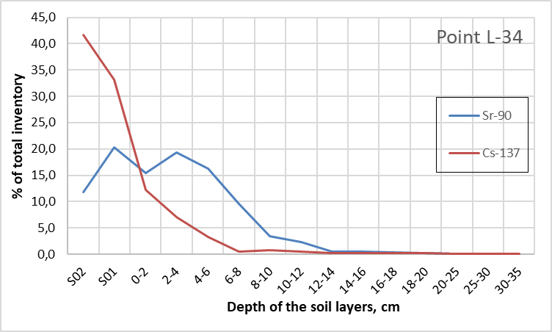
Cs-137 and Sr-90 depth distribution in natural conditions
The studies of depth distribution performed in 2019 confirmed a deeper Sr-90 migration from the top layers and showed considerable difference in vertical Sr-90 and Cs-137 distribution in the top 20-cm layer of undisturbed soil profiles located in different elevation positions of ELGS
A study of vertical distribution in the undisturbed soil profile within the period of 12 years 30 years after the accident showed no significant depth migration of both radioisotopes below 15-20 cm (Sr-90>Cs-137) (Tarasov et al., 2009)

Slide 4
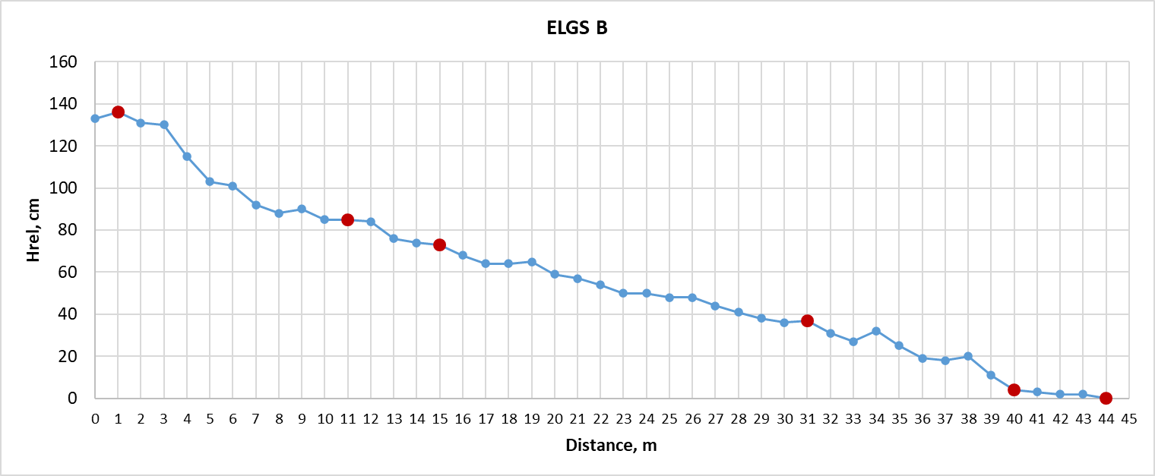
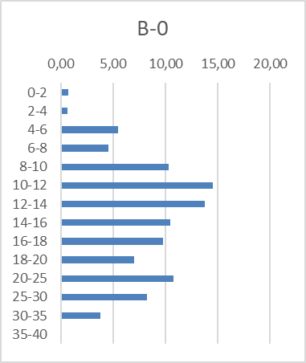
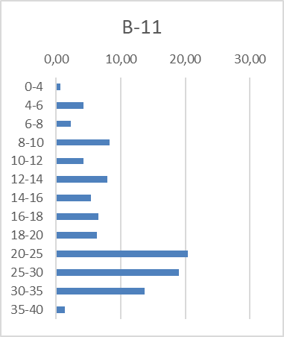
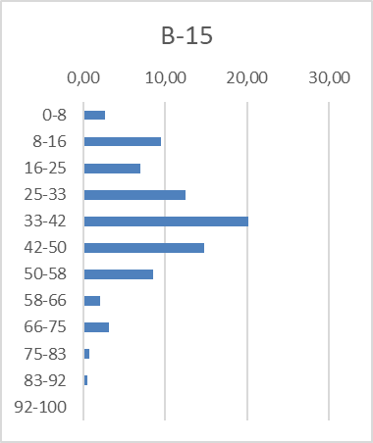
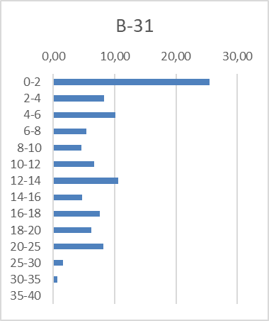
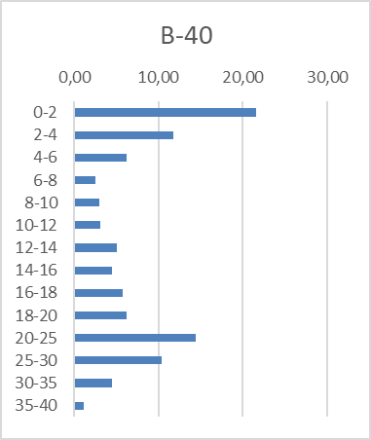
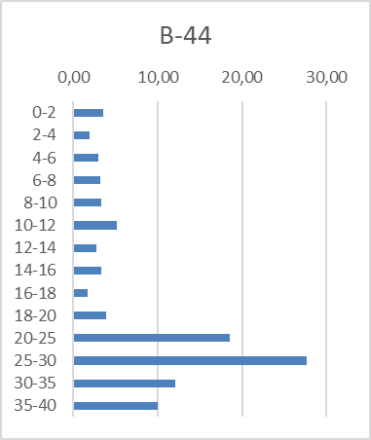
Sr-90 depth distribution after rehabilitation
(ploughed after the accident in 1957)
Vertical distribution of ⁹⁰Sr in soil cores (% of the total inventory) taken in 2019 along ELGS which was ploughed after the accident in 1957
The studies performed in 2019 in the plot which was subjected to ploughing confirmed a deeper Sr-90 penetration and also showed considerable difference in vertical Sr-90 distribution in the top 40-cm layer in different elevation positions of ELGS 60 years after the accident

Slide 5
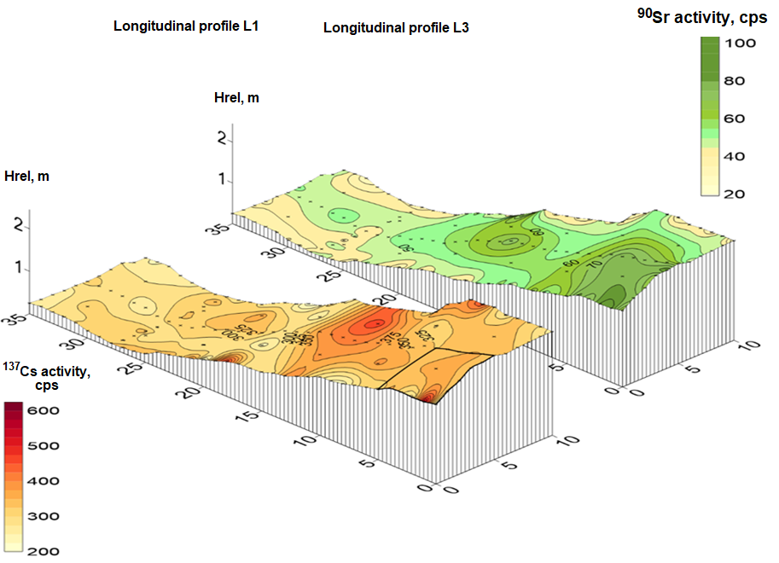
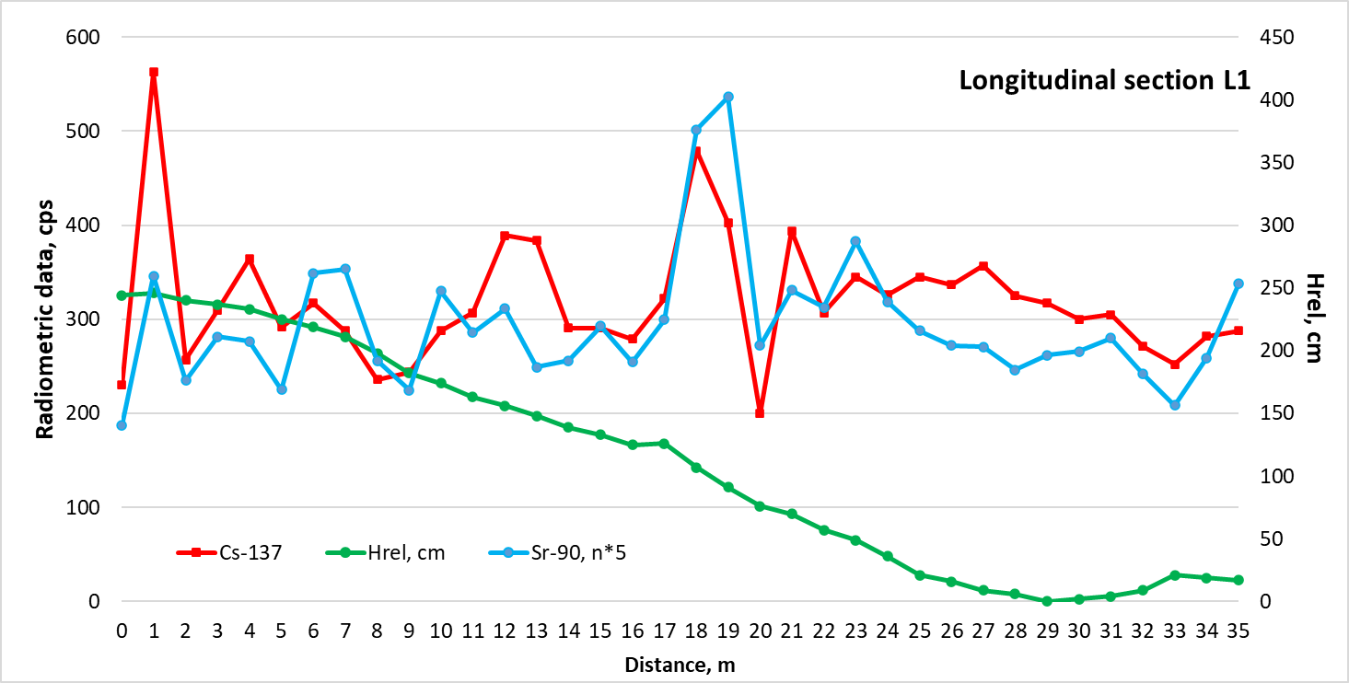
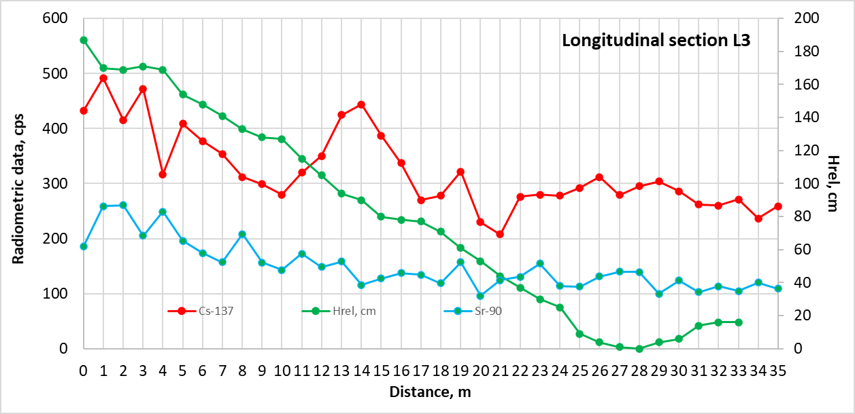
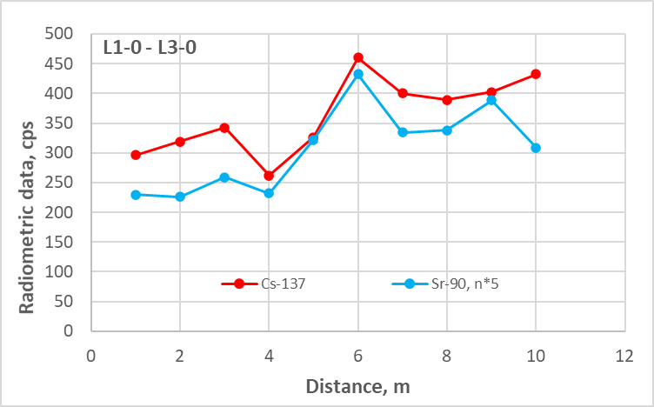
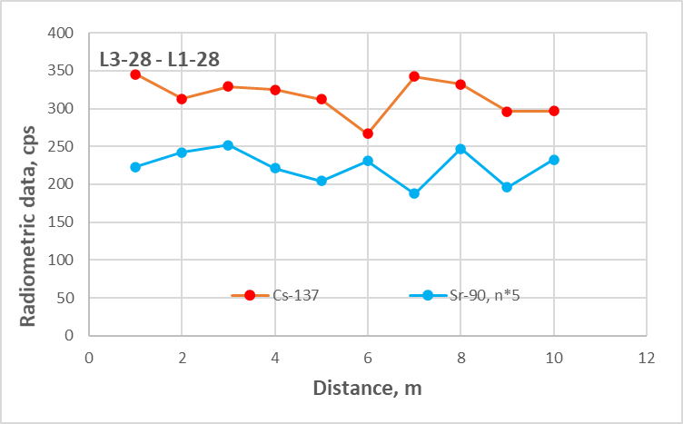
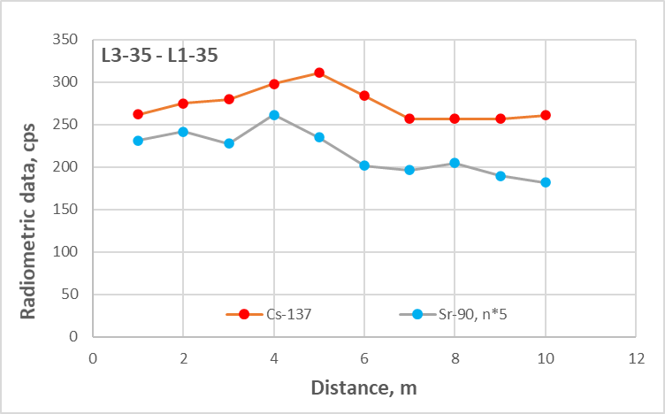
Cs-137 and Sr-90 distribution in soil cover of natural (undisturbed) ELGS
Spatial distribution of both 137Cs and 90Sr manifested itself in a specifically organized polycentric structure.
Downhill variation of ¹³⁷Cs- and ⁹⁰ Sr activity along elevation profiles L1 and L3
(1 m step)
Across slope variation of ¹³⁷Cs- and ⁹⁰ Sr activity at
different distance from the top of ELGS (1 m step)
Against the absence of a pronounced tendency for unidirectional redistribution of radionuclides from the top to the bottom, there was an ordered cyclic change in the activity of both ¹³⁷Cs and ⁹⁰Sr, which in our opinion reflected the unified mechanism of redistribution of substances in ELGS, where the relief is the main controller of water migration.

Slide 6
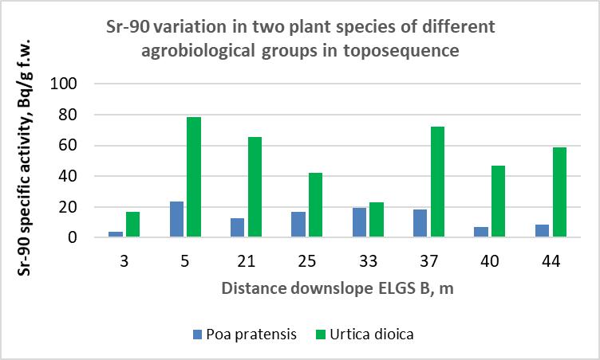
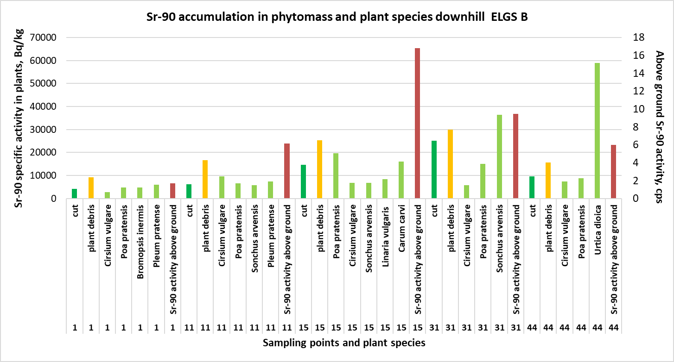
Sr-90 distribution in ELGS vegetation cover
Distribution of ⁹⁰Sr in meadow plants was related to its variation in soil in toposequence at the ELGS level and was species-dependent.
In the ploughed plot B1 the maximum amount of ⁹⁰Sr was found in nettle (Urtica dioica, 86 ± 19 kBq/kg dw, n = 9), the minimum - in bluegrass (Poa pratensis, P. sp., 13.8 ± 1.2 kBq/kg dw, n = 19).
Conclusion. The revealed features of spatial structure of ¹³⁷Cs and ⁹⁰Sr are believed to mark the general tendencies of substances redistribution in ELGS, which seems important for studying soil formation, environmental monitoring and optimization of soil fertilizing.

Slide 7
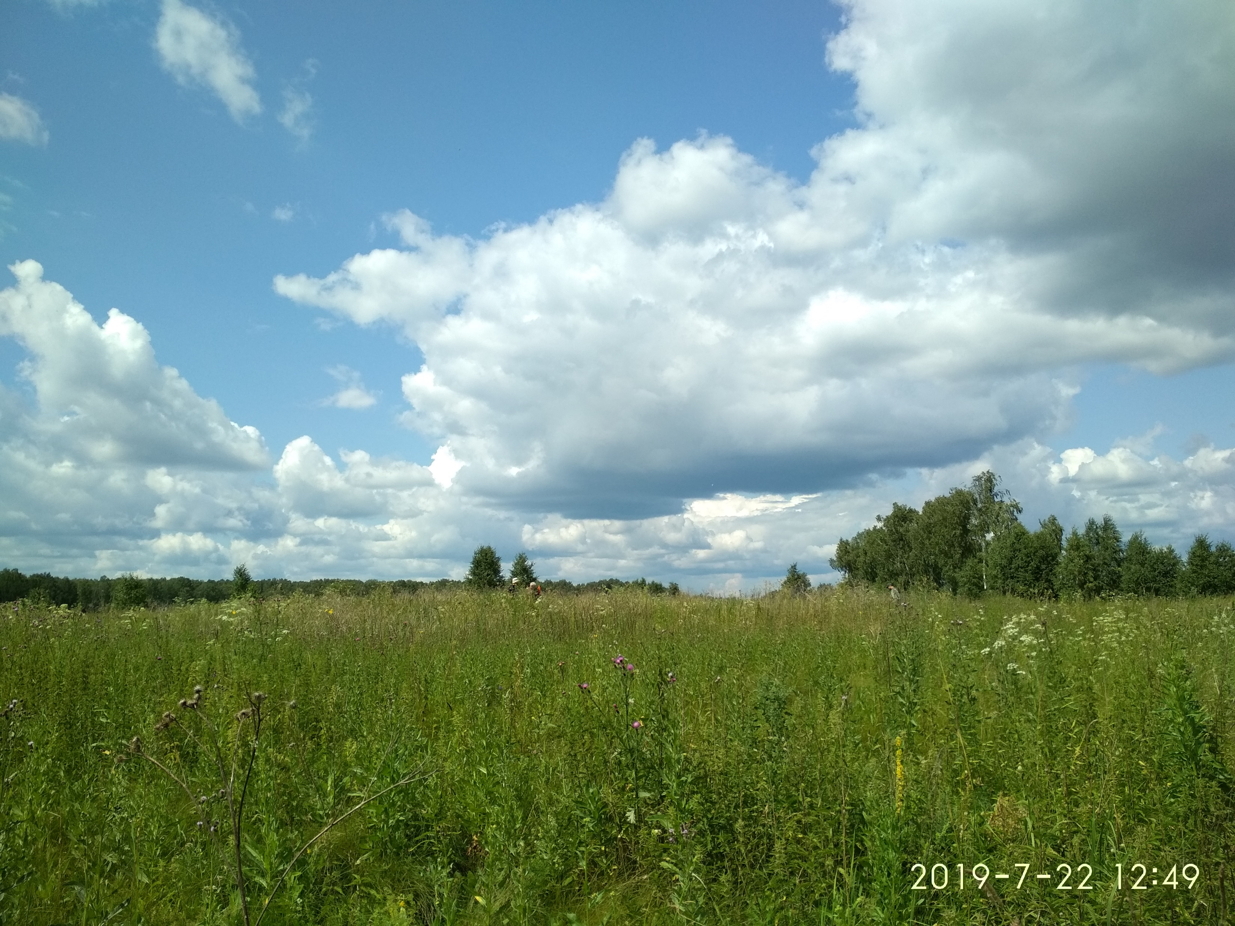
We will be grateful for your comments and, please, note that most of the presented materials have not yet been published.

