Slide 1
Characterization of Interannual and Seasonal Variability of Hydro- Climatic Trends in the Upper Indus Basin
Muhammad Usman Liaqat
PhD Scholar
PhD Advisor: Prof. Roberto RANZI
Co-advisor: Prof. Giovanna GROSSI
Phd Program: Civil and Environmental Engineering, International Cooperation and Mathematics
University of Brescia, Italy

Slide 2
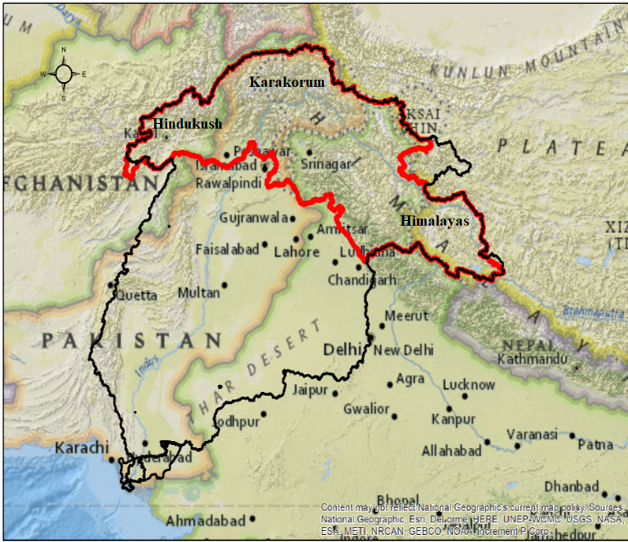
Upper Indus Basin
The UIB@Besham Qila area = 173 213 km²
Glacierized Area∼22 000 km²
In Pakistan (53% of total), India 33%,
China 8%, Afghanistan 6%.
Snow and glaciers in Himalaya at lower latitudes, Karakoram Range in northern side and Hindu Kush Range in western side of basin feed runoff of UIB.
Because of the glaciers’ dynamics it is worth to investigate the existence of any trend of streamflow at sub-basin scale

Slide 3
Study Area

Slide 4
Research Objectives
To investigate the Interannual and Seasonal Variability of Hydro-Climatic Trends in the Upper Indus Basin.
Assessment of differences and performances of four gridded datasets for their applicability in hydrological modelling in the Upper Indus Basin.
Develop high resolution precipitation climatology of Upper Indus Basin at seasonal and annual scale.
Examine the precipitation and discharge annual and seasonal variability using running trend analysis (EDA-Exploratory Data Analysis) tools
In perspective: identify possible reasons of changes as temperature increase, glacier’s retreat, snowmelt runoff, …

Slide 5
Type of Gridded Datasets
Dataset | Resolution/frequency | Data Sources | Algorithm/Assimilation schemes | References
APHRODITE (Observed Values) | 0.25°/daily/3,6 h and daily | Data Integration and Analysis System (DIAS) | Interpolation with rain gauge gridded precipitation | (Yatagai et al. 2012)
CHIRPS (Observed+ Satellite) | 0.05°/daily | USGS, CHG | Smart Interpolation Tech | (Funk et al. 2015)
PERSIANN-CDR (Satellite) | 0.25°/daily | TRMM,NOAA,Metsat-6,GOES 8,DMSP F13 | Artificial Neural Networks | (Ashouri et al. 2015)
ERA5 (which substitute GPCC) | 0.1°/Monthly/Daily | ECMWF | 4D-Var | (Saha et al. 2010; Tarek et al. 2019)
Raingauge data set (see details later) | 24 Stations 1981-2017 (1995-2017) | (WAPDA, PMD, CMD,….) |  | This study

Slide 6
Methods 1) Anomaly Method: The Interpolation Scheme: From Rain-gauge Network to Regular Grid
As the ground observations in upper Indus are sparse and do not cover complete temporal and spatial coverage, it is not appropriate to develop basin wide annual and seasonal precipitation.
Four gridded dataset (Aphrodite, Chirps, Persiann-CDR and ERA5) of 1995-2017 monthly precipitation record over the study area was reconstructed by means of “anomaly method”.
As we are developing precipitation climatology on seasonal and annual scale we converted monthly gridded and observed data into seasonal scale i.e. winter (DJF), Pre-monsoon (MAM), Monsoon (JJA), Autumn (SON) and Annual scale.
The ratio between reference raingauge observations and gridded precipitation is the point ‘anomaly’, computed as below (see Crespi et al., Int. J. Clim, 2020):
P_{test m,i} =$\frac{p_{{test}_{m}}}{p_{refrence,i}}$
${where p}_{{test}_{m}}$ and $p_{refrence,i}$ are gridded and observed ‘true’ precipitation series in the
specified grid point
The point ‘anomalies’ are then interpolated into the ‘anomaly’ field
The gridded precipitation field is then corrected by multiplying it with the anomaly field.

Slide 7
Meteorological Data
Basin | Stations | Period to | Period From | Agency | Latitude | Longitude | Elevation (m asl)
 |  |  |  |  | ( ° ) | ( ° )
Gligat | Gilgit | 1981 | 2017 | PMD | 35.92 | 74.33 | 1460
 | Gupis | 1981 | 2017 | PMD | 36.17 | 73.4 | 2156
 | Ushkoor | 1995 | 2017 | WAPDA | 36.05 | 73.39 | 3051
 | Yasin | 1995 | 2017 | WAPDA | 36.4 | 73.5 | 3280
 | Shnedoor | 1995 | 2017 | WAPDA | 36.09 | 72.55 | 3712
Hunza | Khunjerab | 1995 | 2017 | WAPDA | 36.84 | 75.42 | 4440
 | Ziarat | 1995 | 2017 | WAPDA | 36.77 | 74.46 | 3020
 | Naltar | 1995 | 2017 | WAPDA | 36.17 | 74.18 | 2898
Astore | Astore | 1981 | 2017 | PMD | 35.37 | 74.9 | 2168
 | Ramma | 1995 | 2017 | WAPDA | 35.36 | 74.81 | 3179
 | Rattu | 1995 | 2017 | WAPDA | 35.15 | 74.8 | 2718
 | Burzil | 1995 | 2017 | WAPDA | 34.91 | 75.09 | 4100
Shigar | Shigar | 1996 | 2012 | WAPDA | 35.63 | 75.53 | 2367
 | Askole | 2005 | 2017 | EVK2CNR | 35.68 | 76.82 | 3051
 | Urdukas | 2011 | 2017 | EVK2CNR | 35.74 | 76.51 | 3926
 | Concordia | 2011 | 2017 | EVK2CNR | 35.73 | 76.29 | 4690
Shyok | Hushey | 1995 | 2017 | WAPDA | 35.42 | 76.37 | 3075
 | Skardu | 1981 | 2017 | PMD | 35.3 | 75.68 | 2210
Shingo | Deosai | 1995 | 2017 | WAPDA | 35.09 | 75.54 | 4149
 | Qinghe | 1995 | 2017 | CMDC | 32.5 | 80.08 | 4279
 | Bunji | 1981 | 2017 | PMD | 35.67 | 74.63 | 1372
Indus Down Stream | Chillas | 1981 | 2017 | PMD | 35.42 | 74.1 | 1251
 | Kakul | 1981 | 2017 | PMD | 34.1 | 73.2 | 1308
 | Pir Chanasi | 1995 | 2017 | WAPDA | 34.387 | 73.5477 | 2872
 | Saif Muluk | 1995 | 2017 | WAPDA | 34.9 | 73.65 | 2362
 | Saidu Sharif | 1981 | 2017 | WAPDA | 34.7 | 72.4 | 949

Slide 8
Results: Climatologies, anomalies and precipitation records based on CHIRPS grids

Slide 9
Results: Evaluation Criteria for 5 raingauge stations
Datasets | Seasons | MAE (mm) | MAPE [%] | BIAS (mm) | RMSE (mm)
CHIRPS | Uncorrected Annual | 69.66 | 20.48 | -2.5 | 93.37
 | Annual | 50.15 | 14.88 | 21.1 | 56.90
 | DJF | 19.74 | 27.09 | 13.9 | 23.01
 | MAM | 27.12 | 26.36 | 15.3 | 28.40
 | JJA | 23.09 | 25.71 | 10.7 | 34.41
 | SON | 17.30 | 36.29 | -10.22 | 20.92
ERA5 | Uncorrected Annual | 716.65 | 64.82 | 716.65 | 763.82
 | Annual | 53.67 | 15.43 | 27.73 | 61.57
 | DJF | 36.65 | 35.38 | 32.58 | 41.42
 | MAM | 20.50 | 15.74 | 14.49 | 23.27
 | JJA | 25.62 | 33.20 | -14.30 | 40.27
 | SON | 17.38 | 33.07 | -5.03 | 22.11
Aphrodite | Uncorrected Annual | 111.3574 | 30.69 | 36.07 | 118.41
 | Annual | 68.44 | 19.05 | 28.19 | 75.29
 | DJF | 30.1 | 31.31 | 26.89 | 34.94
 | MAM | 36.44 | 30.84 | 12.52 | 40.05
 | JJA | 36.1 | 39.88 | -4.97 | 42.11
 | SON | 15.87 | 26.17 | -6.24 | 18.33
PERSIANN-CDR | Uncorrected Annual | 198.48 | 36.19 | 171.61 | 251.85
 | Annual | 155.61 | 28.93 | 155.69 | 195.45
 | DJF | 70.43 | 45.82 | 70.45 | 81.20
 | MAM | 48.45 | 29.36 | 31.77 | 56.34
 | JJA | 39.38 | 33.71 | 28.12 | 37.71
 | SON | 29.58 | 33.84 | 22.31 | 37.29
Observed Rain gauge | Mean (mm)
 | Annual | 368.86
 | DJF | 86.64
 | MAM | 131.58
 | JJA | 96.87
 | SON | 53.85

Slide 10
Methods: Exploratory Data Analysis of Streamflow Upper Indus Basin
A running trend approach based on Brunetti et al. (2012) is used to calculate trends for discharge over different time window scale (y axis) and time (x axis) and assess their statistical significance.
As climate is defined by WMO as average of meteorological variables over 30 years we imposed minimum duration of 20 years to assess trends of for discharge.
Trends are estimated using robust nonparametric regression techniques, Mann–Kendall (MK) Test in conjunction with Theil–Sen (Sen 1968; Theil 1950) Slope method to determine its slope.
The nonparametric Pettitt Test (Change Point Analysis) is mostly used to observe change point in hydro-climatic time series (see e.g. Palaniswami and Muthiah 2018; Zhang et al. 2015)

Slide 11
Precipitation EDA

Slide 12
Precipitation EDA

Slide 13
Precipitation EDA

Slide 14
Dataset (Streamflow stations)
Serial. No | Gauge River | Discharge Gauging Point | Period From | Period to | Latitude (⁰) | Longtitude (⁰) | Elevation (m asl)
1 | Indus | Kharmong | 1983 | 2017 | 34.93 | 76.21 | 2542
2 | Shyok | Yogo | 1973 | 2017 | 35.18 | 76.1 | 2469
3 | Shigar | Shigar* | 1985 | 1997 | 35.33 | 75.75 | 2438
4 | Indus | Kachura | 1973 | 2017 | 35.45 | 75.41 | 2341
5 | Hunza | Dainyor | 1973 | 2017 | 35.92 | 74.37 | 1370
6 | Gilgit | Gilgit | 1973 | 2017 | 35.92 | 74.3 | 1430
7 | Gilgit | AlamBridge | 1973 | 2017 | 35.76 | 74.59 | 1280
8 | Indus | Bunji | 1973 | 2013 | 35.73 | 74.62 | 1792
9 | Astore | Doyian | 1974 | 2011 | 35.54 | 74.7 | 1583
10 | UIB | BeshamQila | 1973 | 2017 | 34.92 | 72.88 | 580

Slide 15
Variability and trends of Runoff in the Upper Indus Basin. Running spectral trends, Mann-Kendall and Pettitt-test analysis

Slide 16
Conclusions (1)
The results indicated that bias corrected CHIRPS precipitation datasets performed better in simulating raingauge-observed precipitation with RMSE, MAE, MAPE [%] and BIAS followed by APHRODITE.
The annual and seasonal precipitation climatology exhibited higher precipitation in the lower side of the basin.
The annual running trend analysis of precipitation exhibited a very slight change whereas a more significant increase was found in the winter season (DJF) and most of sub-basins feature a significant decreasing precipitation and constant change point within the monsoon period (JJA).
Overall, the analysis shows that streamflow variabilities are more pronounced seasonally than at the annual scale. This can be an effect of warming, an issue now under investigation.

Slide 17
Conclusions (2)
Seasonal flow analysis reveals more complex regime:
Winter (DJF) and Pre-Monsoon (MAM) exhibits rising trends in stream flow (possibly because of snowmelt and glacier’s retreat), while Monsoon (JJA) showed declining trend in flow.

