Slide 1
Impact of deposition borehole geometry on mechanical spalling in nuclear waste repositories
Cristina Saceanu¹, Adriana Paluszny¹, Robert Zimmerman¹ & Diego Mas Ivars²
¹ Department of Earth Science and Engineering, Imperial College, London, UK
² Swedish Nuclear Fuel and Waste Management Company (SKB), Solna, Sweden; Division of Soil and Rock Mechanics, Royal Institute of Technology (KTH), Stockholm
EGU General Assembly 2020
4th May 2020

Slide 2
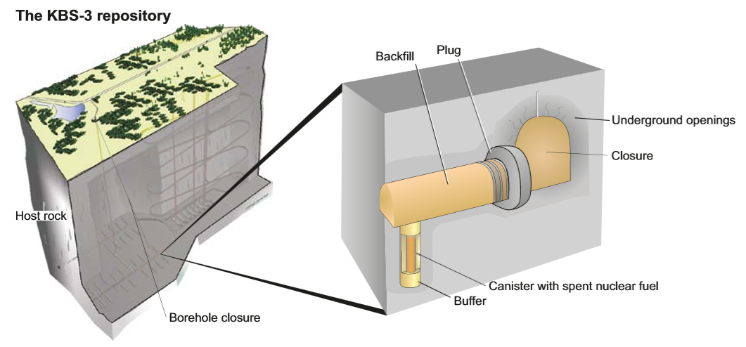
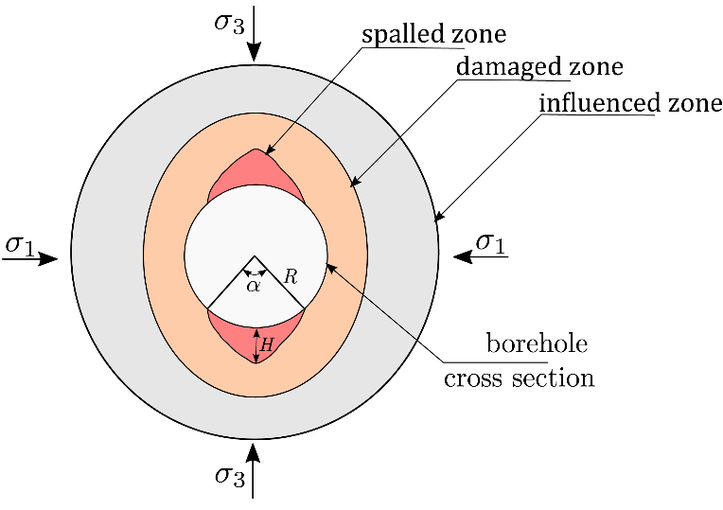
Spalling & Nuclear Waste Disposal
1
Spalling is a common type of rock failure that occurs at the boundaries of deep excavations, and it is usually defined as tensile failure that occurs when the tangential stress at the borehole boundary exceeds the tensile strength of the rock (Martin, 2005).
Spalling is expected to occur around the deposition boreholes in deep mined nuclear waste repositories (Martin, 2005).
Modified from Read (2004)
Schematic representation of a deep nuclear waste repository (SKB-TR-10-12 (2010))

Slide 3
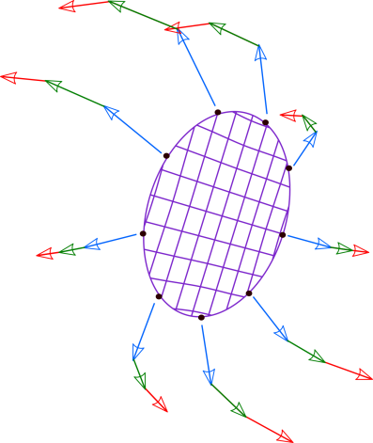
Modelling Approach
2
The simulations are conducted using a finite element-based fracture growth simulator that computes deformation in the system based on the mechanical properties of the rock (Paluszny and Matthäi, 2009).
A damage mechanics approach is used to describe the fracture initiation process (Mazars et al., 2015).
Fracture growth is determined by stress intensity factors (SIFs), that are calculated at the fracture tips. These control the stress magnitude at the tips and determine whether or not the crack will extend at the specified tip (Thomas et al., 2020).
Failure, length, and angle criteria are evaluated to determine which fracture tips will extend, by how much, and in what direction (Thomas et al., 2020).
Initial fracture surface
Propagation vectors at
different growth steps

Slide 4
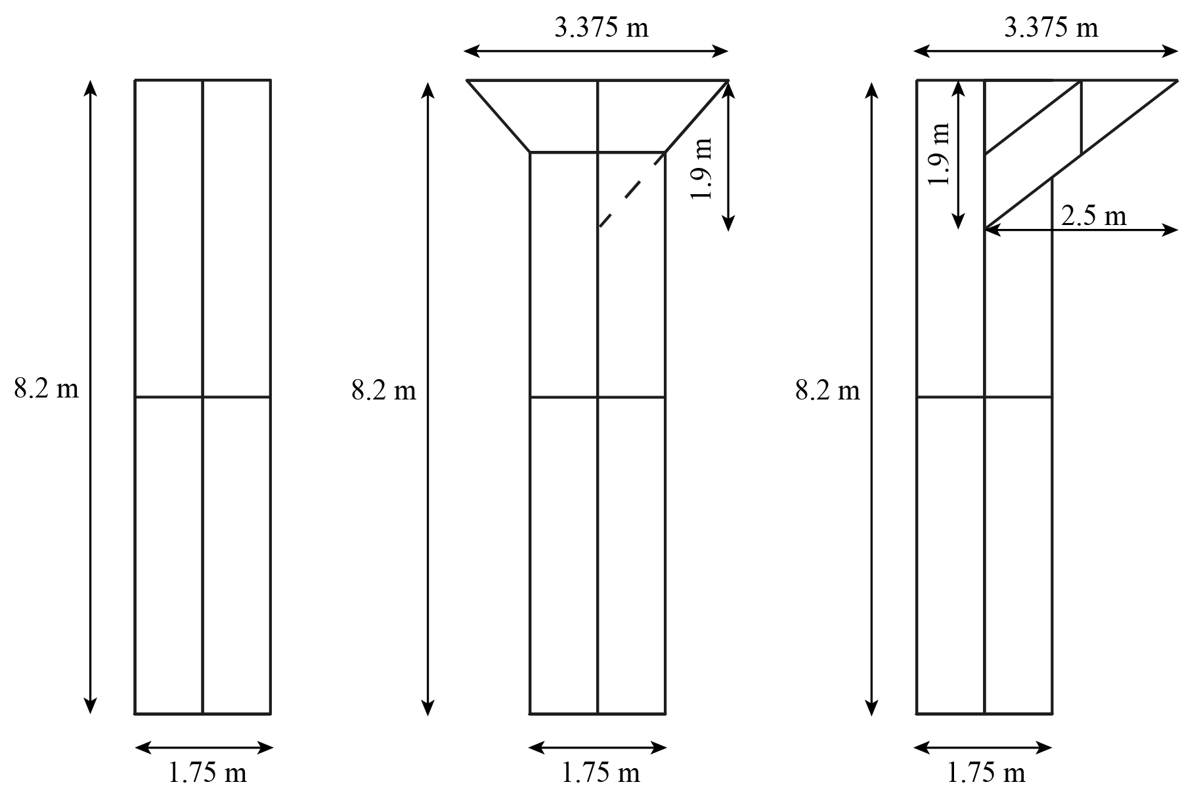
Experimental Setup
3
Model Properties (SKB TR-08-05 (2007))
Borehole configurations
Rock properties | Value used
Density | 2.73 g/cm3
Young’s Modulus | 76 GPa
Poisson’s Ratio | 0.23
Uniaxial Compressive Strength | 226 MPa
Tensile Strength | 13 MPa
K_{IC} | 3.8 MPa/m^{1/2}
Borehole properties
Young’s Modulus | 10 Pa
Poisson’s Ratio | 0
K_{IC} | 10¹⁰ MPa/m^{1/2}
Circular
borehole
Cone shaped
borehole
Wedge shaped
borehole
Boundary Conditions

Slide 5
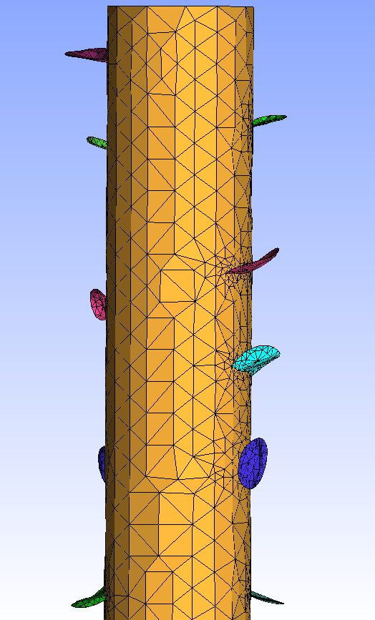
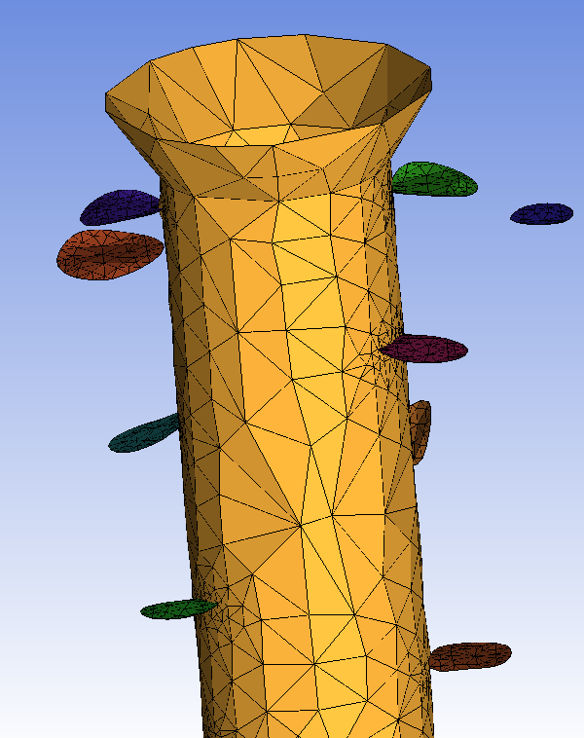
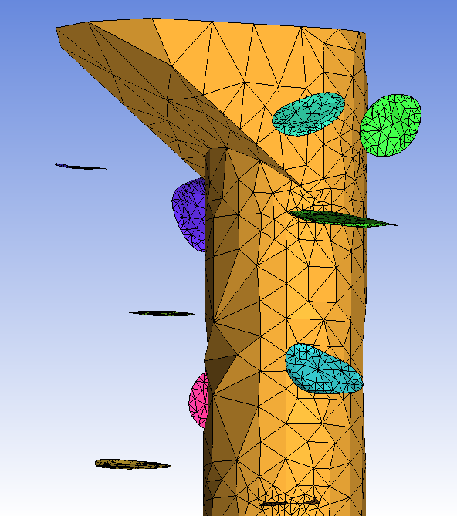
Results
4
Circular
borehole
Cone-shaped
borehole
Wedge-shaped
borehole
Borehole configuration | Maximum Spalling Depth (m) | Spalling Width (°) | Total Fracture Surface Area (m²)
circular | 0.44 | 63 / 52 | 2.0
cone | 0.47 | 60 / 62 | 2.23
wedge | 0.49 | 90 / 47 | 2.46
Perspective view
Top view

Slide 6
References
1. Martin, D. (2005). Preliminary assessment of potential underground stability (wedge and spalling) at Forsmark, Simpevarp and Laxemar sites. Technical report R-05-71, Svensk Karnbranslehantering AB.
2. SKB TR-10-12 (2010). Design and production of the KBS-3 repository. Technical report TR-10-12, Svensk Karnbranslehantering AB.
3. Read, R. (2004). Twenty years of excavation response studies at AECL’s Underground Research Laboratory. International Journal of Rock Mechanics and Mining Sciences, 41(8), 1251-1275.
4. Paluszny, A. and Matthäi, S. (2009). Numerical modeling of discrete multi-crack growth applied to pattern formation in geological brittle media. International Journal of Solids and Structures, 46(18-19), 3383-3397.
5. Mazars, J., Hamon, F. and Grange, S. (2015). A new 3D damage model for concrete under monotonic, cyclic and dynamic loadings. Materials and Structures, 48(11), 3779-3793.
6. Thomas, R.N., Paluszny, A., and Zimmerman, R.W. (2020). Growth of three-dimensional fractures, arrays, and networks in brittle rocks under tension and compression. Computers and Geotechnics, 121, 103447.
7. SKB TR-08-05 (2007). Site description of Forsmark at completion of the site investigation phase. SDM-Site Forsmark. Technical report TR-08-05, Svensk Karnbranslehantering AB.

