Slide 1


Sensitivity of global gross primary production to environmental drivers
To what extent are climate change affecting plant growth?
Wenjia Cai, Iain Colin Prentice

Slide 2
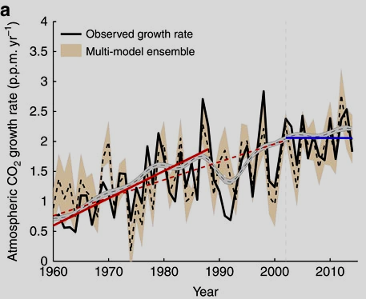
Gross primary production (GPP) is one of the largest carbon flux in carbon cycle
Increased photosynthesis rate induced by surging CO2 levels has absorbed over 1/3 of anthropogenic CO2 emission. This increased GPP has partially offset the effect of global warming
Uncertainty in GPP estimates and effects of environmental drivers persist, hindering future GPP projection and strategies under climate change
Why gross primary production (GPP)?
Keenan et al., 2016

Slide 3
Why P model?
Current data-driven models hinge on availability of sufficient data, and often perform poorly in very different conditions
Process-based models use numerous parameters distinguishing between different PFTs, thus difficult to implement
P model provide a generic and mechanistic approach that unifies Farquhar biochemical model with LUE model, which performed well against other GPP products

Slide 4
Contribution of drivers to total GPP change at site scale

Slide 5
Contribution of CO2 and climate to GPP trend globally
For 100ppm increase in CO2, increase in GPP for P model:
DGVMs:
17.8 ± 0.8
21.7 ± 0.7

Slide 6
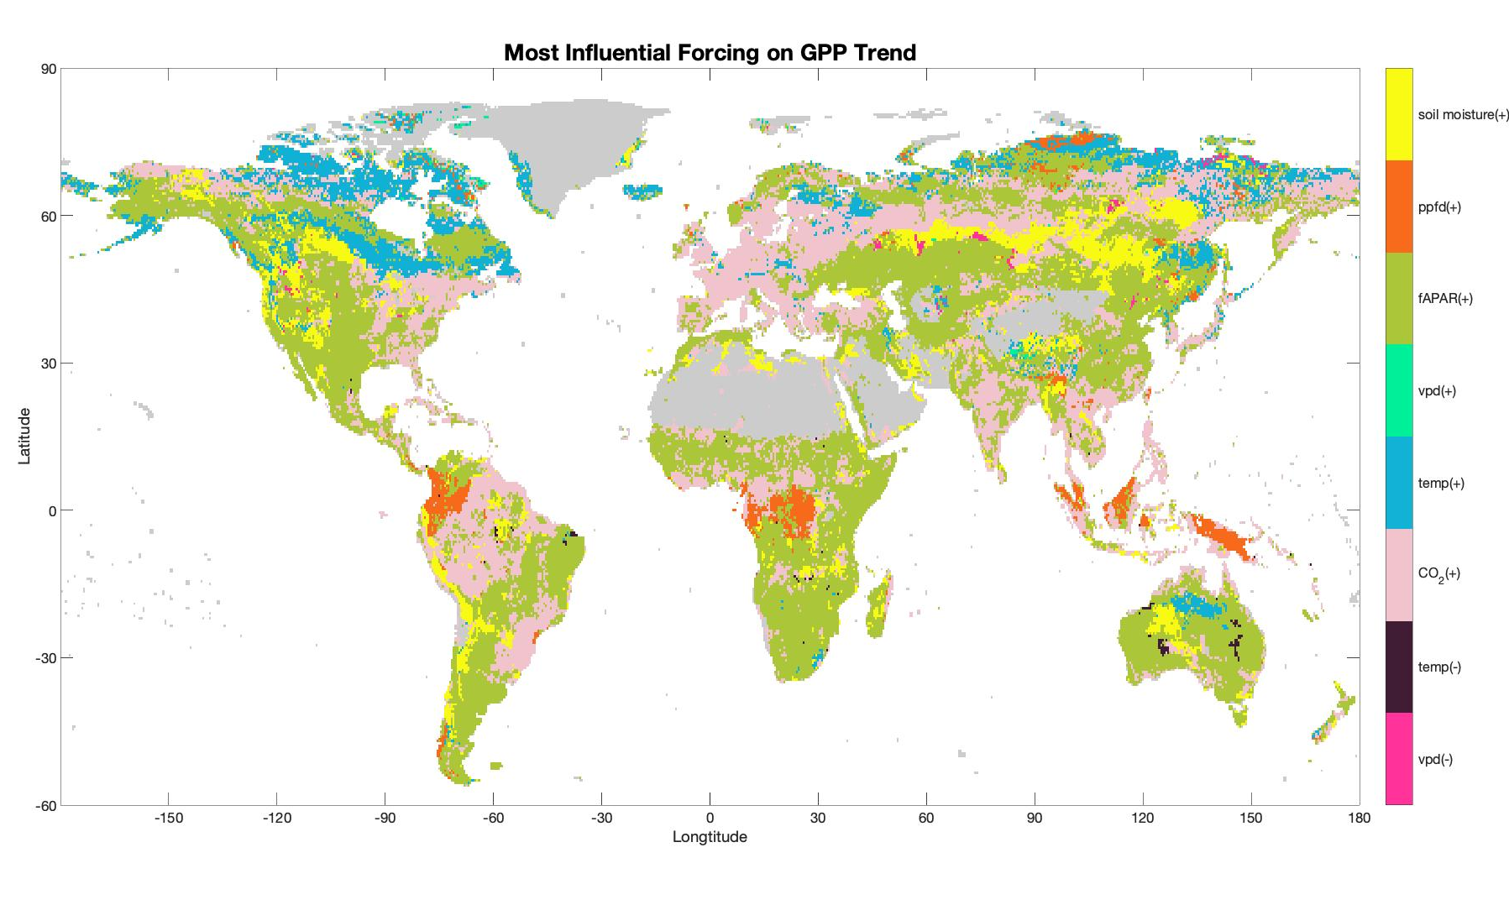
Spatial distribution of most influential driver
Contribution of different drivers

