Slide 1
Variations of oceanic and atmospheric heat fluxes in the North Atlantic and their link to the North Atlantic Oscillation Index
Iakovleva Diana¹, Bashmachnikov Igor^{1,2}
¹Saint Petersburg State University, Saint Petersburg, Russian Federation
²Nansen International Environmental and Remote Sensing Centre,
Saint Petersburg, Russian Federation

Slide 2
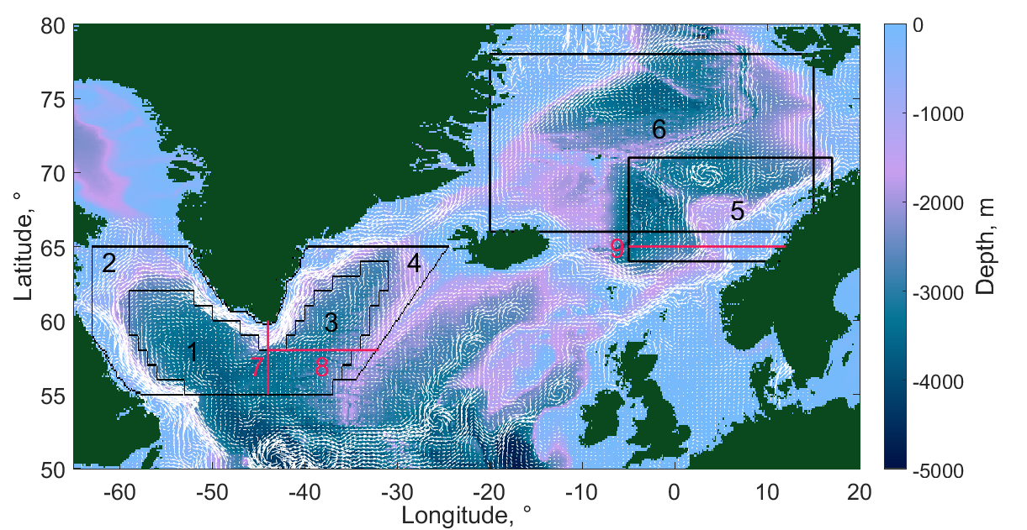
The study region
Map of regions and sections:
the central part of the Labrador Sea
the peripheral part of the Labrador Sea
the central part of the Irminger Sea
the peripheral part of the Irminger Sea
the Norwegian Sea
the Nordic Seas
section 44° W (55-60° N)
section 58.5° N (44-32° W)
section 65.5° N (5° W - 12° E)

Slide 3
Datasets
Methods
Dataset | Spatial resolution | Temporal resolution
ARMOR-3D | 0.25×0.25° | month
ORAS5 | 1×1° | month
SODA3.4.2 | 0.5×0.5° | month
SODA3.12.2 | 0.5×0.5° | month
OAFlux | 1×1° | month
NAOI | - | month
Integral oceanic heat fluxes of the upper 500-m layer are calculated as:
$$Q=ρCp\left(T−Tref\right)U(V)dy(dx)dz$$
where ρ is the water density (1027 kg m⁻³); Cp is the specific heat capacity of seawater (3900 J kg⁻¹ °C⁻¹); T is the water temperature (°C); dz is the layer thickness (m); U(V) is the zonal (meridional) current velocity on meridian (parallel) (m s⁻¹); dy(dx) is the distance between point on meridian (parallel) (m); Tref is the reference temperature (-1.8°C).
Oceanic heat fluxes: ARMOR-3D, ORAS5, SODA3.4.2 and SODA3.12.2
Latent and sensible heat fluxes: OAFlux (http://oaflux.whoi.edu/).
The North Atlantic Oscillation Index (NAOI): NOAA climate indices (http://www.cpc.ncep.noaa.gov/).
Notes:
The North Atlantic Oscillation is a leading pattern of weather and climate variability over the Northern Hemisphere (Hurrell and Deser, 2010). It is characterized by NAOI and it calculated as the difference of pressure between the Azores high and the Icelandic low.
ARMOR-3D - http://marine.copernicus.eu/
ORAS5 - https://www.ecmwf.int/en/research/climate-reanalysis/ocean-reanalysis
SODA3.4.2, SODA3.12.2 - http://www.soda.umd.edu/

Slide 4
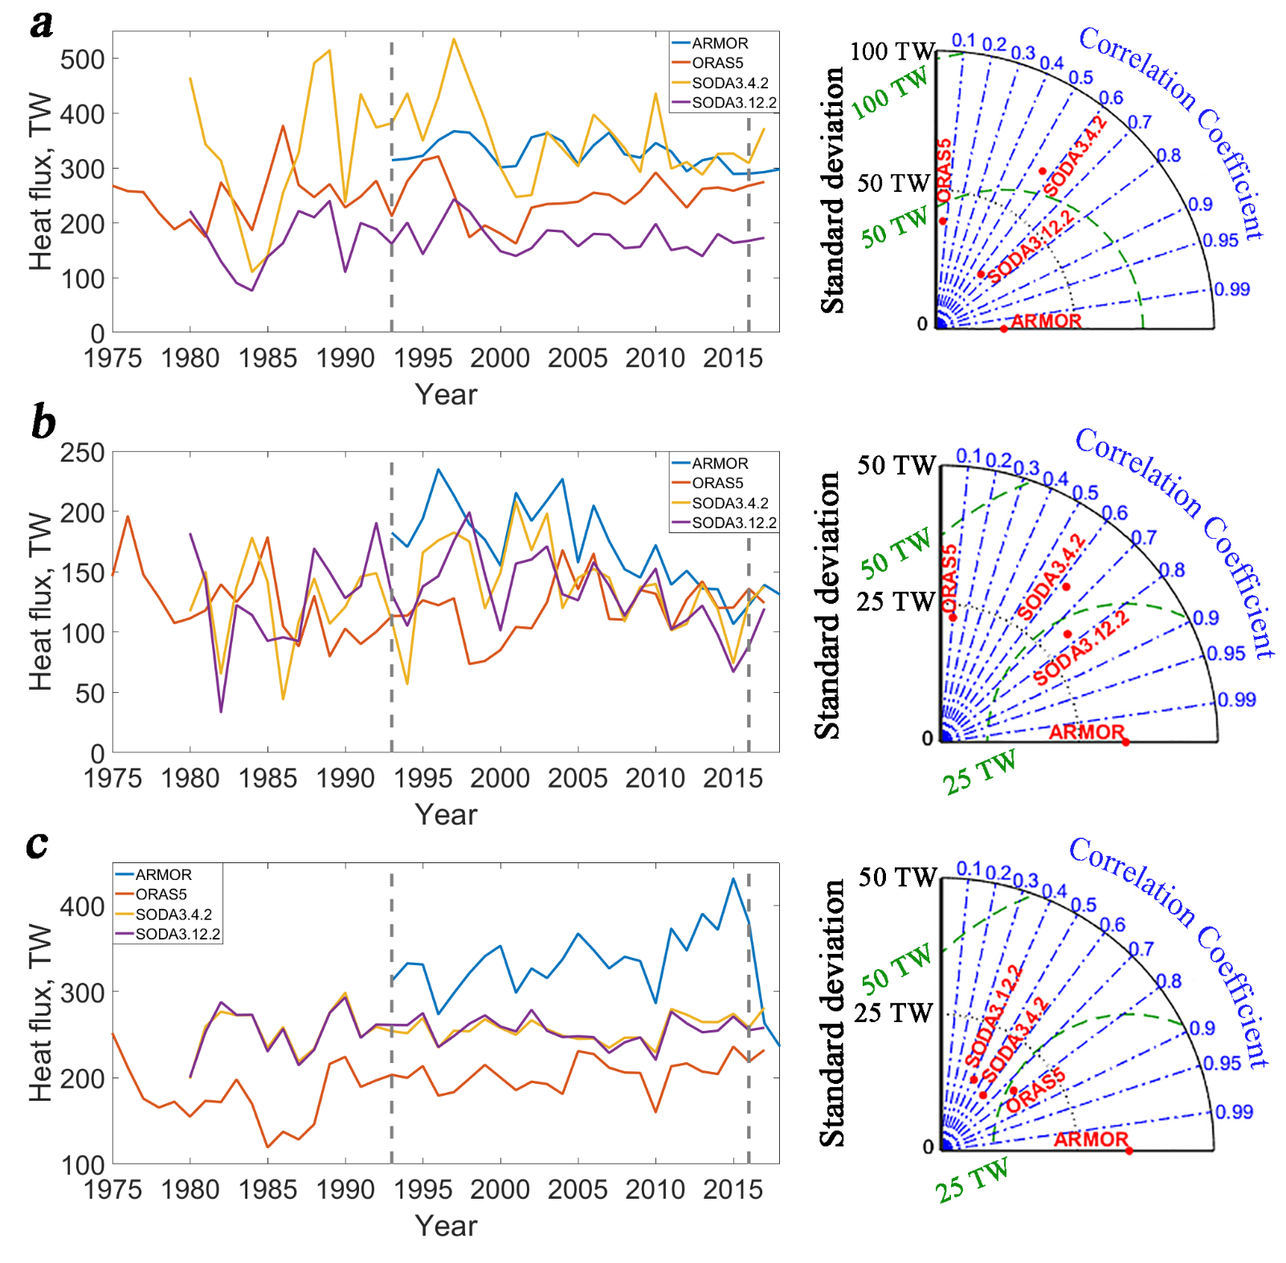
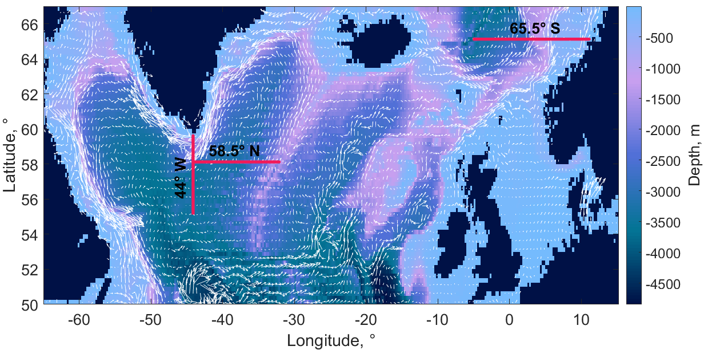
Advective heat flux
The mean annual heat fluxes (TW) and water transport (Sv) across 44˚ W, 58.5˚ N, 65.5˚ N, integrated over the upper 500-m layer. The standard deviations are indicated in brackets.
 |  | ARMOR | ORAS5 | SODA3.4.2 | SODA3.12.2
44˚ W | Heat flux | 326 (26) | 246 (42) | 344 (93) | 170 (37)
 | Transport | 12.52 (0.85) | 10.54 (1.83) | 5.96 (1.60) | 5.93 (1.45)
58.5˚ N | Heat flux | 170 (34) | 122 (26) | 133 (36) | 130 (35)
 | Transport | 5.56 (1.01) | 3.96 (0.85) | 4.69 (1.00) | 4.55 (0.99)
65.5˚ N | Heat flux | 332 (42) | 194 (29) | 256 (19) | 255 (18)
 | Transport | 10.16 (1.09) | 5.94 (0.90) | 8.01 (0.71) | 7.95 (0.74)
Interannual variability of the annual mean heat fluxes from ARMOR-3D, ORAS5, SODA3.4.2, SODA3.12.2 and Taylor diagrams:
across 44° W
across 58.5 °N
across 65.5 °N

Slide 5
Anomalies of the sea-surface current velocity
Spatial distributions of the winter mean (January-March) anomalies of the sea-surface current velocity (m s⁻¹):
years with high values NAOI (NAOI>0.9)
minus
years with low values NAOI (NAOI<-0.1).
ARMOR
ORAS5
SODA3.4.2
SODA3.12.2.
The gray shading marks the regions with the velocity
≤ 0.05 m s⁻¹.
The black line is the 300 m isobath.

Slide 6
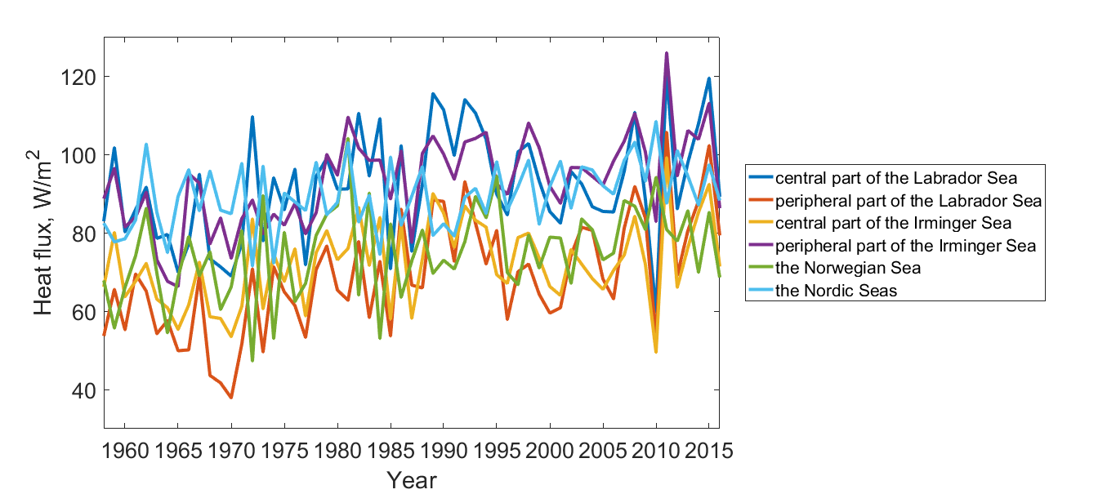
Heat fluxes to the atmosphere
The annual mean heat fluxes from the ocean to the atmosphere (latent+sensible)

Slide 7
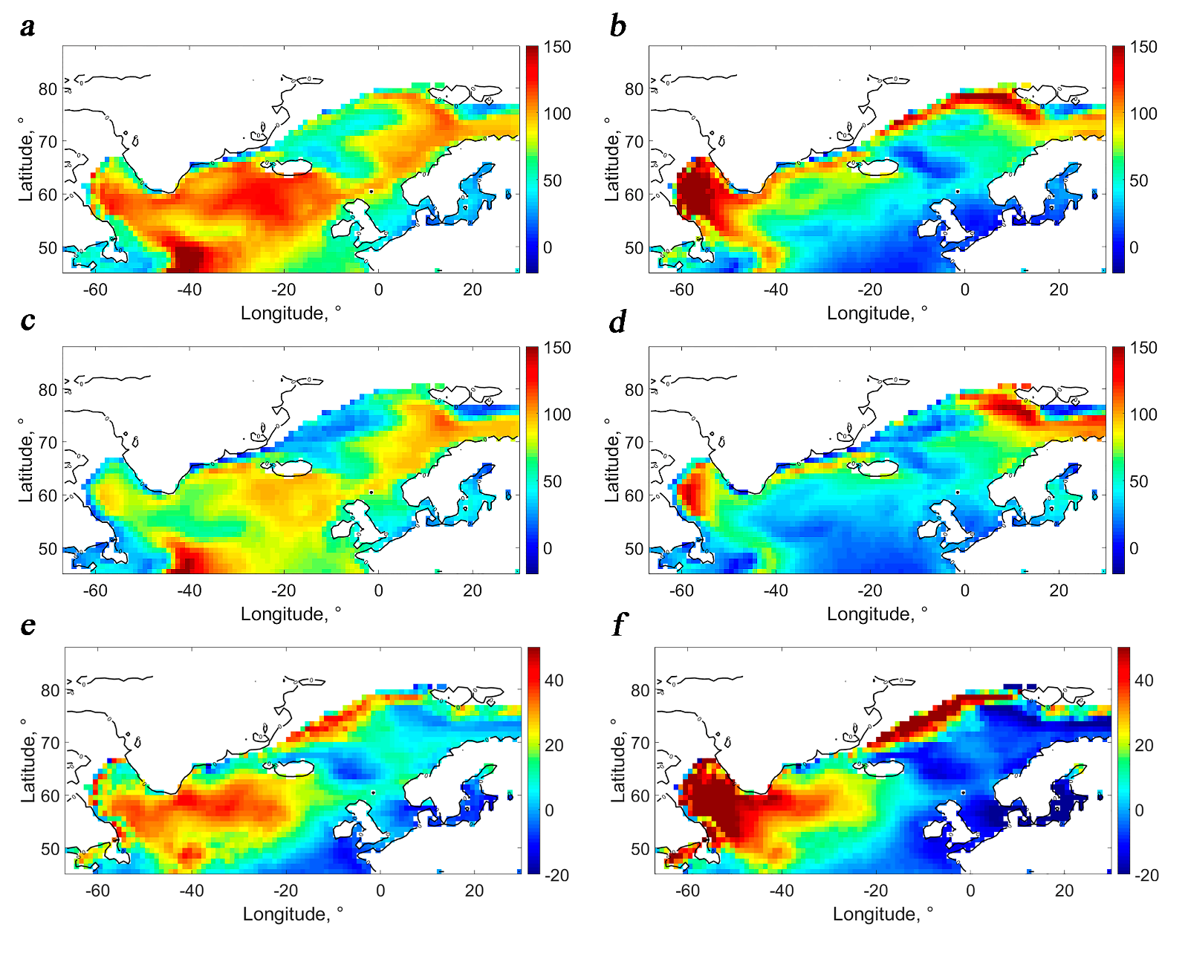
Heat fluxes to the atmosphere
latent
sensible
high NAOI (>0.9)
latent
sensible
low NAOI (<-0.1)
latent HF anomaly
sensible HF anomaly
high NAOI – low NAOI
Notes:
HF – heat flux

Slide 8
Conclusions
During the years with high winter NAOI, strengthening of atmospheric circulation leads to intensification of the Labrador, the Norwegian, the West Spitsbergen and the slope East Greenland Currents, but to weakening of the West Greenland and the Irminger Currents.
When the upper ocean heat release (sensible and latent) over the Labrador and Irminger seas increases, over the Norwegian Sea it decreases.
During the positive NAO phase, the observed decrease of the heat content in the upper Labrador and Irminger seas is linked to both, a higher oceanic heat release and a lower intensity of advection of warm water from the south. In the Norwegian Sea, the opposite sign of both fluxes leads to a simultaneous warming of the upper ocean.

