Slide 1
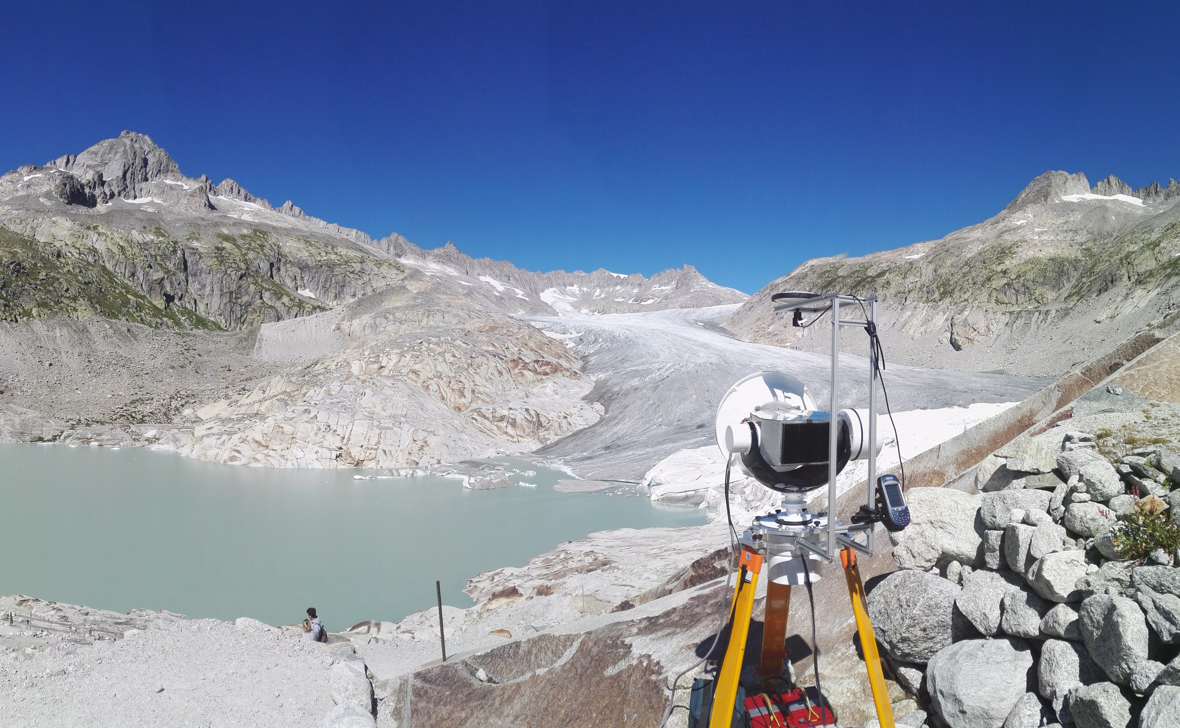
Observing the Cryosphere with millimetre wave radar: The case study of Rhône Glacier
William D. Harcourt, David G. Macfarlane, Duncan A. Robertson, Brice R. Rea, Matteo Spagnolo

Slide 2
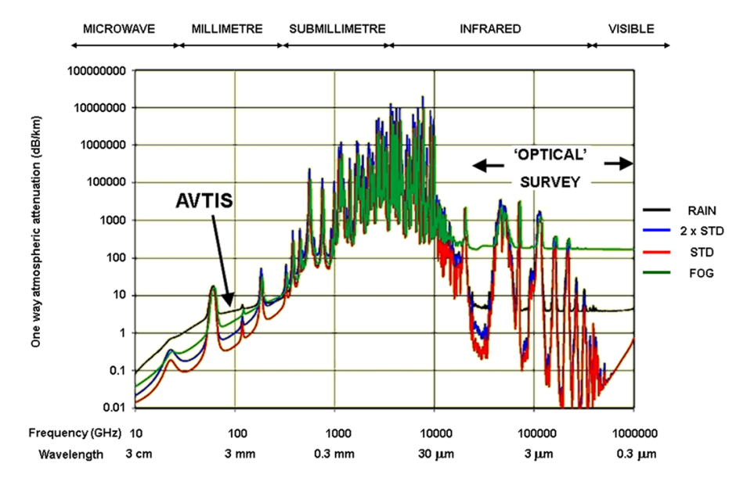
The Case for Millimetre Wave Radar
100,000,000
10,000,000
Key Points
Lower attenuation at lower frequencies, but lower angular resolution.
High attenuation at high frequencies i.e. optical surveying region.
Millimetre wave region of electromagnetic spectrum:
30-300 GHz
Millimetre waves offer a compromise
Imaging at high angular resolution and through atmospheric obscurants.
Largest attenuation with increasing rain rate.
1,000,000
100,000
1,000
Attenuation (dB/km)
100
10
1
0.1
0.01
10
100
1,000
10,000
100,000
1,000,000
Frequency (GHz)
US STD Atmosphere + Rain
US STD Atmosphere + x2 H₂0
US STD Atmosphere + Fog
US STD Atmosphere
From Wadge et al. (2014)
@will_harcourt
www.williamharcourt.co.uk
mm-wave Radar
AVTIS2
Rhône Glacier
3D Surfaces
Reflectivity
Summary
Notes:
Key points
Urgent need for high resolution measurements of glaciers.
Previous ground-based sensors are impeded by poor weather conditions (frequencies > 300 GHz) or low angular resolution (frequencies < 30 GHz).
Millimetre wave region (30-300 GHz) offers a unique trade off: high angular resolution with lower atmospheric attenuation in poor weather conditions.
Graph from: Wadge, G., Macfarlane, D.G., Odbert, H.M., Stinton, A., Robertson, D.A., James, M.R., Pinkerton, H. (2014). AVTIS observations of lava dome growth at Soufriere Hills Volcano, Montserrat: 2004-2011, Geological Society, London, Memoirs, 39, 229-240.

Slide 3
The AVTIS2 Radar
Frequency | 94 GHz
Wavelength | 3.18 mm
Two-way Radar Beamwidth | ~0.5°
Radar Azimuth Resolution (per km) | 6.1 m
Range Resolution | 0.75 m
Max Range | ~6 km
Image acquisition time (20°x 5°, 0.1° inc.): | 50 mins
Weight: Radar Head | 40 kg
2 Car Batteries | 46 kg
GPS
AVTIS2 Head
Cassegrain Antenna
Power Supply Unit and Control Box
Gimbal
Surveyors Tripod
x2 12V Car Batteries
@will_harcourt
www.williamharcourt.co.uk
mm-wave Radar
AVTIS2
Rhône Glacier
3D Surfaces
Reflectivity
Summary
Notes:
Key points
AVTIS2 can acquire reflectivity maps and DEMs at high resolution.
It acquires measurements at high azimuth and range resolution, obtaining high angular resolution.
Maximum range of system is ~6 km.
It is powered by 2 car batteries and is positioning on a tripod.
Accurate positioning is determined through dGPS.

Slide 4
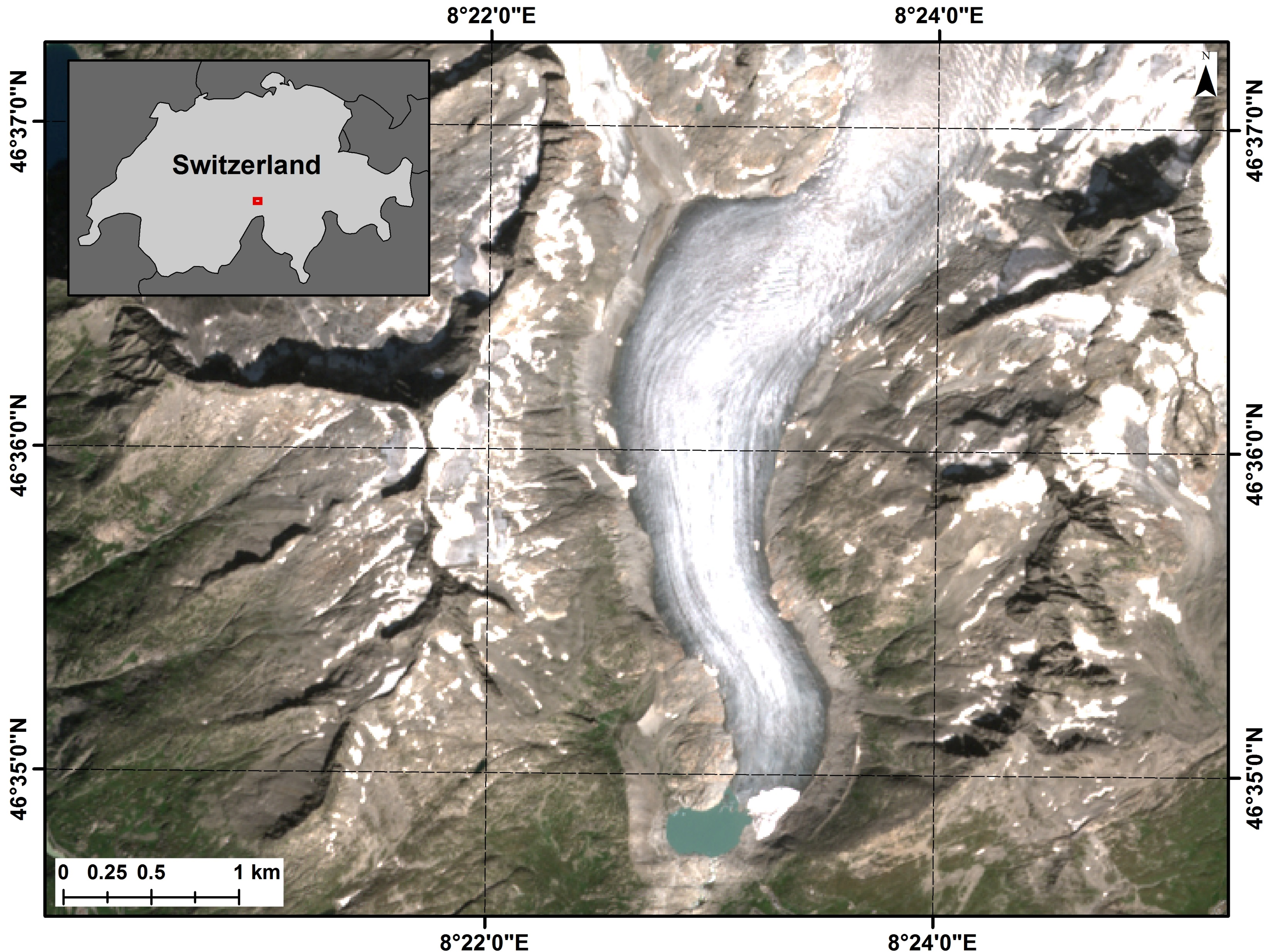
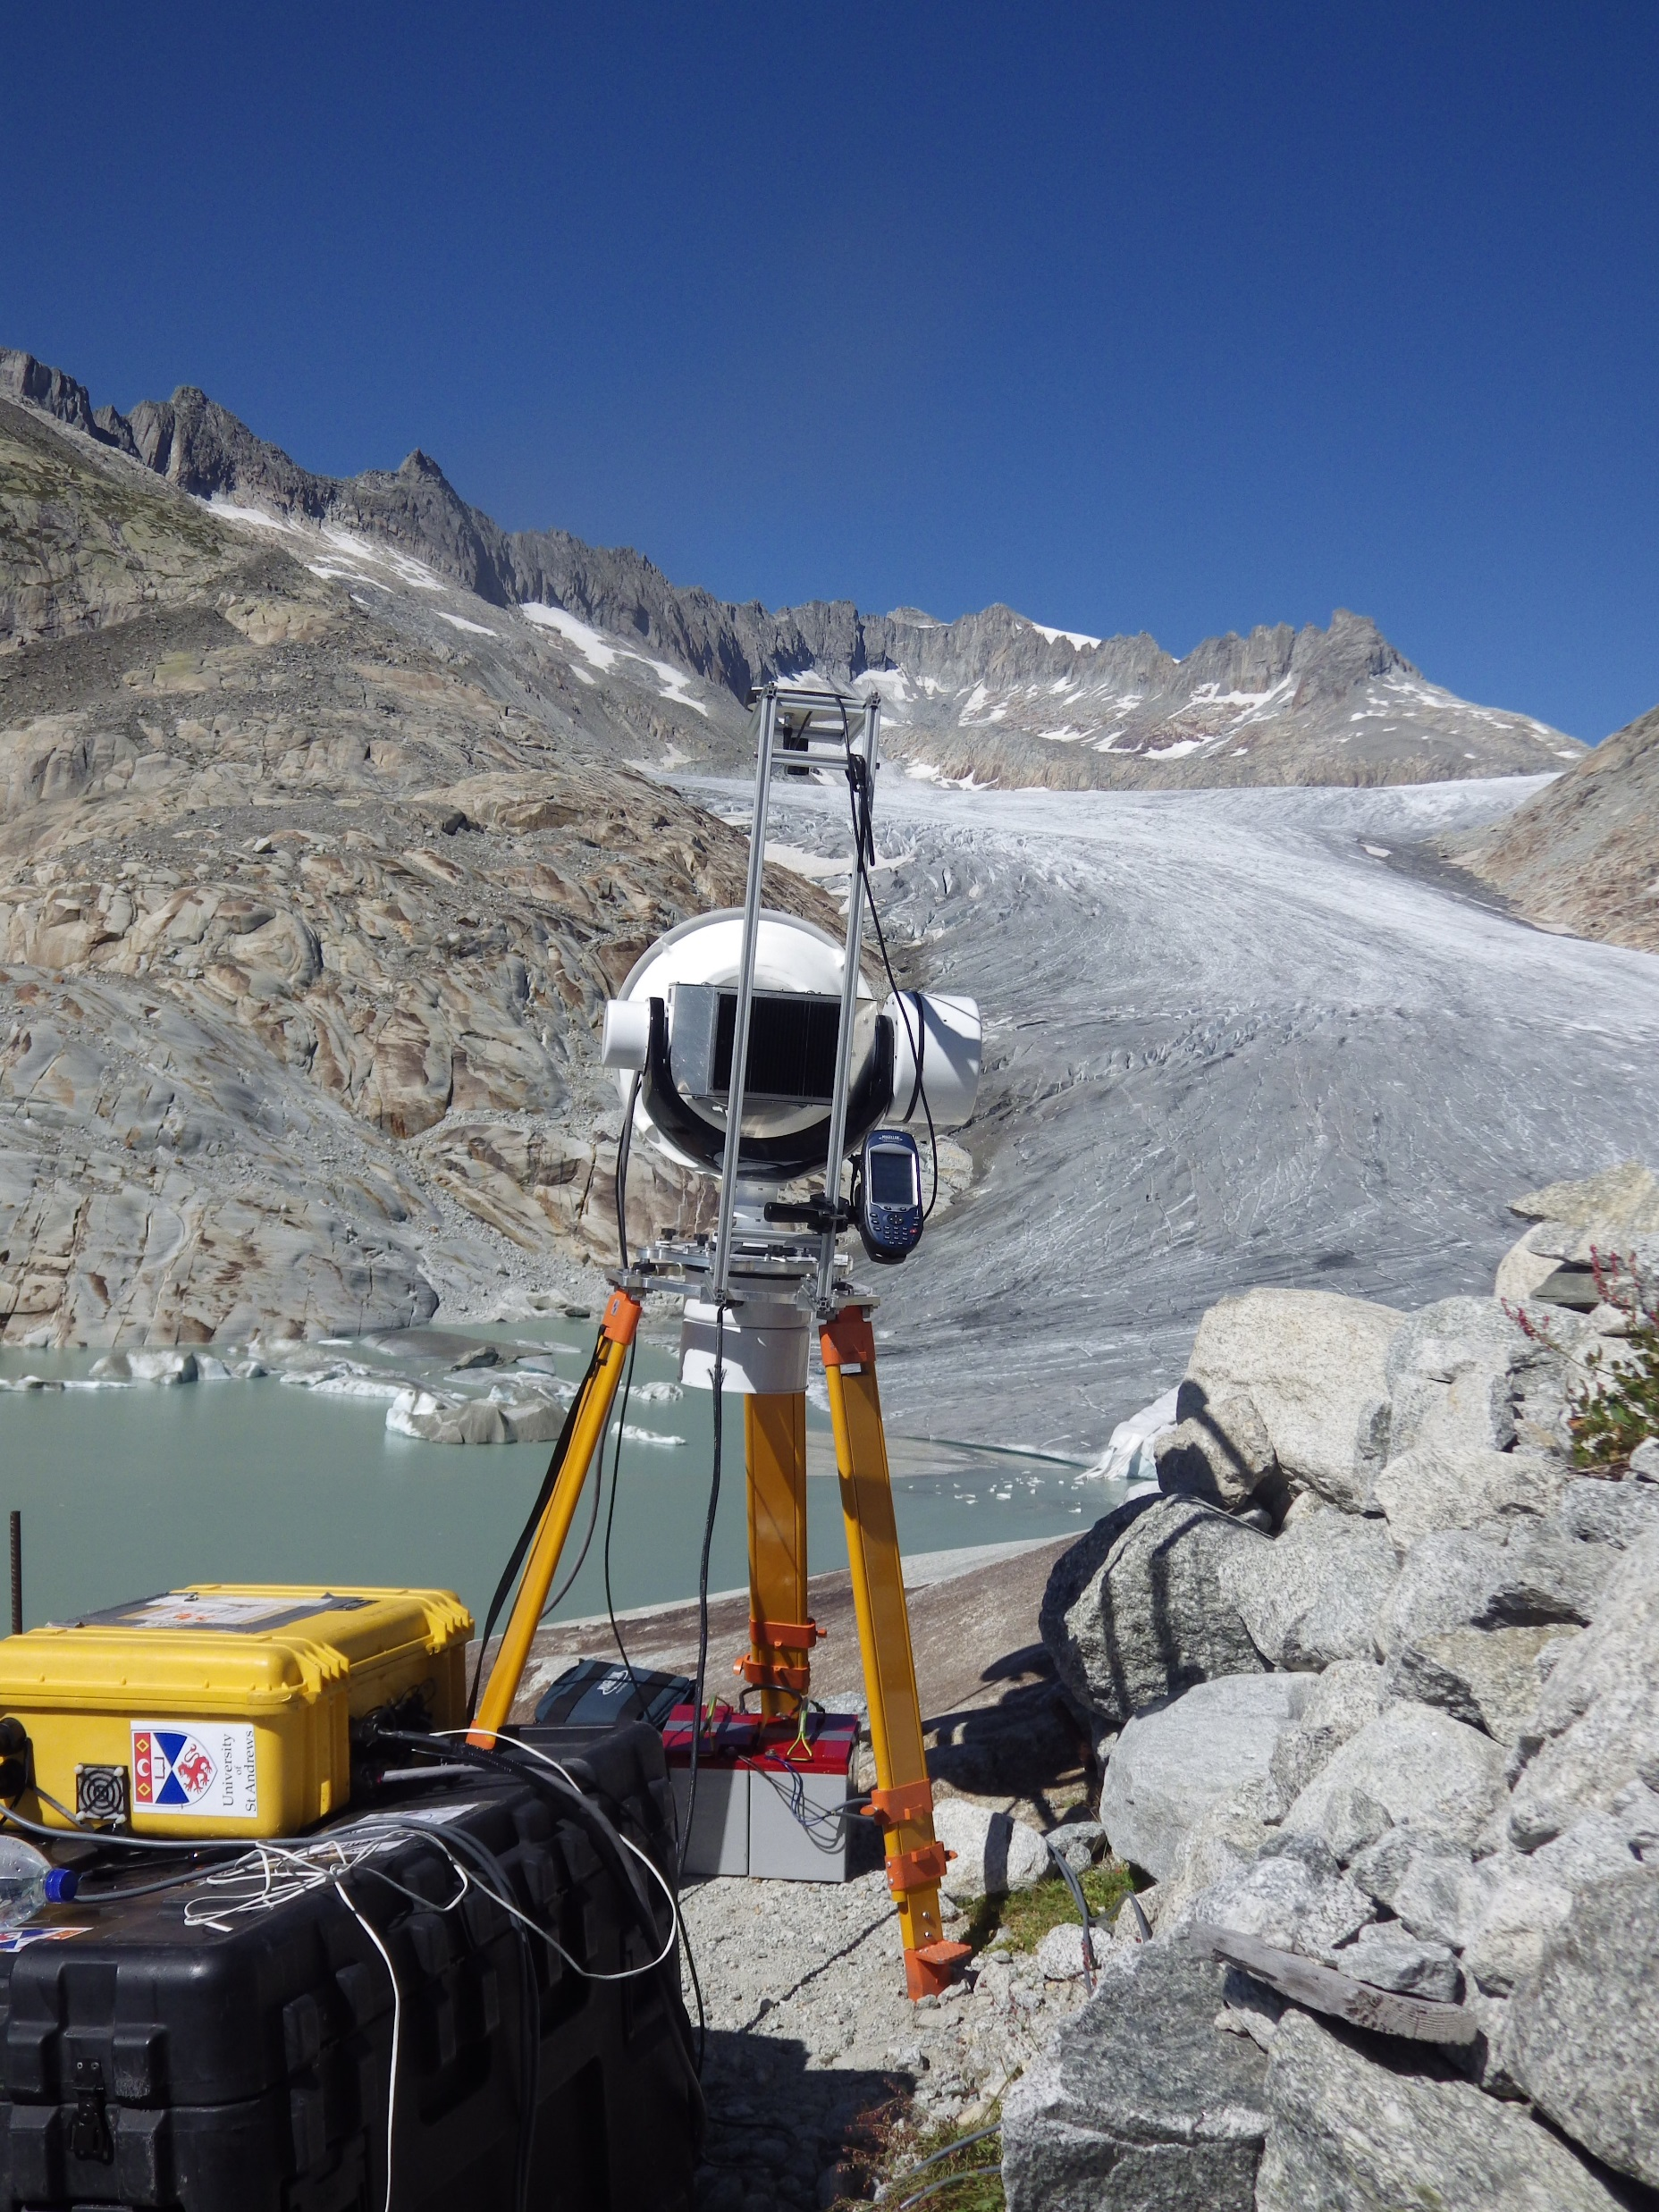
Fieldtrip to Rhône Glacier, September 2019
Aims
Analyse reflectivity of glacial ice at 94 GHz
Test the ability of millimetre wave radar to generate DEMs
Sentinel-2 image: 4th September 2019
@will_harcourt
www.williamharcourt.co.uk
mm-wave Radar
AVTIS2
Rhône Glacier
3D Surfaces
Reflectivity
Summary
Notes:
Key points
We deployed AVTIS2 at Rhône Glacier in the Swiss Alps in September 2019.
Aim 1: Determine the reflectivity of glacial ice at 94 GHz.
Aim 2: Assess the performance of AVTIS2 in generating DEMs of glacier surfaces.

Slide 5
AVTIS2 Scanning Pattern
Video
Elevation
Azimuth
@will_harcourt
www.williamharcourt.co.uk
mm-wave Radar
AVTIS2
Rhône Glacier
3D Surfaces
Reflectivity
Summary
Notes:
Key points
AVTIS2 mechanically scans from left to right (azimuth), bottom to top (elevation).
It measures backscatter along each line of sight to generate reflectivity maps.

Slide 6
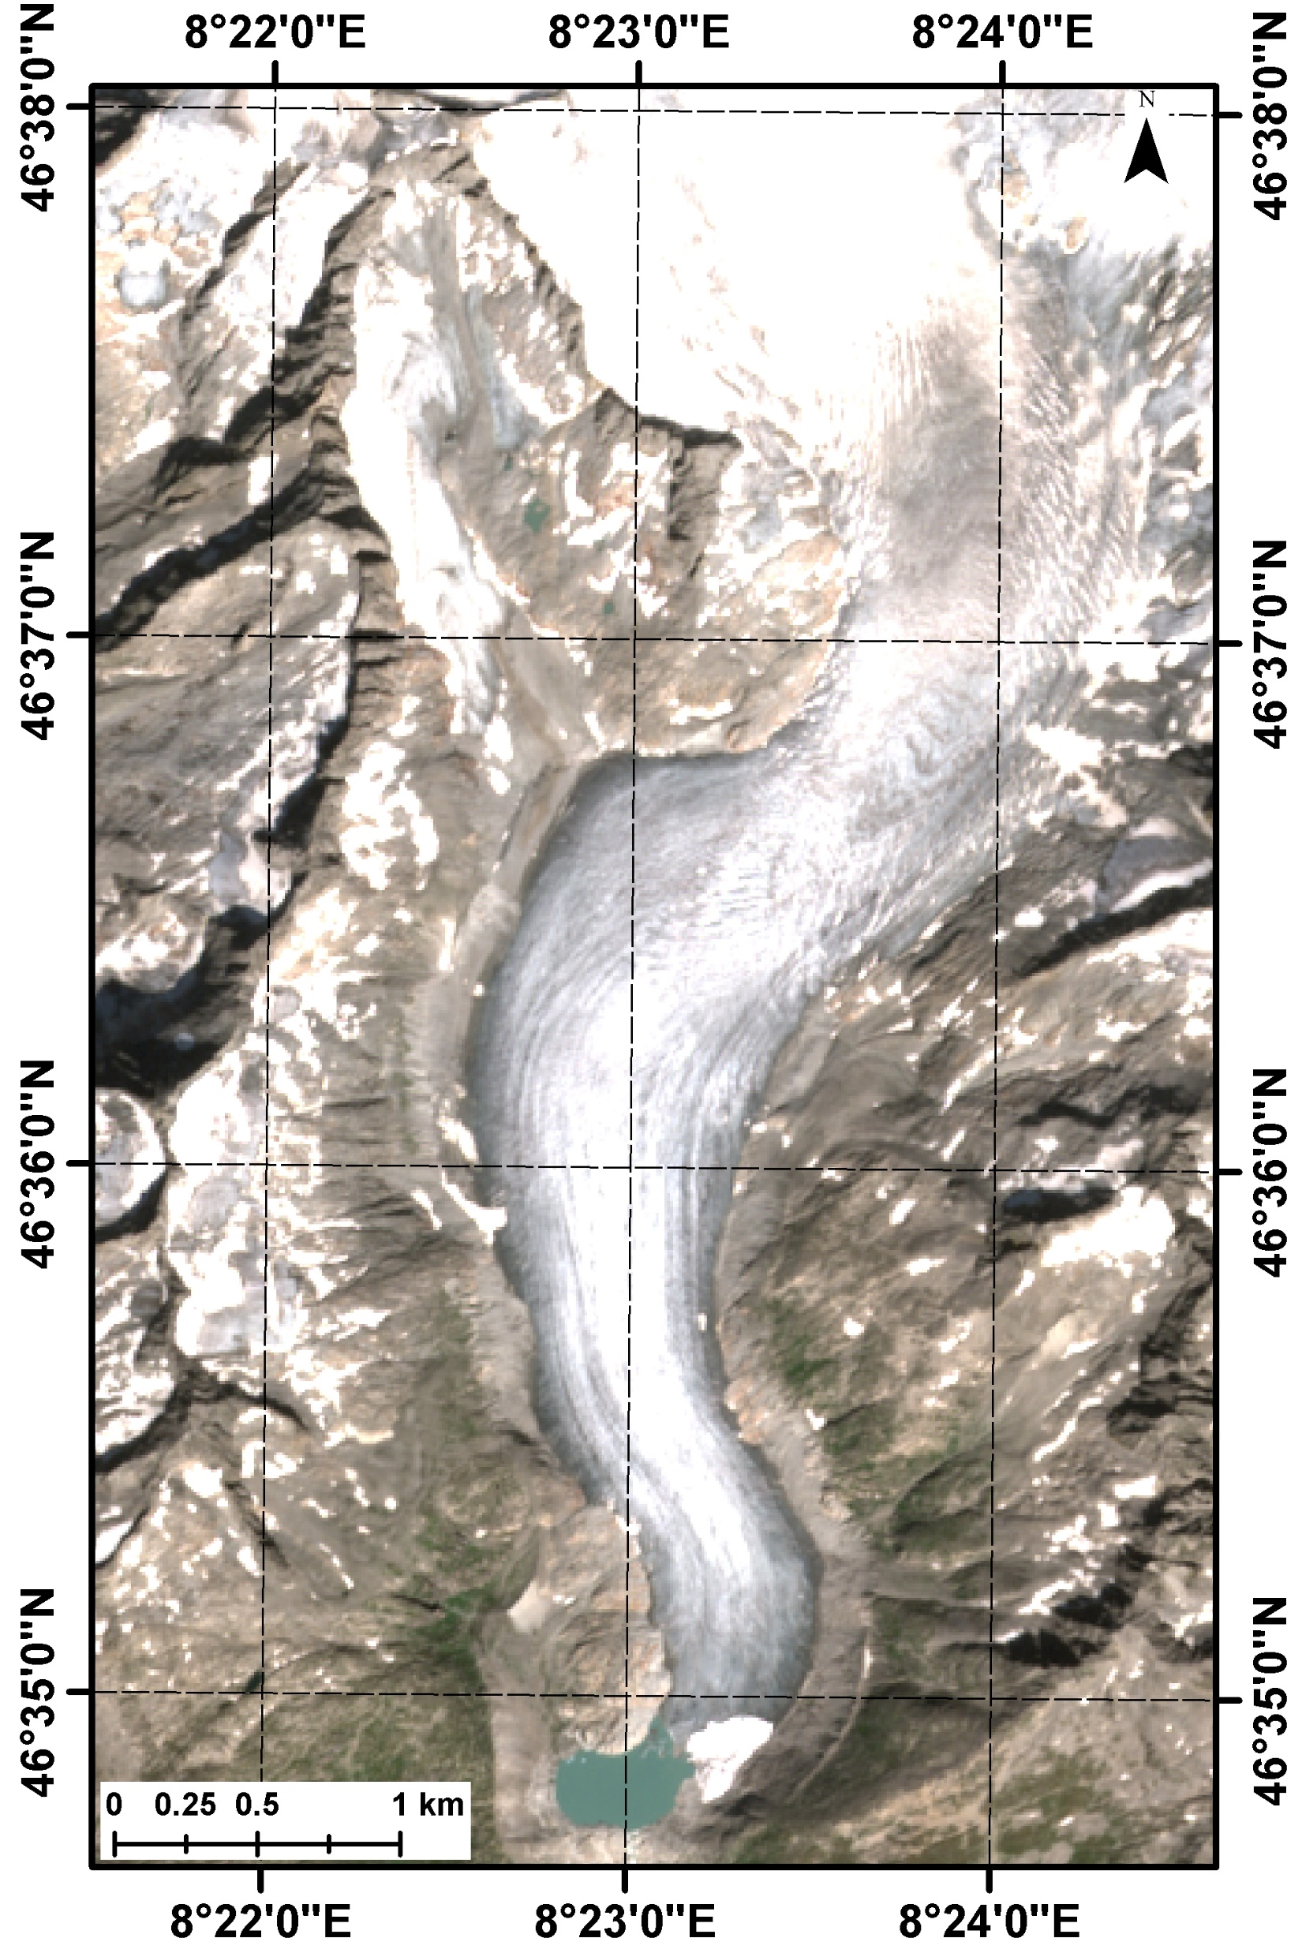
AVTIS2 Elevation Scanning
Video
4
4
3
2
1
3
AVTIS2
2
1
AVTIS2
@will_harcourt
www.williamharcourt.co.uk
mm-wave Radar
AVTIS2
Rhône Glacier
3D Surfaces
Reflectivity
Summary
Notes:
Key points
We deployed AVTIS2 at the glacier snout and imaged the field of view visible to AVTIS2.
Each plots shows a ‘left to right’ (azimuth) scan.
Bright areas indicate terrain.
We extract these ‘echoes’ and generate point clouds and then DEMs; these are also used to generate reflectivity maps.

Slide 7
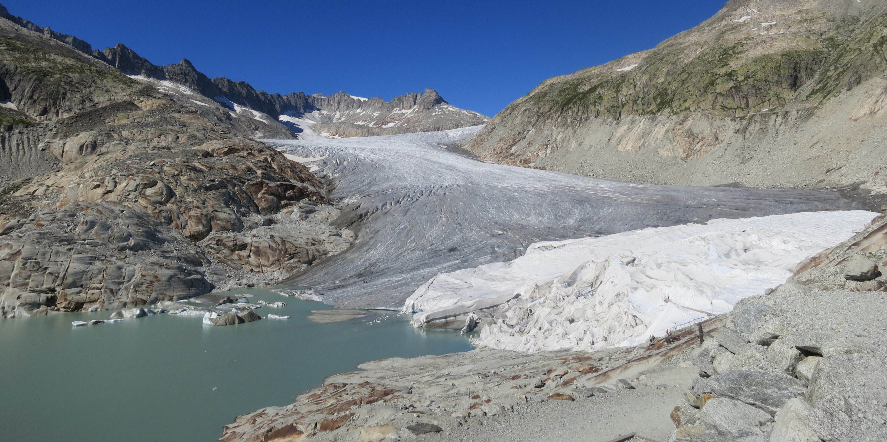
Point Cloud Generation
Range to Max Power
Point Clouds
Terrain Backscatter
AVTIS2
Noise
Key Points
Data presented in this presentation focusses on the glacier snout (bottom right).
AVTIS2 measures backscatter at each range bin along every Line of Sight (LOS) in azimuth and elevation.
‘Echoes’ within each range profile represent backscatter from terrain (top left).
Point clouds are generated by extracting the range to maximum power along each range profile (top right).
@will_harcourt
www.williamharcourt.co.uk
mm-wave Radar
AVTIS2
Rhône Glacier
3D Surfaces
Reflectivity
Summary
Notes:
Key points
When AVTIS2 scans across in elevation and azimuth it measures backscatter at each range bin, leading to a 3D data cube of backscattered power.
Terrain backscatter appears as ‘echoes’ along a range profile.
These echoes represent the size of the beam footprint on the ground.
We generate point clouds by finding the range to maximum power along each range profile.

Slide 8
DEM Generation
Key Points
The point clouds are used to generate DEMs
We have generated the first ever DEM of a glacier using millimetre wave radar (bottom right).
Key features can be identified in both an image of Rhône Glacier (top left) and the DEM (bottom right).
Gaps show regions where no points are acquired due to (1) occlusions and (2) low power returns from sky or water.
B
E
D
C
A
Annotations
A: Proglacial icebergs
B: Valley side
C: Glacier terminus
D: Tarpaulin draped over glacier ‘Eisgrotte’
E: Lateral margin of glacier
E
B
D
C
A
@will_harcourt
www.williamharcourt.co.uk
mm-wave Radar
AVTIS2
Rhône Glacier
3D Surfaces
Reflectivity
Summary
Notes:
Key points
The point clouds generated previously can be used to generate Digital Elevation Models (DEMs).
The data presented here is the first ever DEM of a glacier generated using millimetre wave radar.
Region D represents a DEM of the glacier covered by tarpaulin, where the ice thickness is larger and the blocks the radar line of sight behind it.
The valley sides, ice front, icebergs and glacier trunk are all visible.
This demonstrates the capability of millimetre wave radar to generate DEMs.

Slide 9
Raw Radar Received Power
Ice Flow
Key Points
Plot (left) shows maximum received power at each range bin at each elevation angle.
Glacier surface features become visible:
Crevasses
Icebergs
Glacier terminus delineated by contrast between water and ice backscatter.
Bottom right area covered by tarpaulin:
Raises ice thickness creating ‘blind’ spots.
Occlusion
@will_harcourt
www.williamharcourt.co.uk
mm-wave Radar
AVTIS2
Rhône Glacier
3D Surfaces
Reflectivity
Summary
Notes:
Key points
In this slide, raw radar reflectivity is plotted by finding the maximum power at each range bin across each elevation angle. We focus on the glacier snout.
The plot can be thought of as a ‘SAR-style’ image.
Areas further from the radar ((0,0) position) backscatter less due to the larger beam footprint and low incidence angle.
Front facing surfaces, such as the ice front, is highly reflective and appear as bright regions in the map.

Slide 10
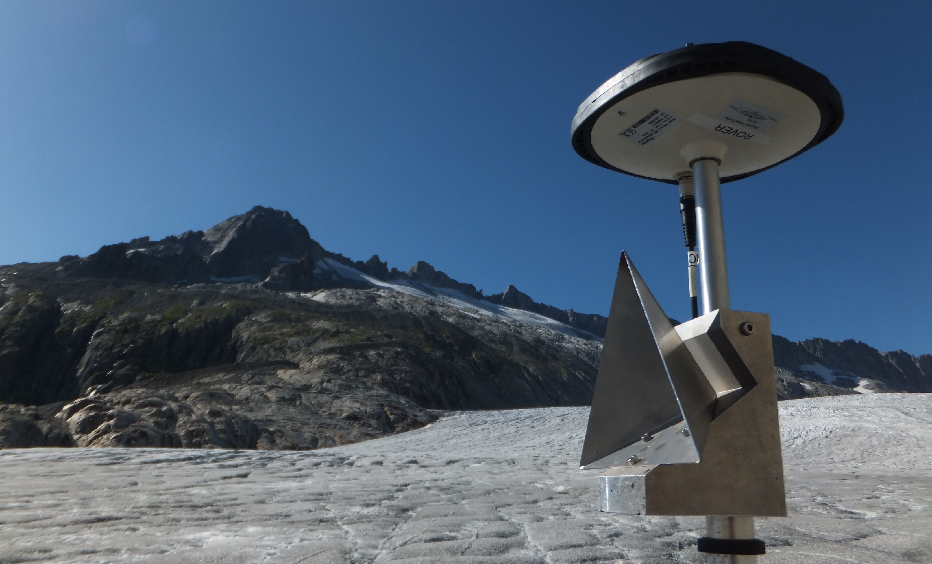
Calibrating Radar Received Power
Atmospheric Attenuation | 1 dB/km
Corner Cube RCS | 20 dBsm
Transmit Power | 16.35 dBm
Antenna Gain | 51.2 dBi
Wavelength | 3.18 mm
Key Point
The radar range equation is used to calibrate radar received power and the Normalised Radar Cross Section ($σ^{0}$) is derived from this.
@will_harcourt
www.williamharcourt.co.uk
mm-wave Radar
AVTIS2
Rhône Glacier
3D Surfaces
Reflectivity
Summary
Notes:
Key points
The reflectivity data must be calibrated based in order to predict quantities such as Radar Cross Section (RCS).
The radar model is the simulated radar received power predicted by the theoretical radar range equation.
We adjusted the parameters in the radar range equation using measurements of known RCS: trihedral radar reflectors, 20 dBsm.
Atmospheric attenuation models (ITU) and hardware characterisations have been used to adjust the model to line up with the measurements.

Slide 11
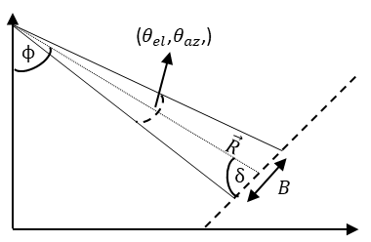
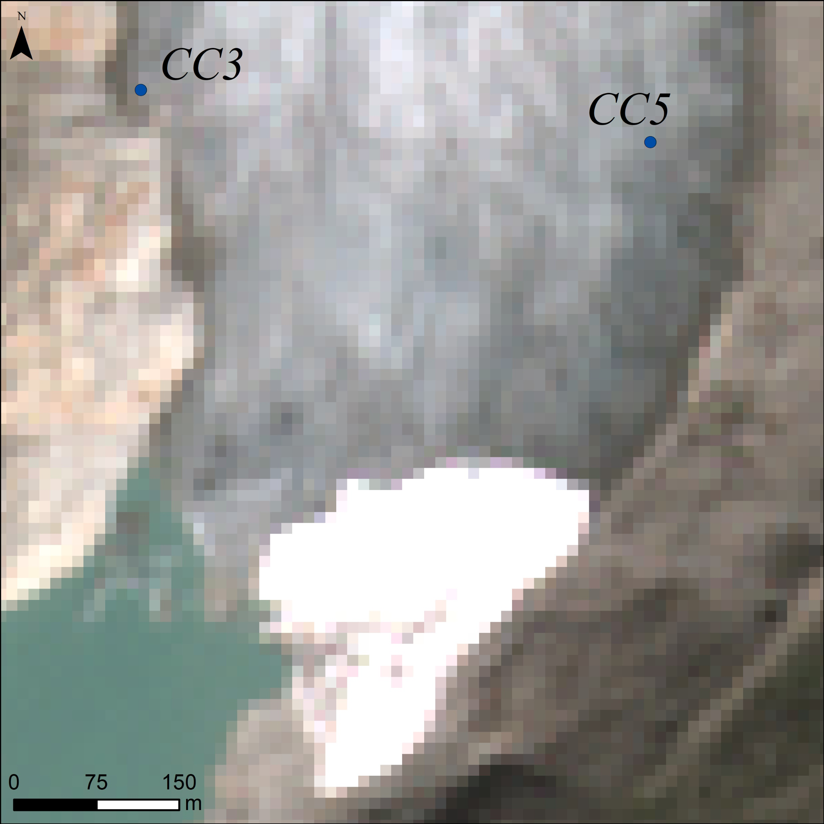
Normalised Radar Cross Section ($σ^{0}$)
Correct for Beam Footprint Area
$σ^{0}$ Map
Key Points
94 GHz glacial ice backscatter:
$−22 dB<σ^{0}<−10 dB$
Differences in $σ^{0}$ may be attributed to differences in debris cover.
Values of $σ^{0}$ at 94 GHz differ between rock and glacial ice.
New potential for terrain classification.
Sentinel-2 Image from Fieldwork
Range of $σ^{0}$ Values
@will_harcourt
www.williamharcourt.co.uk
mm-wave Radar
AVTIS2
Rhône Glacier
3D Surfaces
Reflectivity
Summary
Notes:
Key points
The value of interest for extended terrain such as a glacier is the Normalised Radar Cross Section ($σ^{0}$).
We have corrected for the size of the beam footprint using:
The measured radar beamwidth in azimuth and elevation
The local angle of incidence calculated from the DEM generated previously.
We find values that the $σ^{0}$ for glacial ice at 94 GHz has a range of values between -22 and -10.
Differences between the valley side and the glacier suggest that these surfaces have different scattering properties at 94 GHz.

Slide 12
First ever DEM generated using millimetre wave radar
The AVTIS2 94 GHz radar has proven its capability to generate DEMs of glacier surfaces.
Radiometric normalisation calculated using the DEM generated from AVTIS2 measurements
We calculated the local incidence angle ($δ$) using slope calculations across the DEM.
Summary
Quantified the Normalised Radar Cross Section of glacial ice at 94 GHz
Our measurements show a range of values between $−21 dB<σ^{0}<−10 dB$
Values of $σ^{0}$ for glacial ice at 94 GHz are larger than bare surfaces, but lower than snow.
Other $σ^{0}$values at 94 GHz:
Volcanic terrain: -16 dB
Bare surfaces: -20 dB
Wet Snow: -9 dB
Refrozen Snow: -7 dB
@will_harcourt
www.williamharcourt.co.uk
mm-wave Radar
AVTIS2
Rhône Glacier
3D Surfaces
Reflectivity
Summary

Slide 13
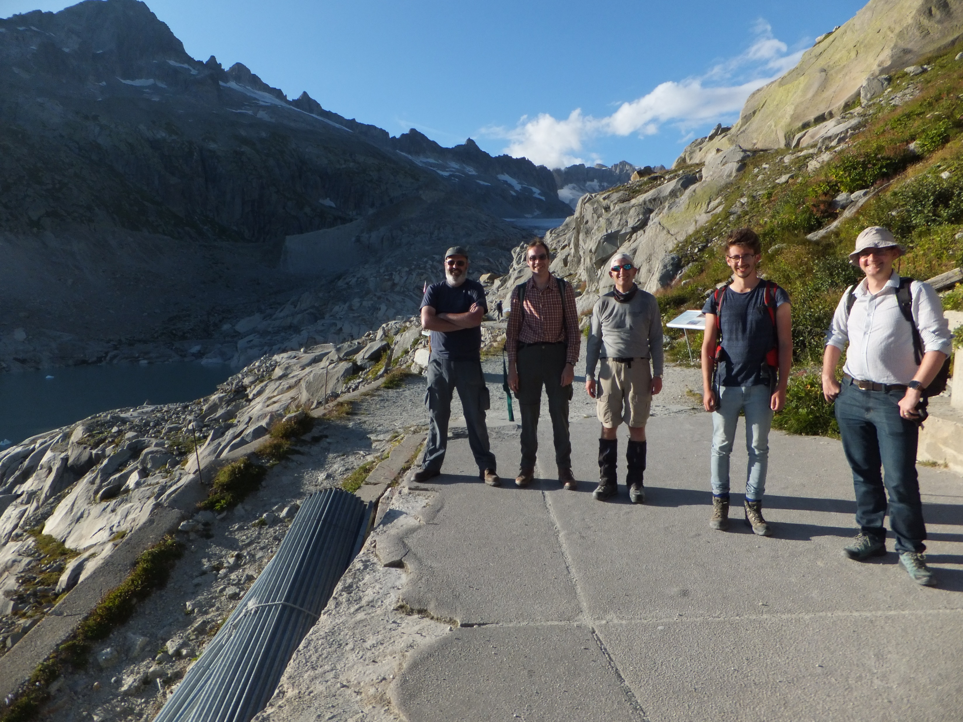
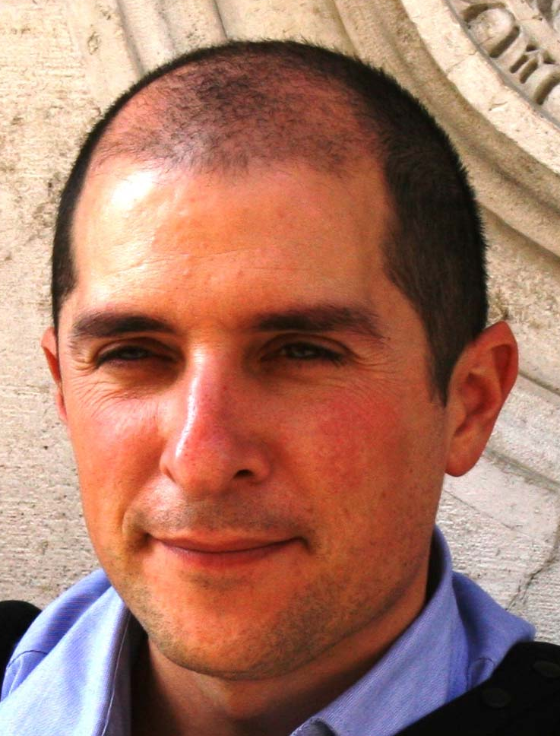
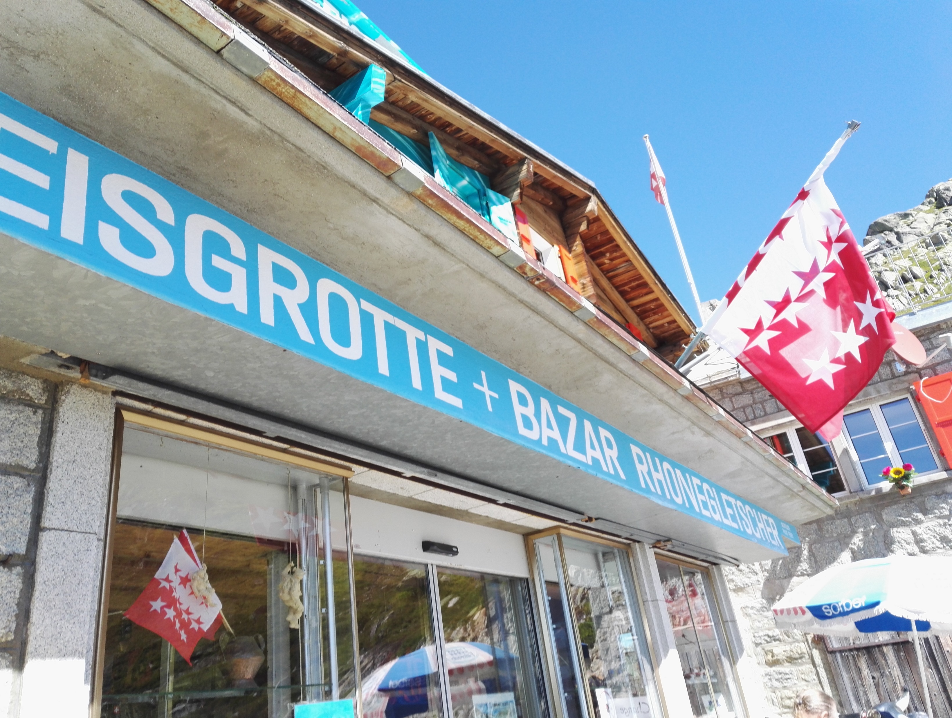
Acknowledgements
From left to right:
Dr Matteo Spagnolo
Dr David G. Macfarlane
Dr Duncan A. Robertson
Prof. Brice R. Rea
Mr William Harcourt
Dr Peter Speirs
Thank you for your interest!
Notes:
Key points
This trip was primarily funded through the SAGES small grant scheme (SSGS), for which we are extremely grateful.
Additional funds were acquired from Mr Harcourt’s PhD studentship, which includes EPSRC.
We would like to thank the people of the Eisgrotte Café at Rhône Glacier for accommodating us during the fieldwork.
And thanks to all members of the team for their help and support: Dr Matteo Spagnolo, Dr David Macfarlane, Dr Duncan Robertson, Prof. Brice Rea, Mr William Harcourt and Dr Peter Speirs.

