Slide 1






Triple isotopic composition of oxygen in water and dioxygen during deglaciations recorded in the EPICA Dome C ice core to link climate, biosphere productivity and water cycle
Definitions
Controlled biology experiments
Ice core Δ¹⁷O of O₂ measurements and past productivity
Ice core ¹⁷O-excess measurements and climate of source evaporative regions
Amaëlle Landais, Ji Woong Yang, Nicolas Pasquier, Antoine Grisart, Margaux Brandon, Thomas Extier, Frédéric Prié, Bénédicte Minster, Clément Piel, Joanna Sauze, Alex Milcu, Barabara Stenni, Thomas Blunier

Slide 2
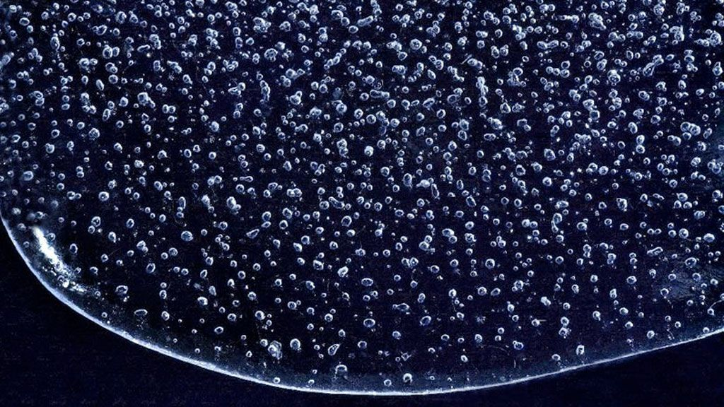
Δ¹⁷O of O₂ and ¹⁷O-excess definition
Δ¹⁷O of O₂ measured in air bubbles, a proxy for past biosphere productivity.
¹⁷O-excess measured in ice phase, a proxy for moisture trajectory from evaporation to polar precipitation site
In the gas phase: Δ¹⁷O of O₂ = ln(δ¹⁷O+1) – 0.516×ln(δ¹⁸O+1)
In the water phase: ¹⁷O-excess = ln(δ¹⁷O+1) – 0.528×ln(δ¹⁸O+1)

Slide 3

Controlled biology experiments – Δ¹⁷O of O₂
connected to a thermostat bath
Pressure balancing system
Heat exchanger
T
CO₂
P
CO₂ injection
CO₂
trap
Connected to a Restek® tedlar gas bag to maintain constant pressure
T et ϴ
Légende :
probe
fan
pump
Gas sampling system (with flasks)
2/2 valve

Slide 4
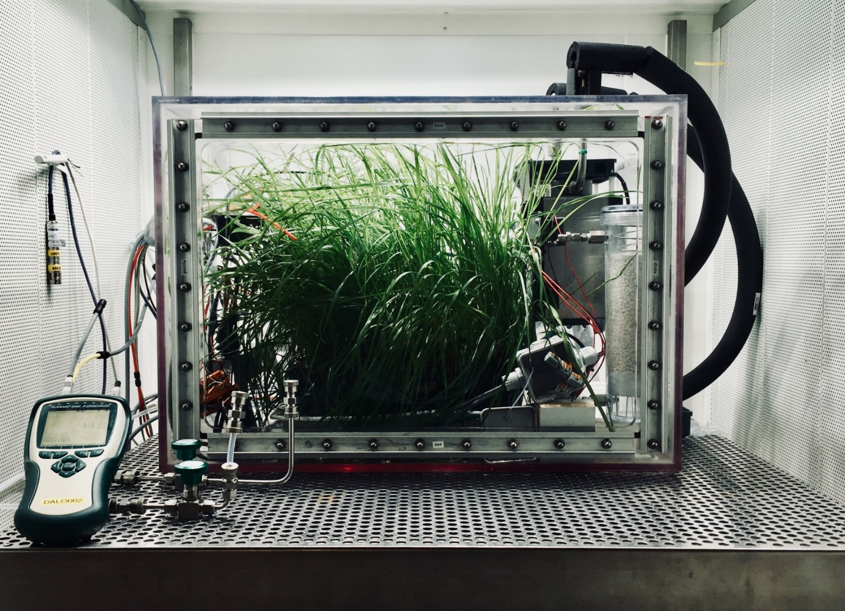
Controlled biology experiments – Δ¹⁷O of O₂

Slide 5
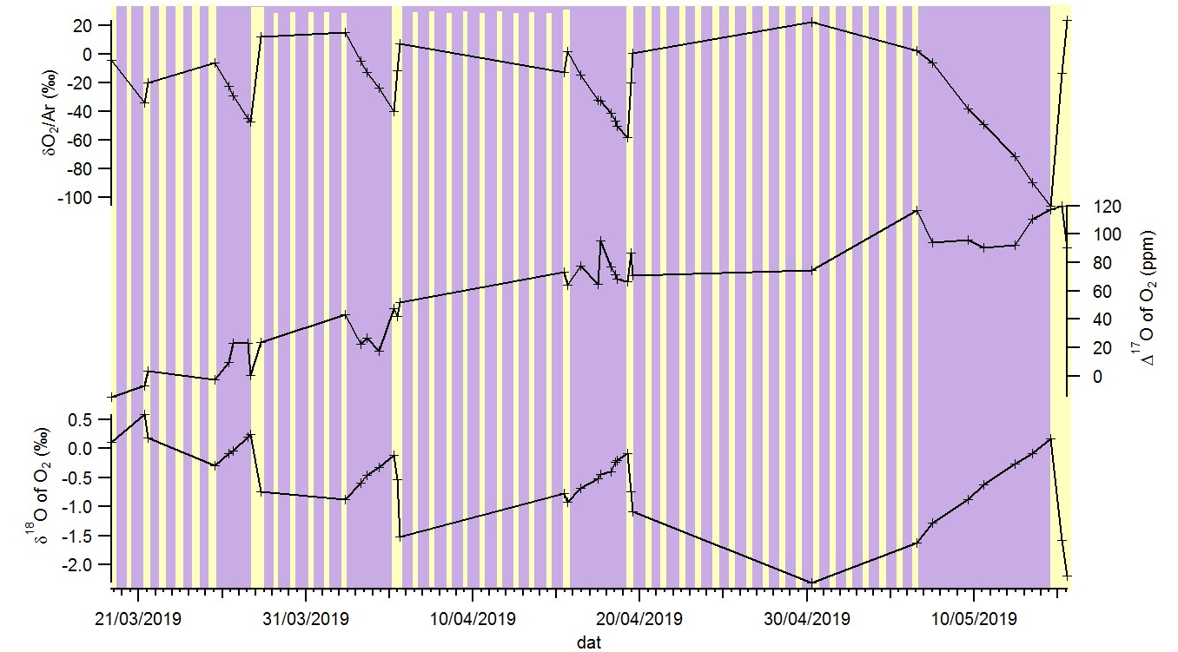
Controlled biology experiments
δ¹⁸O decreases during photosynthesis + respiration
δ¹⁸O increases during pure respiration
Δ¹⁷O increases with time
δO₂/Ar (‰)
Δ¹⁷O of O₂ (ppm)
This experiment was repeated 3 times and permitted to better constrain oxygen isotopic fractionation associated with respiration and photosynthesis
δ¹⁸O of O₂ (‰)

Slide 6
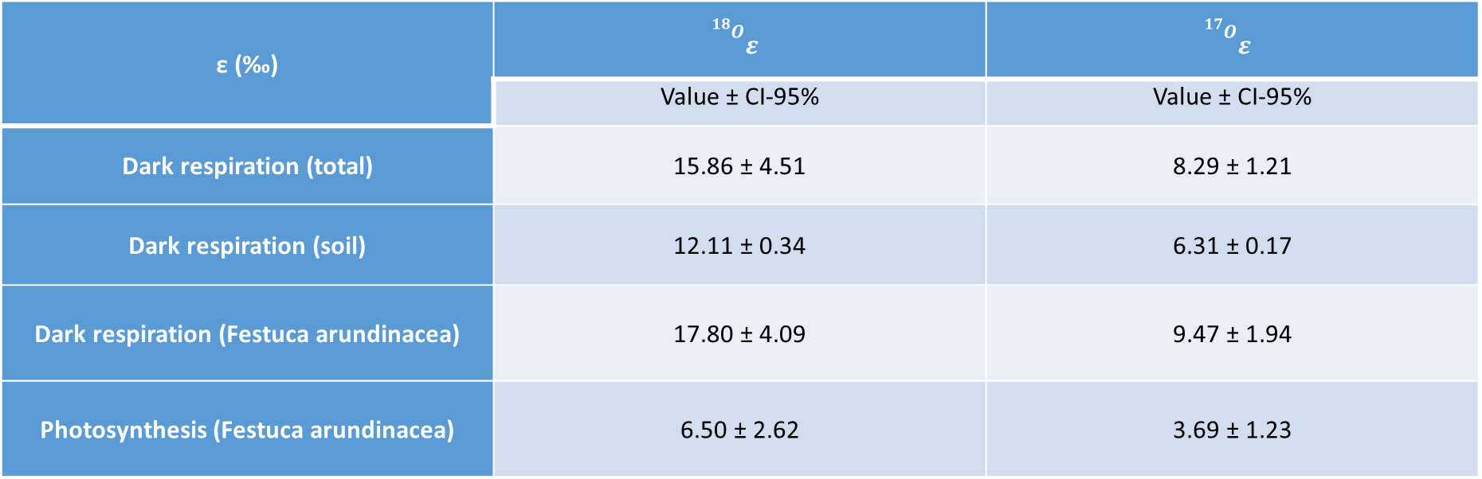
Preliminar determination of fractionation coefficients
ε (‰) | $${}_{}^{{}_{}^{18}O}{ε_{ }}$$ | $${}_{}^{{}_{}^{17}O}{ε_{ }}$$
 | Value ± CI-95% | Value ± CI-95%
Dark respiration (total) | 15.86 ± 4.51 | 8.29 ± 1.21
Dark respiration (soil) | 12.11 ± 0.34 | 6.31 ± 0.17
Dark respiration (Festuca arundinacea) | 17.80 ± 4.09 | 9.47 ± 1.94
Photosynthesis (Festuca arundinacea) | 6.50 ± 2.62 | 3.69 ± 1.23
Pasquier et al., on going work – preliminary data and calculations

Slide 7
Understanding the Δ¹⁷O of O₂ signal and its link to productivity
Δ¹⁷O of O₂ (ppm)
SMOW
250
Reference standard for water samples
0
O₂ of atmospheric air
Reference standard for Δ¹⁷O of O₂
-23.5
0
δ¹⁸O of O₂ (‰)

Slide 8
Understanding the Δ¹⁷O of O₂ signal and its link to productivity
Δ¹⁷O of O₂ issued from stratosphere (link to CO₂ concentration) is smaller (negative with respect to Δ¹⁷O of O₂ of atmospheric air) than Δ¹⁷O of O₂ issued from biospheric processes (positive with respect to Δ¹⁷O of O₂ of atmospheric air)
Δ¹⁷O of O₂ (ppm)
Biologic processes
SMOW
250
O₂ of air in biologic chamber
Evapotranspiration + photosynthesis
respiration
0
O₂ of atmospheric air
Reference standard for Δ¹⁷O of O₂
0
δ¹⁸O of O₂ (‰)
-23.5
Stratospheric air (Mass independent fractionation)

Slide 9
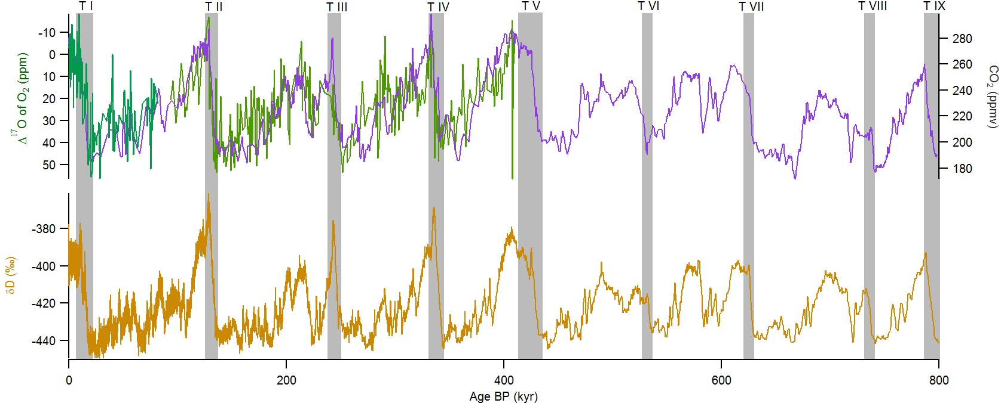
Ice core measurements
Δ¹⁷O of O₂ (ppm)
CO₂ (ppm)
δD (‰)
Classical interpretation: Strong co-variations of Δ¹⁷O of O₂ and CO₂ because of the combination of 2 effects:
1- biosphere productivity
2- stratospheric flux of Δ¹⁷O of O₂ anomaly limited by CO₂ concentration
δD: Jouzel et al., 2007; CO₂: Lüethi et al., 2008 – Bereiter et al., 2015; Δ¹⁷O of O₂ data: Blunier et al., 2002; 2012

Slide 10
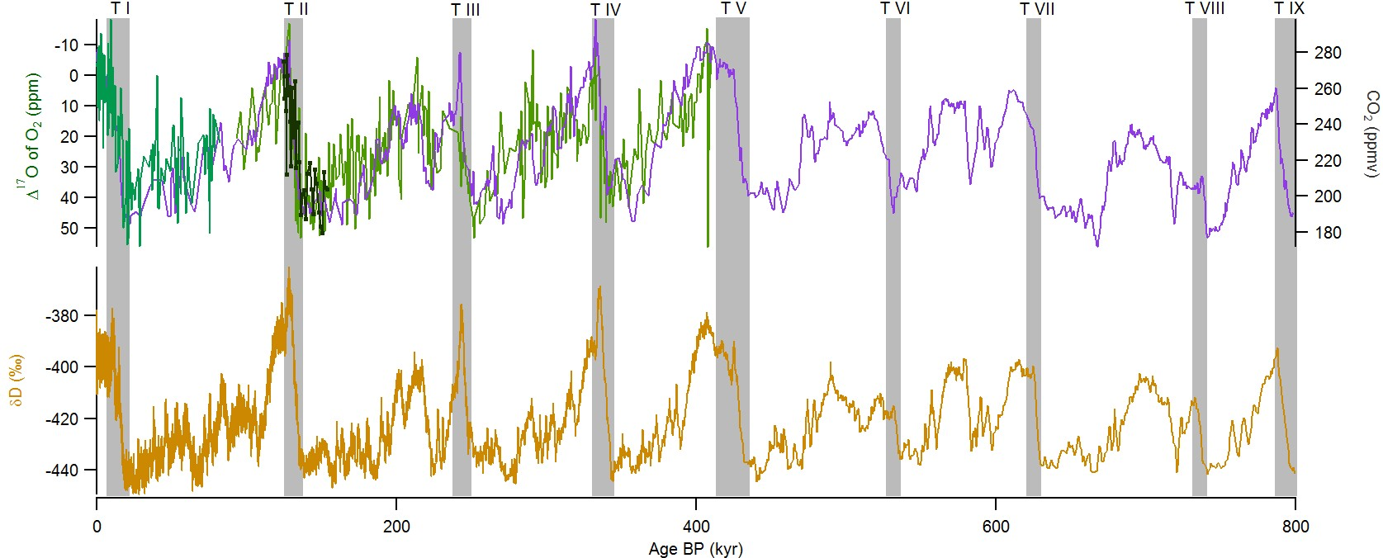
Ice core measurements
Δ¹⁷O of O₂ (ppm)
CO₂ (ppm)
δD (‰)
Brandon et al., Nat Com, in press

Slide 11
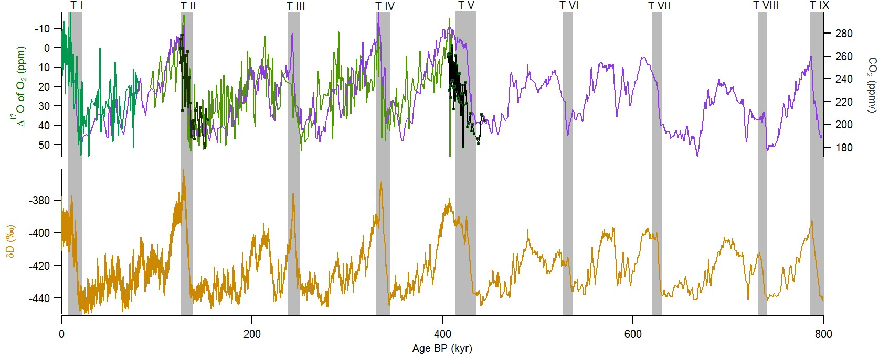
Ice core measurements
Δ¹⁷O of O₂ (ppm)
CO₂ (ppm)
δD (‰)
Brandon et al., Nat Com, in press

Slide 12
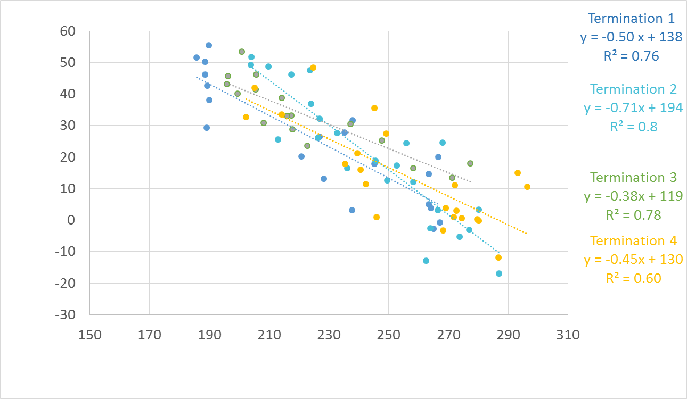
Ice core measurements
Δ¹⁷O of O₂ (ppm)
CO₂ (ppm)

Slide 13
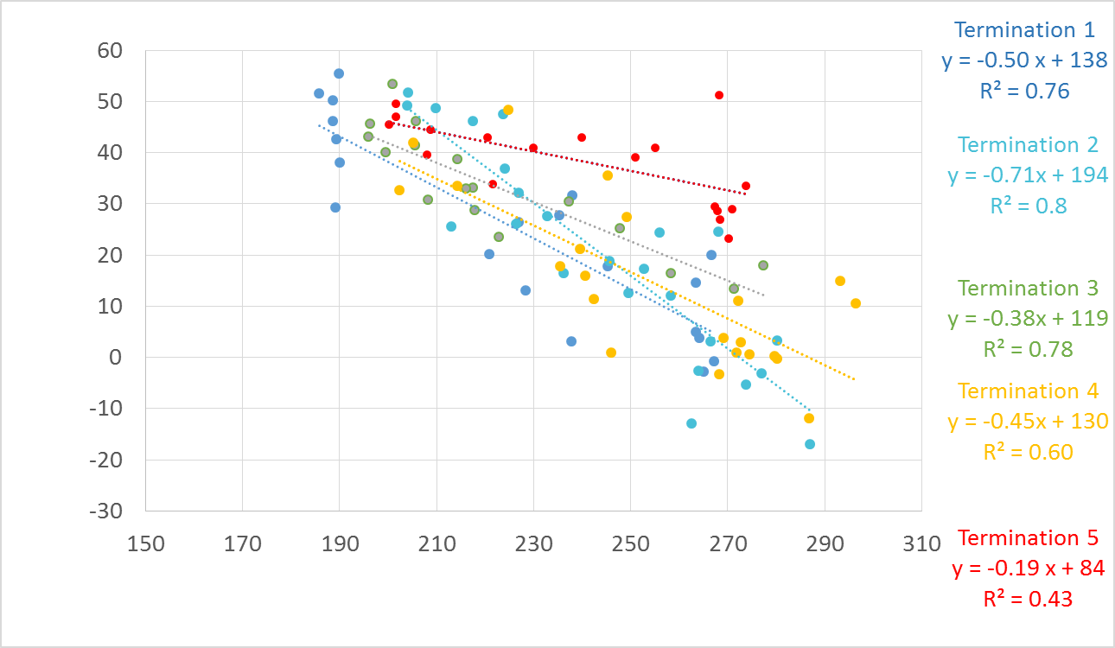
Ice core measurements
Δ¹⁷O of O₂ (ppm)
CO₂ (ppm)
Δ¹⁷O of O₂ is significantly higher during the beginning of marine isotopic stage 11 than over the other interglacials

Slide 14
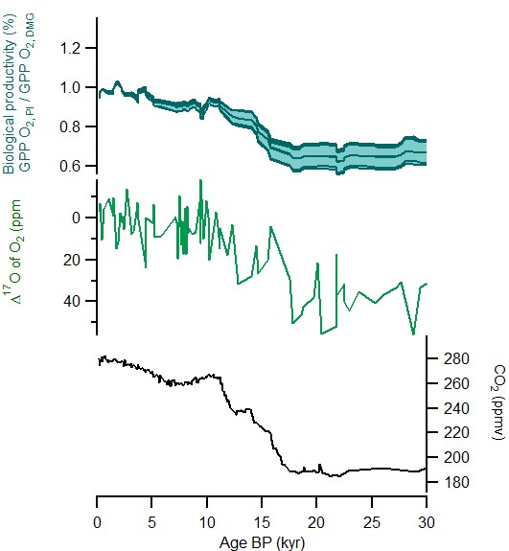
Quantification of past global productivity (GPP) from Δ¹⁷O of O₂
Example of the last deglaciation
Data
IPSL general circulation coupled model
Vegetation module -> ORCHIDEE
Marine biosphere module -> PISCES
GPP O₂
Δ¹⁷O of O₂
CO₂
GPP O₂ during LGM = 65% GPP O₂ during pre-industrial both for model output and reconstruction from Δ¹⁷O of O₂

Slide 15
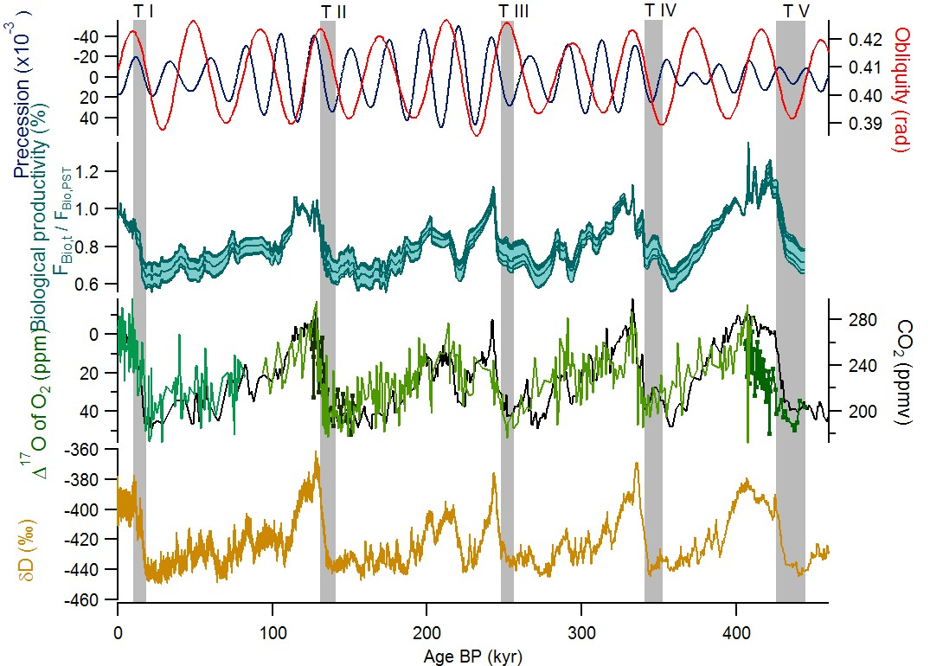
An exceptionnal productivity over Termination V
GPP O₂
CO₂
Δ¹⁷O of O₂
Brandon et al., ongoing work

Slide 16
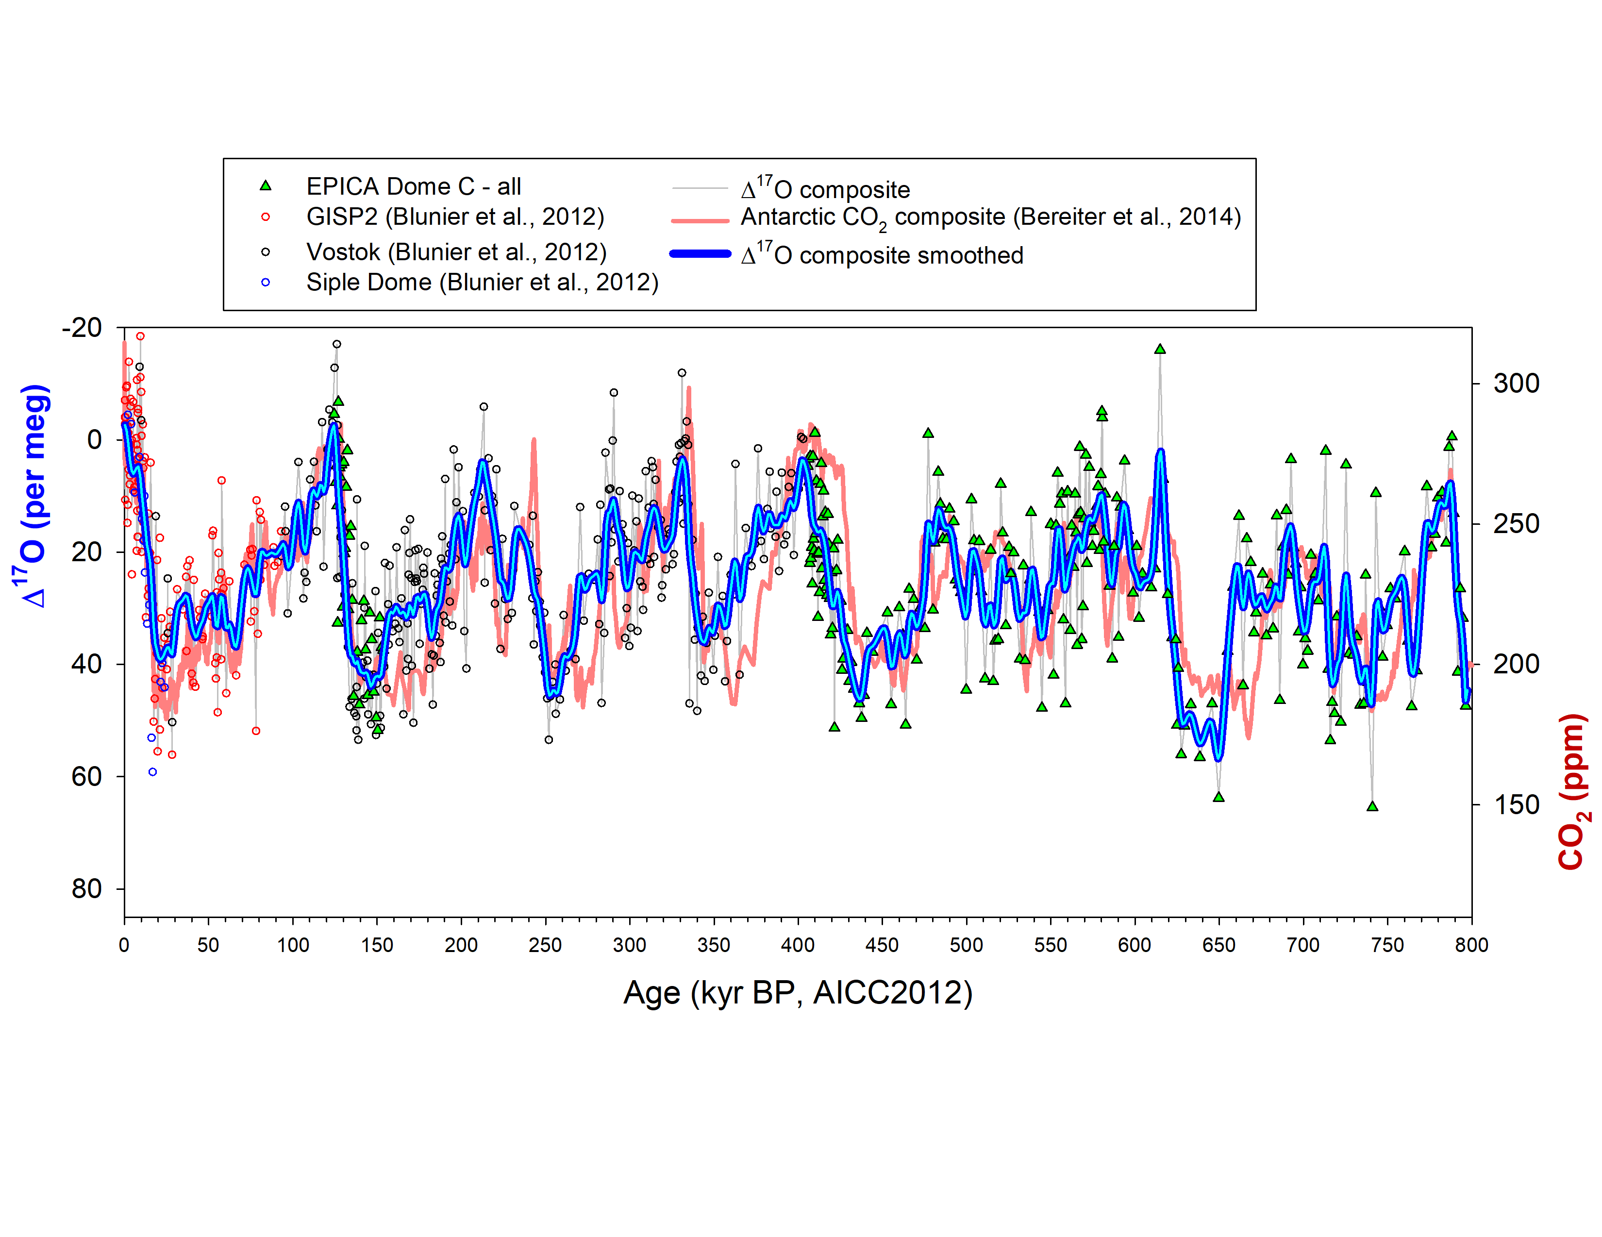
Δ¹⁷O of O₂ over the last 800 ka
Higher CO₂
→ More strato O₂ prod.
→ Lower Δ¹⁷O
Lower CO2
→ Less strato O2 prod.
→ Higher Δ¹⁷O
Yang, Brandon et al., in prep – preliminary data

Slide 17
Decoupling between Δ¹⁷O of O₂ and CO₂
Δ¹⁷O-CO₂ decoupling is observed in each Ice Age (R² = 0.01) + MIS 11 interglacial.
The decoupling occurs when biosphere productivity is either anomalously large or small.
Examples: Strong biosphere productivity → MIS 11 / Weak biosphere productivity → MIS 16
Lower Δ¹⁷O (w.r.t. CO₂)
→ Weaker bio. O₂ prod.
Higher Δ¹⁷O (w.r.t. CO₂)
→ Stronger bio. O₂ prod.
Yang, Brandon et al., in prep – preliminary data

Slide 18
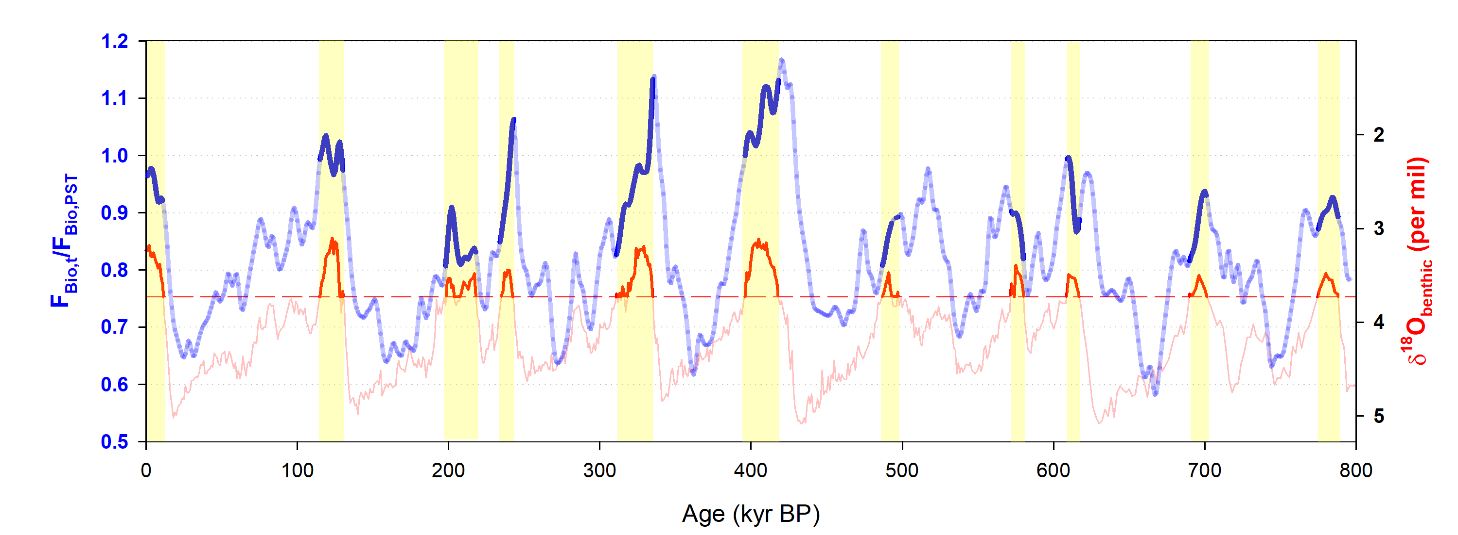
Global biological O₂ productivity pre- vs. post-MBE
Δ¹⁷O-based global productivity during post-MBE interglacials are 7~10% higher than pre-MBE ones.
NH high latitude land productivity might have been reduced during pre-MBE interglacials, probably due to:
  Less perennial Arctic sea ice
  Larger NH ice sheet volume (extent + altitude)
Mid-Brunhes Event (MBE)
Yang, Brandon et al., in prep – preliminary data

Slide 19
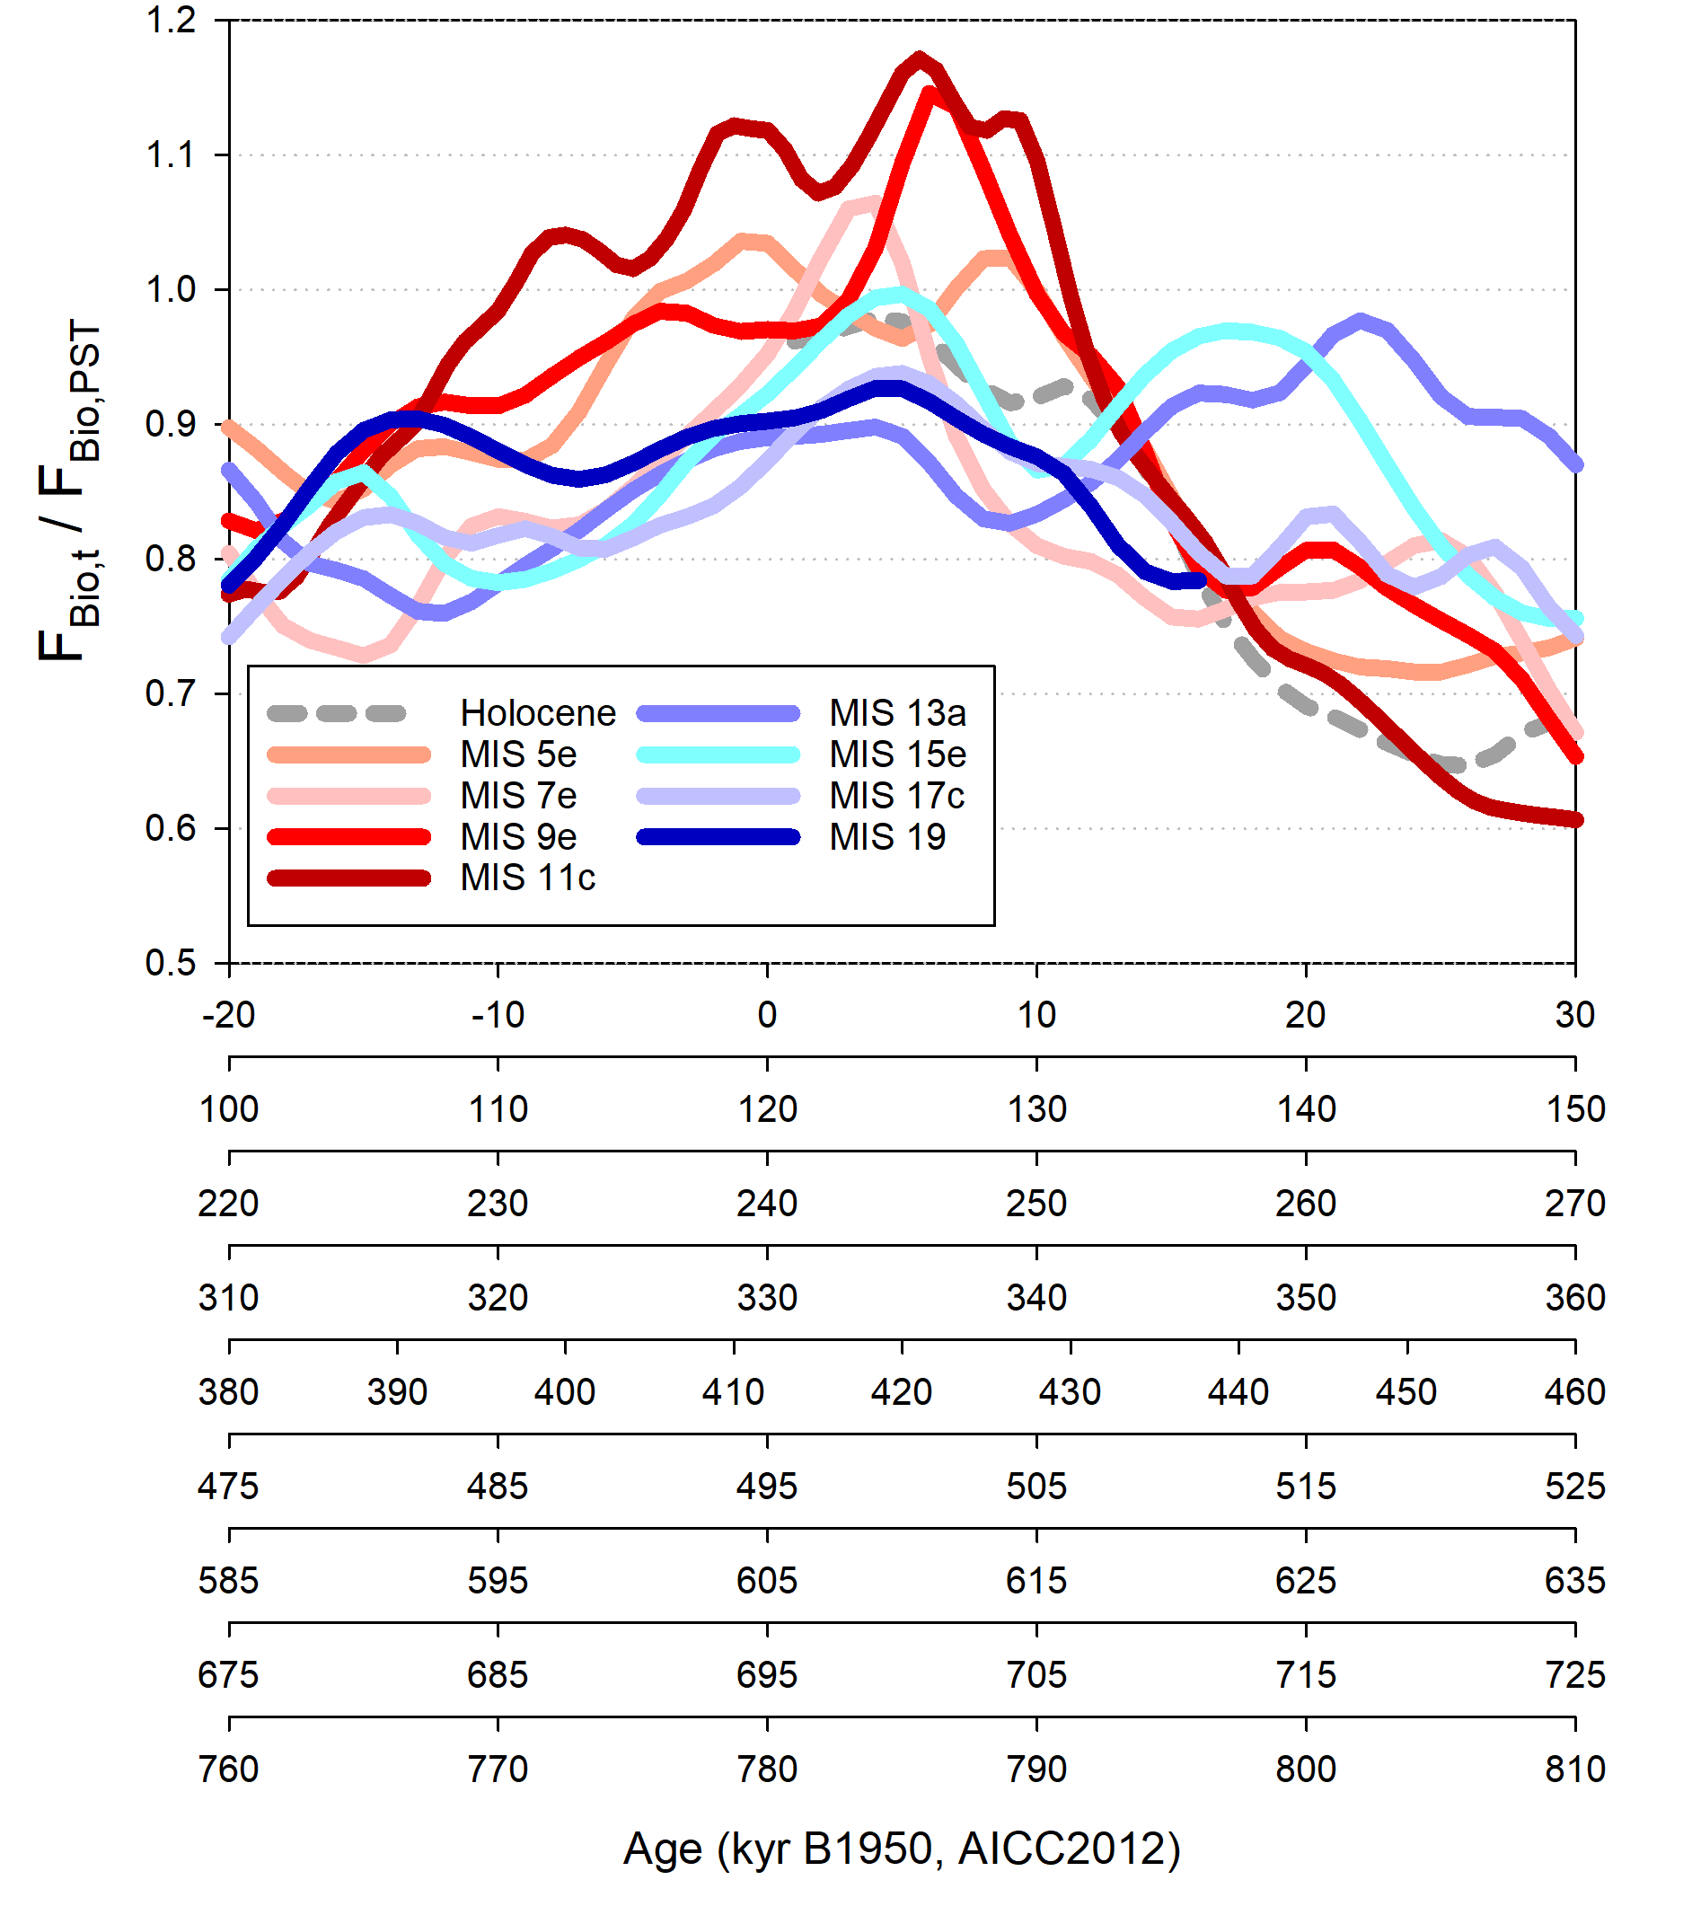
Global biological O₂ productivity pre- vs. post-MBE
Student’s t-test rejects the null hypothesis at 95%.
→ Post-MBE interglacials have stronger productivity.
 | F_{bio,t}/F_{bio,PST}
MIS1 | 0.94±0.06
MIS5 | 1.00±0.08
MIS7a | 0.84±0.03
MIS7c | 1.01±0.09
MIS9 | 0.95±0.08
MIS11 | 1.08±0.08
Post-MBE mean (except MIS7a) | 0.96±0.09 (0.99±0.07)
MIS13a | 0.86±0.03
MIS15a | 0.88±0.03
MIS15e | 0.93±0.05
MIS17 | 0.88±0.04
MIS19 | 0.90±0.02
Pre-MBE mean | 0.89±0.04
Yang, Brandon et al., in prep – preliminary data

Slide 20
¹⁷O-excess = tracer of evaporation + moisture trajectory
δ¹⁷O
MWL
Equilibrium fractionation
Equilibrium
Relative humidity = 100%
Ocean
H₂O_{vap}
Equilibrium
Diffusion
Relative humidity
H₂O_{liq}
vapor
¹⁷O-excess humid conditions
H₂O_{vap}
Equilibrium
+ Diffusion
¹⁷O-excess dry conditions
H₂O_{liq}
Uemura et al., GRL, 2008, 2010
δ¹⁸O

Slide 21
¹⁷O-excess = tracer of evaporation + moisture trajectory
Touzeau et al., TC, 2016

Slide 22
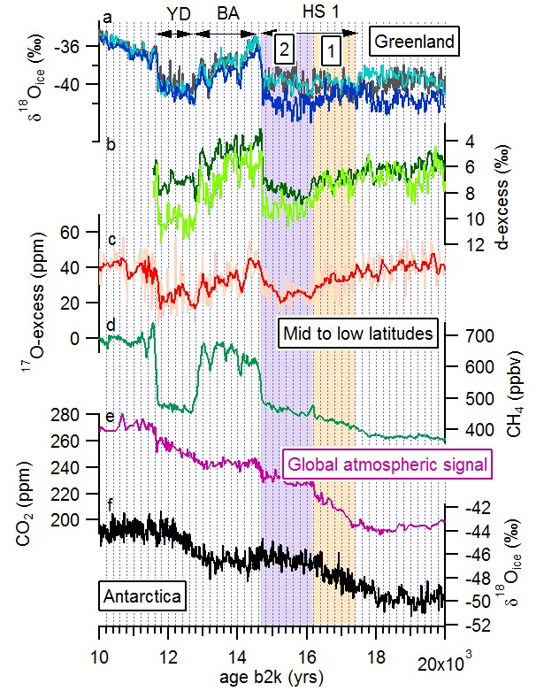
¹⁷O-excess application:
Termination 2
At 16.1 ka, a millennial event is recorded in CH₄, d-excess and ¹⁷O-excess, three « low latitude » tracers
At the same time, the δD from Antarctic ice cores are increasing and δ¹⁸O from Greenland is uniformly low.
→ Decoupling between high and low latitudes
NGRIP comm. members, 2004
Grootes et al., 1993
EDML comm. members, 2006
Marcott et al., 2014
Jouzel et al., 2005
Landais et al., 2018
Rhodes et al., 2015

Slide 23
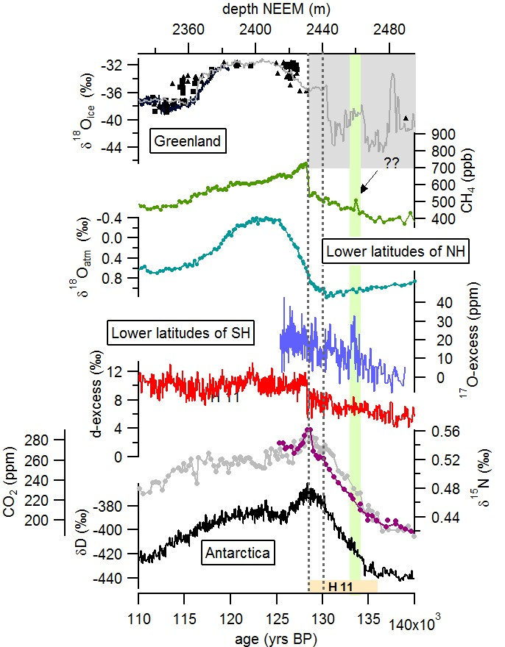
¹⁷O-excess application:
Termination 2
At 134 ka, a millennial event is recorded in CH₄ and ¹⁷O-excess, two « low latitude » tracers
At the same time, the δD from the EDC ice core is steadily increasing
→ Decoupling between high and low latitudes
Landais et al., 2003
Suwa et al., 2006
NEEM comm. Members, 2013
Jouzel et al., 2007
Lourantou et al., 2010
Bigler et al., 2010
Masson-Delmotte et al., 2010
Loulergue et al., 2008
Landais et al., 2013
Grisart et al., ongoing work – preliminary data

Slide 24
Conclusions
Possible improvement of the Δ¹⁷O of O₂ quantitative interpretation through biology experiments
Exceptionnal productivity during Termination V:
  +20% compared to the pre-industrial
  probably due to continental productivity
Δ¹⁷O of O₂ record over the last 800 ka permits to highlight periods with changes in biopshere productivity (differences before and after MBE)
¹⁷O-excess permits to identify decoupling betweet high and low latitude climate changes

