Slide 1
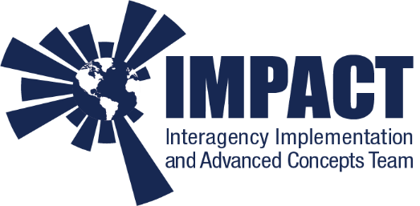
Data Systems to Enable Open Science: The Joint ESA-NASA Multi-Mission Algorithm and Analysis Platform’s Data Ecosystem
Kaylin Bugbee¹, Aaron Kaulfus¹, Aimee Barciauskas², Manil Maskey³, Rahul Ramachandran³, Dai-Hai Ton That¹, Christopher Lynnes⁴, Katrina Virts¹, Kel Markert¹, Amanda Whitehurst⁵
(1) University of Alabama in Huntsville (2) Development Seed (3) NASA Marshall Space Flight Center (4) NASA Goddard Space Flight Center (5) NASA Headquarters

Slide 2
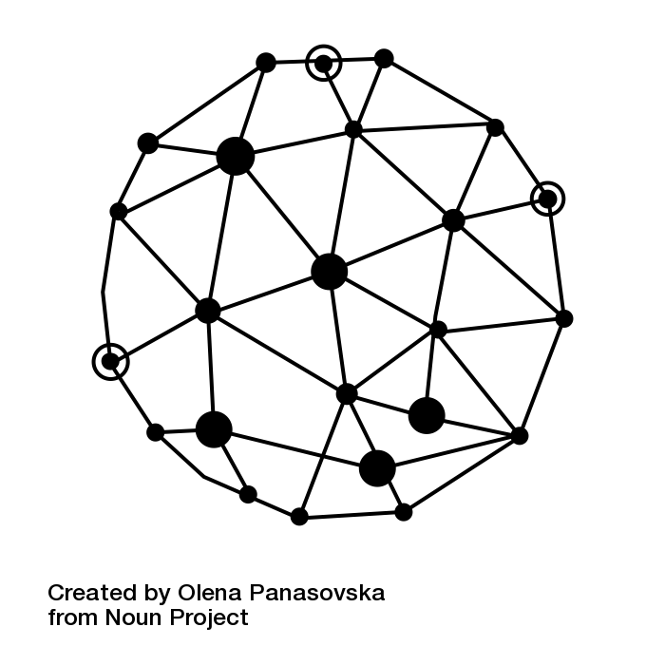
Introduction: Open Science in the 2.0 Era
Open Science – “the idea that scientific knowledge of all kinds should be openly shared as early as it is practical in the discovery process” (University of Cambridge)
Science 2.0 – “all scientific culture, including scientific communication, which employs features enabled by Web 2.0 and the Internet”
What does open science look like in the 2.0 era?
Open Science = Open Data + Open Software + Open Information Sharing
Scientists collaborate through sharing these components & research can begin with any one of these aspects
Scientists want and need to work more collaboratively and openly in the 2.0 era

Slide 3
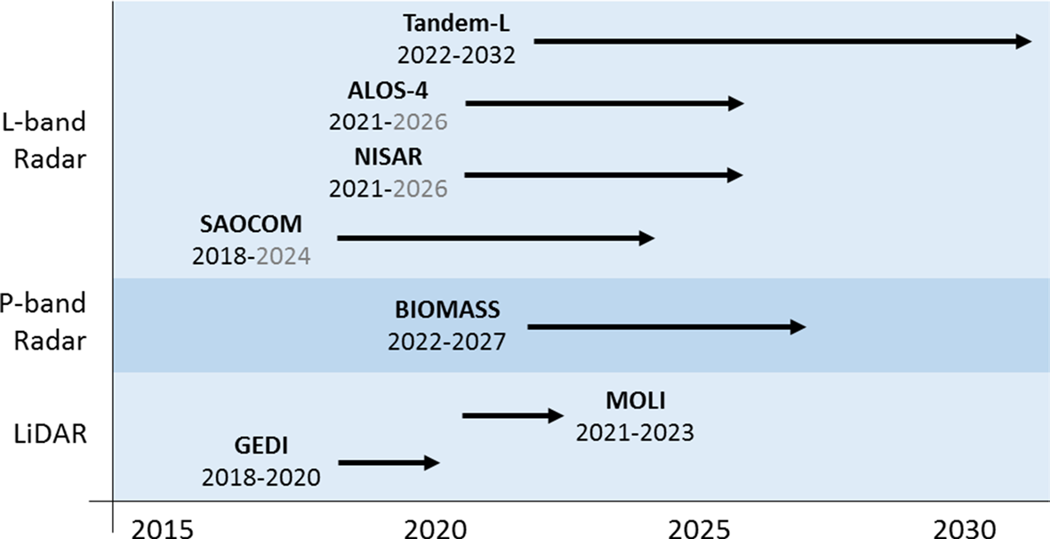
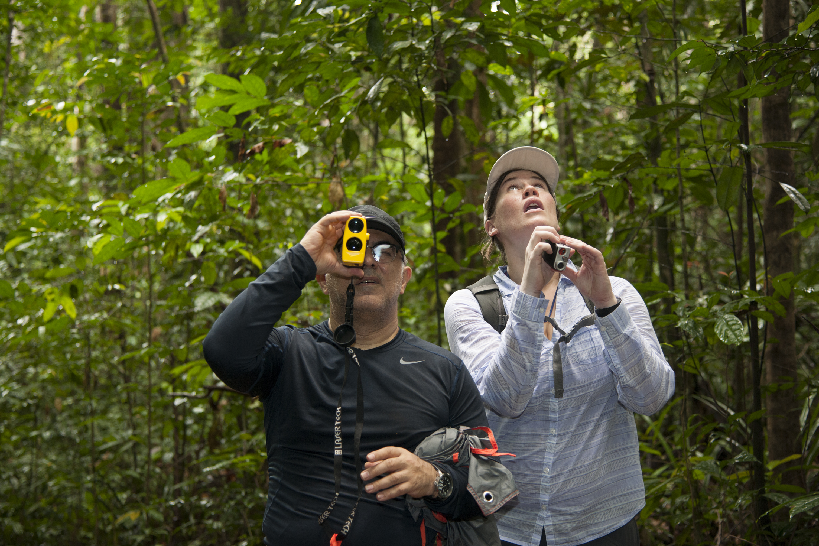
Science Community Use Case
Global Aboveground Terrestrial Carbon Dynamics Research Community
Understanding biomass distribution and changes in biomass is critical to understanding the global carbon cycle and global climate change
Space-based data can improve understanding by providing (Herold at al)
Improved geographic coverage
Better spatial resolutions
Ongoing period of temporal observations
These data, in combination with field and airborne observations for calibration/validation, can greatly improve the community’s understanding
Upcoming space-based missions which may contribute to biomass monitoring.
Image Credit: Herold, M., Carter, S., Avitabile, V. et al. Surv Geophys (2019) 40: 757. https://doi.org/10.1007/s10712-019-09510-6
https://www.jpl.nasa.gov/images/earth/africa/20160225/earth20160225d.jpg

Slide 4
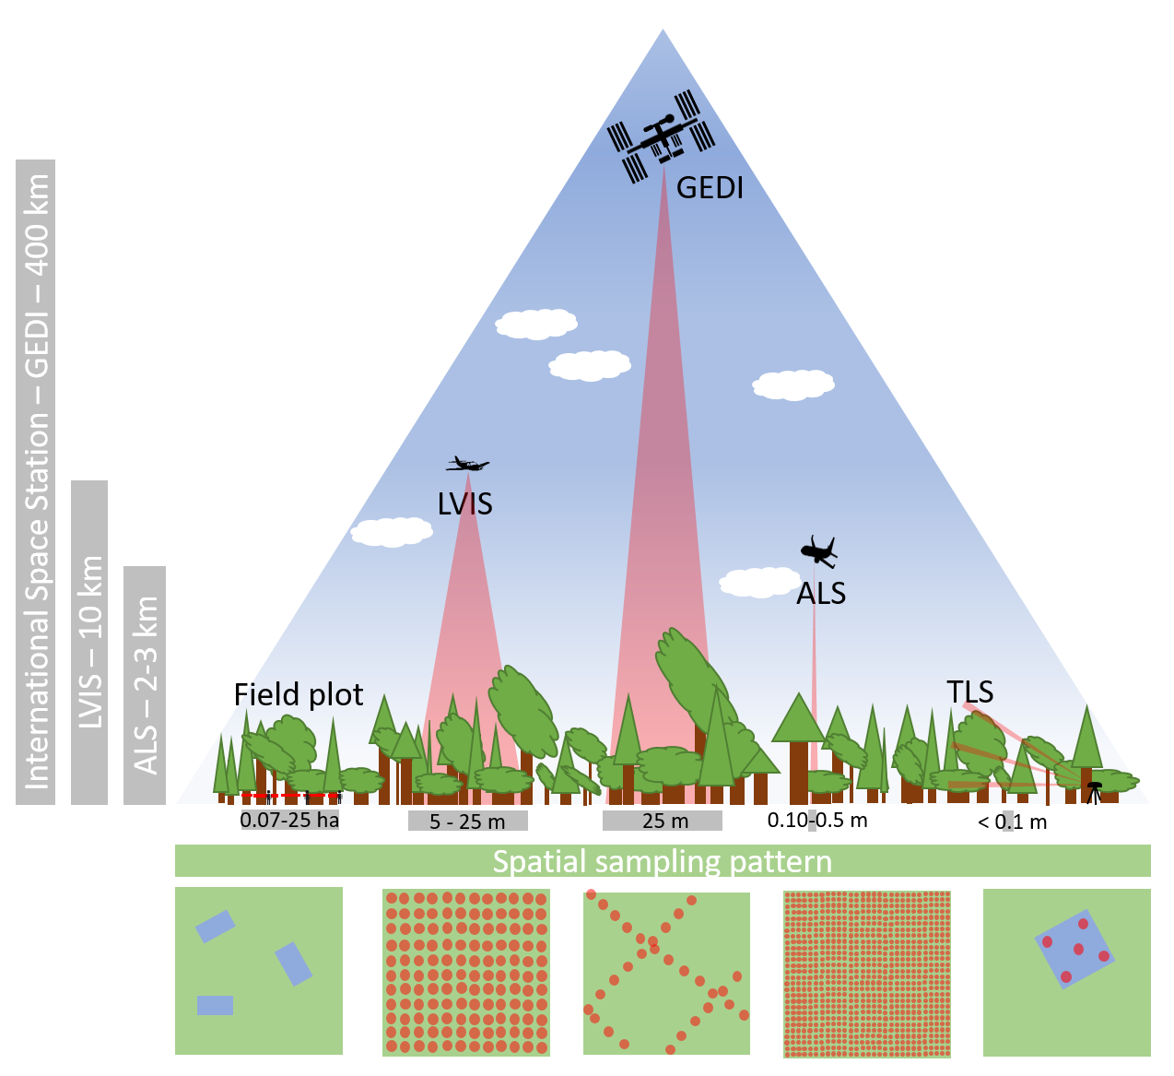
Science Community Use Case
Obstacles to Research
Relevant data are dispersed, making global analysis of data from various sources difficult
Not all data and algorithms are openly shared
Data for biomass research are heterogeneous in nature
Multiple spatial scales
Various observation geometries (footprints vs pixels vs plots)
Researchers want to share algorithms and data easily and quickly since these algorithms are highly customizable
What can we do to support the open data, information and compute needs of this research community?
An example of various spatial sampling patterns used by the biomass community.
Image Credit: https://gedi.umd.edu/science/calibration-validation/

Slide 5
What is MAAP?
The MAAP is a virtual environment dedicated to the unique needs of sharing and processing data from relevant field, airborne and satellite measurements related to ESA and NASA missions
Jointly managed by ESA and NASA and accessible to designated ESA and NASA scientists.
Initially populated with pre-launch and complimentary data from other projects.
Science focus is to improve the understanding of global terrestrial carbon dynamics & to support algorithm development
Addresses a need expressed by the science community to more easily share and process data collected by NASA and ESA activities

Slide 6
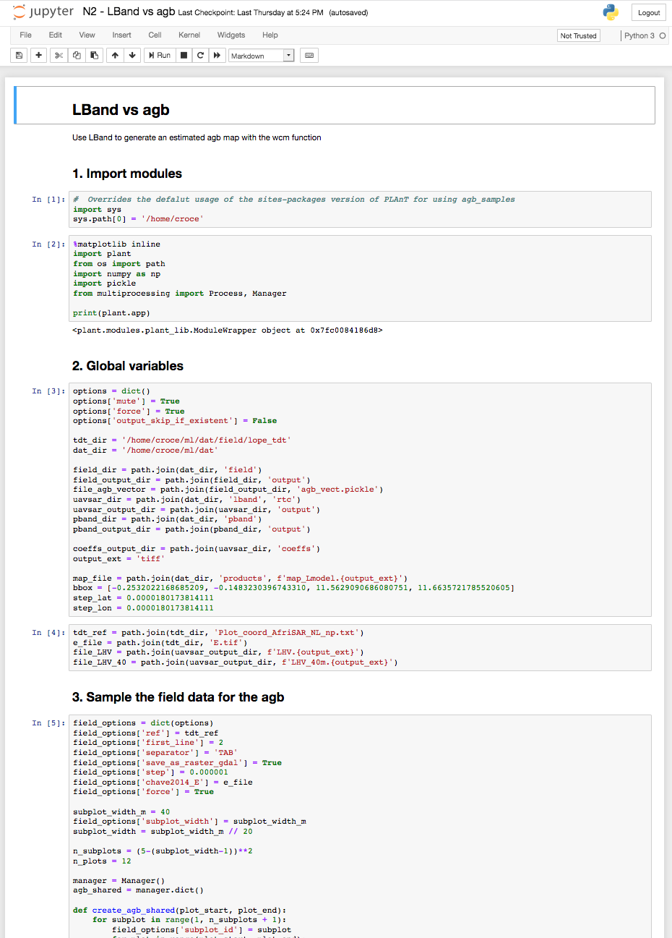
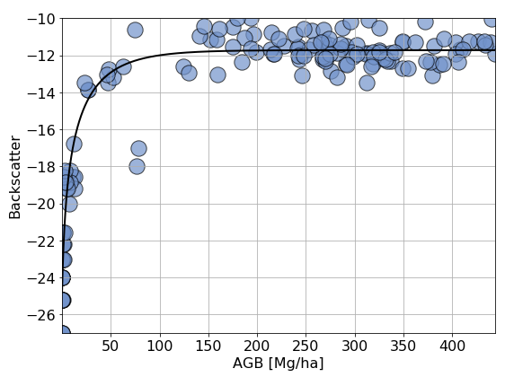
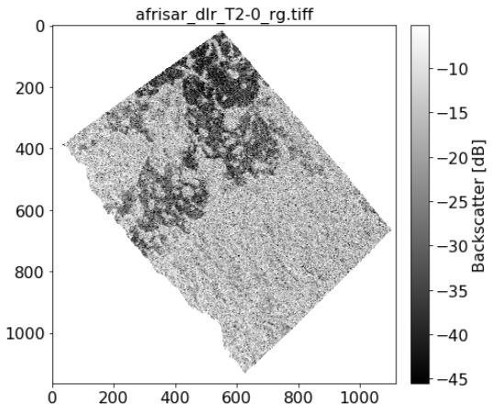
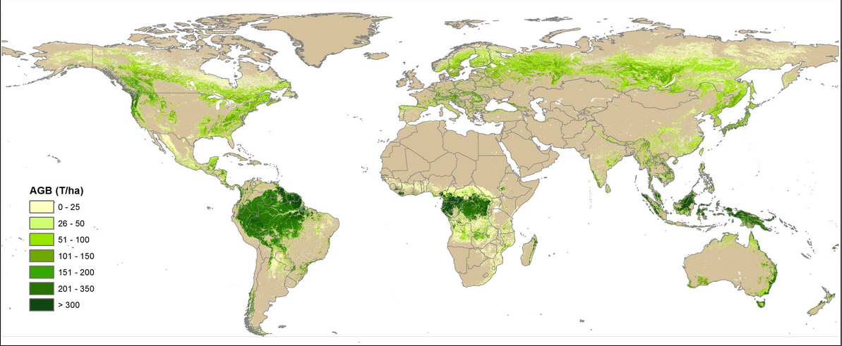
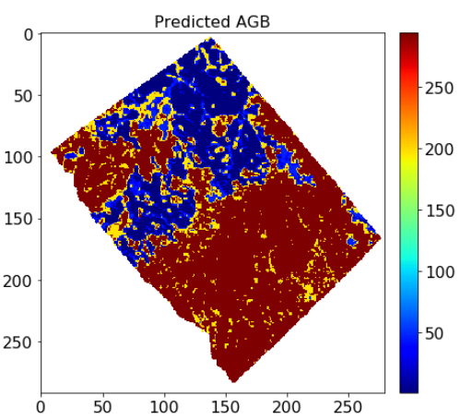
MAAP Goals
Seamless open access to airborne, spaceborne and field ESA and NASA data for biomass mapping
Ability to upscale user’s algorithms (Jupyter notebooks) from small regions of interest to global scale
Collaboration on end-to-end calibration and validation of higher-level science products
ESA field data + NASA L-band
ESA
P-band
Sample global biomass map (for illustration only)
Biomass map from L/P band and lidar fusion
Develop and collaborate on Jupyter notebooks
Upscale processing to generate global biomass map and validate
Calibrate and fine-tune algorithms accessing multiple data sources

Slide 7
NASA MAAP Data Ecosystem
‘the people and technologies collecting, handling, and using the data and the interactions between them” (Parsons et al 2011)

Slide 8
MAAP Data Ecosystem Architecture
Direct data access via files
Data Lake: large repository of heterogeneous raw data (Sawadogo et al.)
Data spaces highly coupled to containers and workflows
Want to minimize direct file access
Data processed by sending code to data
Analytics Optimized Data Store
Data structured and organized based on schema/ontology
Client Access
(APIs, Tools)
Structured Data Store
Data structured and organized based on schema or ontology
Core Data Services
Lowers barriers to use by providing a metadata catalog, documentation visualization
Data Spaces
Curate, harmonize data in personalized workspace
Containers
Workflows
Run code for in-situ data analysis
Data Lake
Ability to access files
Data Lake
(Object Store, Tiered storage)

Slide 9
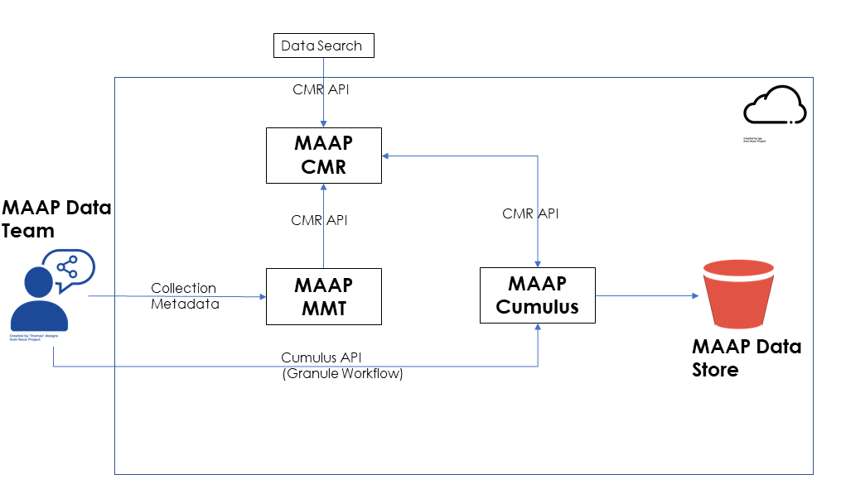
MAAP Data Lake
Data publication process into data lake similar to those followed by NASA’s archives
Over 40 datasets ingested for MAAP
Data products identified by SMEs
Reuses open source components developed by NASA’s ESDIS project
Data ingested into MAAP data lake enabled by Cumulus – available on the cloud
Metadata Management Tool to author and curate metadata
Common Metadata Repository to facilitate discovery of objects in the data lake

Slide 10
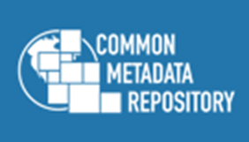
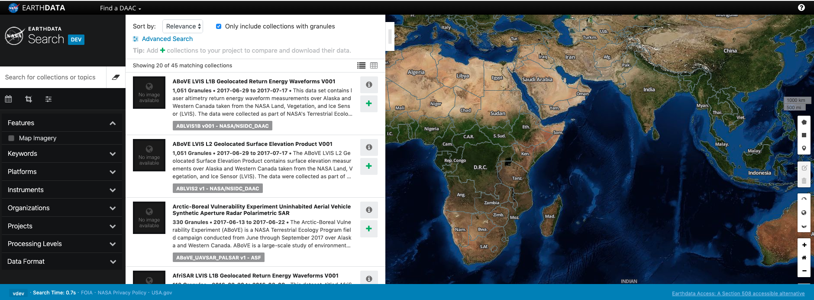
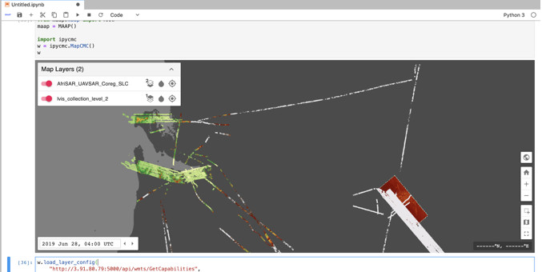
MAAP Core Data Services
Discovery of biomass relevant data via a centralized catalog
ESA and NASA are contributing metadata to a single repository (CMR)
Meta(data) may be discovered via an API in the data spaces environment or via the Earthdata Search client
Additional metadata information provided to support biomass search needs
Other core services include:
Visualization
Fast browse capabilities
Documentation
Links to data documentation, relevant publications

Slide 11
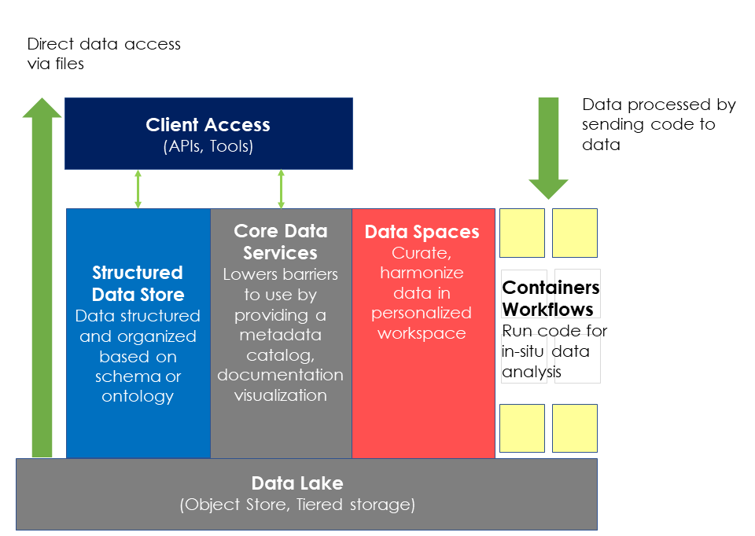
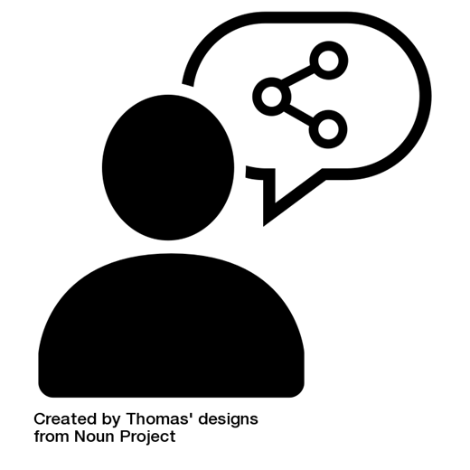
Connecting Data Spaces to Core Services
Users leverage the data lake and private data spaces to run analysis at scale via containers or workflows
MAAP enables quick & easy sharing of data from a user’s data space to the broader data ecosystem
Users can share data with select collaborators
Share data more broadly from their private workspace to the MAAP data lake and CMR catalog so users can discover it
New Data Source
Requires data stewardship and corresponding core services for user shared data

Slide 12
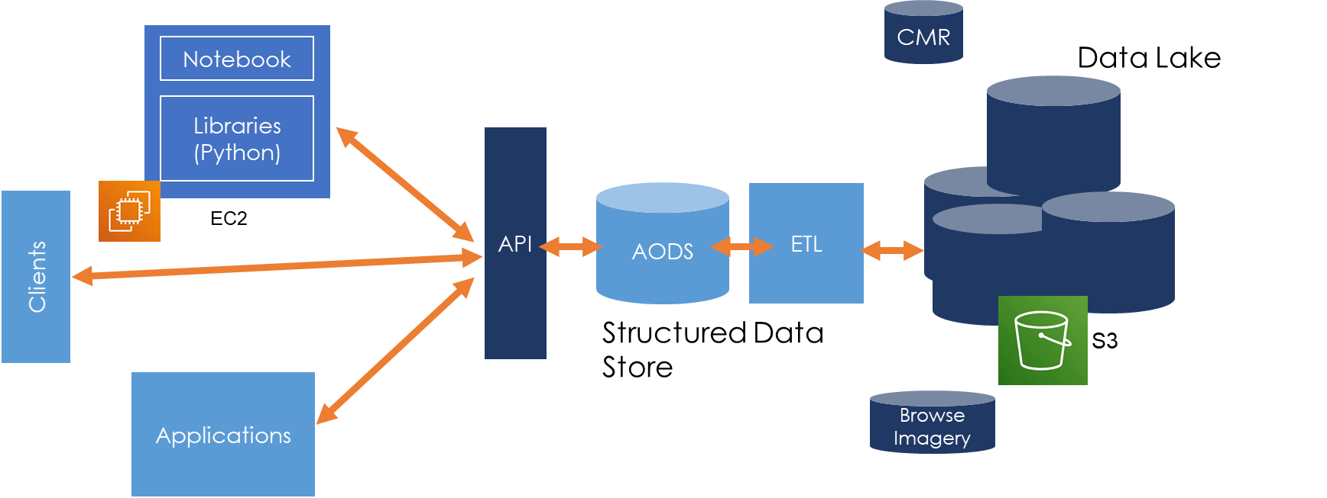
MAAP Structured Data Store
To continue to evolve, MAAP will also be exploring data engineering by offering structured data stores
Optimized for big data analysis tools
Preprocessed to meet goals
Focus on improved/efficient performance
Current: Postgres database for cal/val data
Future: Analytics Optimized Data Stores (AODS) and other solutions

Slide 13
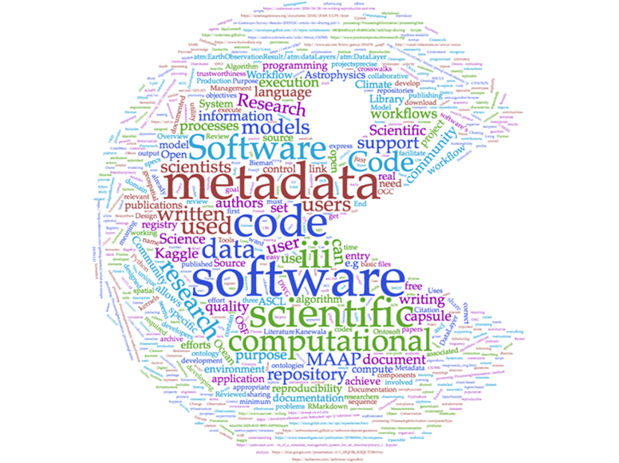
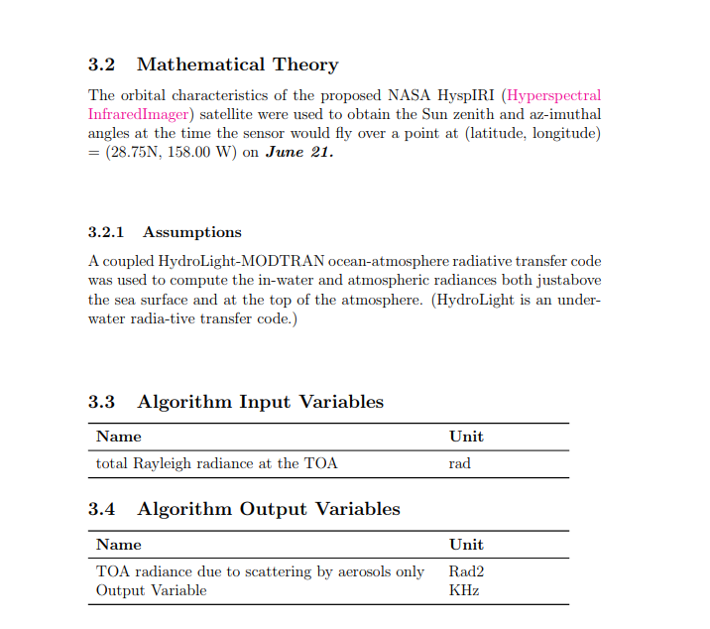
Future Work: MAAP User Shared Software
New core service - encourages sharing of algorithms and software to the broader MAAP community
Create metadata to support sharing of and creating documentation of algorithm methodology
Scientific and mathematical rationale
Algorithm Theoretical Basis Documents (ATBDs) or similar
Create metadata to support sharing of algorithm implementation software
Document inputs, outputs, processing steps, computation needed
Metadata to be stored in MAAP CMR to facilitate discovery

Slide 14
Discussion
To be a true data ecosystem that supports open science, MAAP will need to continue to adapt and evolve
Extensible to new technologies, changes in data distribution methods
New community research needs
In the 2.0 open science era
Technology will continue to evolve and be more widely adopted
Data discovery, interoperability, accessibility may look quite different
Best practices at data repositories will need to continually evolve to support these changing needs and to support the broader open science movement
MAAP explores both the technology and data repository best practices
Includes evolving data stewardship best practices
The MAAP data team is in the process of expanding the traditional data management plan to include not just data but all information within the platform. The plan highlights stewardship activities for data and information moving through the platform
The MAAP data team is also developing a level of service plan for a cloud-based data system.

Slide 15
References
Bartling S., Friesike S. (2014) Towards Another Scientific Revolution. In: Bartling S., Friesike S. (eds) Opening Science. Springer, Cham. https://doi.org/10.1007/978-3-319-00026-8_1
Herold, M., Carter, S., Avitabile, V. et al. Surv Geophys (2019) 40: 757. https://doi.org/10.1007/s10712-019-09510-6
Parsons, M., Oystein, G., LeDrew, E., De Bruin, T., Danis, B., Tomlinson, S. and D. Carlson. (2011). A Conceptual Framework for Managing Very Diverse Data for Complex, Interdisciplinary Science. Journal of Information Science, Vol 37:6.
Sawadogo, Pegdwendé Nicolas & Scholly, Etienne & Favre, Cécile & Ferey, Eric & Loudcher, Sabine & Darmont, Jérôme. (2019). Metadata Systems for Data Lakes: Models and Features.
Scholarly Communication – Open Research. University of Cambridge. https://osc.cam.ac.uk/open-research. Accessed 11/20/19

Slide 16
Questions?
Contact me at:
Kaylin.m.Bugbee@nasa.gov
Special thanks to all our collaborators on this project: Laura Jewell, George Chang, Hook Hua, Marco Lavalle, Laura Duncanson, Björn Fromnknecht, Clement Albinet, Valerie Dixon, Kevin Murphy, Gerald Guala

