Slide 1
Concurrent Miocene Antarctic ice sheet growth and CO₂ increase caused by disequilibrium EGU General Assembly, May 4th 2020 Lennert B. Stap, G. Knorr, and G. Lohmann Alfred-Wegener-Institut, Helmholtz-Zentrum für Polar- und Meeresforschung Bremerhaven, Germany

Slide 2
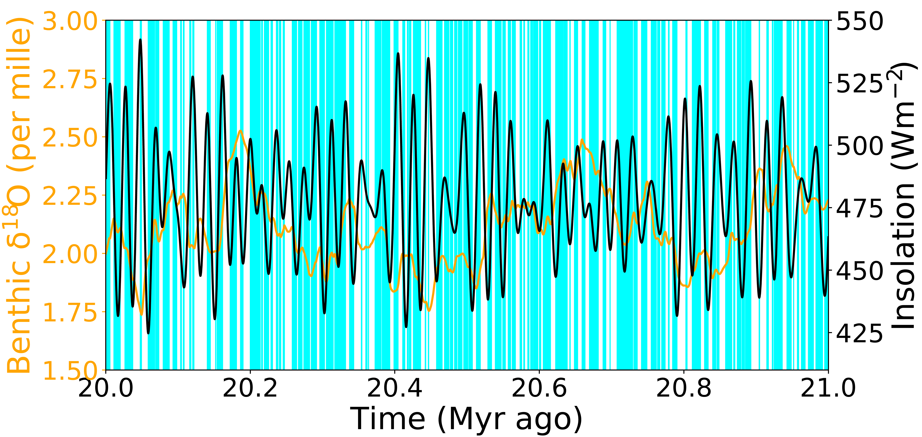
INTRODUCTION
During the early to mid-Miocene
(23-14 Myr ago), benthic δ¹⁸O and
solar insolation variability show discrepancies, i.e. times when both simultaneously increase or decrease.
For the period 21-20 Myr ago, and the stacked benthic δ¹⁸O record from
Zachos et al. (2008) and 80⁰ S January insolation from Laskar et al. (2004),
these are marked cyan in this plot.

Slide 3
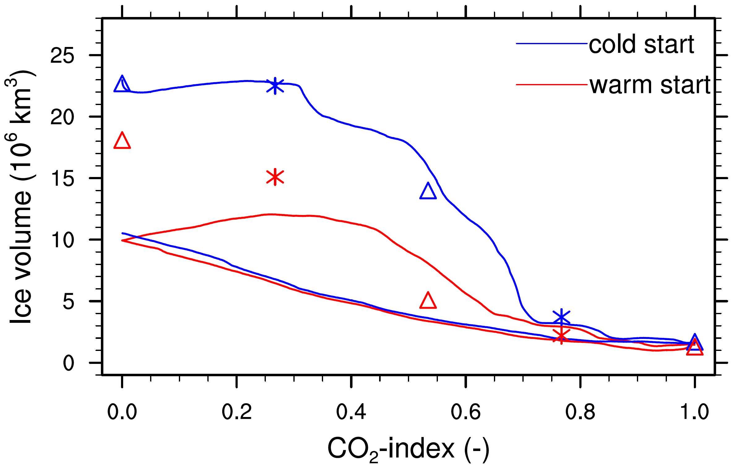
INTRODUCTION
Assuming the Antarctic ice sheet (AIS) is in equilibrium with the forcing climate, these discrepancies can be caused by CO₂ not co-varying with insolation. Otherwise, the ice sheet must grow (shrink) with in(de)creasing CO₂ due to precipitation changes outweighing temperature-induced melt changes.
However, our previous research using the Parallel Ice Sheet Model (PISM) has shown that the transiently evolving AIS is far from equilibrium with the forcing climate (figure).
Symbols: equilibrium results
Solid lines: transient results
Figure from Stap et al. (2019), GRL

Slide 4
METHODOLOGY
We conceptualize transient ice volume variability using a model based on the notion that at any level of a control parameter
(e.g. CO₂) an ice sheet will grow or shrink by a specified rate (g, d) towards a prescribed equilibrium state. The equilibrium solution can contain hysteresis, so that is has a top (V_{eq,top}) and bottom branch (V_{eq,bottom}).
Here, we show how this can cause discrepancies between benthic δ¹⁸O and solar insolation variability,
even in case of co-varying CO₂ and
solar insolation changes, and equilibrium ice volume monotonically decreasing with CO₂.

Slide 5
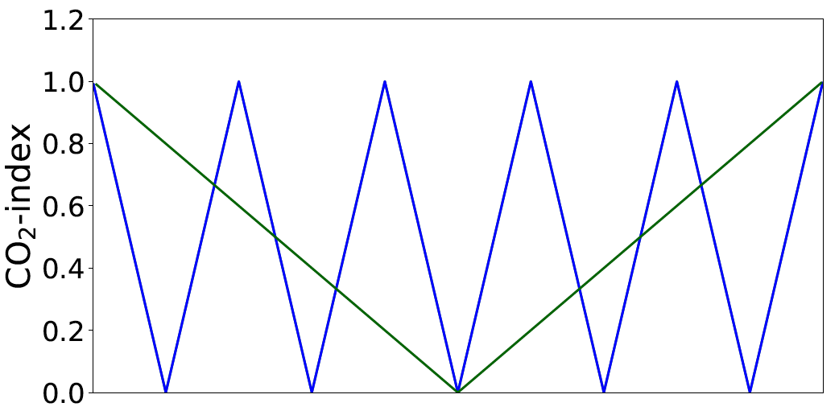
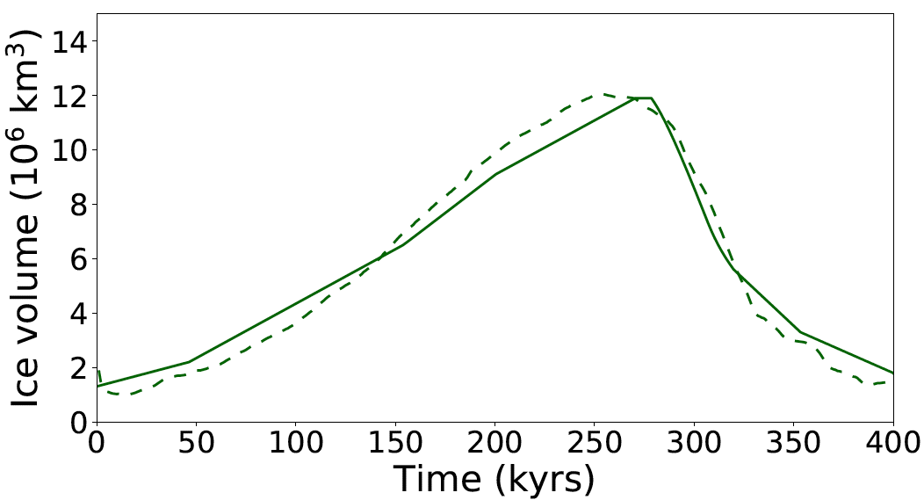
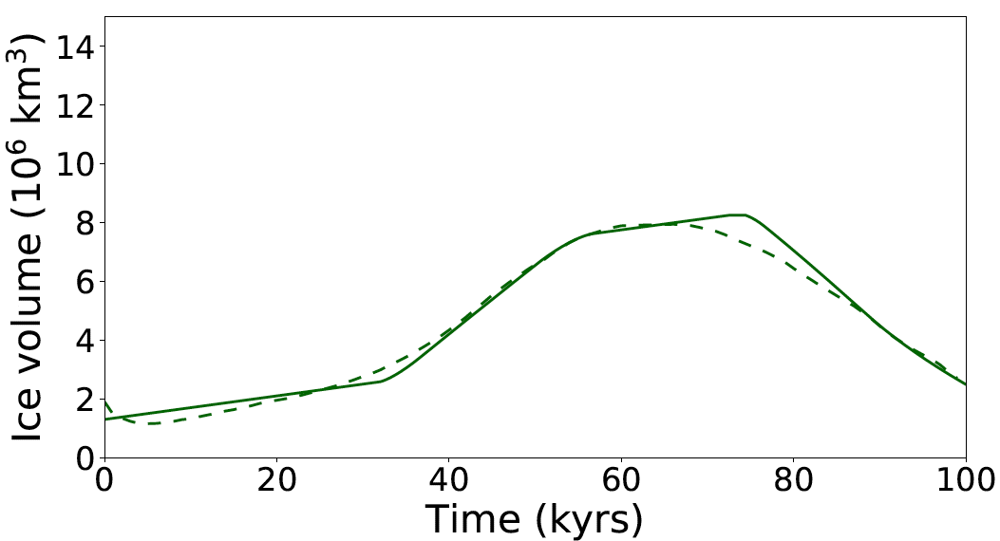
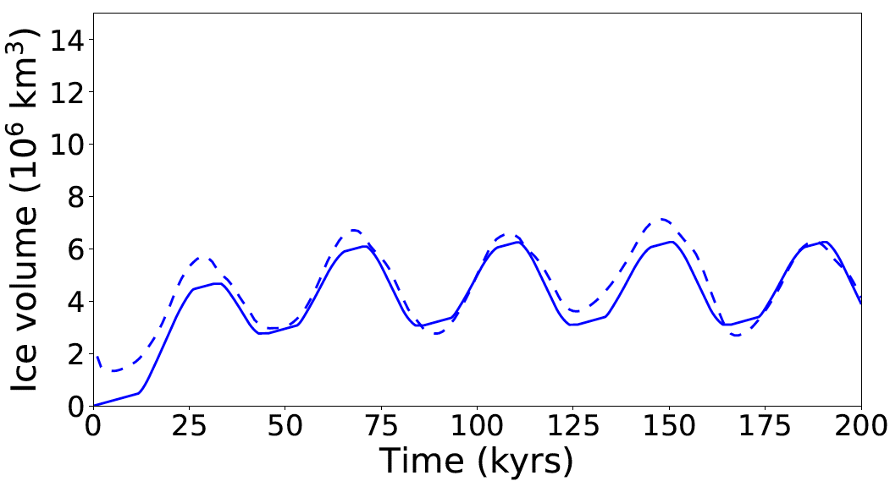
RESULTS
Prescribing equilibrium ice volumes obtained from PISM results, and adjusting the growth and decay rates, our model can reproduce transient PISM results.
a) Forcing
c) 400 kyr cycle
Dashed: PISM results
Solid: Conceptual
model results
b) 100 kyr cycle
d) 5 times 40 kyr cycle

Slide 6
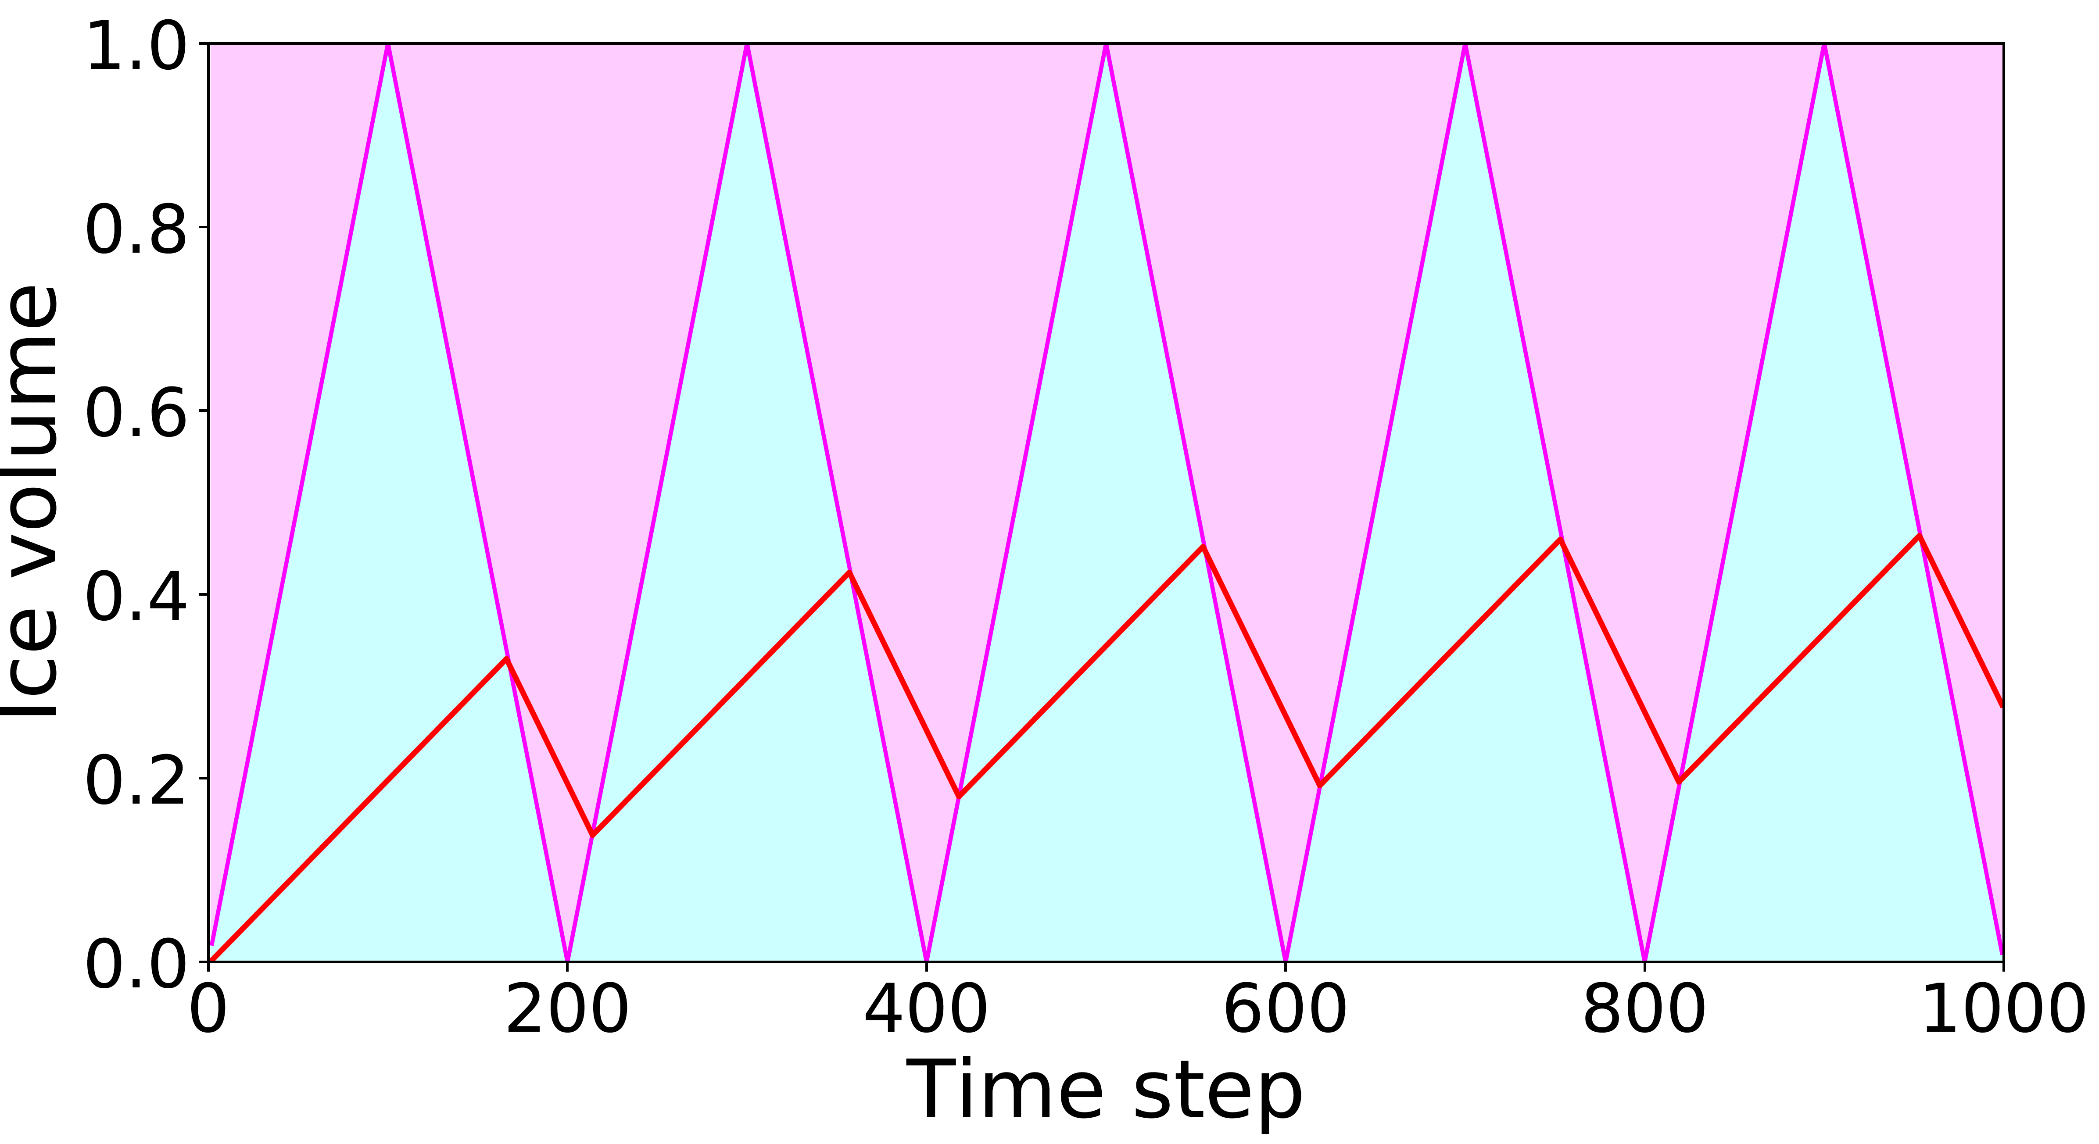
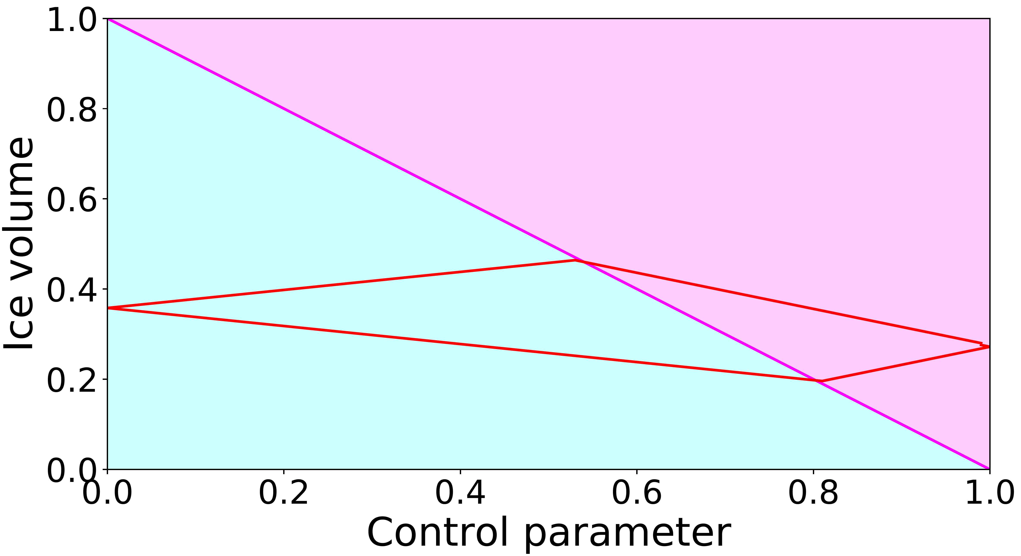
RESULTS
We investigate further, prescribing a simple linear CO₂-V_{eq} relation without hysteresis. We show here that phases of simultaneous ice volume growth and CO₂ increase can arise when the ice volume is out of equilibrium with the forcing climate. Due to the slow growth rate of the ice sheet, it continues to adapt to a relatively large equilibrium ice sheet after a CO₂ decrease, when the CO₂ level is already increasing again. Likewise, but to a lesser extend because d > g, for simultaneous ice volume decay and CO₂ decrease.
Ice volume growth during CO₂ increase
Red: transient ice volume
Magenta: larger than V_{eq(top)}
Cyan: smaller than V_{eq(bottom)}

Slide 7
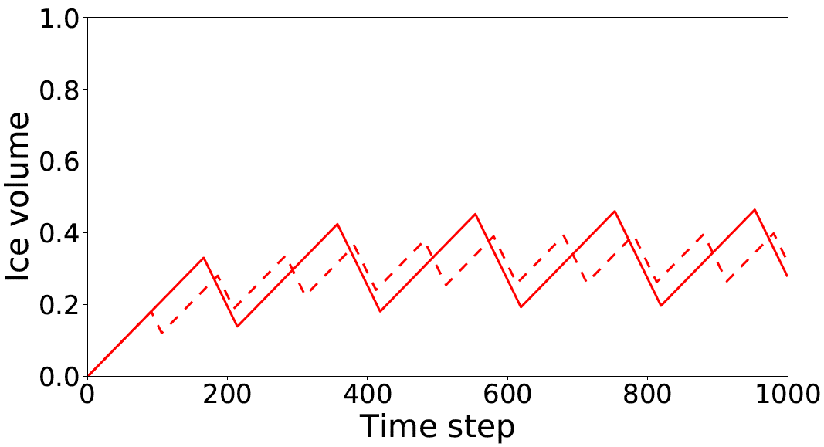
RESULTS
When the frequency of CO₂ variability is increased, the disequilibrium and therefore the relative length of CO₂-ice volume phase differences grows.
Relative length grows
Disequilibrium increases
Solid: 200 timestep forcing period
Dashed: 100 timestep forcing period

Slide 8
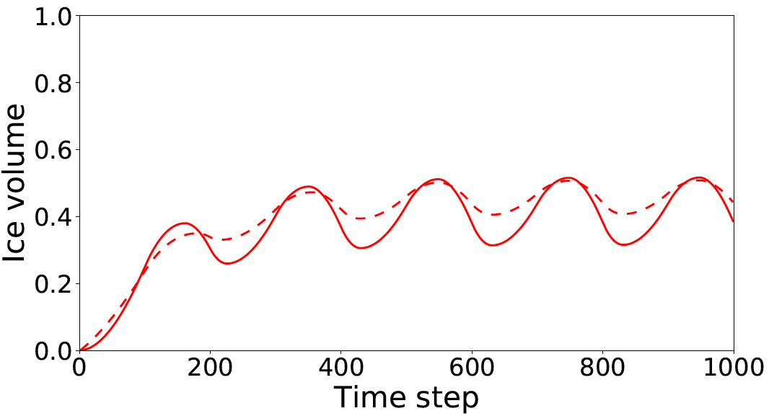
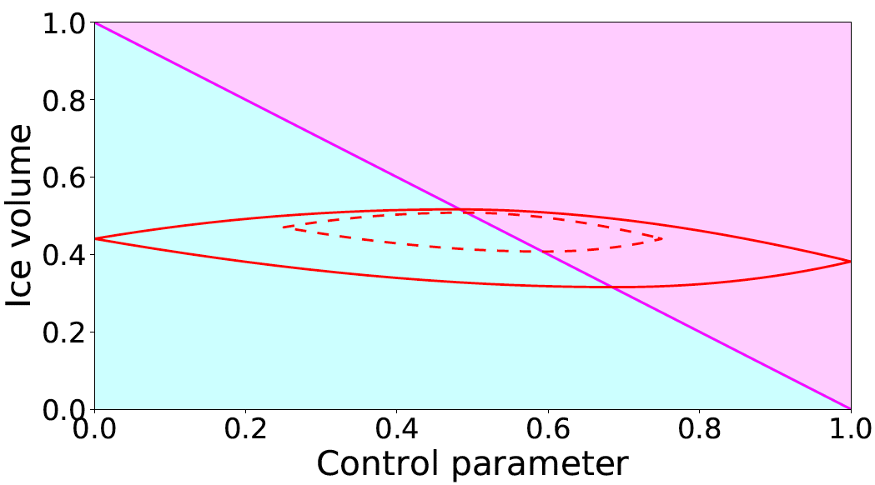
RESULTS
When the amplitude of CO₂ variability is decreased, we obtain a large ice sheet on average in case the growth rate is smaller than the decay rate. Only when the growth and decay rates of the ice sheet depend on the difference between the ice volume and the equilibrium ice volume, do we also obtain decreased ice volume variability (figures).
Smaller average size,
smaller amplitude variability
Solid: 0 – 1 forcing amplitude
Dashed: 0.25 – 0.75 forcing amplitude

Slide 9
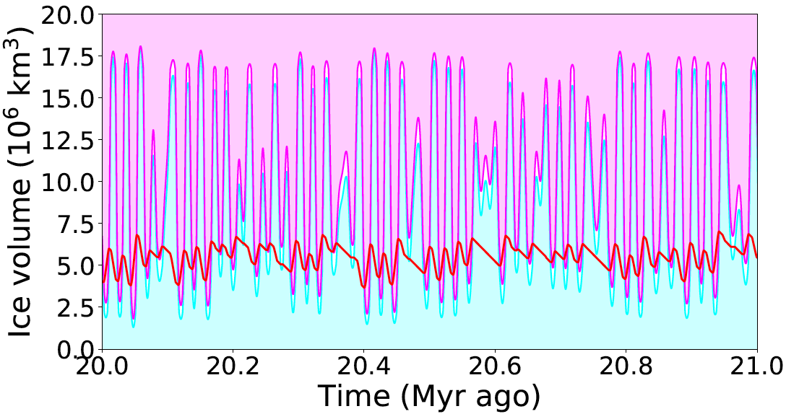
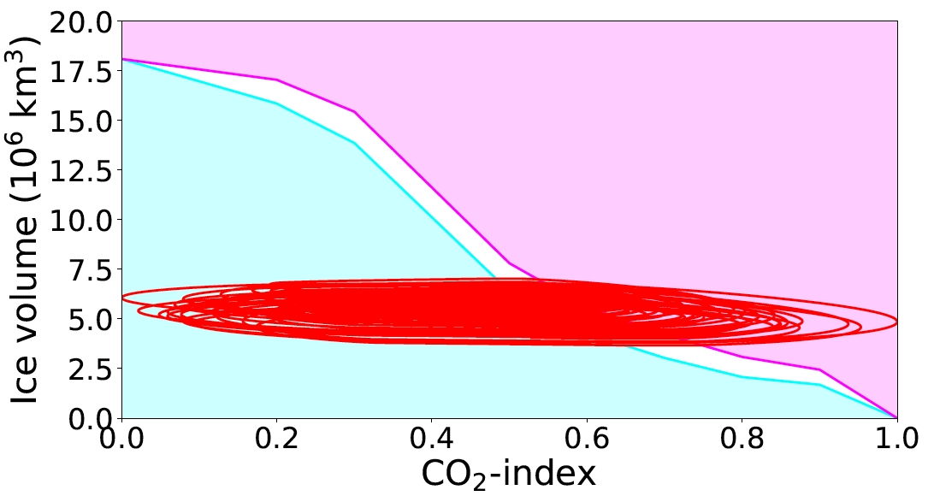
RESULTS
Finally, we use the PISM-derived CO₂-V_{eq} relation and growth and decay rates, and assume the CO₂ forcing co-varies with the 80⁰ S January insolation from Laskar et al. (2004) over the period 21-20 Myr ago.
The convoluted forcing frequency leads to a disorderly relation between CO₂ and ice volume. Also, the delayed and non-linear response of the AIS to (co-varying) solar insolation and CO₂ va-lues can lead to skipped forcing cycles and power modulation in the benthic δ¹⁸O spectrum.

Slide 10
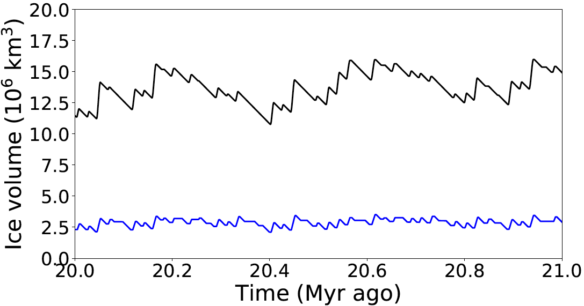
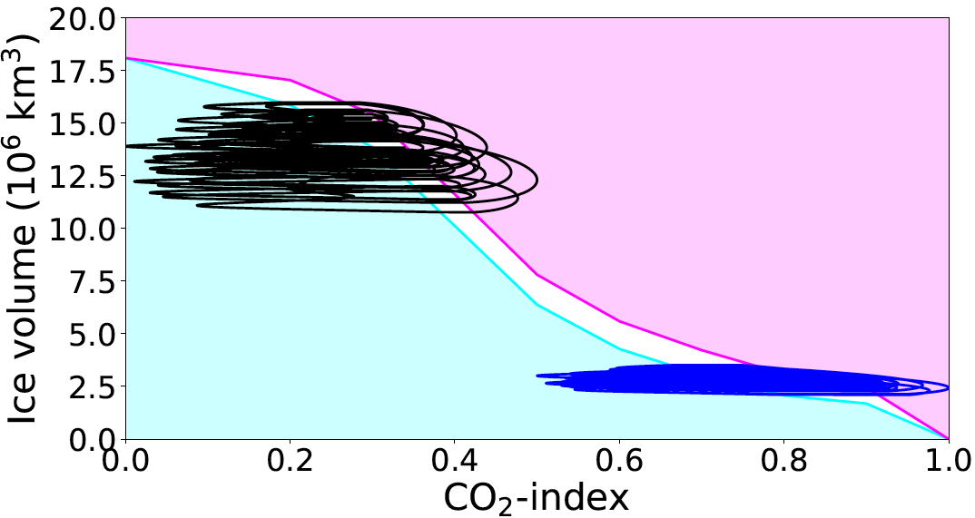
RESULTS
Ice volume variability and the relation between CO₂ and ice volume, depend on the amplitude and range of CO₂ variability.
Black: 0 – 0.5 forcing amplitude
Dashed: 0.5 – 1 forcing amplitude

Slide 11
REFERENCES
Laskar, J., Robutel, P., Joutel, F., Gastineau, M., Correia, A. C. M., Levrard, B., et al. (2004). A long-term numerical solution for the insolation quantities of the Earth. Astronomy & Astrophysics, 428(1), 261-285
Stap, L. B., Sutter, J., Knorr, G., Starz, M., & Lohmann, G. (2019). Transient variability of the Miocene Antarctic ice sheet smaller than equilibrium differences. Geophysical Research Letters, 46(8), 4288-4298.
Zachos, J. C., Dickens, G. R., & Zeebe, R. E. (2008). An early Cenozoic perspective on greenhouse warming and carbon-cycle dynamics. Nature, 451(7176), 279-283
THE WORK SHOWN HERE IS CURRENTLY UNDER REVIEW:
Stap, L.B, Knorr, G., & Lohmann, G. (2020). Anti-phased Miocene ice volume and CO₂ changes by transient Antarctic ice sheet variability. Submitted to: Paleoceanography and Paleoclimatology

