Slide 1
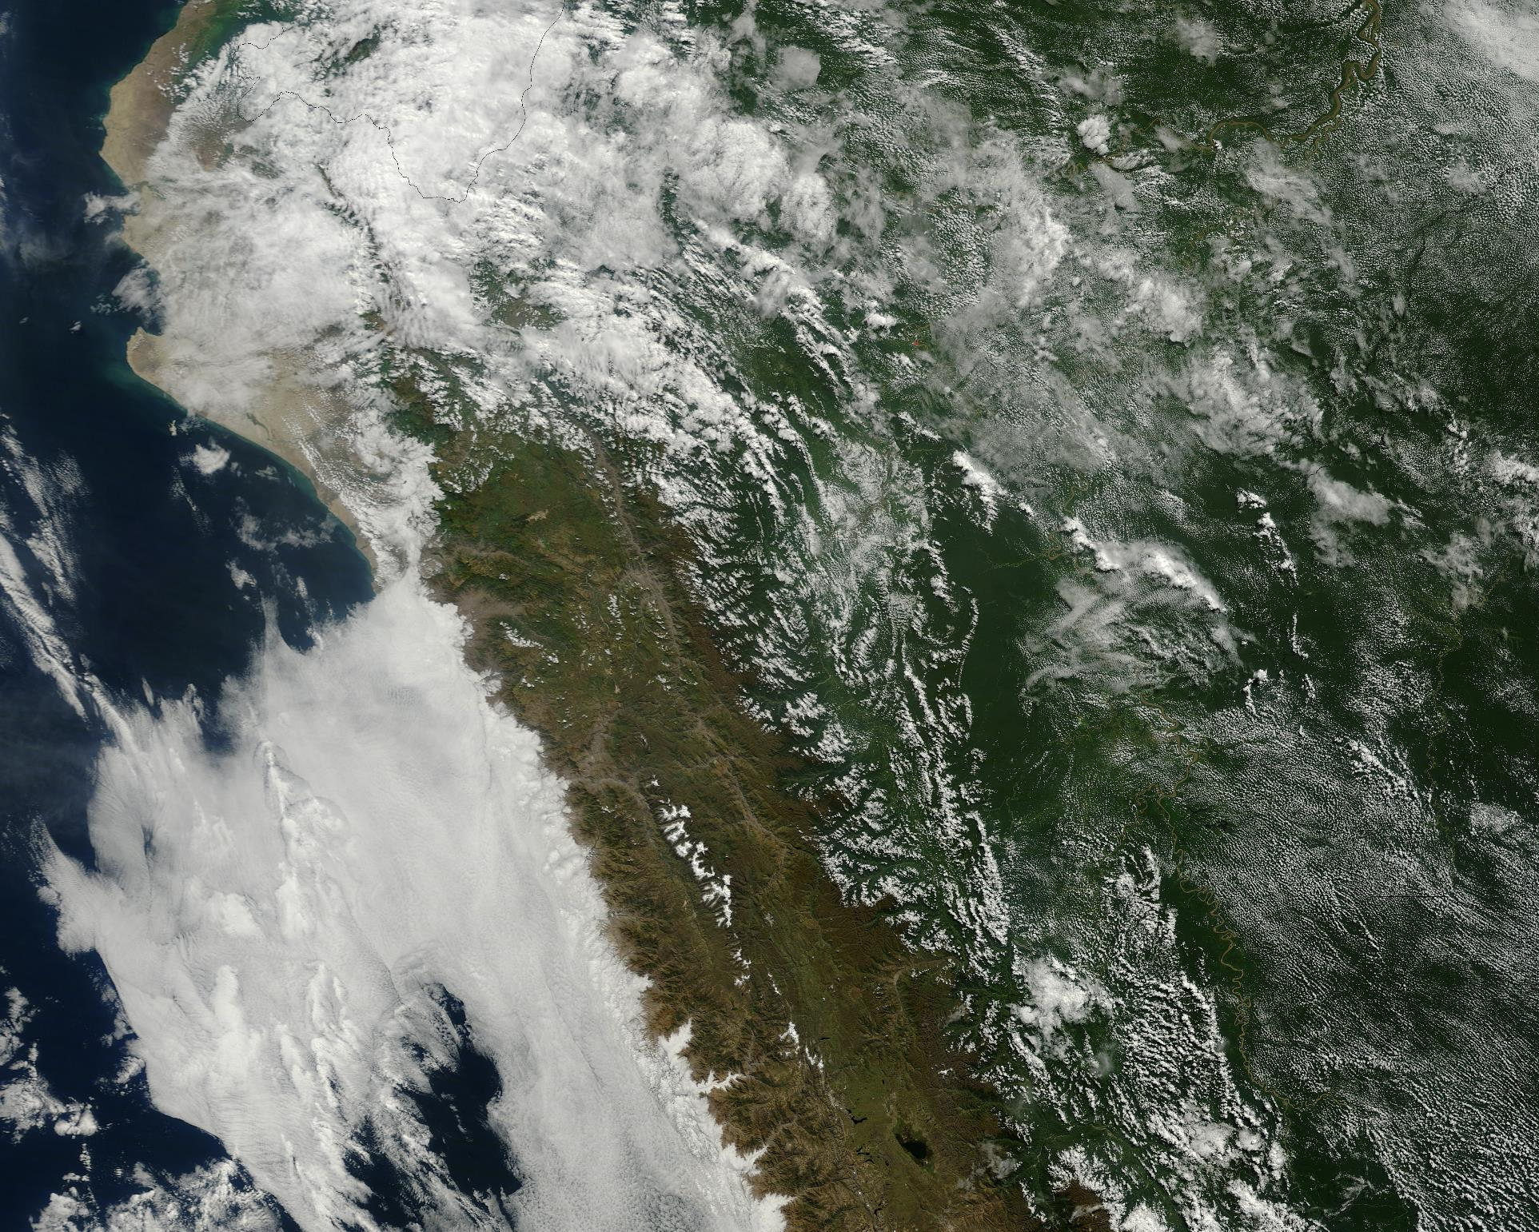



Designing a multi-objective framework for forecast-based action of extreme rains in Peru
Jonathan Lala, Juan Bazo, and Paul Block
7 May 2020
NASA Earth Observatory

Slide 2


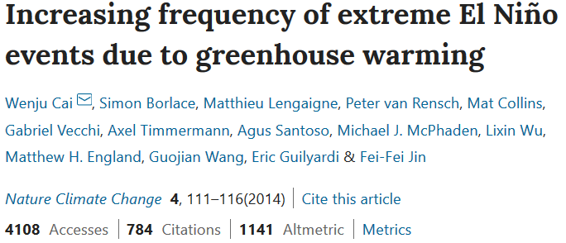
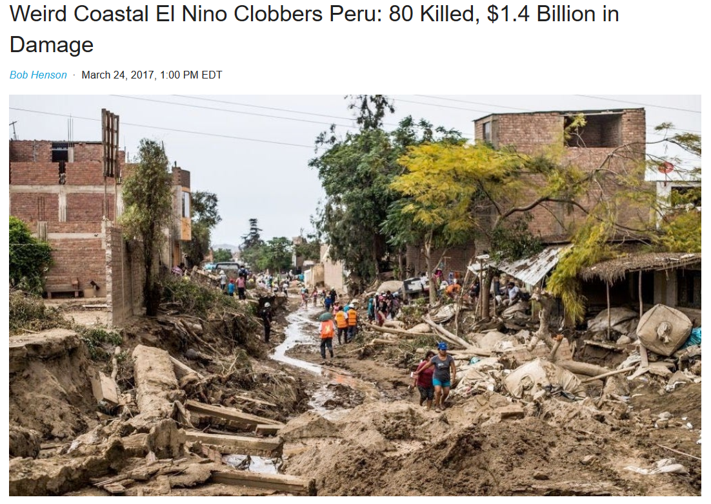

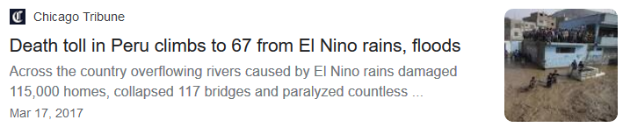
Notes:
In 2017, Peru was hit by torrential downpours that were featured all over the news. The death toll kept climbing, as did the economic damage. This wasn’t the only time this had happened—it happened back in 1997-98 and in 1982-83. The root cause of these rains—an extreme El Nino—is only expected to become more frequent in the future due to climate change

Slide 3
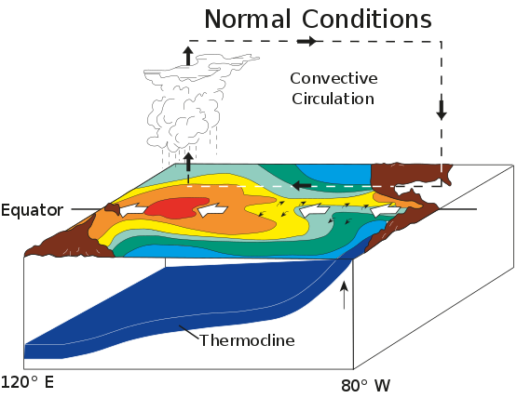
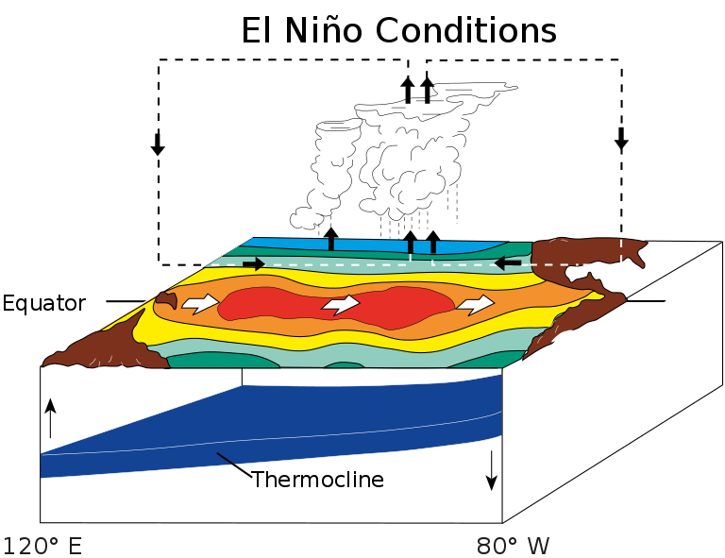
El Niño – Southern Oscillation
Wikimedia Commons
Notes:
Normally, atmospheric circulation patterns result in warm waters in the western pacific and an upwelling of cold waters in the eastern pacific. In an El Nino year, these patterns are disrupted and warm water dominates over the entire pacific. This can lead to droughts in some places, and extreme rains in others, like Peru

Slide 4
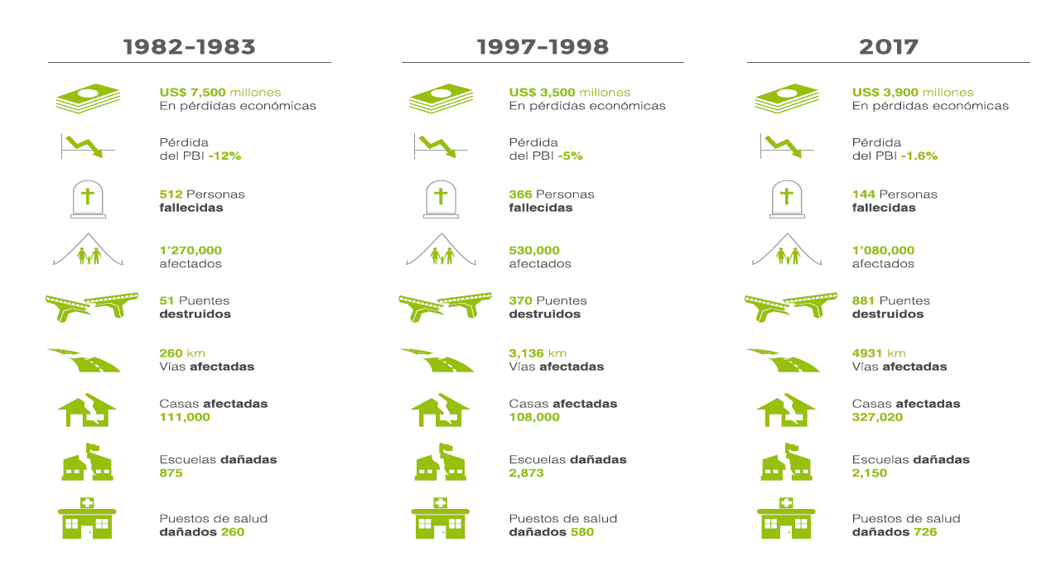
Impact of El Niño in Peru
Peruvian Red Cross
Notes:
El Nino occurs every few years, but three stand out in the last 40 years that had the greatest impact

Slide 5
Red Cross Early Action Plan
Extreme rains in coastal Peru
Targets WaSH, emergency health, and cash transfers
230,000 CHF per community of 1500 families
Based on three forecasts: seasonal, monthly, and short-term (5-7 days)
Notes:
Shift forward to today, and an improved ability to forecast these events has prompted the Red Cross to shift some of its resources from disaster response to disaster preparedness

Slide 6
Forecast-based action (FbA)
Government
Donors
$, support services
$
Services, goods
Forecast provider
Local disaster management unit
Private Sector
Forecast
$
Preventive/
relief services
Beneficiaries
(households, enterprises)
Vaibhav Anand

Slide 7
Breaking it down
1. Identify disaster
Hazard
Exposure
Damage Function
Loss
4. Assess performance metrics
Transportation and evacuation
Drainage canal clearing
WaSH kits, vaccinations
Early actions
Supply prepositioning,
Training
Reactive Actions
2. Identify actions
Vaibhav Anand
3. Define trigger mechanism

Slide 8
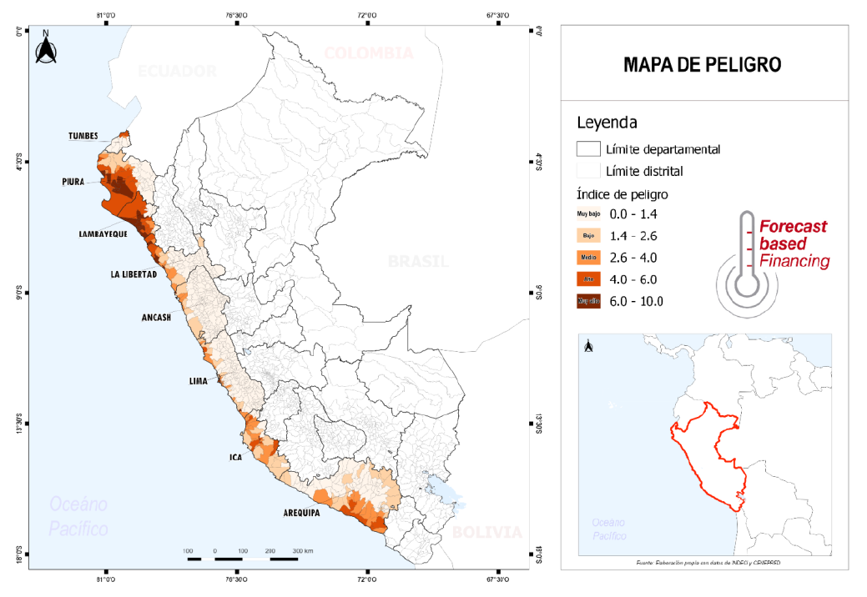
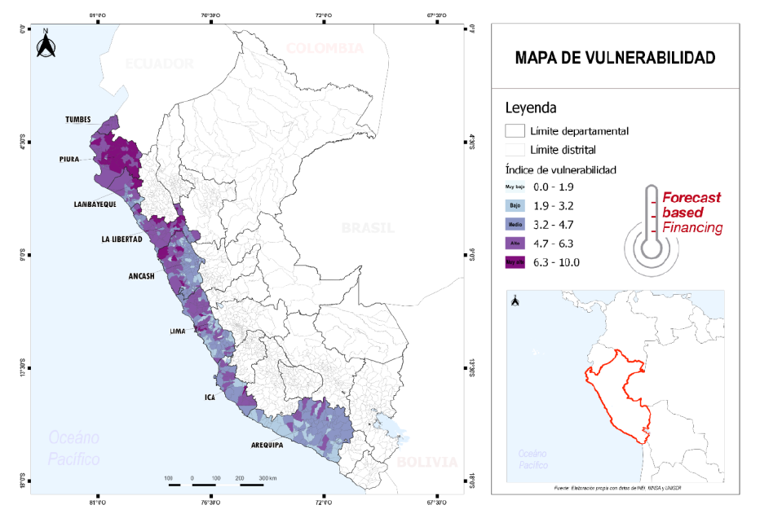
Case study: Piura

Slide 9

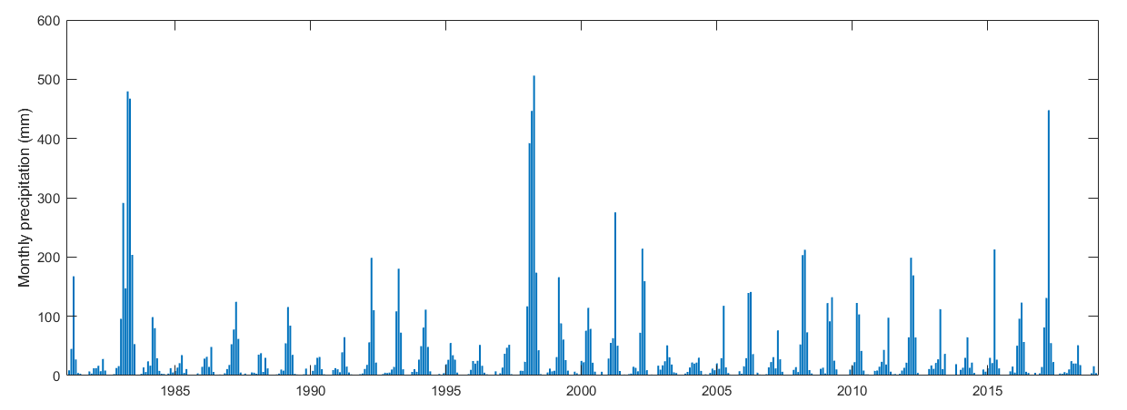
Case study: Piura
PISCO: Peruvian Interpolated data of the SENAMHI’s Climatological and hydrological Observations (Aybar et al., 2019)

Slide 10
1. Identify disaster
El Niño events of 1982-83, 1997-98, and 2017 all surpassed 95th percentile of monthly precipitation in the summer months (December-April)

Slide 11


2. Identify actions
WaSH
  Education
  Water, hygiene, and antivectoral kits
  Well and canal drainage
Emergency health
  Mobilization of healthcare workers, social workers, and volunteers
  Medical and first aid kits
Cash transfers
  Vulnerable families: pregnant mothers, young children, chronic illness

Slide 12
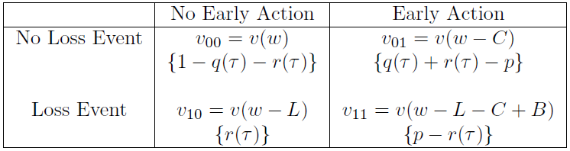
3. Define trigger mechanism
Early Action Plan: 70% probability of 95th percentile
Unbiased forecast, risk neutral preferences: optimal trigger = inverse of benefit-to-cost ratio
Payoff Utilities and Probabilities
Vaibhav Anand
Notes:
q(t) = P(F>=t)
r(t) = basis risk = P(loss and F<t)
p = probability of disaster

Slide 13


4. Assess performance metrics
Normally, we would simply calculate costs and benefits and optimize
But this is a novel project—quantifying benefits and utility leaves very wide confidence bounds
Assess performance of forecasts themselves
  Hit score = # of correctly predicted disasters / total # of disasters
  False alarm ratio = # of false alarms / total # of triggered actions
  Brier score: , where f_{t} is the forecasted probability of an event and o_{t} is the actual outcome (1 if event occurs, 0 otherwise)
Preliminary economic metric: relative expense reduction
  , where C is the cost of action, La is the avoidable loss, and Cav is the cost of action in vain (Lopez et al., 2017)

Slide 14
Goal: optimization through sensitivity analysis
Quantify alternative performance metrics
Test sensitivity to changing trigger thresholds and forecast technology
Focus on seasonal and monthly forecasts for now

Slide 15
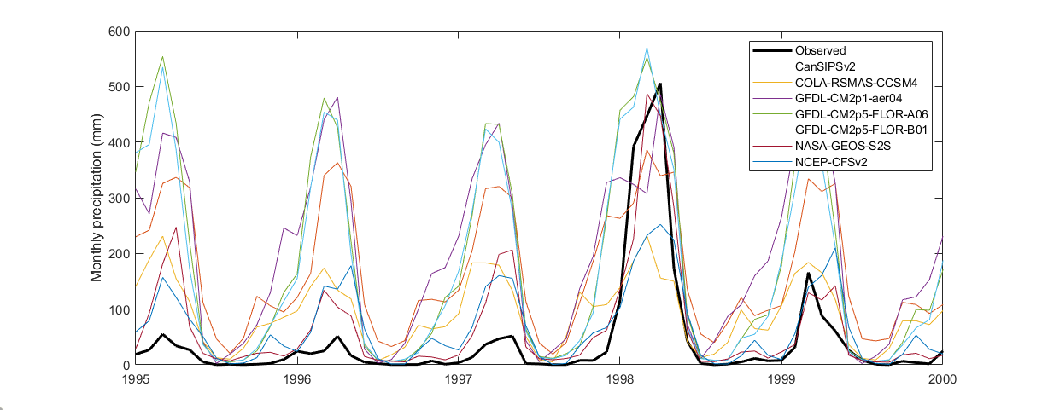
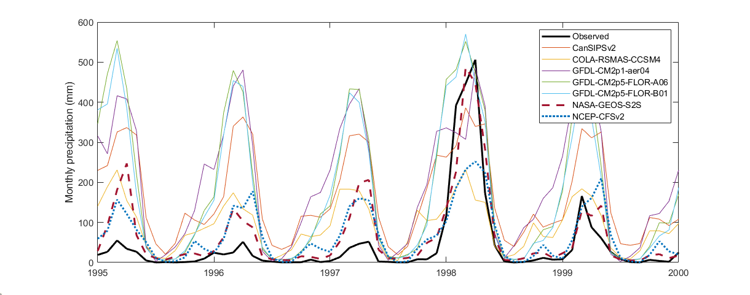
Monthly and seasonal forecasts
Predictors: North American Multimodel Ensemble (NMME) model averages
Regression methods
  Logistic regression—estimates probability of exceedance
  Partial least squares (PLS) regression—estimates actual precipitation amount
Ensemble forecast: bias-corrected sampling from gamma distribution of residuals

Slide 16
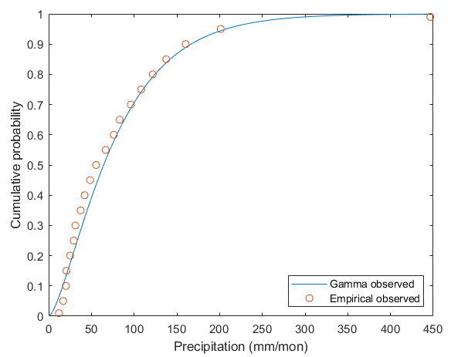
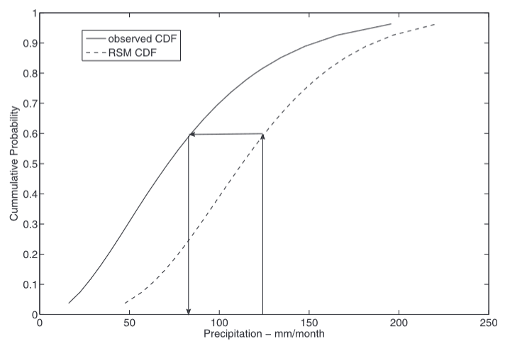
Bias correction
Separate data (forecast and observed) by month
Fit gamma distributions using MLE
Map quantiles of forecasts to observations
Block et al. (2009)

Slide 17
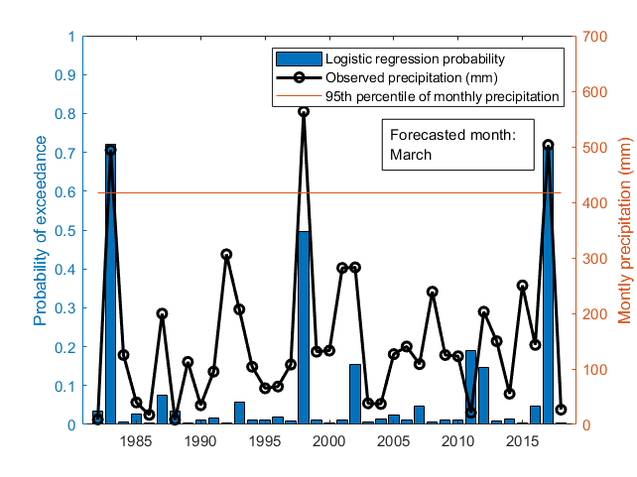
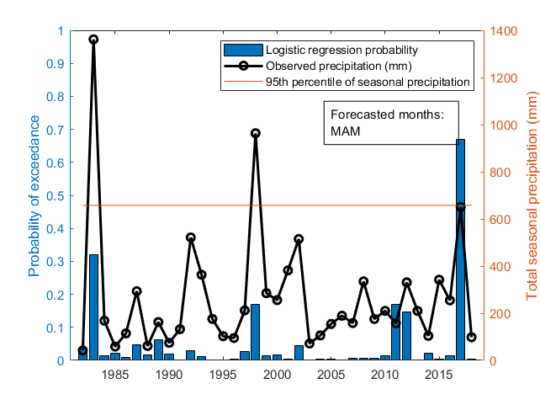
Results: Ensemble hindcasts, logistic regression
Monthly hindcast
Seasonal hindcast
Notes:
Logistic regression captures major events but probabilities are rarely high

Slide 18
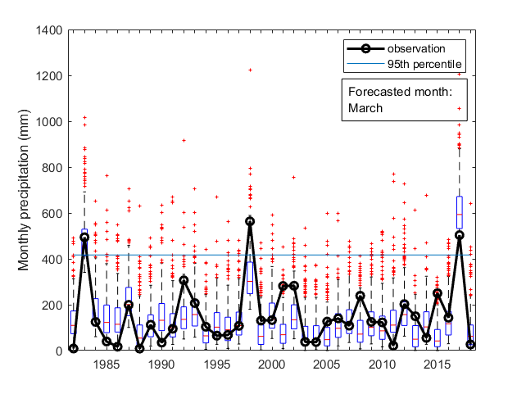
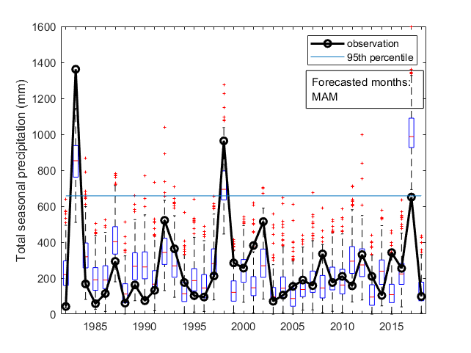
Results: Ensemble hindcasts, PLS regression
Monthly hindcast
Seasonal hindcast
Notes:
PLS regression also captures most major years, with varying levels of probability

Slide 19
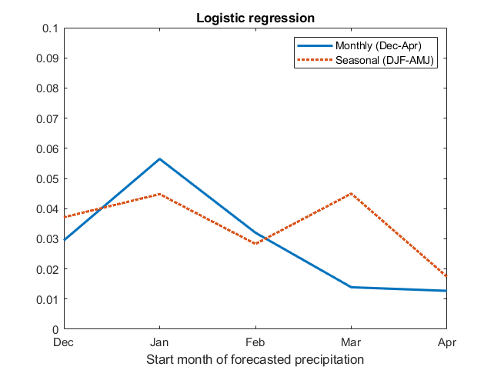
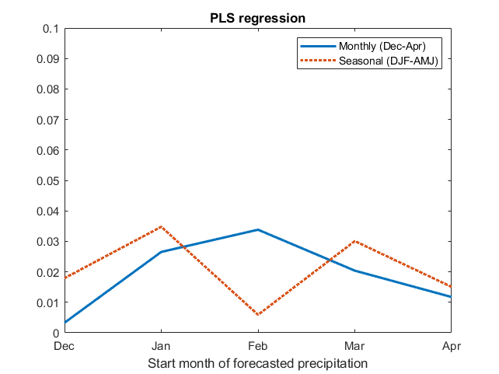
Results: Brier scores
Notes:
PLS regression (left) tends to outperform logistic regression for both monthly and seasonal forecasts

Slide 20
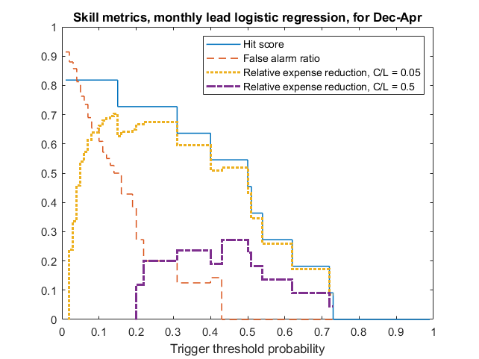
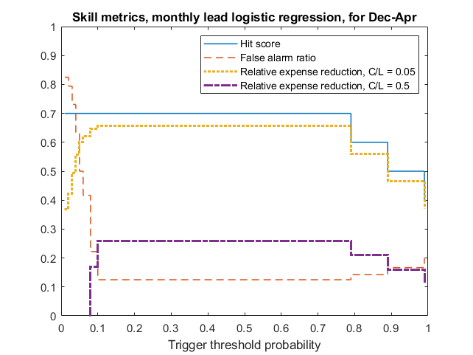
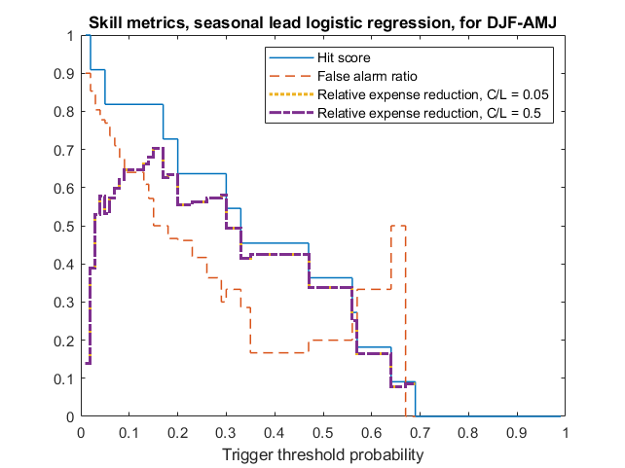
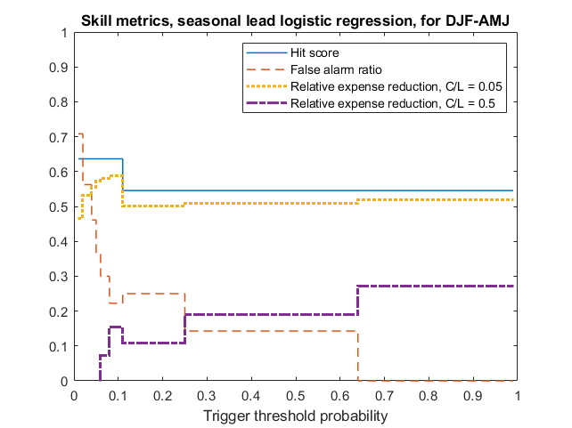
Results: Hit scores, false alarm ratios, relative expense reduction, logistic regression
Equal weighting of all NMME models
NASA GEOS-S2S model only
Notes:
Cav/L = 0.8*C/L. Results suggest maximum cost reductions at low or moderate trigger thresholds, but risk aversion and the false alarm effect would likely push the optimal thresholds to the right. Single model output (NASA GEOS-S2S) performs better than equal weighting of all seven NMME models

Slide 21
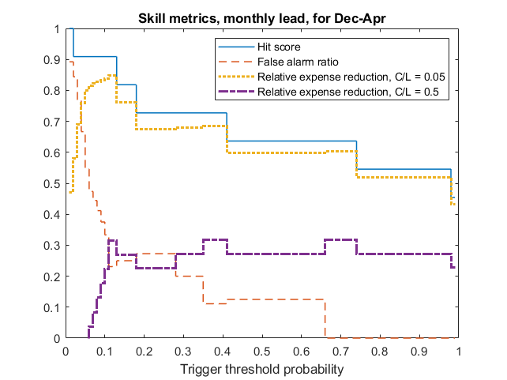
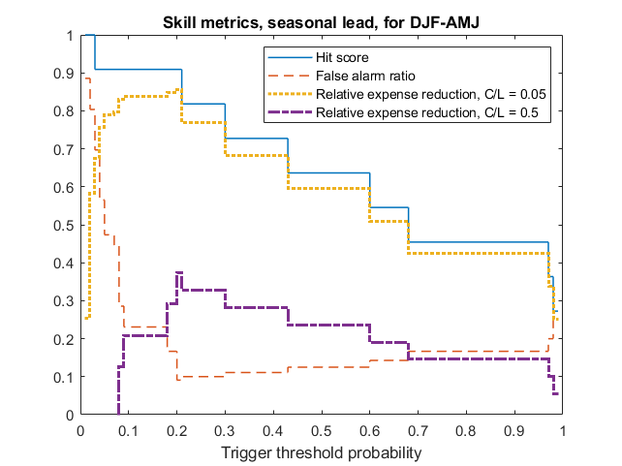
Results: Hit scores, false alarm ratios, relative expense reduction, PLS regression
Notes:
PLS regression tends to outperform logistic regression for both seasonal and monthly forecasts

Slide 22
Conclusion
EAP weighs each NMME model equally, but some models demonstrate greater skill or more weight than others, particularly NASA-GEOS-S2S
Skill metrics can be improved by reducing number of NMME models (logistic regression) or by bias correction of NMME models (PLS regression)
PLS regression generally outperforms logistic regression

Slide 23

Discussion
Disaster defined as 95th percentile of monthly or seasonal precipitation, but this ranges from 50 mm in December to 360 mm in March
Study period only captures three extreme El Niño events—difficult to properly capture upper tail of precipitation distribution
Forecasts presented are only an approximation of actual forecasts used in the EAP, as the latter are either not available or difficult to reconstruct

Slide 24
Future work
Quantify costs of inaction and benefits of action, consider effects of risk aversion
Integrate forecasts into full framework of lead times

Slide 25




Questions?
Special thanks to Vaibhav Anand, Rémi Cousin, Colin Keating, Fuyao Wong, Dr. Steve Vavrus, Dr. Justin Sydnor, and the UW-2020 Project
Contact: jlala@wisc.edu

Slide 26
References
Aybar, C., Fernandez, C., Huerta, A., Lavado, W., Vega, F., and Felipe-Obando, O. (2019). Construction of a high-resolution gridded rainfall dataset for Peru from 1981 to the present day. Hydrological Sci. J., 65, doi:10.1080/02626667.2019.1649411
Block, P., Filho, F. A. S., Sun, L., and Kwon, H-H. (2009). A streamflow forecasting framework using multiple climate and hydrological models. J. Am. Water Res. Ass., 45, 828-843, doi:10.1111⁄j.1752-1688.2009.00327.x
Lopez, A., Coughlan de Perez, E., Bazo, J., Suarez, P., van den Hurk, B., and van Aalst, M. (2017). Bridging forecast verification and humanitarian decisions: A valuation approach for setting up action-oriented early warnings. Weather and Climate Extremes, 27, doi:10.1016/j.wace.2018.03.006
NASA Earth Observatory (2015). https://earthobservatory.nasa.gov/images/86032/at-the-intersection-of-coastal-peru-and-a-cloud-bank
Peruvian Red Cross (2018). Fenomeno El Nino (Lluvias Extremas), Plan de Accion Temprana.

