Slide 1
Operationalizing Continental-Domain Hydrologic Models:
What can we learn?
William H. Farmer and Jessica Driscoll
<wfarmer@usgs.gov>
07 May 2020
EGU 2020: Sharing Geoscience Online
HS2.5.1 Large Scale Hydrology

Slide 2
Abstract
The explosion in the number of hydrologic models and technological advances in cloud infrastructure have combined to create new opportunities in operationalization of hydrologic science and models over the past decade. Colloquially, operationalization has been used to refer to deployments of previously existing model codes, themselves realizations of existing hydrologic science and conceptualizations, run in an unsupervised manner (e.g., automatically) driven by climate input variables that are contemporary (now-casting) or projected (forecasting). With advances in computational infrastructure and power, it has become possible to read, run, and visualize output from automated, operational models across continental domains. In the United States, recent endeavors include U.S. Geological Survey’s integrated water availability assessments, an operational configuration of the Precipitation Runoff Modeling System in the National Hydrologic Model Infrastructure; the National Weather Service’s National Water Model, an operational configuration of WRF-Hydro for flood forecasting; and several more nascent efforts. While these efforts show significant technological advances in the communication of results of hydrologic models, we ask how they have contributed to advances towards expanding knowledge of the hydrologic sciences more generally. Operational configurations of continental-domain models build upon advances of catchment-scale hydrology generally focused on addressing a single management scenario. The extent to which these model configurations have the fidelity to address a wider range of management scenarios and the translation across spatial and temporal scales is not straightforward. In addition, continental-domain operational deployments allow for the visualization of large-scale hydrologic events (e.g., droughts and floods), but perpetuate problems with communication of accuracy and uncertainty at management-relevant scales. Here we explore how these technological advances can be leveraged to advance the hydrologic science that underlies our models.

Slide 3
Background
Often, hydrologic research is driven by targeted investigations
  We hypothesize a solution to a problem (as stakeholder driven or academic investigation) and we build or use a model to advance the field
  “We have a problem, we build a solution.”
Recently, we have moved to a world where model configurations are run in a general and automated sense
  Model output is constantly available as a baseline for stakeholders and investigators and can be improved upon for targeted research
  “We run a baseline, our users identify improvements and applications.”
This more recent mode of operation means that models are often running without clear application. How can these models advance our hydrologic understanding?

Slide 4
National Integrated Water Availability Assessment
Led by the U.S. Geological Survey
  https://www.usgs.gov/mission-areas/water-resources/science/integrated-water-availability-assessments-iwaas
  https://labs.waterdata.usgs.gov/estimated-availability/
Powered by the Precipitation Runoff Modeling System in the National Hydrologic Model Infrastructure
  https://www.usgs.gov/mission-areas/water-resources/science/national-hydrologic-model-infrastructure
Goal: Produce assessments of water availability that integrates processes across water quantity, quality and use to provide perspectives on historic, current and future water availability to support informed water resources management
Currently: A metric of current water storage in the United States without integration of water use
Example 1

Slide 5
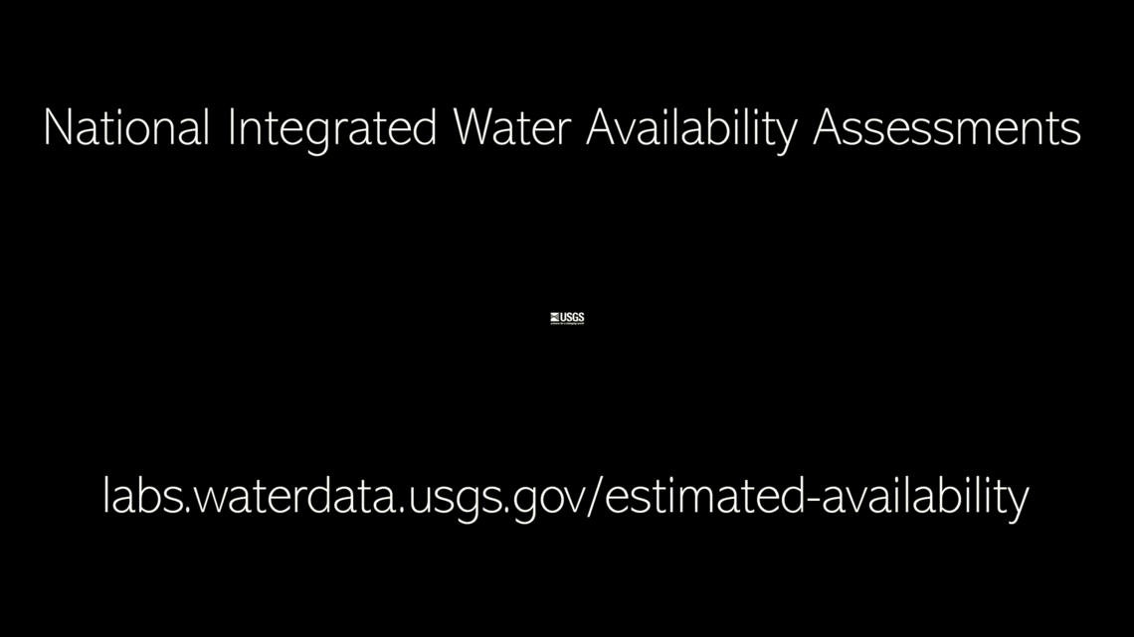
USGS – NIWAA (Stories GIF)

Slide 6
National Water Model
Lead by the National Weather Service
  https://water.noaa.gov/
  https://water.noaa.gov/map
Powered by the Weather Research and Forecasting Model Hydrological modeling system (WRF-Hydro)
  https://water.noaa.gov/about/nwm
Goal: Produce hydrologic forecasts at a very fine spatial and temporal scale to complement forecasts made by NWS river forecast centers
Currently: Past 28 hours to future 30 day forecasts, mostly tuned towards peak flows
Example 2

Slide 7
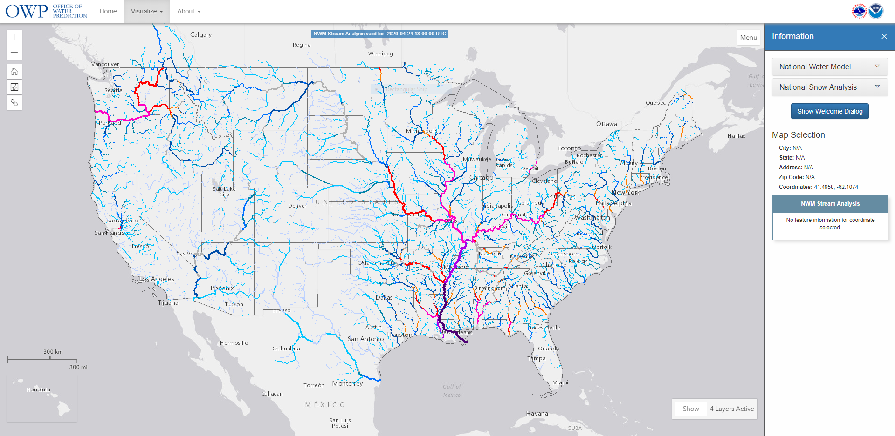
NWS – NWM (Screenshot)

Slide 8
And those aren’t the only ones out there…
Continental applications of ParFlow, VIC, TopModel, HSPF, SWB, …
We can all list many, many models that are being explored on continental domains
But what are we learning?

Slide 9
The Challenges
Operationalization
  How do we get a model ingesting forcing data, representing complex processes and producing output to run automatically and continuously?
  What computer systems are needed?
Process Representation
  Hydrologic understanding is incomplete, so models are often targeted towards a finite set of objectives – Currently, there is no single model that does everything perfectly.
  How do we represent enough processes such that hydrology is robustly represented while maintaining operational feasibility?
Communication
  How we share our knowledge and our caveats with stakeholders? How do we do this when stakeholders might be accessing our operational models without interacting with “us”?
  How do we communicate uncertainty?

Slide 10
Where to go?
Targeted investigations will never go away
Automated applications will become more frequent with increasing access to computing power
Automated applications allow us a world to compare and contrast process representations in real time so as to advance hydrologic understanding

Slide 11
Conclusions
Automated applications can be more than just baseline products for stakeholders
Automated applications are experiments in communication
Automated applications test our ability to drive hydrologic understanding toward informed water resources management

Slide 12
THANK YOU
William H. Farmer and Jessica Driscoll
<wfarmer@usgs.gov>
07 May 2020
EGU 2020: Sharing Geoscience Online
HS2.5.1 Large Scale Hydrology

