Slide 1




Potential vulnerability of demersal fisheries to Western Mediterranean warming
J. Tomàs-Ferrer, M. Sanz-Martín, G. Jordà, M. P. Tugores and E. Massutí

Slide 2
Introduction
The Western Mediterranean is a hotspot for climate change. Climate simulations point to a future accelerated warming at all depths (Soto-Navarro et al., 2020).
Temperature rise could be a key driver of the geographic distribution of demersal species in the Western Mediterranean (Puerta et al., 2014).
The effects of the Mediterranean warming might have an impact on demersal species. Knowing it is of paramount importance for fisheries management.
Information about thermal tolerance of demersal species is scarce, due to:
- Little relevance of temperature information in fisheries management.
- Relative long-term thermal stability of W. Mediterranean Deep Waters.

Slide 3
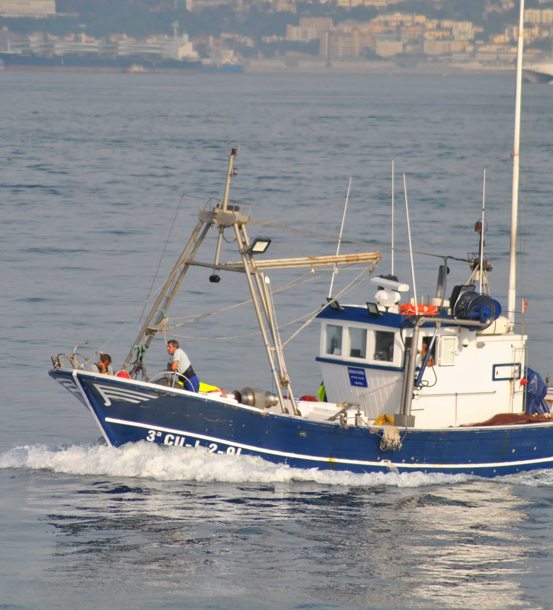
Objectives
To establish thermal limits of tolerance of 24 demersal and benthopelagic species of commercial interest species in the Western Mediterranean.
To determine the potential effects of sea warming on the geographical distributions of these species in the Western Mediterranean.

Slide 4
Selected species
Bony fishes (13)
Helicolenus dactylopterus | Pagellus bogaraveo
Lepidorhombus boscii | Pagellus erythrinus
Lophius budegassa | Phycis blennoides
Lophius piscatorius | Solea solea
Merluccius merluccius | Trachurus mediterraneus
Mullus barbatus | Trachurus trachurus
Mullus surmuletus
Cephalopods (7) | Crustaceans (4)
Eledone cirrhosa | Aristaeomorpha foliacea
Eledone moschata | Aristeus antennatus
Illex coindetii | Nephrops norvegicus
Loligo vulgaris | Parapenaeus longirostris
Octopus vulgaris
Sepia officinalis
Todarodes sagittatus

Slide 5


Methodology
Establishment of the species thermal ranges (TR)
Literature review:
  Selection of 89 papers with information about the target species and temperature-related information, at least 3 papers mentioning each species.
  73 of them contained data collected in the Mediterranean Sea.
  51 of these papers were actually useful to frame the thermal tolerance ranges of the 24 species.
  38 papers were discarded as they mentioned temperature variables not in the depths where the species inhabit (e.g. SST).
Consultations with experts of each species:
  Are the literature-based TR consistent and realistic?

Slide 6


Methodology
Establishment of the species thermal ranges (TR)
FishBase (fishes) and SeaLifeBase (cephalopods and crustaceans) data:
  Analysis of maps of geographical distribution of each species containing probability of occurrence.
  Obtaining bottom temperatures of their locations from climatic databases.
  Conservative TR were set by taking the percentiles P₁₀-P₉₀ of the obtained temperatures.

Slide 7
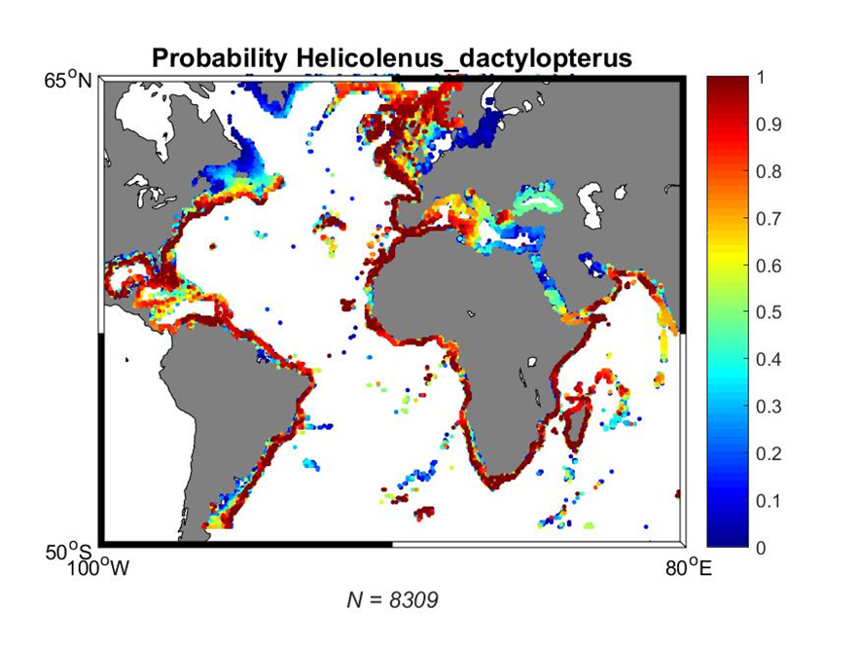
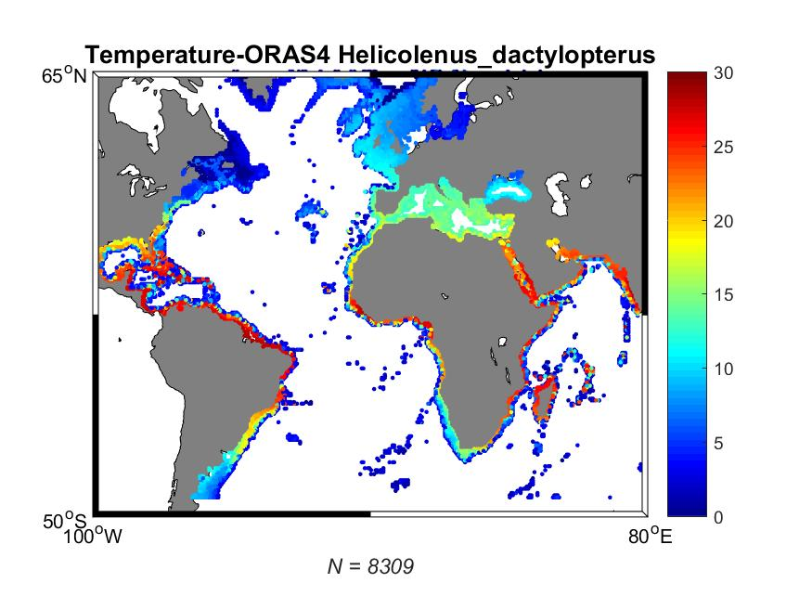
Methodology
Establishment of the species thermal ranges (TR)
FishBase (fishes) and SeaLifeBase (cephalopods and crustaceans) data:
  Present bottom temperatures from hydrographic databases.
  Projections of bottom temperature (Soto-Navarro et al., 2020).
FishBase probability of occurrence map
Bottom temperature data map

Slide 8
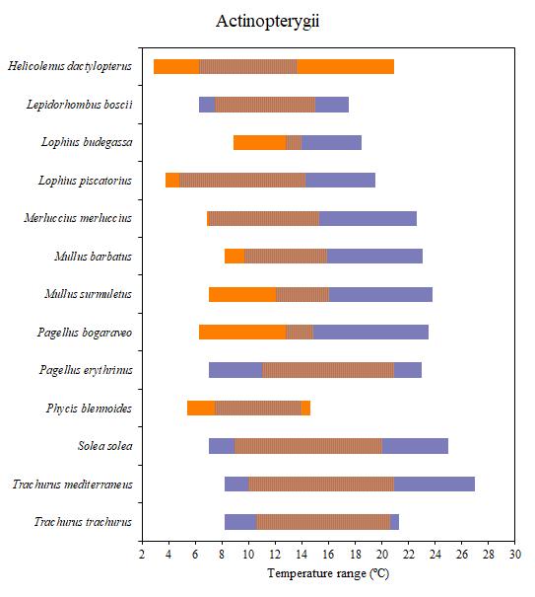
Results
Literature TR
FishBase TR
Literature-based TR are usually warmer than FB-based ones.
Huge discrepancies in some species.

Slide 9
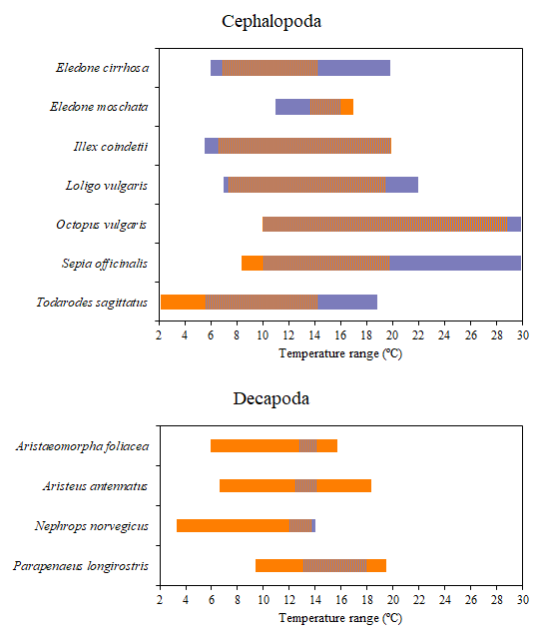
Results
Literature TR
SeaLifeBase TR
Great overlapping between TR of both methods in Cephalopods.
Literature-based TR tend to be wider than SeaLifeBase-based ones.
Literature-based TR for Decapods are extremely narrow.
SeaLifeBase-based TR show far colder lower limits.

Slide 10
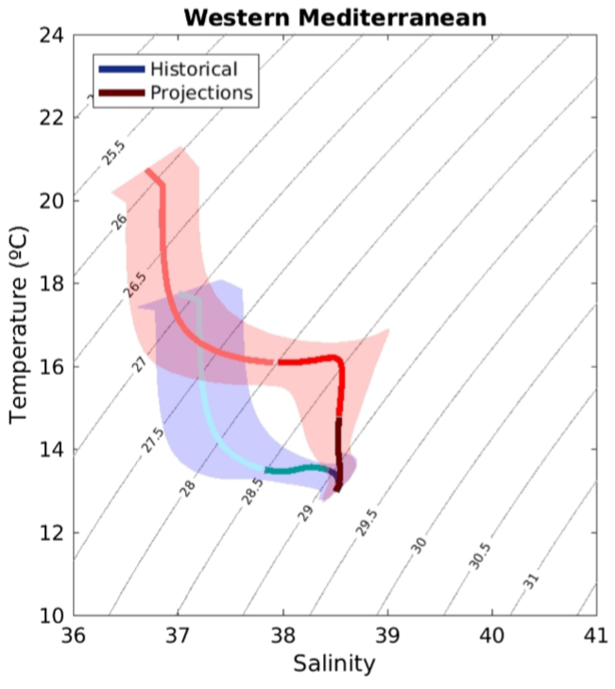
Results
All analysed species occur (not exclusively) between 150-600 m depth.
This intermediate layer of water presents a relatively stable temperature all year round between 12 and 14ºC.
A ~2ºC warming is projected in this layer by the end of the century.
Depth layer:
0-150m
150-600m
>600m
1980 - 2005
2075 - 2100
TS diagram of the RCP 8.5 scenario (Soto-Navarro et al., 2020)

Slide 11


Results
Present T
Future – pessimistic scenario
Most Mediterranean populations of the analysed species are already living at temperatures near the upper limits of their suggested thermal tolerance.

Slide 12
Results
Present T
Future – pessimistic scenario
Most cephalopod species present great tolerances towards warmer temperatures.
Most decapod species do not occur at warm waters.

Slide 13
Results
Under a business-as-usual scenario, at the end of the XXI Century:
  12 species will have their potential habitats greatly reduced (54% of fishes, 29% of cephalopods and 75% of decapods).
  3 species will have their potential habitats moderately reduced (15% of fishes and 14% of cephalopods).
  9 species will not have noticeable variations on their potential habitats (31% of fishes, 57% of cephalopods and 25% of decapods).

Slide 14
Conclusions
In the Mediterranean Sea, most of the studied species are already living at the warmest end of their thermal ranges, future projections of temperature suggest WM intermediate waters may be excessively warm for them.
Literature-based and FB/SLB-based thermal ranges show noticeable discrepancies in certain analysed species.
Literature is an important source to consider when setting thermal ranges, but the information is still being scarce.
This study considers only the effect of temperature on the geographical distribution of the species. Further steps would imply considering other environmental and biological factors. The rate of the increase of temperature and the ability of each species to adapt to it should also be considered.

