Slide 1





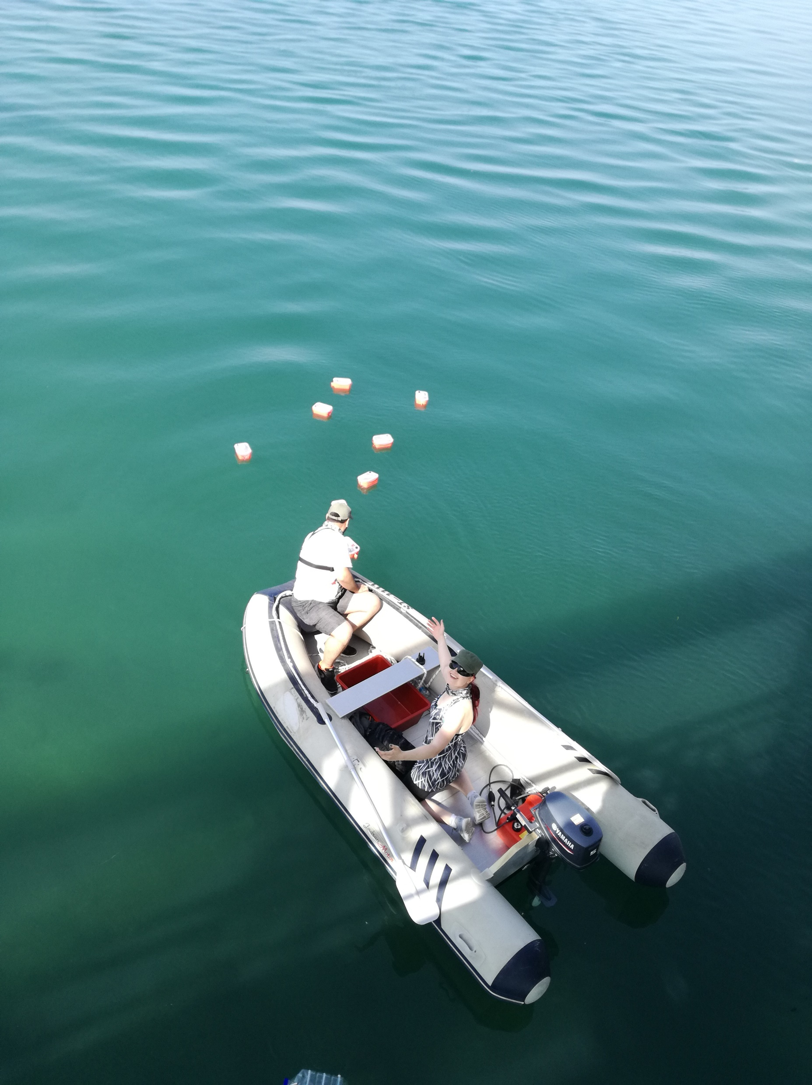
DIY approach to measuring surface water properties in the estuary
Prof. Vladimir Divić ¹, Dr. Morena Galesic ¹, Dr. Mariaines Di Dato ², Marina Tavra ¹, Prof. Roko Andricevic ^{1,3}
¹ University of Split, Faculty of Civil Engineering, Architecture and Geodesy, Croatia
² Helmholtz Centre for Environmental Research - UFZ, Department of Computational Hydrosystems, Germany
³University of Split, Center of Excellence for Science and Technology-Integration of Mediterranean Region, Croatia
EGU General Assembly 2020
may the 4th May 2020, 16:15 – 18:00
©Authors. All rights reserved
1

Slide 2
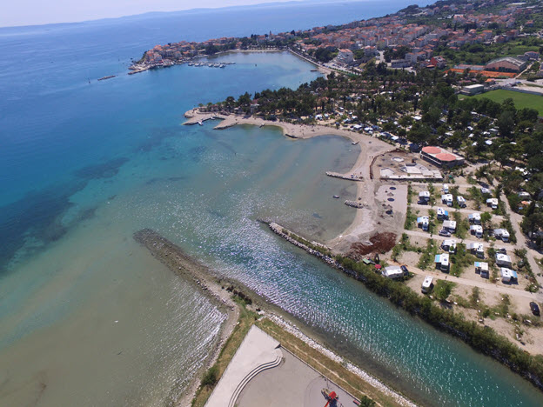
Introduction
Estuaries are dynamic ecosystems due to their nature of being a transitional zone among sea, river, and land [1].
Evaluation of such a dynamic environment requires versatile systems to monitor different water properties [2].
Salinity is recognized as one of the most studied water properties, both for its importance for the ecosystem and cost-effectiveness [3,4,5,6].
The main goal for the development of presented measurement probes was to determine salinity and velocity of surface water in the most frugal way.
Figure 1: River Žrnovnica estuary near Split, Croatia
©Authors. All rights reserved
2

Slide 3
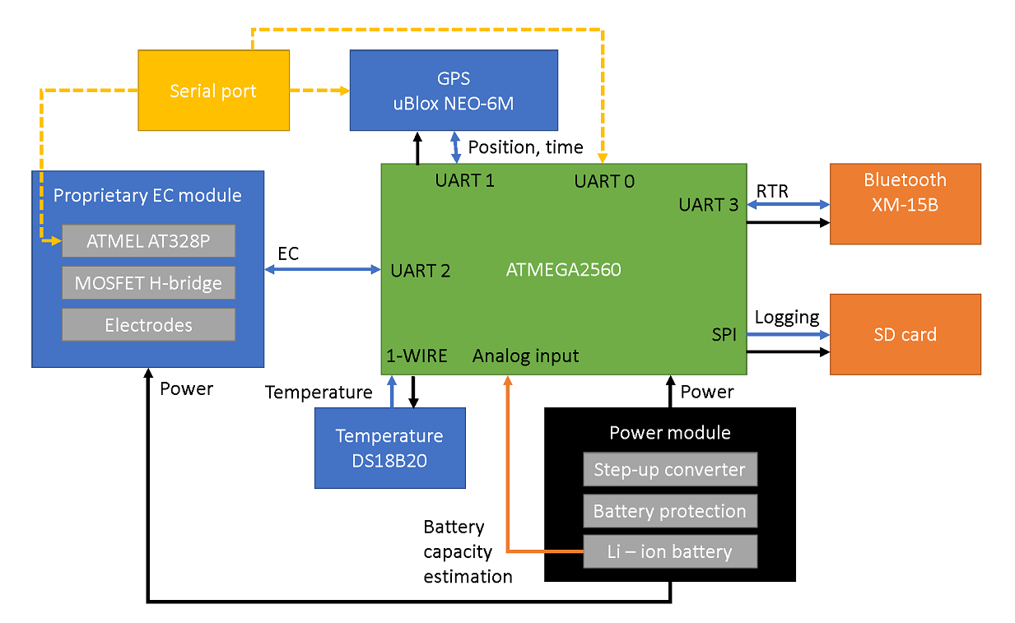
Design challenges - System
The probe system is built around the Arduino open-source platform [7].
The mainboard is an Arduino Mega board based on the ATMEGA2560 microprocessor [8].
The position of the probe and time are measured using the uBlox NEO-6M GPS receiver module [9]. The module is communicating to the mainboard via hardware UART port [10].
Temperature sensing is done by DS188B20 module [11] and transmitted to the mainboard using the 1-wire protocol.
The electroconductivity module is built using an additional Arduino Pro Mini module, MOSFET H-bridge, and set of electrodes.
All data is logged on the SD card via the SPI interface.
Telemetry data are transmitted via Bluetooth protocol.
Figure 2: Schematics of developed probe system
©Authors. All rights reserved
3

Slide 4
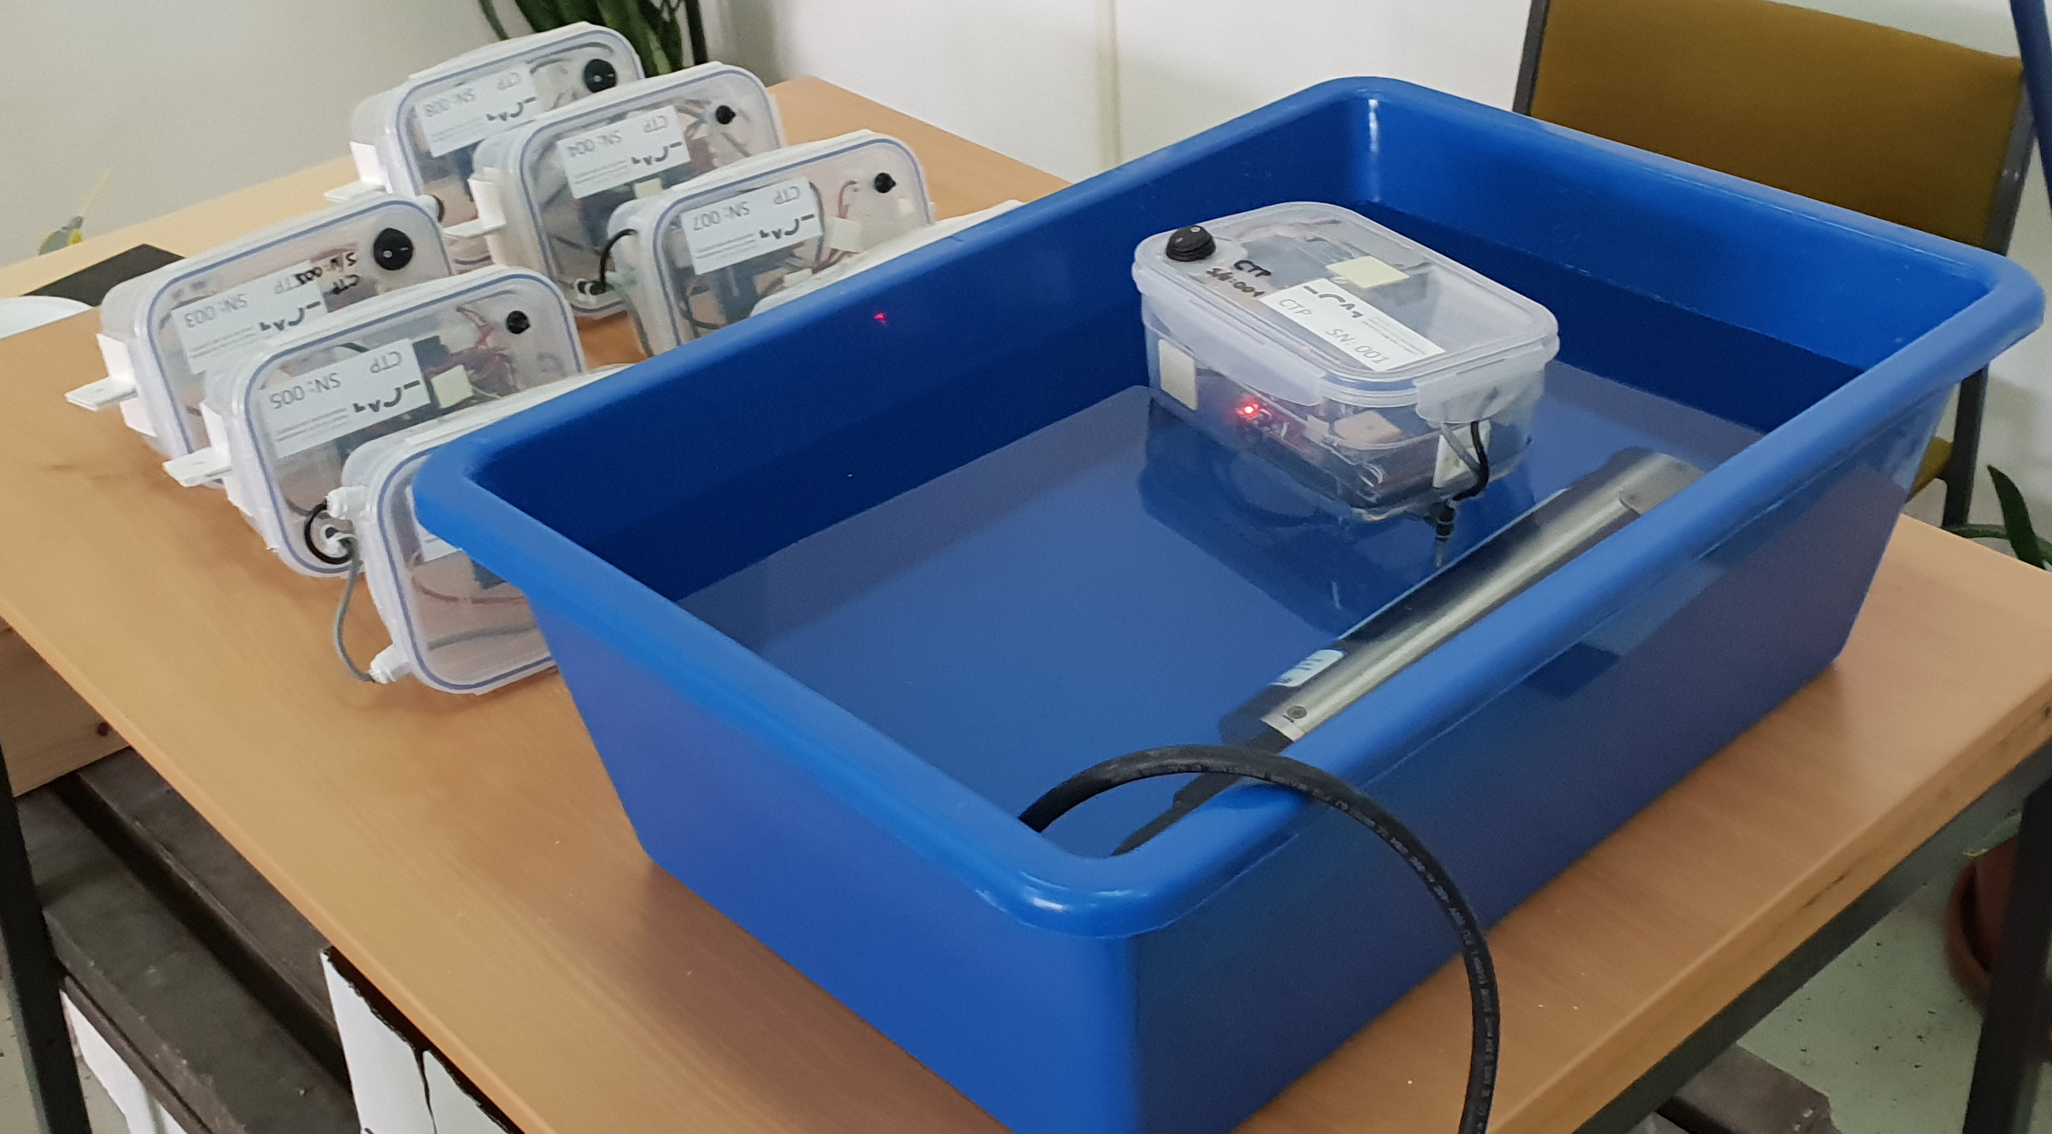
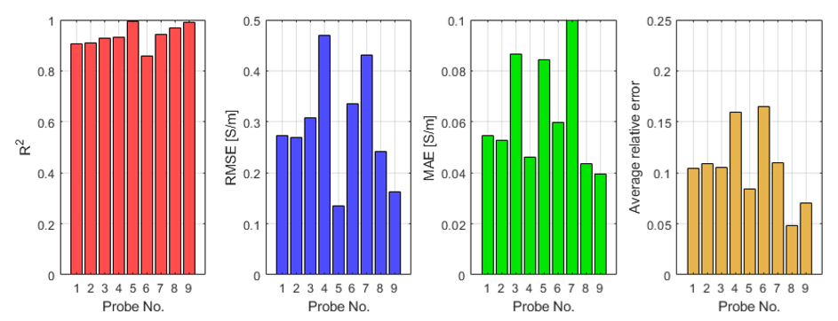

Design challenges – EC sensor
Significant calibration effort was required due to nonlinearities in sensor and Arduino’s internal circuits for analog to digital conversion (ADC).
The calibration was performed over ten steps in the expected measurement range (0 – 20 PSU).
Best fit for calibration was yielded using the equation:
Conversion from electroconductivity and temperature to salinity is done using 1978 Perkins and Lewis equation [12].
Figure 3: Upper panel: the calibration procedure, lower panel: results of the calibration
©Authors. All rights reserved
4

Slide 5
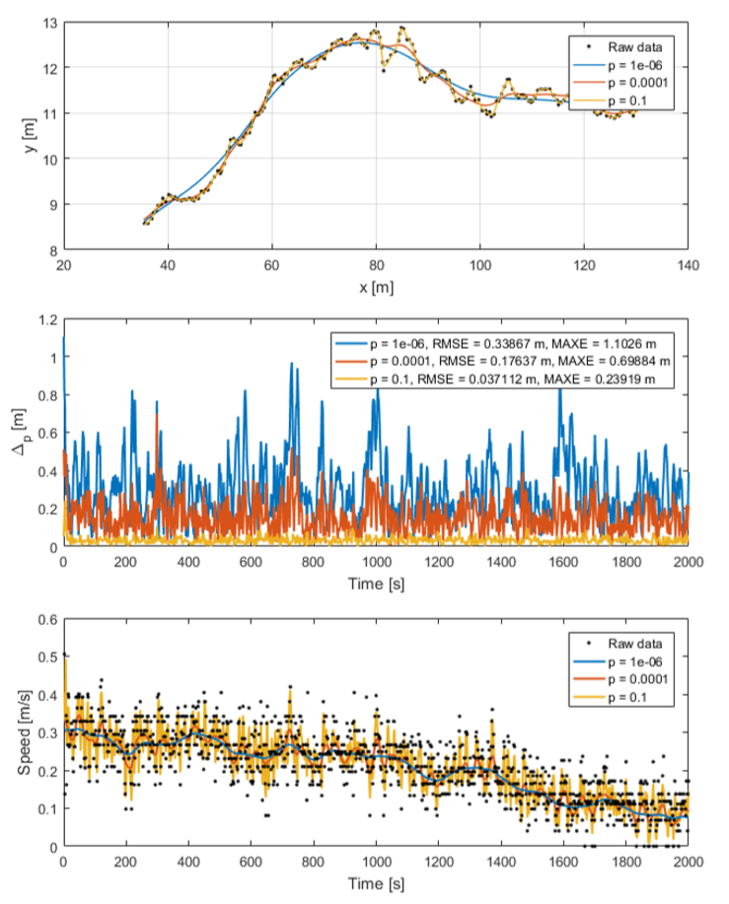
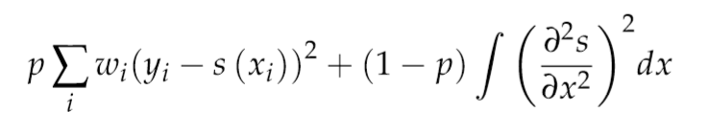
Design challenges – Position tracking
Due to the strong interference of water vapor and multi-point reflections on water, postprocessing was needed to obtain realistic data [13].
Data were smoothed using a smoothing spline function [14]. Splines were obtained by minimization of the expression:
where p is the parameter of smoothing, w is weight to specific recorded point (calculated from HDOP measure),(x_{i},y_{i}) are data points, and s is smoothing spline. The chosen parameter of smoothing is 10⁻⁶.
Figure 4: Topmost panel: trajectories of a probe for different smoothing parameter p, Middle panel: deviation in position depending on parameter p, Bottom panel: the derived speed with various parameters p vs. raw calculated speed
©Authors. All rights reserved
5

Slide 6
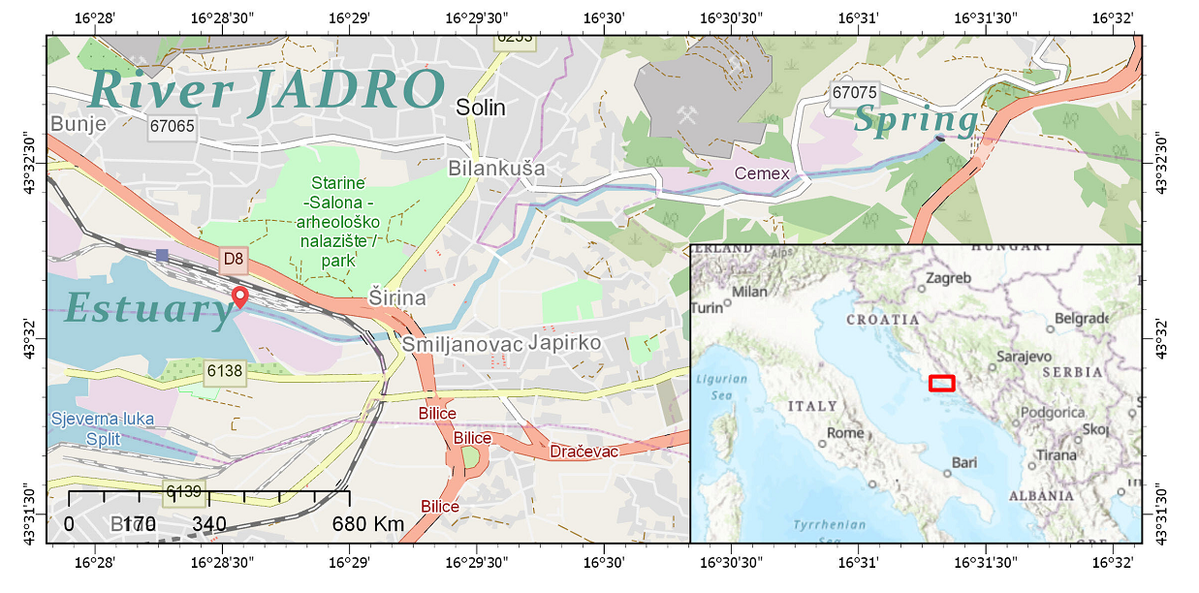
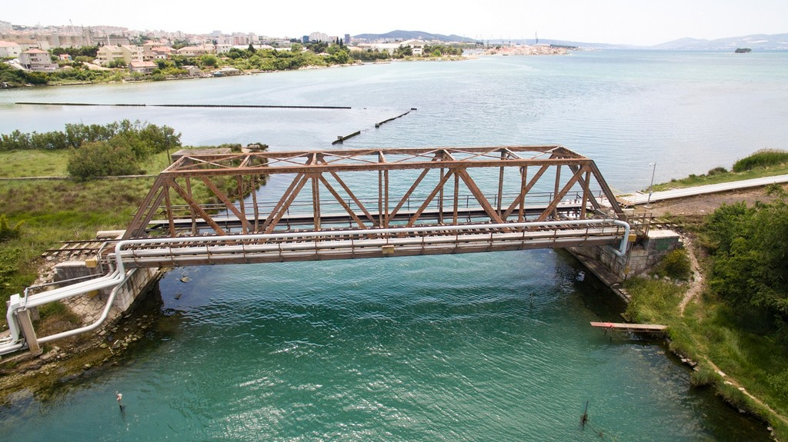
Case study
The case study was the estuary of the river Jadro near Split, Croatia [15].
The measurement campaign was focused on the river-dominated part.
Mesohaline properties with salinity up to 20 PSU were expected.
The measurement was conducted on July 3rd, 2018.
Wind and tidal induced currents had minimal impact on the flow.
Figure 5: Case study location
Figure 6: River Jadro estuary – digital image – © Solin Live portal 25.5.2016. http://www.solin-live.com/index.php/adriatic-jadro-usce-rijeke-jadro/
©Authors. All rights reserved
6
Notes:
6

Slide 7
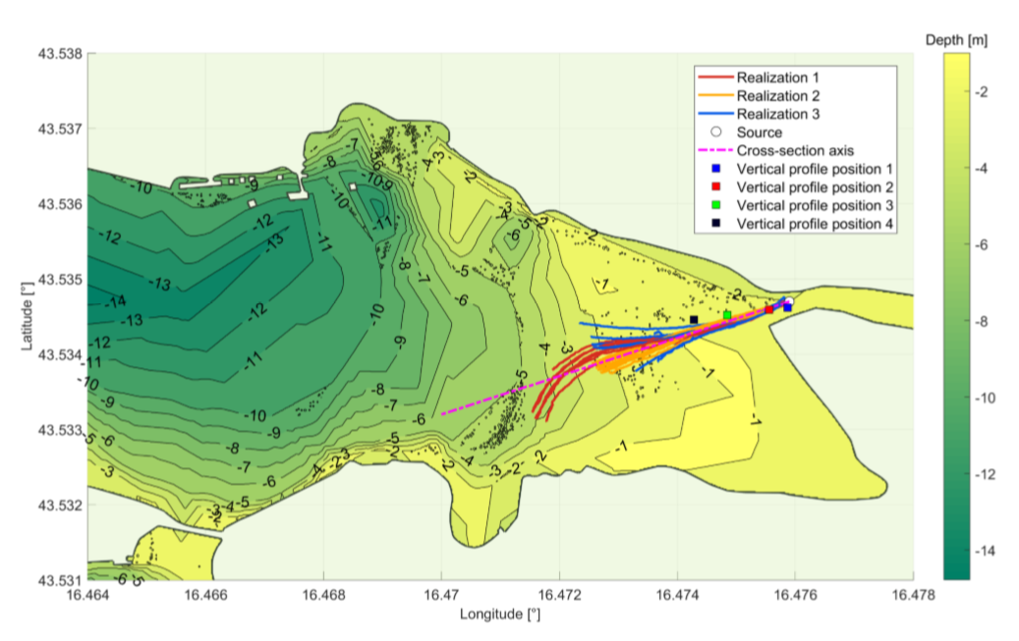
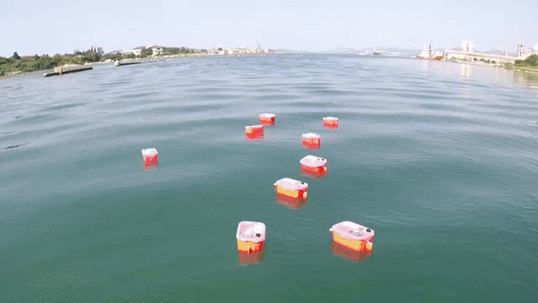

Results
Three sets of measurements were conducted by releasing nine DIY probes at the river mouth.
The probes were tracked until they reached a steady position.
Figure 7: Plan view of the study area with annotated depths and positions of probes
Figure 8: Video of released probes
©Authors. All rights reserved
7

Slide 8
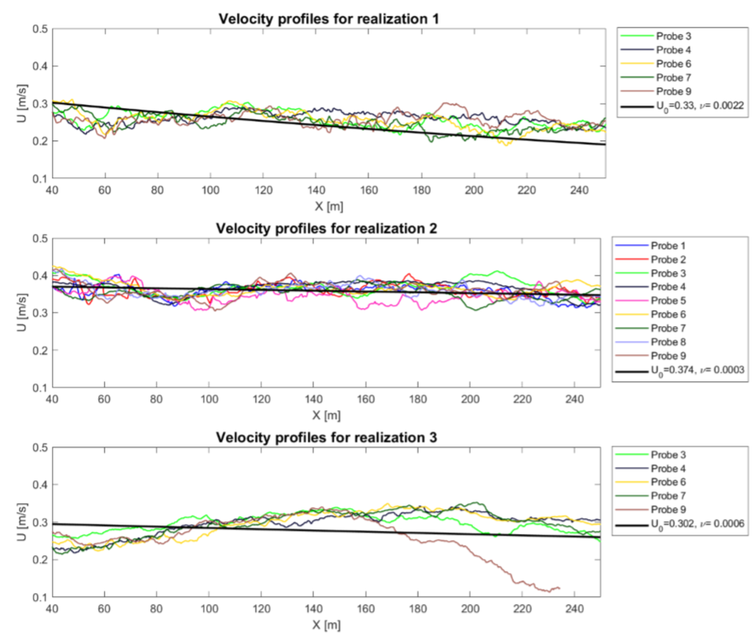

Results
After postprocessing of the GPS data, velocity was calculated using smoothed positions of the probe.
The analytical approximation of the mean velocity in the near-filed of an estuary and a steady source was given:
where U₀ is the initial velocity at the river mouth, and ν is the velocity attenuation coefficient.
Using curve fitting, the parameters of the flow U0 and v were obtained.
Figure 9: Measured velocity vs. analytical model
©Authors. All rights reserved
8
Notes:
8

Slide 9
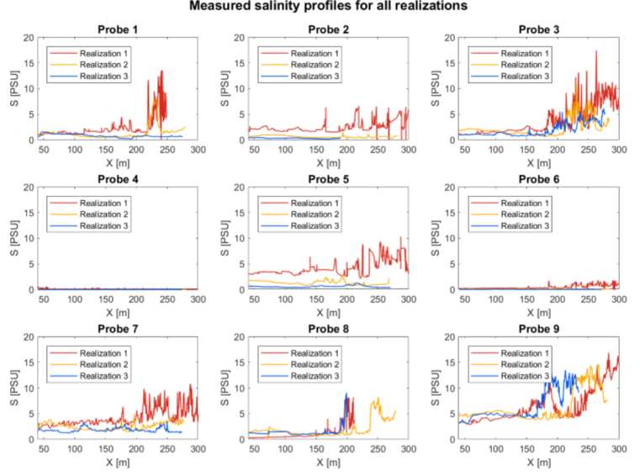
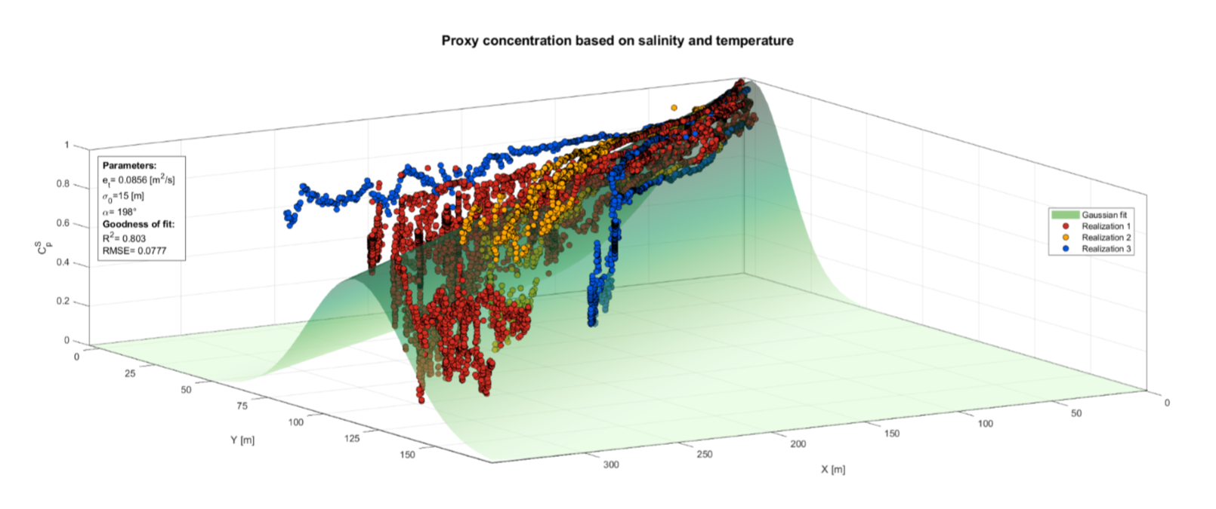
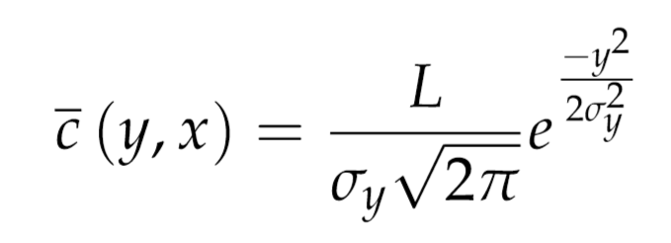
Results
After the end of the measurement campaign, data was collected from SD cards and analysed.
Most of the probes had expecting behaviour – low and stationary salinity profile near the river mouth, rising in amplitude and variability as they progressed further into the sea.
There is a significant correlation with analytical model of proxy concentration based on salinity profile in estuary.
Figure 10: Horizontal salinity profile of the probes
Figure 11: Measured data vs. analytical model (proxy derived from salinity)
©Authors. All rights reserved
9
Notes:
9

Slide 10
Conclusions
An innovative low-cost measurement system for surface waters was developed.
The probes require very basic tools and equipment for development, and the cost of materials is very small compared to commercially available probes.
Due to the low-cost approach, a significant amount of time is required for proper calibration and testing.
It is necessary to make a more stable hull of the probe in order to reduce problems of overturning and air bubbles trapping near electrodes. Currently, we are developing a hull that is easy 3D printable and can be used in different measurement scenarios.
The Arduino platform is robust – it features multiple protocols, and it is compatible with a lot of sensors. The probes can be made modular so that the configuration can change from campaign to campaign.
Obtained results have a good correlation with analytical models for conservative solute transport in the estuary.
©Authors. All rights reserved
10

Slide 11
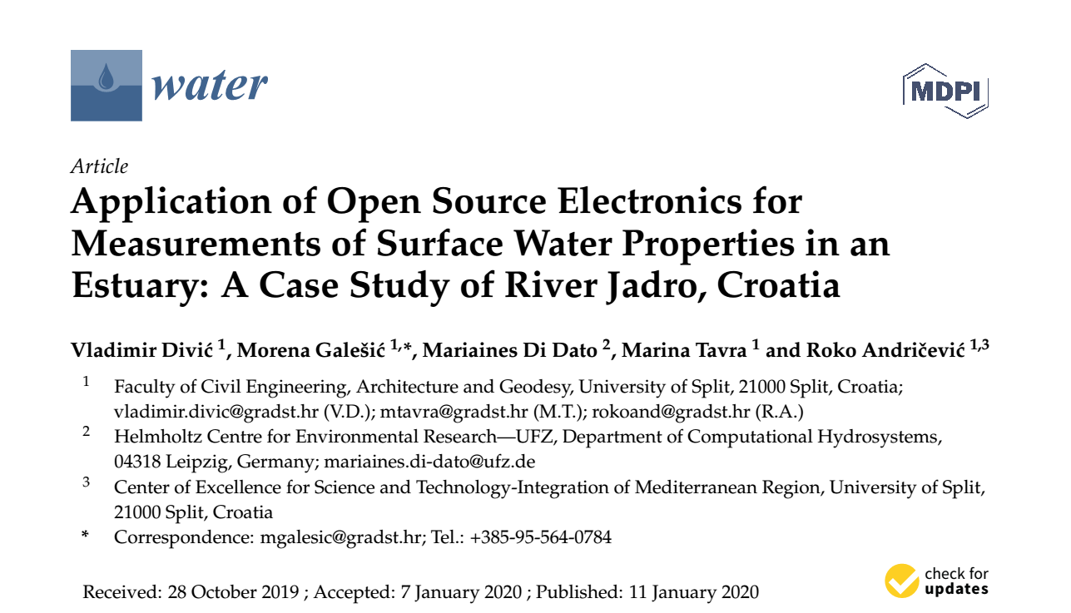
Our publication - Divić et al. (2020) [16]
Further details about the methodology and the results can be found in our recently published paper:
Divic, V., Galešić, M., Di Dato, M., Tavra, M., & Andričević, R. (2020). Application of Open Source Electronics for Measurement of Surface Water Properties in an Estuary: A Case Study of River Jadro, Croatia. Water 12, 209.
©Authors. All rights reserved
11

Slide 12
References
[1] Elliott, M.; Whitﬁeld, A.K. Challenging paradigms in estuarine ecology and management. Estuar. Coast. Shelf Sci. 2011, 94, 306–314. doi:10.1016/j.ecss.2011.06.016.
[2] Montagna, P.; Palmer, T.A.; Pollack, J.B. Hydrological Changes and Estuarine Dynamics; Springer Science & Business Media: Berlin, Germany, 2012; Volume 8.
[3] Lockridge, G.; Dzwonkowski, B.; Nelson, R.; Powers, S. Development of a low-cost arduino-based sonde for coastal applications. Sensors 2016, 16, 528
[4] Andricevic, R.; Galesic, M. Contaminant dilution measure for the solute transport in an estuary. Adv. Water Resour. 2018, 117, 65 – 74. doi:10.1016/j.advwatres.2018.05.005.
[5] Galesic, M. Concentration Statistics for Conservative Solute Transport in River Estuaries. Ph.D. Thesis, University of Split, Split, Croatia, 2018
[6] Galesic, M.; Andricevic, R.; Divic, V.; Mateus, M.; Pinto, L. Potential data used for validation of concentration statistics obtained using analytical model for conservative transport in an estuary. EGU General Assembly 2016. Water Resour. 2016, 31, 714–725.
[7] Arduino. What is Arduino. 2019. Available online: https://www.arduino.cc/en/Guide/Introduction (accessed on 5 October 2019).
[8] Microchip. 2019. Available online: https://www.microchip.com/wwwproducts/en/ATmega2560 (accessed on 5 October 2019).
[9] U-blox. 2019. NEO-6Series. Available online: https://www.u-blox.com/en/product/neo-6-series (accessed on 5 October 2019).
[10] Association, N.M.E. 2019. Available online: https://www.nmea.org (accessed on 5 October 2019).
[11] Maxim Integrated. 2019. Available online: https://www.maximintegrated.com/en/products/sensors/ DS18B20.html (accessed on 5 October 2019).
[12] Perkin, R.; Lewis, E. The Practical Salinity Scale 1978: Fitting the data. IEEE J. Ocean. Eng. 1980, 5, 9–16. doi:10.1109/JOE.1980.1145441
[13] Jun,J.;Guensler,R.;Ogle,J.H. Smoothing methods to minimize impact of global positioning system random error on travel distance, speed, and acceleration proﬁle estimates. Transp. Res. Rec. 2006, 1972, 141–150..
[14]de Boor, C. A Practical Guide to Splines; Springer: New York, NY, USA, 1978; Volume 27.
[15] Ljubenkov, I.; Vranjes, M. Zaslanjivanje ušca rijeke Jadro - mjerenje i hidrodinamičko modeliranje. Hrvat. Vode 2013, 545, 225–234.
[16] Divić, V., Galešić, M., Di Dato, M., Tavra, M., Andričević, R. . Application of Open Source Electronics for Measurement of Surface Water Properties in an Estuary: A Case Study of River Jadro, Croatia. Water 2020 12, 209.
©Authors. All rights reserved
12

Slide 13

Acknowledgments
This research was partially supported through next projects:
STIM-REI (Center of Excellence for Science and Technology–Integration of Mediterranean Region (STIM), connecting research (R), education (E) and innovation (I)), a project funded by European Union from European Structural and Investment Funds 2014.–2020., Contract Number: KK.01.1.1.01.0003
CAAT (Coastal Auto-purification Assessment Technology) also funded by European Union from European Structural and Investment Funds 2014.–2020., Contract Number: KK.01.1.1.04.0064.
©Authors. All rights reserved
13

