Slide 1
EGU 2020 Session AS3.6 Acidity in the Atmosphere and its Impacts CO₂ hydrate equilibria at atmospheric partial pressures: implications for atmospheric acidity
Brian Durham, University of Birmingham (b.durham@bham.ac.uk)
Christian Pfrang, University of Birmingham

Slide 2
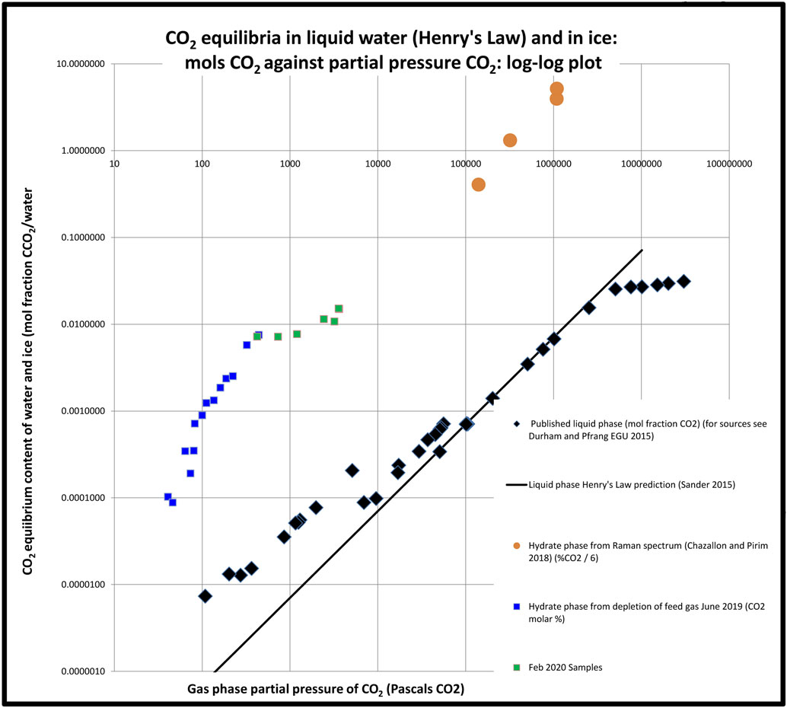
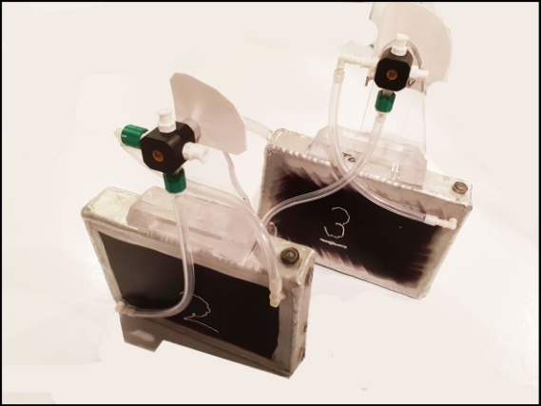
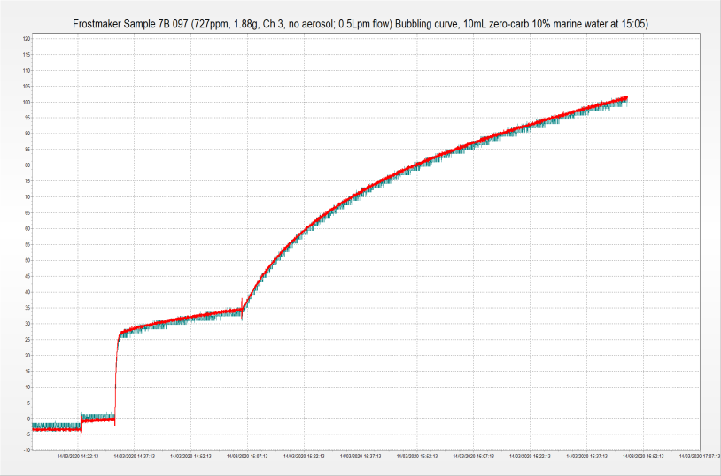
Frost-maker : the 2019-20 experiment
For RMetS conference July 2019 we presented data that gave a consistent picture of µmols CO₂ depleted by frost from natural air in the range 40 - 330 Pa CO₂ partial pressure (Chart 1, blue, see also Fig. 3 below). To this we have added points from degassing of frost samples (green). We plot these values alongside the equilibrium content of liquid water over a wider range of partial pressures of the gas (Henry’s Law, R. Sander 2015).
Chart 1 illustrates that the ice is surprisingly rich in CO₂ by comparison with liquid water, and we now seek to replicate this differential under conditions of pure reagents. This has been interrupted by COVID-19, but meantime it will be noted that our differential at low pressures is proportionate to that at higher pressures (orange, Chazallon and Pirim 2018).
The Lille team used Raman spectroscopy in identifying the structure of hydrate caging in their ice. They appear not to employ `promoters’ as in other hydrate research, perhaps explaining the long reaction time (up to 30 days, ibid. Table 2).
Pending availability of promoters (SDS; THF; TBAB) we have investigated the effect of marine chemistry (arrowed right). After 2 hours, Sample 7B.097 had out-gassed 3.6 µmols CO₂ on a log curve (R² = 0.996) that extrapolated a further 3.4 µmols before equilibrium.
Chart 1: Equilibrium CO₂ content of water (EGU 2015-3386) and ice against partial pressure in gas phase.
Fig. 1: Frost chambers – aluminium heat-sink plates, fins facing inward.
Fig. 2: Real time monitoring of a de-gassing (Sample 7B.097), showing effect of injected marine chemistry.

Slide 3
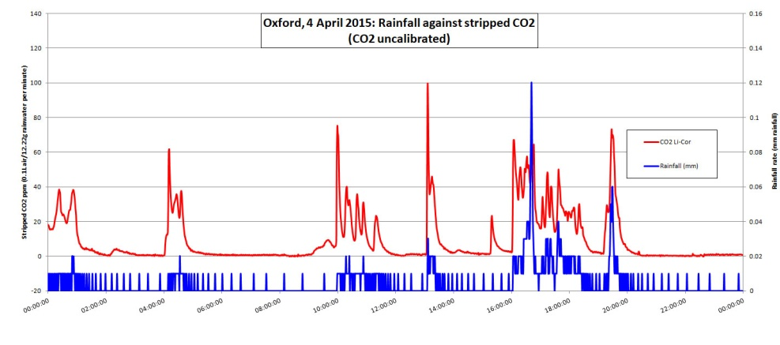
Relevance to atmospheric acidity?
CO₂ is listed with non-polar molecules for the purpose of gas hydrate studies (Sloan and Koh 2008, Table 3.1), but it ionises weakly in solution, and its acidity (an intensive property) can be a useful tool for monitoring its behaviour in water where its IR signature is masked.
The upper chart shows a showery week at the University of Reading Observation Site where the acidity in the sample well rose abruptly at the onset of rainfall, afterwards decaying over around four hours to a base level of pH 6-7.
A link between this acidity and CO₂ is provided by a comparable pattern using an inline de-gasser, which understates the CO₂ released (an extensive property) because of the reluctance of the molecule to leave solution (EGU 2015-3386 accessed 2/05/2020).
The highest spike in Chart 2 (15 July 2009) represents pH 3.8, the average of 60 values over one minute (arrowed).
Chart 2 – Acidity [H³O]⁺ in rain sample well at Univ Reading Observation Site ,
week of12 July 2009 See ` solution (EGU 2015-3386 accessed 2/05/2020).
Chart 3 – CO₂ effluxed from fresh rainwater at Oxford on 4 April 2015
solution (EGU 2015-3386 accessed 2/05/2020).

Slide 4
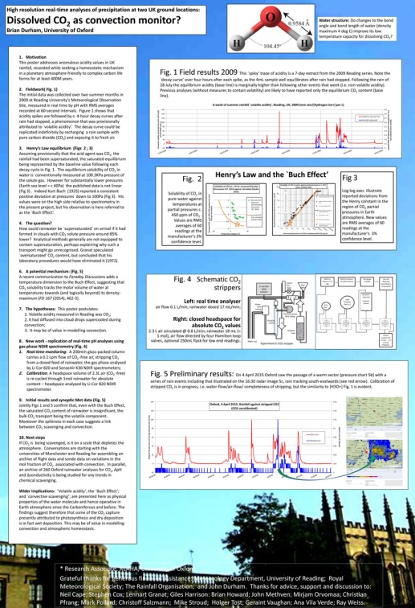
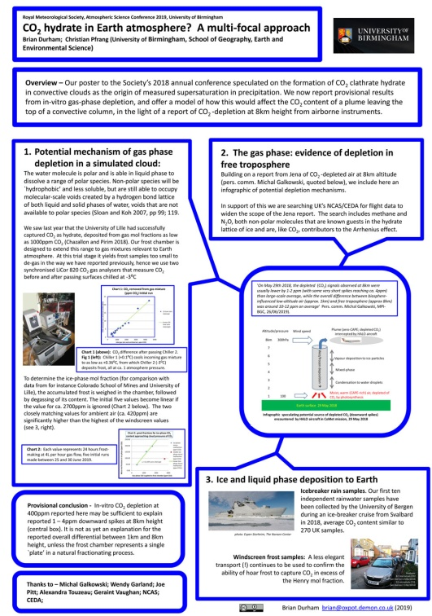
What generated these spikes?
Our suggestion in 2015 was that CO₂ had been captured in ice grown under adiabatic cooling during convective uplift, and that melting of the ice had contributed to the ionic balance of the rainwater, thereby generating the peaks (EGU 2015-3386 accessed 2/05/2020, image opposite).
Our contribution to today’s session is therefore to speculate the acidity that would be generated locally by the melting of an ice crystal formed during convective uplift as follows:
The partial pressure of CO₂ at sea level is currently around 40 Pascals, diminishing to 14 Pa at 8 km altitude (chosen because of MPI Jena flight record of 29 May 2018, see opposite and below). The ice/CO₂ equilibrium averaged over this range can be read off Chart 1 as around 100 µmols CO₂, which would give a pH around 3, comparing with pH 3.8 average over 1 minute in 2009 (Chart 2).
Fig. 2 EGU 2015-3386 accessed 2/05/2020
Fig. 3 CO₂ hydrate poster, Royal Meteorological Society Annual Conference, Birmingham 2019

Slide 5
Discussion – Is capture of CO₂ localised within the atmosphere?
Dependence on partial pressure – whereas mol fraction of CO₂ (ppm) can be consistent up the atmospheric column, partial pressure of CO₂ will decrease exponentially with height, in parallel with atmospheric pressure. This infers that ice-capture would tend to decrease with height, hence mainly a boundary layer process.
Depletion rate in stratosphere: `bomb carbon’ (¹⁴CO₂) as tracer - The CO₂ from atmospheric detonations of the 1960s is a convenient tracer as follows:
The depletion curve of bomb 14C (half-life 5K years) should level out at a value lower than pre-bomb because of dilution from burning of fossil carbon (pers. comm. Christopher Bronk Ramsay), but on the present curve (to 2011) that will take a long time.
Depletion rate in troposphere – aircraft observation - MPI Jena’s observations from above Silesia (right) suggest that depletion in the troposphere can be dramatic (see also PDF at Fig. 3 above).
Fig. 4: Hua et al. (2013) Figure 4 showing progress in depletion of `bomb carbon’.
'On May 29th 2018, the depleted (CO₂) signals observed at 8km were usually lower by 1-2 ppm (with some very short spikes reaching ca. 4ppm) than large-scale average, while the overall difference between biosphere-influenced low-altitude air (approx. 1km) and free troposphere (approx 8km) was around 10-12 ppm on average' Pers. comm. Michal Galkowski, MPI-BGC, 26/06/2019).
Fig 5: statement from MPI-BGC Jena on troposphere CO₂ depletion, following EGU 2019

Slide 6
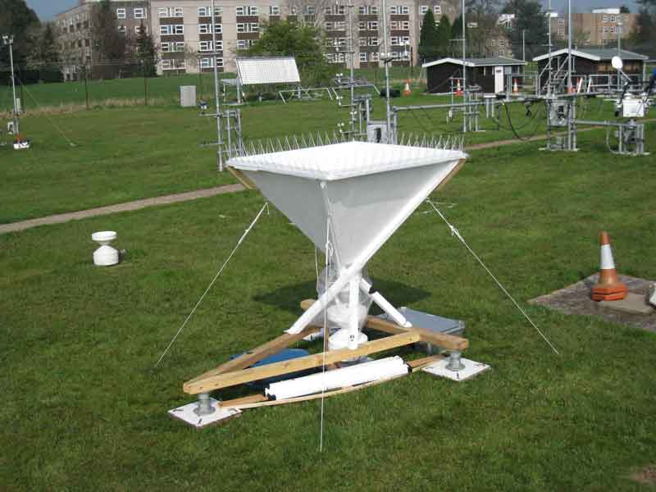
Conclusion and wider implications
The recognition in 2009 of the volatile nature of rainfall acidity has added a third natural capture process for atmospheric CO₂, being the first that is `atmosphere-based’ (see Fig. 6).
For Earth surface there may be implications for:
Acid rain;
Solution and re-deposition of carbonate and olivine rocks;
Ocean acidification;
Residence time of anthropogenic GHGs emitted at altitude.
Fig. 6: 1m² rain gauge at University of Reading Observation Site 2009
Fig. 7: IPCC AR5 Working Group 6, Figure 6.4 Simplified schematic of the global carbon cycle.
Brian Durham
b.durham@bham.ac.uk

