Slide 1
EGU 2020 Session AS3.6 Acidity in the Atmosphere and its Impacts CO₂ / ice equilibria at atmospheric partial pressures: implications for atmospheric acidity
Brian Durham, University of Birmingham (b.durham@bham.ac.uk; brian@oxpot.co.uk)
Christian Pfrang, University of Birmingham

Slide 2
Introduction: CO₂ ice as source of atmospheric acidity, and gas hydrate science
We consider here the acidity that could appear regularly in convective cells, arising from the melting of CO₂ ice that had formed during the uplift phase, approached here by juxtaposing atmospheric chemistry with gas hydrate science.
Ice growing within a dilute solution will retain part or all of the solute. The proportion is expressed as the retention coefficient (R), being:
`The ratio of the gas concentration in the ice phase to the concentration of the gas in the water in equilibrium with the surrounding gas’ (Pruppacher and Klett 1997, 163).
Thus the content in the growing ice phase will typically not be higher than its Henry content in the liquid phase, and values between zero and 1 have recently been generated for thirteen atmospheric contaminants by the Mainz vertical wind tunnel project (Jost et al 2017).
The Mainz list does not include CO₂, for which a relatively high value for R (i.e. R >> 1) has been anticipated from spikes of acidity measured at ground level, and from degassing of rainwater and snowmelt (this project).
In case these high values have their origin in a process separate from the Henry’s Law ice retention coefficients (where R ≤ 1), we are therefore now growing `CO₂ frost’, and moving towards growing it from pure reagents, while provisionally linking the high level of retention to the known property of CO₂ as a `hydrate-guest’ in gas pipelines and deep sea clathrate deposits.

Slide 3
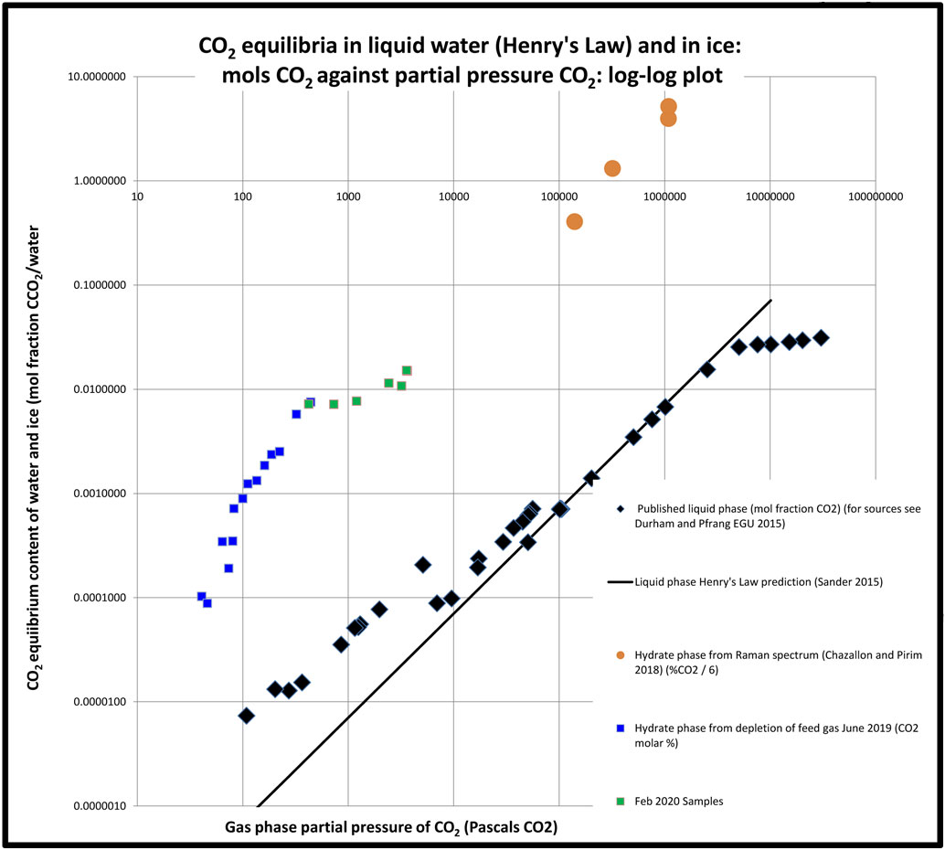
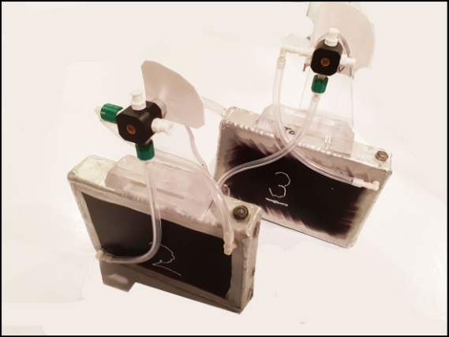
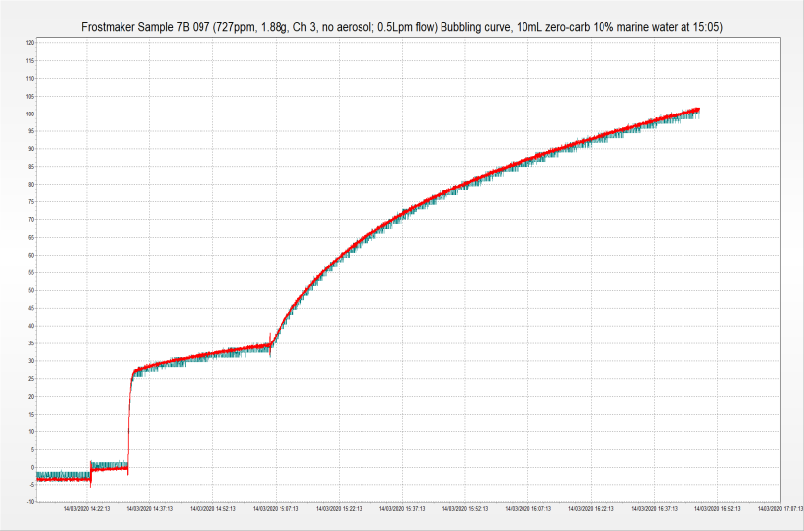
Frost-maker : the 2019-20 experiment
For RMetS annual conference July 2019 we presented a consistent picture of µmols CO₂ depleted by frost from natural air in the range 40 - 330 Pa CO₂ partial pressure (Chart 1, blue squares; Fig. 4 below). To this we have added points from degassing of frost samples (green squares). The chart compares these values with literature values for liquid water (black lozenges) (Henry’s Law, R. Sander 2015).
On this evidence, frost is surprisingly rich in CO₂ (i.e. R >> 1) compared with liquid water, and we now seek to replicate this differential under conditions of pure reagents. This has been interrupted by COVID-19, but meantime it will be noted that our differential at low pressures of CO₂ conforms with that at higher pressures (orange dots, Chazallon and Pirim 2018).
The Lille team used Raman spectroscopy in identifying the structure of hydrate caging in their ice. They do not refer to `promoters’ as in other hydrate research, perhaps explaining the long reaction time (up to 30 days, ibid. Table 2).
Pending availability of promoters (SDS; THF; TBAB) we have investigated the effect on de-gassing rate of adding marine chemistry (arrowed right). There is an immediate and sustained increase in out-gassing rate. On this real-time image, 10ppm CO₂ in headspace ≡ 1 µmol CO₂ out-gassed, and it will be seen that over 2 hours the sample had released 3.6 µmols CO₂ on a log curve (R² = 0.996;). Extrapolation of that curve adds a further 3.4 µmols before equilibrium.
Chart 1: Equilibrium CO₂ content of water (EGU 2015-3386) and ice against partial pressure in gas phase.
Fig. 1: Frost chambers – aluminium heat-sink plates, fins facing inward.
Fig. 2: De-gassing of Sample 7B.097. De-gassing started 14:32, marine chemistry injected 15:15. Real-time monitoring shows effect on de-gas rate.

Slide 4
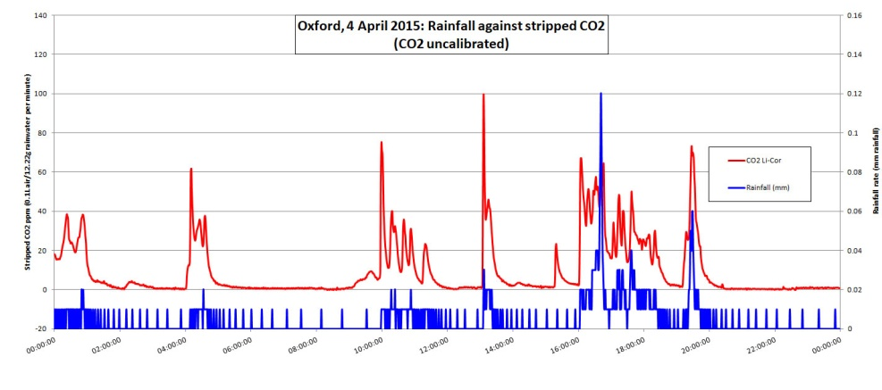
Discussion 1: Relevance to atmospheric acidity?
The slow but sustained release of our target from frost-melt is consistent with our previous reports. CO₂ is listed with nonpolar guest molecules for the purpose of gas hydrate studies (Sloan and Koh 2008, Clathrate Hydrates of Natural Gases: Table 2.5a and b). It ionises weakly in solution, and its acidity (an intensive property) can be a useful tool for monitoring its behaviour in water where its IR signature is masked.
Chart 2 shows a showery week at the University of Reading Observation Site where the acidity in the sample well rose abruptly at the onset of rainfall, afterwards decaying over around four hours to a base level of pH 6-7.
A link between this acidity and CO₂ is provided by a comparable pattern using an inline de-gasser, which understates the CO₂ released (an extensive property) because of the reluctance of the molecule to leave solution (EGU 2015-3386 accessed 2/05/2020).
The highest spike in Chart 2 (15 July 2009) represents pH 3.8, the average of 60 values over one minute (arrowed).
Chart 2 – Acidity [H₃O]⁺ in rain sample well at Univ Reading Observation Site ,
week of12 July 2009 (EGU 2015-3386 accessed 2/05/2020).
Chart 3 – CO₂ effluxed from fresh rainwater at Oxford on 4 April 2015
solution (EGU 2015-3386 accessed 2/05/2020).

Slide 5
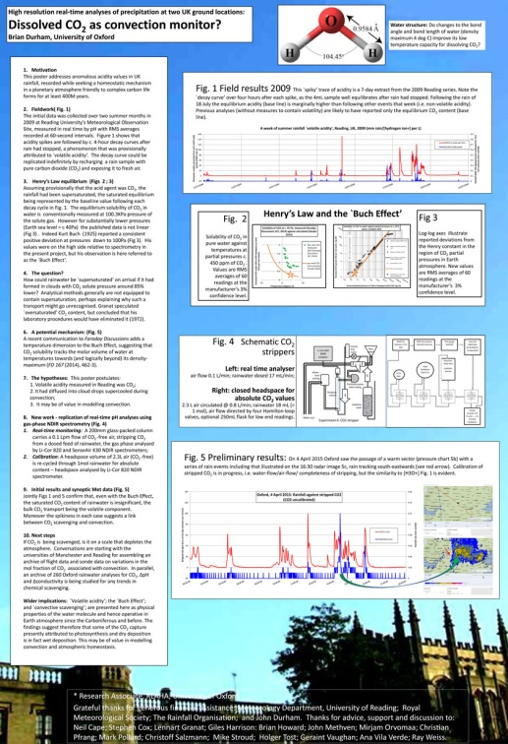
Discussion 2: What generated these spikes?
Our suggestion in 2015 was that our CO₂ had been captured by ice growing under adiabatic cooling during convective uplift and that, in melting, the CO₂ had contributed to the ionic balance of the rainwater, thereby generating the peaks (EGU 2015-3386 accessed 2/05/2020; image opposite).
Our challenge today is therefore to speculate the acidity that would be generated locally by the melting of an ice crystal formed during convective uplift as follows:
The partial pressure of CO₂ at Earth sea level is currently around 40 Pascals, diminishing to 14 Pa at 8 km altitude (chosen because of MPI Jena flight record of 29 May 2018, see opposite and Fig. 6). The ice/CO₂ equilibrium averaged over this range can be read off Chart 1 as around 100 µmols CO₂, which would give a pH around 3, comparing with pH 3.8 measured in the field in 2009 (Chart 2).
Fig. 3 EGU 2015-3386 accessed 2/05/2020
Fig. 4 CO₂ hydrate poster, Royal Meteorological Society Annual Conference, Birmingham 2019
(click on object)

Slide 6
Discussion 3: Is capture of CO₂ universal within the atmosphere?
Dependence on partial pressure – whereas mixing fraction of CO₂ (ppm) can be consistent up the atmospheric column, partial pressure of CO₂ will decrease exponentially with height, in parallel with atmospheric pressure. This infers that ice-capture would tend to decrease with height, hence mainly a boundary layer process.
Depletion rate in stratosphere: `bomb carbon’ (¹⁴CO₂) as tracer - The CO₂ from atmospheric detonations of the 1960s is a convenient tracer as follows:
The depletion curve of bomb 14C (half-life 5K years) should level out at a value lower than pre-bomb because of dilution from burning of fossil carbon (thanks Christopher Bronk Ramsay), but on the present curve (to 2011) that will take a long time.
Depletion rate in troposphere – aircraft observation - MPI Jena’s observations from above Silesia (right) suggest that depletion in the troposphere can be dramatic (see also embedded poster at Fig. 4 above).
Fig. 5: Hua et al. (2013) Figure 4 showing progress in depletion of `bomb carbon’.
'On May 29th 2018, the depleted (CO₂) signals observed at 8km were usually lower by 1-2 ppm (with some very short spikes reaching ca. 4ppm) than large-scale average, while the overall difference between biosphere-influenced low-altitude air (approx. 1km) and free troposphere (approx 8km) was around 10-12 ppm on average' Pers. comm. Michal Galkowski, MPI-BGC, 26/06/2019).
Fig 6: statement from MPI-BGC Jena on troposphere CO₂ depletion, following EGU 2019

Slide 7
Discussion 4: Distribution of hydrate forming molecules including greenhouse gases (GHGs), in the atmosphere and as `guests’ in ice
In hydrate studies, Earth air would be described as a `multicomponent gas mixture’ (Sloan and Koh (2008) pp 448-461), for which a list of 62 hydrate-forming `guest’ molecules includes all the major components of Earth atmosphere: N₂; O₂; six noble gases; and trace gases including GHGs, but excluding water (Sloan and Koh 2008, p78-9, Table 2.5a and b).
In climate change studies the GHG group in question (CO₂; methane; N₂O and halocarbons) constitutes a mol fraction of around half of 1‰ of Earth atmosphere (IPCC AR4 Technical Summary (2013), Table TS 5).
The exception molecule, water vapour, is a powerful greenhouse gas, while in gas hydrate studies it forms hydrogen-bond caging but is not listed among the 62 guest molecules, which may be because it is a polar molecule.
Assumptions in the ongoing project: Based on the above, this project will provisionally assume that ice that is growing in the presence of air at ≤ 1 Bar offers:
Hydrogen-bonded caging for poorly soluble nonpolar molecules (Sloan and Koh (2008), p199);
Mix of species broadly in proportion to respective partial pressures (Sloan and Koh (2008) pp 448-461);
Packing broadly according to overall gas pressure (Chazallon and Pirim (2018) Fig. 3);
Slow release in the absence of `promoters’ (Slide 3 above);
Monitorable by intensive properties (acidity in case of CO₂ and N₂O) (Slides 4 and 5 above);
Earth boundary layer process (Slide 6 above).

Slide 8
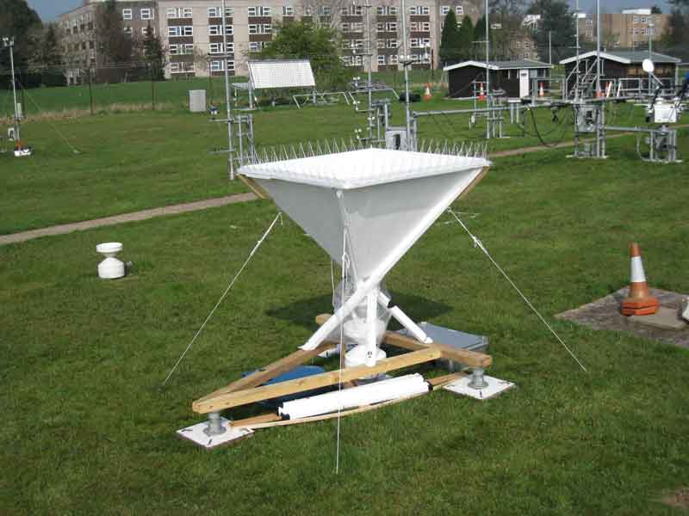
Conclusion and wider implications
In juxtaposing atmospheric chemistry and hydrate science, we present six reasoned assumptions arising from the apparent ability of ice to offer `cages’ that are friendly to otherwise weakly soluble nonpolar atmospheric gases, thereby to exceed unity in the respective ice retention coefficient R, and to retain this architecture for several hours into the melt phase.
If confirmed elsewhere this adds a third natural capture process for atmospheric CO₂, being the first that is `atmosphere-based’ (see Fig. 8).
For Earth surface there may be implications for:
Acid rain;
Solution and re-deposition of carbonate and olivine rocks;
Ocean acidification;
Residence time of anthropogenic GHGs.
We are grateful to Barbara Ervens (ICCF/ CNRS) for detailed discussion on the ice retention coefficient as used in modelling of atmospheric chemistry.
Fig. 7: 1m² rain gauge at University of Reading Observation Site 2009
Fig. 8: IPCC AR5 Working Group 6, Figure 6.4 Simplified schematic of the global carbon cycle.
Brian Durham
b.durham@bham.ac.uk
brian@oxpot.co.uk

