Slide 1
Advance in a meteorological station, developed in educational environment, for agricultural and urban purposes
Ilaria Cantini¹, Benedetto Allotta¹, Luca Bini², Marco Vieri³
¹ DIEF University of Florence, Italy
² Azienda Agricola La Capannaccia – Agricultural Farm, Italy
³ DAGRI University of Florence, Italy

Slide 2
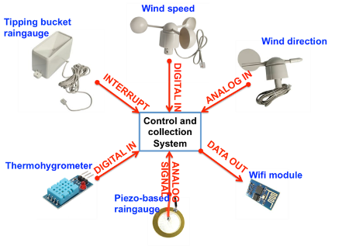
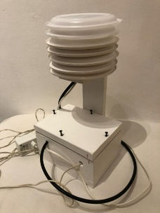
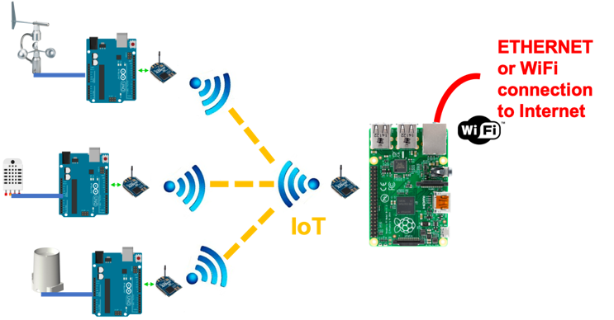
THE PROJECT DESCRIPTION
Meteorological station prototype
Sensors Connections scheme
System architecture

Slide 3
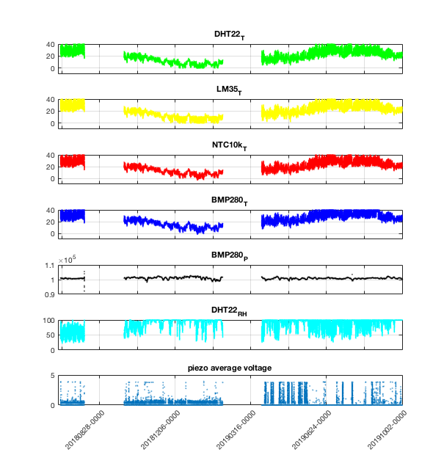
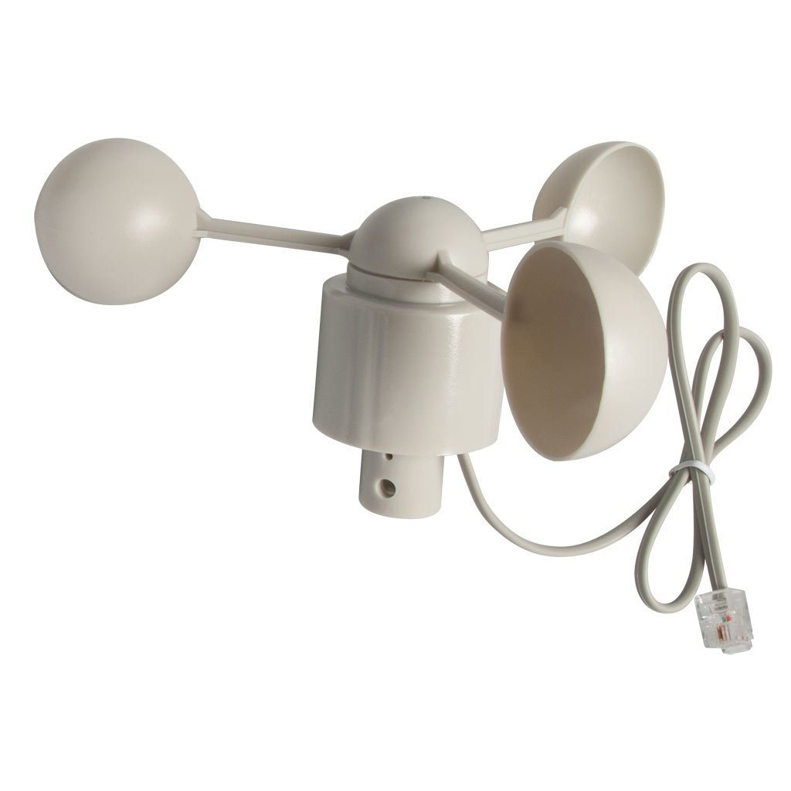
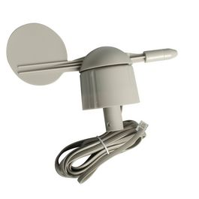
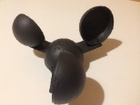
Measurements collected
during the entire
period of observations
THE RAINGAUGE

Slide 4
Comparison of different temperature sensors with a reference measurement (bottom black curve)

Slide 5
Comparison of relative humidity with a reference sensor (bottom black curve)

Slide 6
Comparison between pressure measurements using BMP280 sensor and a reference sensor (bottom black curve)

Slide 7
Comparison of piezoelectric outputs with a reference rain gauge (bottom black curve)

Slide 8
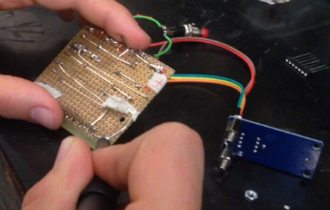
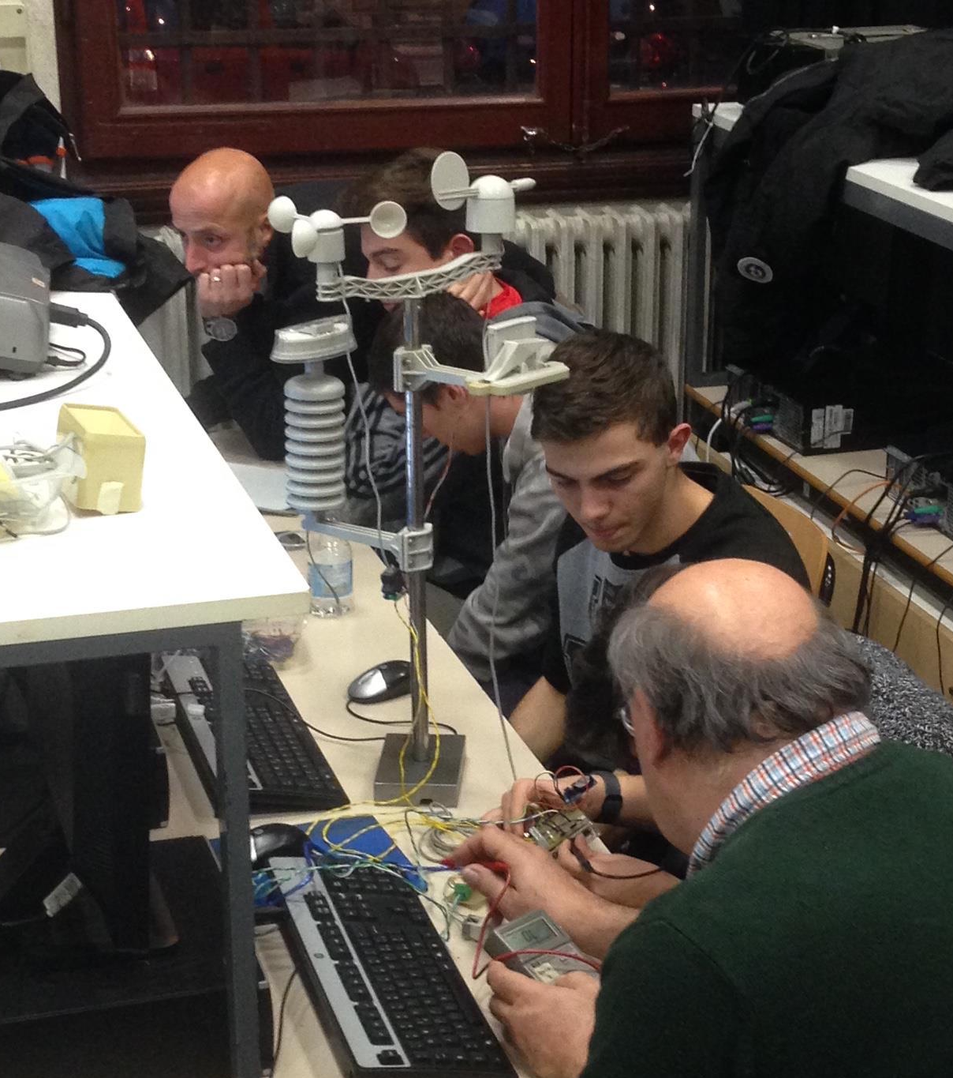
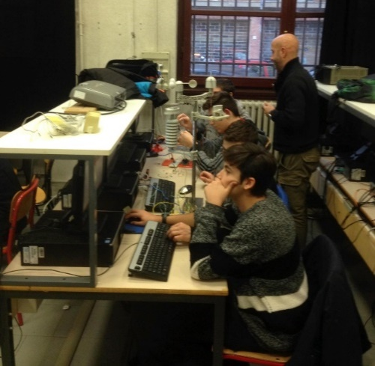
Pedagogical and Teaching aspects
The success of the initiative was measured on the basis of the teachers’ personal evaluation; they follow up the students work both in curricular and extra-curricular activities, based on three parameters:
the learning of the Electronic concepts,
the technology perception and attitudes,
the perception of collaborative work attitudes
Technical Laboratory of the Benvenuto Cellini Institute of Florence, Italy, under the organizational and learner supervision of teachers, and external expert tutors and researchers.
Within FabLab, the proposal to build up a board finalized at measuring atmospheric parameters (i.e. a meteorological station) played a catalytic role for students in apprehending specific competences

Slide 9
Teaching conclusions
The project was entirely conceived and carried out inside a high school, and has become an integral part of teaching, involving different annual courses with students able to analyse the project from different skills related to high school programs. The technical aspects of the system development allowed students to actively explore real-world problems and to achieve a deeper knowledge.

Slide 10
Scientic conclutions
Some scientific aspects have been also introduced, as the concepts of and precision of sensors. . A series of factors can affect the matching with the reference measurements, including errors determined by the site location, as discussed above. However, an evident calibration fault emerges from the data analysis, since the sensor measurements are very often affected by signal saturation. measurements and data processing for the assessment of the accuracy

