Slide 1
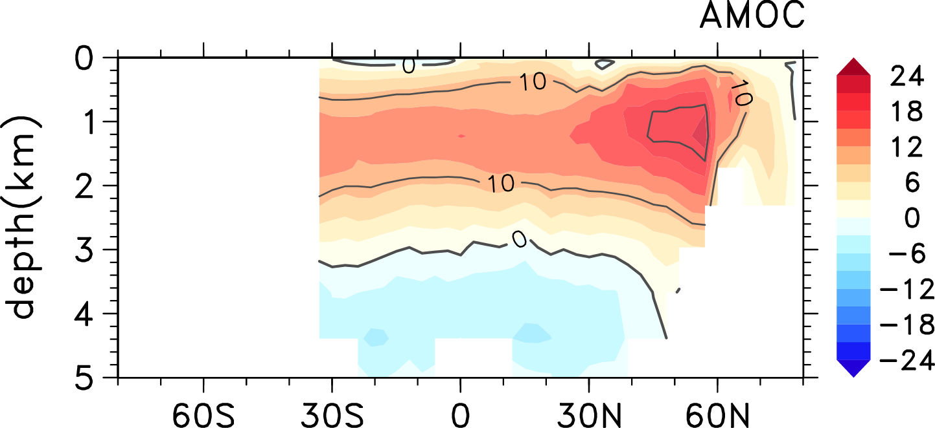
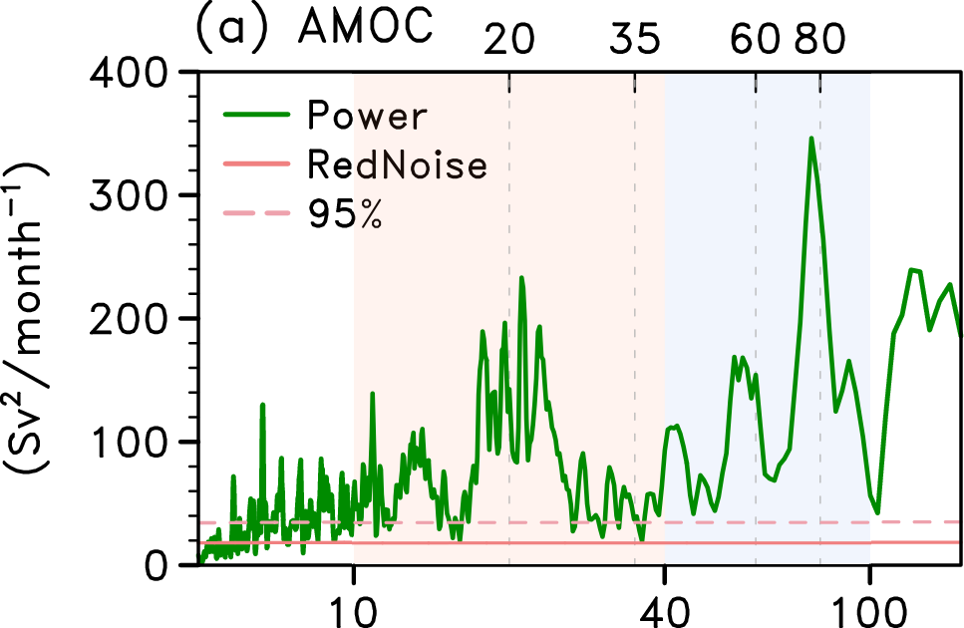
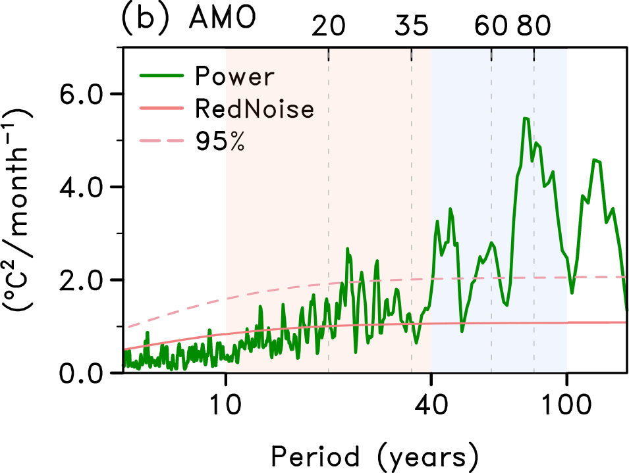
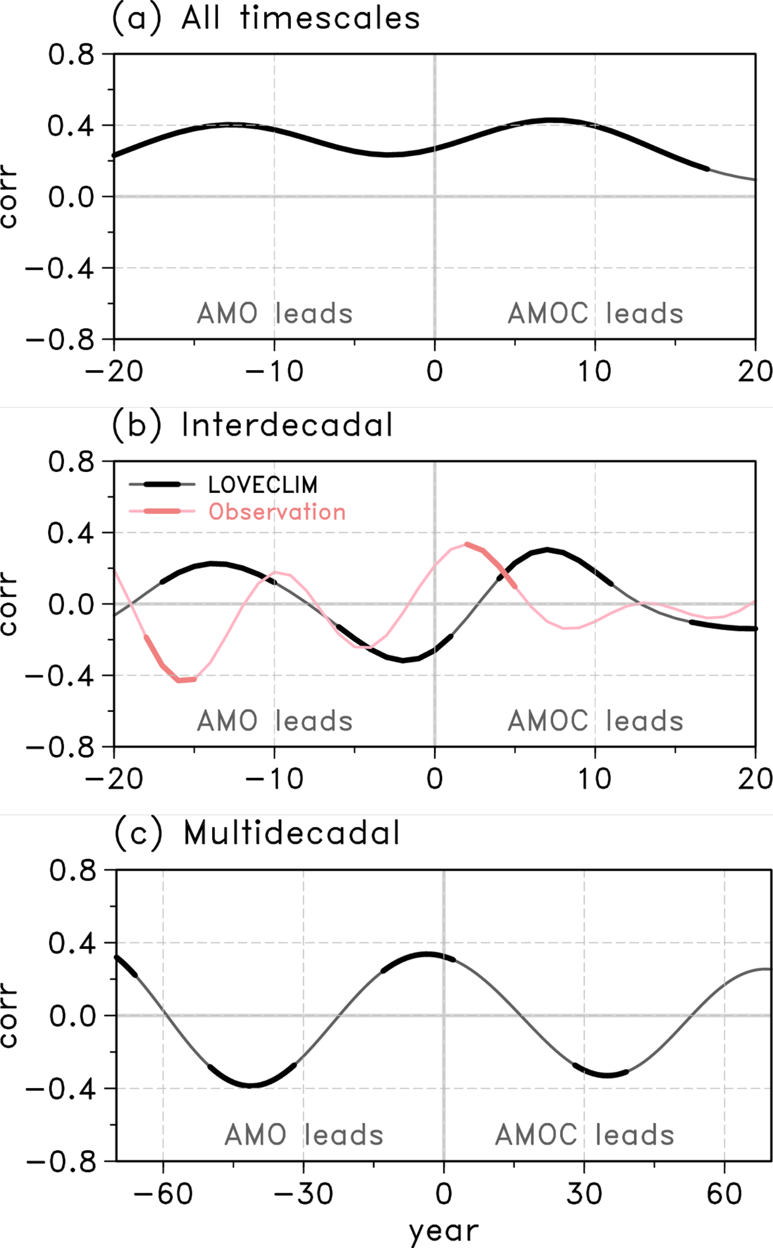
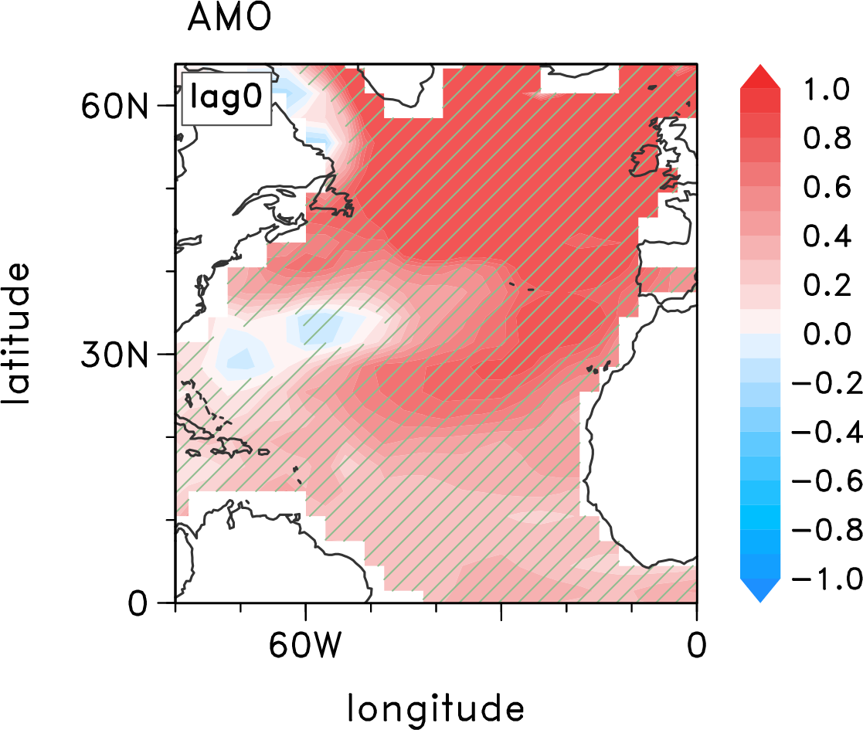
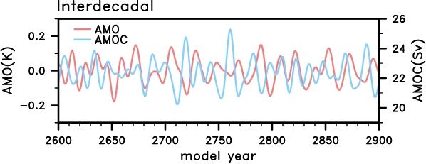
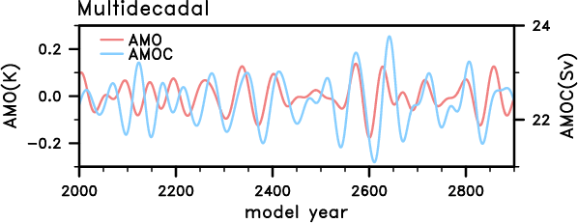
Timescale-dependent AMOC-AMO relationship
H.-J.Kim¹, S.-I.An¹ and D.Kim²
¹Department of Atmospheric Sciences/Irreversible Climate Change Research Center, Yonsei University, Seoul, South Korea ² ¹Department of Atmospheric Sciences, University of Washington, Seattle, Washington, USA.
1. The LOVECLIM model
2. Semi-periodicity of AMOC and AMO
4. Timescale-dependent relationship between AMOC and AMO
Power spectrum of AMOC and AMO simulated by LOVECLIM
Distinct peaks at inter- (10–40 year) and multi-(40-100year) decadal periods
3. Timescale separation
Despite the downscaled complexity and resolution of the model, LOVECLIM well-captures spatial structures of AMOC and AMO.
Lead-lag correlation for each timescale
Oscillatory relationship for (b)
Simultaneous positive relationship for (c)
Time series of inter[multi]-decadal AMOC, AMO indices
extracted by band-pass filtering method
Goosse, H., Brovkin, V., Fichefet, T., Haarsma, R., Huybrechts, P., Jongma, J., et al. (2010). Description of the Earth system model of intermediate complexity LOVECLIM version 1.2. Geoscientific Model Development, 3(2), 603–633. https://doi.org/10.5194/gmd-3-603-2010
Carton, J. A., & Giese, B. S. (2008). A reanalysis of ocean climate using Simple Ocean Data Assimilation (SODA). Monthly Weather Review, 136(8), 2999–3017. https://doi.org/10.1175/2007MWR1978.1
Zhang, R. (2010). Latitudinal dependence of Atlantic meridional overturning circulation (AMOC) variations. Geophysical Research Letters, 37(16), 1–6. https://doi.org/10.1029/2010GL044474
Zhang, L., & Wang, C. (2013). Multidecadal North Atlantic sea surface temperature and Atlantic meridional overturning circulation variability in CMIP5 historical simulations. Journal of Geophysical Research: Oceans, 118(10), 5772–5791. https://doi.org/10.1002/jgrc.20390

