Slide 1
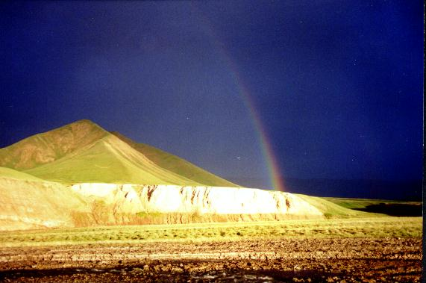
EGU2020
ERE 5.4
Integrated dynamic interactive models of ore-magmatic concentres in Uzbekistan
,
Irina Sidorova
Head, Dept. «Structure of Lithosphere»
Institute of Geology&Geophysics of State Committee of Uzbekistan on Geology and Mineral Resources
sidoirina@yahoo.com

Slide 2
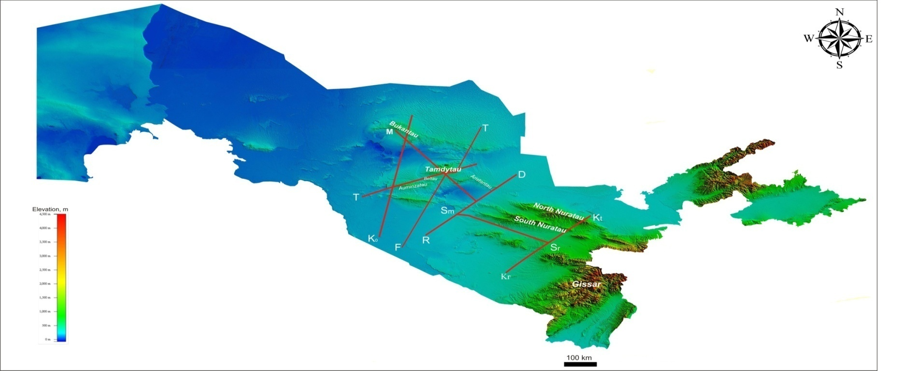
Location of regional seismic profiles DSS-MRW:
T-Tamdy, M - Muruntau, K - Kokpatas, F-T -Farab-Tamdybulak, R-D -Romitan-Darbazatau, Kr- Kt- Karabekaul-Koitash, Sm-Sr –Samarkand-Sarikazgan
Introduction
Our study was made with complex geophysical and geological observations by the DSS-MRW seismic reflection and refraction profiles, which cross Uzbekistan. The aim of our study was to reveal new features, which are characteristic of the upper mantle rocks, related to morphology of bodies, their physical properties, consisting mainly in their contrasting values for contiguous blocks, and general increased velocity and density of the rocks they contain.

Slide 3
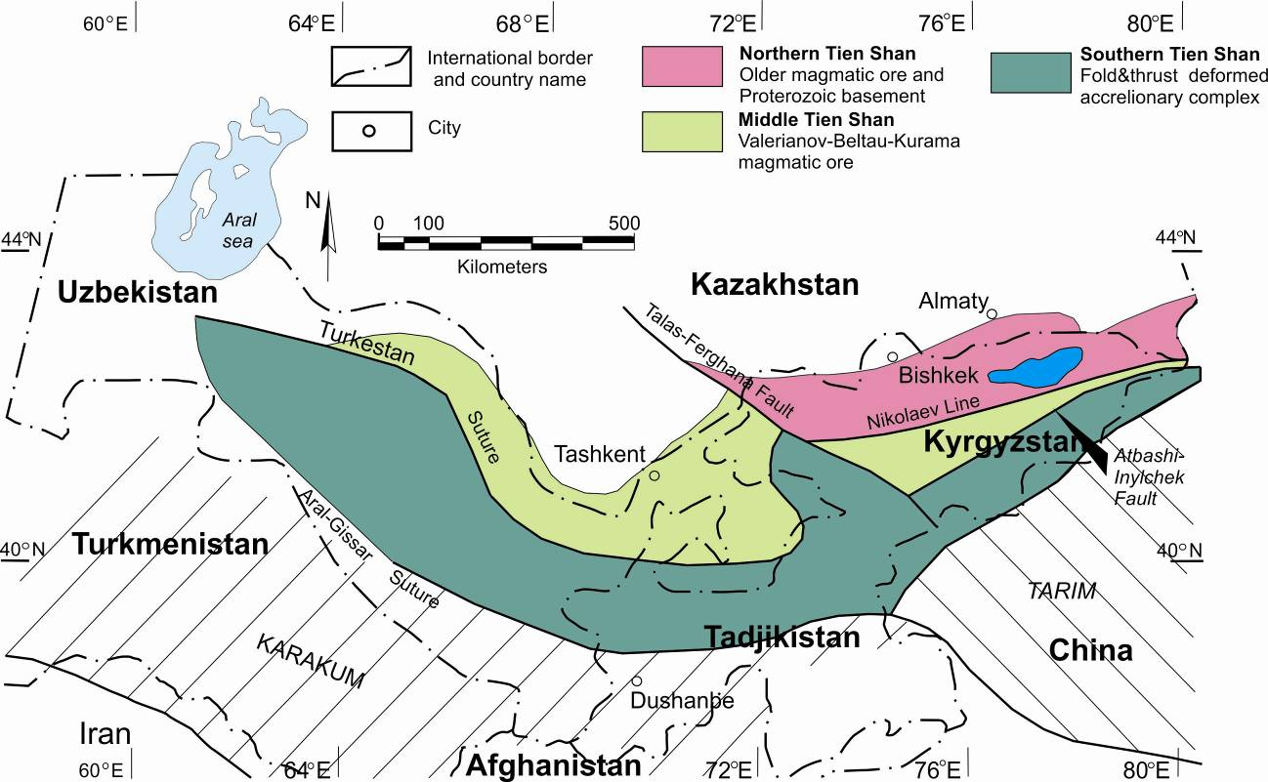
Tectonic framework of Western Central Asia region (modified from Biske, 1996; Bazhenov et al., 1999; Yakubchuk et al, 2005)
Traditionally Western Central Asia region is divided into subunits, namely: Northern, Middle, and South Tien Shan. Previous work in the Soviet Union (Burtman, 1975; Khain, 1985) described several magmatic arcs, ophiolite belts and intramontane belts in the region; additionally, the location of important mineral deposits can be linked to accretionary processes to the north along the Tien Shan-Solonker suture zone (Seltmann et al., 2011).

Slide 4
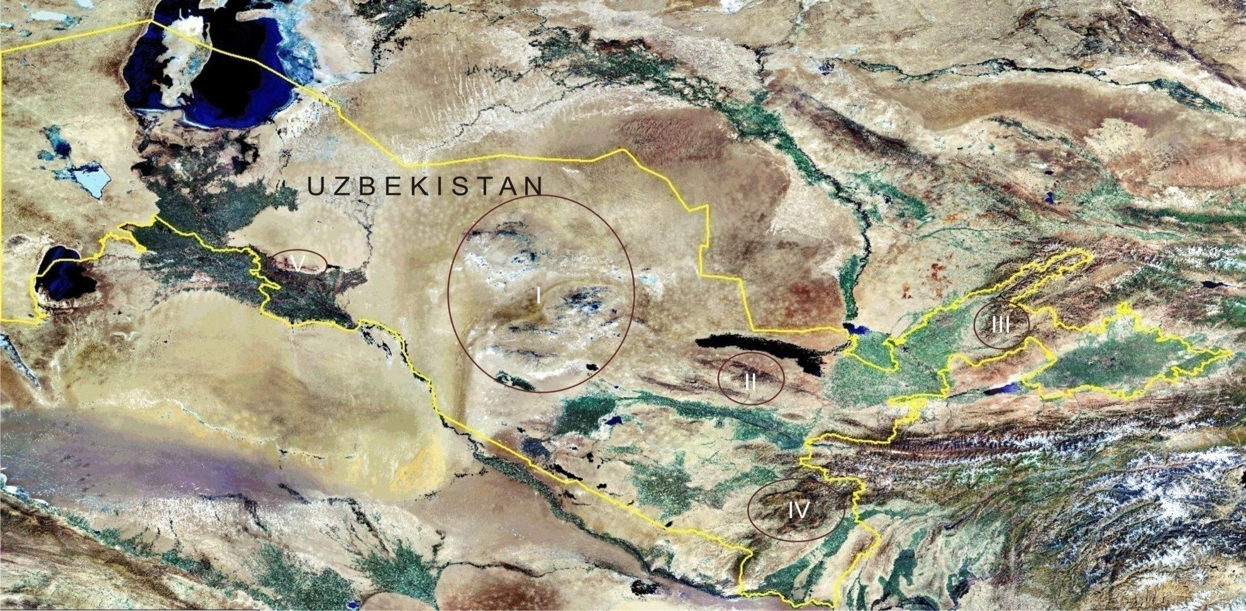
Concentration of majority of magmatism manifestations and ore deposits within limited area between the Middle and the Southern Tien Shan permits to consider this province as a single ore-magmatic concentre. Such limited sections of the Earth crust, where diverse deposits are localized and spatial conjugated with products of multiple and different magmatism, have been named ore-magmatic concentre (OMC).
The Landsat space image of Uzbekistan (yellow contour)with location of Ore-Magmatic Concentres: I – Central Kyzylkum; II- Nurata; III – Chatkal-Kurama;IV – Baisun; V- Sultanuvais

Slide 5
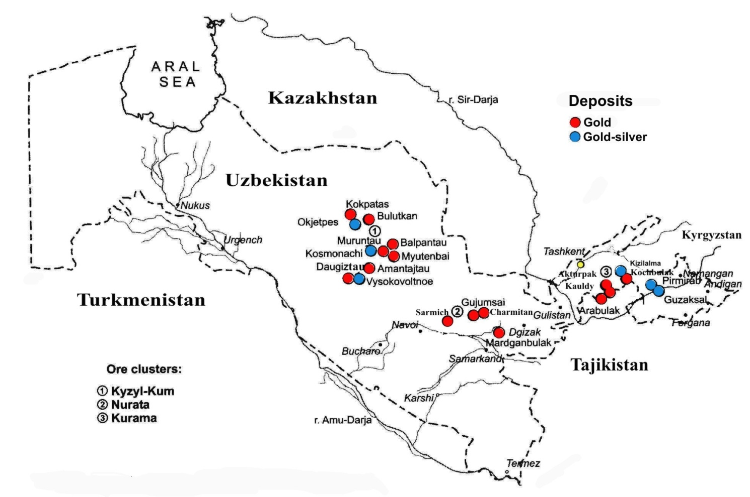
Gold and gold-silver deposits on the territory of the Republic of Uzbekistan
Notes:
Epithermal, porphyry and orogenic gold deposits in the geodynamic structures of Tien Shan. 1 - Northern Tien Shan, 2 - Middle Tien Shan, 3 - Southern Tien Shan. Deposits: 4 - orogenic gold, 5 - Hg-Sb, 6 - porphyry and epithermal gold. (Yakubchuk et al, 2005).

Slide 6
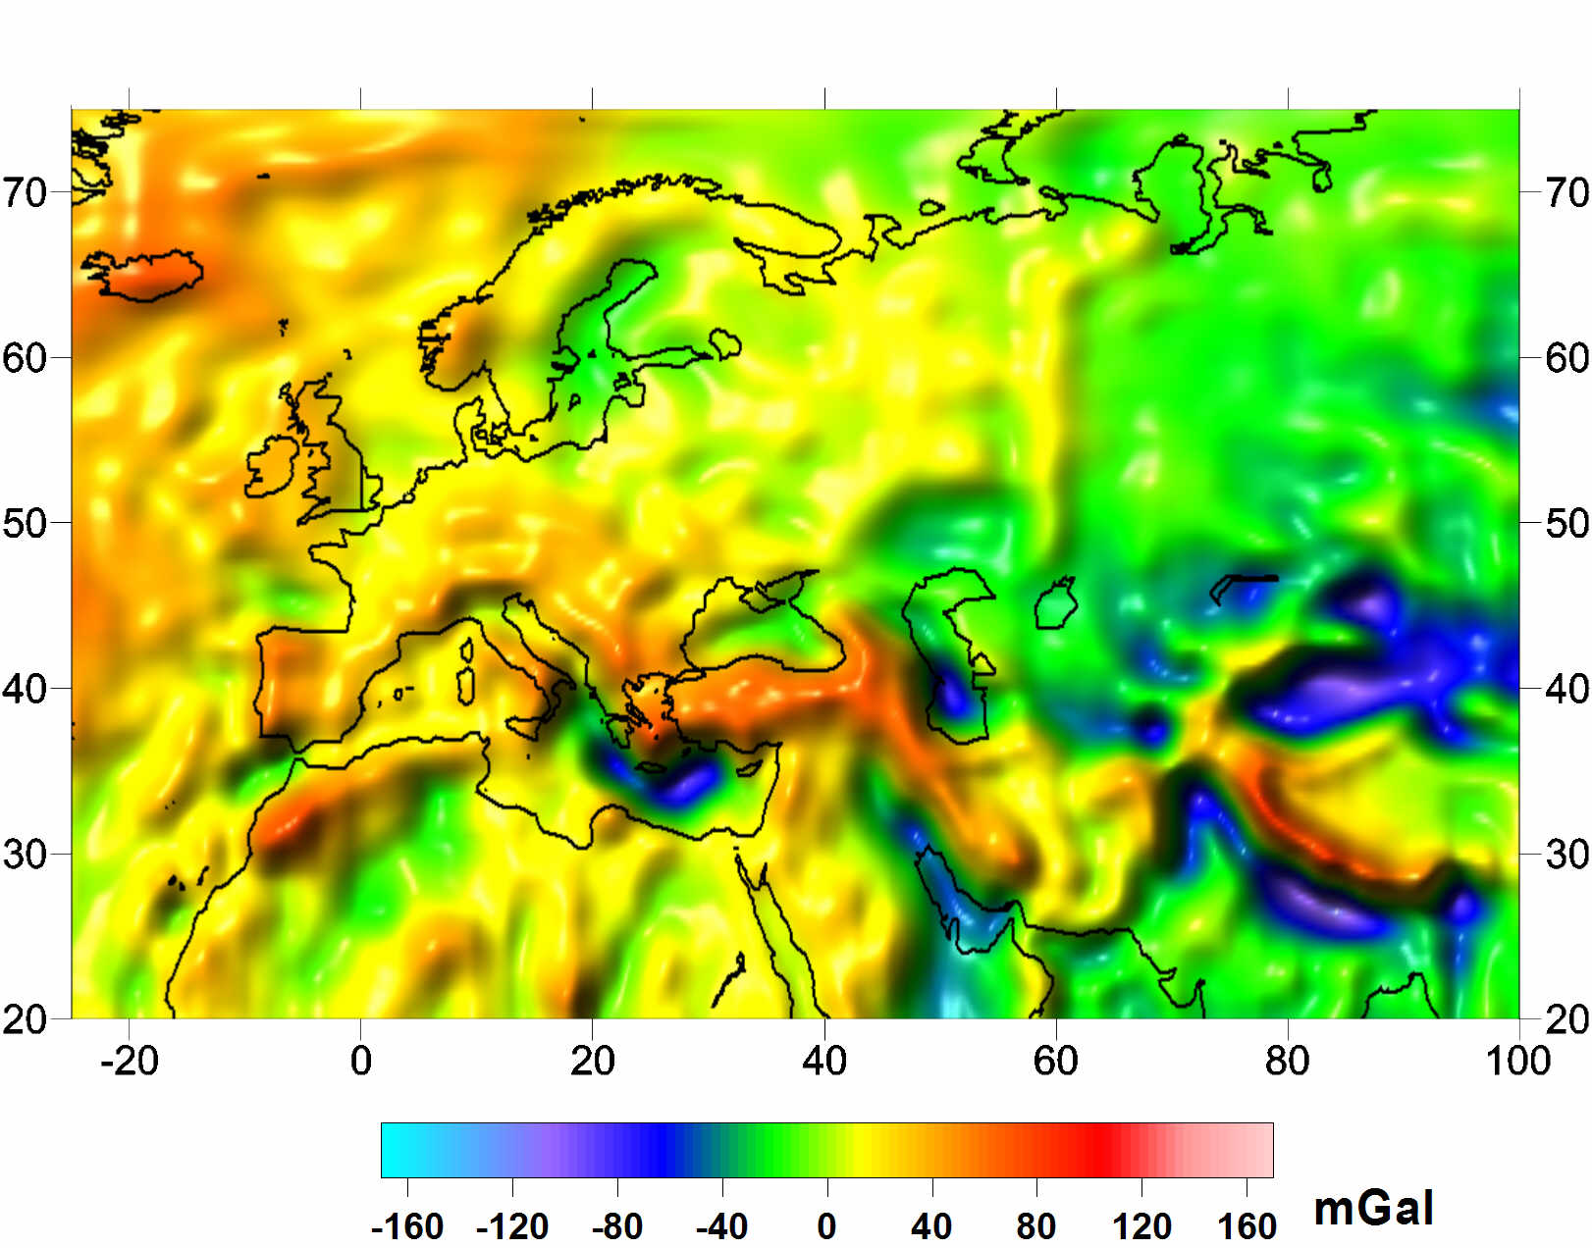
CHAMP/GRACE model

Slide 7
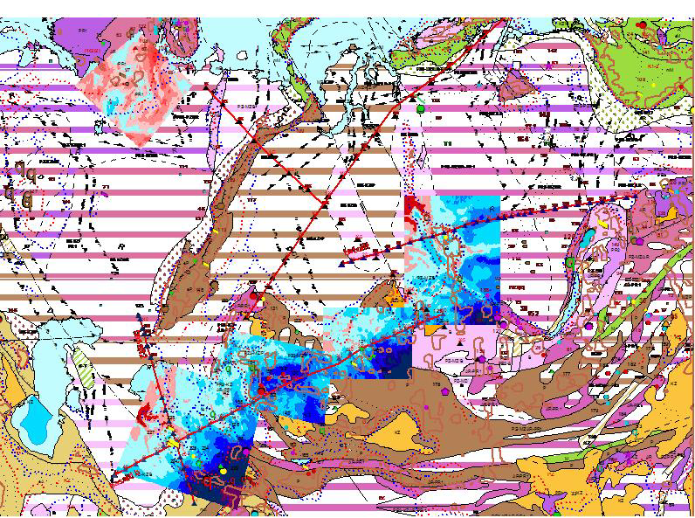
1:1.000.000 scale gravity maps
Uzbekistan

Slide 8
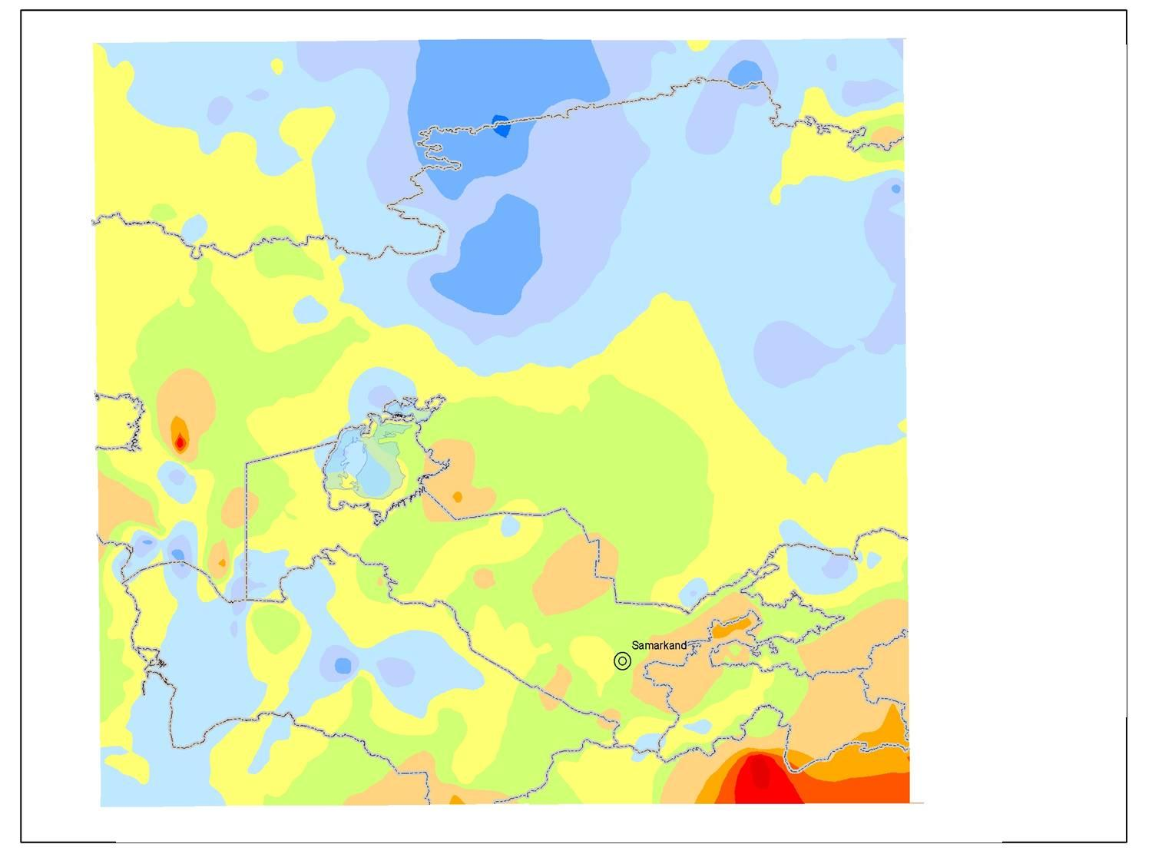
Map of Heat Flow in Uzbekistan

Slide 9
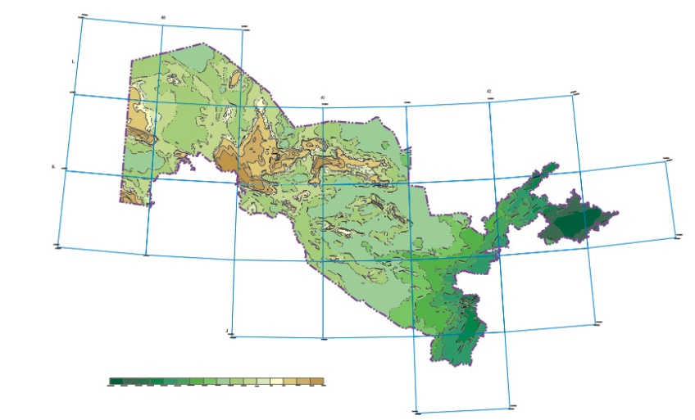
MAGNETIC MAP OF WEST-CENTRAL UZBEKISTAN WITH FAULTS INFERRED FROM GEOPHYSICAL DATA

Slide 10
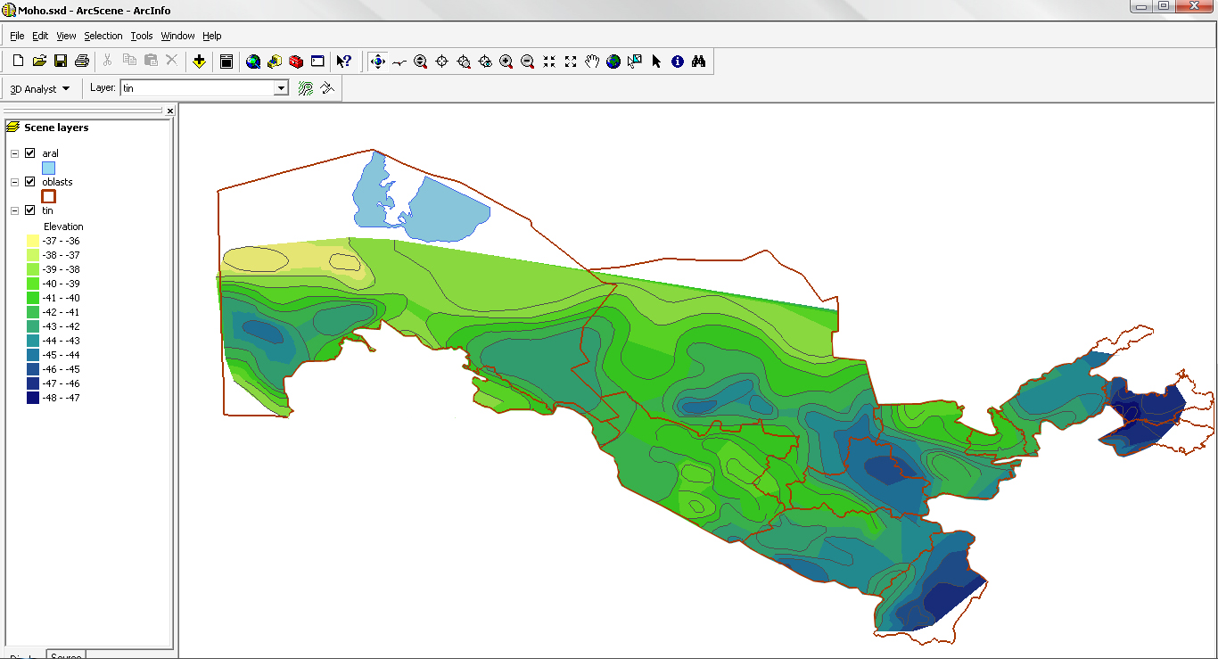
Depth to Moho map (km)

Slide 11
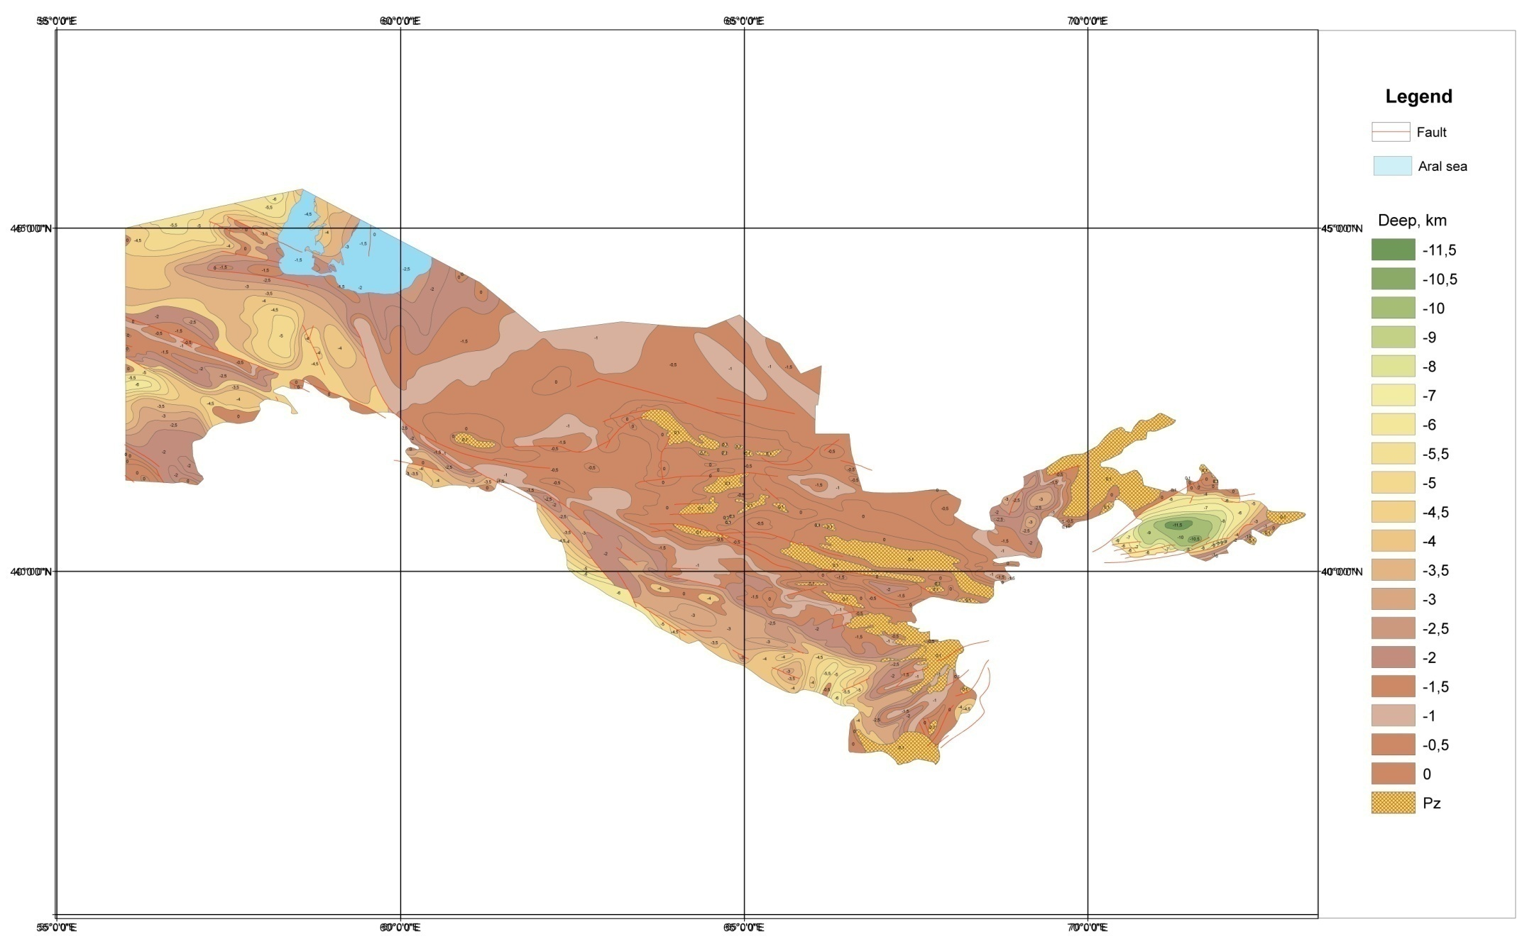
Depth to crystalline basement surface in Uzbekistan (km)

Slide 12
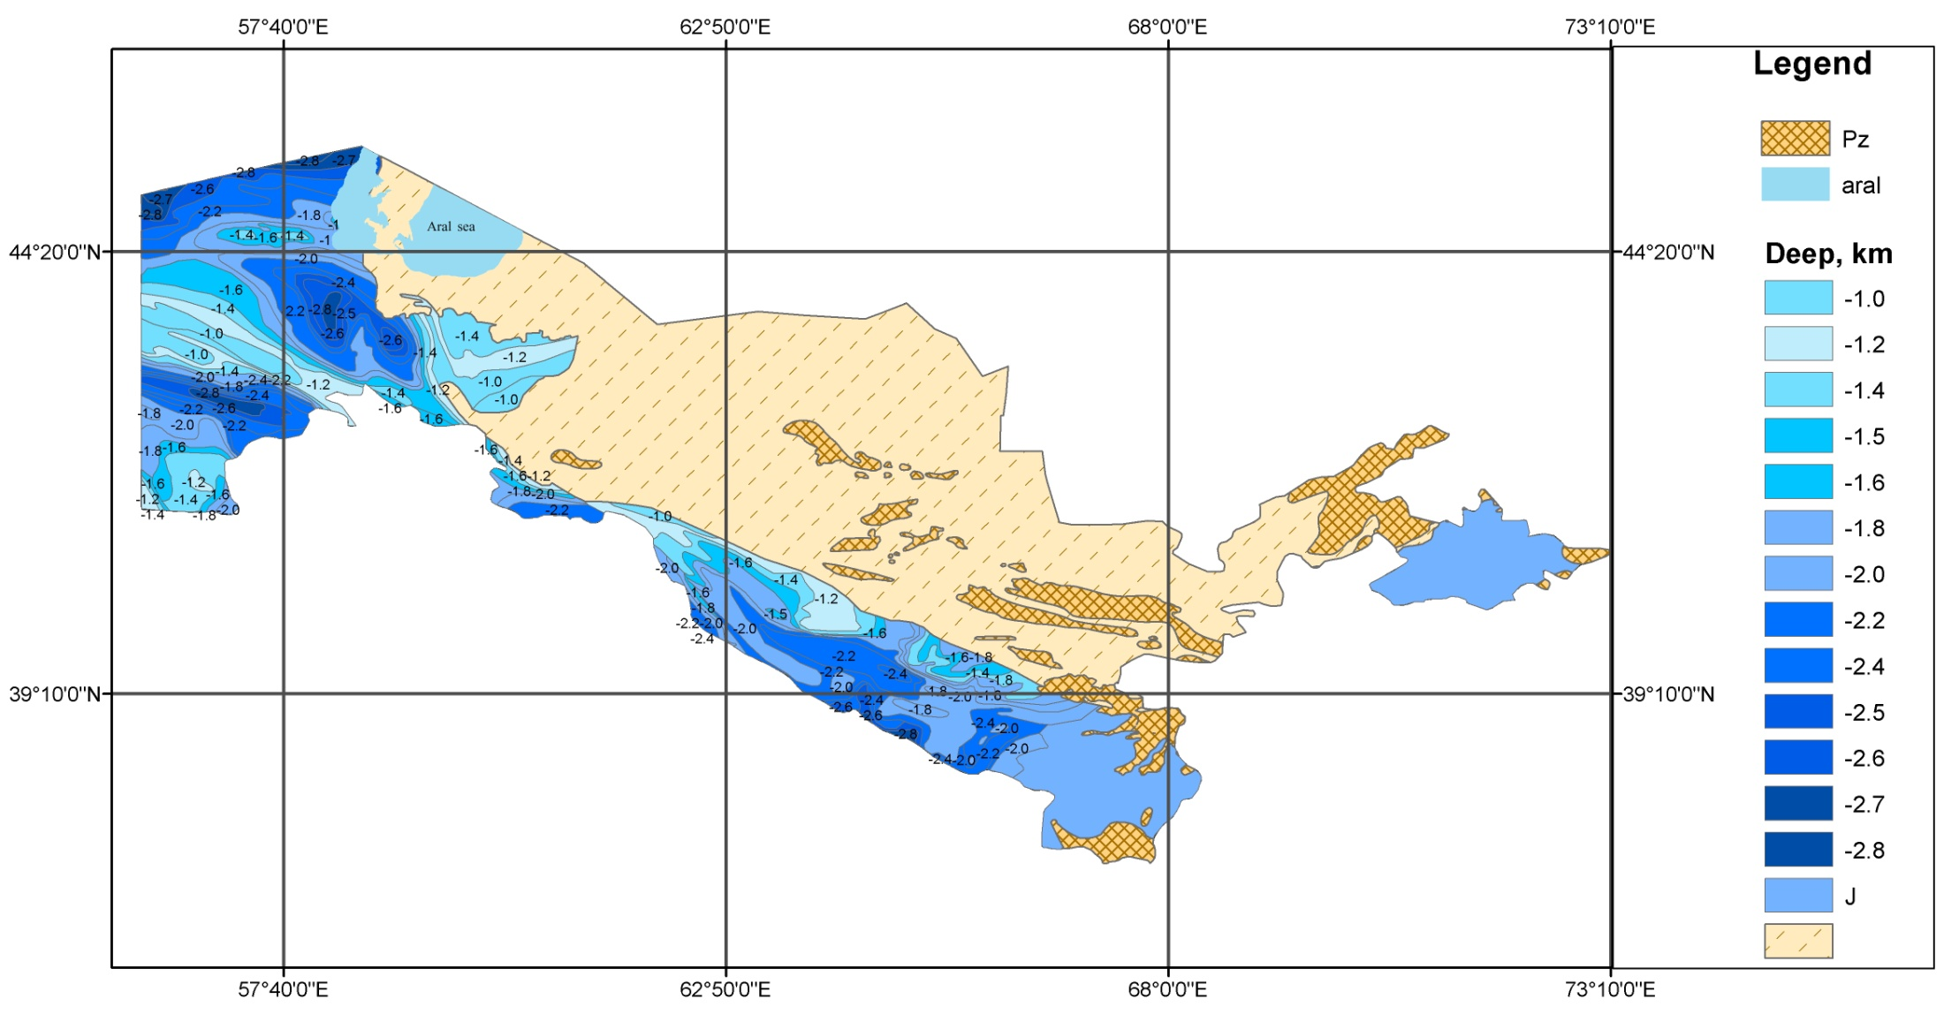
Jurassic isopach map (km thickness)

Slide 13
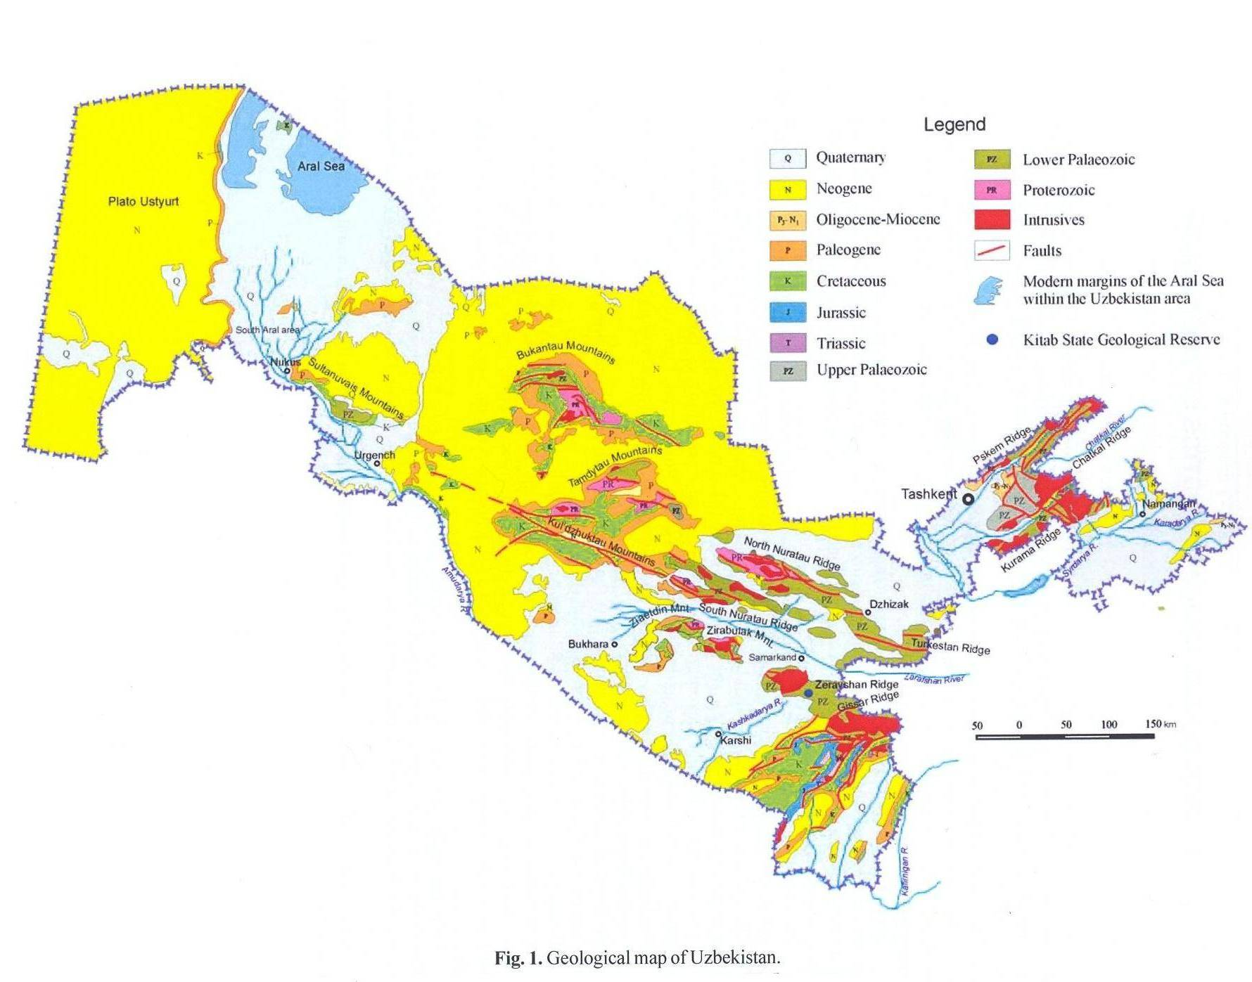
The contour of Central Kyzylkum Ore Magmatic concentre (CKOMC) on geological map of Uzbekistan

Slide 14
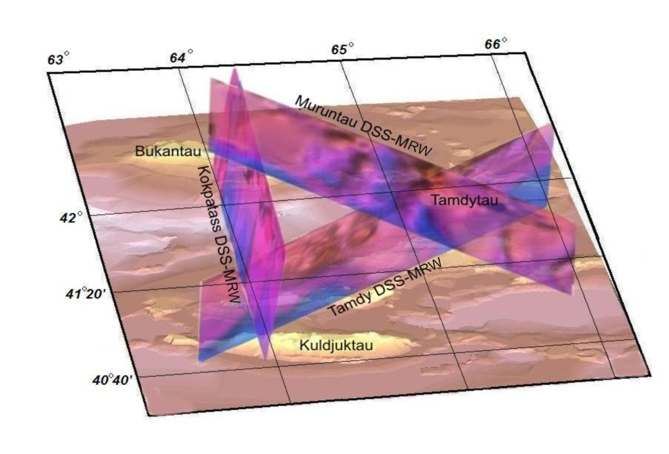
Perspective view of the location of deep seismic profiles crossing orogenic structure in CKOMC

Slide 15
Velocity section along the Muruntau profile
8
7.8
7.6
7.4
7.2
7
6.8
6.6
6.4
6.2
6
5.8
5.6
5.4
5.2
5
8
4.8
7.8
4.6
7.6
4.4
7.4
7.2
7
6.8
6.6
6.4
6.2
6
5.8
5.6
5.4
5.2
5
4.8
4.6

Slide 16

Velocity section along the Kokpatass profile
8.1
8
7.9
7.8
7.7
7.6
7.5
7.4
7.3
7.2
7.1
7
6.9
6.8
8
6.7
7.9
6.6
7.8
6.5
7.7
6.4
7.6
6.3
7.5
50
100
150
200
250
6.2
7.4
6.1
7.3
6
7.2
5.9
7.1
5.8
7
5.7
6.9
5.6
6.8
6.7
6.6
6.5
6.4
6.3
6.2
6.1
6
5.9
5.8
5.7
5.6
5.5
50
100
150
200
250
5.4

Slide 17
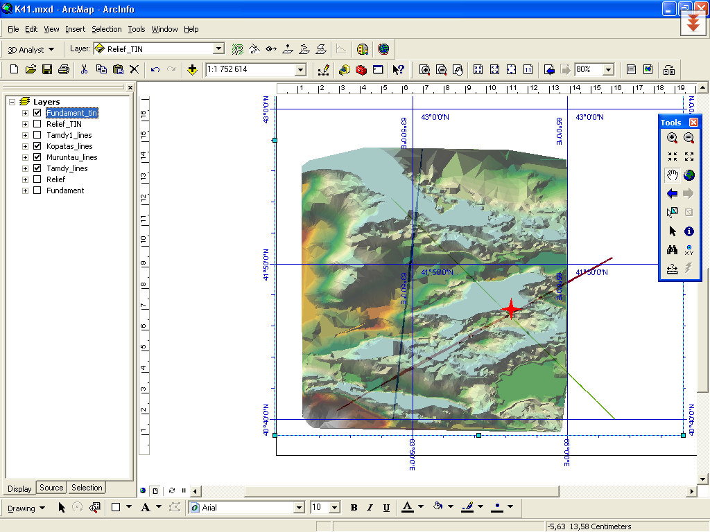
GIS mapping – basement surface

Slide 18
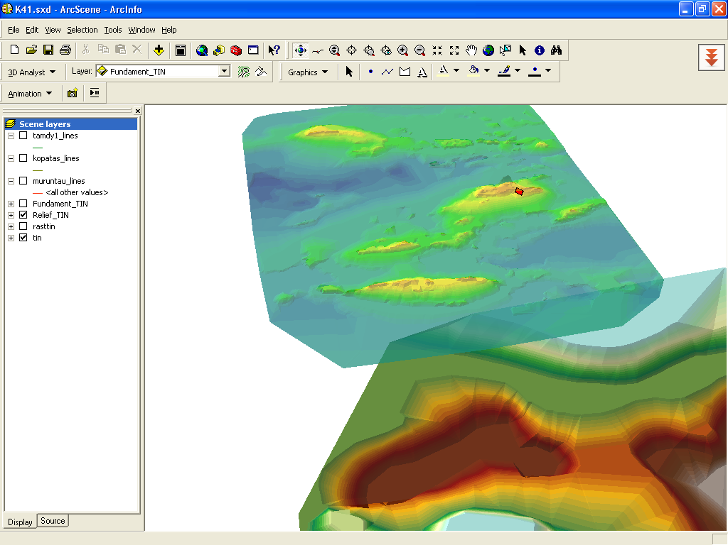
Topographic (DEM) surface and Moho surface

Slide 19
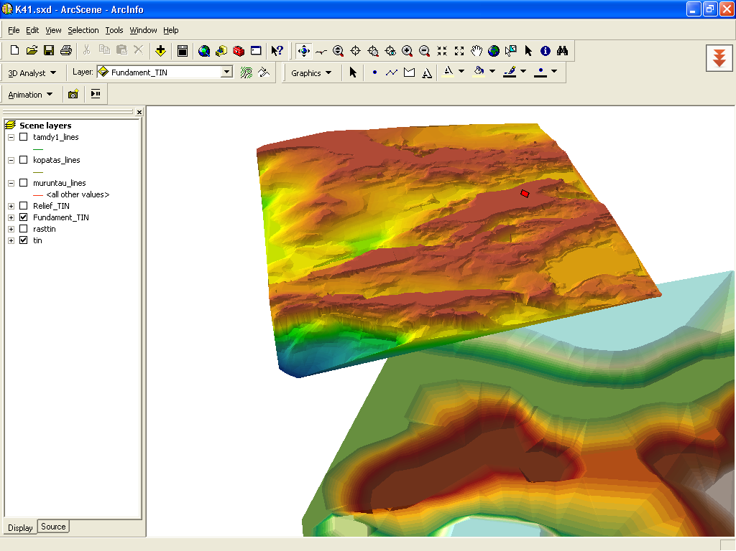
Crystalline basement surface and Moho surface

Slide 20
Topographic (DEM), crystalline basement and Moho surfaces – interactive GIS&RS model of CKOMC

Slide 21
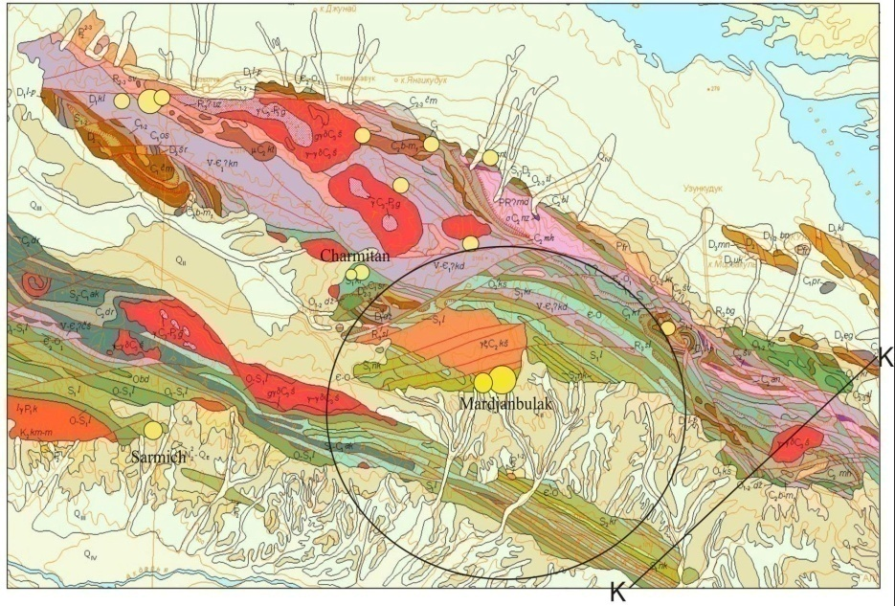
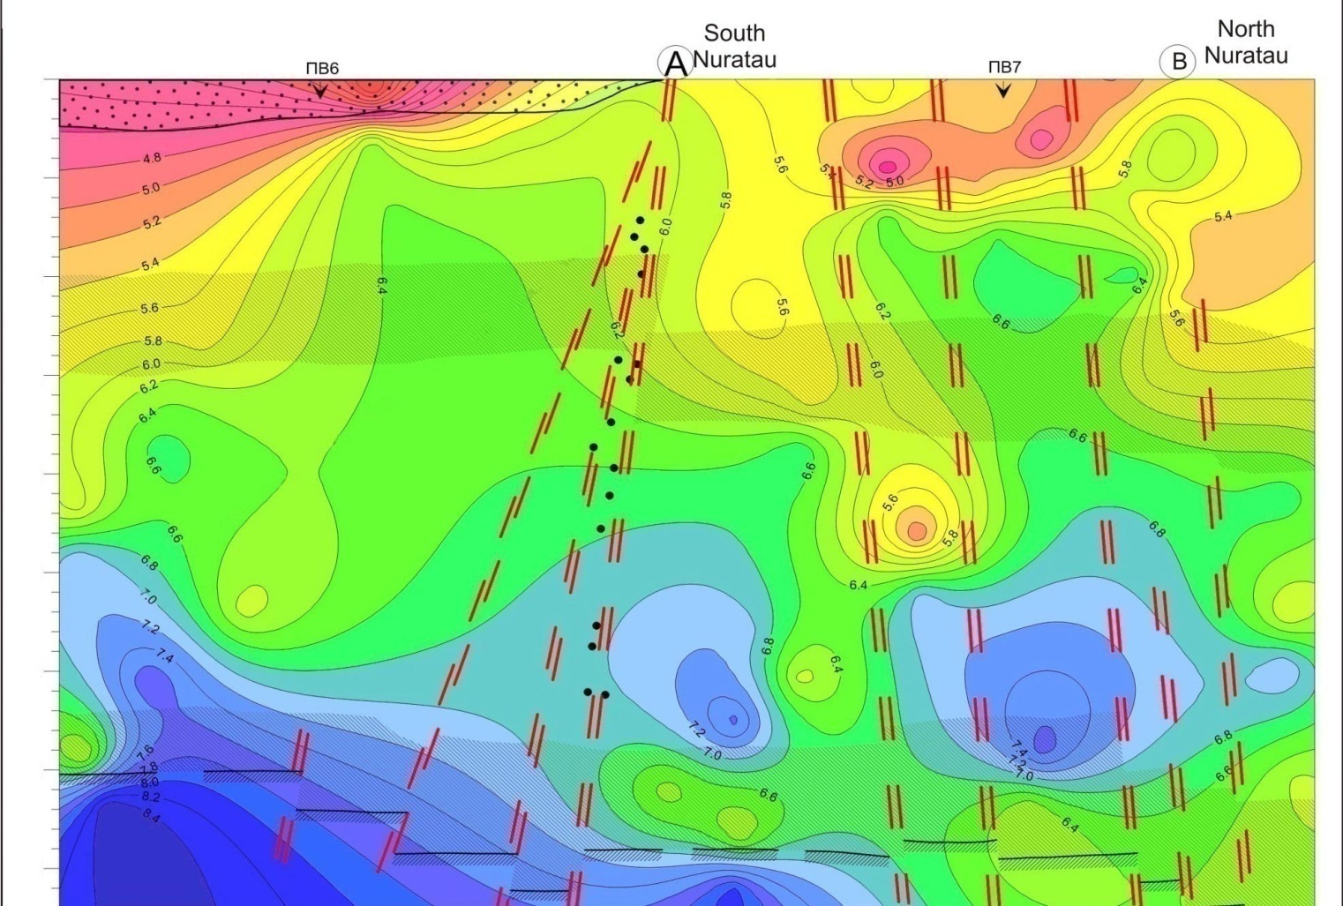
The contour of Nurata Ore-Magmatic Concentre with NE part of DSS profile Karabekaul-Koitash
Sidorova I.P., Kustarnikova A.A. Ore magmatic concentres in Uzbekistan
in monography “Geosciences in Uzbekistan” Tashkent, 2012

Slide 22
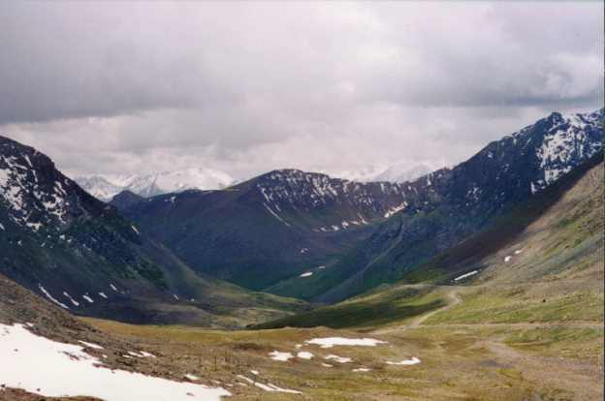
Summary and conclusions
  Geophysical data of Ore-Magmatic Concentres in Uzbekistan, including subsurface (borehole) data, have been integrated into an interactive GIS&RS model. This interactive GIS&RS model promotes an understanding of the significant of parameters,controlling the region’s lithosphere structures. Examples were shown from the Central Kyzylkum and Nurata regions in Western Uzbekistan.
  An integrated interpretation of potential fields enablers the maximal use of information available in this field for the analysis of the deep structure.
  The GIS&RS model will provide a basis for new interpretations of the geophysical and subsurface data The processing of data is an important integrated part of the whole process of development of the 3-D model of the ore-magmatic concentre within the frames of the GIS project. New regional features have been revealed: they include peculiarities of the Earth's crust's deep geological structure and spatial distribution of deposits; they are contact areas of the Earth's crust geoblocks with anomalously high and low seismic and density parameters. Mapping of these zones helps select new ways in the search for mineral deposits.

Slide 23
Thank you

