Slide 1
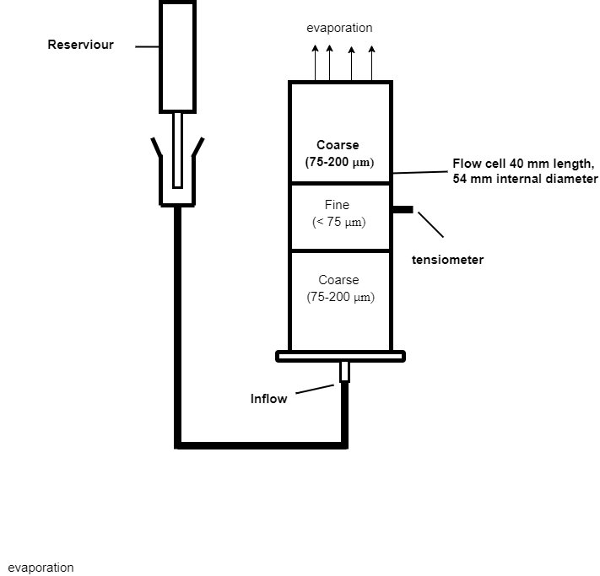
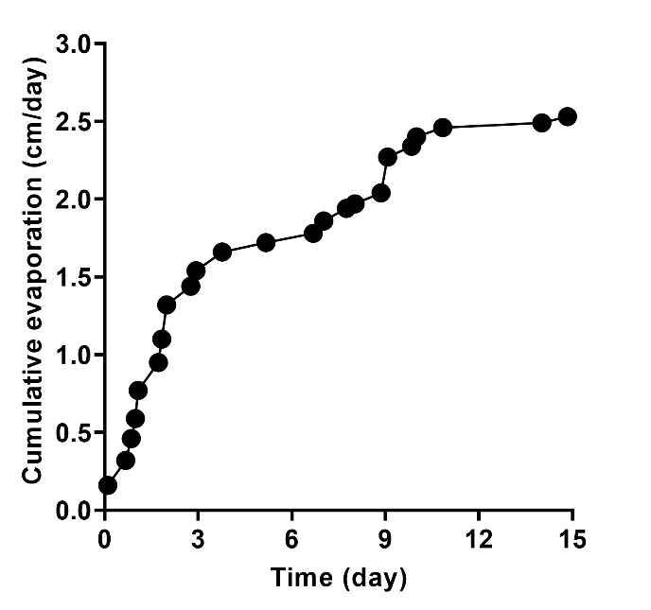
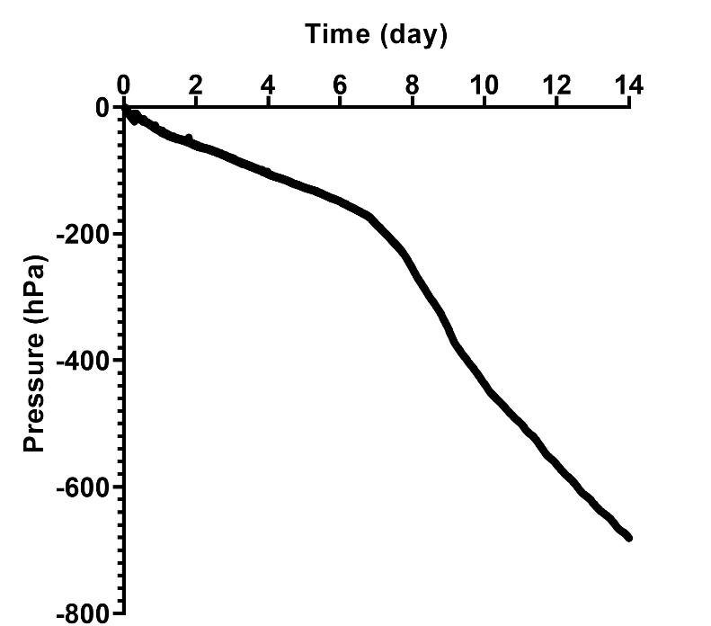
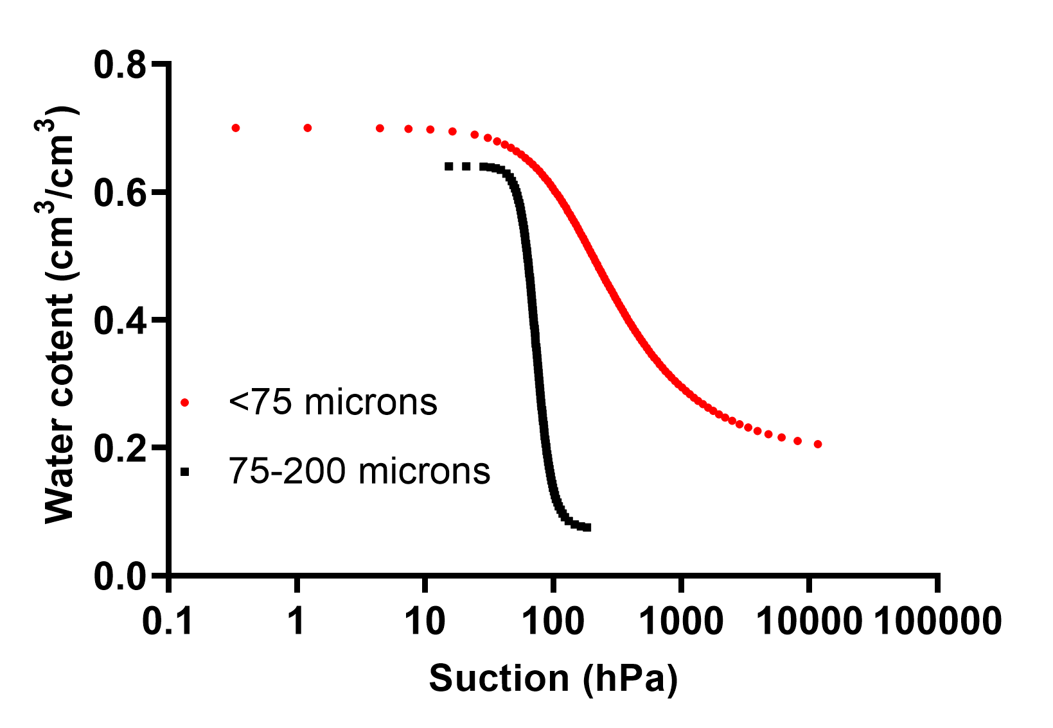
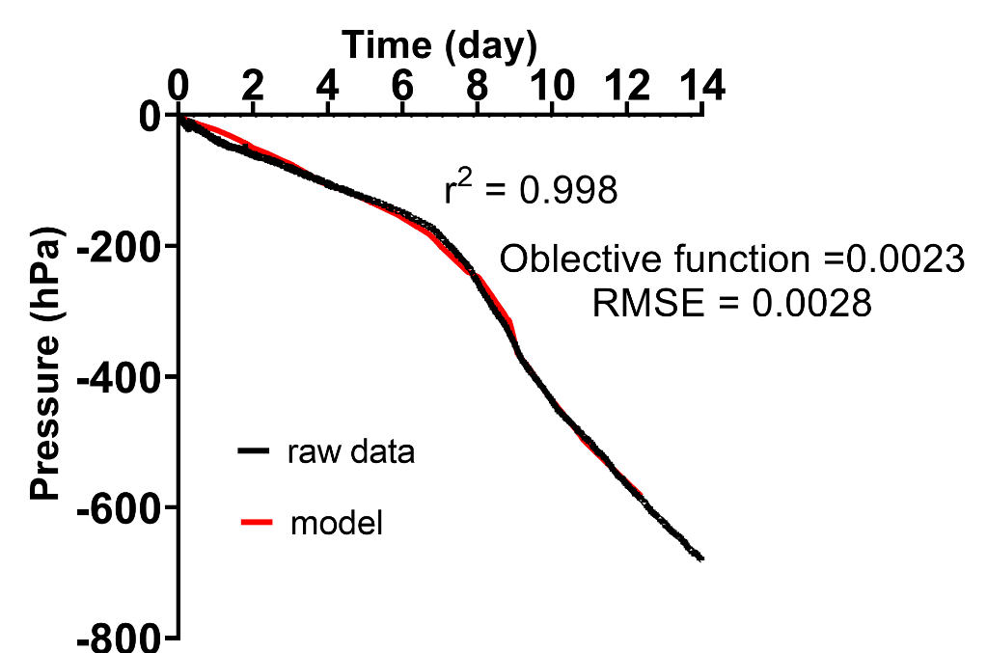
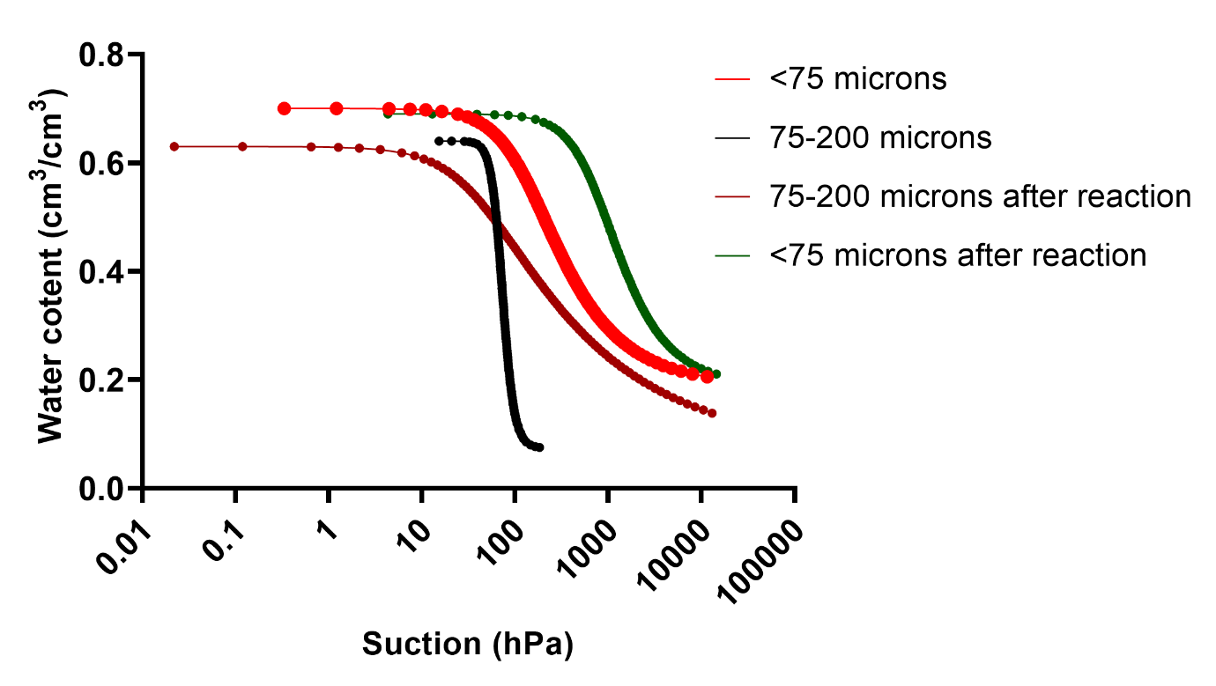
Examining saturated and unsaturated hydraulic parameter changes as a result of geochemical reactions in tailings
R. Akesseh¹, M. Edraki² and T. Baumgartl^{3,4}
¹PhD student, Sustainable Minerals Institute, The University of Queensland, St Lucia QLD 4069, r.akesseh@uq.edu.au
²Principal Research Fellow, Sustainable Minerals Institute, The University of Queensland, St Lucia, QLD 4069. m.edraki@cmlr.uq.edu.au
³Director, Geotechnical and Hydrogeological Engineering Research Group (GHERG), Federation University Australia, Gippsland VIC 3841, t.baumgartl@federation.edu.au
⁴Honary Professor, Sustainable Minerals Institute, The University of Queensland, St Lucia QLD 4069. t.baumgartl@uq.edu.au
1. INTRODUCTION
Water flow and solute transport in the unsaturated zone is governed by the hydraulic properties and the hydraulic conductivity function. However, geochemical reactions induce changes in the hydraulic properties as oxidation occurs in reactive materials. Transient flow experiment can be designed to indirectly estimates these changes. This is an easy and practical method which relies on easily measureable parameters. Our aim was to test the hypothesis of induced hydraulic properties changes due to geochemical reaction using inverse numerical modelling.
2. HYDRAULIC PROPERTIES ESTIMATION
3. MATERIALS AND METHODS
One dimensional vertical flow in rigid porous media is governed by Richards equation,
$$C\left(\right)\frac{∂h}{∂t}=\frac{}{}\left[k\left(h\right)\left(\frac{∂h}{∂z}−1\right)\right]$$
Initial and Boundary condition
$h\left(z,t\right)=h_{0}\left(z\right) t=0, 0≤z≤L$
$$k\left(h\right)\left(\frac{∂h}{∂z}−1\right)=E\left(t\right)$$
Van Genucten-Mualem hydraulic function
$$S_{e}\left(h\right)=\frac{\left(θ\left(h\right)−θ_{r}\right)}{θ_{s}−θ_{r}}={\left[1+{\left(αh\right)}^{n}\right]}^{−m}$$
$$K\left(S_{e}\right)=K_{s}{S_{e}}^{0.5}{\left[1−{\left(1−S_{e}^{1/m}\right)}^{m}\right]}^{2}$$
INVERSE ANALYSIS
Hydraulic parameters α and n determined by minimisation of objective function
$$O\left(b\right)=\sum_{i=1}^{2}{\sum_{j=1}^{M}{{\left[h\left(z_{i}−t_{j}\right)−h^{∗}\left(z_{i},t_{j},b\right)\right]}^{2}}}$$
Solution by Levenberg-Marquardt algorithm
Solution was implemented in HYDRUS-1D
Material Composition
Dolomite (25%)
Pyrite (25%)
Quartz (35%)
Chlorite (15%)
Two categories of particle size range
<75 µm
75-200 µm
Column: 4 cm, bulk density: 1.4 g/cm3
Nine drying and wetting cycles over nine months
Initial hydraulic parameters determined by desiccation
Curve fitting in RETC
Transient water flow experiment by evaporation
Mass of water loss was measured by a balance
Hydraulic conditions in the tailings measured by tensiometer
Fig 1: Evaporation Experiment
4. RESULTS
Fig 2: Cumulative water loss vs time
Fig 3: Time series of hydraulic condition in the column
Fig 4: Initial water retention curve for different particle sizes
Table 1: Initial parameter and optimised values after changes
Parameter | Initial value |  | Optimised value
 | Fine | Coarse | Fine | Coarse
$K_{s}$(cm/day | 1.06 | 128.76 | 1.05 | 127.47
$O_{s}({cm}^{3}{cm}^{−3}$) | 0.7 | 0.64 | 0.69 | 0.63
$$O_{r}({cm}^{3}{cm}^{−3})$$ | 0.19 | 0.07 | 0.19 | 0.07
n | 1.78 | 7.36 | 1.36 | 2.09
$${α(cm}^{−1})$$ | 0.007 | 0.01 | 0.0013 | 0.026
Fig 5: Plot of inversely modelled hydraulic conditions in the column
Fig 6: Comparison of initially measured hydraulic parameters and inversely measured parameters
5. CONCLUSION
REFERENCES
The model results show that hydraulic parameters of the studied material changed over time
The inverse model was effective in establishing these changes
On the assumption of the saturated volumetric and saturated conductivity decreased by 1% during this period the alpha and n parameters of the coarse and fine material changed with time
NAKHAEI, M., ŠIMŮNEK, J. J. J. O. H. & HYDROMECHANICS 2014. Parameter estimation of soil hydraulic and thermal property functions for unsaturated porous media using the HYDRUS-2D code. 62, 7-15.
ROMANO, N. & SANTINI, A. 1999. Determining soil hydraulic functions from evaporation experiments by a parameter estimation approach: Experimental verifications and numerical studies. Water resources research, 35, 3343-3359.
ŠIMŮNEK, J., VAN GENUCHTEN, M. T. & WENDROTH, O. 1998. Parameter estimation analysis of the evaporation method for determining soil hydraulic properties. Soil Science Society of America Journal, 62, 894-905.
TOORMAN, A., WIERENGA, P. & HILLS, R. 1992. Parameter estimation of hydraulic properties from one‐step outflow data. J Water Resources Research, 28, 3021-3028.

