Slide 1

Surface and sub-surface flow estimation at high temporal resolution using deep neural networks
CONTACT
Ather Abbas
Environmental Modeling and Monitoring Laboratory
4rth Engineering Building Room 1001
Tel. +82 52 217 2829 https://firstkh.wixsite.com/ueeem2

Slide 2

CONTENTS
2
1. Introduction
03
2. Material and Methods
06
3. Results
16
4. Conclusion
27

Slide 3
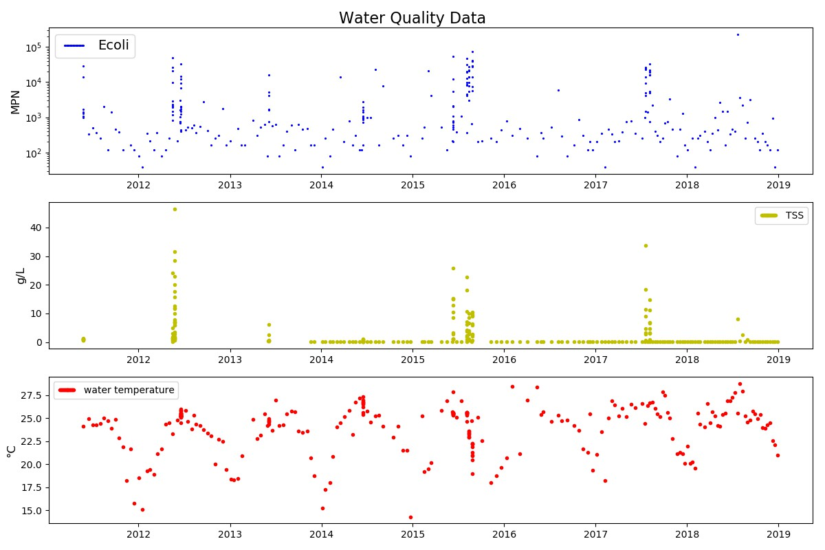
Introduction
3
Modeling of fecal micro-organisms in surface water is important to protect surface waters from fecal pollution.
Bacteria concentration can change drastically in short span of time.
This requires modeling hydrology at high temporal resolution
Comparison of process-based and data-driven models to model surface and sub-surface flows at 6-minute time-step.
Observed Bacteria concentration at Laos from 2011 to 2018

Slide 4
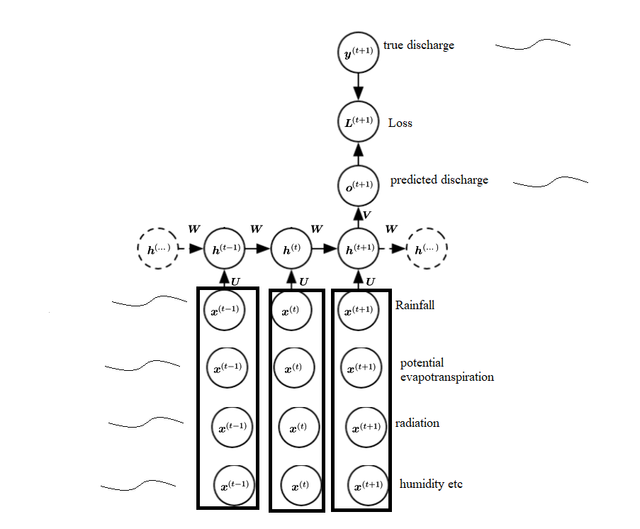
Why data-driven models
4
More data is available than ever before.
With the rise in computation power, more sophisticated algorithms (e.g. neural networks) have been developed which can learn complex functions from data.
Complexity is handled by machine
Can make use of various kinds of input data while process-based models are limited by their conceptual model.
Inputs
A typical neural network for rainfall-runoff modelling.
Modified after Goodfellow et al., 2016

Slide 5
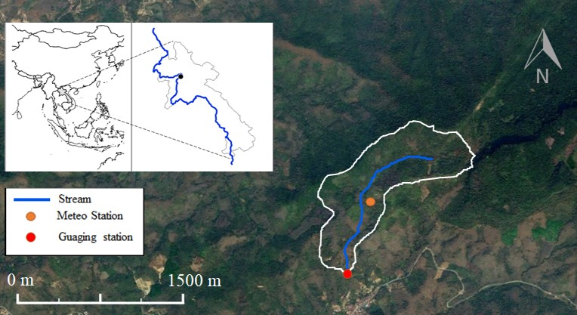
Study Area
5
A 0.6 km² Houay Pano headwater catchment, located 10 km south of Luang Prabang city in Northern Lao P.D.R.
It is a sub-basin of the Houay Xon river basin, which is a tributary of the Mekong River
Location of the Houay Pano catchment in northern Lao P.D.R. and the observation stations. Topographic map is taken from Google Earth (19°51′29.49″ N, 102°10′21.51″ E) (Google, 2014).

Slide 6
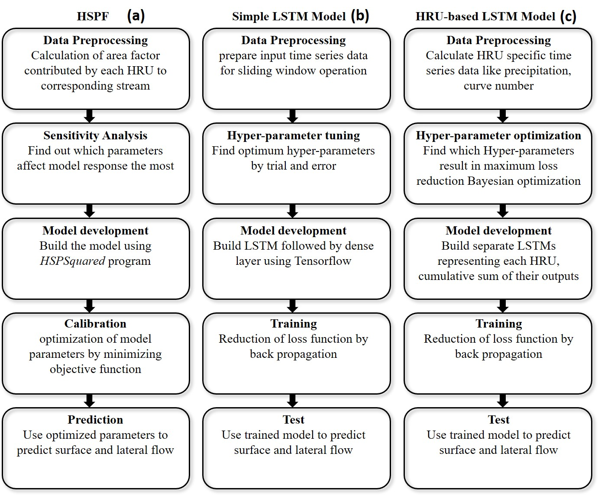
Workflow
6
We developed and compared the performance of three models.
Models include one process-based model HSPF and two data-driven models based on LSTM.
All models follow same procedure i.e. model development, parameter calibration, prediction.

Slide 7
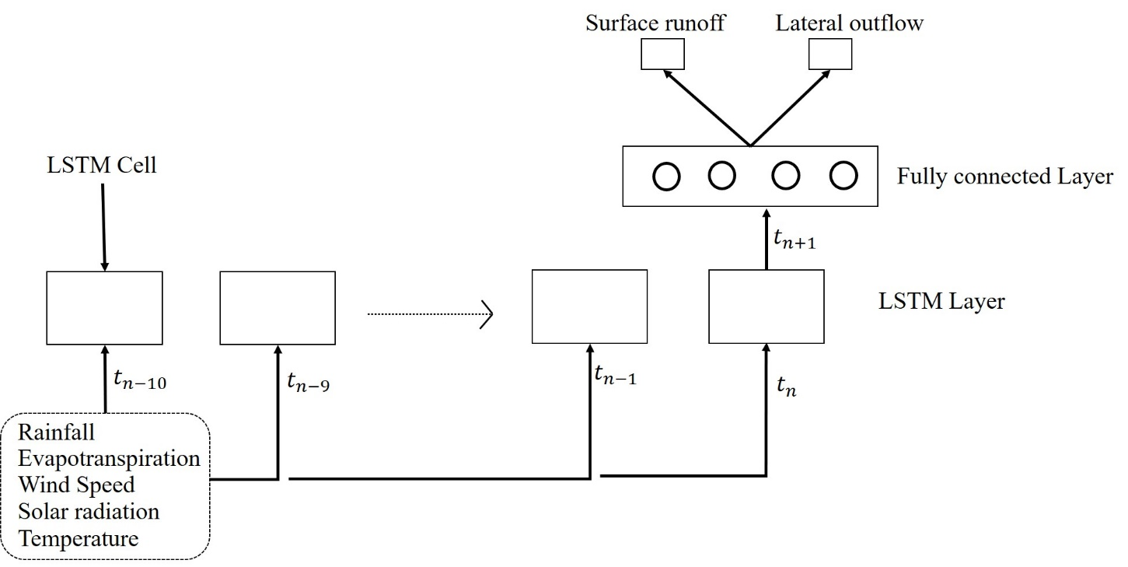
Simple LSTM Model
7
The simple LSTM model consists of a single LSTM layer responsible for modeling processes in whole catchment.
An LSTM layer consists of several LSTM cells.
Outputs from LSTM layer goes to fully connected layer which generates two outputs.
These two outputs are considered as representative of surface and sub-surface flow.

Slide 8
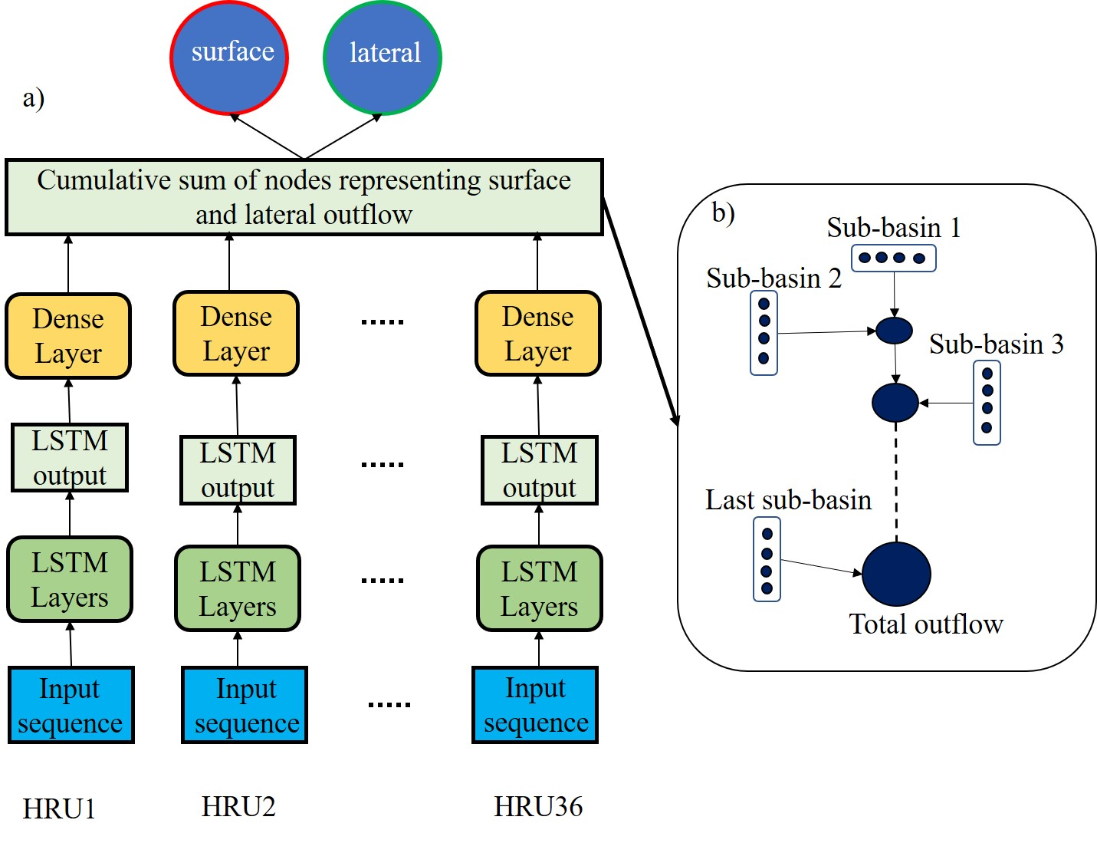
HRU-based LSTM Model
8
Single LSTM layer to model processes in one HRU.
Each HRU-based LSTM uses corresponding HRU-specific input and produces HRU-specific outputs (surface and sub-surface flow).
Outputs from each layer are added in cumulative manner.

Slide 9
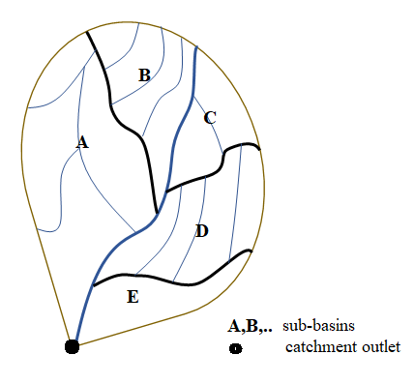
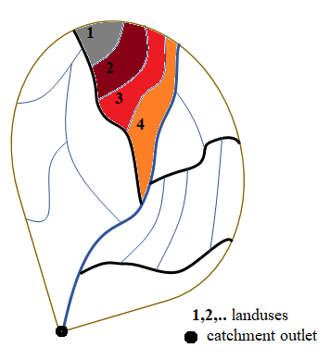
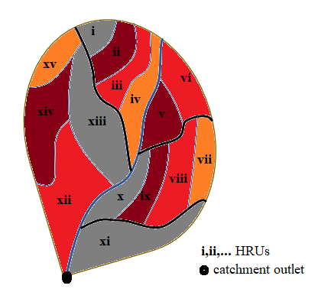
HRU-Discretization for HRU-based LSTM model
9
An HRU is the basic building block of hydrologic model where all process are modeled.
An HRU has relatively same characteristics and parameters affecting processes in an HRU are same.
We defined an HRU as ‘a unique land-use in a unique sub-basin’.
Each land-use in a distinct sub-basin is considered as a separate HRU.
More number of HRUs mean more detailed information but also more computation power.

Slide 10
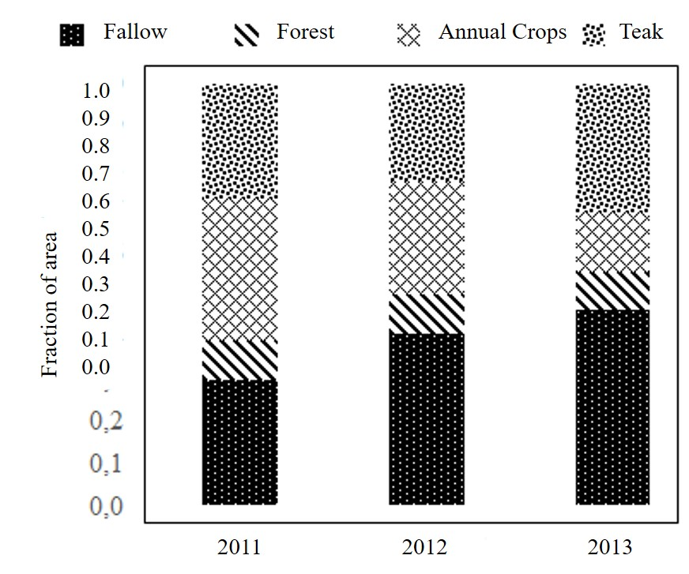
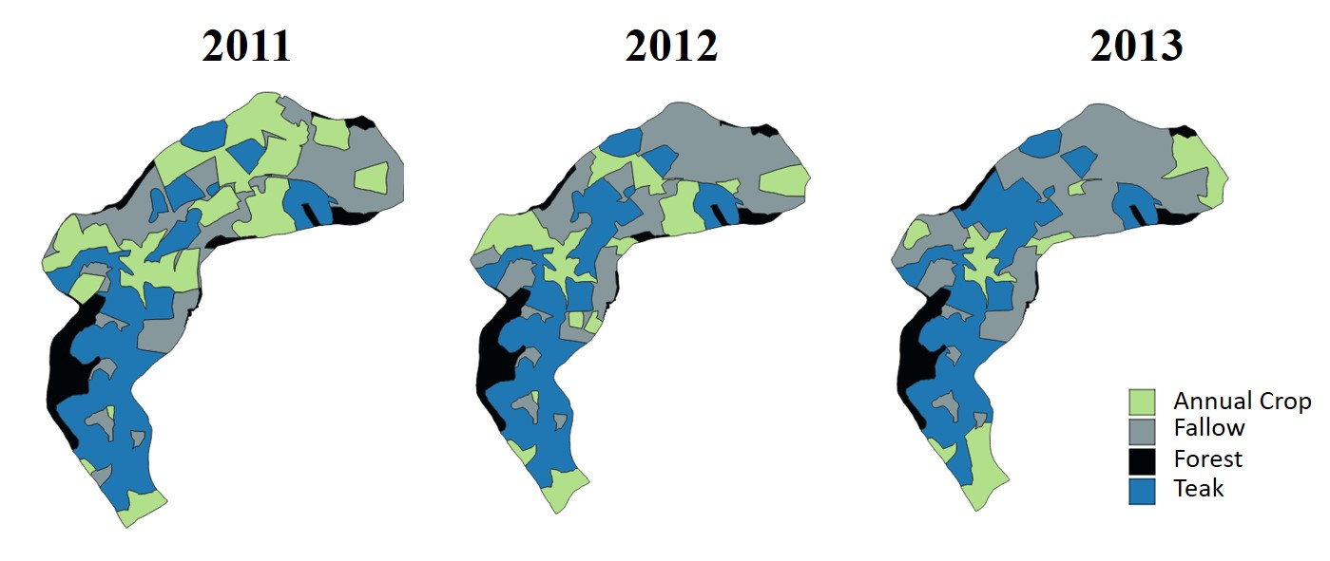
Land-use change in study area
10
From 2011 to 2013, the study area underwent an increase in fallow and teak areas at the expense of annual crops, while forest area remained the same.

Slide 11
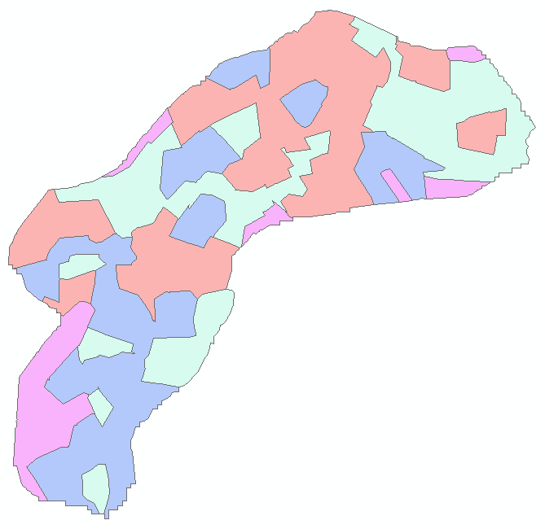
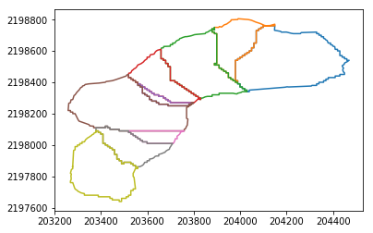
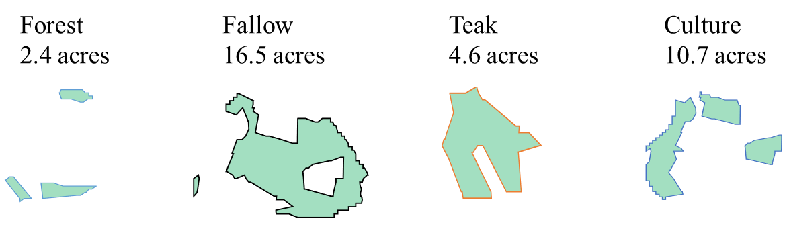
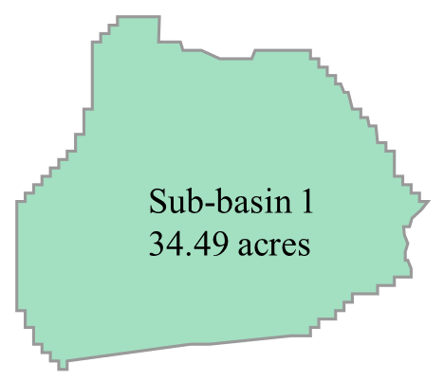
Formation of an HRU
11
An HRU is formed by intersection of sub-basin and land-use.
Total HRUs = Number of sub-basins * land-uses
36 = 9 * 4
2011 Land-use
All sub-basins

Slide 12
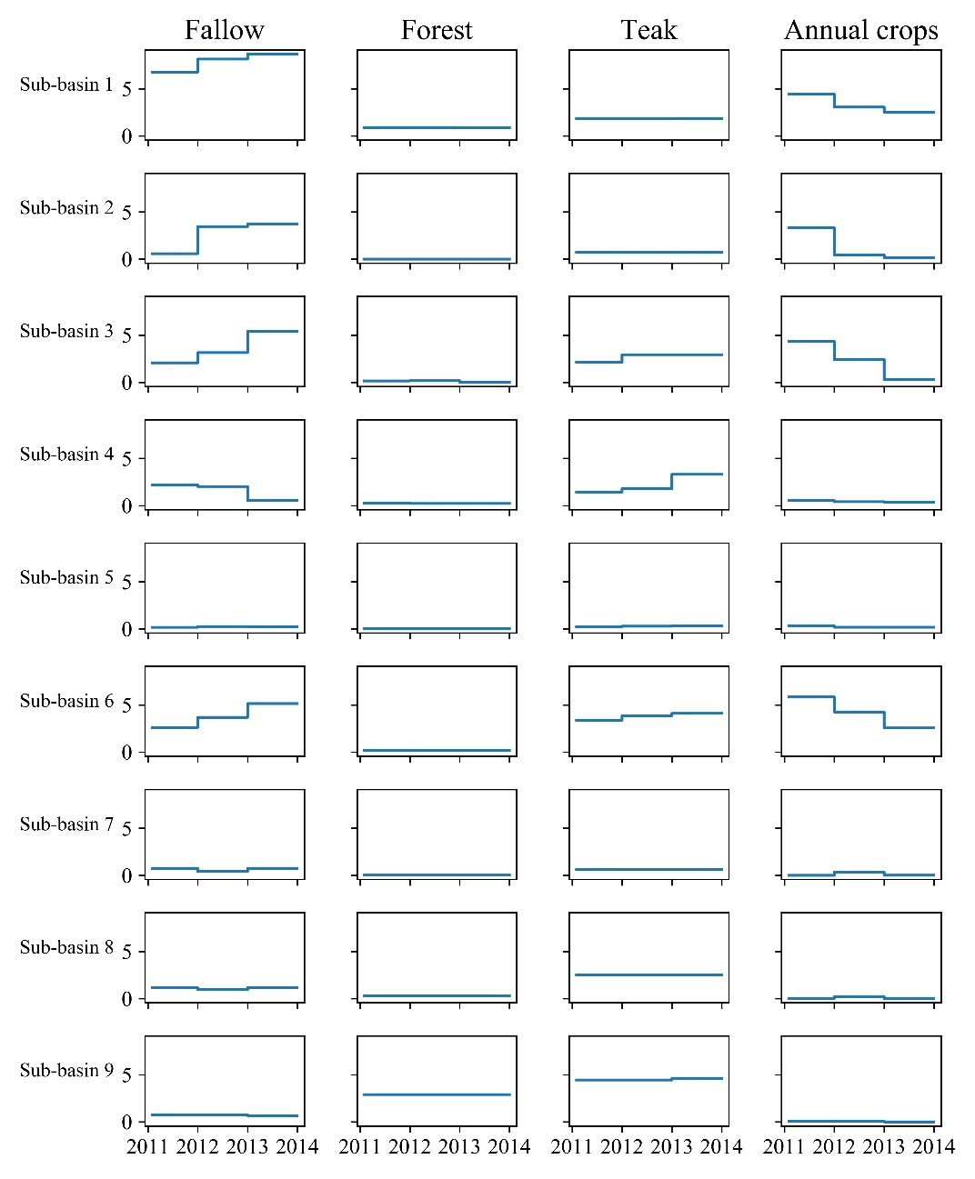
HRU-based input data
12
By processing land-use shapefiles of each year, we can find out how area of each land-use varied with time.
Area of all 36 HRUs as a function of time in hectares.

Slide 13
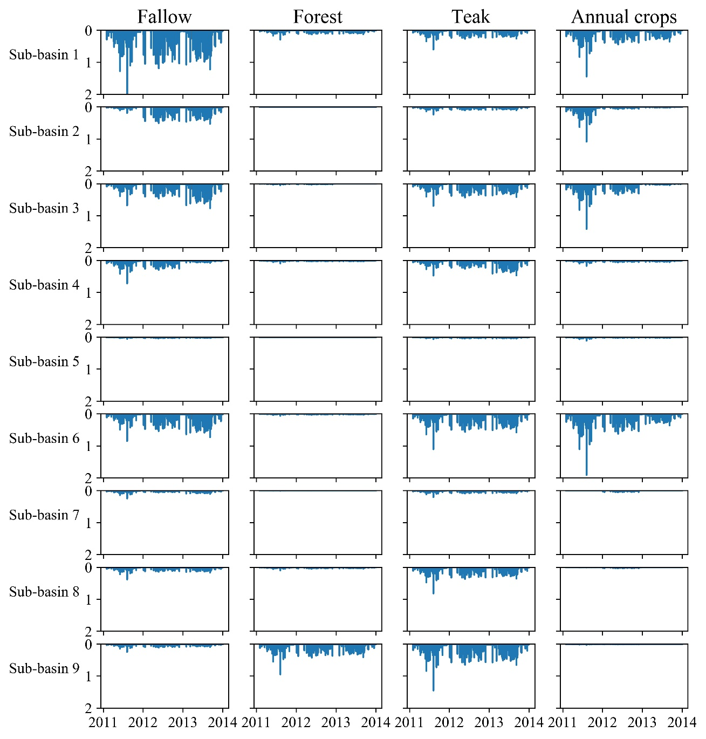
HRU-based input data
13
Based upon area of each HRU, we can also find out HRU-specific rainfall, which is rainfall (mm) received by each HRU.

Slide 14
All Input data
14
Data | Type | frequency
Discharge | Time series | 6 minute
Precipitation | Time series | 6 minute
Air temperature | Time series | 1 hour
Relative humidity | Time series | 1 hour
Solar radiation | Time series | 1 hour
Wind speed | Time series | 1 hour
DEM | Shapefile
Landuse | Shapefile | 1 year
All data is prepared as 6-minute time-series.
Simulation period: 2011-2013
Calibration period: First 26 months
Validation period: Last 10 months

Slide 15
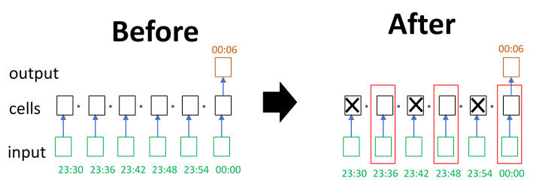
Data Preparation for LSTM
15
We skipped input data at certain intervals to reduce amount of memory consumption and computation power.
Outputs are still predicted at 6-minute time-step.

Slide 16
16
Results

Slide 17
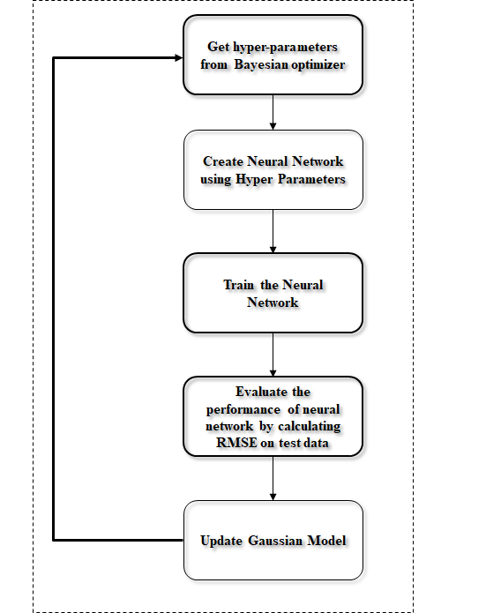
Hyper-parameter optimization
17
At each iteration, a new model is built with hyper-parameters suggested by ‘Bayesian algorithm’.
The model is trained and evaluated on validation dataset.
Based on model’s performance, the algorithm suggests new hyper-parameters.
Process of hyper-parameter optimization using Bayesian optimization (Shahriari et al., 2015)

Slide 18
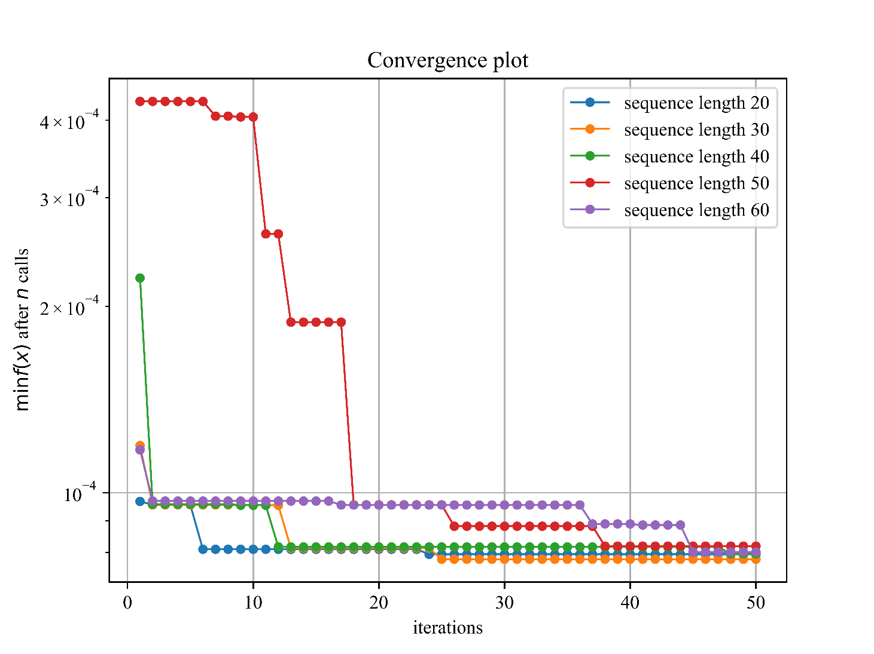
Hyper-parameter optimization results
18
Sequence length was not optimized because increasing sequence length causes large increase in memory consumption.
We optimized parameters for different sequence lengths.
Every point represents validation loss obtained from a trained model.

Slide 19
Hyper-parameter optimization results
19
Weighted loss means, more weightage to storm events for loss calculation.
ReLu shows better performance
Sequence length | Learning rate | Hidden units | NN layers | Normalization | Loss calculation method | Type of NN cell | Activation function | Validation MSE (m³s⁻¹ )
20 | 1.164e-6 | 128 | 4 | True | Weighted | LSTM | ReLu | 6.3e-3
30 | 3.07e-4 | 128 | 3 | True | Normal | LSTM | ReLu | 6.0e-3
40 | 5.123e-5 | 264 | 3 | True | Weighted | LSTM | ReLu | 6.2e-3
50 | 9.15e-4 | 128 | 1 | True | Weighted | LSTM | Tanh | 6.5e-3
60 | 5.441e-5 | 128 | 4 | True | Normal | LSTM | ReLu | 6.4e-3

Slide 20
Hyper-parameters for building simple and HRU-based LSTM models.
20
 | Value for simple model | Values for HRU-based model
Activation function | Rectified Linear Unit | Rectified Linear Unit
Batch size | 64 | 64
Learning rate | 1e-5 | 1e-5
Sequence length | 13 h | 80 h
Hidden units | 128 | 128
Input data | Precipitation moving average, air temperature, precipitation, wind speed, solar radiation | Precipitation moving average, air temperature, precipitation, wind speed, solar radiation, potential evapotranspiration
HRU specific data | None | Rainfall, distance to outlet, curve number
Calibration epochs | 214 | 66

Slide 21
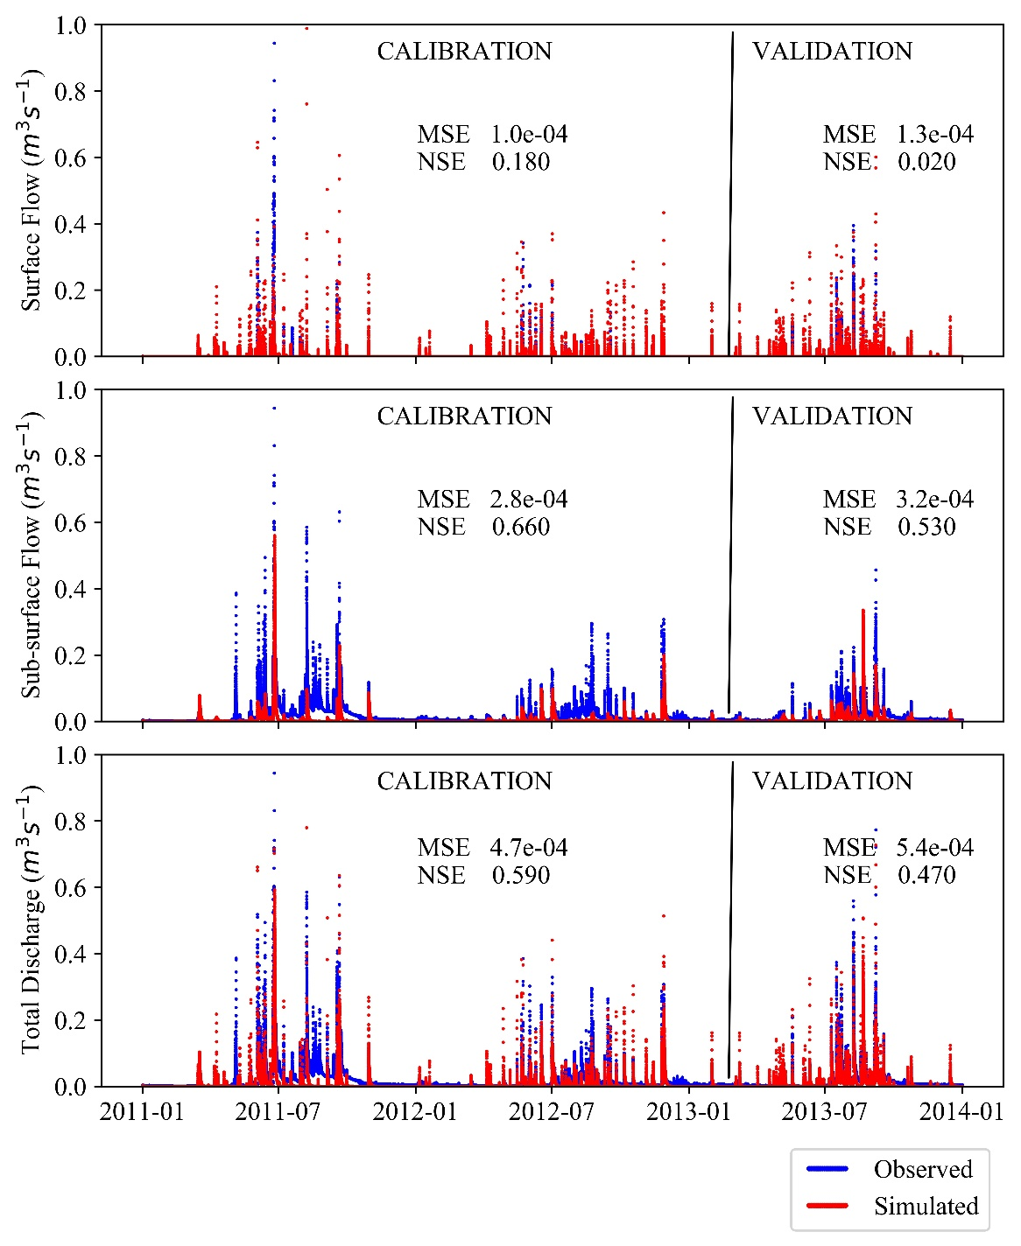
HSPF Results
21
Over-estimation of surface flow and under-estimation of sub-surface flow.
Higher sub-surface flow in 2013 → higher teak and fallow during 2013.

Slide 22
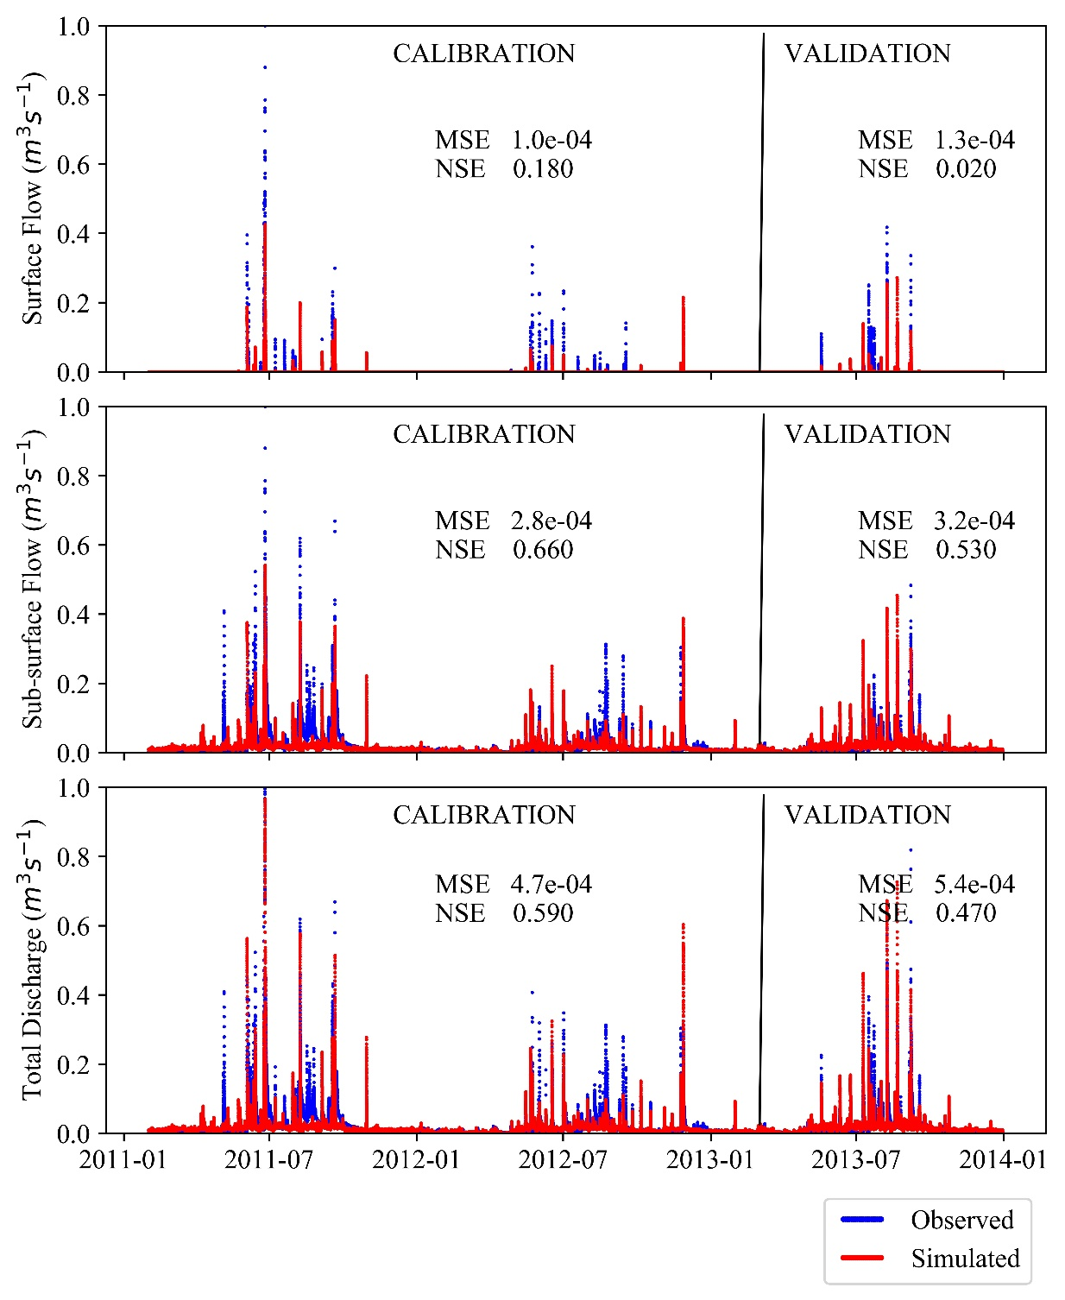
Simple LSTM results
22
Model captures most of the peaks in surface flows, although the predicted peaks are lower than observed.
For sub-surface flow, the model captures the peaks but fails to follow rising and falling limb of hydrograph.

Slide 23
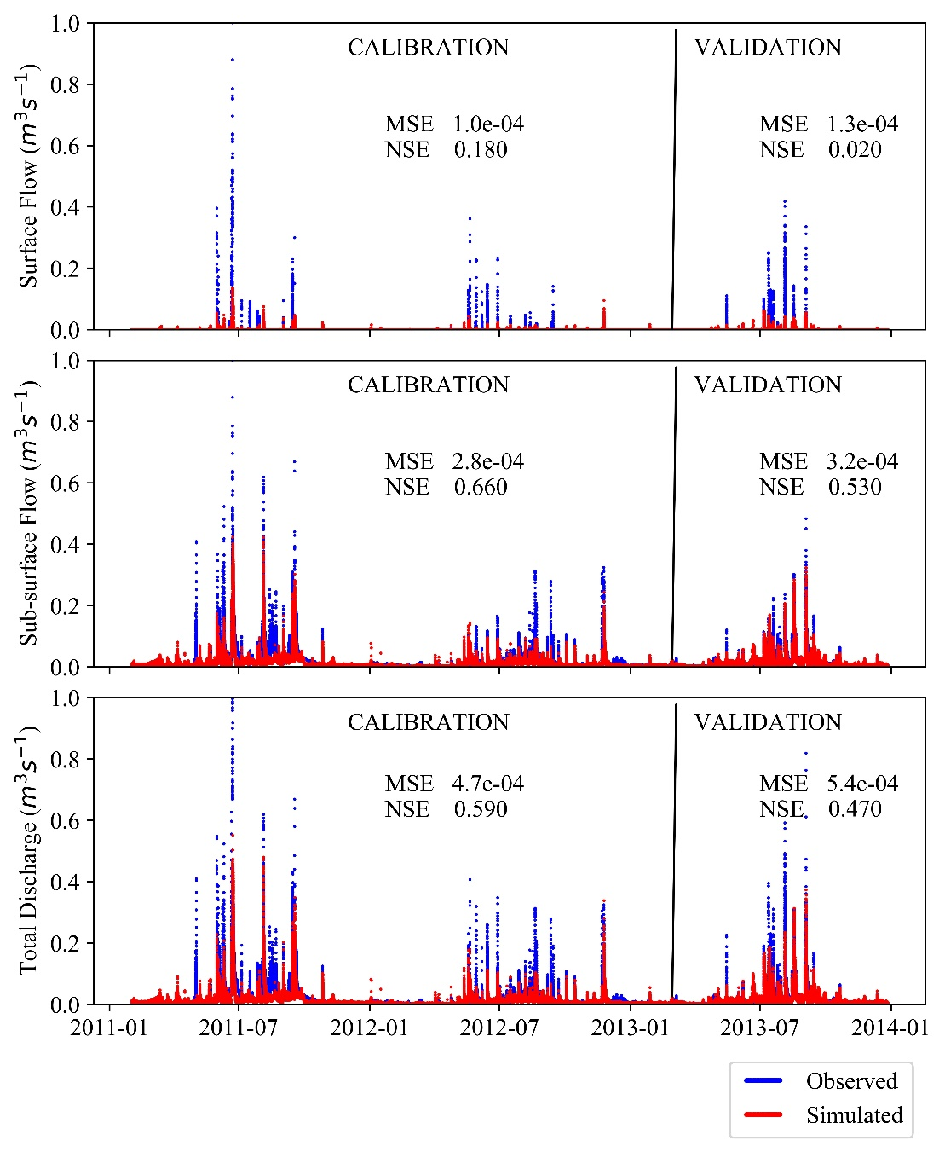
HRU-based LSTM results
23
More under-estimation of surface runoff as compared to simple LSTM.
The under-estimation of peaks in surface runoff is also reflected in total discharge.

Slide 24
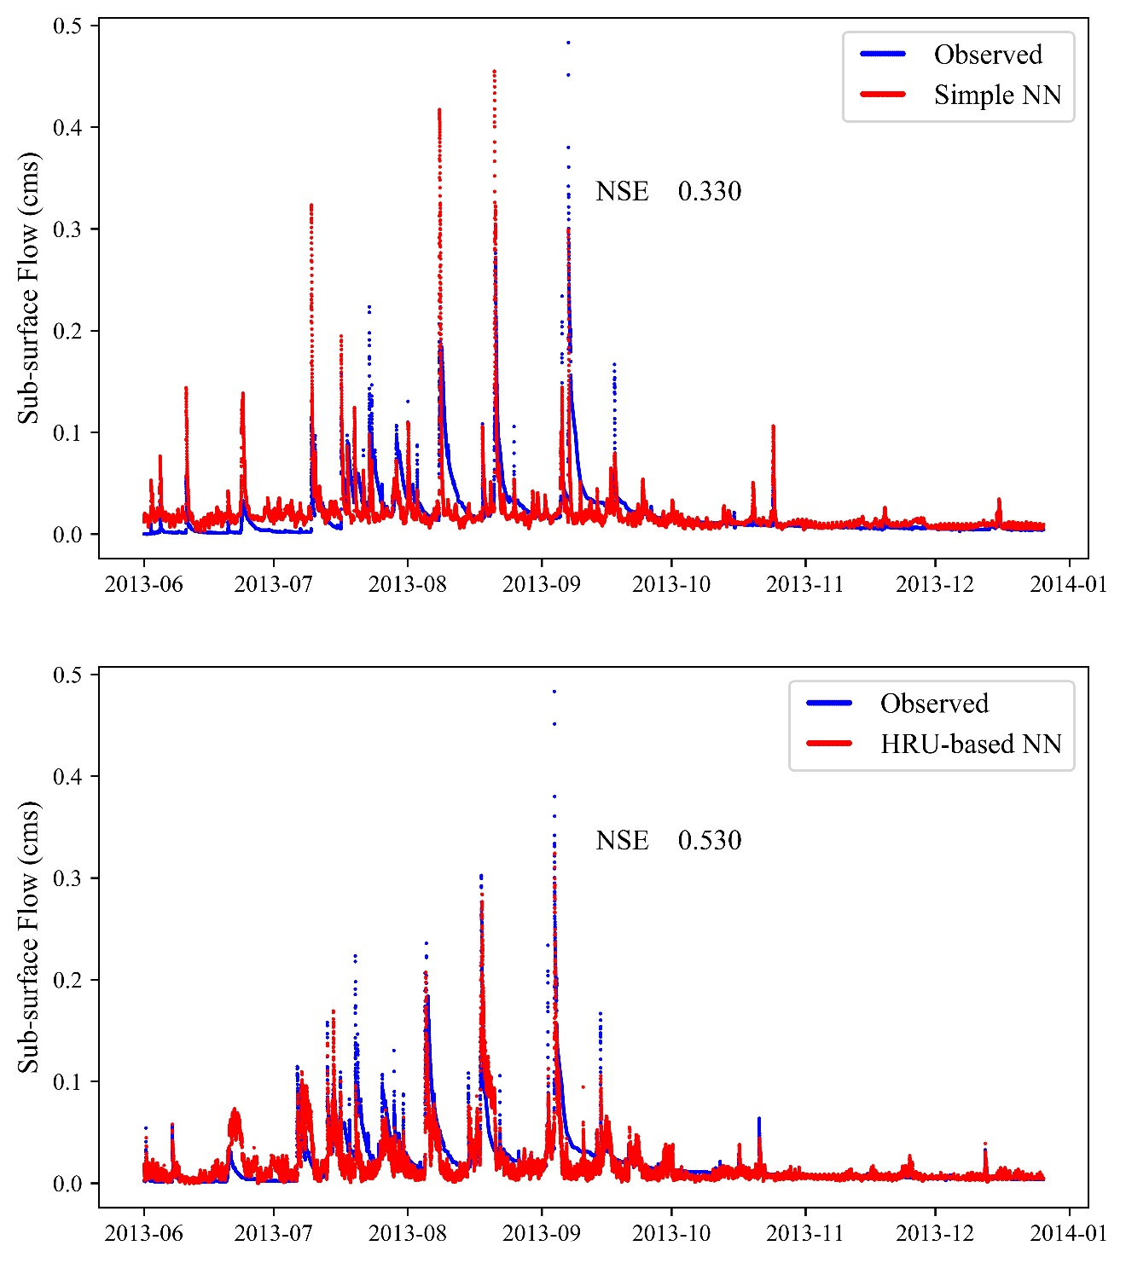
Simple LSTM vs HRU-based LSTM
24
Predicted sub-surface flow from simple LSTM (upper) and HRU-based LSTM model (lower).
Rising and falling limbs from HRU-based LSTM model are curved.
HRU-based LSTM follows trend in hydrograph better as compared to simple LSTM model.

Slide 25
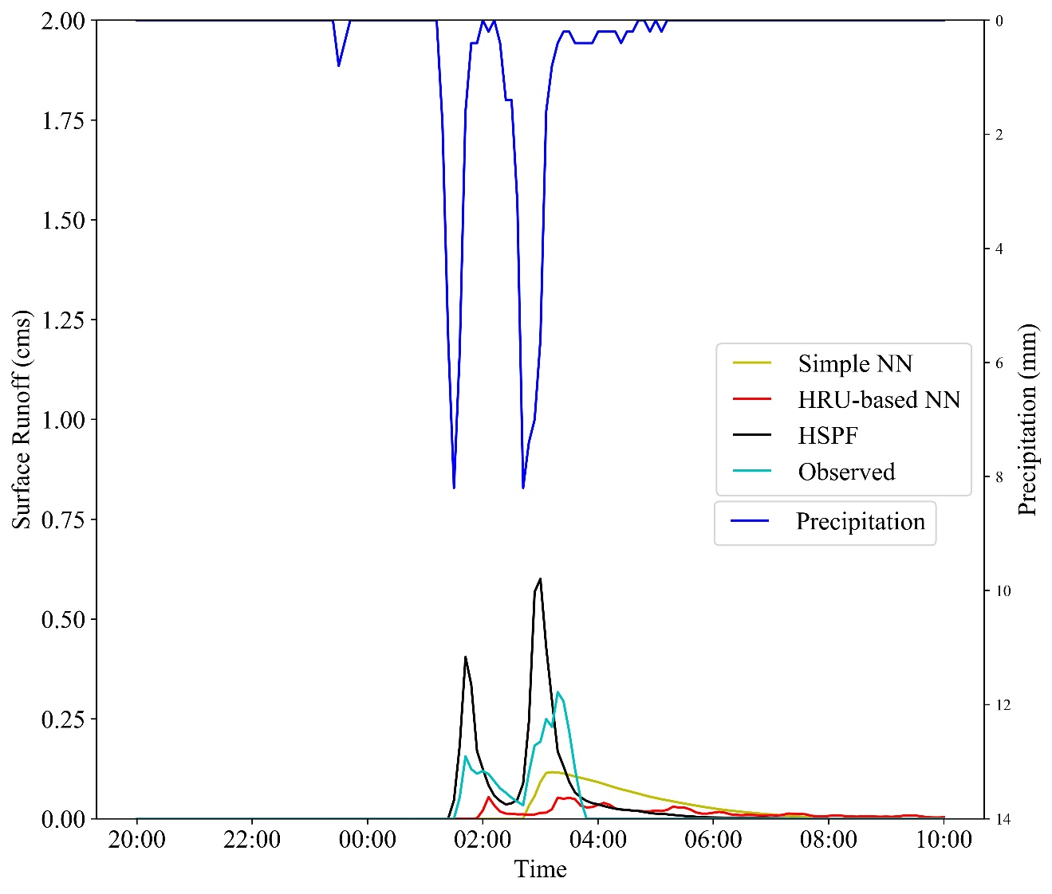
Lag Time
25
Figure represents two storm events are in validation period.
No lag time from HSPF while both simple and HRU-based LSTM models show lag time.
HRU-based LSTM shows response for both storm events while simple LSTM shows response for only one event.

Slide 26
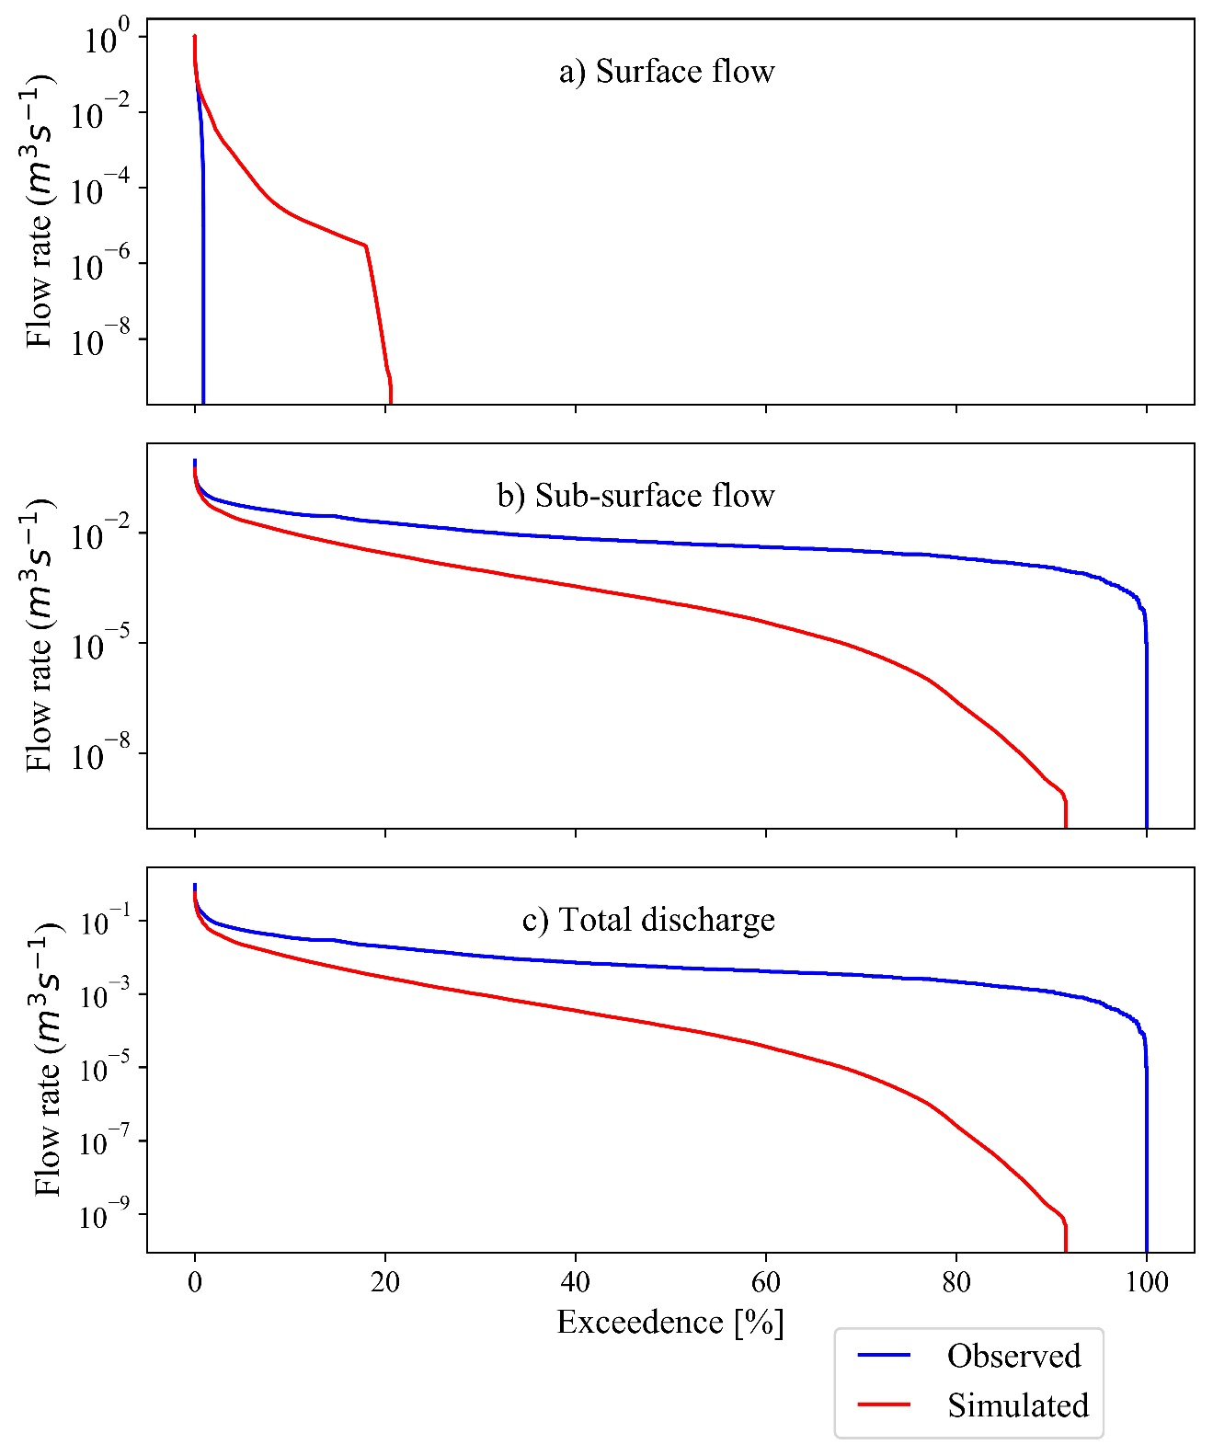
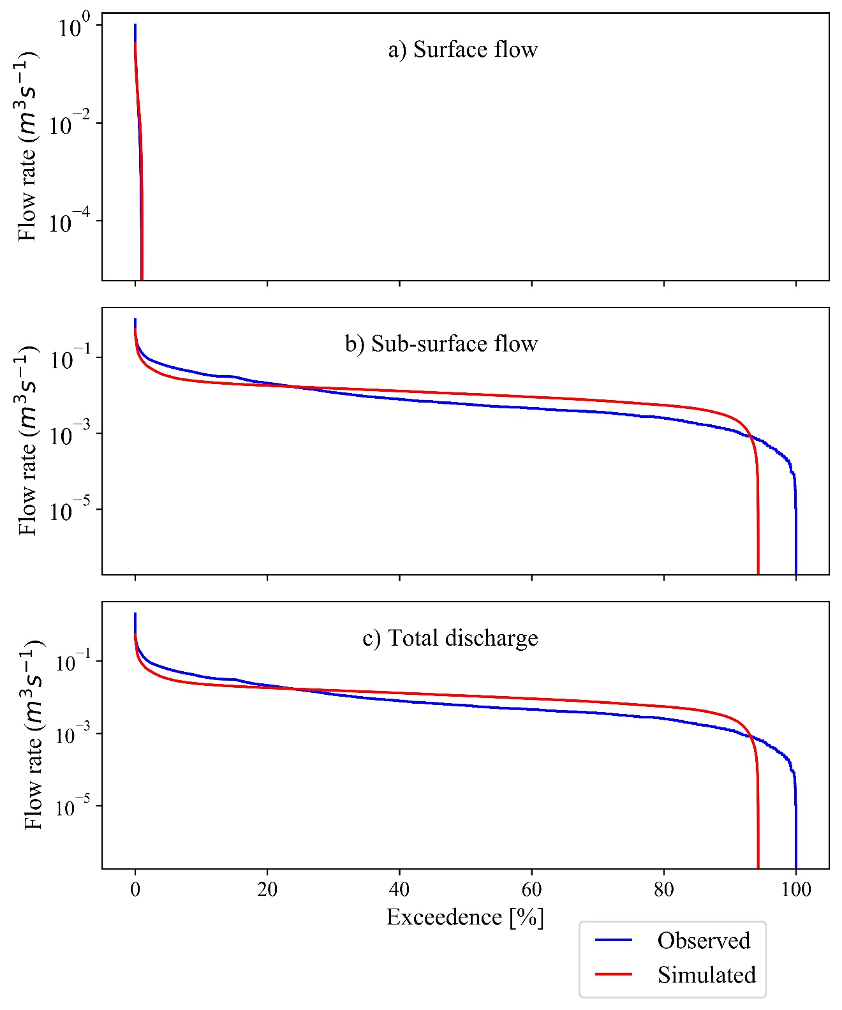
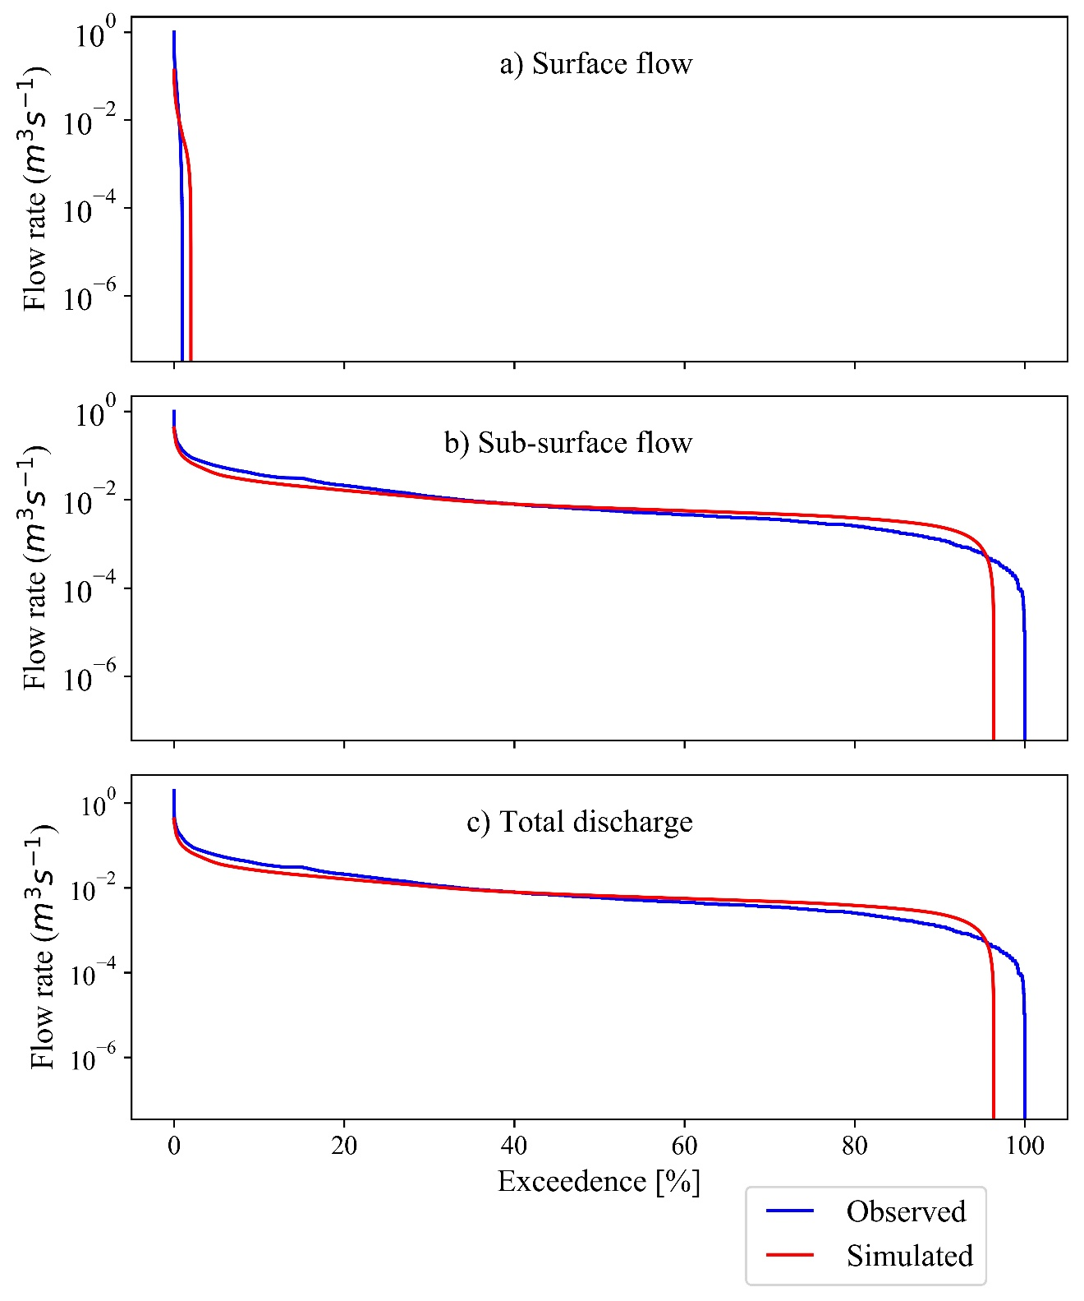
Flow duration curves
26
Under-prediction in high flow regimes from all models
HSPF
Simple LSTM
HRU-based LSTM

Slide 27
Conclusions
27
Over-estimation of surface flow and under-estimation of sub-surface flow from HSPF.
Simple LSTM model performs better for surface runoff prediction.
HRU-based LSTM model has best performance for total stream discharge prediction. Moreover, it produces more realistic results.
Bold numbers represent values that fall under the category of ‘satisfactory’ after Moriasi et al., (2015).
Model Type | Flow Type | Calibration |  |  | Validation
 |  | MSE (m³s⁻¹ ) | NSE | PBIAS (%) | MSE (m³s⁻¹ ) | NSE | PBIAS (%)
HSPF | Surface flow | 1.4e-4 | -0.234 | 58.7 | 1.1e-4 | -0.024 | 23.7
 | Sub-surface flow | 4.8e-4 | 0.355 | -70.7 | 2.3e-4 | 0.579 | -53.7
 | Total discharge | 5.0e-4 | 0.403 | -66.1 | 3.2e-4 | 0.597 | 49.9
Simple LSTM | Surface flow | 7.9e-5 | 0.371 | -7.1 | 7.4e-5 | 0.467 | -21.9
 | Sub-surface flow | 4.7e-4 | 0.438 | -10.1 | 4.6e-4 | 0.330 | -0.5
 | Total discharge | 5.6e-3 | 0.563 | -10.0 | 5.2e-4 | 0.493 | -1.6
HRU-based LSTM | Surface flow | 1.0e-4 | 0.182 | -64.3 | 1.3e-4 | 0.028 | -61.4
 | Sub-surface flow | 2.8e-4 | 0.660 | -20.9 | 3.2e-4 | 0.528 | -10.3
 | Total discharge | 4.7e-4 | 0.595 | -22.3 | 5.4e-4 | 0.469 | -12.8

Slide 28
References
28
Goodfellow, I., Bengio, Y., Courville, A., 2016. Deep learning. MIT press.
Moriasi, D.N., Gitau, M.W., Pai, N., Daggupati, P., 2015. Hydrologic and water quality models: Performance measures and evaluation criteria. Transactions of the ASABE, 58(6), 1763-1785. https://doi.org/10.13031/trans.58.10715
Shahriari, B., Swersky, K., Wang, Z., Adams, R. P., & De Freitas, N. (2015). Taking the human out of the loop: A review of Bayesian optimization. Proceedings of the IEEE, 104(1), 148-175.

Slide 29
THANK YOU

Slide 30
Supplementary Materials

Slide 31
Hyper-parameter name | Range | Description
Learning Rate | 1e-2 - 1e-6 | Jump in weights and biases at each step of calibration
Hidden units | 1 - 264 | Number of parameters to be learned by NN
Normalization | True/False | Normalization of all input data before its use in NN
Loss calculation method | Weighted / Normal | Weighted loss calculation method gives more weightage to peaks thus making loss function more sensitive to peak flows
Activation function | ReLu, tanh | Type of non-linearity applied to the output of NN. ReLu squashes input ‘x’ between 0 and ‘x’ while tanh squashes them between -1 and +1.
Number of NN layers | 1 - 4 | If more than one, it means NN layers are stacked the output from first layer goes as input to next layer and the output from last layer is considered as final output.
Types of NN cell | (LSTM/GRU) | GRU and LSTM use different algorithms to learn time dependent features in time series data
Sequence length | 10 – 100 hours | Sequence length is obtained after multiplying step size of input data in input array with length of input array. As step size of input data in our model is 6 minutes, thus to have sequence length of 10 hours, the input array should have length of 100.
Batch size | 32 - 512 | Number of samples to work with before updating weights and biases using back-propagation.
Hyper-parameters used to build LSTM-based models, their range and their description.

Slide 32
Water balance
January to April accounts for large amounts of potential evapotranspiration
 | 2011 | Jan-April (2011) | 2012 | Jan-April (2012) | 2013 | Jan-April (2013) | Total (2011-2013)
Rainfall | 1546 | 191 | 1353 | 185 | 1633 | 171 | 4533
Pot ET | 1081 | 302 | 1168 | 345 | 1090 | 341 | 3339
Q (Simple LSTM) | 870 | 145 | 610 | 62 | 756 | 76 | 2238
Q (HRU-based LSTM) | 829 | 87 | 491 | 52 | 624 | 58 | 1946
Q (HSPF) | 331 | 26 | 218 | 10 | 319 | 12 | 868

Slide 33
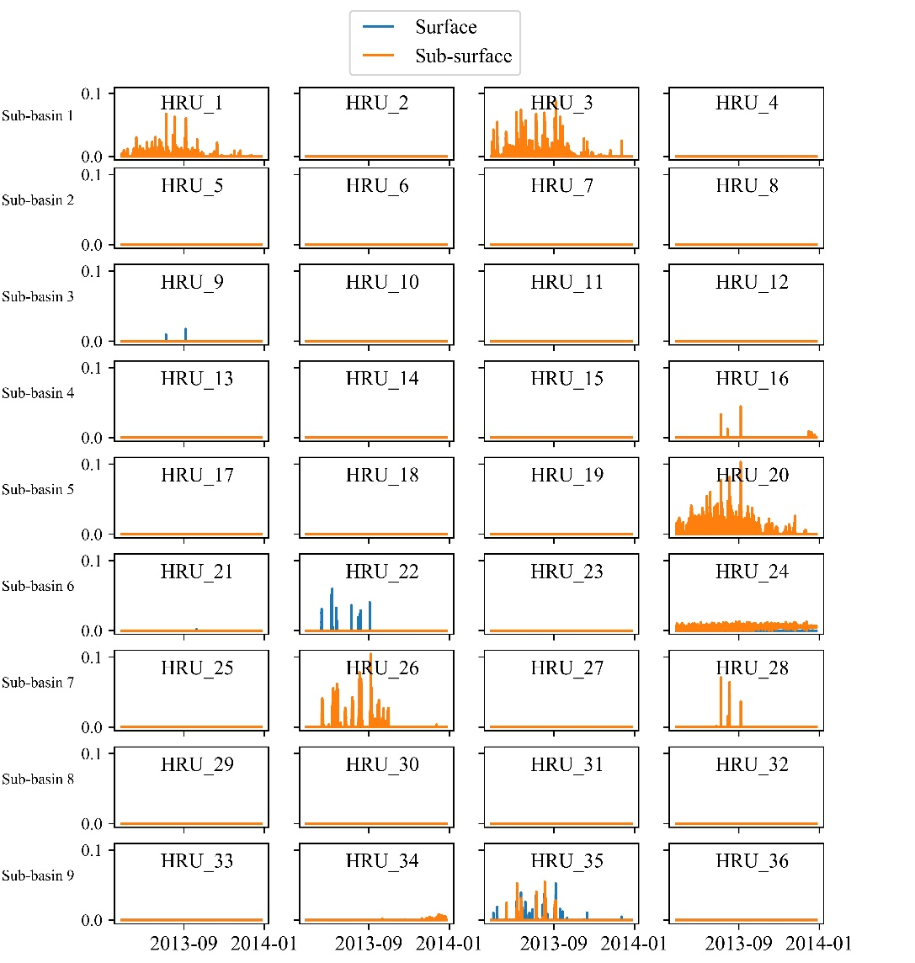
Flows from each HRU
Surface and sub-surface flow from each HRU based upon results of HRU-based LSTM model.

