Slide 1
Identification of Interplanetary Parameter Schemes which Drive the Variability of the Magnetospheric Radiation Environment
Ch. Katsavrias ^{(1,2,3)}, A. Nasi^{(1,2)}, C. Papadimitriou⁽²⁾,
S. Aminalragia-Giamini⁽²⁾, I. Sandberg⁽²⁾,
P. Jiggens⁽⁴⁾, I. A. Daglis^{(1,3,5)} and H. Evans⁽⁴⁾
1. Department of Physics, National and Kapodistrian University of Athens, Greece. 2. Space Applications and Research Consultancy (SPARC), Athens, Greece
3. Institute of Accelerating Systems and Applications, National and Kapodistrian University of Athens, Greece. 4. ESA/ESTEC, Netherlands.
5. Hellenic Space Center, Athens, Greece.
EGU General Assembly, May 2020, Vienna, Austria.

Slide 2
Motivation
Identify Solar, Solar wind and geomagnetic parameters that drive the variability of the radiation environment
Identify Solar cycle variations
EGU General Assembly, May 2020, Vienna, Austria.

Slide 3
Data & Analysis
FEDO (α_{eq} > 75 deg)
GEO
(L~6.6)
Outer Belt
(2.5<L<6)
GOES
(MAGED)
HIMAWARI
(SEDAe⁻)
RBSP
(MagEIS & REPT)
Time: 1/2011 – 7/2019
Energy: 30 – 1500 keV
Time: 9/2012 – 7/2019
Energy: 30 – 9900 keV
EGU General Assembly, May 2020, Vienna, Austria.

Slide 4
Data & Analysis
OMNIWeb
Interplanetary Magnetic Field (IMF) and Bx, By and Bz component in GSM coordinates and nT.
Azimuthal electric field (Ey = -Vsw*BzGSM*10⁻³) in mV/m and Bs (the difference between Ey and Bs is that for the calculation of the latter all positive Bz values are set to zero).
Solar wind speed (Vsw) in km/s and dynamic pressure (Psw) in nPa.
Proton density (Νp) in particles/cm³ and temperature (Tp) in K.
Solar wind Plasma beta and Alfven Mach number
Kp, Ap, Dst, AE, AL and AU geomagnetic indices.
Sunspot number (Rz) and Solar flux (f10.7) index.
EGU General Assembly, May 2020, Vienna, Austria.

Slide 5
Data & Analysis
Universal coupling functions
Southward magnetic field [Bs = Bz(Bz≤0)]
Half-Wave Rectifier [$HWR=VSW∙BS$] (corresponds to the rate of reconnection)
Epsilon [$ε=VSW∙Β^{2}∙\sin^{4}\left(\frac{θ}{2}\right)\text{]}$ (epsilon describes the Poynting flux incident at the magnetopause [Akasofu, 1981])
$\frac{dφ}{dt}= {VSW}_{}^{4/3}∙{ΒTAN}^{2/3}∙\sin^{8/3}\left(\frac{θ}{2}\right)$ (the universal coupling function s proportional to the rate at which magnetic flux is opened at the magnetopause [Newell et al., 2007])
$E_{WAV}= VSW∙Β_{ΤΑΝ}∙\sin^{4}\left(\frac{θ}{2}\right)$ [Wygant et al., 1983]
$E_{KL}= VSW∙Β_{ΤΑΝ}∙\sin^{2}\left(\frac{θ}{2}\right)$ [from Kan and Lee, 1979]
EGU General Assembly, May 2020, Vienna, Austria.

Slide 6
Data & Analysis
3 different binnings:
annual,
monthly
daily
For each type of binning a full distribution is provided (mean, std, median, quantiles)
For each component of the distribution we calculate:
Pearson's product moment correlation coefficient
Spearman’s rank-order correlation coefficient
EGU General Assembly, May 2020, Vienna, Austria.

Slide 7
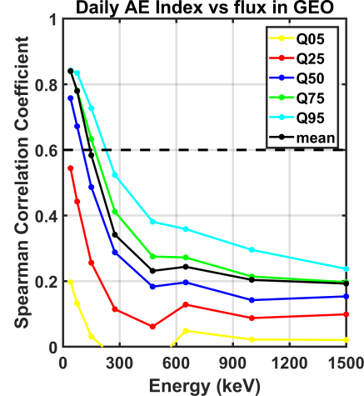
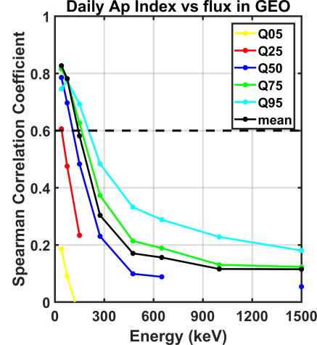
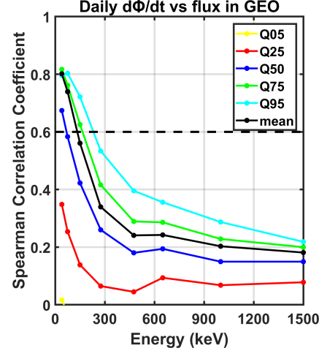
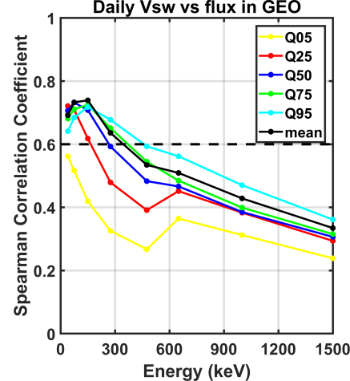
GEO results
CCs vs Energy
(a)
(b)
(c)
(d)
EGU General Assembly, May 2020, Vienna, Austria.

Slide 8
GEO results
CCs vs Energy
(a)
(b)
Strong correlation of the lower energy channels of GOES (40 and 75 keV) with the AE and AP index along with the Newell function especially concerning Q50, Q75, Q95 and the mean which clearly indicates the relationship between substorm activity and source electron flux at GEO.
(c)
(d)
EGU General Assembly, May 2020, Vienna, Austria.

Slide 9
GEO results
CCs vs Energy
(a)
(b)
(c)
(d)
Strong correlation of the 150 and 275 keV electron flux with the solar wind speed.
EGU General Assembly, May 2020, Vienna, Austria.

Slide 10
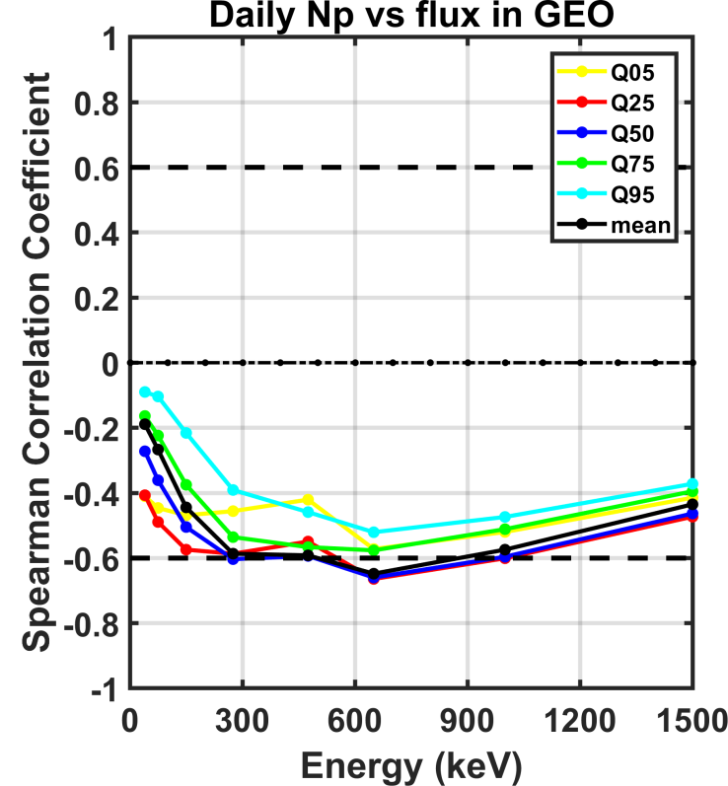
GEO results
Strong anti-correlation of the lower energy channels of ~ 600 keV with density.
Nevertheless, this result is based on HIMAWARI data which have much less time-span.
EGU General Assembly, May 2020, Vienna, Austria.

Slide 11
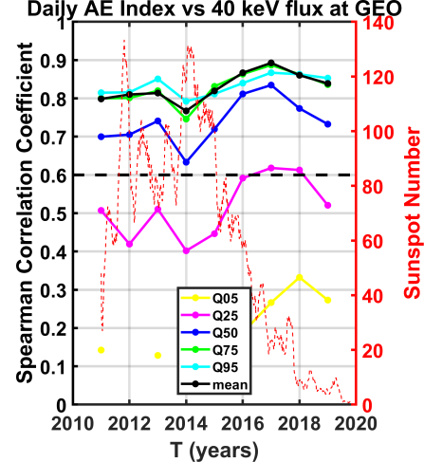
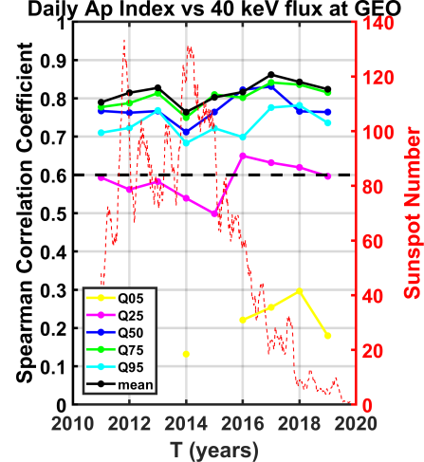
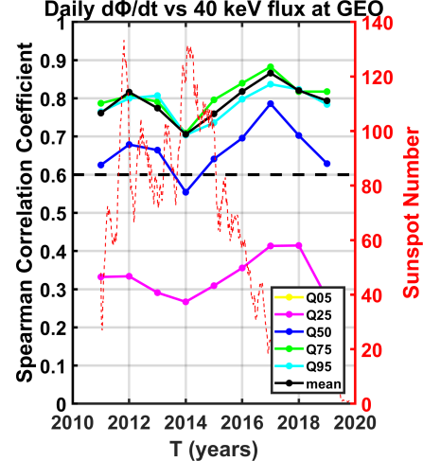
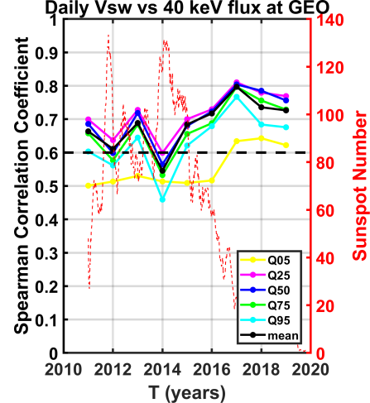
GEO results
CC vs Year for 40 keV
(a)
(b)
There is a clear dependence (anti-correlation) on solar cycle phase between the CCs of 40 keV flux and AE index and solar wind speed.
Their minimum is during 2014 (SC maximum) and their maximum during 2017 (SC declining phase).
(c)
(d)
EGU General Assembly, May 2020, Vienna, Austria.

Slide 12
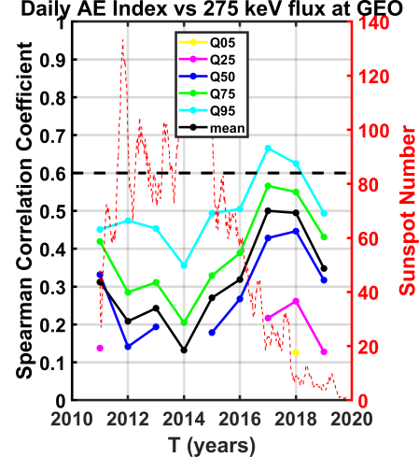
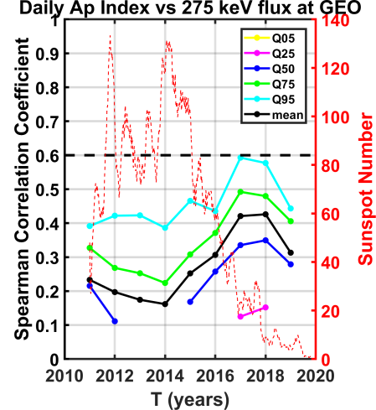
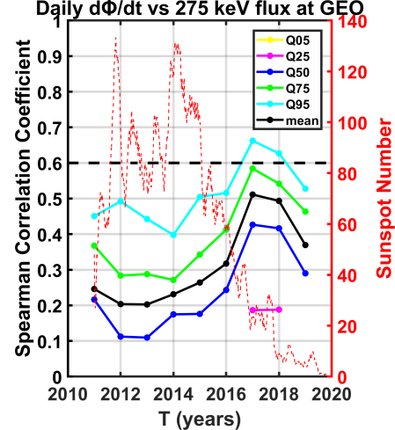
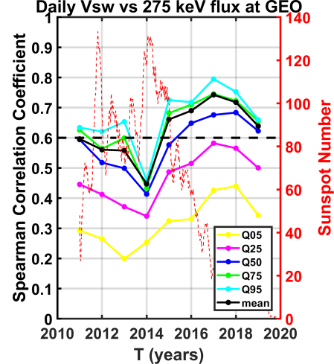
GEO results
CC vs Year for 275 keV
(a)
(b)
This anti-correlation is exhibited by all GOES channels.
Yet solar wind speed becomes more important for electrons higher than 150 keV.
(c)
(d)
EGU General Assembly, May 2020, Vienna, Austria.

Slide 13
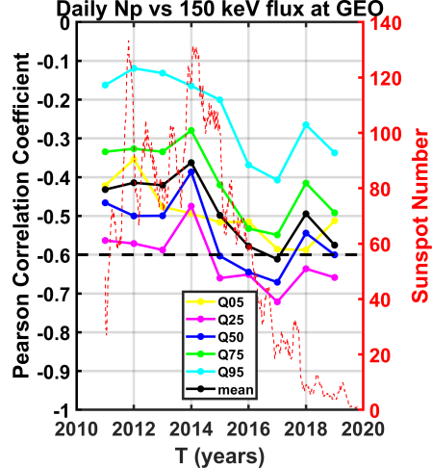
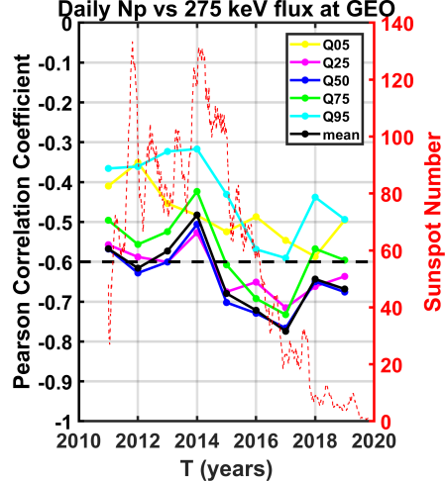
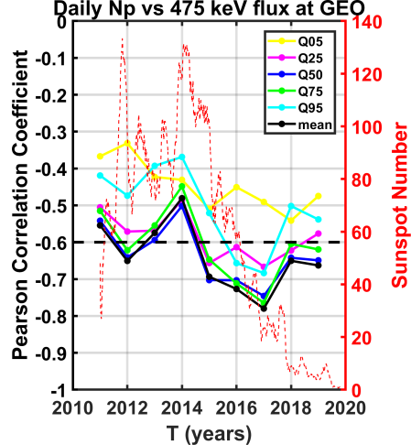
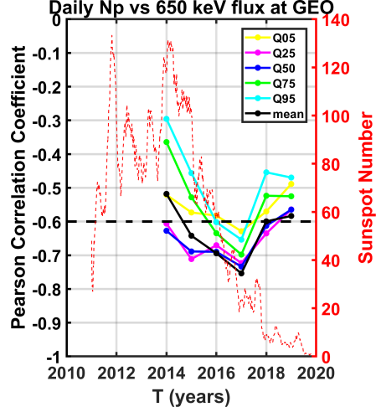
GEO results
CC vs Year for Np
(a)
(b)
(c)
(d)
EGU General Assembly, May 2020, Vienna, Austria.

Slide 14
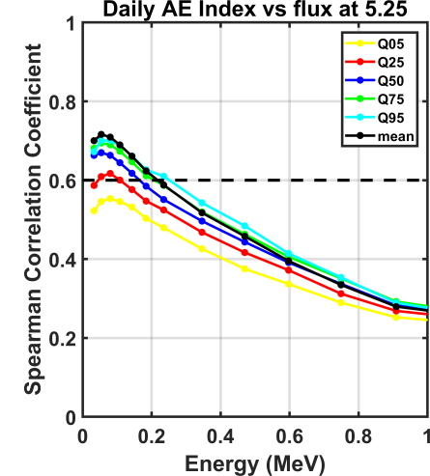
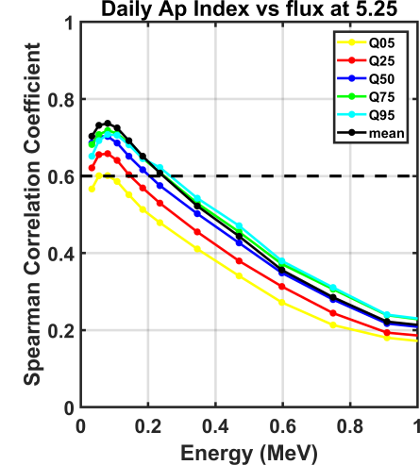
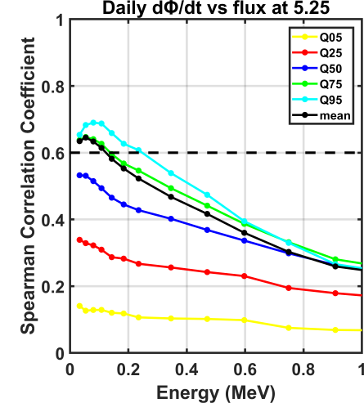
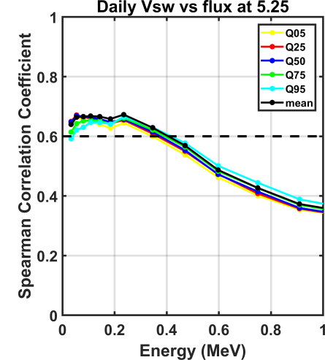
Outer Belt results
CCs vs Energy
(a)
(b)
Strong correlation of the lower energy channels of MagEIS (especially 54 and 80 keV) with the AE and AP index along with the Newell function especially concerning Q50, Q75, Q95 and the mean which clearly indicates the relationship between substorm activity and source electron flux at GEO.
(c)
(d)
Strong correlation of the >200 keV electron flux with the solar wind speed.
EGU General Assembly, May 2020, Vienna, Austria.

Slide 15
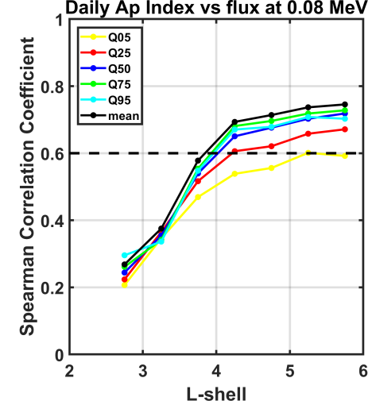
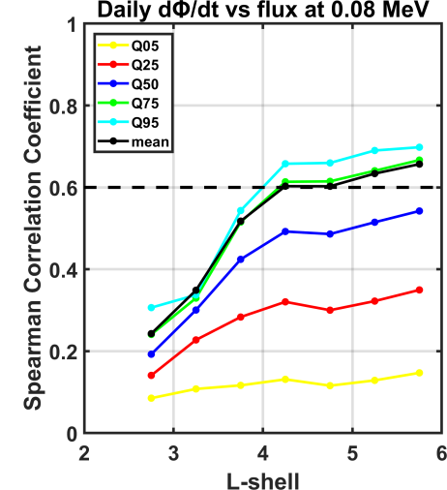
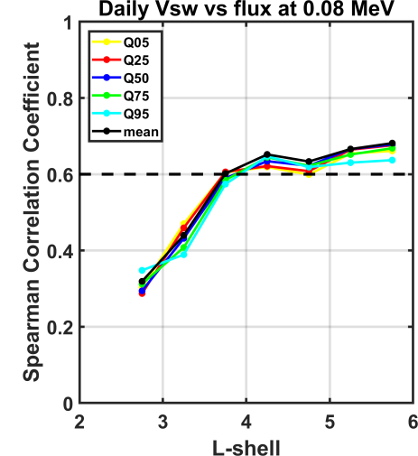
Outer Belt results
CCs vs L for 80 keV
(a)
(b)
CCs are L-dependent as they increase with increasing L-shell.
Generally, we accept CCs down to L=4.
(c)
(d)
EGU General Assembly, May 2020, Vienna, Austria.

Slide 16
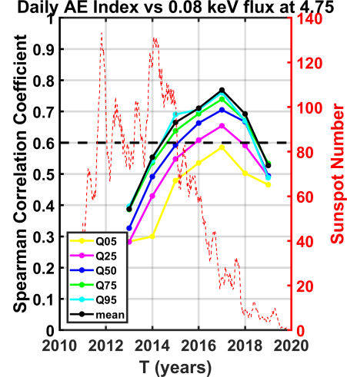
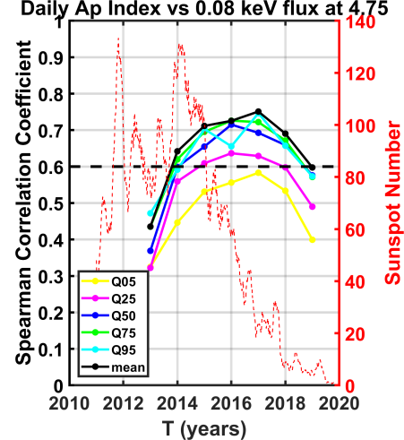
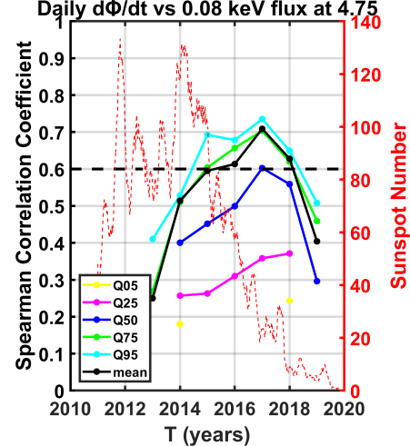
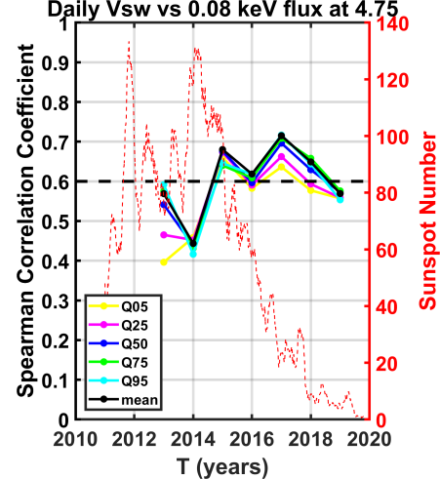
Outer Belt results
CCs vs Year for 80 keV
(a)
(b)
There is a clear dependence (anti-correlation) on solar cycle phase between the CCs of 80 keV flux and AE index and solar wind speed.
Their minimum is during 2013 (SC maximum) and their maximum during 2017 (SC declining phase).
(c)
(d)
EGU General Assembly, May 2020, Vienna, Austria.

Slide 17
Empirical Multiple Regression Model
General form:
$\log_{10}{J}=a0+a1∙X1+a2∙X2$ $+a3∙X3$ $+a4∙X4$ $+a12∙X1∙X2+a13∙X1∙X3+a14∙X1∙X4$
$$+a23∙X2∙X3+a24∙X2∙X4+a34∙X3∙X4$$
where
$X1={PSW}^{γ1}$, $X2={ΒS}^{γ2}\text{, }X3={VSW}^{γ3} \text{and} X4={IMF}^{γ4}$
γ₁ | 0.5
γ₂ | 0.0014
γ₃ | 0.01
γ₄ | 0.01
EGU General Assembly, May 2020, Vienna, Austria.

Slide 18
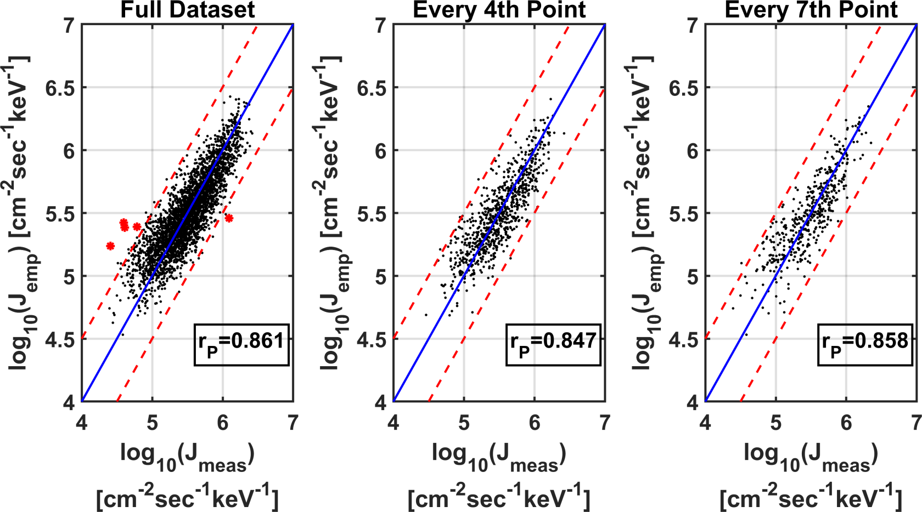
Empirical Multiple Regression Model
Daily MLT averaged flux at 40 keV
α₀ | α₁ | α₂ | α₃ | α₄ | α₁₂ | α₁₃ | α₁₄ | α₂₃ | α₂₄ | α₃₄
-39618 | 7056.4 | 4.7637 | 30381 | 39615 | -4.911 | 183.6 | -7222 | 6.136 | -6.076 | -30401
EGU General Assembly, May 2020, Vienna, Austria.

Slide 19
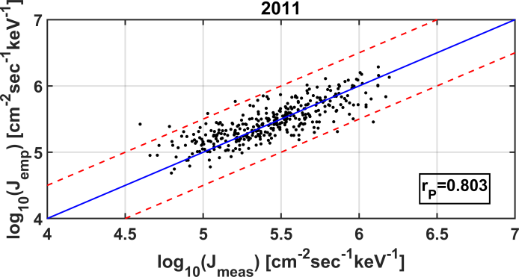
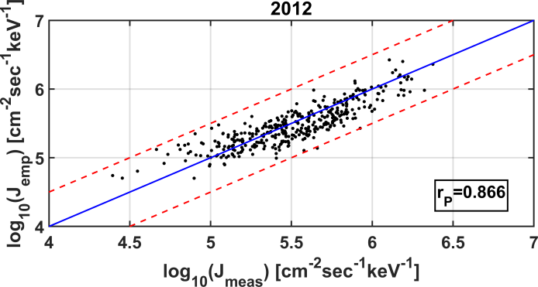
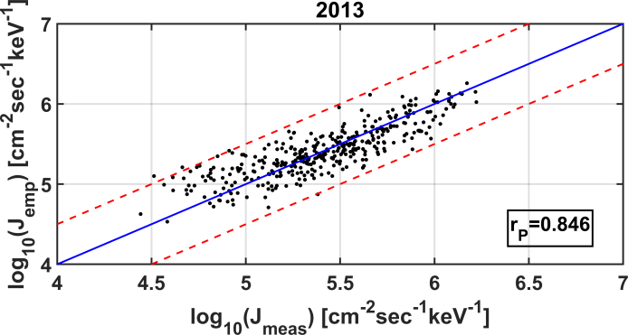
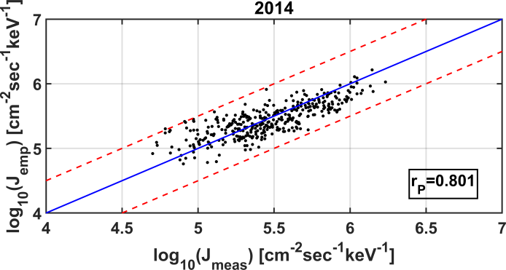
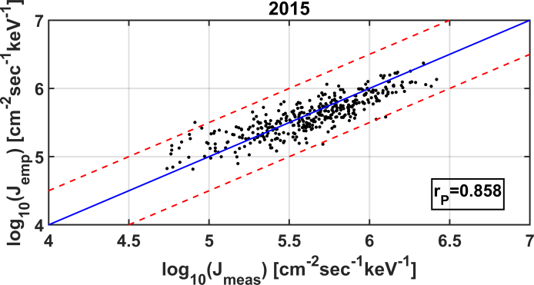
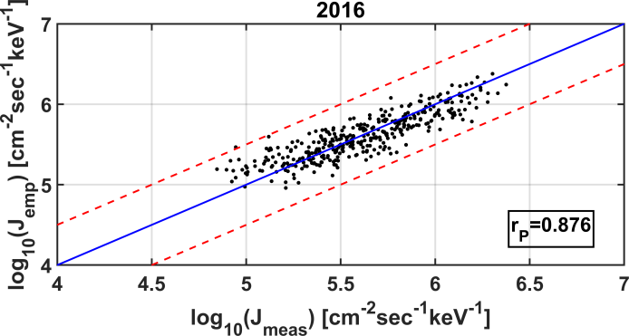
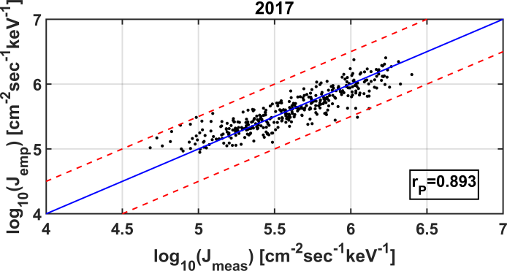
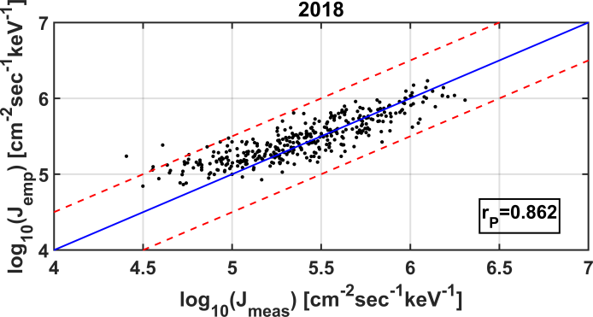
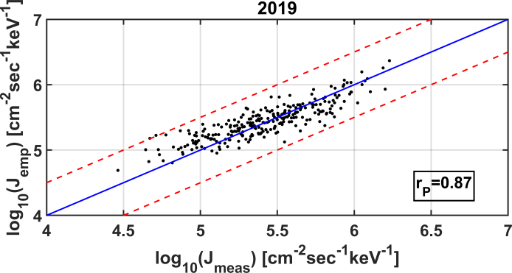
Empirical Multiple Regression Model
Daily MLT averaged flux at 40 keV per year
EGU General Assembly, May 2020, Vienna, Austria.

Slide 20
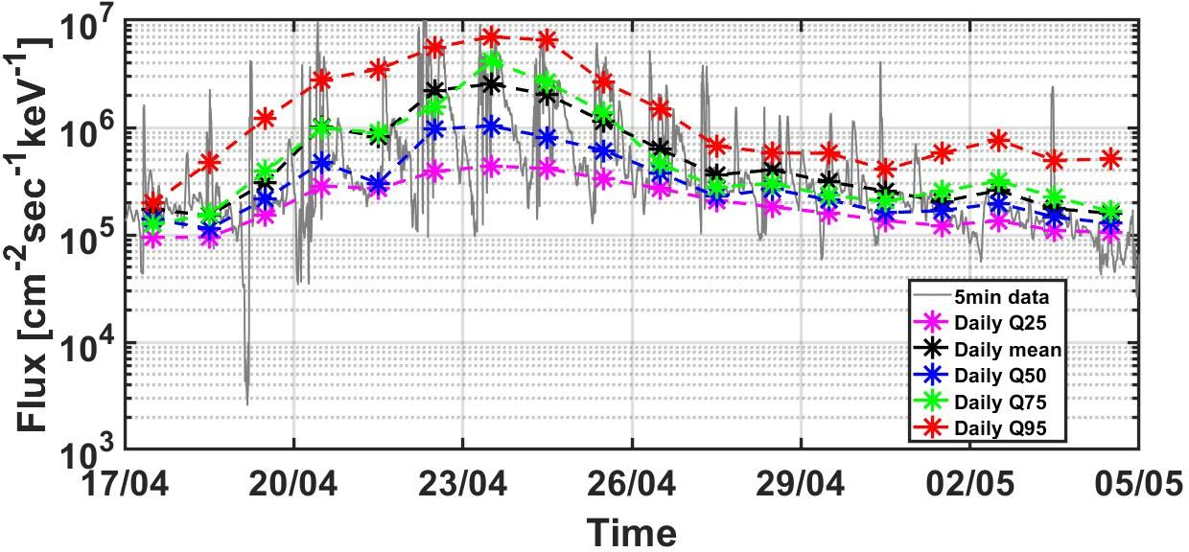
Empirical Multiple Regression Model
Comparison with 5-min flux from GOES 15
EGU General Assembly, May 2020, Vienna, Austria.

Slide 21
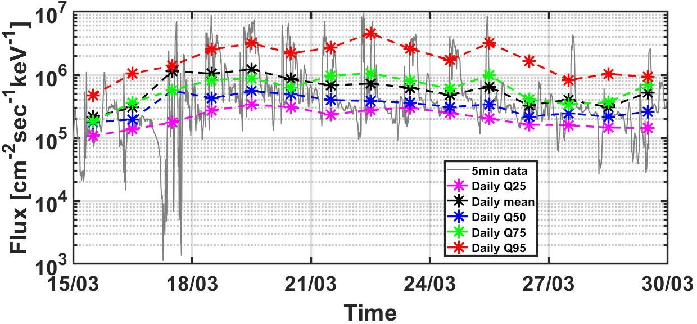
Empirical Multiple Regression Model
Comparison with 5-min flux from GOES 15
EGU General Assembly, May 2020, Vienna, Austria.

Slide 22
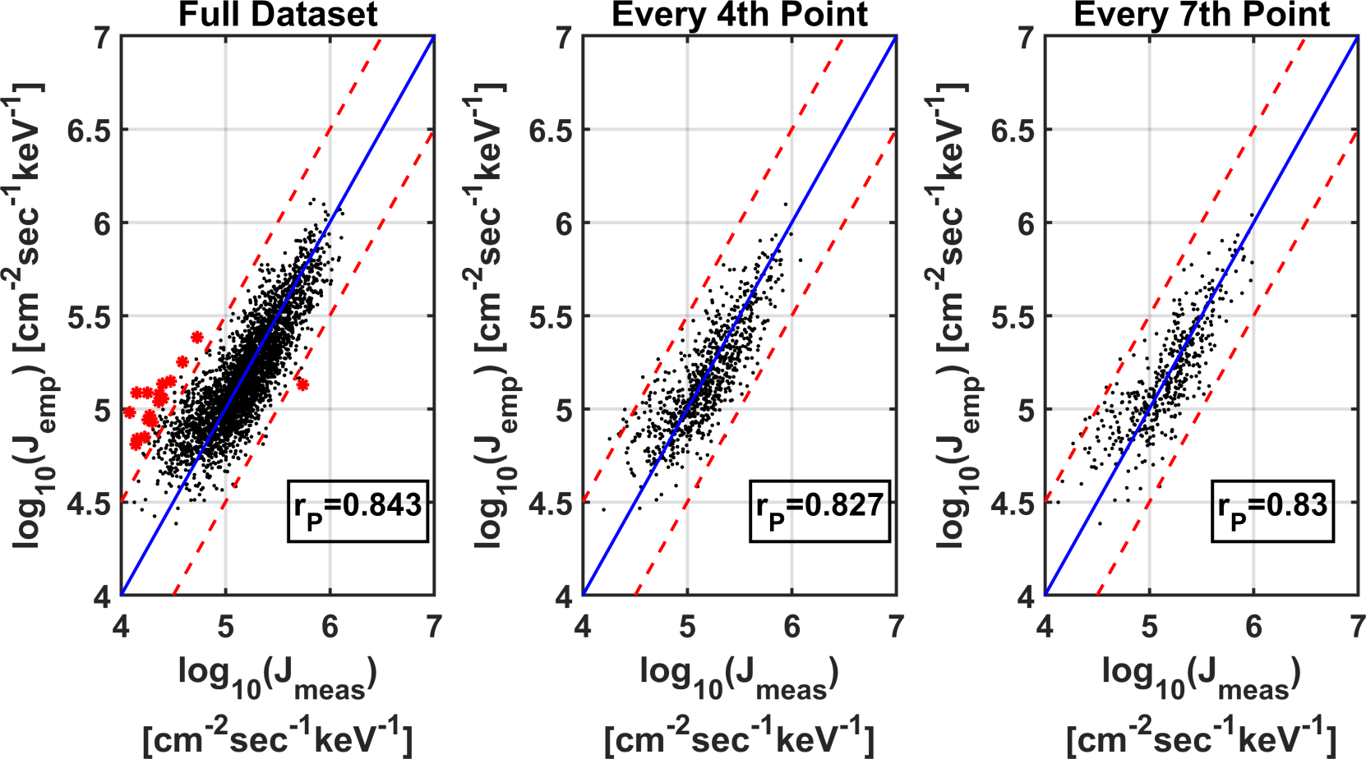
Empirical Multiple Regression Model
Daily MLT averaged flux at 75 keV
α₀ | α₁ | α₂ | α₃ | α₄ | α₁₂ | α₁₃ | α₁₄ | α₂₃ | α₂₄ | α₃₄
-31349 | 5164.5 | 14.445 | 23747 | 32062 | -1.559 | 833.29 | -6029 | 11.276 | -24606 | -24433
EGU General Assembly, May 2020, Vienna, Austria.

Slide 23
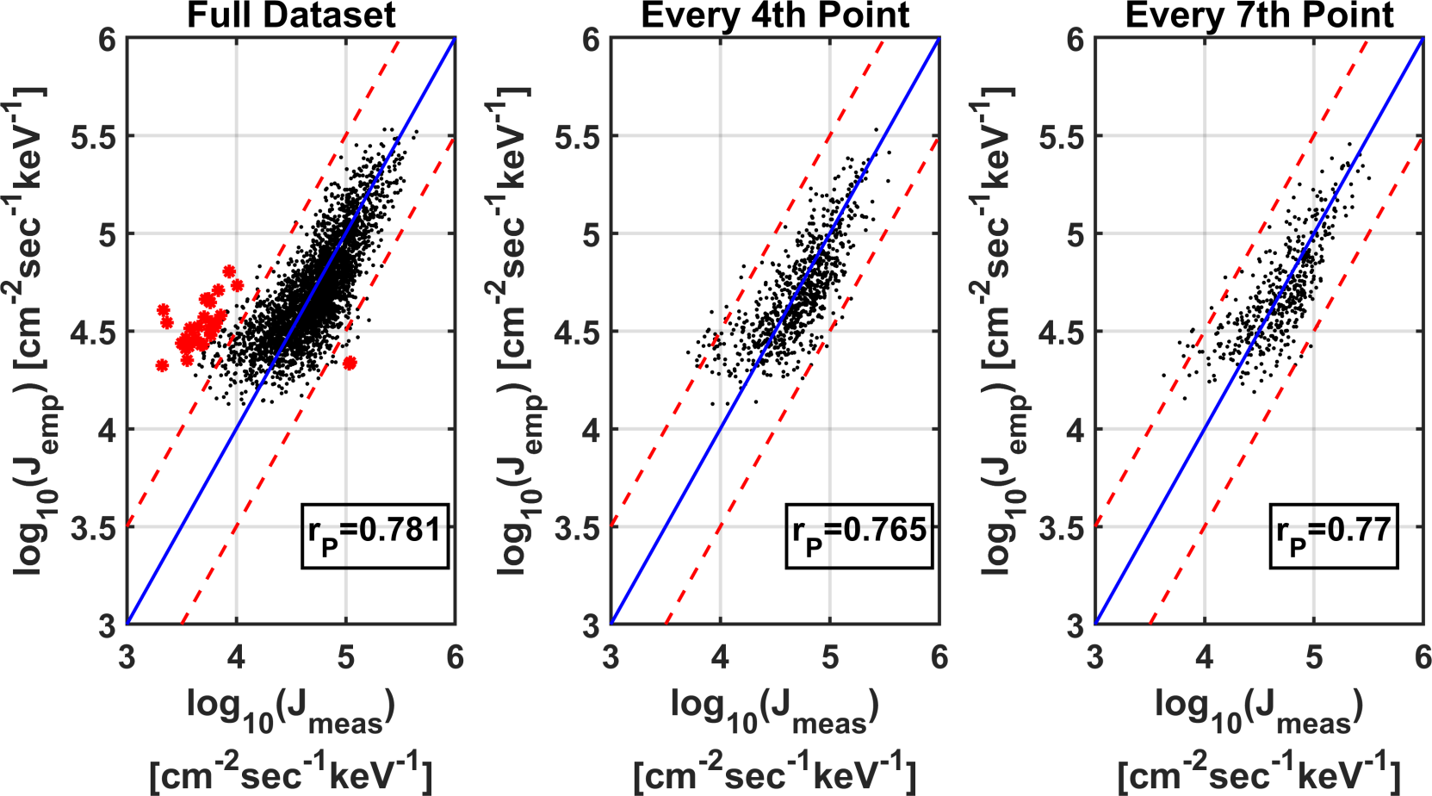
Empirical Multiple Regression Model
Daily MLT averaged flux at 150 keV
α₀ | α₁ | α₂ | α₃ | α₄ | α₁₂ | α₁₃ | α₁₄ | α₂₃ | α₂₄ | α₃₄
-16794 | 2084.5 | -4.961 | 12576 | 18010 | -1.411 | 1270 | -3429 | 12.859 | -7.12 | -13722
EGU General Assembly, May 2020, Vienna, Austria.

Slide 24
Conclusions
Stronger Correlation
CCs depend strongly on the Solar cycle phase (anti-correlation) with larger CCs appearing during the declining phase (max at 2017).
CCs remain higher than 0.6 for L-shells down to 4.
Non-linear multiple regression reveals that the most significant parameters for source/seed electron flux prediction are: V_{SW}, P_{SW}, IMF and B_{S}.
The predicted daily values are correlated with the measured with CCs in the 0.8 – 0.9 range, depending on Solar cycle phase.
Source electrons (30 – 100 keV)
Seed electrons (100 – 300 keV)
AE index
Ap index
dφ/dt
V_{SW}
EGU General Assembly, May 2020, Vienna, Austria.

Slide 25
Thank you for your Attention
EGU General Assembly, May 2020, Vienna, Austria.

Slide 26
Backup Slides
EGU General Assembly, May 2020, Vienna, Austria.

Slide 27
GEO results
CCs Distribution
DAILY Q50 | IMF | B_{X} | B_{Y} | B_{Z} | B_{TAN} | E_{Y} | V_{SW} | P_{SW} | T | N | Plasma β | M_{Alfven} | Dst | AE | AU | AL | Ap | Kp | Rz | Flux 10.7 | E_{WAV} | ε | Bs | E_{KL} | HWR | dφ/dt
40 keV | 0,289 | NaN | NaN | -0,404 | 0,175 | 0,427 | 0,706 | 0,327 | 0,618 | -0,272 | -0,156 | -0,376 | -0,762 | 0,758 | 0,705 | 0,772 | 0,786 | 0,789 | 0,058 | 0,061 | 0,134 | 0,619 | -0,411 | 0,257 | 0,459 | 0,674
75 keV | 0,202 | NaN | NaN | -0,323 | 0,083 | 0,348 | 0,732 | 0,245 | 0,603 | -0,361 | -0,114 | -0,357 | -0,742 | 0,672 | 0,607 | 0,688 | 0,697 | 0,7 | NaN | 0,038 | 0,104 | 0,515 | -0,326 | 0,21 | 0,377 | 0,583
150 keV | NaN | NaN | NaN | -0,222 | -0,122 | 0,247 | 0,708 | 0,058 | 0,518 | -0,505 | NaN | -0,276 | -0,668 | 0,487 | 0,395 | 0,507 | 0,483 | 0,486 | NaN | NaN | 0,053 | 0,327 | -0,208 | 0,102 | 0,259 | 0,423
275 keV | -0,223 | NaN | NaN | -0,16 | -0,329 | 0,183 | 0,593 | -0,159 | 0,351 | -0,603 | 0,115 | -0,156 | -0,52 | 0,288 | 0,194 | 0,312 | 0,23 | 0,233 | -0,086 | -0,09 | NaN | 0,134 | -0,123 | NaN | 0,166 | 0,26
475 keV | -0,322 | NaN | NaN | -0,145 | -0,408 | 0,164 | 0,483 | -0,248 | 0,234 | -0,593 | 0,178 | -0,076 | -0,4 | 0,183 | 0,105 | 0,207 | 0,099 | 0,101 | -0,105 | -0,116 | -0,045 | 0,044 | -0,096 | -0,095 | 0,131 | 0,18
DAILY Q75 | IMF | B_{X} | B_{Y} | B_{Z} | B_{TAN} | E_{Y} | V_{SW} | P_{SW} | T | N | Plasma β | M_{Alfven} | Dst | AE | AU | AL | Ap | Kp | Rz | Flux 10.7 | E_{WAV} | ε | Bs | E_{KL} | HWR | dφ/dt
40 keV | 0,349 | NaN | 0,099 | -0,28 | 0,276 | 0,646 | 0,681 | 0,384 | 0,632 | -0,164 | -0,189 | -0,37 | -0,651 | 0,84 | 0,765 | 0,716 | 0,816 | 0,819 | 0,043 | 0,048 | 0,3 | 0,721 | -0,283 | 0,407 | 0,649 | 0,817
75 keV | 0,301 | 0,037 | 0,07 | -0,249 | 0,221 | 0,577 | 0,711 | 0,338 | 0,631 | -0,224 | -0,177 | -0,375 | -0,671 | 0,781 | 0,705 | 0,685 | 0,776 | 0,779 | NaN | 0,038 | 0,274 | 0,653 | -0,24 | 0,375 | 0,58 | 0,762
150 keV | 0,138 | NaN | NaN | -0,25 | 0,051 | 0,436 | 0,725 | 0,18 | 0,571 | -0,375 | -0,124 | -0,356 | -0,699 | 0,633 | 0,55 | 0,601 | 0,626 | 0,629 | NaN | NaN | 0,205 | 0,486 | -0,186 | 0,276 | 0,439 | 0,625
275 keV | -0,12 | NaN | -0,05 | -0,289 | -0,197 | 0,264 | 0,651 | -0,053 | 0,414 | -0,536 | NaN | -0,264 | -0,641 | 0,412 | 0,328 | 0,461 | 0,373 | 0,376 | -0,069 | -0,074 | 0,077 | 0,237 | -0,139 | 0,098 | 0,264 | 0,416
475 keV | -0,255 | NaN | -0,085 | -0,316 | -0,319 | 0,18 | 0,545 | -0,168 | 0,284 | -0,566 | 0,066 | -0,182 | -0,543 | 0,275 | 0,2 | 0,358 | 0,214 | 0,216 | -0,098 | -0,109 | NaN | 0,099 | -0,123 | NaN | 0,178 | 0,289
DAILY Q95 | IMF | B_{X} | B_{Y} | B_{Z} | B_{TAN} | E_{Y} | V_{SW} | P_{SW} | T | N | Plasma β | M_{Alfven} | Dst | AE | AU | AL | Ap | Kp | Rz | Flux 10.7 | E_{WAV} | ε | Bs | E_{KL} | HWR | dφ/dt
40 keV | 0,346 | 0,094 | 0,182 | -0,04 | 0,301 | 0,702 | 0,641 | 0,365 | 0,608 | -0,09 | -0,169 | -0,3 | -0,482 | 0,842 | 0,713 | 0,481 | 0,746 | 0,746 | NaN | NaN | 0,45 | 0,653 | -0,123 | 0,487 | 0,702 | 0,796
75 keV | 0,355 | 0,126 | 0,164 | NaN | 0,306 | 0,689 | 0,685 | 0,377 | 0,634 | -0,104 | -0,169 | -0,313 | -0,502 | 0,834 | 0,7 | 0,487 | 0,774 | 0,774 | NaN | NaN | 0,461 | 0,655 | -0,108 | 0,501 | 0,689 | 0,803
150 keV | 0,254 | 0,1 | 0,104 | -0,069 | 0,201 | 0,57 | 0,718 | 0,275 | 0,603 | -0,216 | -0,175 | -0,342 | -0,573 | 0,727 | 0,597 | 0,488 | 0,693 | 0,693 | NaN | NaN | 0,402 | 0,546 | -0,088 | 0,435 | 0,57 | 0,722
275 keV | NaN | NaN | NaN | -0,217 | NaN | 0,36 | 0,678 | 0,061 | 0,467 | -0,391 | -0,133 | -0,324 | -0,617 | 0,524 | 0,412 | 0,46 | 0,484 | 0,484 | -0,048 | -0,05 | 0,24 | 0,314 | -0,074 | 0,256 | 0,36 | 0,534
475 keV | -0,123 | -0,042 | -0,093 | -0,304 | -0,167 | 0,232 | 0,593 | -0,063 | 0,345 | -0,459 | -0,078 | -0,273 | -0,585 | 0,381 | 0,286 | 0,407 | 0,332 | 0,332 | -0,08 | -0,087 | 0,119 | 0,161 | -0,067 | 0,123 | 0,232 | 0,396
EGU General Assembly, May 2020, Vienna, Austria.

