Slide 1

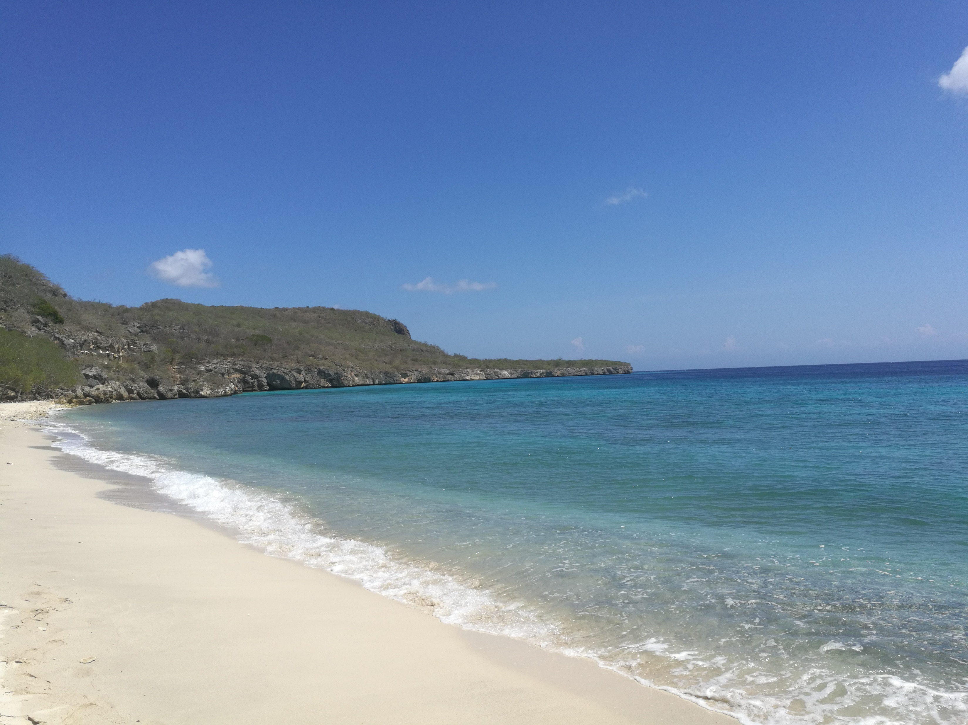
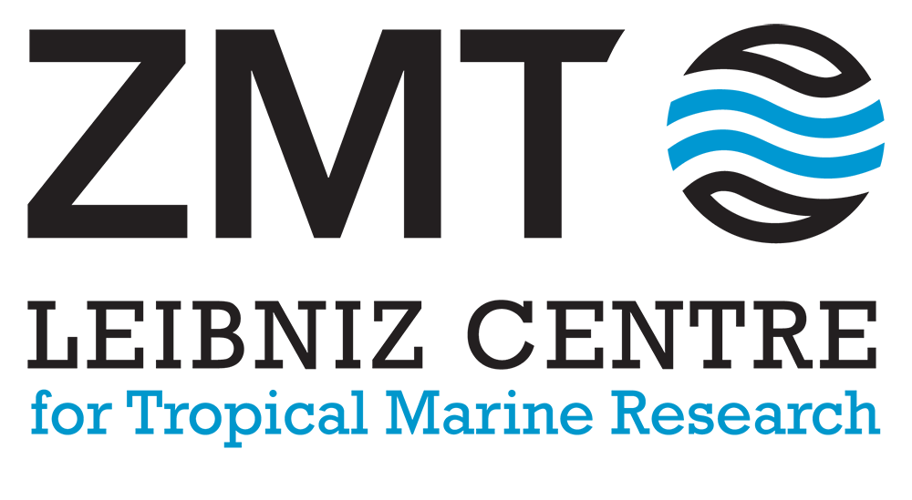

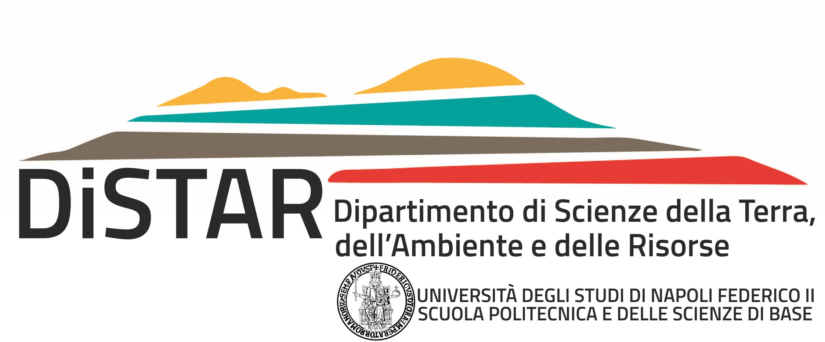



SSP1.2
New and re-interpreted Pleistocene sea-level records from around the Globe
Online |4-8 May 2020
3D Mapping of Quaternary coral reef terraces on Curaçao Island, Southern Carribean Sea
Cerrone C., Petersen A.K., Stocchi P., Rovere A., Casella E.

Slide 2
Study Area
The Leeward Antilles islands of Aruba, Bonaire and Curaçao are situated in the southernmost part of the Caribbean Sea.
Leeward Antilles ridge is underlain by the Cretaceous Great Arc of the Caribbean plate that diachronously collided with the continental passive margin of South America plate from Late
Cretaceous to recent time span
Topographic-bathymetric map
Hippolyte & Mann, 2011
The topographic-bathymetric data and free-air gravity data (Sandwell and Smith,1997) illustrate the distribution of the major tectonic and geologic provinces present in the southern Caribbean
Free-air gravity map

Slide 3
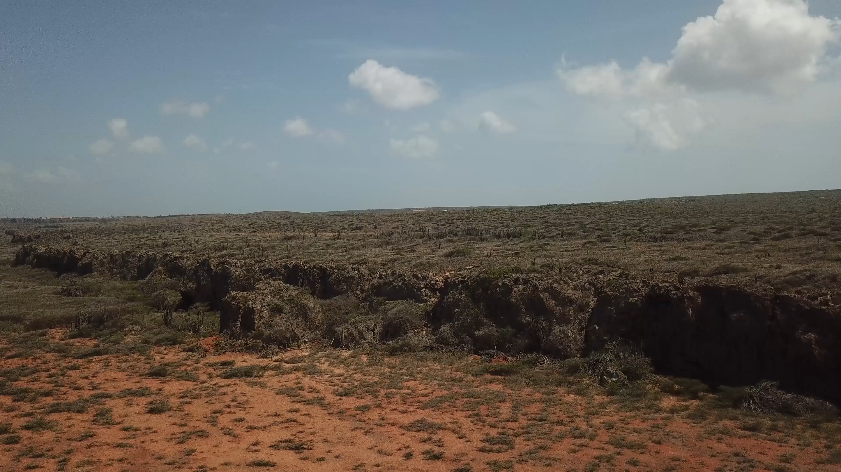

Collection of field data

Slide 4
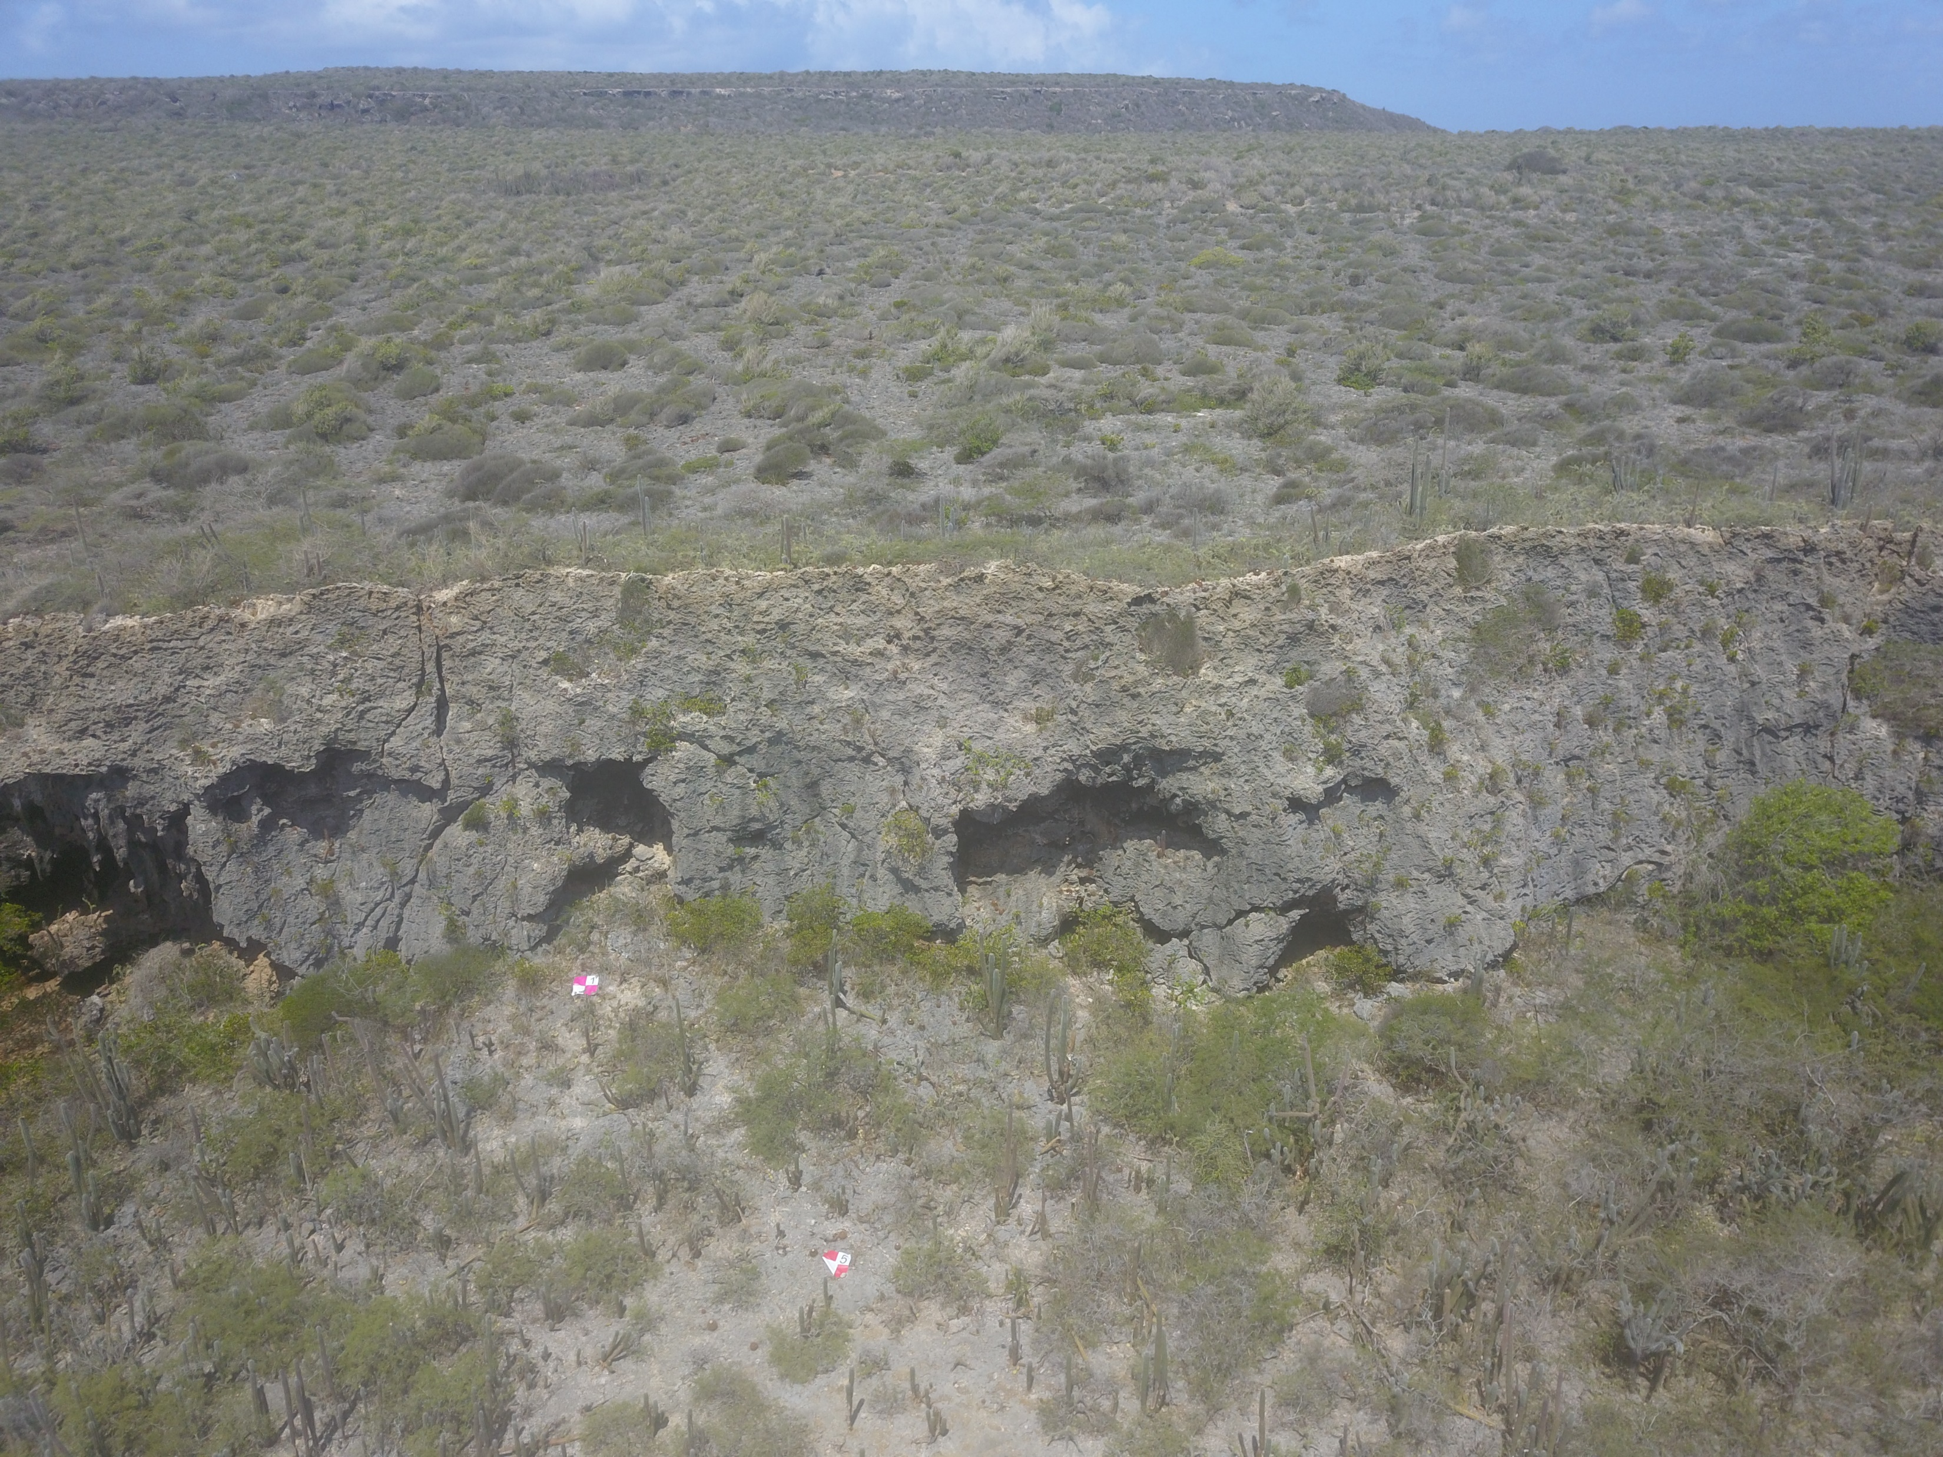

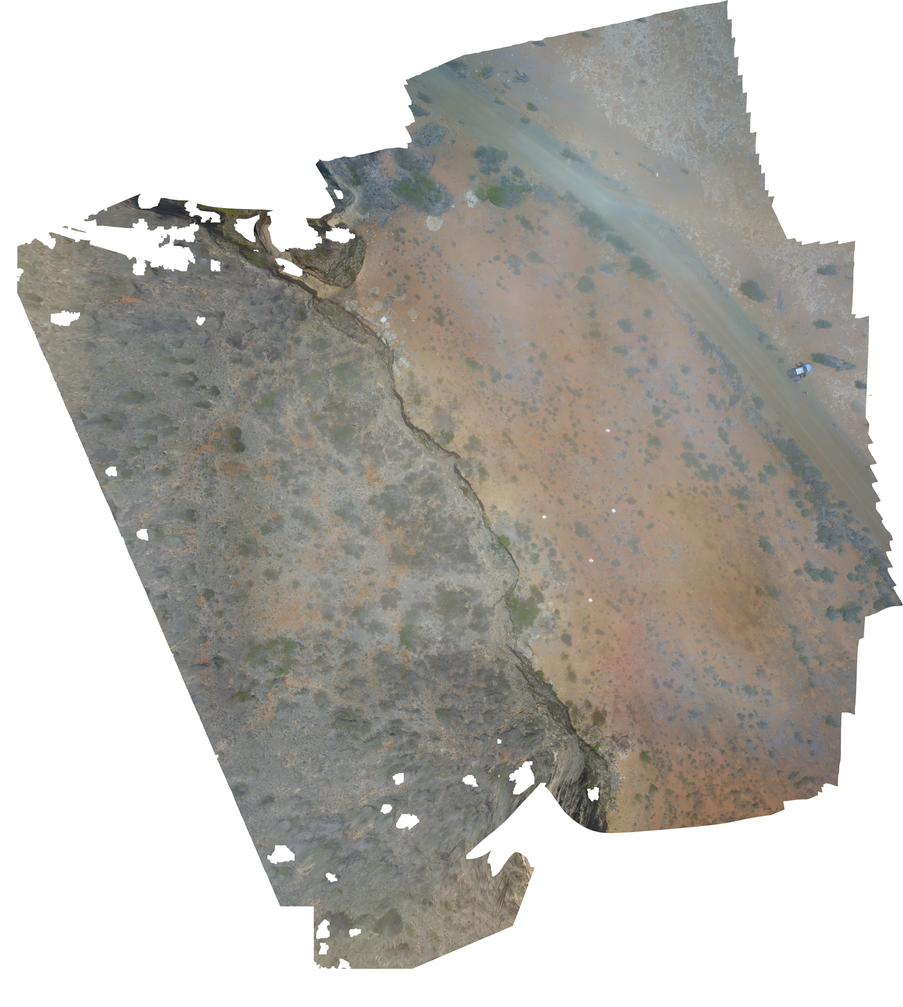
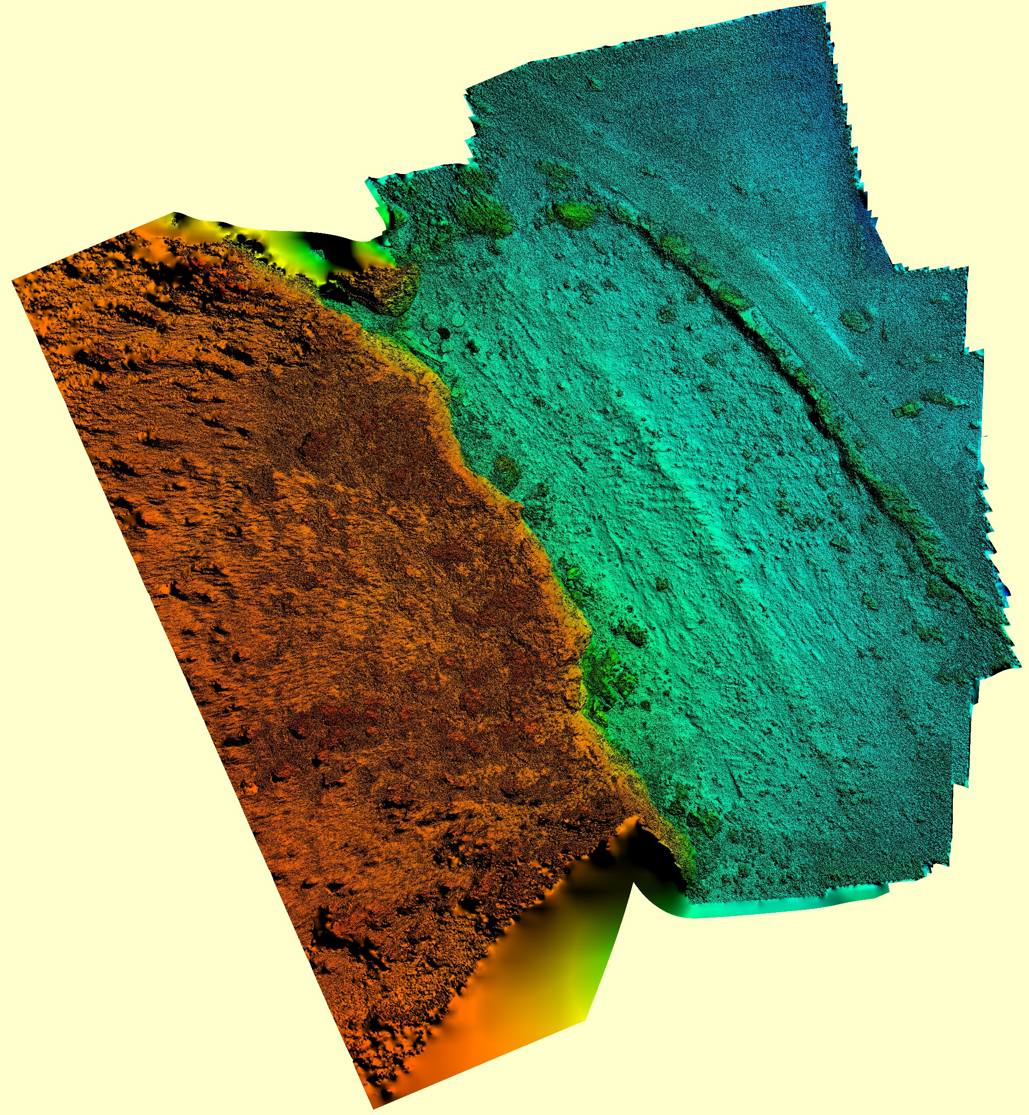
Photogrammetry to obtain high detail DEM and orthophoto in order to measure accuratly RSL indicators
Upper Terrace
Drone flight
GCP
Tidal notch
Lower Terrace
Orthophoto
DEM
Upper Terrace
Upper Terrace
Paleo cliff
GCP
Paleo cliff
Lower Terrace
Lower Terrace

Slide 5
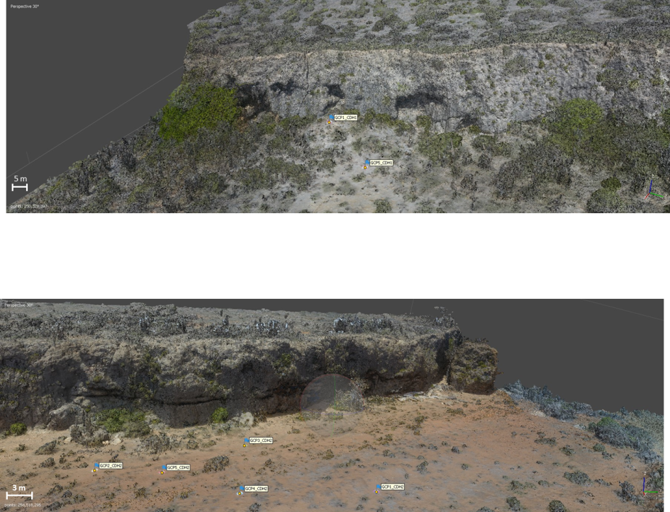
Upper Terrace
Orthophotos
Lower Terrace
5 m

Slide 6
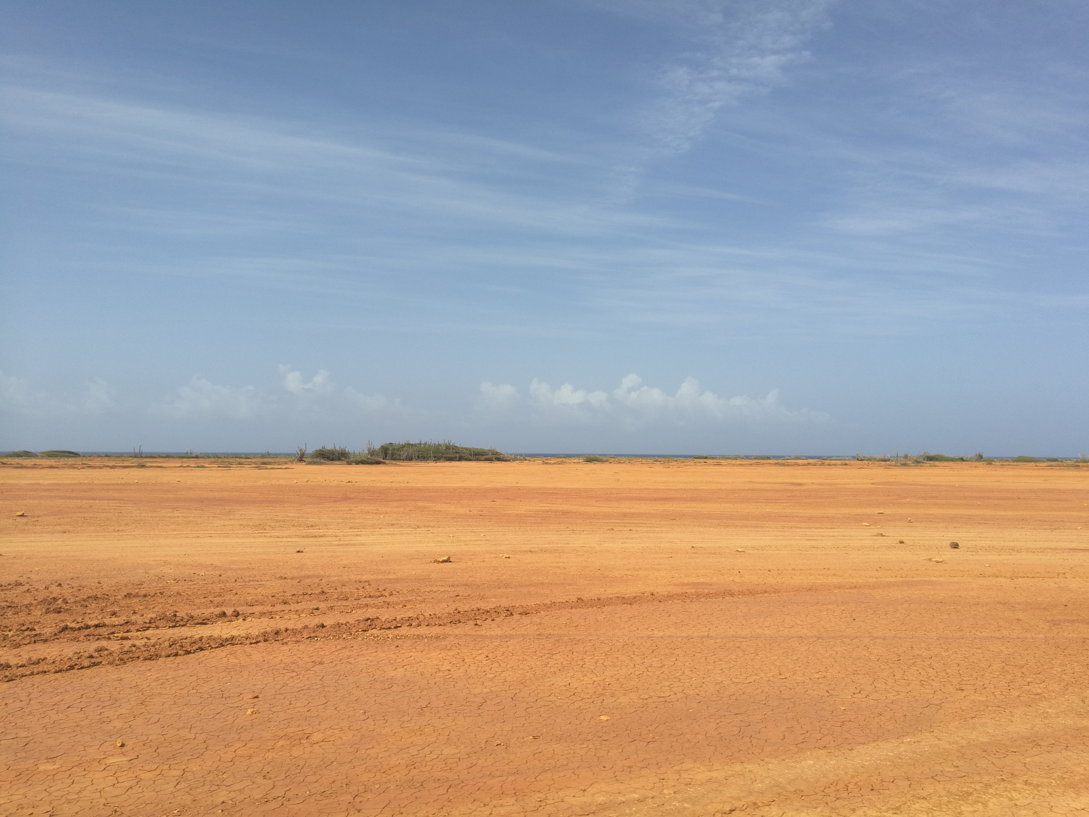

The fieldwork for this work was funded by the Helmholtz Exzellenznetzwerks “The Polar System and its Effects on the Ocean Floor (POSY)”.
The authors acknowledge the Center for Tropical Marine Ecology (ZMT), and the German Academic Exchange Service (DAAD).
ciro.cerrone@unina.it

