Slide 1



Early and late Holocene paleoenvironmental reconstruction of the Pearl River estuary, South China Sea
Huixian Chen, Jianhua Wang, Nicole S. Khan, Lali Waxi, Jiaxue Wu, Benjamin P. Horton
Notes:
Investigations of Holocene estuarine sediments reveal important information about changes in sea level, climate and human activities , which elucidate the patterns of natural variability and thus provide a background to compare against the increasing environmental stresses. Especially Early Holocene climate warmed and sea-level rose rapidly, which highly resembles modern days.

Slide 2
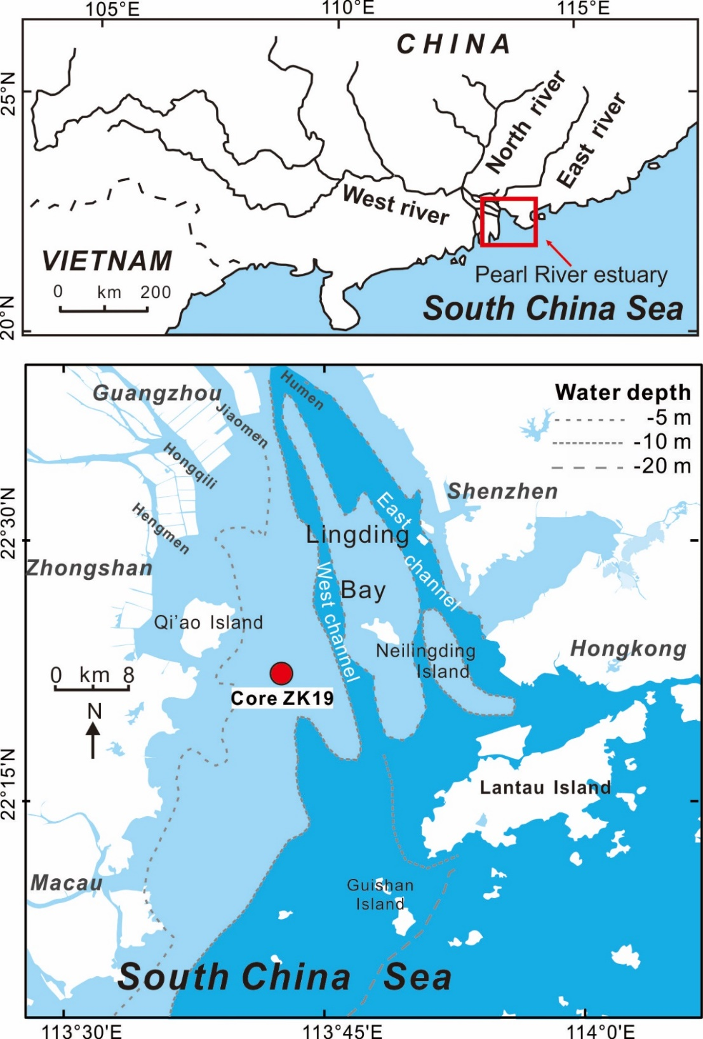
Study area
Sediment core ZK19
Location: western Lingding Bay
Water depth: -5m
Subaqueous deltaic deposits
Within the range of Paleo-valley
Climate : Asian monsoon
precipitation changes significantly
with the seasons
Four estuarine zones:
1. inner estuary;
2. middle estuary;
3. outer estuary;
4. marine environment
Notes:
Pearl River is the second largest river with dense population of China. This study core ZK19 was within the range of one of the paleo-valleys, thus it contained early Holocene sediments, which provided a relative longer Holocene record.

Slide 3
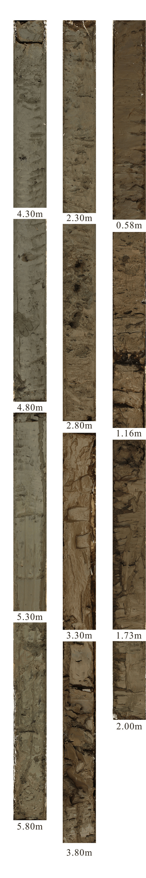
Study methods
Dating
Radiocarbon dating AMS¹⁴C
Multiple-proxies
Grain size analysis
Median size of particles, sediment fraction
Micropaleontology
Benthic foraminifera
Organic geochemistry
Organic TOC, TN，TOC/TN, Stable carbon isotope δ¹³C

Slide 4
Dating data
Sample ID | Laboratory code | Depth (m) | Material stateª | Material matrix | δ¹³C (‰) | ¹⁴C Age (a) | Calibrated age (cal a BP)
19-C02 | Beta-378385 | 3.0 | TP | plant frag. | -31.3 | 440±30 | 496±36
19-C04 | Beta-378386 | 4.8 | SI | gastropods | -0.9 | 810±30 | 551±78
19-C06 | Beta-378387 | 7.1 | SS | shell | -1.4 | 1380±30 | 1056±121
19-C08 | Beta-378388 | 11.0 | SS | shell | -5.9 | 2200±30 | 1954 ±133
19-C09 | Beta-378389 | 13.1 | SS | shell | +1.0 | 2910±30 | 2823±105
19-C11 | Beta-378390 | 16.0 | SL | shell | -1.8 | 2440±30 | *2226±118
19-CB01 | Beta-383041 | 17.0 | SS | shell | -2.6 | 7620±30 | 8126±123
19-CB02 | Beta-383042 | 19.0 | SS | shell | -7.9 | 8640±30 | *9421±101
19-C13 | Beta-378391 | 20.1 | TP | plant frag. | -30.3 | 7990±30 | 8874±124
19-C14 | Beta-378392 | 23.0 | TP | plant frag. | -28.9 | 8410±40 | 9459±63
19-C19 | Beta-378394 | 30.4 | SS | shell | -12.2 | 9470±30 | 10474±103
19-C22 | Beta-378395 | 34.6 | SS | shell | -8.8 | 9700±30 | 10775±139
Hiatus
* outlier dates
Notes:
Here is the dating sheet with12 radiocarbon dates, and 10 of them were used to establish the age-depth model, and the hiatus was confined within the 1 m depth with ages span nearly 5000 years between 16 and 17m. SL indicated single broken shell, SS indicated small intact shells.

Slide 5
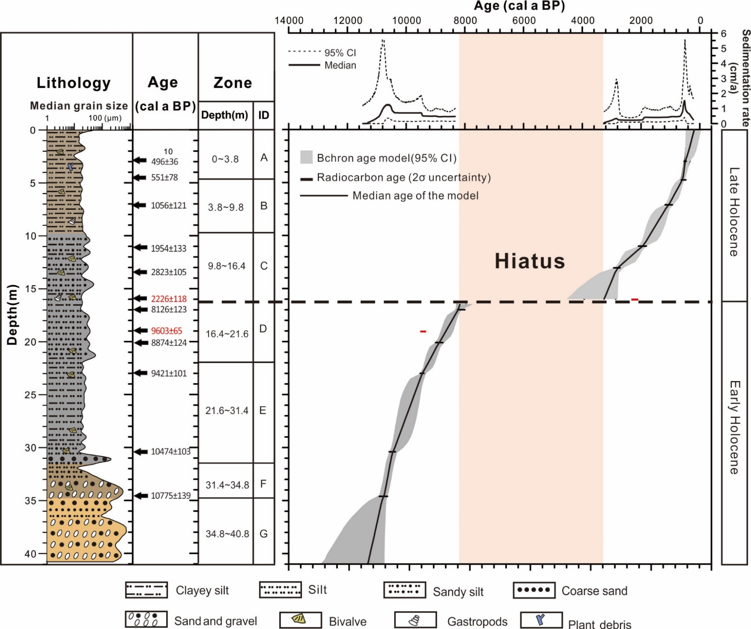
Age-depth model

Slide 6
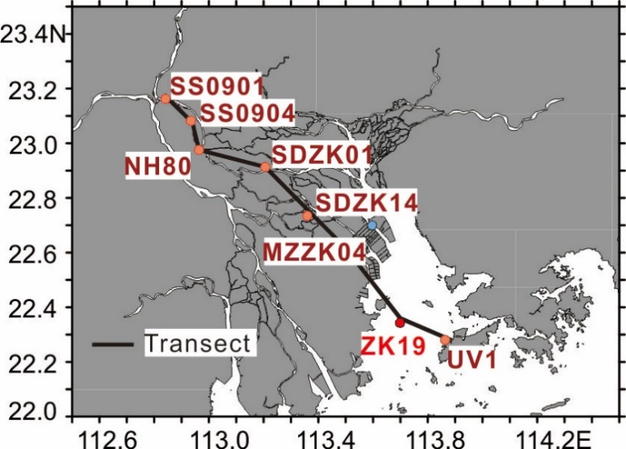
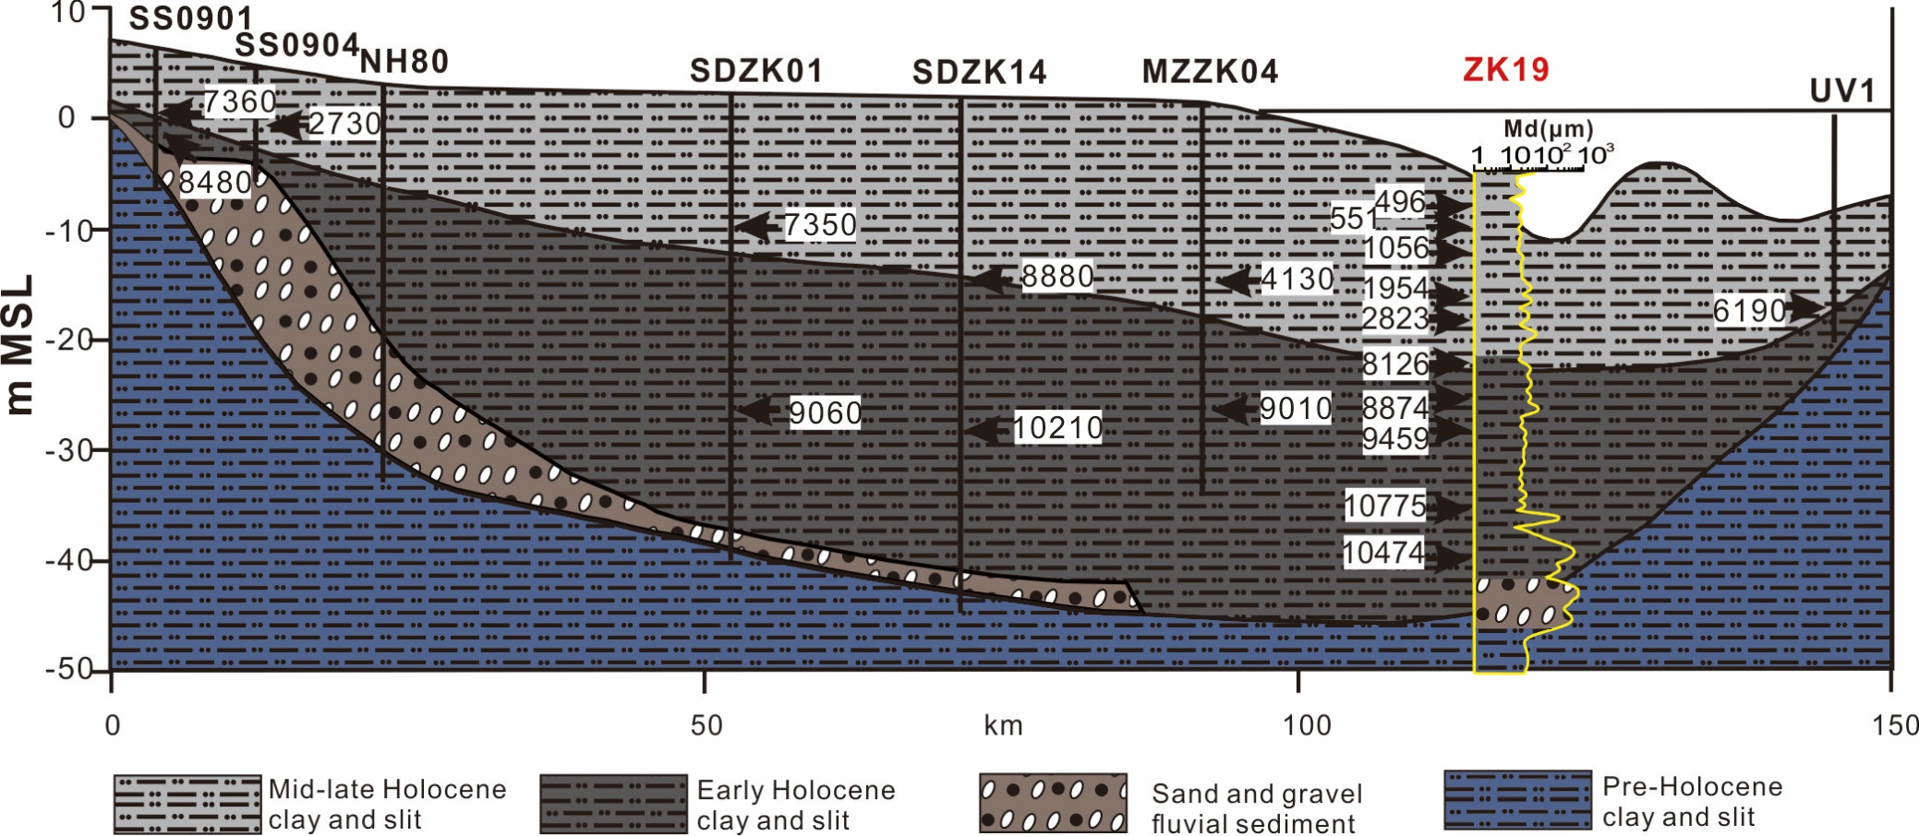
Stratigraphy of paleo-valley profiles
Hiatus exist at the infilled surface of paleo-valley between 8100~3300 cal a BP
Revised from
Zong et al. (2012)
ZK19
Notes:
When compared core ZK19 with nearby profile which was established by Zong et al.(2012), the stratigraphy were consistent. Hiatus existed at the infilled surface of paleo-valley between 8100~3300 cal a BP.

Slide 7
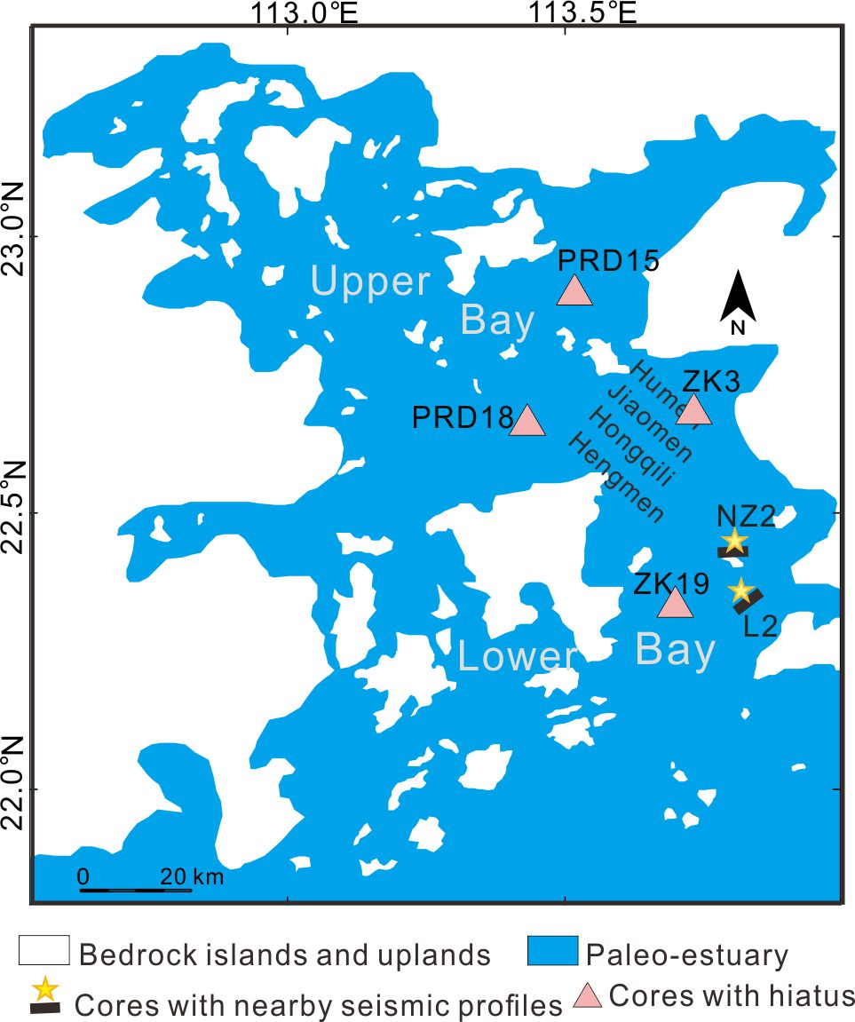
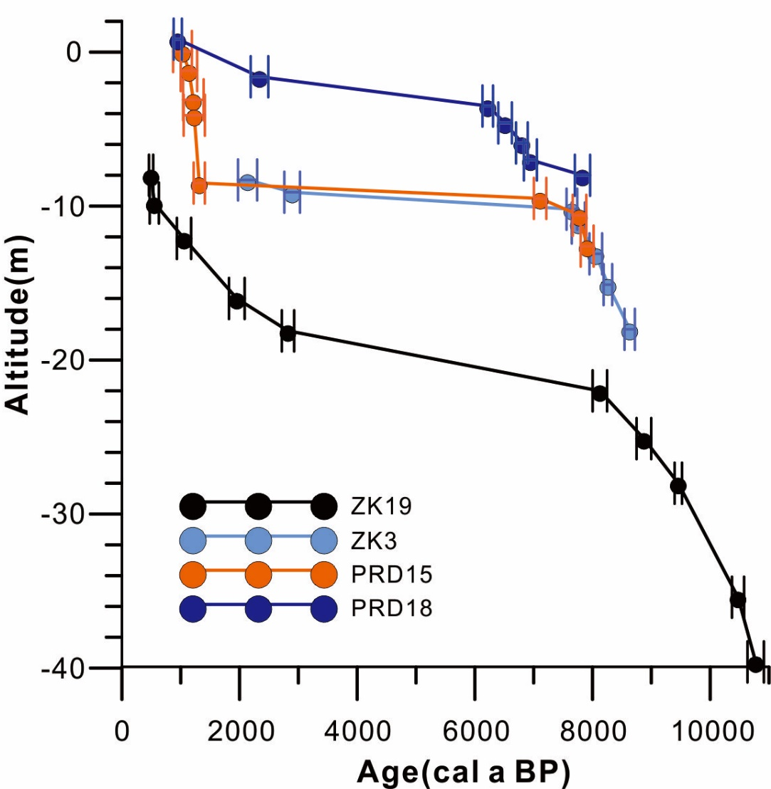
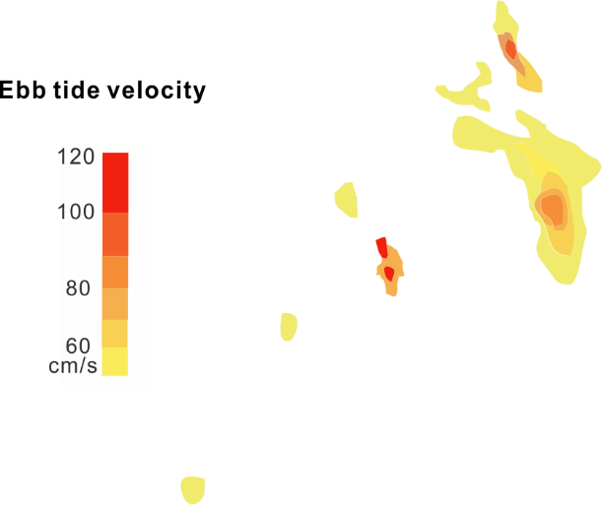
Hiatus in Middle Holocene
Paleo-estuary of Pearl River
(6000 cal a BP)
Age-depth models
Revised from Wei and Wu (2011),Wei(2010)
Notes:
We checked the chronology of the sediment cores around Lingding Bay and found three cores which are similar to core ZK19. Their locations are marked in left figure, age-depth models all show a middle Holocene hiatus. In order to figure out the cause of the hiatus, we find clues from the paleo-estuary of Pearl River, when sea-level is high in middle Holocene, the coastal line is much inland than modern days. Low sedimentation rate is expected in core location due to landward migration of deposition center. A simulation of ebb tide flow fields between 6000 and 2500 cal a BP shows that the area with highest velocity is near the “gates” and in the lower bay (Wei, 2010), consistent with the locations of cores showing a sedimentation hiatus.

Slide 8
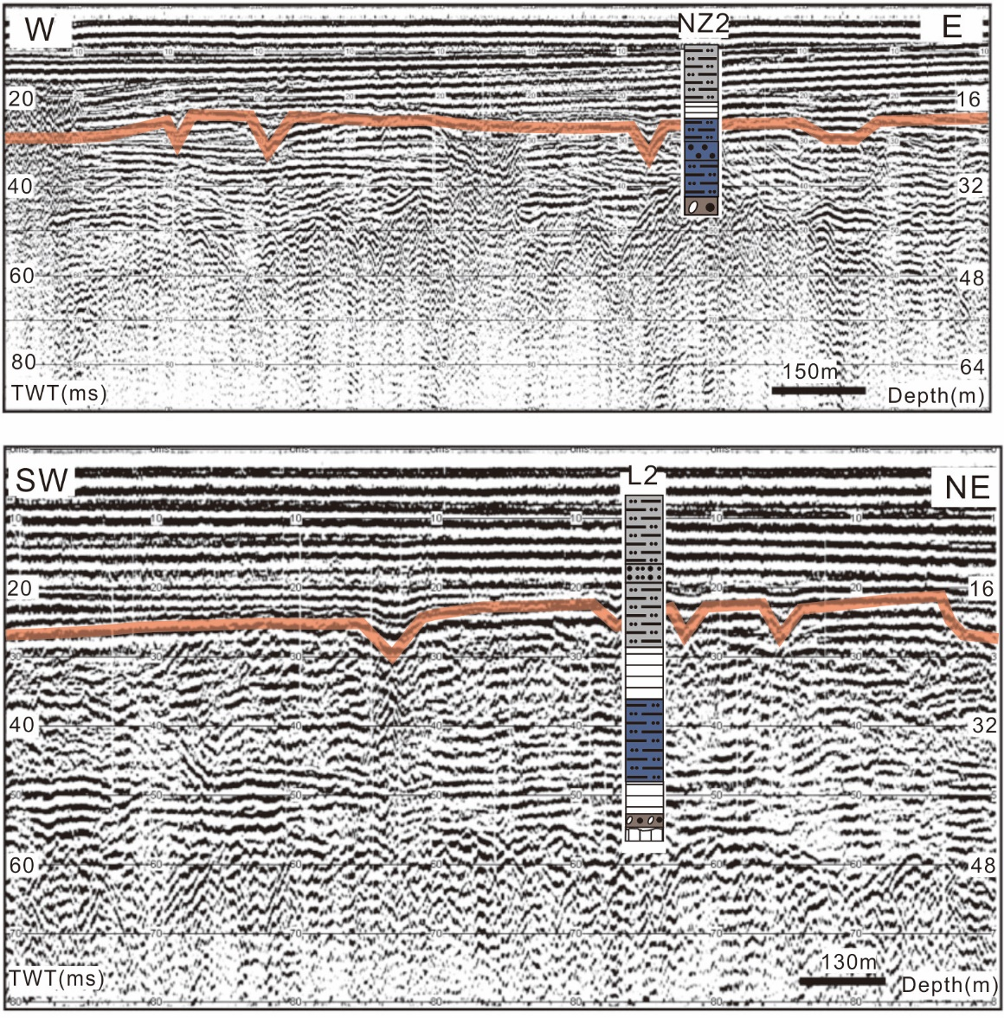
Seismic profiles
of Lingding Bay
A tidal ravinement surface exists between the depths of 16–24 m, corresponding to the infilled surface of paleo-valley.
The enhanced tidal action and low sedimentation rate lead to this middle Holocene hiatus.
Revised from Tang(2010)
Notes:
These two seismic profiles from Lingding Bay indicate that a tidal ravinement surface existes between the depths of 16–24 m, corresponding to the infilled surface of paleo-valley. Therefore, we believe that the middle Holocene hiatus was caused by the formation of tidal ravinement due to enhanced tidal actions.

Slide 9
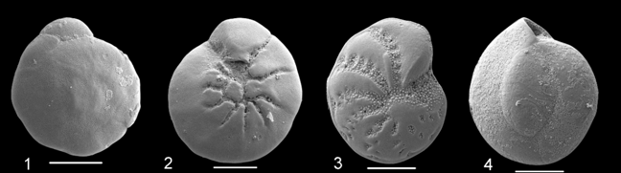
Modern distribution of foraminifera
1=inner estuary; 2=middle estuary; 3=outer estuary; 4=shallow marine
The different gray scale of circle represent different proportion of the species in the assemblage: >50%, 20-40%, 10-20%, 5-10%.
Notes:
Foraminifera are good indicator of marine influence. We summarized foraminiferal distribution of modern Lingding Bay from different publications to be the basic to interpret the record from core ZK19. With the sedimentary facies changed seaward, foraminiferal assemblages changed accordingly and the diversity of foraminifera increased.

Slide 10
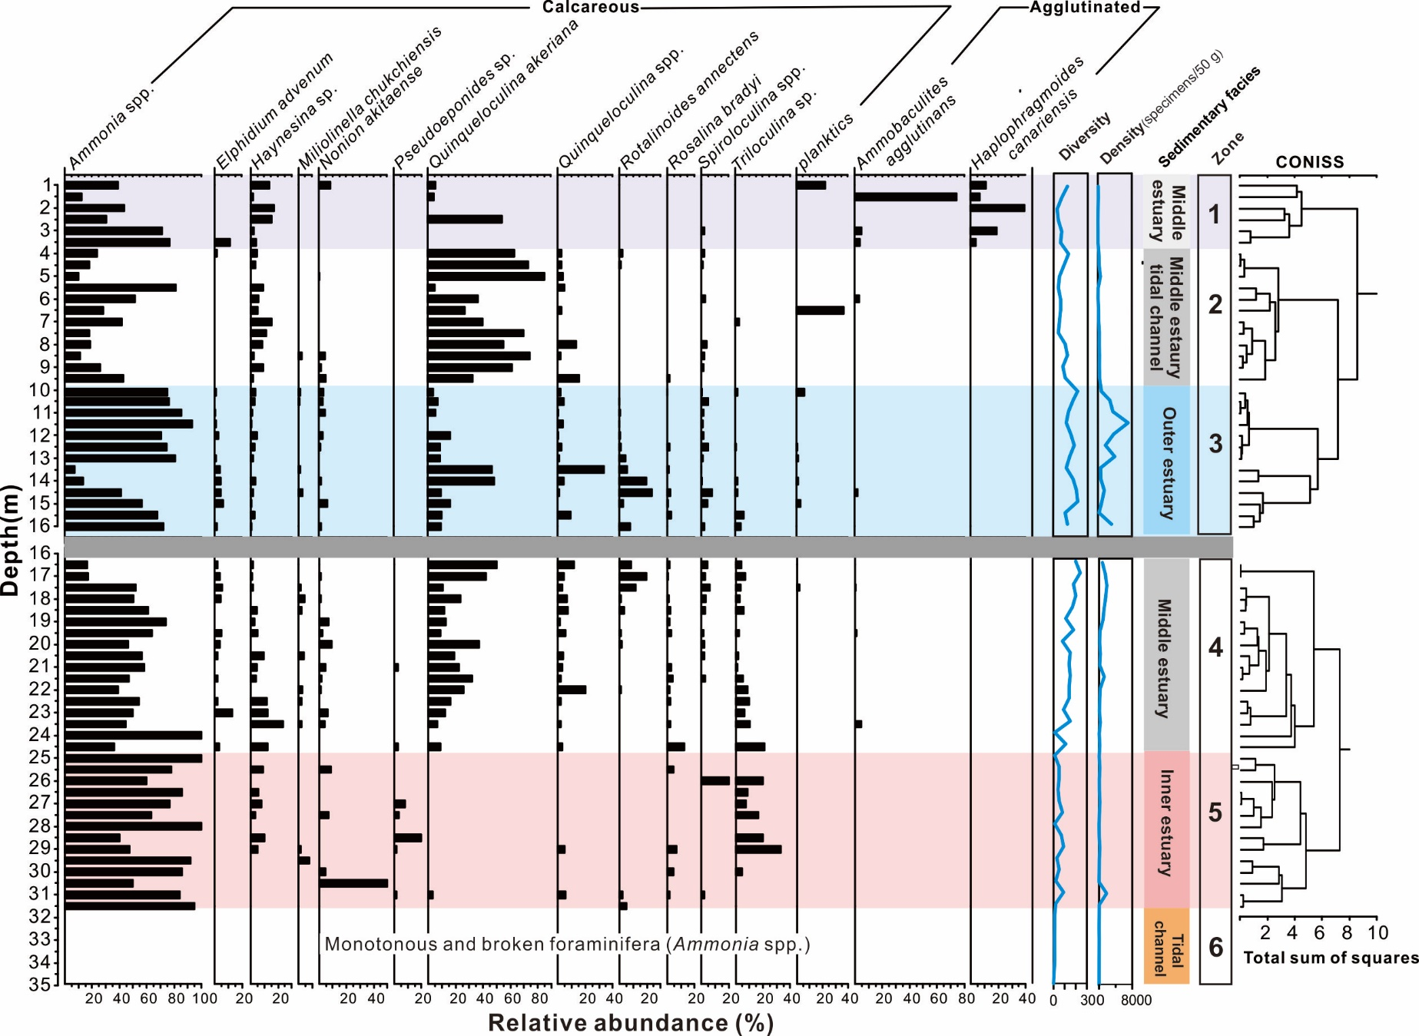
Foraminiferal record of core ZK19
Notes:
This is the foraminiferal record from core ZK19, foraminifers began to occur within the transition zone which have an upward-fining grain size, but they are monotonous and broken individuals. In the gray clay-silt sediments, foramimifers were continuous appeared with reasonable density. We used a stratigraphically constrained cluster analysis to divided these foraminiferal population. Five clusters has been recognized, corresponding to five sedimentary facies, from bottom to top were inner estuary, middle estuary, outer estuary, and middle estuary tidal channel, middle estuary shoal.

Slide 11
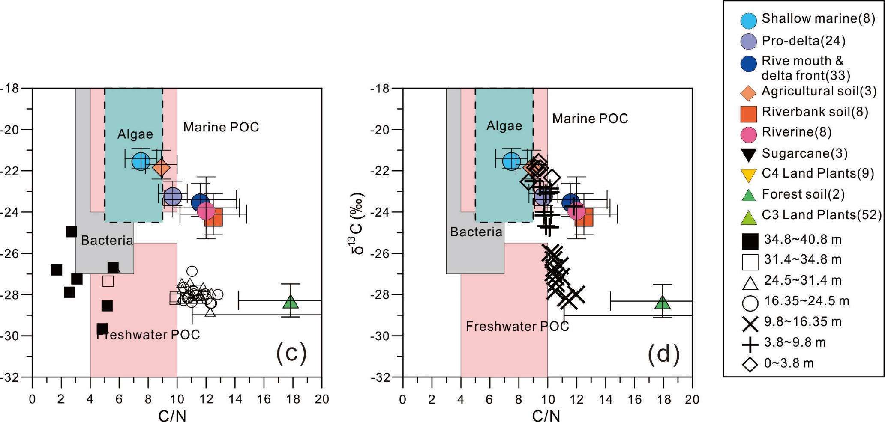
Binary diagrams of δ¹³C and C/N
Distinguish organic matter source
Terrestrial
Marine
Low δ¹³C, High C/N
High δ¹³C, Low C/N
Revised from Lamb(2006),Yu(2010)
Notes:
The binary diagrams are used to distinguish the organic matter source, except the classical defined range of marine, freshwater particle organic carbon, algae. We also summarized the δ¹³C and C/N values from the organic materials from modern Pearl River Delta, such as C3, C4 plants, and all kind of soil, and the estuarine surface sediment. We put the δ¹³C and C/N values of core ZK19 into the diagram to indicate its source, results show that there are three kinds of sources.

Slide 12
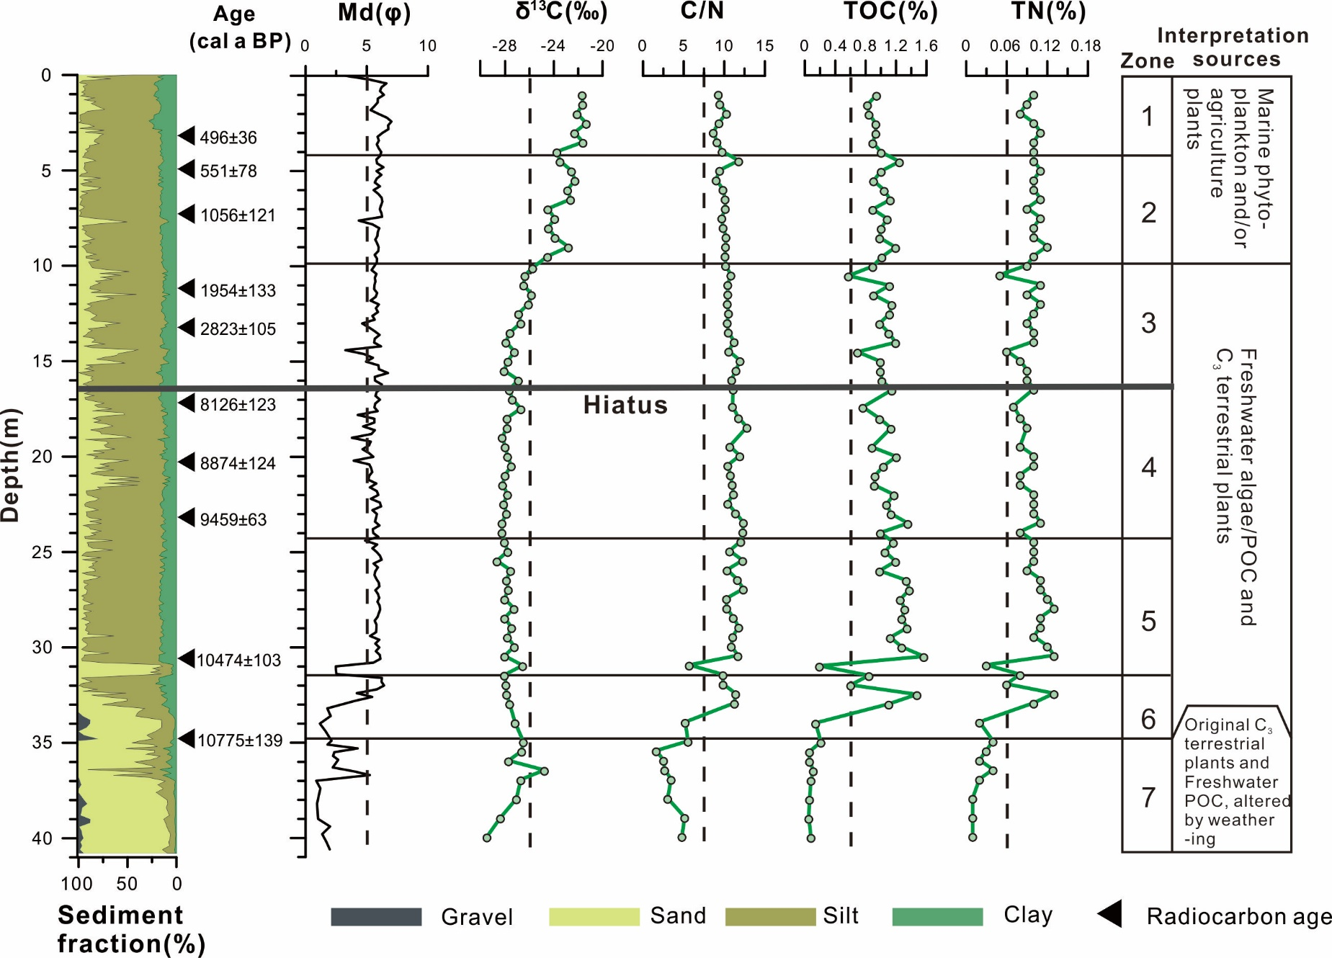
Geochemical records of core ZK19
Notes:
This figure show the vertical variation of geochemical records of core ZK19, based on the binary diagrams of δ¹³C and C/N, organic matter of the sediments are corresponded to three sources. From bottom to top there are Original terrestrial C3 plants and freshwater POC, altered by bacteria; Terrestrial C3 plants and freshwater POC; Marine POC and/or agriculture soil.

Slide 13
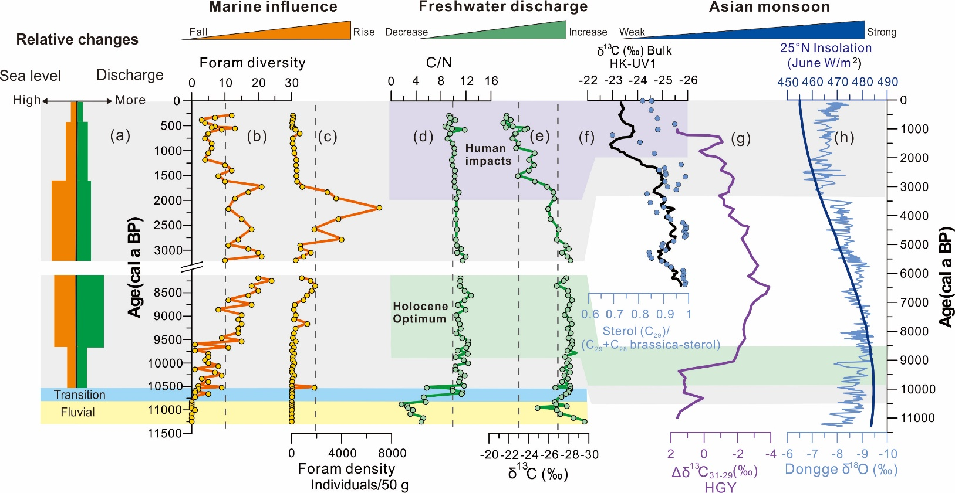
Holocene sea-level and monsoon history
Marine infulence
Freshwater discharge
Asian monsoon
Notes:
The complex diagram combined all the information. We selected classical Asian monsoon index δ¹⁸O of the stalagmite from the Dongge Cave and biomarker from Huguanyan Maar Lake to compared with freshwater discharge (influenced by precipitation) proxy. The results are quite similar, in early Holocene, sea-level rose rapidly, monsoon precipitation enhanced gradually. In late Holocene, deltaic progradation, monsoon precipitation continuingly declined , and human impacts increased in last 2000 years.

Slide 14
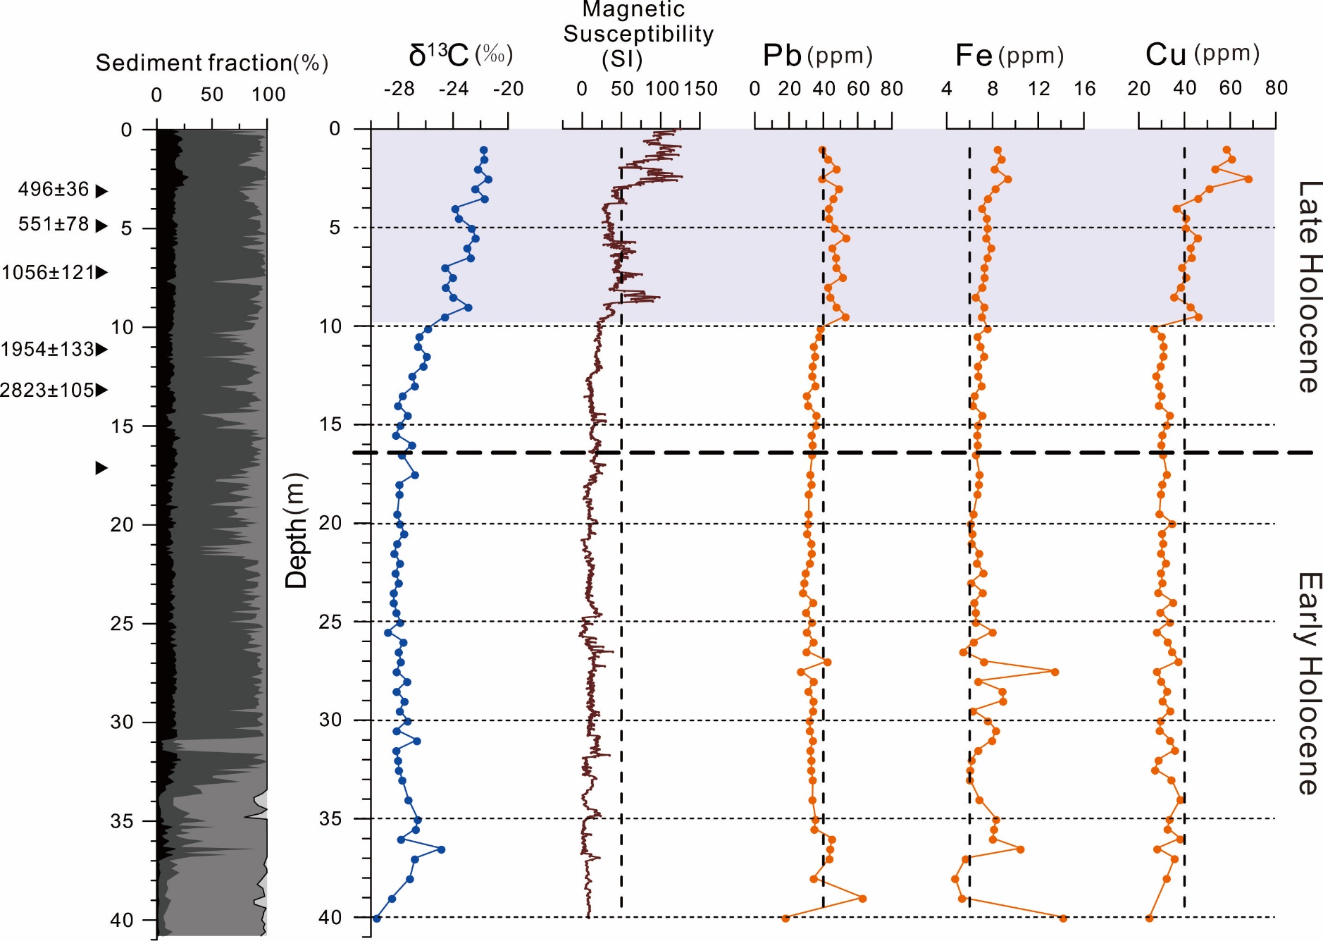
Late Holocene human impacts
Notes:
The scenario of human impacts is also supported by a synchronous increase of heavy metal elements Pb, Fe and Cu, which were introduced by use of metal tools in agricultural activity.

Slide 15
Summary
A fluvial environment was formed from ~11300 to 10800 cal a BP. Rapid sea-level rise lead to marine transgression of Lingding Bay from a fluvial to an estuarine environment from 10800 to 10500 cal a BP.
From 10500 to 8100 cal a BP, foraminifera indicated increasing marine influence. However, δ¹³C and C/N values of sediments indicated greater delivery of terrestrial material from freshwater discharge associated with an enhanced monsoon precipitation.
A sedimentary hiatus was observed in the core from 8100 to 3300 cal a BP.
In the late Holocene (3300 cal a BP to present), sedimentary facies transformed due to deltaic progradation. Increase in δ¹³C and decrease in C/N values suggested a weakening monsoon, in the last 2000 years, human activities have a big impact on the sedimentary process.

Slide 16
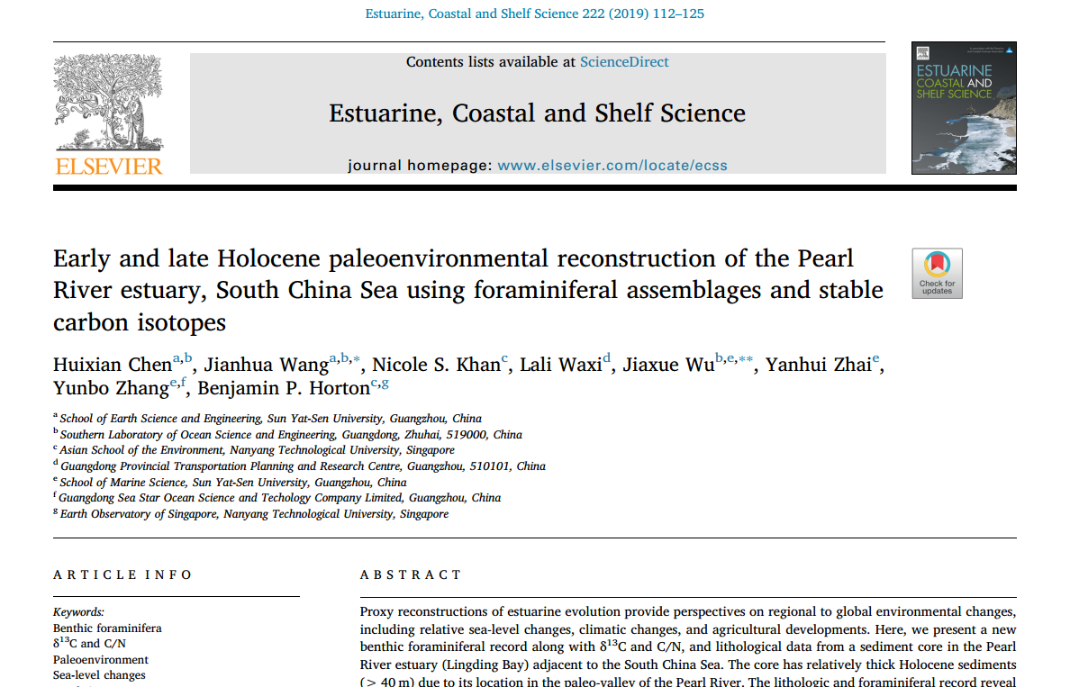
Notes:
Welcome to download the paper if you are interested in this research.

Slide 17
The end, Thank you!

