Slide 1
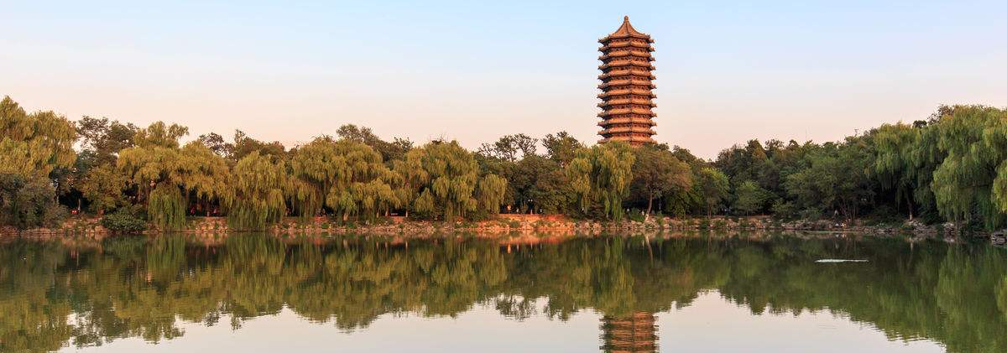
Post-fire regeneration strategies contribute to plant growth dynamics and habitat selection in subtropical monsoon fire-prone ecosystem
Caifang Luo & Zehao Shen
Department of Urban and Environmental Sciences

Slide 2
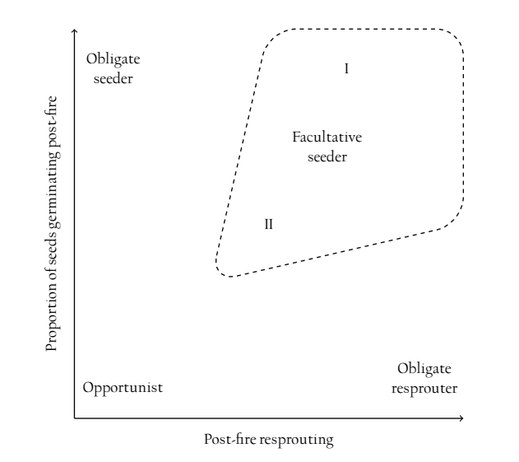
1. Introduction
Background
Niche difference is exhibited from spatial distributions along topography, nutrient or disturbance gradient (Murrell & Lawes 2003; Rosbakh et al. 2019), and temporal distributions mediated by different regeneration niche and time niche (Grubb 1977; Chesson 2000, 2018).
The variation of different PFRS species in response to fire is not well reflected in current typologies (Vivian et al. 2010).
Objective
Exploring the growth dynamics and habitat selection of the subtropical Monsoon fire-prone ecosystems after fire with different PFRS;
Disentangling the contribution of PFRS from environmental factors.
Cowan, 2010, UC Berkley

Slide 3
2. Samplings and Methods
Data samplings
Southwest China
144 plots (10*10 m²)
Four co-occurring species
(1 FS species + 3 OR species)
Statistical analysis
1 FS
3 OR
Ordination Analysis
Burl size;
Growth
Growth;
Habitat
Subclassify
PFRS
LMMs
PFRS Test

Slide 4
3. Results and Discussion — Plant Growth and Habitat Selection
The associations of Hmax, BD, HGR and BDGR were all significant (all P < 0.05).
Sprout numbers of per clump positively correlated with plant coverage and IV, and negatively related with plant BD.
Pinus and Lithocarpus performed better on the plant IV, coverage and clump density; Cyclobalanopsis had distinct advantage on Hmax, BD and growth rate.
Species occupying different topographic position and demanding different soil nutrient availability.

Slide 5
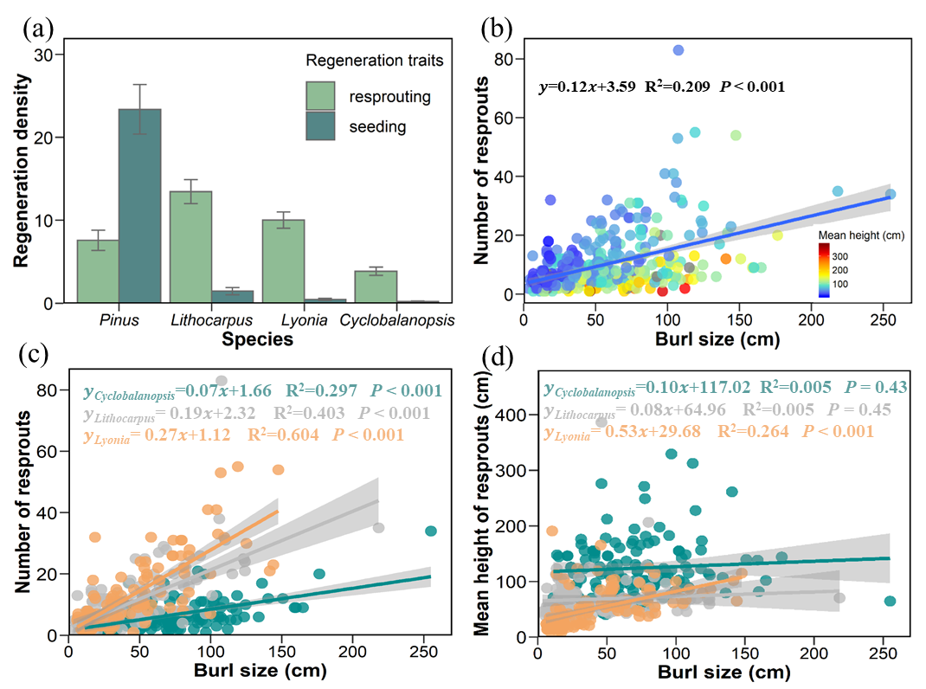
3. Results and Discussion — Subclassification of PFRS
OR species were subclassify into OR-N and OR-H by the growth priority to quantity or height.
The variations explanation all increased when the random factors were subclassification of regeneration strategies

Slide 6
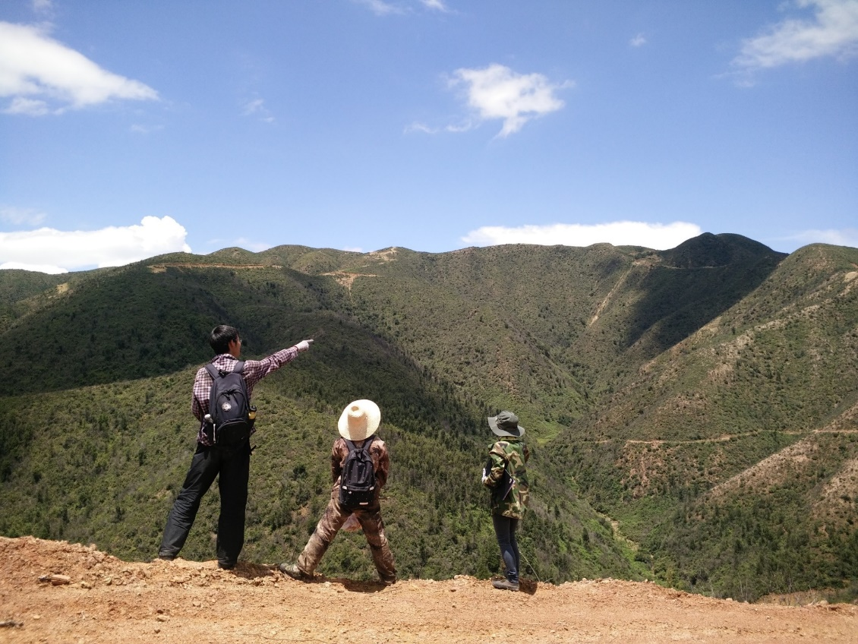
4. Conclusions
Different growth dynamics and habitat preferences of four tree species during the post-fire regeneration enables their coexistence.
Subclassification of regeneration strategies to increase the prediction power of species performance and niche partitioning.
Thanks for your attention!

