Slide 1


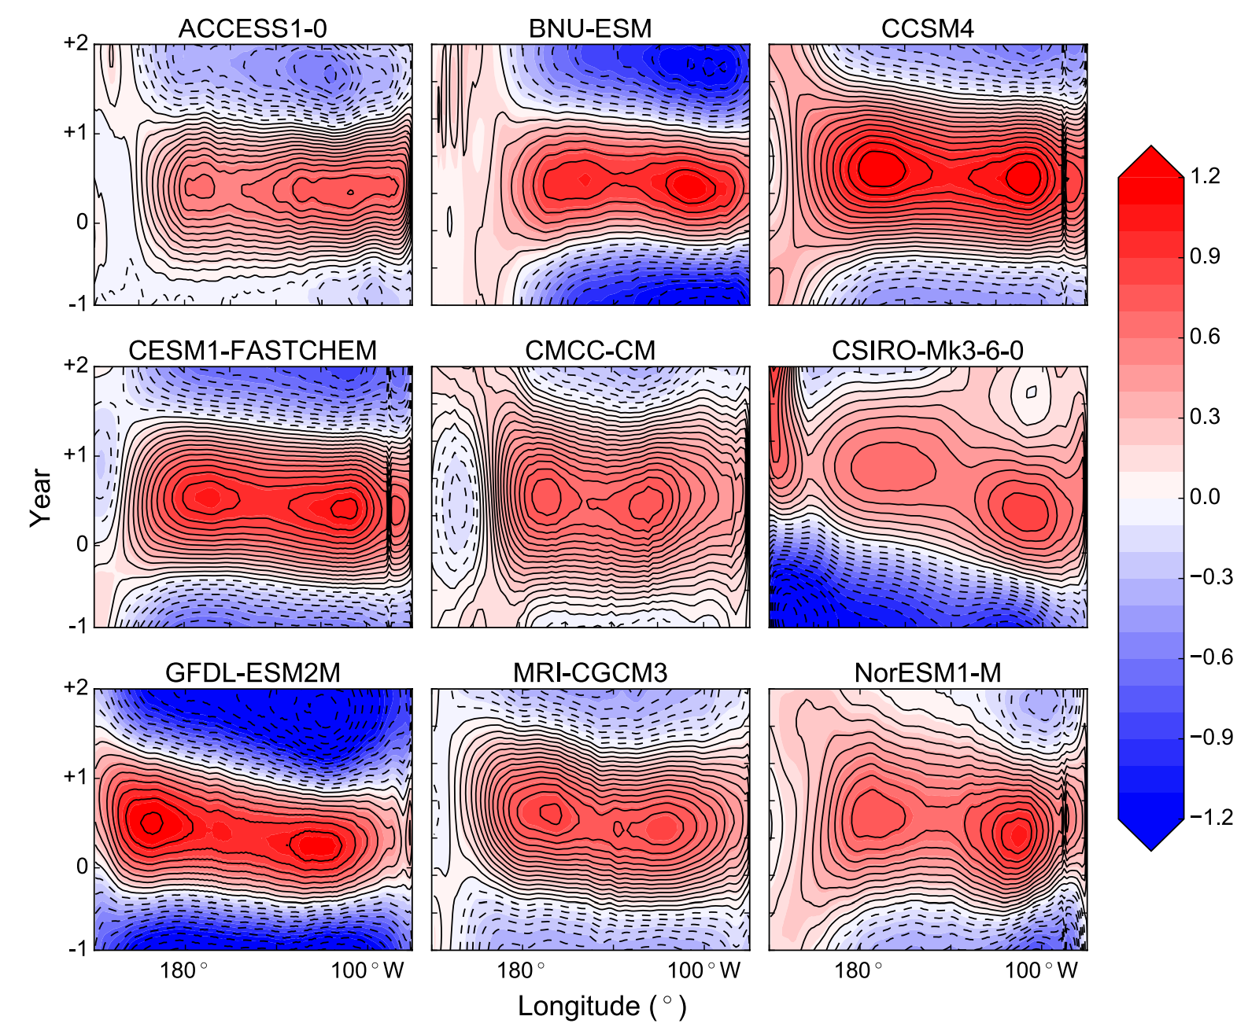
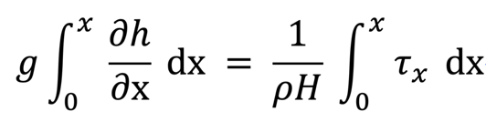
EGU 2020
Mechanism of Double Peaked El Nino
Na-Yeon Shin¹ , Jong-Seong Kug¹ , Felicity S. McCormack² , and Neil J. Holbrook²
¹ Pohang university of Science and Technology, Division of Environmental Science and Engineering, Korea, Republic of
² Institute for Marine and Antarctic Studies, University of Tasmania, Hobart, Tasmania 7001, Australia
nyshin@postech.ac.kr
Introduction
Eastern peak
Fig. 1 Evolution of SSTA(Double Peaked El Nino) in CGCM
Fig. 2 SSTA of individual Double Peaked El Nino
The biggest term is thermocline feedback term in Double peaked El Nino compared to Warm Pool El Nino.
Fig. 6 Advection terms of eastern peak
Double peaked El Nino is Two separated, concurrently grow and center of warming are identified.
Double peaked El Nino cases have been evidenced in CGCMs and are without precedent in observation.
Generating mechanism in the model results is because of the cold tongue bias. It induces westward shift of zonal SST gradient and zonal current anomalies, then western warm peak is happened.
BUT, Double peaked El Nino cases are also found in observation. Double peaked El Nino cases occur frequently after 21C. It is because of La Nina like trend under the global warming.
It can be develop by this mechanism
Then, what is the mechanism in real world ?
Stronger ITCZ precipitation
Distribution of Type
Stronger
Westerly
Wind stress
Fig. 7 Developing phase average sea level, zonal wind stress and precipitation
The types of El Nino
Higher sea level
In Eastern Pacific
DP : 02/03, 06/07, 18/19
CT : 82/83, 97/98, 15/16
WP : 86/87, 87/88, 91/92,
94/95, 04/05, 09/10
Higher
Subsurface SST
Fig. 3 Evolution of SSTA
Fig. 8 Evolution of sea level
Zonal wind stress and precipitation of Mature phase of Double peaked El Nino are very similar to Warm pool El Nino. But the SST pattern is quite different. Therefore, We need to know what difference makes this. Let’s check the developing phase.
The reason of Higher sea level in Eastern Pacific
First, the initial value of sea level is higher than Warm Pool El Nino
Western peak
Second, the slope of sea level caused by zonal wind stress is higher than Warm Pool El Nino. The black bars mean real sea level data and pink bars mean dynamic height from wind stress.
Fig. 9 sea level index and dynamic height from wind stress
Summary
Fig. 4 Advection terms of western peak
Double peaked El Nino events have different generating mechanism in the Western peak and the Eastern peak.
The biggest term is zonal advection feedback term in Double peaked El Nino and it is similar to Warm Pool El Nino.
Western peak
Zonal advection feedback term
Less Evaporation
Cooling
Eastern peak
Fig. 5 wind speed anomalies
Stronger ITCZ
precipitation
Stronger zonal wind stress
Double peaked El Nino also has negative wind speed anomalies. These can decrease the evaporation cooling. Therefore negative wind speed anomalies effect the development of warm center.
Thermocline
feedback term
Higher Sea level in Eastern Pacific

