Slide 1
The characteristics of the mid-depth striations in the North Indian Ocean
Yifan Xia, Yan Du*, Bo Qiu, Xuhua Cheng, Tianyu Wang, and Qiang Xie
Xia Y., Y. Du*, B. Qiu, X.H. Cheng, Tianyu Wang, Qaing Xie, 2020: The characteristics of the mid-depth striations in the North Indian Ocean. Deep Sea Res.-I
Notes:
abstract：
Argo float trajectory data has been used to estimate the velocities of mid-depth (1000 db) currents in the North Indian Ocean (NIO). The structure of the upper ocean absolute geostrophic currents can be derived more accurately from the Argo temperature and salinity profiles by referring to the estimated velocities rather than by assuming a level of “no motion”. The derived flow field reveals that the eastward zonal velocities generate striation-like structures in the Arabian Sea, which is most prominent above the layer of 500 db layer, with a meridional scale of ~300 km; however, such structures are barely observed in the Bay of Bengal. This meridional scale as well as the distribution of the mid-depth striations are unique to the NIO, as compared with the other ocean basins. The nonlinear 11/2-layer reduced-gravity model combined with the triad baroclinic Rossby wave interaction theory have been used to determine the essential factors controlling the characteristics of the quasi-zonal striation structure. Compared with the North Pacific Ocean, the meridional scale in the NIO is narrower, and is caused by the smaller basin size in the equatorial zone, rather than by the semiannual wind stress forcing period or the eastern boundary angle. Furthermore, the coastal trapped Kelvin waves significantly contribute to the generation of the zonal striations in the Arabian Sea

Slide 2
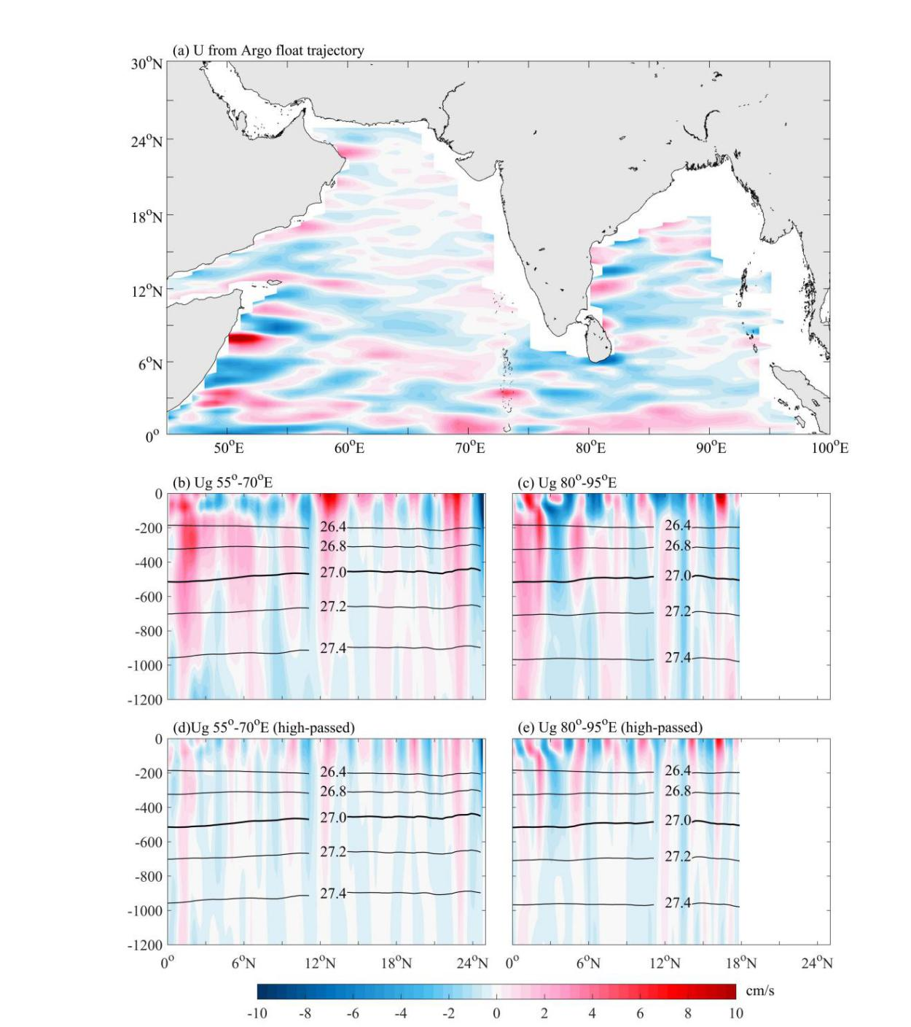
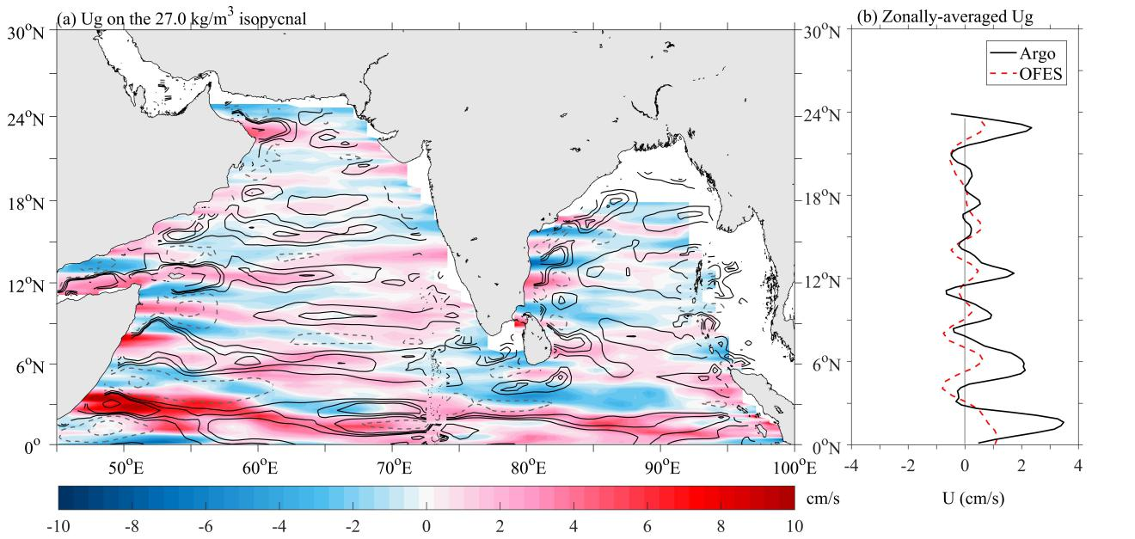
Does the striation-like structure exist in the Indian Ocean?
The eastward zonal velocities have a striation-like structure in the Arabian Sea, while barely observed in the Bay of Bengal.
zonal velocity at 1000db
vertical structure
(color shading: Argo observations contour: OFES simulations)
high-pass filtered
The locations of the eastward/westward jets derived by the OFES simulation are consistent with the Argo observations

Slide 3
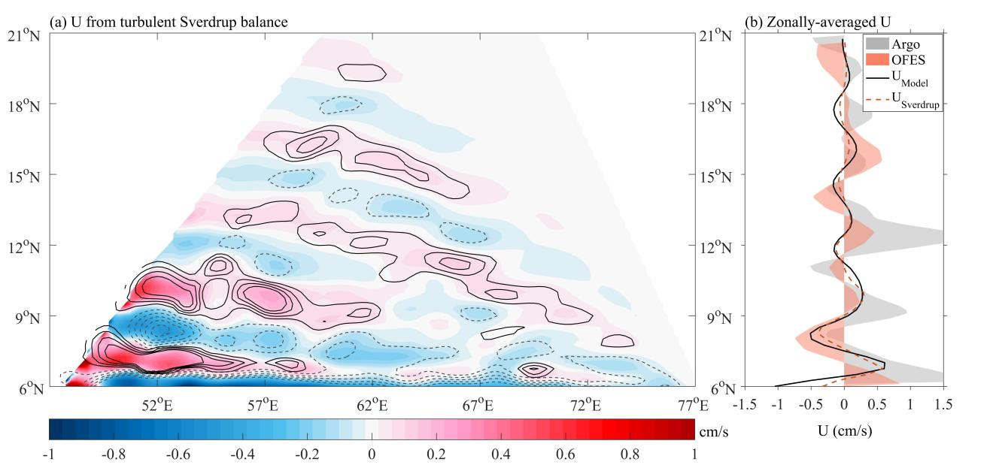
The result from the nonlinear 1 1/2 layer reduced gravity model
How does the striation generate?
The convergence of eddy potential vorticity fluxes contributes to the mean flow across the mean potential vorticity gradient (Turbulent Sverdrup balance, Rhines and Holland, 1979).

Slide 4
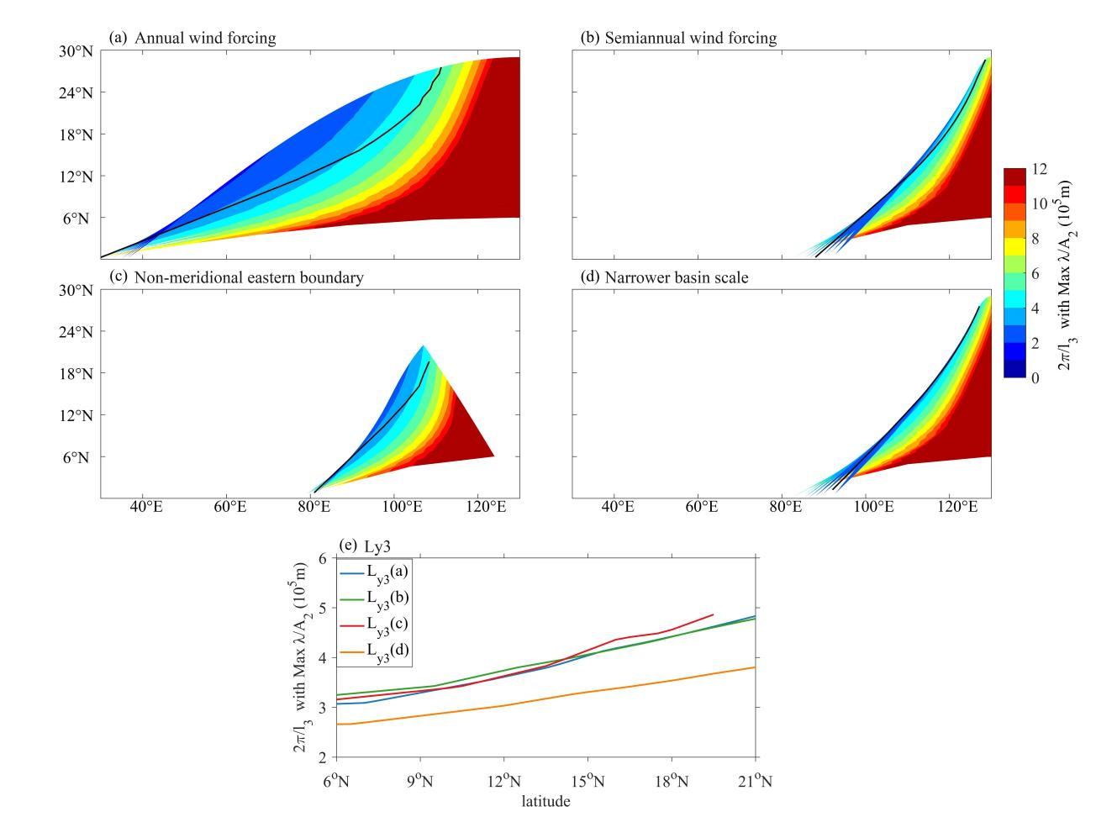
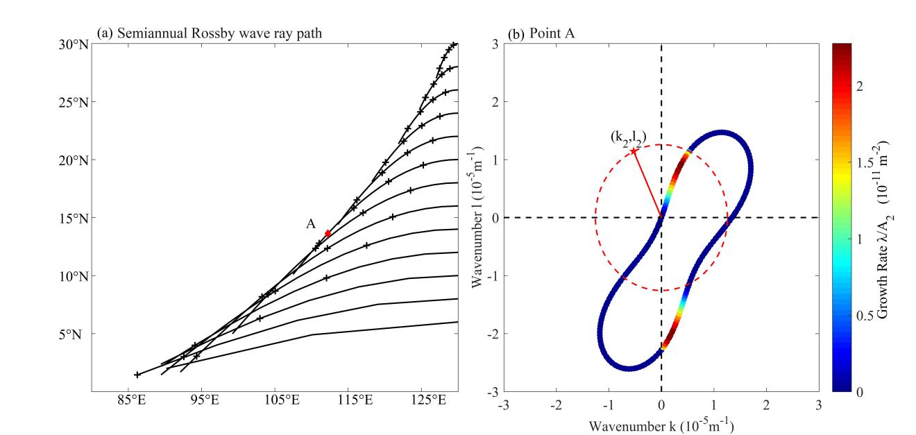
Baroclinic Rossby wave ray path theory
Triad baroclinic Rossby wave interaction theory
（Schopf et al., 1981）
The black lines indicate the locations where the advection time scale of the primary baroclinic Rossby wave equals to the e-folding time scale of the secondary waves.
What controls the meridional scale of the observed striations?
The narrower meridional scale in the NIO is due to the smaller basin size in the equatorial zone.
(Pedlosky, 1987and Qiu et al. , 2013b)
Notes:
References :
Schopf, P. S., D. L. T. Anderson, and R. Smith, 1981: Beta-dispersion of Low-frequency Rossby Waves. Dyn. Atmos. Oceans, 5, 187-214. doi:10.1016/0377-0265(81)90011-7.
Pedlosky,J., 1987:Geophysical Fluid Dynamics. Springer-Verlag, 710 pp.
Qiu, B., S. Chen, and H. Sasaki, 2013b: Generation of the North Equatorial Undercurrent Jets by Triad Baroclinic Rossby Wave Interactions. J. Phys. Oceanogr., 43, 2682-2698. doi:10.1175/jpo-d-13-099.1.

