Slide 1
The impact of Ghislain de Marsily in nuclear waste management
Jordi Bruno and Salvador Jordana

Slide 2
A personal note
JB met Ghislain de Marsily very early in his career, around the mid 80’s
As a young researcher immediately got attracted by the combination of rigour and sympathy that emanated from GdM and although I never collaborated with him directly (but a lot through E. Ledoux) I always thought that he was one of this people that gives you the key concepts you need to know when dealing with a scientific or technological issue.
The 1977 paper in Science is a basic compendium of what were at that point the key issues regarding radioactive waste management and introduced the key elements of what has become the French concept of geological disposal of reprocessing waste.

Slide 3
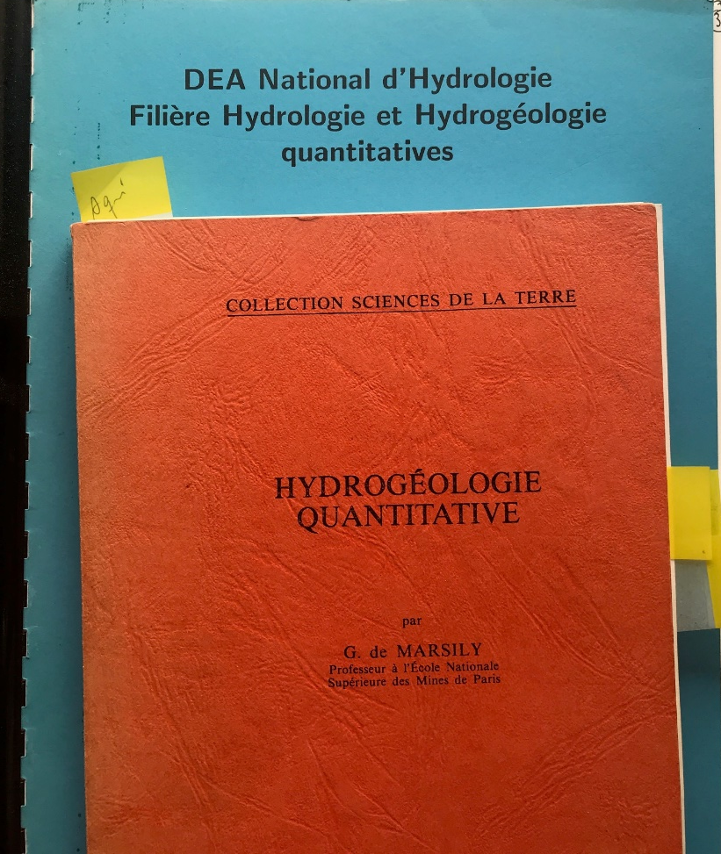
A personal note
As a student, Salvador Jordana met Ghislain de Marsily during the 1991’s edition of the DEA National d’Hydrologie held at the Université P. et M. Curie and at the École de Mines de Paris.
Despite the fact that other students and people who knew him had already told me, I was captivated by his level and ability to teach, his closeness, and the ability to listen, help and bring out the best in people, while still being demanding, rigorous and very respectful.
Thanks to GdM and my colleagues from the DIREN of Orléans I definitely took the path of hydrogeology.
GdM gave me the opportunity of a one-year stay at the University of Québec, and later it allowed me to meet Jordi Bruno.

Slide 4
From Quantitative Hydrogeology to Nuclear Waste Management
In 1977 GdM published a seminal paper in Science which had a strong influence on the development of nuclear waste management concepts, particularly in France.

Slide 5
From Quantitative Hydrogeology to Nuclear Waste Management
In that paper a number of key concepts were introduced:
Vitrification of reprocessing waste
Alternatives for nuclear waste management were presented by finally deep geological disposal recommended
The comparison between radionuclide decay half-lives and geological times
The authors discussed the lifetime of the three main barriers:
The waste barrier
The steel container
The geological barrier
Incidentally, they indicated that the lifetime expectancy of the steel container was relatively short, hundreds of years and therefore it should not be considered

Slide 6
From Quantitative Hydrogeology to Nuclear Waste Management
In that paper a number of key concepts were introduced:
Concerning the role of the glass matrix, they already pointed out some of the key mechanisms for radionuclide migration inside:
Fickian diffusion
Soret effect
The authors also discussed what we know would define as the safety functions of the rock
Total confinement
Confinement beyond the decay time of most radionuclides
Retardation by the rock so that radionuclides reach the biosphere at a safe rate
They introduced the concept of waste retrievability

Slide 7
From Quantitative Hydrogeology to Nuclear Waste Management
The authors also discussed probabilistic vs deterministic safety assessments and they dismissed the idea of random geological events (like faulting)
Introduction of groundwater movement as the key process in radionuclide migration
They introduced sorption as the main retardation process
and clay as the preferred geology from groundwater movement point of view.
They introduced the Oklo phenomenon and pointed out the difficulty of establishing the boundary conditions some 2000 million years ago!

Slide 8
From Quantitative Hydrogeology to Nuclear Waste Management
In conclusion, in that seminal paper GdM and colleagues brought about some of the key concepts we have been walking through in the last 40 years.

