Slide 1
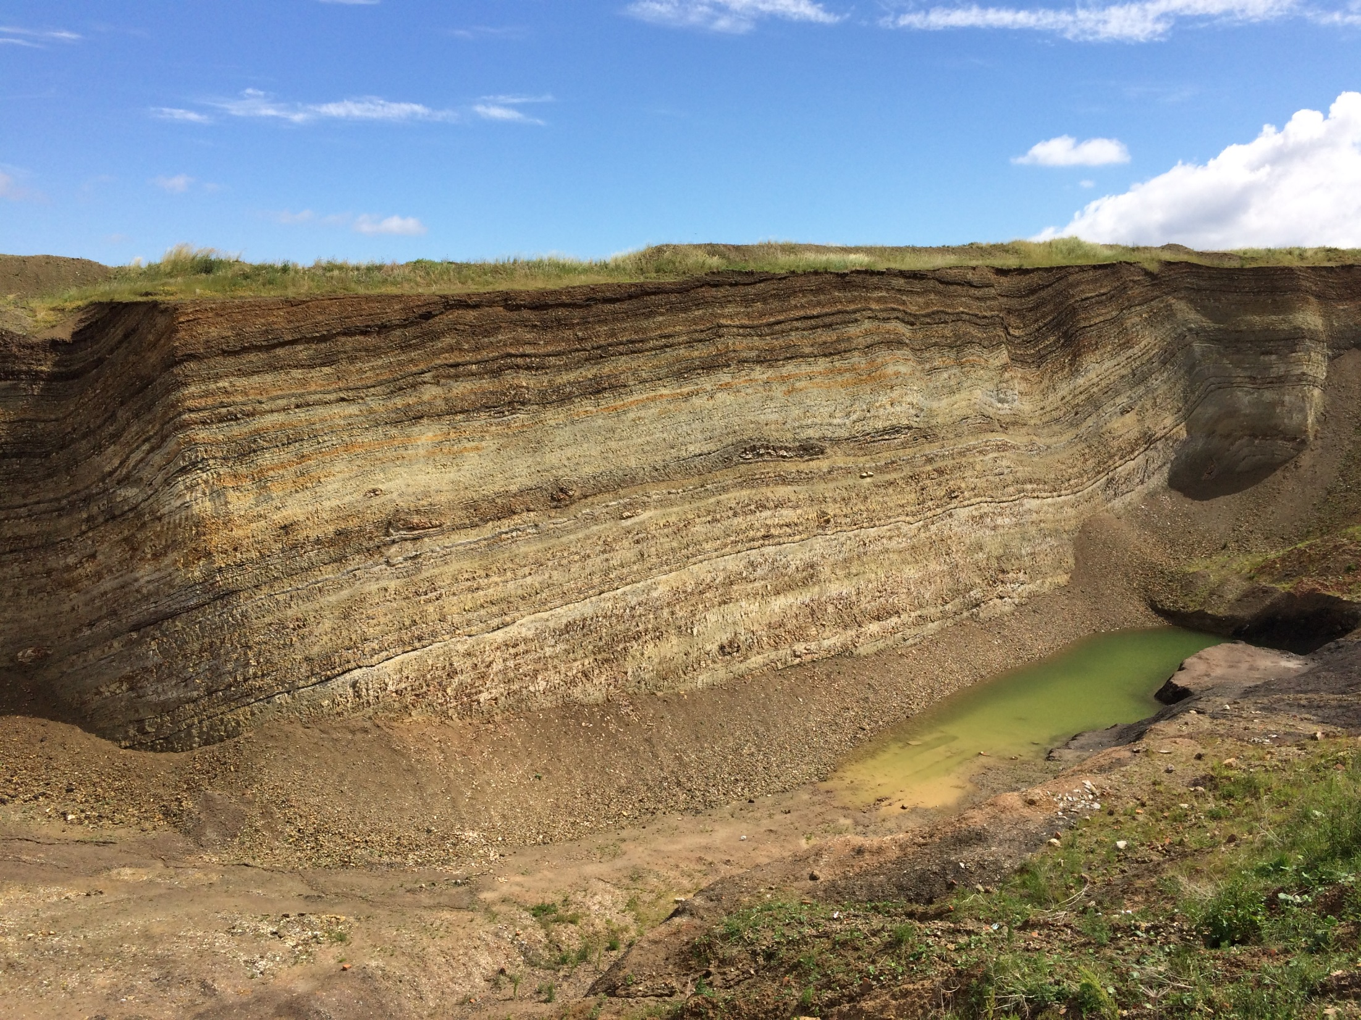

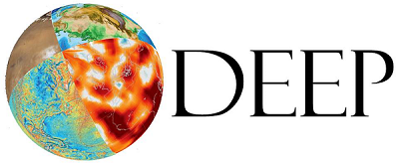
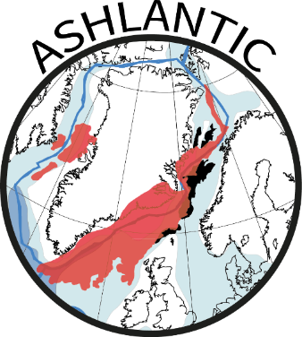

Constraining North Atlantic Igneous Province (NAIP) activity during the late Paleocene and early Eocene
Morgan Jones, Ella Stokke, Lars Augland, Sverre Planke, Henrik Svensen (University of Oslo)
Philip Pogge von Strandmann, Emma Liu (University College London)
Tamsin Mather, Jack Longmann (University of Oxford)
Alan Rooney (Yale University)
Jessica Whiteside (University of Southampton)
Jessica Tierney (University of Arizona)
Christian Tegner (Aarhus University)
Bo P. Schultz (Fur Museum, Denmark)

Slide 2


Covid-19 Limitations
Sadly, some of the results we hoped to present cannot be shown as the papers are still in review or in preparation.
Instead, we will highlight the ongoing work of the project Ashlantic.
This is also a call for potential collaboration. We are in the process of applying for funding for ICDP and IODP drilling projects in Denmark and the Norwegian margin. If successful, we hope to have core material covering the mid-Paleocene to Oligocene. If this is of potential interest, please get in contact.

Slide 3
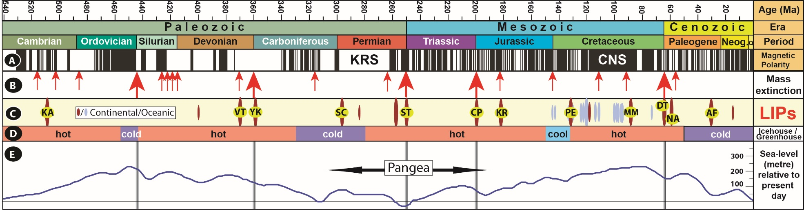
LIPs and Climate Change
(Jones et al, 2016)
There is a temporal correlation between Large Igneous Provinces (LIPs) and mass extinctions
This suggests a possible causal relationship
Therefore, we need to understand how LIPs can potentially drive rapid climate change

Slide 4
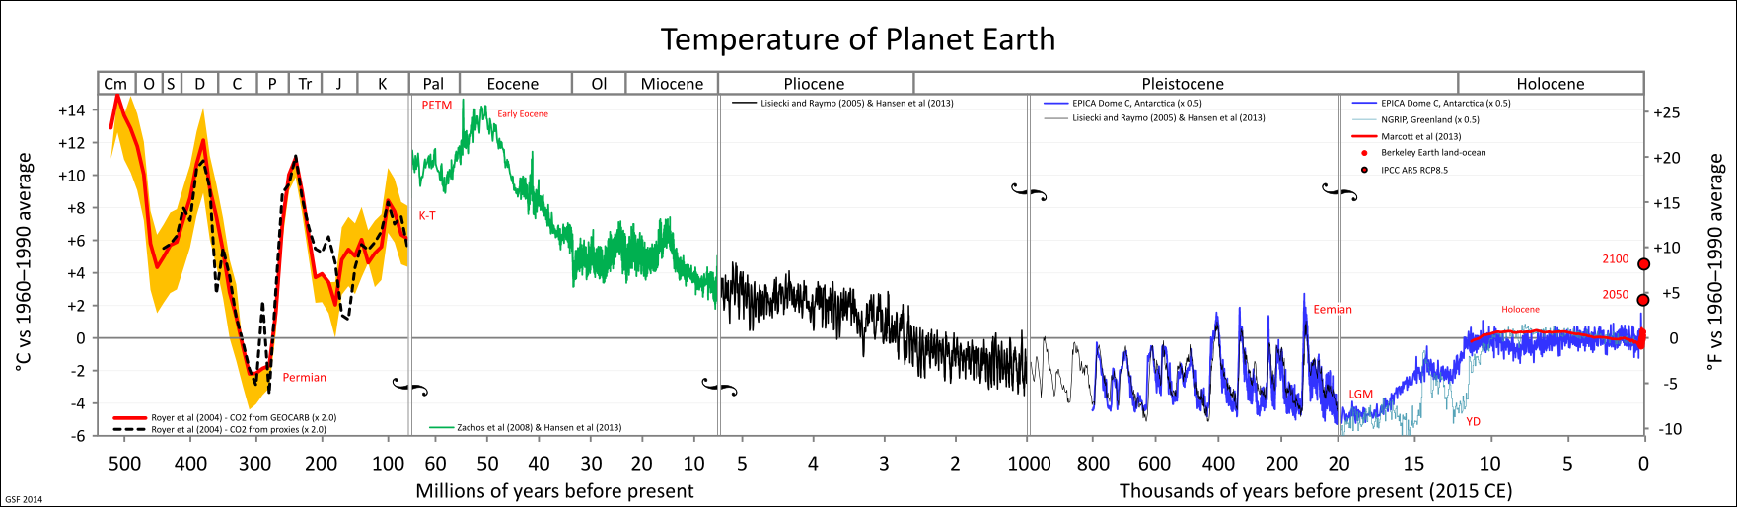
The Paleocene-Eocene
(by Glen Fergus)
The Warmest Surface Temperatures in the last 60 Ma
Largest hyperthermal event is called the
Palaeocene-Eocene Thermal Maximum (PETM)

Slide 5
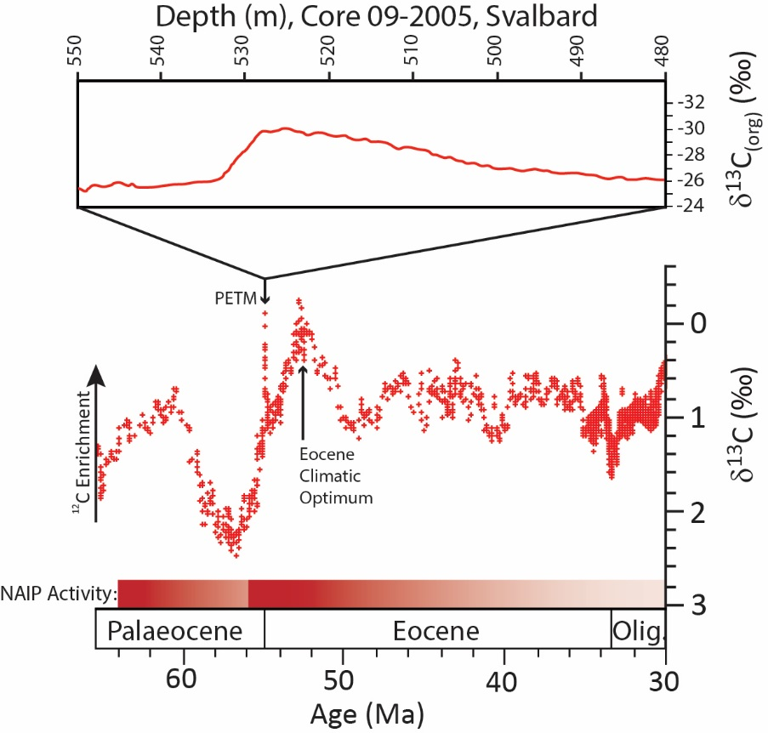
The PETM
Global negative carbon isotope excursion (3-5‰)
Rapid and sustained warming
4-6 °C globally, locally >10 °C
CO₂ Degassing Estimates
Warming requires two doublings of CO₂ in climate models
Rough estimates:
7000-10000 Gt C
(Zachos et al, 2005, Charles et al, 2011)

Slide 6
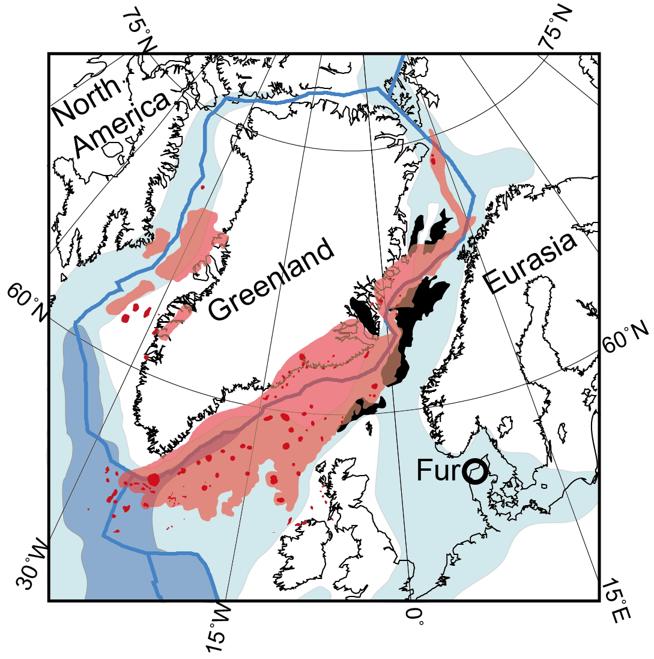
North Atlantic Igneous Province
Closely associated with the break-up of the North Atlantic
6-10 x 10⁶ km³ magma emplaced
~80 of volume emplaced between 56-54 Ma
Thick lava flows, large intrusions, central complexes, tephra layers
Explosive eruptions are among the largest recorded

Slide 7
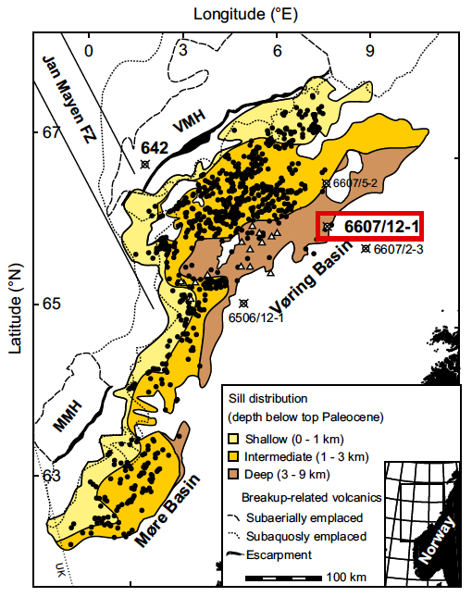
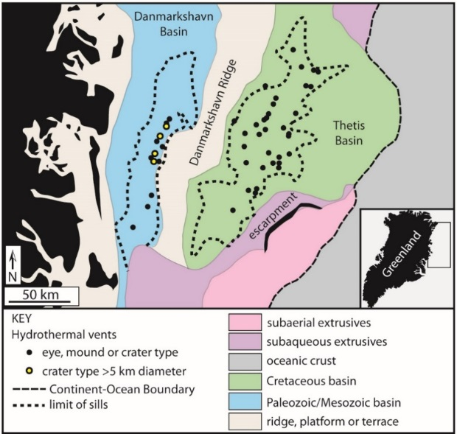
NAIP Activity - Intrusions
Reynolds et al. (2017)
Svensen et al. (2004)
Extensive degassing from contact metamorphism around the Paleocene-Eocene boundary

Slide 8
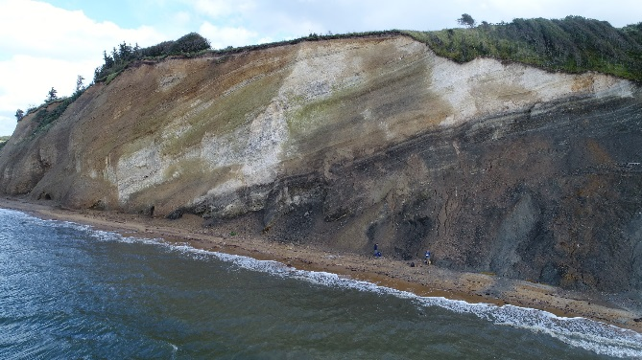
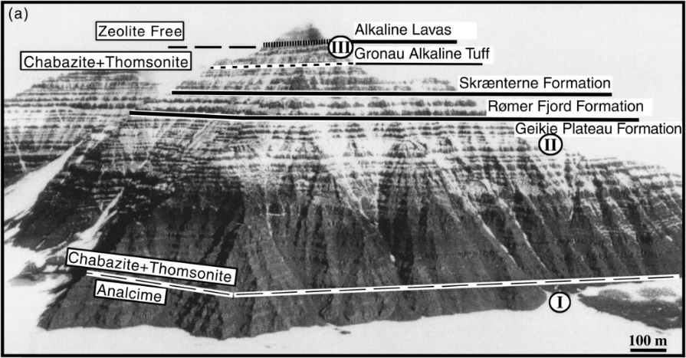
NAIP Activity - lavas
Skaergaard began crystallization at 56.02 Ma (Wotzlaw et al., 2012)
Skaergaard buried by 5.3-6.3 ±2.7 km of basalts as it crystallized (Larsen & Tegner, 2006)
Ash -17 in Denmark dated to 55.6 ± 0.12 Ma (Storey et al., 2007)
Ash -17 matches the Gronau Tuff at the top of the East Greenland lavas (Heister et al., 2001)
Significant eruptive activity from 56.0 to 55.6 Ma
Larsen & Tegner (2006)

Slide 9
Fur Island, Denmark: An ideal PETM locality
Close enough to the NAIP to record volcanic and climatic proxies in the same section
Expanded sections allow for decadal (possibly even annual) resolution
Thermally immature sediments: numerous inorganic and organic proxies can be used
Hundreds of tephra layers present, which allows high precision tephrochronology

Slide 10
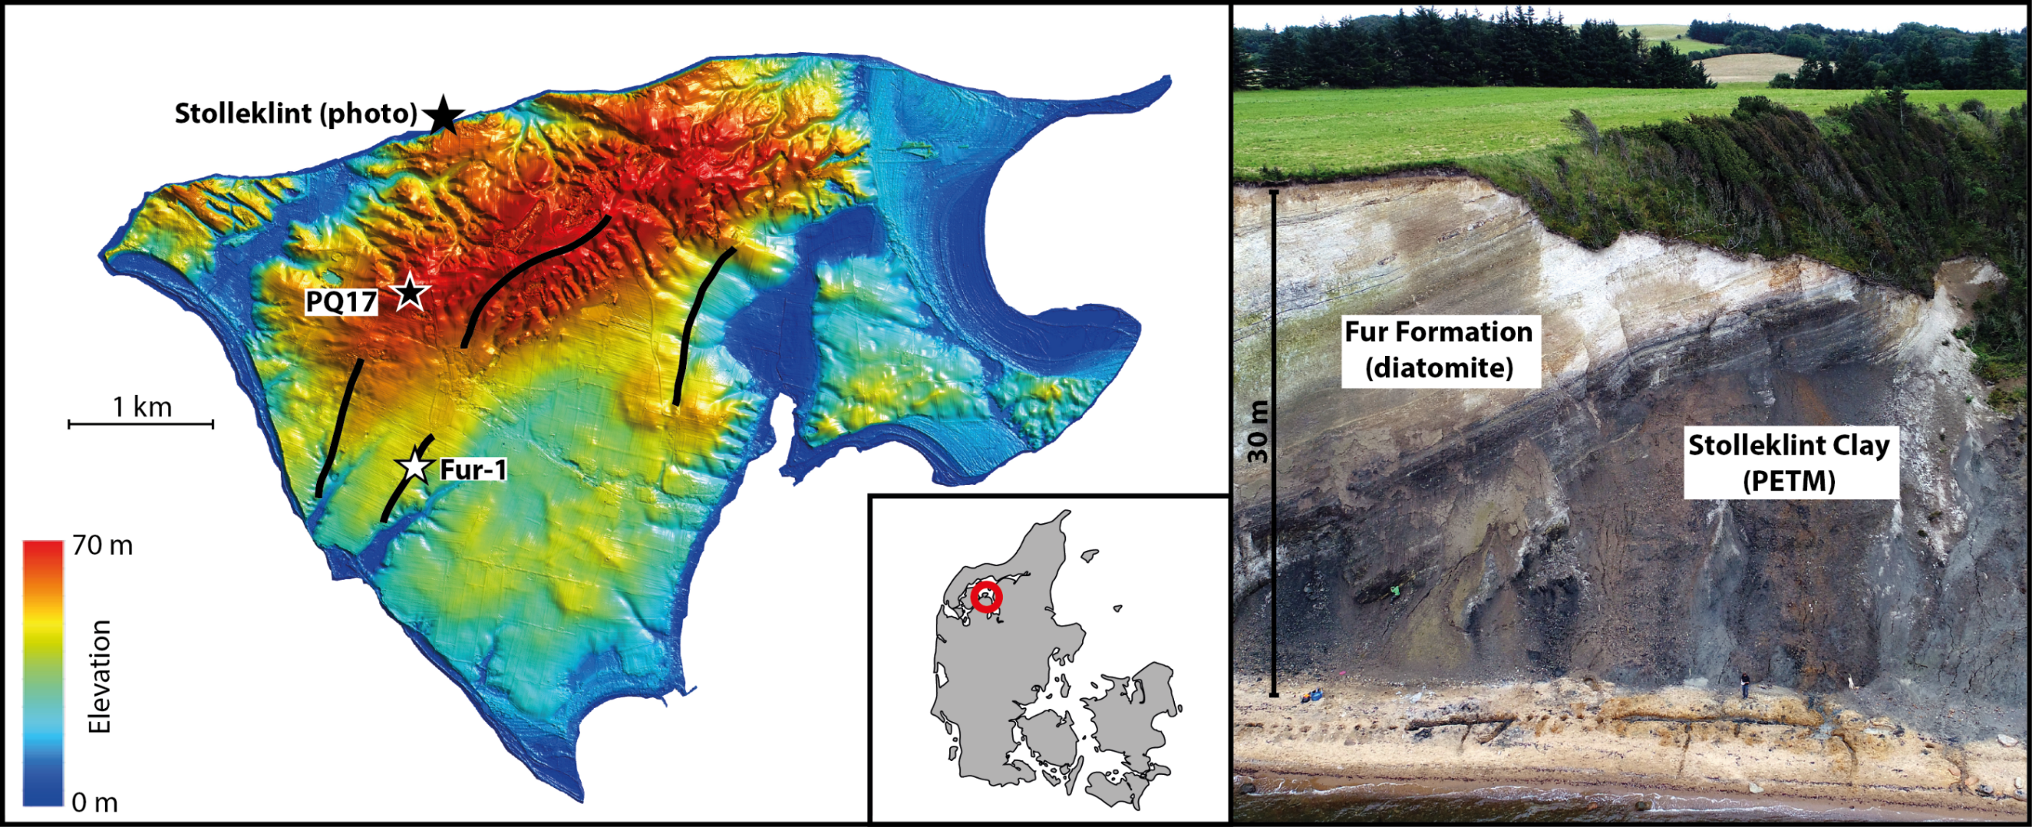
Fur Island: An ideal PETM locality
The Stolleklint Clay (PETM) & Fur Formation (Eocene) are well preserved on Fur Island
PETM section is 24 m thick and has experienced nearly no diagenesis

Slide 11
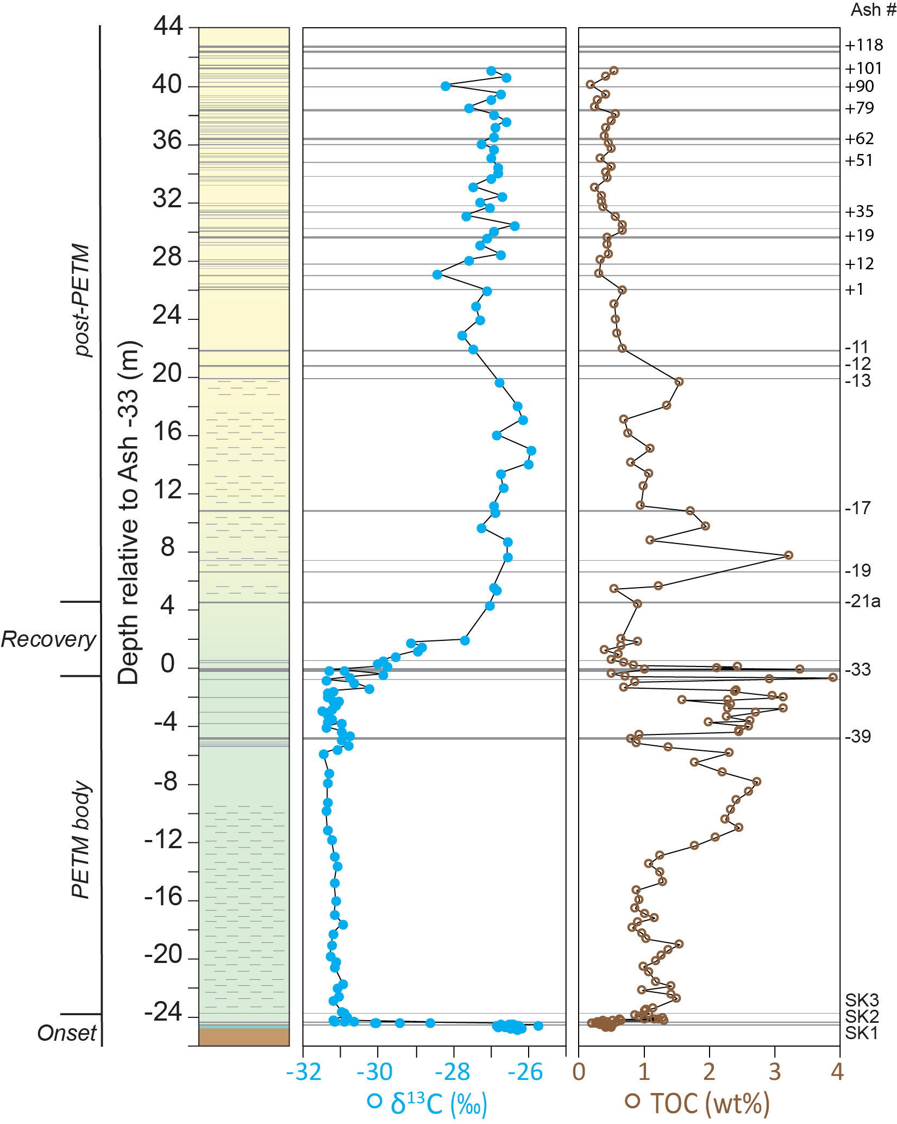
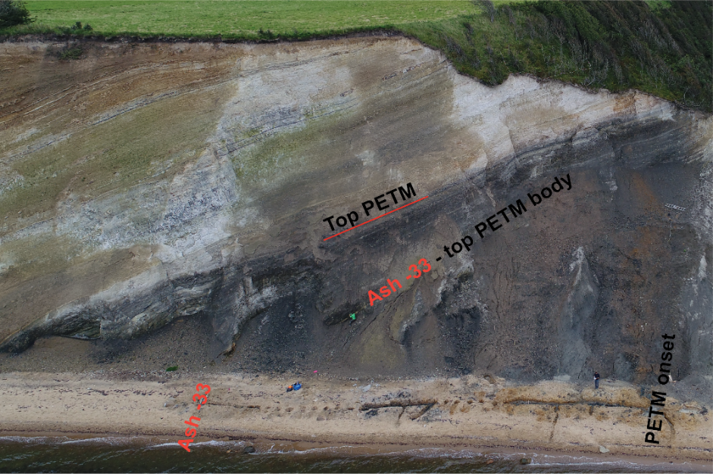
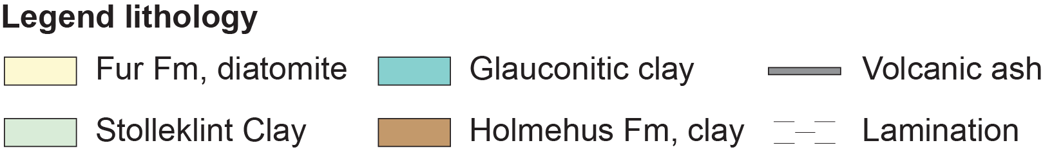
Stolleklint Beach Section
Stokke et al. (in review)

Slide 12
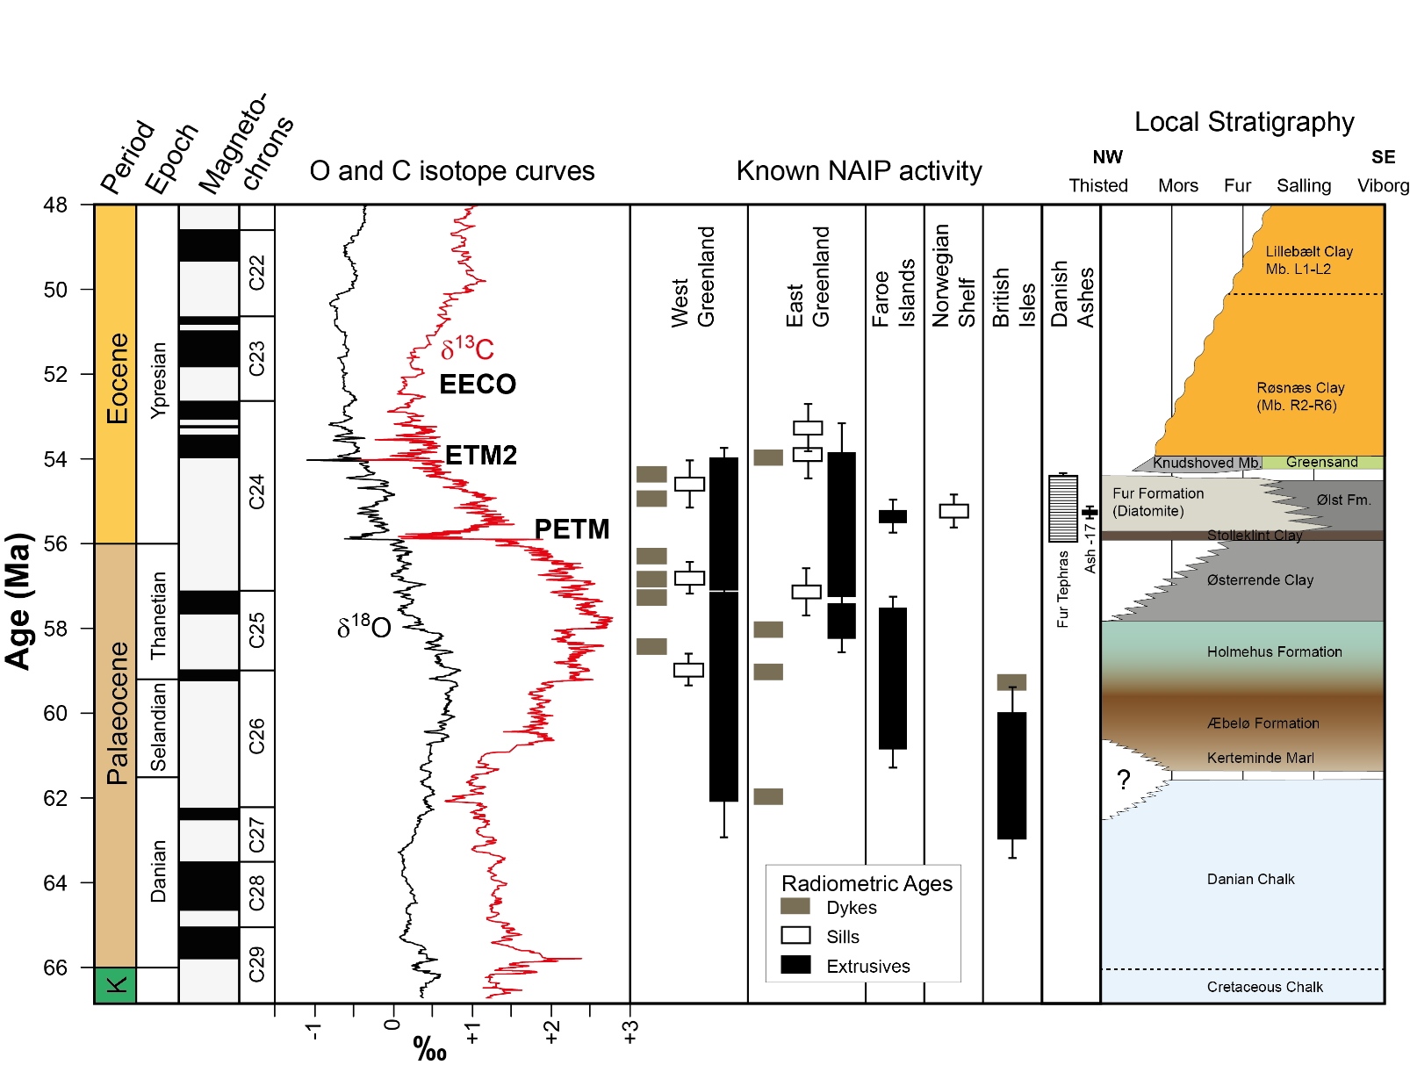
Volcanic Proxies
Danish sequence contains over 180 ash layers
Exceptional tephra preservation
Other key volcanic proxies present (Hg, Ir, ¹⁸⁷Os/¹⁸⁸Os)
Stratigraphy from Claus Heilmann-Clausen

Slide 13
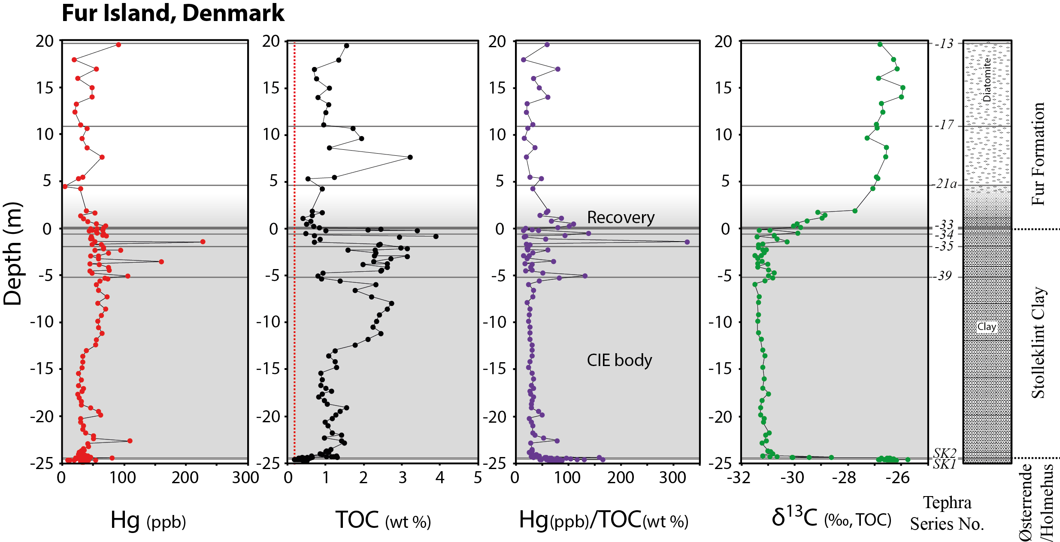
Hg Anomalies: Fur, Denmark
Mercury anomalies coincide with tephra-rich intervals before and after the PETM, but importantly they are absent from the PETM body on Fur Island (Jones et al., 2019)

Slide 14
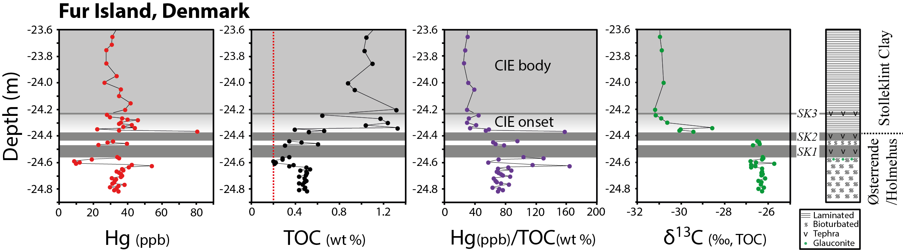
Hg Anomalies: Fur, Denmark
Hg anomalies at the PETM onset. There is at least a 10 x increase in sedimentation rates into the body of the PETM, so the timing of the onset of volcanic activity prior to the PETM onset is currently poorly constrained. (Jones et al., 2019)

Slide 15
Recent & Upcoming work
Pogge von Strandmann et al. (in review). Lithium isotope evidence for enhanced weathering and erosion during the Palaeocene-Eocene Thermal Maximum. Proceedings of the National Academy of Sciences (PNAS).
Stokke et al. (in review). Temperature changes across the Paleocene-Eocene Thermal Maximum – a new high-resolution TEX₈₆ temperature record from the Eastern North Sea Basin. Earth and Planetary Science Letters.
Longmann et al. (in review). Widespread diagenesis of volcanic deposits accelerated termination of the Paleocene-Eocene Thermal Maximum. Nature Geoscience.
Heimdal et al. (2020). Thermogenic carbon release from the Central Atlantic Magmatic Province caused major end-Triassic carbon cycle perturbations. Proceedings of the National Academy of Sciences (PNAS), in press.
Berndt et al. (2019). Breakup volcanism and consequences for climate change – MagellanPlus Workshop report. Scientific Drilling, 26, 69-85.
Jones et al. (2019). Mercury anomalies across the Palaeocene–Eocene Thermal Maximum. Climate of the Past, 15 (1), 217-236.

Slide 16
Future Work
Is
Hydromagmatic origins of basaltic tephra layers in Denmark (Stokke et al., in prep.)
Volcanic proxies and Os isotopes in pre-PETM sediments (Jones et al., in prep.)
Improved geochronology of the PETM using U-Pb dating of tephra layers (Jones et al., in prep.)
Constraining weathering intensity in the Stolleklint Clay during the PETM (Stokke et al., in prep.)
Sadly we cannot present the preliminary data here, but we would be happy to chat with you about this work either in the EGU session or elsewhere
There are several areas of possible collaboration going forward:

Slide 17
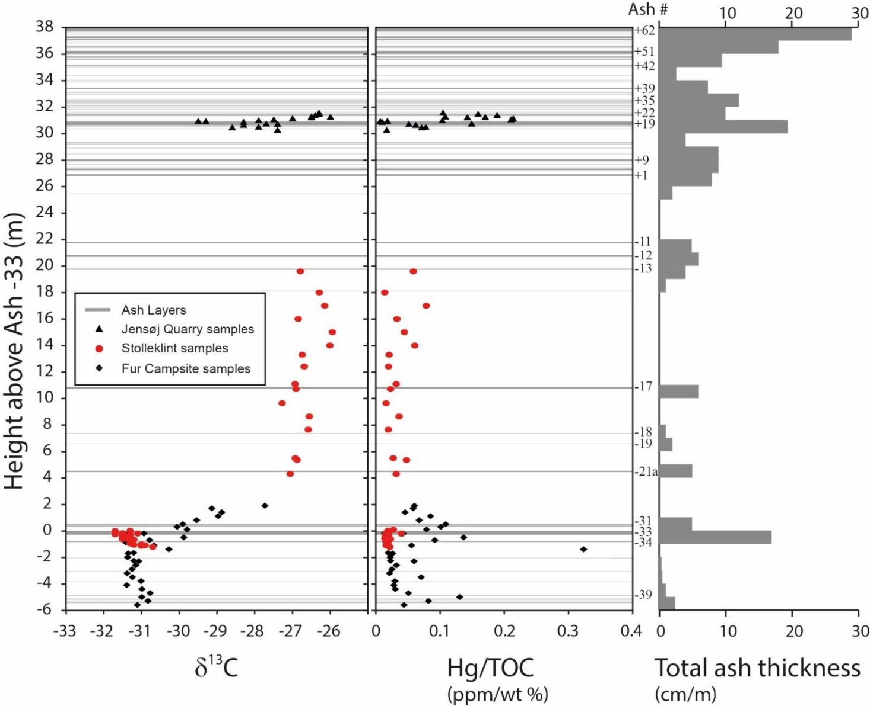
Improved Geochronology
Is
Ash +19 = ~55.5 Ma
(U-Pb; Jones et al., in prep.)
Ash -17 = 55.6 ± 0.12 Ma
(Ar/Ar; Storey et al., 2007; corrected)
Ash -31(?)* = 55.765 ± 0.086 Ma
(U-Pb, Charles et al., 2011)
*Svalbard
U-Pb dating is ongoing. We have material for Ar/Ar dating if a lab wants to collaborate

Slide 18
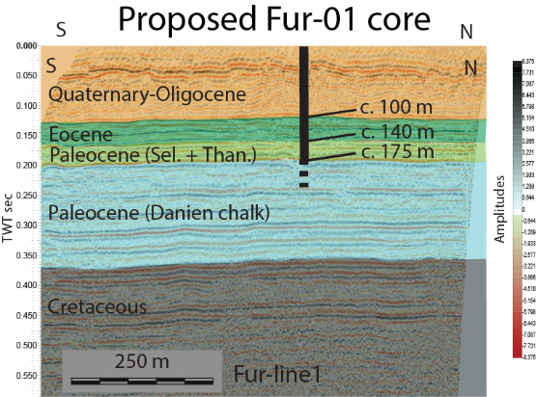
ICDP Application
Current ICDP application (PVOLC) to drill entire Paleogene sequence (including pre-PETM)
If successful, collaborations welcome!

Slide 19
IODP Application
Current IODP application (P944-Full2) to drill Vøring Basin and Norwegian margin (see Berndt et al., 2019)
If successful, collaborations welcome!

Slide 20

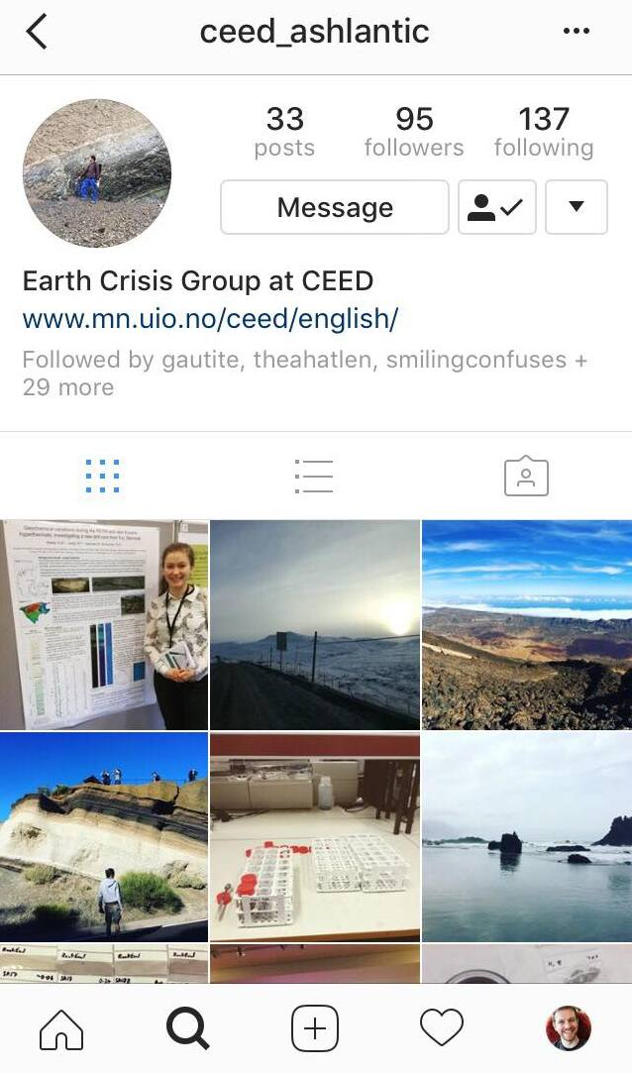
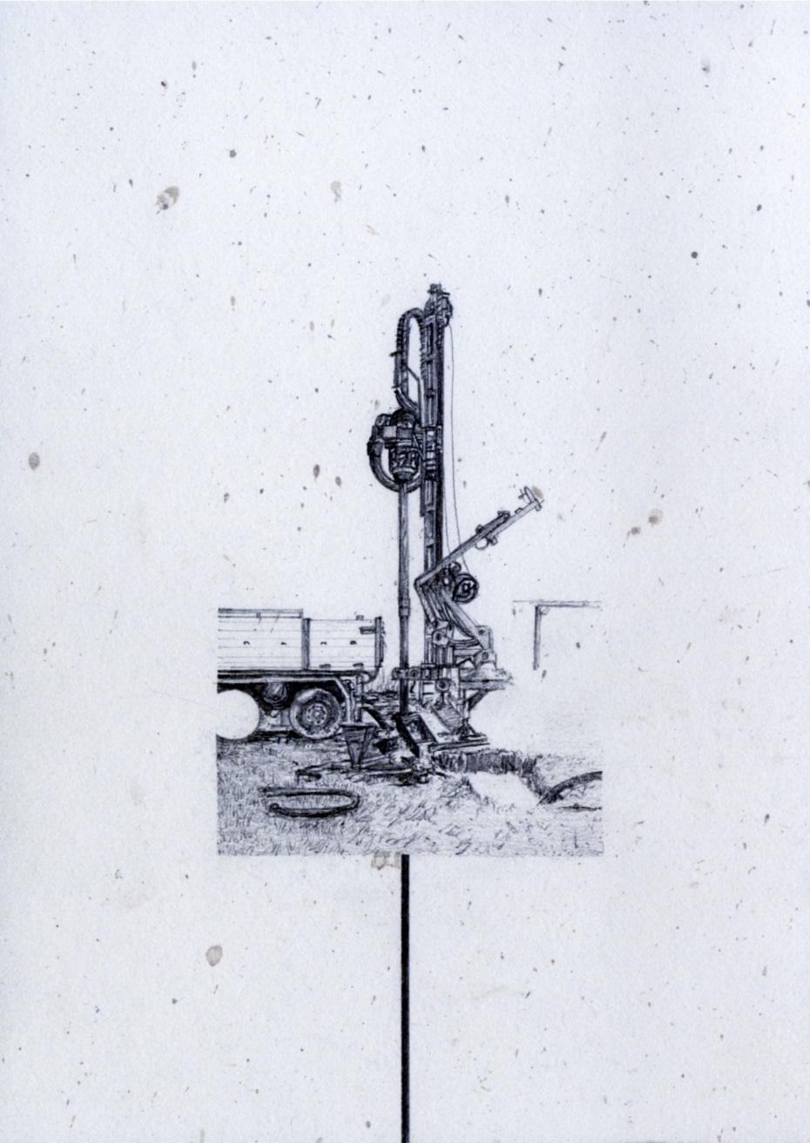
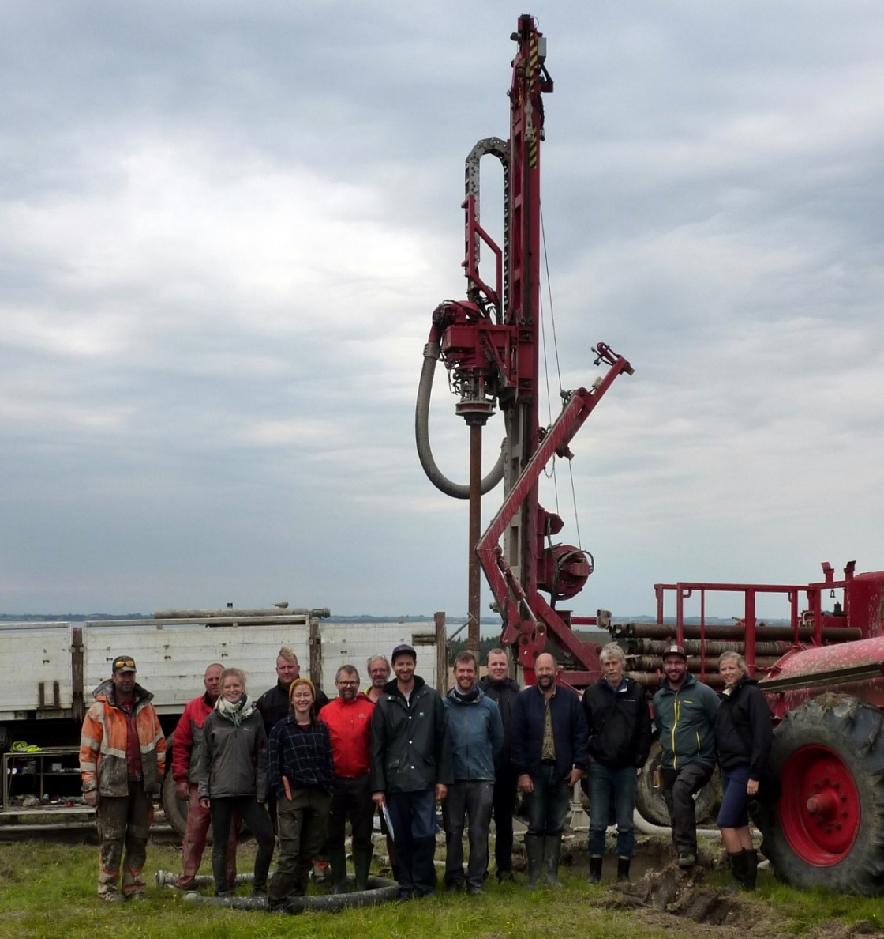
Project ASHLANTIC
Follow us on Instagram to find out more about our work
Artist in Residence:
oliviajonesartist.com

