Slide 1





Interaction of exogenous microbial inoculum with soil organic matter fractions
Luciano Beneduce, Cesar Plaza, Stefano Trotta, and Claudio Zaccone
D1987 | EGU2020-6731

Slide 2

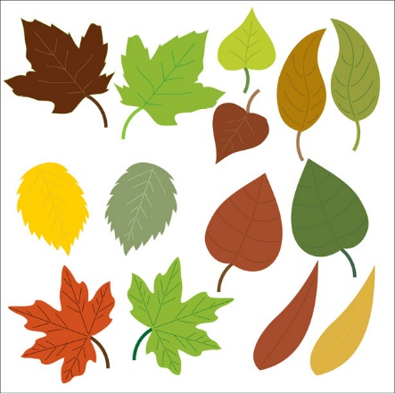
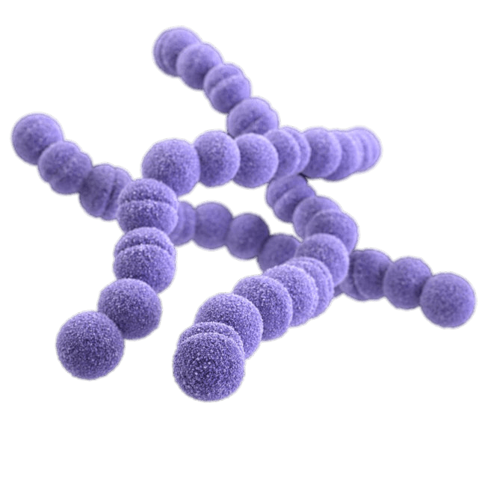

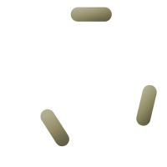

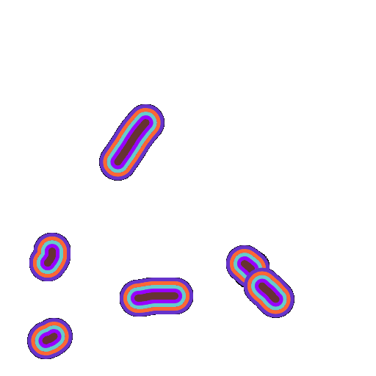

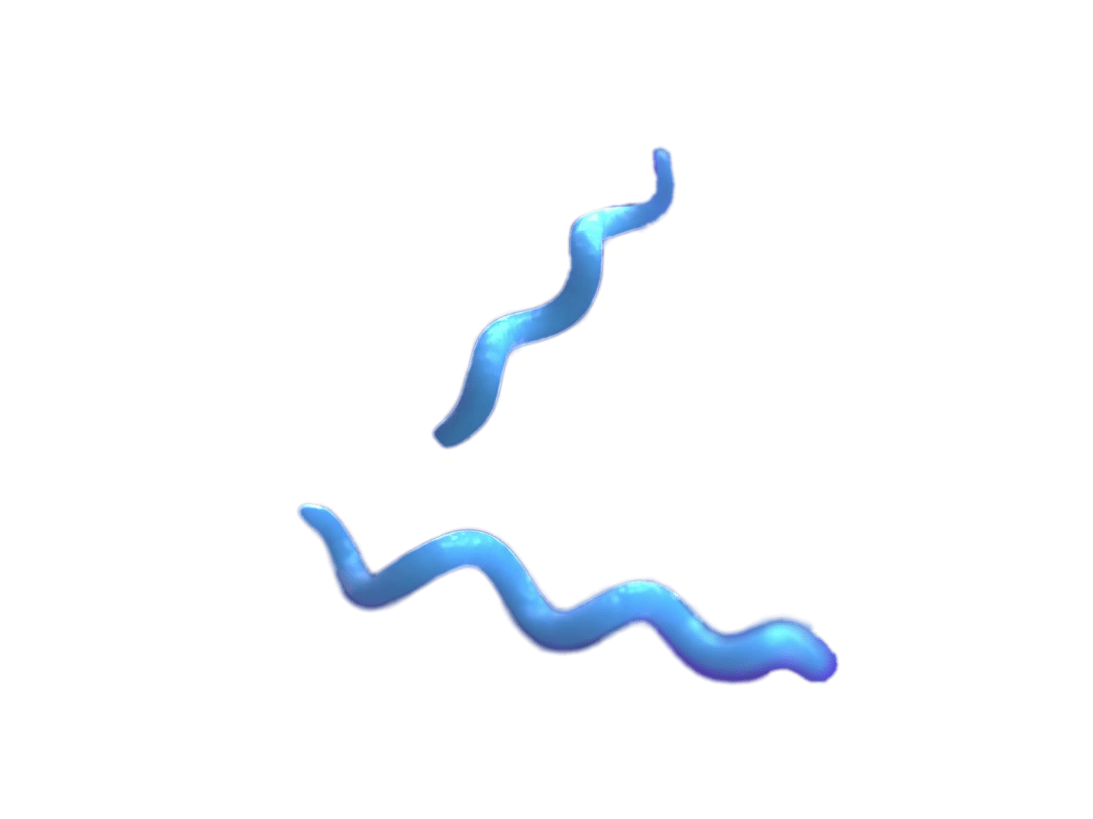

Uneven distribution of Microbial DNA in SOM pools
Different levels of DNA protection from degradation
Diverse ecological niches for soil microbiota
The fate of Microbial DNA turnover in SOM depends on both degradation and regeneration paths
modified from Zaccone et al., 2018, App. Soil Ecol.

Slide 3
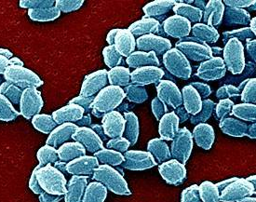
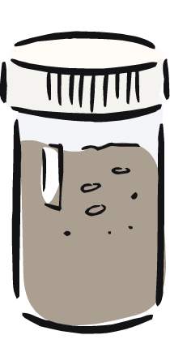
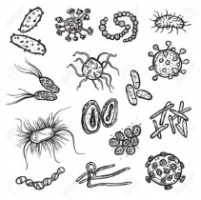
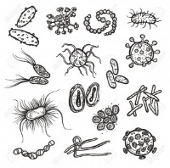
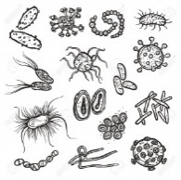
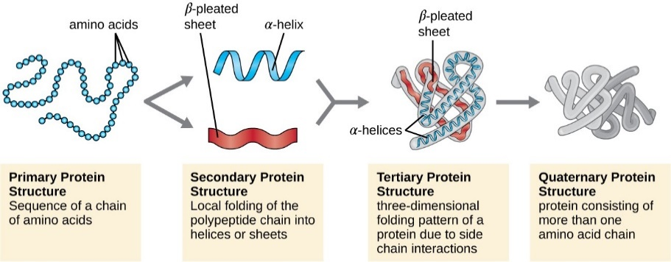
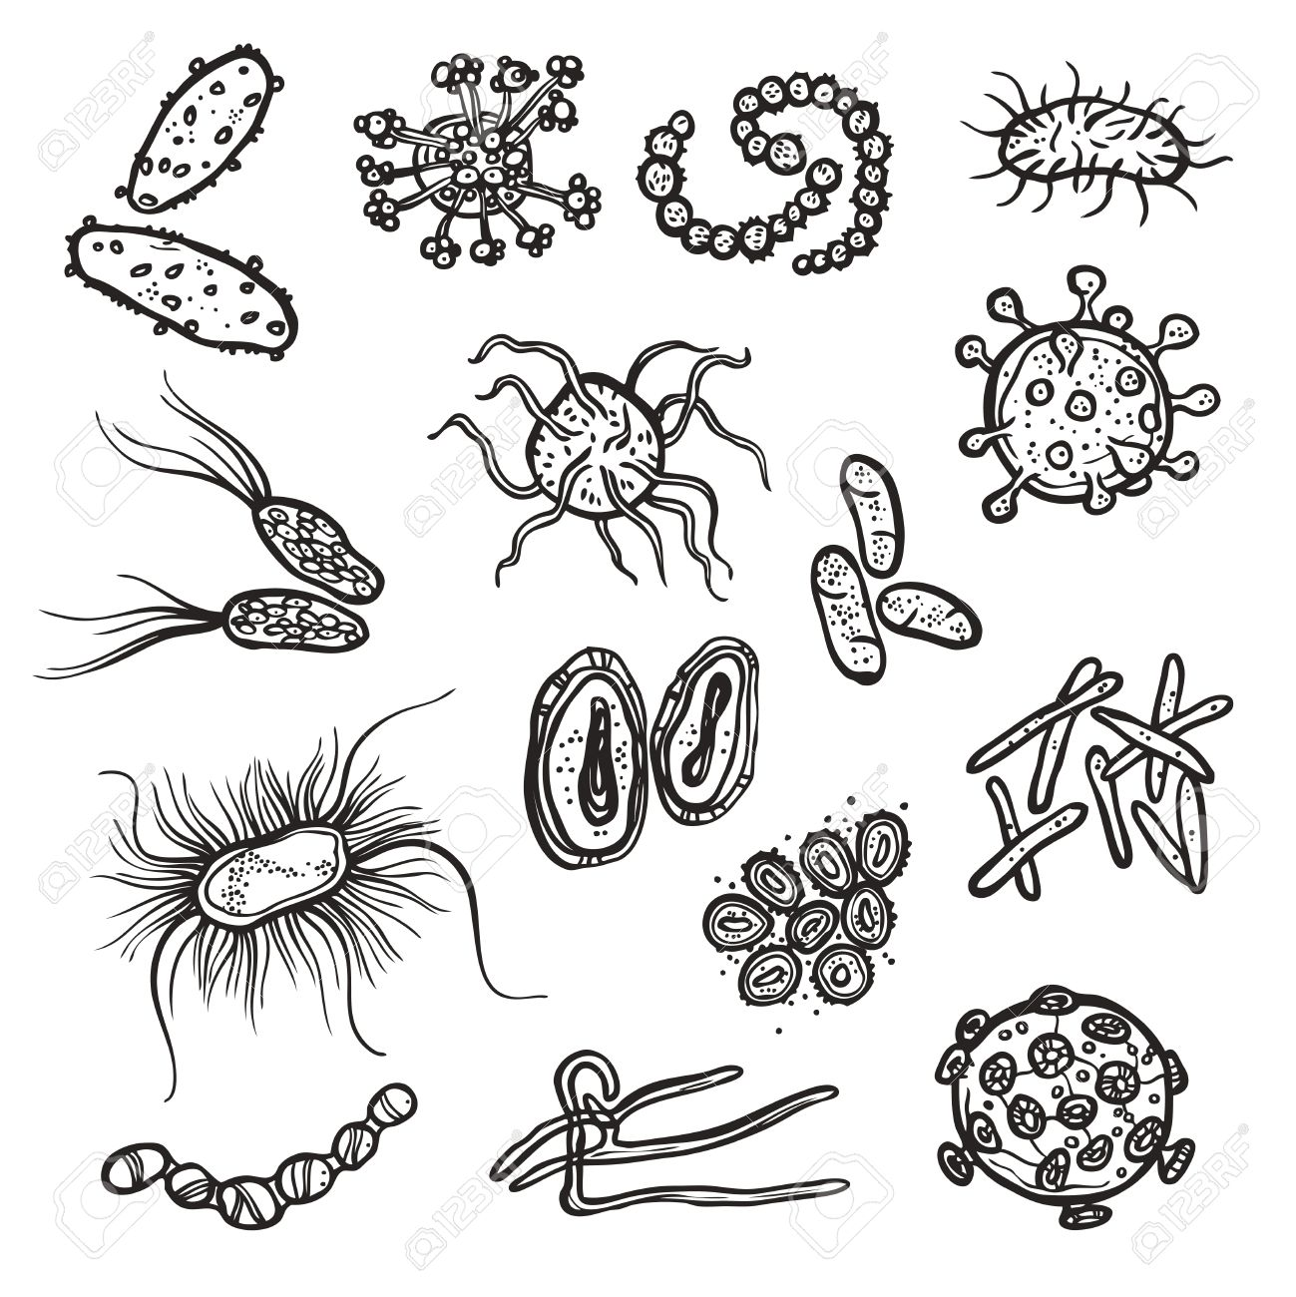
How exogenous DNA is distributed in SOM pools after short-term augmentation?
Bacillus spp. Spores added (8 Log g⁻¹)
on 3 types of soil :
incubated 30 days at 25 °C
SOM physical fractions:
FR = free
MA = macroaggregate
MI= microaggregate
MIN= mineral associated
DNA quantification of each fraction
MI
FR
MA
Mn²⁺
MIN
-
-
-
-
Mn²⁺
-
-
Modified from Zaccone et al., 2018, App. Soil Ecol.)

Slide 4
Hypotheses to test
Exogenous baterial spores cannot reach protected SOM
Exogenous baterial spores interact with all SOM pools
Fate of «native» vs exogenous DNA
Spore germination
Interaction with endogenous microbiota

Slide 5
Preliminary results
Free SOM DNA affected by the inoculum
Protected SOM DNA dependent on soil type
Thesis:
Exogenous DNA interacts with free SOM and only secondarily with protected SOM
Spores added
No spores added

Slide 6
Conclusions
DNA recovered from spiked vs. non-spiked samples followed two different patterns of distribution, according to the SOM fractions.
Even if very preliminary, our results point out a possible mechanism of short-term distribution of exogenous DNA from the free to the intra-macroaggregate OM fraction, with no apparent influence on MI and MIN yet.
Further analyses will allow to disclose whether indigenous vs. exogenous bacterial DNA are differentially distributed among SOM fractions, increasing our knowledge on the distribution of microbial communities in soil, according to the to the arrangement of the SOM in the mineral matrix.

