Slide 1
2015 Cold Blob Update and Simulation
Jennifer Mecking¹
Sybren Drijfhout², Joel Hirschi¹, Alex Megann¹
¹National Oceanography Centre Southampton
²University of Southampton
(c)Authors. All rights reserved

Slide 2
Motivation

Slide 3
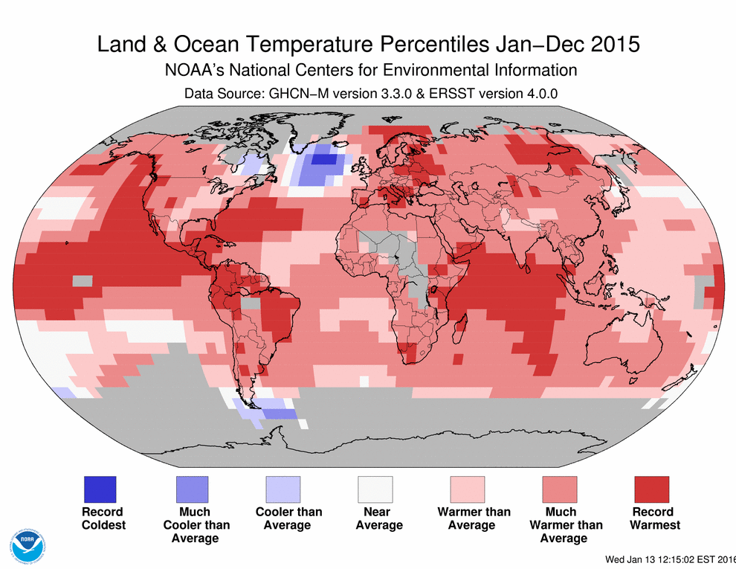
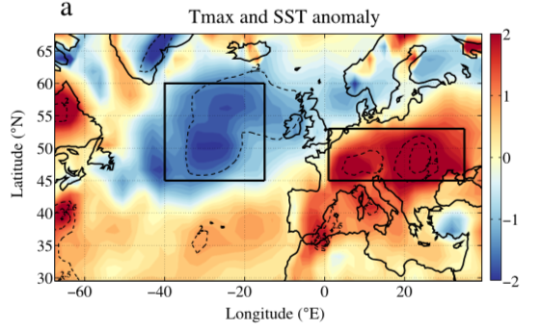
2015 Atlantic Cold Blob
2015 warmest year on record at the time
Currently 3rd warmest
North Atlantic Cold Blob stands out
NOAA – Global Climate Report – Annual 2015
https://www.ncdc.noaa.gov/sotc/global/201513
Linked to 2015 European heatwave (Duchez et al. 2016)
Duchez et al. 2016

Slide 4
Cold Blob Region Current Conditions

Slide 5
Atlantic Cold Blob Current Conditions
Temperature Anomaly w.r.t. 1981-2010
Salinity Anomaly
Persistent cold and fresh anomalies in North Atlantic cold blob region.
Winter 2014/15 had persistent positive NAO enhancing cold blob (Josey et al. 2018)
Cold blob region is defined as 40-15°W, 50-60°N

Slide 6
Simulating 2015 Cold Blob

Slide 7
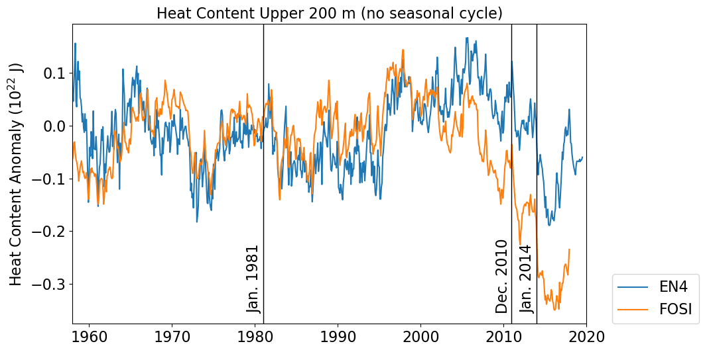
Simulating the 2015 Cold Blob
Anomalous initialization using forced ocean initial condition anomalies:
NEMO v3.6 Forced ocean model (FOSI):
~25km horizontal resolution (extended ORCA025) 75 vertical levels
JRA-55-do atmospheric forcing fields
January 1958 to December 2017
Simulates a more extreme cold blob relative to EN4 data, capturing first drop major drop in winter 2013/14 and second drop in 2014/15.

Slide 8
Simulating the 2015 Cold Blob
Anomalous initialization using forced ocean initial condition anomalies:
HadGEM3-GC3.1 coupled model:
Same ocean/sea ice as forced ocean
~60km atmospheric horizontal resolution
85 vertical levels
Climatology from last 200 years of present-day control simulation
Initialized Experiments (EXPn):
Coupled model initialized with anomalous 3D
temperature and salinity on November 1st, 2014 from FOSI simulation and added to the
present-day control climatology.
Experiments are run for 5 years
5 ensemble members (i.e. n = 1,2,3,4,5)

Slide 9
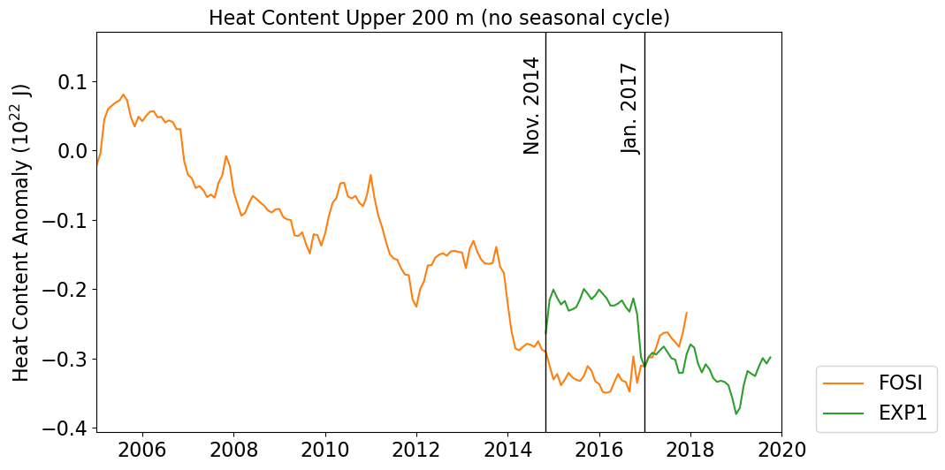
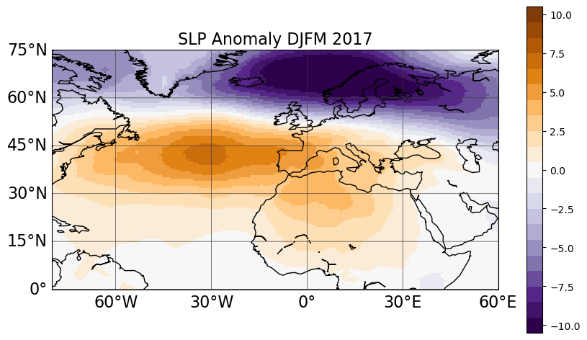
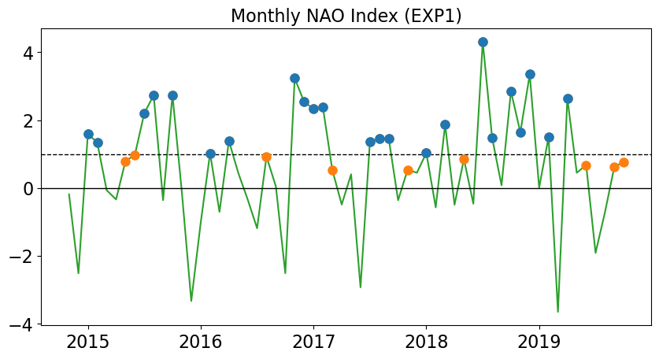
Heat Content In EXP1
Persistent +ve NAO November to March
Notes:
Heat Content at various depths in FOSI simulation

Slide 10
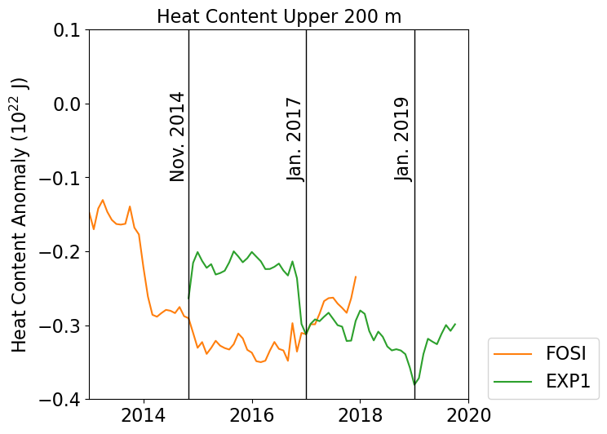
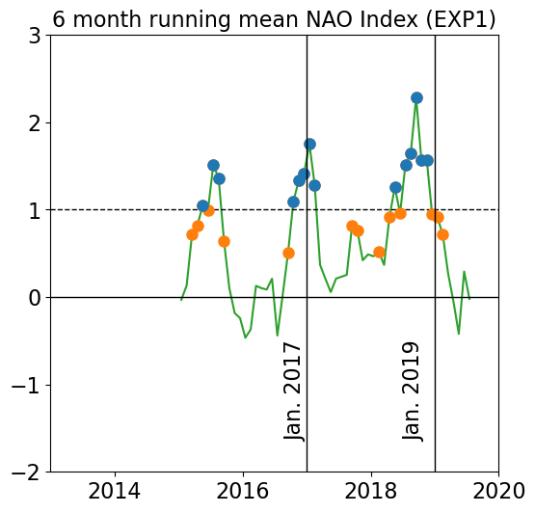
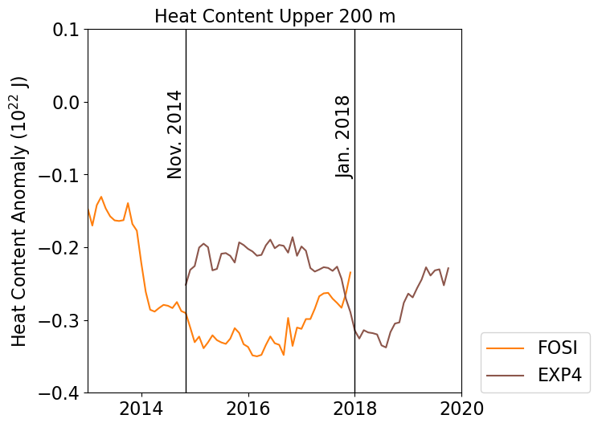
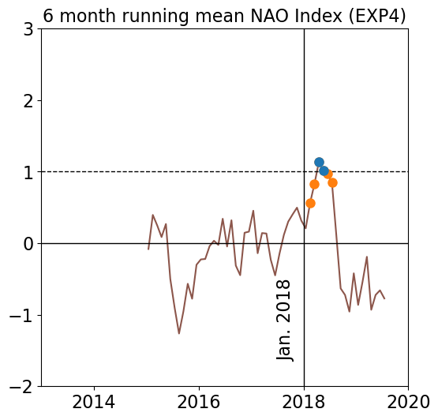
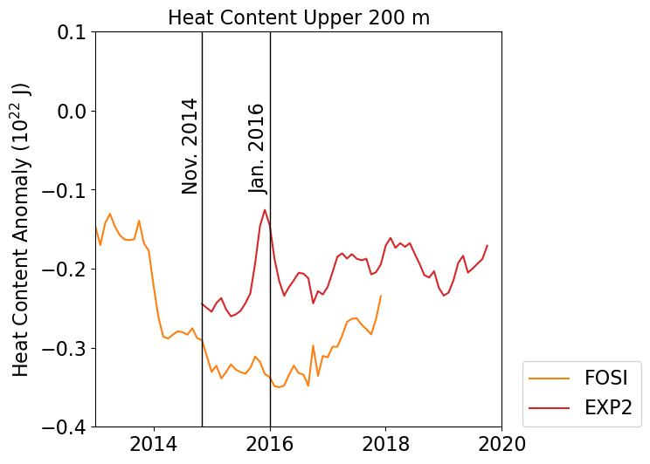
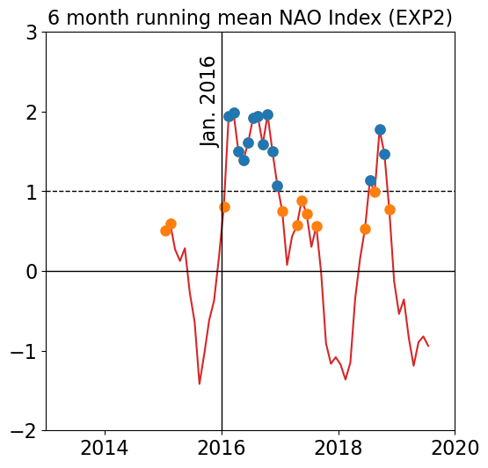
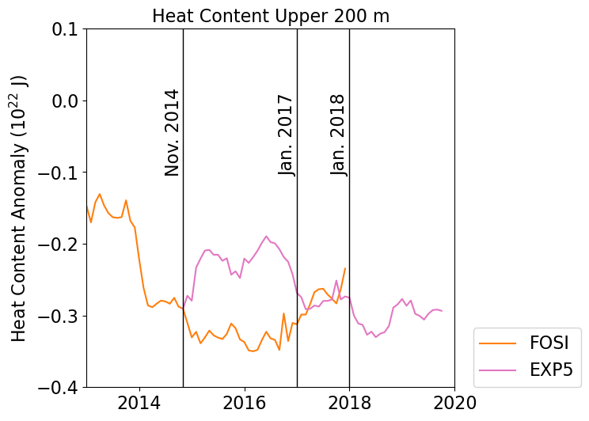
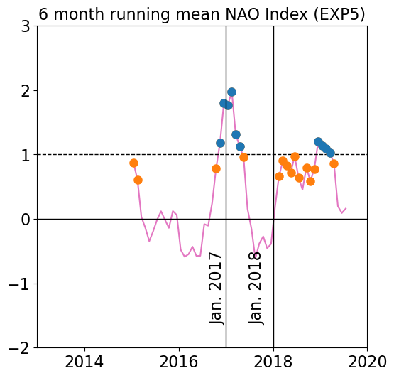
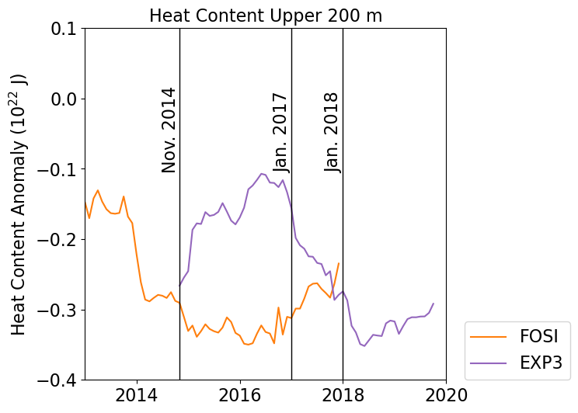
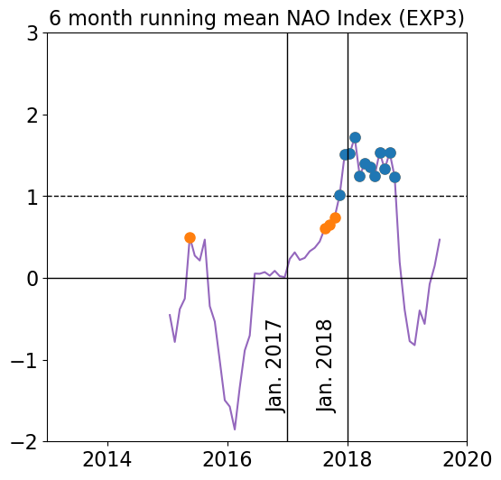
Heat Content In All EXPs
Large wintertime heat loss often coincides with persistent positive NAO.
Notes:
Heat Content at various depths in FOSI simulation

Slide 11
Conclusions
Cold (and fresh) anomalies in N. Atlantic eastern SPG still ongoing, suggesting the 2015 conditions could be more common in the future.
An anomalous initialized coupled simulation is able to capture the 2015 cold blob. However, the timing is delayed by 2-3 years.
There is often a persistent positive NAO prior to the cold blob as was observed in winter of 2014/15.
The Blue-Action project has received funding from the European Union’s Horizon 2020 research and innovation programme under grant agreement No 727852

