Slide 1
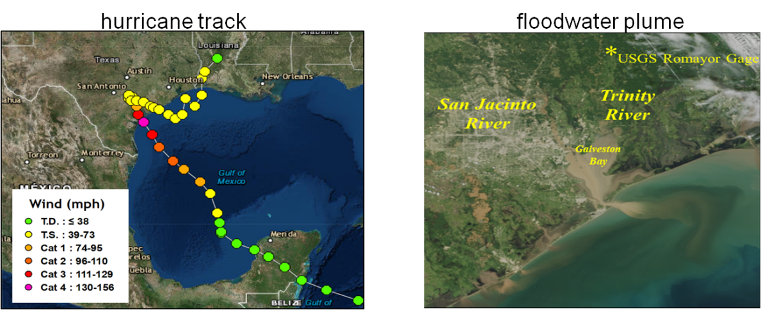
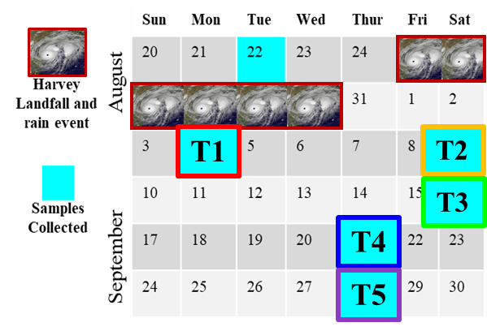
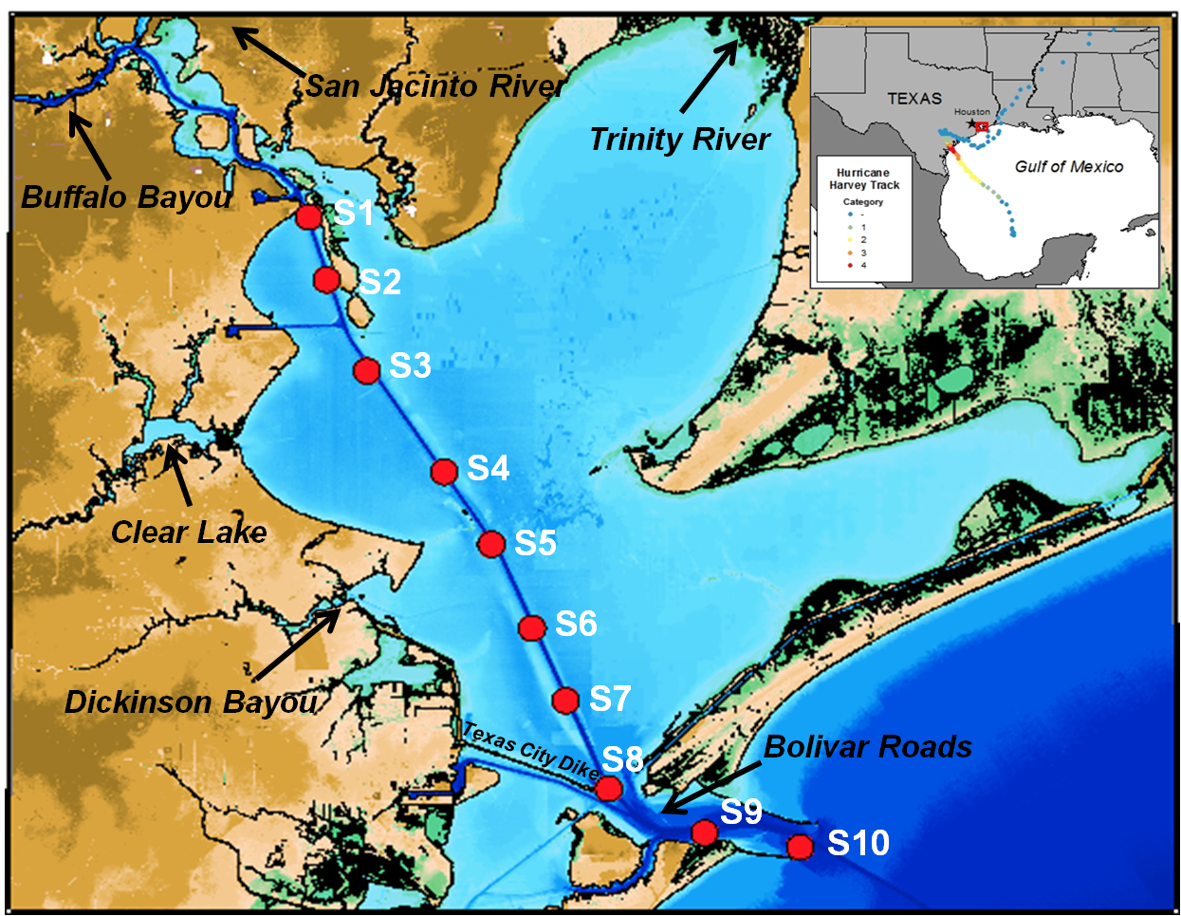
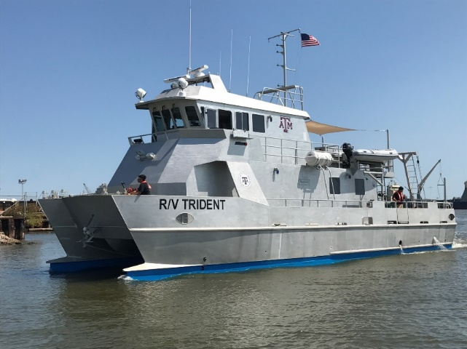
- August 26-30, 2017
Category 4(>130 mph)
R/V Trident
five trips (T1-T5), 10 stations (S1-S10)
surface water
0.2 μm filtration

Slide 2
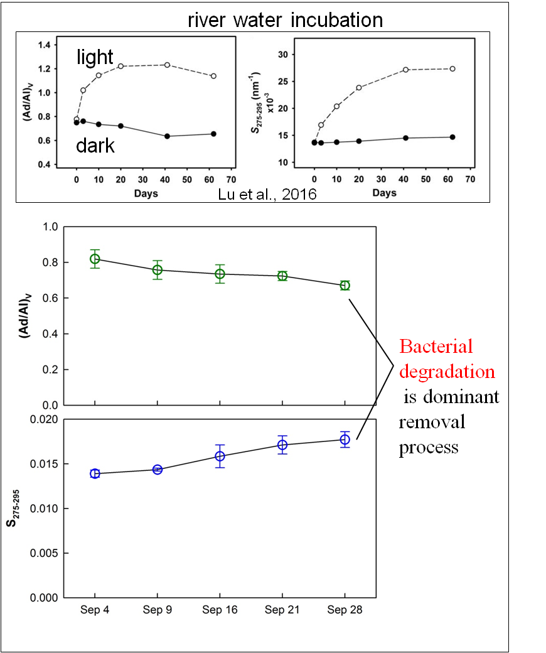
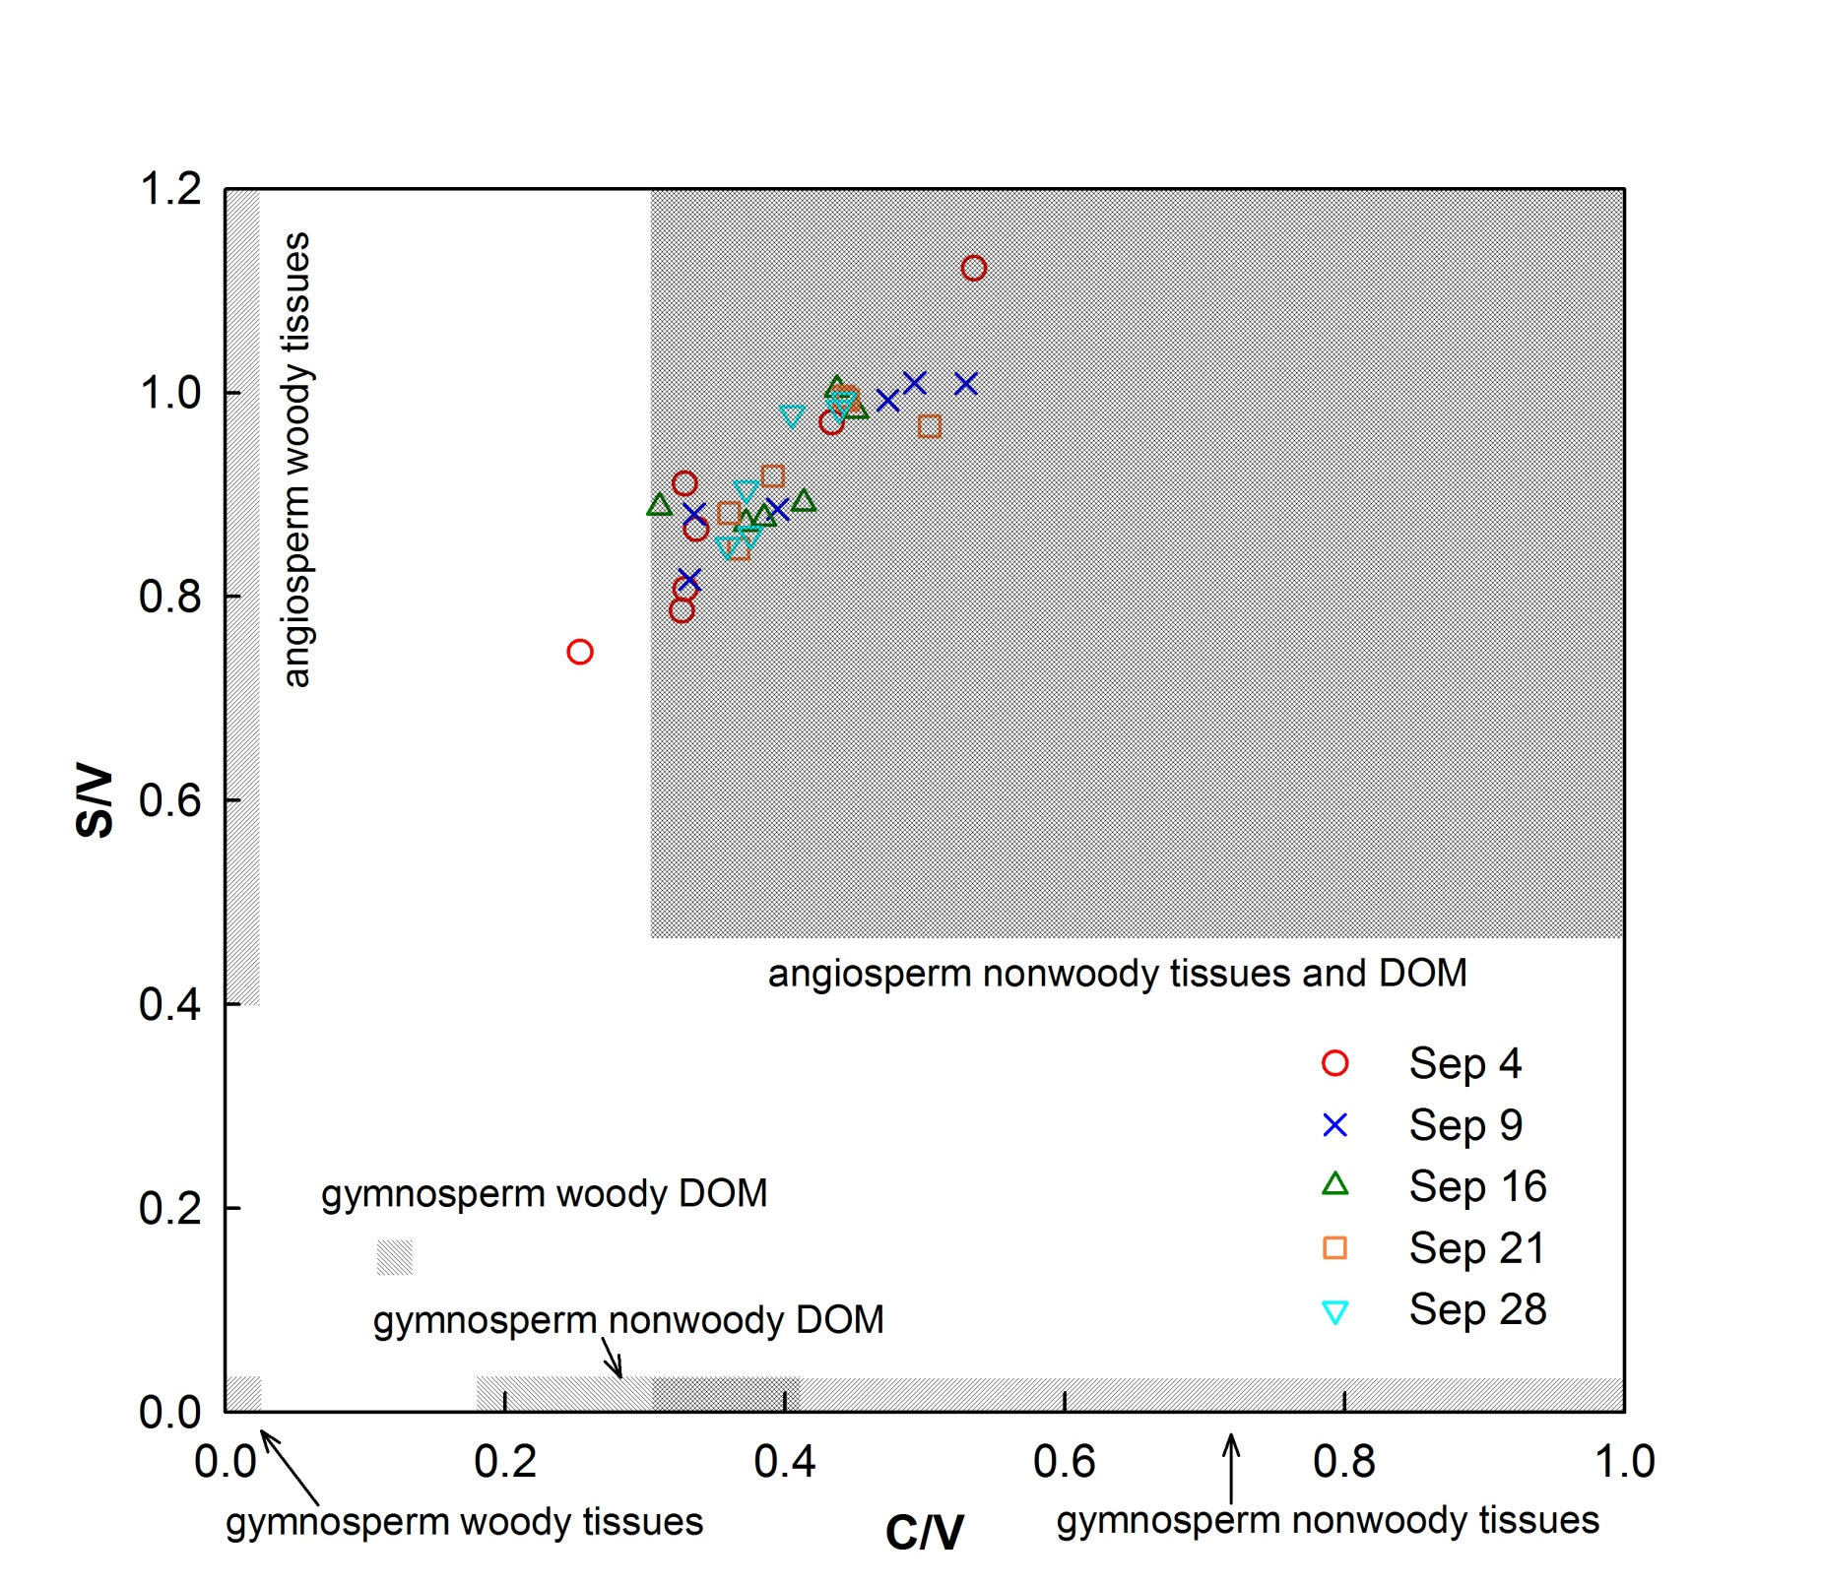
S → angiosperm
C → nonwoody
V → ubiquitous
Major source ─ leachates from nonwoody tissues (e.g., leaves and grasses) of angiosperm vegetation

Slide 3
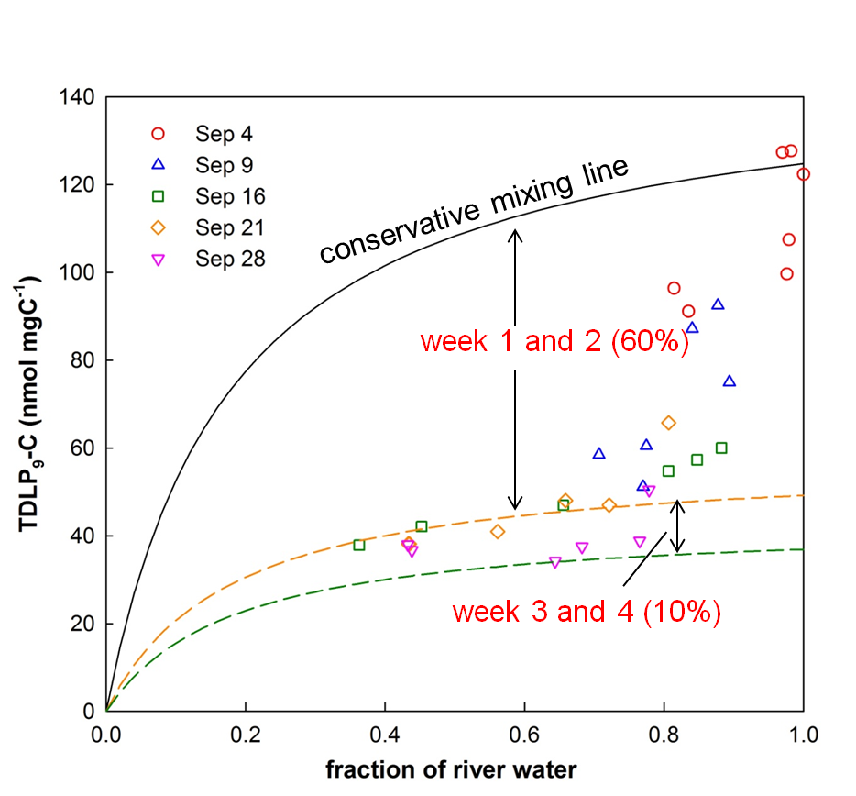
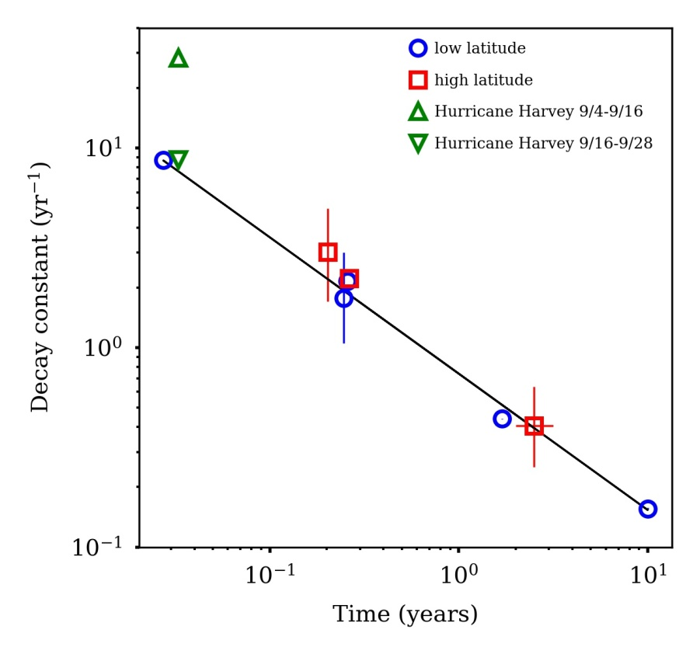
tDOC removal
tDOC decay constant
global decay constant
f_{R} – fraction of river water
α,β – model parameters
Freshwater endmember
-measured values in river water during first cruise
Seawater endmember
-DOC assumed to be 80 μM
-lignin = 0
TDLP₉-C_{sample} – fitted concentration at f_{R} =1
TDLP₉-C_{river} – concentration of river endmember
t – water residence time in years
High decay constant (~3 times)
→ highly labile tDOC and/or efficient removal process

Slide 4
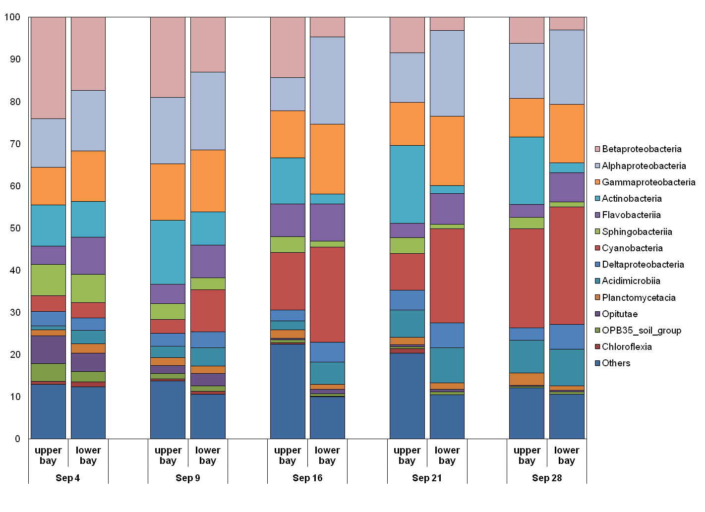
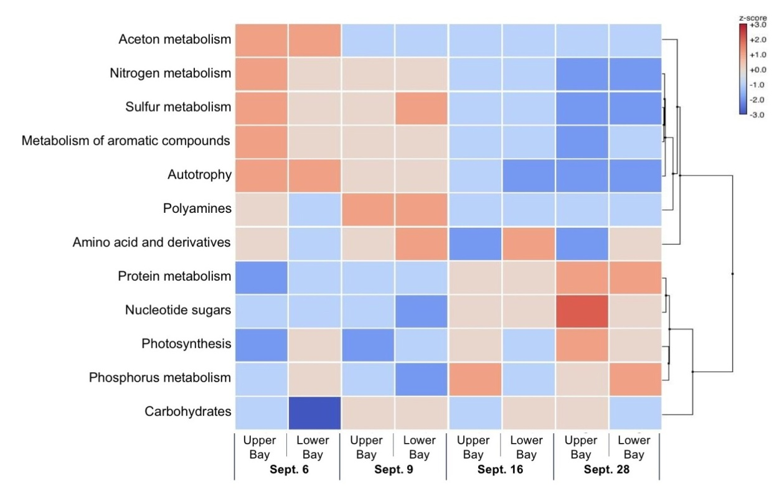
relative composition of major bacterial classes
bacterial community change → change in decay rate
freshwater/soil/sedimentary microorganisms (e.g., Betaproteobacteria)
→ estuary/marine microorganisms (e.g., Cyanobacteria)
heat map showing scores of gene expressions
heterotrophy/tDOC metabolism
→ autotrophy/planktonic DOC metabolism
Yan G, Labonté JM, Quigg A and Kaiser K (2020)
Hurricanes Accelerate Dissolved Organic Carbon Cycling in Coastal Ecosystems. Front. Mar. Sci. 7:248. doi: 10.3389/fmars.2020.00248

