Slide 1
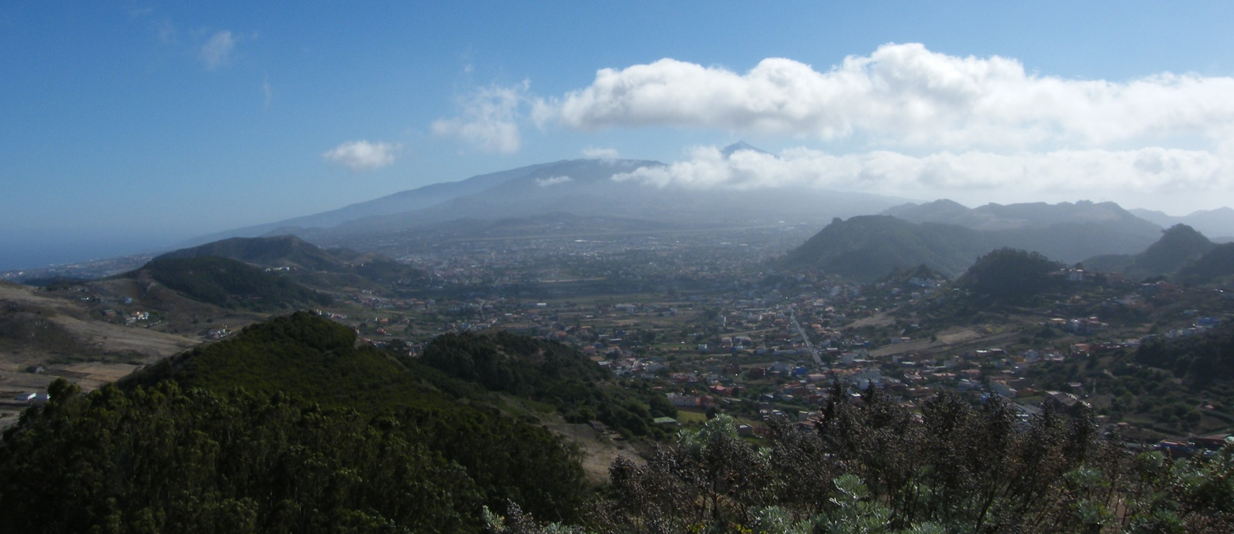
Germán Cervigón Tomico¹, Diana Patricia Fernández del Campo², Efrén Fernández Agudo², Andrés Felipe García Salamanca^{2,3}, Rory Tisdall⁴, Iván Cabrera-Pérez¹, David Martínez van Dorth¹, Jean Soubestre¹, Garazi Bidaurrazaga Aguirre¹, Víctor Ortega Ramos¹, Luca D'Auria^{1,5}, and Nemesio M. Pérez^{1,5,6} 1Instituto Volcanológico de Canarias (INVOLCAN), San Cristóbal de La Laguna, Tenerife, Spain 2Facultad de Ciencias Geológicas, Universidad Complutense de Madrid, Madrid, Spain 3Department of Geoscience, University of Calgary, Alberta, Canada 4School of Environmental Sciences, University of Liverpool, Liverpool, UK 5Instituto Tecnológico y de Energías Renovables (ITER), Granadilla de Abona, Tenerife, Canary Islands, Spain 6Agencia Insular de la Energía de Tenerife (AIET), Granadilla de Abona, Tenerife, Canary Islands, Spain
High resolution seismic microzonation of San Cristóbal de La Laguna (Tenerife, Spain)
ACKNOWLEDGEMENTS
This work has been possible thanks to the support of the TFInnova program, financed by Cabildo Insular de Tenerife and to the project VOLRISKMAC (MAC/3.5b/124), co-financed by the European Union MAC 2014-2020 Cooperation Transnational Programs. We acknowledge students from Universidad Complutense de Madrid, which significantly contributed to the field surveys and data analysis.

Slide 2
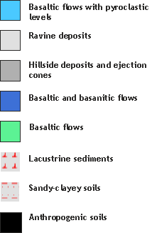
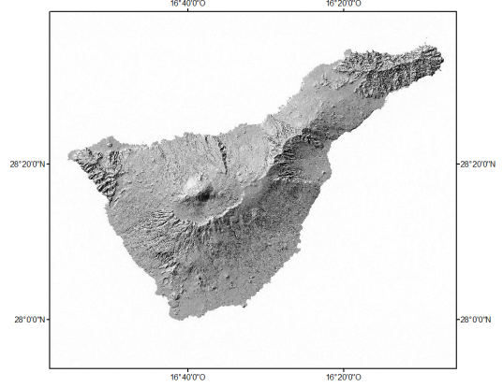
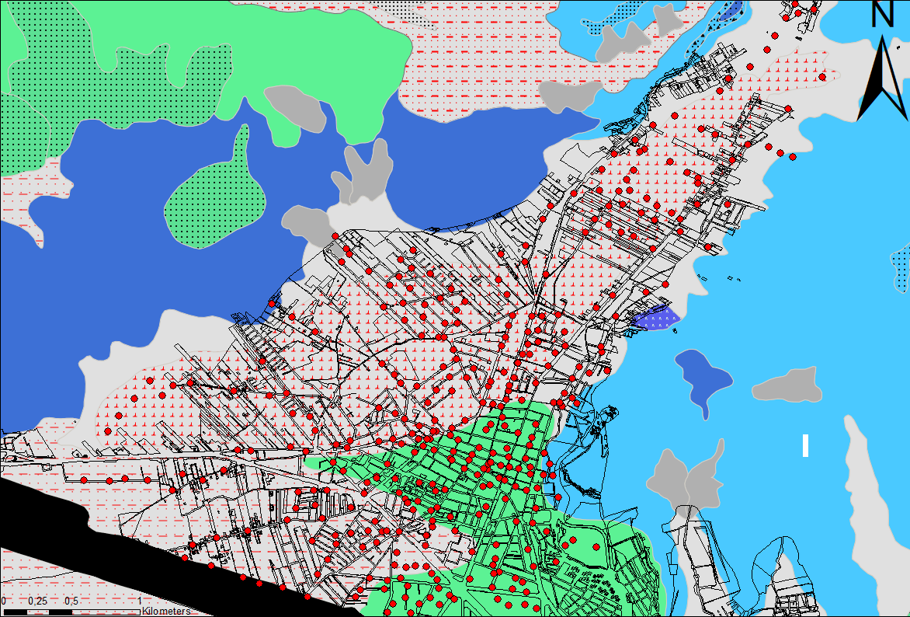
Introduction & objectives
Tenerife is located on the Canary Islands volcanic archipelago, in front of the northwestern coasts of Africa. This island is one of those from this archipelago which has experienced historical volcanism. Actually, the majority of casualties associated with historical eruptions on Tenerife were linked to the seismicity associated to the eruptive activity. Therefore, the volcano-tectonic seismicity constitutes a relevant natural hazard. Moreover, the tectonics of the archipelago and paleoseismological evidences in the southern part of the island, suggest the possibility of destructive earthquake shaking on the island.
The complex geology of the island also affects seismic wave propagation and can lead to local seismic amplification phenomena. Actually, a recent moderate earthquake (M_{l}=4.4), has been recorded by a dense broadband network: Red Sísmica Canaria (C7) operated by Instituto Volcanológico de Canarias (INVOLCAN), showing relevant local amplification effects at different sites. Thus, in 2019, INVOLCAN started a research program (TFsismozon) aimed at characterizing the local seismic response of the urban areas of Tenerife in order to mitigate the seismic risk of the island. The first town selected for this purpose was the town of San Cristóbal de La Laguna (World Heritage Site by UNESCO since 1999), partially built over lacustrine sediments (Fig.1), which can be responsible for seismic wave amplification.
Fig. 1. Geologic map of San Cristóbal de La Laguna extracted from Infraestructura de Datos Espaciales de Canarias (IDE Canarias). Red circles represent the measuring points.

Slide 3
Methods
SELECTION OF THE MOST STATIONARY WINDOWS
COMPUTATION OF FOURIER SPECTRA FOR EACH COMPONENT
CALCULATION OF THE AVERAGE OF HORIZONTAL COMPONENTS
PROCESSING OF THE TIME SERIES
COMPUTATION OF THE AVERAGE HV CURVE
For this purpose, during the summer of 2019, INVOLCAN realized a dense seismic survey of the town, performing seismic noise measurements on 453 sites located in the downtown and its surroundings, for a total surface of about 11 km². The measurements were realized using mini-arrays, composed of 3-4 elements, for a duration of 2-3 hours.
The recommendations of the SESAME project (Acerra et al., 2004) were taken into account in order to obtain the best possible data, choosing only those measurements with enough quality.
The H/V method (Nakamura, 1989) was applied to the data in order to obtain the resonance frequencies of each site. This method is able to estimate dynamic characteristics of the top layers measuring the seismic ambient noise of the subsurface soil and also contributes to estimate the seismic amplification phenomena.
Moreover, in order to improve our model, a cross-correlation for each pair of seismic stations has been performed to obtain the empirical Green’s function (EGF) which, through FTAN (Frequency-Time-Analysis) allows determining Rayleigh waves dispersion curves.

Slide 4
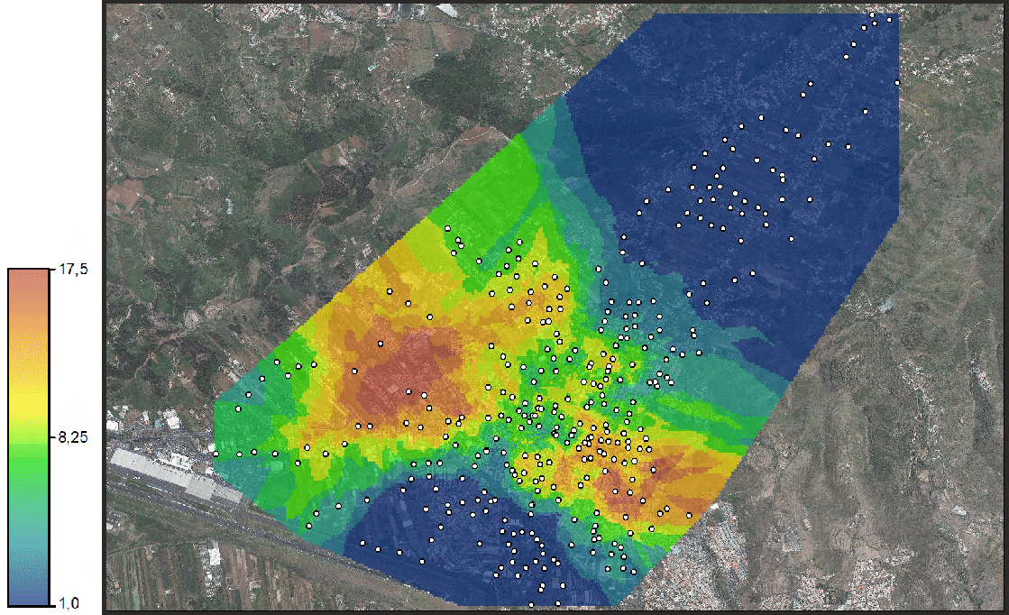
Results & discussion
The map of fundamental frequencies at San Cristóbal de La Laguna (Fig.2) shows a large medium-high resonance frequency zone (8 - 17.5 Hz) located in the city center. This area hosts the bulk of the urban population and its historical centre, declared World Heritage Site by UNESCO in 1999. The results or our work, together with previous geological data, show it could consist of basaltic lavas covered by a thin layer of sediments (Fig.4) or by slightly developed soils, resulting in high resonance frequencies. On the other hand, in the surrounding areas, frequencies decrease due to a thicker sediment or soil layer.
In the northeast, the Aguere valley is characterized by low resonance frequencies (Fig.3) that corresponds to the lacustrine deposits and the ravines close to the slopes (Fig.5). These soils are composed by clayey-silty layers that can reach a thickness of more than 20 metres and their presence is evidenced by H/V curves with clear peaks in the range of 0.8 - 1.5 Hz.
A second low resonance frequency zone (≈ 1 Hz) located in the southwest (Los Rodeos). It is represented as basaltic lava flows on geological maps and some outcrops seen all along the main roads confirm it (Fig.6). However further field studies showed that the materials are quite loose corresponding to a sandy-clayey soil resulting from the alteration of the volcanic materials.
Fig. 2. Resonance frequencies of soils map from San Cristóbal de La Laguna.
Frequency (Hz)
Fig. 3. HV curve for point number Z3906 located over thin lacustrine deposits.
Fig. 4. HV curve for point number Z013 located over over basaltic lavas.
Fig. 5. HV curve for point number Z2903 located over ravine deposits.

Slide 5
Conclusions
The high resonance frequencies which characterize the central part of the town can be related to thin soil overlying a hard bedrock of lavas. On the other hand, the northeast and southwest sectors are characterized by lower resonance frequencies, making these areas more likely to be affected by seismic amplification phenomena.
The low frequencies in the northwestern area are due to a thick basin fill of lacustrine sediments, which can reach more than 20 meters thickness. Besides, the low frequencies of the southwestern area are linked with a well developed soil in volcanic rocks, mainly basaltic lava flows.
Geophysical data should be integrated with existing geological data to improve geological cartography of the area. In particular the degree of alteration of the outcropping lithologies must be taken into account (Fig.6).
Ongoing studies are being carried out with the aim of determining vertical S-wave velocity profiles for each measure point, through a non-linear inverse method in order to improve the knowledge of the subsurface structure of the area.
Fig.6. Los Rodeos (SE area of the survey) rock alteration to soil.
Acerra, C., Aguacil, G., Anastasiadis, A., Atakan, K., Azzara, R., Bard, P. Y., ... & Bonnefoy-Claudet, S. (2004). Guidelines for the implementation of the H/V spectral ratio technique on ambient vibrations measurements, processing and interpretation. European Commission–EVG1-CT-2000-00026 SESAME.
Nakamura, Y. (1989). A method for dynamic characteristics estimation of subsurface using microtremor on the ground surface. Railway Technical Research Institute, Quarterly Reports, 30(1).
References

